Slide 1
Exploring Galatia

Slide 2
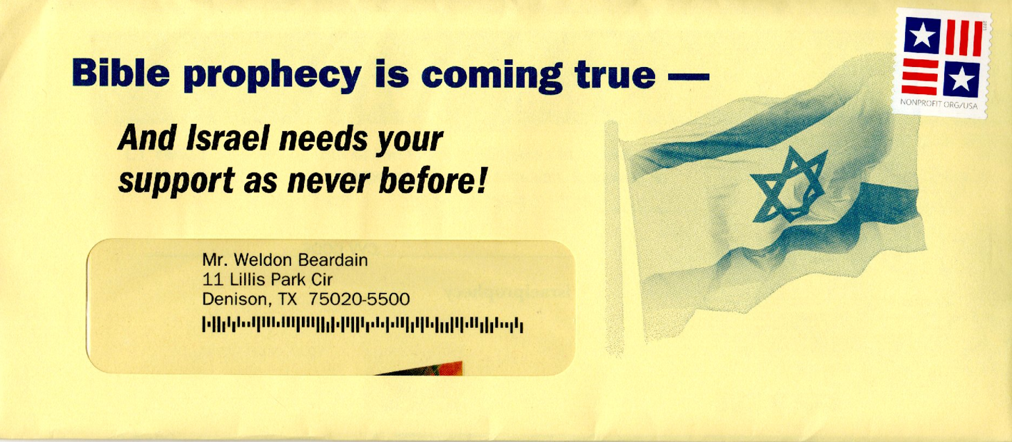

Slide 4
Galatians 4
Hagar and Sarah

Slide 5
Galatians 4
For the scholarly Rabbi scriptures have more than one meaning: (commentary)
Peshat - literal or simple meaning
Remaz: Suggested meaning
Derush: meaning deduced by investigation
Sod: allegorical meaning

Slide 6
Galatians 4 timeout
The issue with having other meanings than thew simple meaning is direct opposition to the hermeneutic we understand. (Rusty’s class can be reviewed)
The rabbinical list seems exactly upside down.

Slide 7
Galatians 4 timeout
Levirate marriage is mentioned in the Bible, particularly in the Old Testament. One of the clearest references is found in Deuteronomy 25:5-10, where the practice is described as a duty of the brother-in-law to marry the widow if the deceased brother had no children.
The Jewish writings has hundreds of lines of regulations regarding levirate marriage.

Slide 8
Galatians 4
The summit of meanings was the allegorical meaning. On occasion, Rabbis would take a simple bit of historical narrative from the old testament and read into it inner meanings which were very convincing to the people of their day.
Paul was using his training to present information in such a way to cause more contemplation and thinking (wb)

Slide 9
Galatians 4
Paul being well educated in the Law is going to use a Rabbinical technique to contrast Judaism with Christianity.
This is a break away from the Guardian / Slave discussion up to this point.

Slide 10
Galatians 4
²¹ Tell me, you who want to be under the law, are you not aware of what the law says? ²² For it is written that Abraham had two sons, one by the slave woman and the other by the free woman. ²³ His son by the slave woman was born according to the flesh, but his son by the free woman was born as the result of a divine promise.

Slide 11
Galatians 4
²⁴ These things are being taken figuratively: The women represent two covenants. One covenant is from Mount Sinai and bears children who are to be slaves: This is Hagar. ²⁵ Now Hagar stands for Mount Sinai in Arabia and corresponds to the present city of Jerusalem, because she is in slavery with her children. ²⁶ But the Jerusalem that is above is free, and she is our mother.

Slide 12
Galatians 4
²⁸ Now you, brothers and sisters, like Isaac, are children of promise. ²⁹ At that time the son born according to the flesh persecuted the son born by the power of the Spirit. It is the same now. ³⁰ But what does Scripture say? “Get rid of the slave woman and her son, for the slave woman’s son will never share in the inheritance with the free woman’s son.” ³¹ Therefore, brothers and sisters, we are not children of the slave woman, but of the free woman.

Slide 13
Palestine Information
Babylonian
Persian
Greek
Polemic and Seleucid Partitions of Greece control Palestine
Seleucid Partition (begins rule of Palestine 197 BC)
Antiochus IV Epiphanes 175 BC
Maccabean ~140 BC 63 BC (Pompey
Herod the Great 37 BC
7th century Muslim conquest of the Shaam Region of the Roman Byzantine Empire.
November 636 Jerusalem is captured by Muslim led Army.

Slide 14
Palestine Information
400 Roman Empire is Partitioned. Palestine is part of the Roman Byzantine Empire.
7th century Muslim conquest of the Shaam Region of the Roman Byzantine Empire.
November 636 Jerusalem is captured by Muslim led Army.

Slide 15
Palestine Information
1099 Crusaders established Kingdom of Jerusalem
1187 Ayyubid Sultanate recaptures Jerusalem
1250s Mongol Raids into Palestine
1250s Mamluk Sultanate of Egypt defeat Ayyubid Sultanate

Slide 16
Palestine Information
Ottoman Rule 1516-1918 except---
coastal towns Gaza, Jaffa, and Hafia Attached by Napolean in 1799 as an extension of his conquest of Egypt. Campaign stalled with the unsuccessful siege siege of Acre
(Egypt – Ibrahim Ali Pasha attacked Palestine from the south and had control from 1831-1841)

Slide 17
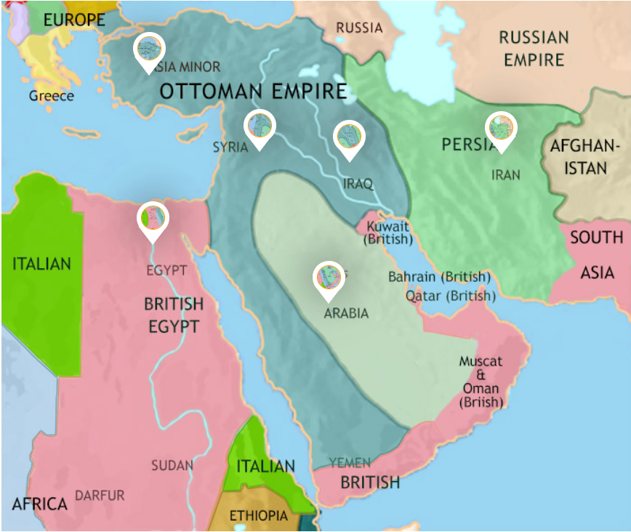
Ottoman Rule 1516-1918
Map ~1916
400 somewhat stable years

Slide 18
Palestine Information
In 1850, according to the Ottoman census provincial yearbook, Palestine had 63,659 recorded households. Roughly 85% were Muslim, 11% were Christian and 4% Jewish.
The Jewish population was recorded at about 15,000
Increased to 24,000 by 1882.[

Slide 19
Palestine Information
In the Russian Empire, waves of pogroms of 1881–1884 (some allegedly state-sponsored), as well as the anti-Semitic May Laws of 1882 introduced by Tsar Alexander III of Russia, deeply affected Jewish communities. More than 2 million Jews fled Russia between 1880 and 1920. The vast majority of them emigrated to the United States, but some decided to form an aliyah to Ottoman-ruled Palestine.

Slide 20
Palestine Information
Aliyah (US: /ˌæliˈɑː/, UK: /ˌɑː/; Hebrew: עֲלִיָּה ʿălīyyā, ( lit. 'ascent') is the immigration of Jews from the diaspora to, historically, the geographical Land of Israel or the Palestine region.
Between 1882 and 1903, approximately 25,000–30,000 Jews immigrated to Palestine during the First Aliyah, mainly from Eastern Europe, establishing agricultural settlements such as Rishon LeZion.

Slide 21
Palestine Information
Ottoman Rule 1516-1918
Palestine is taxed.
Status Quo was maintained for internal groups
Jews and Arabs had interspersed communities
1825 attempted Jewish rebellion in Galilee is quashed.
1880’s saw an increase in Jewish immigration to Palestine due to growth of antisemitism in Europe.

Slide 22
Palestine Information
Tovevei Zion (Lovers of Zion): Before Herzl's efforts, small groups like the Hovevei Zion aimed at encouraging Jewish agricultural settlement in Palestine. These groups laid the groundwork for modern Zionist ideals and established several Jewish communities in Palestine between 1870 and 1897.
(No military aspirations against the Ottomans)

Slide 23
Palestine Information
Theodor Herzl and the Zionist Congress: Herzl, an Austrian journalist, is often called the father of modern political Zionism. He believed that the Jewish people needed a state of their own due to persistent anti-Semitism in Europe. His pamphlet, "Der Judenstaat" ("The Jewish State"), published in 1896, laid out his vision
(an idea seed at this point)

Slide 24
Palestine Information
Historical and Religious Origins: The core idea of Zionism—the return to the Jewish homeland—draws on historical and religious traditions. This sentiment is deeply rooted in Jewish prayers and scriptures that emphasize the longing for Zion (Jerusalem and the land of Israel)

Slide 25
Palestine Information
What is Zion ?

Slide 26
Palestine Information
If you want to understand part of why the Middle East is such a volatile region today, a good place to start finding answers is the partitioning of the region between 1918 and 1920. The Allies defeated the Ottoman Empire in WWI, and needed to decide what would happen to areas previously under Ottoman control. These covered modern-day Syria, The Lebanon, Israel, Iraq and Iran.

Slide 27
Palestine Information
Theoretically, their people could have gained independence, after years of being colonial subjects. However, this wasn’t to be. The British, French and Russians had signed a secret treaty in 1916 (the Sykes-Picot Agreement), whereby they had decided to carve up the Middle East among themselves (like a nice, oil-flavoured cake).

Slide 28
Palestine Information
Thes maps clearly show the division between British and French spheres of influence, often drawn arbitrarily without regard for ethnic or religious demographics, which is considered a major factor in the region's ongoing conflicts today.

Slide 29
Ottoman Rule 1516-1918
MAP ~1916
400 somewhat stable years

Slide 30
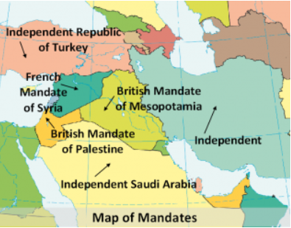
Middle East divided after WWI

Slide 31
Middle East divided after WWI

Slide 32
Anti-Zionism
Until World War II, anti-Zionism was widespread among Jews for varying reasons. Orthodox Jews opposed Zionism on religious grounds, as preempting the Messiah,^{[a]} while many secular Jewish anti-Zionists identified more with ideals of the Enlightenment and saw Zionism as a reactionary ideology.

Slide 33
Anti-Zionism
Opposition to Zionism in the Jewish diaspora was surmounted only from the 1930s onward, as conditions for Jews deteriorated radically in Europe and, with the Second World War, the sheer scale of the Holocaust was felt.
https://en.wikipedia.org/wiki/Anti-Zionism

Slide 34
Zionism
During the 1930s, over 250,000 Jews immigrated to Palestine, many fleeing Nazi persecution in Europe.
World War II
Holocaust
At end of WWII Middle East largely divided as 1920
Iraq Independent 1932
Iran Captured During WWII
Oil Pipeline Built to Russia

Slide 35
Zionism Information
Palestine was under British Mandate in1945
Population of Palestine 1945
1,764,520
Muslims 1,061,270
Jews 553,600
Christians 135,550
Other 14,199

Slide 36
Name | Date of Independence | Colonising Power
Iraq | October 3, 1932 | Great Britain
Lebanon | Independence declared on November 22, 1943. Full Independence granted in 1946 | France
Syria | November 30, 1943. Full Independence granted in 1945 | France
Israel | May 14, 1948 | Great Britain
Cyprus | August 16, 1960 | Great Britain
Kuwait | June 19, 1961 | Great Britain
Oman | 1962 | Great Britain
Yemen | November 30, 1967 | Great Britain
Qatar | September 3, 1971 | Great Britain
Bahrain | August 15, 1971 | Great Britain
United Arab Emirates | December 2, 1971 | Great Britain

Slide 37
Zionism Information
At end of war Palestine still under British Mandate.
The United Nations Partition Plan for Palestine was a proposal to divide Mandatory Palestine into two independent states, one Jewish and one Arab, at the end of the British Mandate. The plan was adopted by the UN General Assembly on November 29, 1947.

Slide 38
Zionism Information
In 1948, following the 1947–1948 civil war in Mandatory Palestine, the Israeli Declaration of Independence sparked the 1948 Arab–Israeli War, which resulted in the 1948 Palestinian expulsion and flight from the land that the State of Israel came to control and subsequently led to waves of Jewish immigration from other parts of the Middle East.

Slide 39
Information ~2023
Palestinians relegated to Gaza and the West Bank
Population of Palestine / Israel
Palestinians 4.5 million ( 2,320 sq miles) 1,893 / sq mi
Israel 10 million (8,500 sq miles) 1,175 /sq mi
75% Jewish.
Texas is 25 times larger than Palestine + Israel
Texas has twice the population of Palestine + Israel

Slide 40
Christian Zionism
Christian Zionism is a political and religious ideology that, in a Christian context, espouses the return of the Jewish people to the Holy Land. Likewise, it holds that the founding of the State of Israel in 1948 was in accordance with biblical prophecies transmitted through the Old Testament: that the re-establishment of Jewish sovereignty in the Levant—the eschatological "Gathering of Israel"—is a prerequisite for the Second Coming of Jesus Christ.

Slide 41
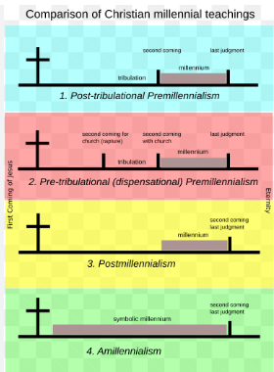

Slide 42
Christian Zionism
The term began to be used in the mid-20th century, in place of Christian restorationism, as proponents of the ideology rallied behind Zionists in support of a Jewish national homeland.
https://en.wikipedia.org/wiki/Christian_Zionism

Slide 43
Why all this stuff
The co-mingling of Jews returning to Isreal and the premillennial return of Christ reigns from Jerusalem is not aligned with Galatians 4 .
Define Jerusalem

Slide 44
Galatians 4
Hagar and Sarah

Slide 45
Galatians 4
For the scholarly Rabbi scriptures have more than one meaning:
Peshat - literal or simple meaning
Remaz: Suggested meaning
Derush: meaning deduced by investigation
Sod: allegorical meaning

Slide 46
Galatians 4 timeout
The issue with having other meanings than thew simple meaning is direct opposition to the hermeneutic we understand. (Rusty’s class can be reviewed)
The rabbinical list seems exactly upside down.

Slide 47
Galatians 4 timeout
Levirate marriage is mentioned in the Bible, particularly in the Old Testament. One of the clearest references is found in Deuteronomy 25:5-10, where the practice is described as a duty of the brother-in-law to marry the widow if the deceased brother had no children.
The Jewish writings has hundreds of lines of regulations regarding levirate marriage.

Slide 48
Galatians 4
The summit of meanings was the allegorical meaning. On occasion, Rabbis would take a simple bit of historical narrative from the old testament and read into it inner meanings which were very convincing to the people of their day.
Paul was using his training to present information in such a way to cause more contemplation and thinking (wb)

Slide 49
Galatians 4
Paul being well educated in the Law is going to use a Rabbinical technique to contrast Judaism with Christianity.
This is a break away from the Guardian / Slave discussion up to this point.

Slide 50
Galatians 4
²¹ Tell me, you who want to be under the law, are you not aware of what the law says? ²² For it is written that Abraham had two sons, one by the slave woman and the other by the free woman. ²³ His son by the slave woman was born according to the flesh, but his son by the free woman was born as the result of a divine promise.

Slide 51
Galatians 4
²⁴ These things are being taken figuratively: The women represent two covenants. One covenant is from Mount Sinai and bears children who are to be slaves: This is Hagar. ²⁵ Now Hagar stands for Mount Sinai in Arabia and corresponds to the present city of Jerusalem, because she is in slavery with her children. ²⁶ But the Jerusalem that is above is free, and she is our mother.

Slide 52
Galatians 4
²⁸ Now you, brothers and sisters, like Isaac, are children of promise. ²⁹ At that time the son born according to the flesh persecuted the son born by the power of the Spirit. It is the same now. ³⁰ But what does Scripture say? “Get rid of the slave woman and her son, for the slave woman’s son will never share in the inheritance with the free woman’s son.”^{[f]} ³¹ Therefore, brothers and sisters, we are not children of the slave woman, but of the free woman.

