Slide 1

Exploring
Galatia

Slide 2
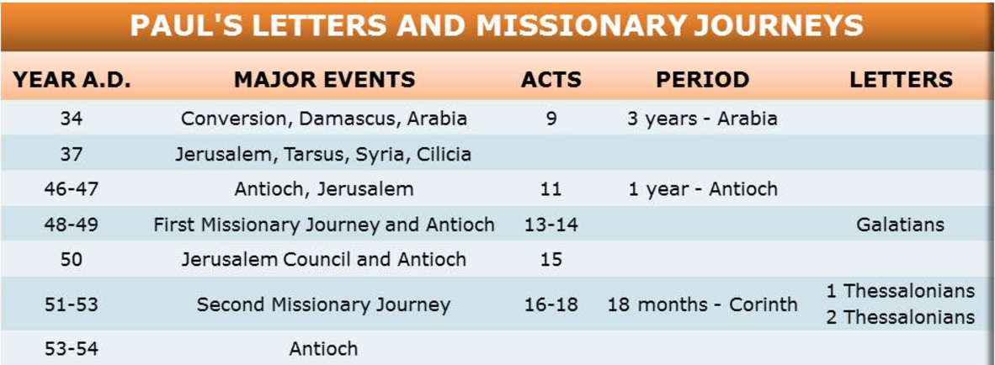

Slide 3
Jewish Requirements Deut 13
13 If a prophet, or one who foretells by dreams, appears among you and announces to you a sign or wonder, ² and if the sign or wonder spoken of takes place, and the prophet says, “Let us follow other gods” (gods you have not known) “and let us worship them,” ³ you must not listen to the words of that prophet or dreamer.

Slide 4
Jewish Requirements Deut 13
The Lord your God is testing you to find out whether you love him with all your heart and with all your soul. ⁴ It is the Lord your God you must follow, and him you must revere. Keep his commands and obey him; serve him and hold fast to him. ⁵ That prophet or dreamer must be put to death for inciting rebellion against the Lord your God,

Slide 5
Jewish Requirements Deut 13
who brought you out of Egypt and redeemed you from the land of slavery. That prophet or dreamer tried to turn you from the way the Lord your God commanded you to follow. You must purge the evil from among you.

Slide 6
Jewish Requirements Deut 13
⁶ If your very own brother, or your son or daughter, or the wife you love, or your closest friend secretly entices you, saying, “Let us go and worship other gods” (gods that neither you nor your ancestors have known, ⁷ gods of the peoples around you, whether near or far, from one end of the land to the other), ⁸ do not yield to them or listen to them. Show them no pity. Do not spare them or shield them..

Slide 7
Jewish Requirements Deut 13
⁹ You must certainly put them to death. Your hand must be the first in putting them to death, and then the hands of all the people. ¹⁰ Stone them to death, because they tried to turn you away from the Lord your God, who brought you out of Egypt, out of the land of slavery. ¹¹ Then all Israel will hear and be afraid, and no one among you will do such an evil thing again.

Slide 8
Jewish Requirements Deut 13
¹² If you hear it said about one of the towns the Lord your God is giving you to live in ¹³ that troublemakers have arisen among you and have led the people of their town astray, saying, “Let us go and worship other gods” (gods you have not known), ¹⁴ then you must inquire, probe and investigate it thoroughly. And if it is true and it has been proved that this detestable thing has been done among you, ¹⁵ you must certainly put to the sword all who live in that town.

Slide 9
Jewish Requirements Deut 13
You must destroy it completely, both its people and its livestock. ¹⁶ You are to gather all the plunder of the town into the middle of the public square and completely burn the town and all its plunder as a whole burnt offering to the Lord your God. That town is to remain a ruin forever, never to be rebuilt, ¹⁷ and none of the condemned things^{[c]} are to be found in your hands. Then the Lord will turn from his fierce anger, will show you mercy, and will have compassion on you.

Slide 10
Jewish Requirements Deut 13
He will increase your numbers, as he promised on oath to your ancestors— ¹⁸ because you obey the Lord your God by keeping all his commands that I am giving you today and doing what is right in his eyes.

Slide 11
Jewish Requirements Deut 13
Deadlocked
  Not looking for a messiah
  Keeping things the same
  Not accepting Jesus as not meeting expectations

Slide 12
Jewish Requirements Deut 13
13 If a prophet, or one who foretells by dreams, appears among you and announces to you a sign or wonder, ² and if the sign or wonder spoken of takes place, and the prophet says, “Let us follow other gods” (gods you have not known) “and let us worship them,” ³ you must not listen to the words of that prophet or dreamer.

Slide 13
Jewish Requirements Deut 13
Deadlocked
  Not looking for a messiah
  Keeping things the same
  Not accepting Jesus as not meeting expectations
Double down and do both.

Slide 14
Galatians 2
2 Then after fourteen years, I went up again to Jerusalem, this time with Barnabas. I took Titus along also. ² I went in response to a revelation and, meeting privately with those esteemed as leaders, I presented to them the gospel that I preach among the Gentiles. I wanted to be sure I was not running and had not been running my race in vain.

Slide 15
Acts 15
15 Certain people came down from Judea to Antioch and were teaching the believers: “Unless you are circumcised, according to the custom taught by Moses, you cannot be saved.” ² This brought Paul and Barnabas into sharp dispute and debate with them. So Paul and Barnabas were appointed, along with some other believers, to go up to Jerusalem to see the apostles and elders about this question.

Slide 16
Acts 15
³ The church sent them on their way, and as they traveled through Phoenicia and Samaria, they told how the Gentiles had been converted. This news made all the believers very glad. ⁴ When they came to Jerusalem, they were welcomed by the church and the apostles and elders, to whom they reported everything God had done through them.

Slide 17
Acts 15
⁵ Then some of the believers who belonged to the party of the Pharisees stood up and said, “The Gentiles must be circumcised and required to keep the law of Moses.”

Slide 18
Galatians 2
³ Yet not even Titus, who was with me, was compelled to be circumcised, even though he was a Greek. ⁴ This matter arose because some false believers had infiltrated our ranks to spy on the freedom we have in Christ Jesus and to make us slaves. ⁵ We did not give in to them for a moment, so that the truth of the gospel might be preserved for you.

Slide 19
Acts 15
⁶ The apostles and elders met to consider this question. ⁷ After much discussion, Peter got up and addressed them: “Brothers, you know that some time ago God made a choice among you that the Gentiles might hear from my lips the message of the gospel and believe. ⁸ God, who knows the heart, showed that he accepted them by giving the Holy Spirit to them, just as he did to us

Slide 20
Acts 15
¹² The whole assembly became silent as they listened to Barnabas and Paul telling about the signs and wonders God had done among the Gentiles through them. ¹³ When they finished, James spoke up. “Brothers,” he said, “listen to me. ¹⁴ Simon has described to us how God first intervened to choose a people for his name from the Gentiles. ¹⁵ The words of the prophets are in agreement with this, as it is written:

Slide 21
Acts 15
¹⁶ “‘After this I will return
and rebuild David’s fallen tent.
Its ruins I will rebuild,
and I will restore it,
¹⁷ that the rest of mankind may seek the Lord,
even all the Gentiles who bear my name,
says the Lord, who does these things’
¹⁸ things known from long ago.”

Slide 22
Acts 15
¹⁶ “‘After this I will return
and rebuild David’s fallen tent.
Its ruins I will rebuild,
and I will restore it,
¹⁷ that the rest of mankind may seek the Lord,
even all the Gentiles who bear my name,
says the Lord, who does these things’
¹⁸ things known from long ago.”

Slide 23
Acts 15
¹⁹ “It is my judgment, (Peter) therefore, that we should not make it difficult for the Gentiles who are turning to God. ²⁰ Instead we should write to them, telling them to abstain from food polluted by idols, from sexual immorality, from the meat of strangled animals and from blood. ²¹ For the law of Moses has been preached in every city from the earliest times and is read in the synagogues on every Sabbath.”

Slide 24
Acts 15
^{……….27} Therefore we are sending Judas and Silas to confirm by word of mouth what we are writing. ²⁸ It seemed good to the Holy Spirit and to us not to burden you with anything beyond the following requirements: ²⁹ You are to abstain from food sacrificed to idols, from blood, from the meat of strangled animals and from sexual immorality. You will do well to avoid these things.
Farewell.

Slide 25
Galatians 2
⁶ As for those who were held in high esteem—whatever they were makes no difference to me; God does not show favoritism—they added nothing to my message. ⁷ On the contrary, they recognized that I had been entrusted with the task of preaching the gospel to the uncircumcised, just as Peter had been to the circumcised.

Slide 26
Galatians 2
⁸ For God, who was at work in Peter as an apostle to the circumcised, was also at work in me as an apostle to the Gentiles. ⁹ James, Cephas and John, those esteemed as pillars, gave me and Barnabas the right hand of fellowship when they recognized the grace given to me. They agreed that we should go to the Gentiles, and they to the circumcised.

Slide 27
Galatians 2
¹⁰ All they asked was that we should continue to remember the poor, the very thing I had been eager to do all along.
The Jerusalem Conference profoundly separated Christianity from Judi am. Paul, Barnabas, and Titus were witnesses of how the Holy Spirit was working among the Gentile Christians.

Slide 28
Galatians 2
Paul Opposes Cephas
¹¹ When Cephas came to Antioch, I opposed him to his face, because he stood condemned. ¹² For before certain men came from James, he used to eat with the Gentiles. But when they arrived, he began to draw back and separate himself from the Gentiles because he was afraid of those who belonged to the circumcision group

Slide 29
Galatians 2
Paul Opposes Cephas
³ The other Jews joined him in his hypocrisy, so that by their hypocrisy even Barnabas was led astray.
¹⁴ When I saw that they were not acting in line with the truth of the gospel, I said to Cephas in front of them all, “You are a Jew, yet you live like a Gentile and not like a Jew. How is it, then, that you force Gentiles to follow Jewish customs?

Slide 30
Galatians 2
¹⁵ “We who are Jews by birth and not sinful Gentiles ¹⁶ know that a person is not justified by the works of the law, but by faith in Jesus Christ. So we, too, have put our faith in Christ Jesus that we may be justified by faith in Christ and not by the works of the law, because by the works of the law no one will be justified.

Slide 31
Galatians 2
¹⁷ “But if, in seeking to be justified in Christ, we Jews find ourselves also among the sinners, doesn’t that mean that Christ promotes sin? Absolutely not! ¹⁸ If I rebuild what I destroyed, then I really would be a lawbreaker.
¹⁹ “For through the law I died to the law so that I might live for God.

Slide 32
Galatians 2
²⁰ I have been crucified with Christ and I no longer live, but Christ lives in me. The life I now live in the body, I live by faith in the Son of God, who loved me and gave himself for me. ²¹ I do not set aside the grace of God, for if righteousness could be gained through the law, Christ died for nothing!”

Slide 33
Galatians 2 Appendix
Remain Slides were not part of the lesson but remain retained for future use as needed .

Slide 34
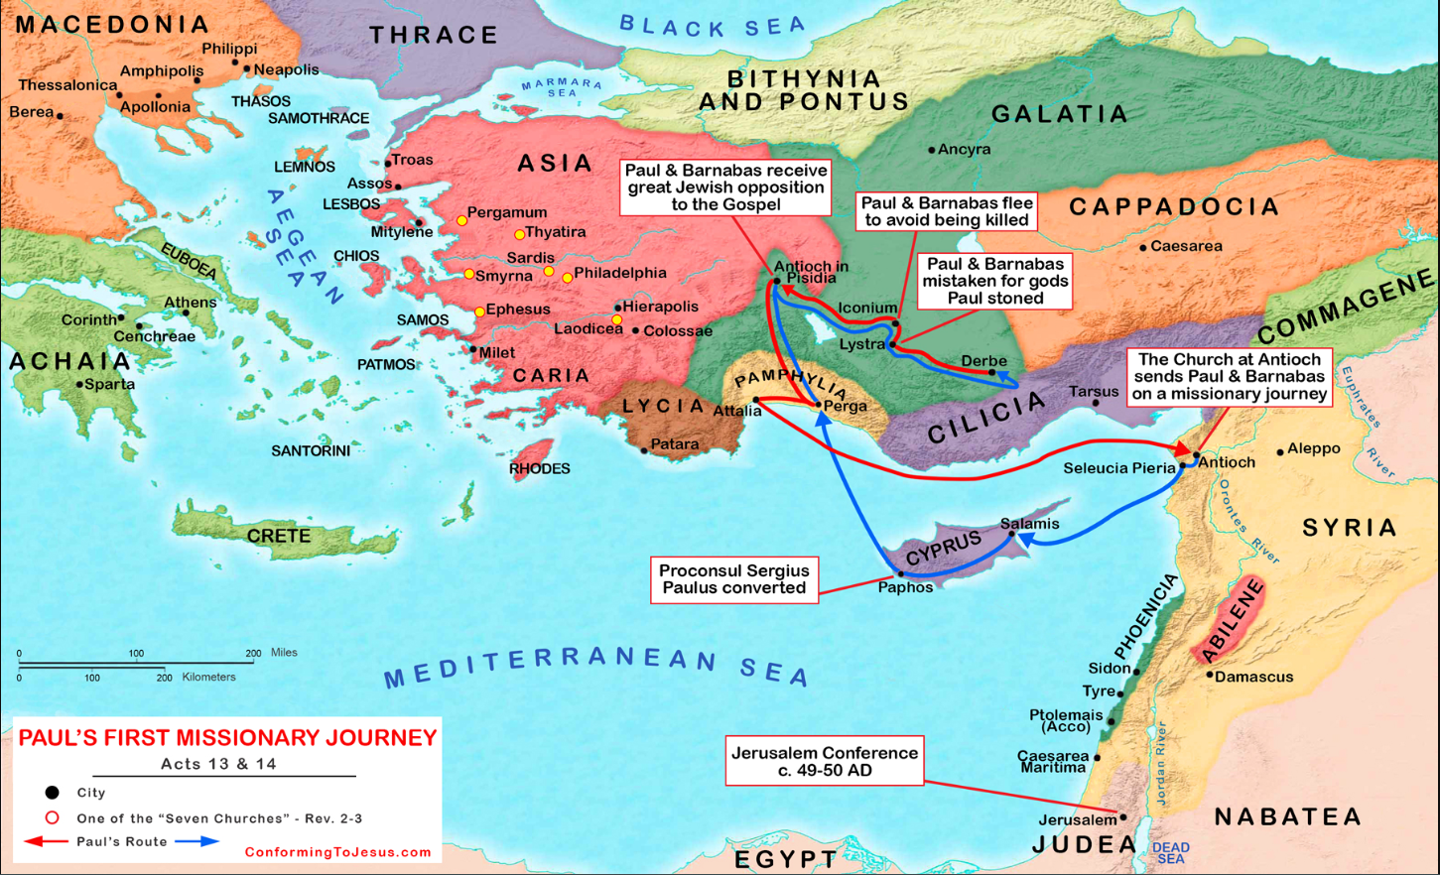

Slide 35
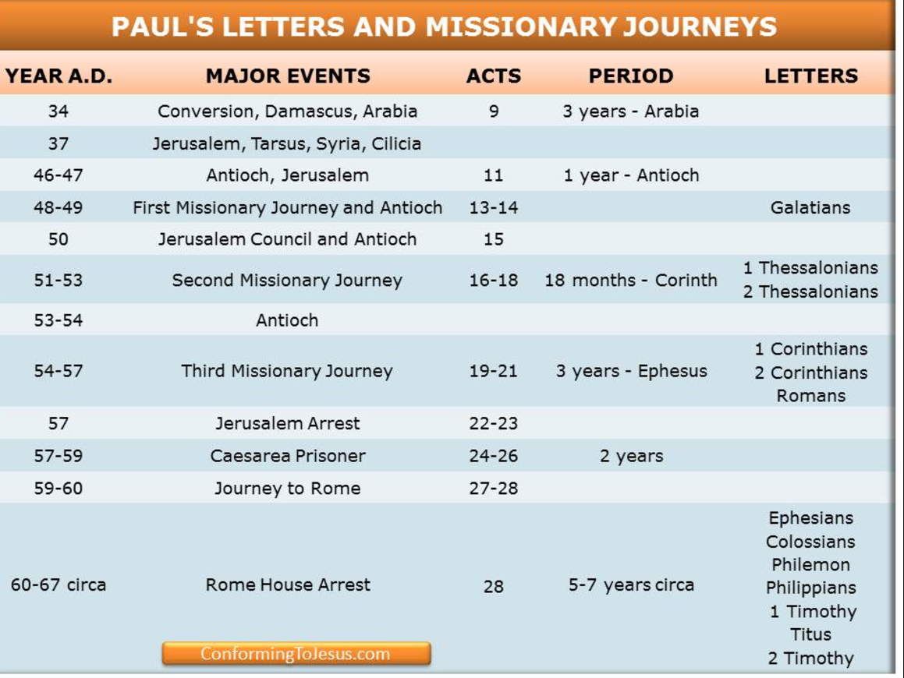

Slide 36
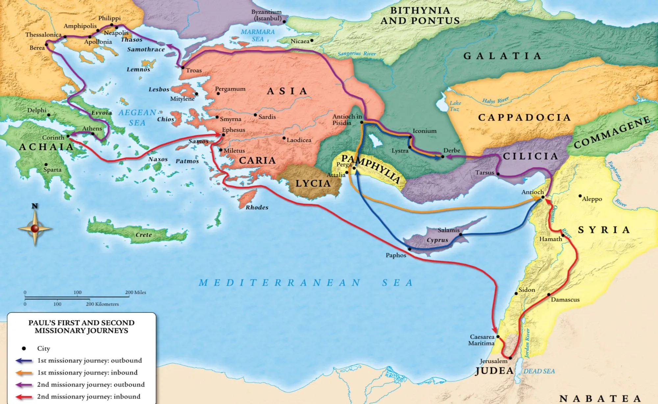
Galatia 1st and 2nd Journeys
Notes:
The KJV translates Strong's G4198 in the following manner: go (117x), depart (11x), walk (9x), go (one's) way (8x), miscellaneous (9x).

Slide 37
Galatia 1st and 2nd Journeys
Notes:
The KJV translates Strong's G4198 in the following manner: go (117x), depart (11x), walk (9x), go (one's) way (8x), miscellaneous (9x).

Slide 38
Galatia 1st and 2nd Journeys
Notes:
The KJV translates Strong's G4198 in the following manner: go (117x), depart (11x), walk (9x), go (one's) way (8x), miscellaneous (9x).

Slide 40
