Slide 1
Exploring Galatia

Slide 2
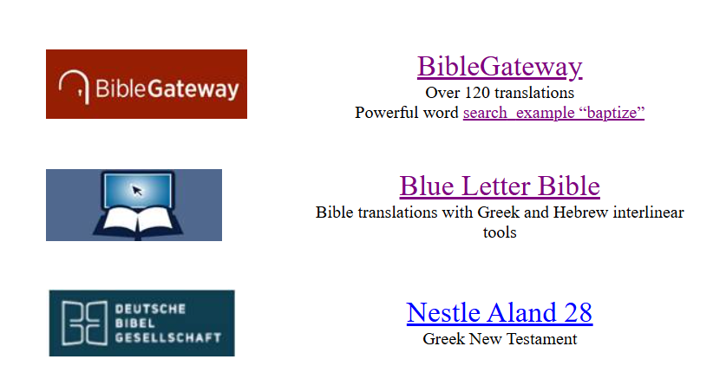
weldonbeardain.website

Slide 3
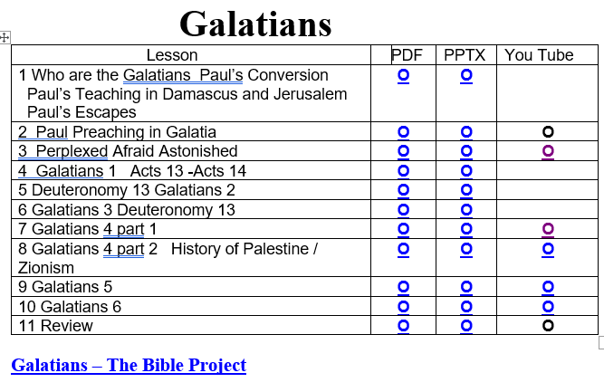
weldonbeardain.website

Slide 4
Galatians Overview
1 Amazed / Anathema
2 Titus at Jerusalem Council / Peter Confronted in Antioch
3 Bewitched (children of Abraham)/ Promised (seed) // School Master- Student
4 Slave- Free // Sarah- Hagar Allegory
5 Freedom in Christ Slavey in Circumcision / / Flesh- Spirit
6 Restoring (and bearing) those who have slipped up / / LARGE LETTERTRS – BOAST IN CHRIST

Slide 5
Galatians Review
From where did the Galatians Originate?

Slide 6
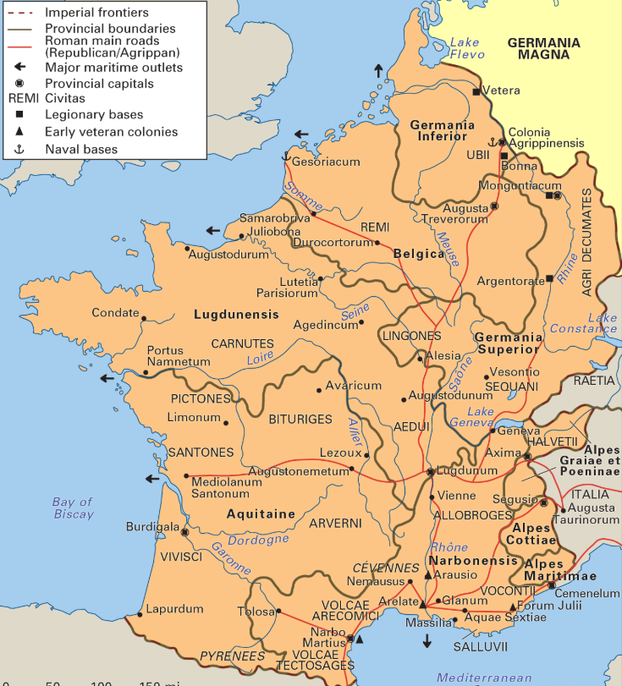
Gaul

Slide 7
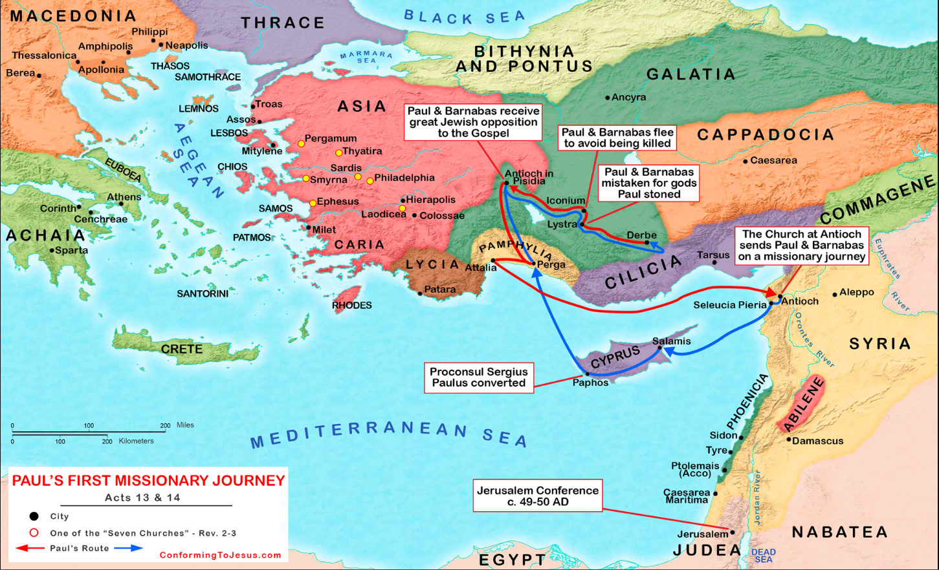

Slide 8
Galatians Review
What cities did Paul visit in Galatia?
How do we know?

Slide 9
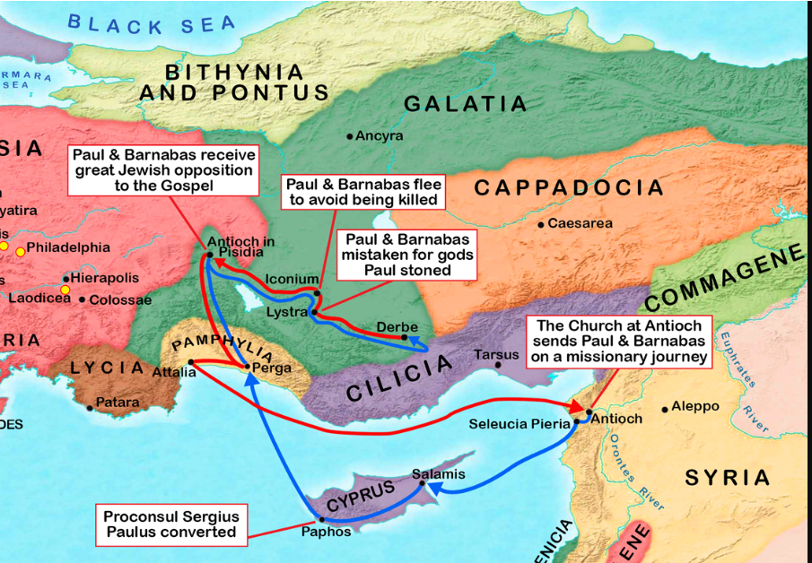

Slide 10
Galatians Review
What key concept summary is in the sermon to Pisidian Antioch?

Slide 11
Galatians Review
What key concept summary is in the sermon to Pisidian Antioch?
³⁸ Therefore let it be known to you, brethren, that through this Man is preached to you the forgiveness of sins; ³⁹ and by Him everyone who believes is justified from all things from which you could not be justified by the law of Moses. (NKJV)

Slide 12
Galatians Review
What key concept summary is in the sermon to Pisidian Antioch?
³⁸ “Therefore, my friends, I want you to know that through Jesus the forgiveness of sins is proclaimed to you. ³⁹ Through him everyone who believes is set free from every sin, a justification you were not able to obtain under the law of Moses.(NIV)

Slide 13
Galatians Review
What primary issue is Paul addressing in the book of Galatians?

Slide 14
Galatians Review
What primary issue is Paul addressing in the book of Galatians? Judaizing Teachers

Slide 15
Galatians Review
What primary issue is Paul addressing in the book of Galatians? Judaizing Teachers
Believe in Christ. The Law is not able to remove sin.

Slide 16
Galatians Review
What primary issue is Paul addressing in the book of Galatians? Judaizing Teachers
Believe in Christ. The Law is not able to remove sin.
It’s Faith not the Law.

Slide 17
Galatians 1
^{3 …………………….}Lord Jesus Christ, ⁴ who gave himself for our sins to rescue us from the present evil age

Slide 18
Galatians Review
Why does Paul use the word anathema is Chapter 1?

Slide 19
Galatians 1
⁶ I am astonished that you are so quickly deserting the one who called you to live in the grace of Christ and are turning to a different gospel
⁸ But even if we, or an angel from heaven, preach any other gospel to you than what we have preached to you, let him be ^{[b]}accursed. ⁹ As we have said before, so now I say again, if anyone preaches any other gospel to you than what you have received, let him be accursed. (NKJV) b Galatians 1:8 Gr. anathema

Slide 20
Galatians 2
Discuss way it may have been important that Titus accompanied Paul and Barnabas to Jerusalem?

Slide 21
Galatians 2
Why did Paul “withstand to Peter’s face?

Slide 22
Galatians 2
Why did Paul “withstand to Peter’s face?
¹⁶ knowing that a man is not justified by the works of the law but by faith in Jesus Christ, even we have believed in Christ Jesus, that we might be justified by faith in Christ and not by the works of the law; for by the works of the law no flesh shall be justified.

Slide 23
Galatians 2
Why did Paul “withstand to Peter’s face?
¹⁶ knowing that a man is not justified by the works of the law but by faith in Jesus Christ, even we have believed in Christ Jesus, that we might be justified by faith in Christ and not by the works of the law; for by the works of the law no flesh shall be justified.
It’s Faith not the Law.

Slide 24
Galatians 3
3 O foolish Galatians! Who has bewitched you
¹¹ But that no one is justified by the law in the sight of God is evident, for “the just shall live by faith.” ¹² Yet the law is not of faith, but “the man who does them shall live by them.”

Slide 25
Galatians 3
3 O foolish Galatians! Who has bewitched you
¹¹ But that no one is justified by the law in the sight of God is evident, for “the just shall live by faith.” ¹² Yet the law is not of faith, but “the man who does them shall live by them.”
It’s Faith not the Law.

Slide 26
Galatians 3
3 O foolish Galatians! Who has bewitched you
¹⁶ Now to Abraham and his Seed were the promises made. He does not say, “And to seeds,” as of many, but as of one, “And to your Seed,” who is Christ. (NKJV)

Slide 27
Galatians 3
²⁵ But after faith has come, we are no longer under a tutor.
²⁶ For you are all sons of God through faith in Christ Jesus. ²⁷ For as many of you as were baptized into Christ have put on Christ.
(NKJV)

Slide 28
Galatians 3
²⁵ But after faith has come, we are no longer under a tutor.
²⁶ For you are all sons of God through faith in Christ Jesus. ²⁷ For as many of you as were baptized into Christ have put on Christ.
(NKJV)
Law.
It’s Faith not the Law.

Slide 29
Galatians 4
²⁸ Now you, brothers and sisters, like Isaac, are children of promise. ²⁹ At that time the son born according to the flesh persecuted the son born by the power of the Spirit. It is the same now. ³⁰ But what does Scripture say? “Get rid of the slave woman and her son, for the slave woman’s son will never share in the inheritance with the free woman’s son.” ³¹ Therefore, brothers and sisters, we are not children of the slave woman, but of the free woman.

Slide 30
Galatians 4
²⁸ Now you, brothers and sisters, like Isaac, are children of promise. ²⁹ At that time the son born according to the flesh persecuted the son born by the power of the Spirit. It is the same now. ³⁰ But what does Scripture say? “Get rid of the slave woman and her son, for the slave woman’s son will never share in the inheritance with the free woman’s son.” ³¹ Therefore, brothers and sisters, we are not children of the slave woman, but of the free woman. What has Paul called the Galatians at this Point ?

Slide 31
Galatians 4
²⁴ These things are being taken figuratively: The women represent two covenants. One covenant is from Mount Sinai and bears children who are to be slaves: This is Hagar. ²⁵ Now Hagar stands for Mount Sinai in Arabia and corresponds to the present city of Jerusalem, because she is in slavery with her children. ²⁶ But the Jerusalem that is above is free, and she is our mother.

Slide 32
Galatians 4
²⁴ These things are being taken figuratively: The women represent two covenants. One covenant is from Mount Sinai and bears children who are to be slaves: This is Hagar. ²⁵ Now Hagar stands for Mount Sinai in Arabia and corresponds to the present city of Jerusalem, because she is in slavery with her children. ²⁶ But the Jerusalem that is above is free, and she is our mother. Where do the Judaizers Stand?

Slide 33
Galatians 4
²⁴ These things are being taken figuratively: The women represent two covenants. One covenant is from Mount Sinai and bears children who are to be slaves: This is Hagar. ²⁵ Now Hagar stands for Mount Sinai in Arabia and corresponds to the present city of Jerusalem, because she is in slavery with her children. ²⁶ But the Jerusalem that is above is free, and she is our mother. Where do the Judaizers Stand?
Can you be a slave and free at the same time?

Slide 34
Galatians
Chater 2-3 contrasts
Living by Faith
Living by the Law
Chater 4 contrasts
Freedom
Sarah
Promise
New Jerusalem
Slavery
Hagar
Mt. Sinai
Present Jerusalem
Chater 5 contrasts
Living in the Spirit
Living in the Flesh

Slide 35
Galatians 5 Freedom in Christ
⁵ For through the Spirit we eagerly await by faith the righteousness for which we hope. ⁶ For in Christ Jesus neither circumcision nor uncircumcision has any value. The only thing that counts is faith expressing itself through love.

Slide 36
Galatians 5 Freedom in Christ
⁵ For through the Spirit we eagerly await by faith the righteousness for which we hope. ⁶ For in Christ Jesus neither circumcision nor uncircumcision has any value. The only thing that counts is faith expressing itself through love.
It’s Faith not the Law.

Slide 37
Galatians 5 Freedom in Christ
¹⁶ So I say, walk by the Spirit, and you will not gratify the desires of the flesh. ¹⁷ For the flesh desires what is contrary to the Spirit, and the Spirit what is contrary to the flesh. They are in conflict with each other, so that you are not to do whatever you want
Spirit
Flesh

Slide 38
Galatians 5 Freedom in Christ
. ¹⁹ The acts of the flesh are obvious: sexual immorality, impurity and debauchery; ²⁰ idolatry and witchcraft; hatred, discord, jealousy, fits of rage, selfish ambition, dissensions, factions ²¹ and envy; drunkenness, orgies, and the like. I warn you, as I did before, that those who live like this will not inherit the kingdom of God..
Freedom does not allow this
Flesh

Slide 39
Galatians 5 Freedom in Christ
. ¹⁹ The acts of the flesh are obvious: sexual immorality, impurity and debauchery; ²⁰ idolatry and witchcraft; hatred, discord, jealousy, fits of rage, selfish ambition, dissensions, factions ²¹ and envy; drunkenness, orgies, and the like. I warn you, as I did before, that those who live like this will not inherit the kingdom of God..
Freedom does not allow this
Flesh

Slide 40
Galatians 5 Freedom in Christ
²² But the fruit of the Spirit is love, joy, peace, forbearance, kindness, goodness, faithfulness, ²³ gentleness and self-control. Against such things there is no law. ²⁴ Those who belong to Christ Jesus have crucified the flesh with its passions and desires. ²⁵ Since we live by the Spirit, let us keep in step with the Spirit. ²⁶ Let us not become conceited, provoking and envying each other.
Spirit

Slide 41
Galatians 5 Freedom in Christ
Based on the preceding slides how may this question be reformulated?
Can you be an you be a slave and free at the same time?

Slide 42
Galatians 5 Freedom in Christ
Can you live in the flesh and the spirit at the same time?

Slide 43
Galatians 6
Restore and Carry
6 Brothers and sisters, if someone is caught in a sin, you who live by the Spirit should restore that person gently. But watch yourselves, or you also may be tempted.
We are in a spiritual battle. We are not to kill the wounded

Slide 44
Galatians 6
Restore and Carry
² Carry each other’s burdens, and in this way you will fulfill the law of Christ.

Slide 45
Galatians 6 notes
Not Circumcision but the New Creation
¹¹ See what large letters I use as I write to you with my own hand!
Paul writing large may be due to a physical affliction. He may have had poor eyesight from his Damascus encounter and could have damaged hands from stonings and beatings. In any case he wanted to write this last section with a point of emphasis.

Slide 46
Galatians 6
¹² Those who want to impress people by means of the flesh are trying to compel you to be circumcised. The only reason they do this is to avoid being persecuted for the cross of Christ. ¹³ Not even those who are circumcised keep the law, yet they want you to be circumcised that they may boast about your circumcision in the flesh.

Slide 47
Galatians 6
¹² Those who want to impress people by means of the flesh are trying to compel you to be circumcised. The only reason they do this is to avoid being persecuted for the cross of Christ. ¹³ Not even those who are circumcised keep the law, yet they want you to be circumcised that they may boast about your circumcision in the flesh.
How effective is he Law for he Judaizers?

Slide 48
Galatians 6
¹⁵ Neither circumcision nor uncircumcision means anything; what counts is the new creation. ¹⁶ Peace and mercy to all who follow this rule—to the Israel of God.

Slide 49
Galatians 6
¹⁵ Neither circumcision nor uncircumcision means anything; what counts is the new creation. ¹⁶ Peace and mercy to all who follow this rule—to the Israel of God.
How is it we are a new creation?

Slide 50
Galatians 6
¹⁵ Neither circumcision nor uncircumcision means anything; what counts is the new creation. ¹⁶ Peace and mercy to all who follow this rule—to the Israel of God.
How is it we are a new creation?
It’s Faith not the Law.

Slide 51
Galatians Review
What key concept summary is in the sermon to Pisidian Antioch?
³⁸ Therefore let it be known to you, brethren, that through this Man is preached to you the forgiveness of sins; ³⁹ and by Him everyone who believes is justified from all things from which you could not be justified by the law of Moses. (NKJV)

Slide 52
Galatians Review
What key concept summary is in the sermon to Pisidian Antioch?
³⁸ “Therefore, my friends, I want you to know that through Jesus the forgiveness of sins is proclaimed to you. ³⁹ Through him everyone who believes is set free from every sin, a justification you were not able to obtain under the law of Moses.(NIV)

Slide 53
Acts 13:38
Textus Receptus (Latin for Received Text) 13:38 γνωστὸν οὖν ἔστω ὑμῖν ἄνδρες ἀδελφοί ὅτι διὰ τούτου ὑμῖν ἄφεσις ἁμαρτιῶν καταγγέλλεται) Morphological GNT (MGNT) 13:38 γνωστὸν οὖν ἔστω ὑμῖν ἄνδρες ἀδελφοί ὅτι διὰ τούτου ὑμῖν ἄφεσις ἁμαρτιῶν καταγγέλλεται NA28 13:38 γνωστὸν οὖν ἔστω ὑμῖν, ἄνδρες ἀδελφοί, ὅτι διὰ τούτου ὑμῖν ἄφεσις ἁμαρτιῶν καταγγέλλεται

Slide 54
Acts 13:38

Slide 55
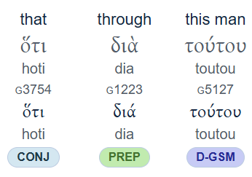
Acts 13:38

Slide 56
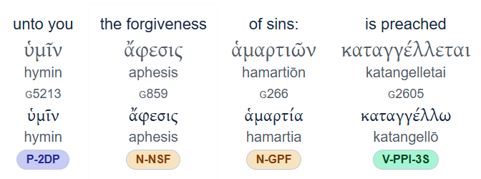
Acts 13:38

Slide 57
Palestine Information
In 1850, according to the Ottoman census provincial yearbook, Palestine had 63,659 recorded households. Roughly 85% were Muslim, 11% were Christian and 4% Jewish.
.[

Slide 58
Palestine Information
In 1850, according to the Ottoman census provincial yearbook, Palestine had 63,659 recorded households. Roughly 85% were Muslim, 11% were Christian and 4% Jewish.
.[

Slide 59
Anti-Zionism
Opposition to Zionism in the Jewish diaspora was diminished only from the 1930s onward, as conditions for Jews deteriorated radically in Europe and, with the Second World War, the sheer scale of the Holocaust was felt.
https://en.wikipedia.org/wiki/Anti-Zionism

Slide 60
Christian Zionism
Christian Zionism is a political and religious ideology that, in a Christian context, espouses the return of the Jewish people to the Holy Land. Likewise, it holds that the founding of the State of Israel in 1948 was in accordance with biblical prophecies transmitted through the Old Testament: that the re-establishment of Jewish sovereignty in the Levant—the eschatological "Gathering of Israel"—is a prerequisite for the Second Coming of Jesus Christ.

