Slide 1
Exploring Galatia

Slide 2
Exploring Churches in Galatia
Starting with Paul’s conversion and travels, the first missionary journey will take us to the locale and establishment of the first churches in Galatia. The Judaizing element challenges the sufficiency of Christ leading Paul to write his harshest letter which deals directly with this issue..

Slide 3
Exploring Churches in Galatia
Galatians is written to these churches which have been infiltrated by Judaizing teachers that insist that the new Christians were obligated to observe Jewish laws in order to be in a “correct” relationship with God. Paul’s response is direct and uncompromising as he confronts those adding a burden to those who have been set free

Slide 4
Exploring Churches in Galatia
The backstory of the Apostle and the Galatian churches comes from Acts

Slide 5
Exploring Churches in Galatia
Who are the Galatians ?

Slide 6
Exploring Churches in Galatia
The Gauls, also known as the Galatians, began moving into the central Turkey region around 278-277 BCE. They were invited by Nicomedes I of Bithynia to help in his conflict with his brother, Zipoetes II. After helping Nicomedes I, the Galatians settled in the region and established their presence in what became known as Galatia.

Slide 7
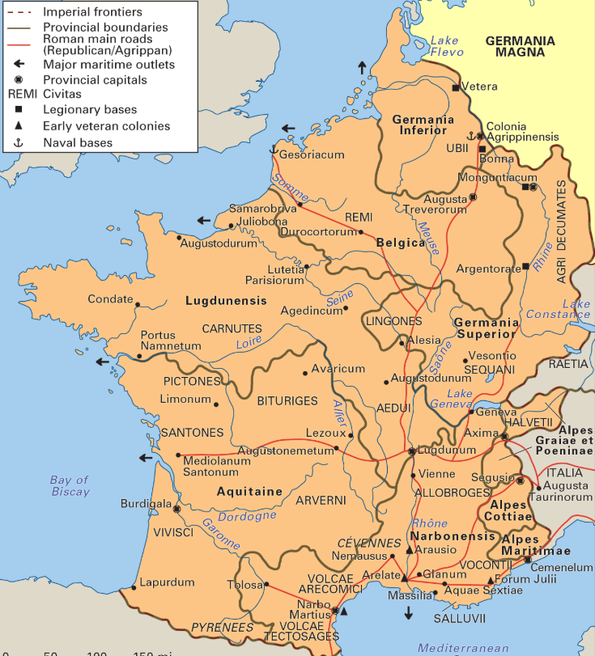
Gaul

Slide 8
Exploring Churches in Galatia
Gaul, the region inhabited by the ancient Gauls, comprising modern-day France and parts of Belgium, western Germany, and northern Italy. A Celtic people, the Gauls lived in an agricultural society divided into several tribes ruled by a landed class. https://www.britannica.com/place/Gaul-ancient-region-Europe

Slide 9
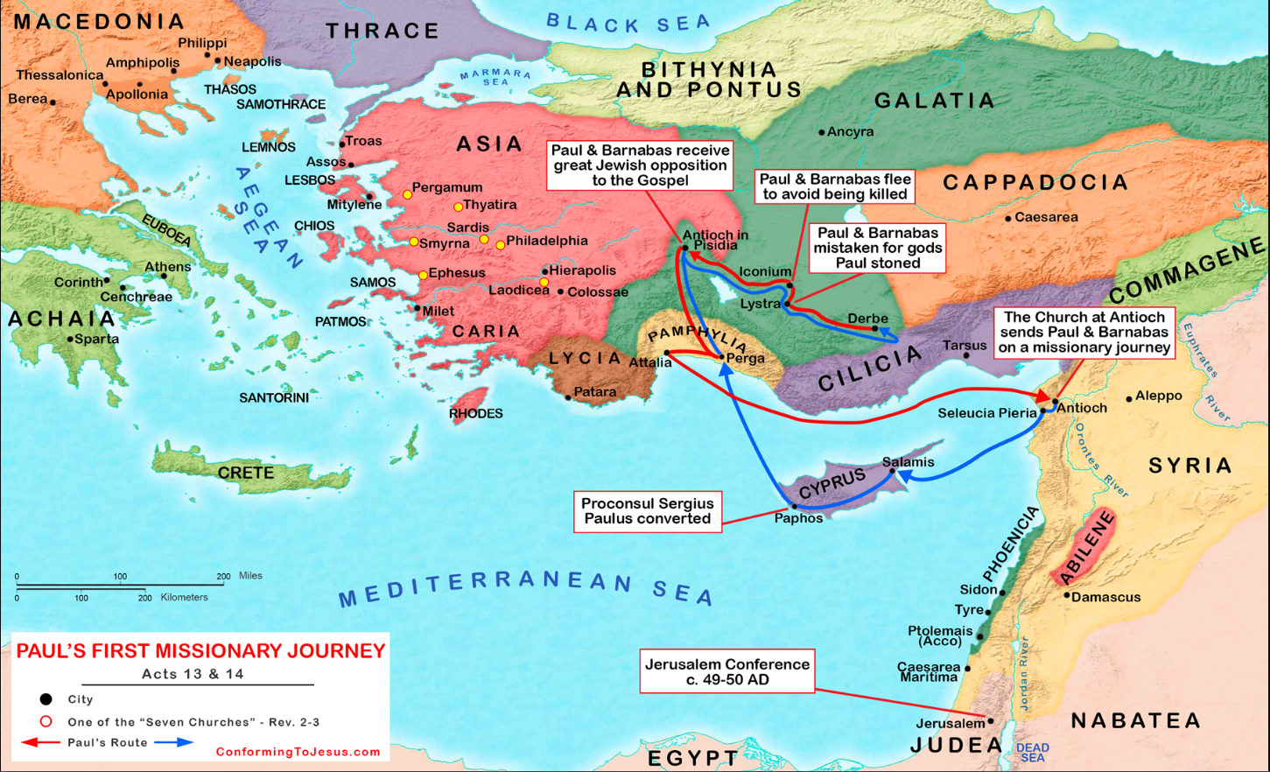

Slide 10
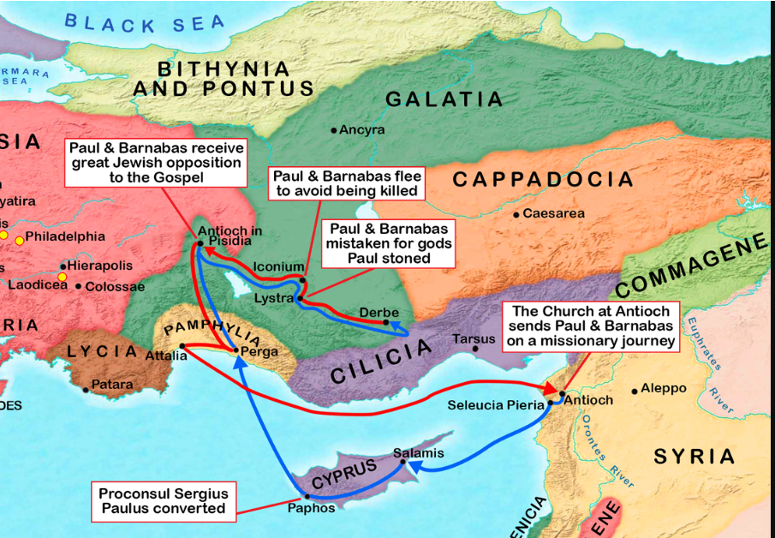

Slide 11
Acts 2
Parthians, and Medes, and Elamites, and the dwellers in Mesopotamia, and in Judaea, and Cappadocia, in Pontus, and Asia,
¹⁰ Phrygia, and Pamphylia, in Egypt, and in the parts of Libya about Cyrene, and strangers of Rome, Jews and proselytes,
¹¹ Cretes and Arabians, we do
.

Slide 12
Exploring Churches in Galatia
Lystra, an ancient city in central Anatolia (modern-day Turkey), was settled around 6 BC when the Roman Empire made it a colony under the name Colonia Iulia Felix Gemina. This was part of Rome's efforts to gain better control over the tribes in the region1

Slide 13
Exploring Churches in Galatia
Iconium, known today as Konya, has a long history of settlement. The earliest known settlement in the area dates back to around 7100 BC with the Neolithic site of Çatalhöyük. This proto-city settlement flourished around 7000 BC and continued until about 5600 BC. The city itself, as Iconium, was later established by the Hittites and became an important city in the region. It was later known as Colonia Iconium during the Roman period

Slide 14
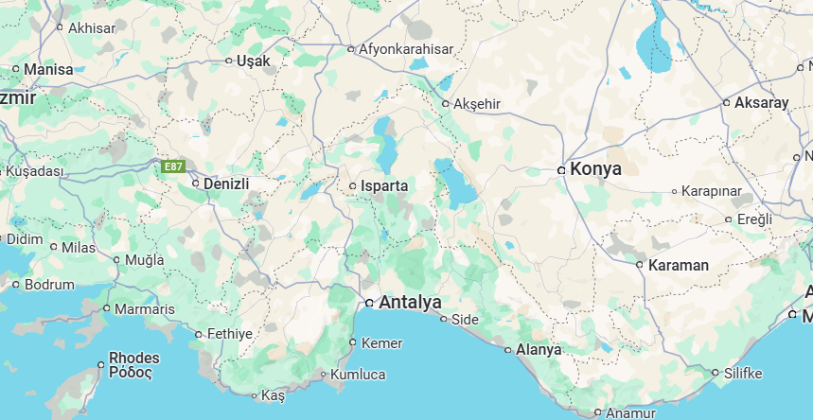

Slide 15
Exploring Churches in Galatia
Derbe, an ancient city in the region of Lycaonia (modern-day Turkey), was settled around 6 BC during the Roman period. It later became part of the Roman province of Galatia

Slide 16
Exploring Churches in Galatia
Antioch in Pisidia, also known as Antiochia in Pisidia, was founded in the last quarter of the 3rd century BC by the Seleucid Dynasty. However, it only gained prominence after it was refounded as a Roman colony by Augustus in 25 BC.

Slide 17
Exploring Churches in Galatia
Augustus (27 BC - 14 AD): The first Roman emperor, who established the Roman Empire and ruled from 27 BC to 14 CE.
Tiberius (14-37 AD): Augustus' stepson and successor, known for his reclusive and paranoid rule.
Caligula (37-41 AD): Known for his eccentric and cruel behavior, his reign was marked by extravagance and tyranny.
Claudius (41-54 AD): Despite being considered an unlikely candidate, he proved to be an effective emperor.
Nero (54-68 AD): Famous for his artistic ambitions and the Great Fire of Rome, his rule ended in rebellion and his suicide.

Slide 18
Exploring Churches in Galatia
Augustus (27 BC - 14 AD
Tiberius (14-37) AD
Caligula (37-41) AD.
Claudius (41-54) AD
Nero (54-68) AD.

Slide 20
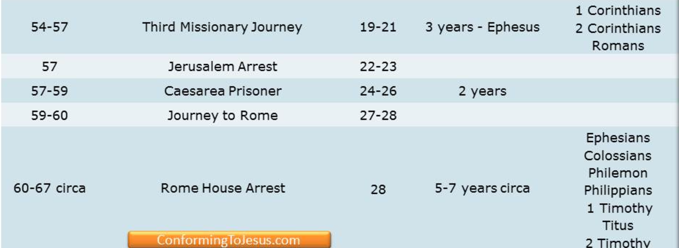

Slide 21
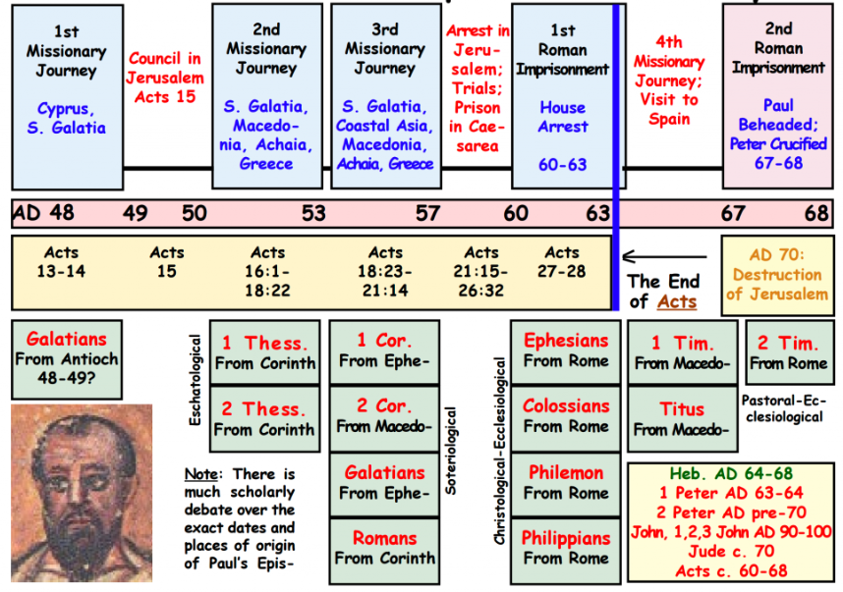

Slide 22
Saul Acts 6 Stephens’s Credentials
⁵ This proposal (choose someone to feed widows) pleased the whole group. They chose Stephen, a man full of faith and of the Holy Spirit; ……….⁶ They presented these men to the apostles, who prayed and laid their hands on them.
….number of disciples in Jerusalem increased rapidly, and a large number of priests became obedient to the faith.

Slide 23
Saul Acts 6 Stephens’s Credentials
⁸ Now Stephen, a man full of God’s grace and power, performed great wonders and signs among the people. ⁹ Opposition arose, however, from members of the Synagogue of the Freedmen (as it was called)—Jews of Cyrene and Alexandria as well as the provinces of Cilicia and Asia—who began to argue with Stephen. ¹⁰ But they could not stand up against the wisdom the Spirit gave him as he spoke.

Slide 24
Saul Acts 7 Stephens’s Lesson
⁵¹ “You stiff-necked people! Your hearts and ears are still uncircumcised. You are just like your ancestors: You always resist the Holy Spirit! ………⁵⁴ When the members of the Sanhedrin heard this, they were furious and gnashed their teeth at him. ⁵⁵ But Stephen, full of the Holy Spirit, looked up to heaven and saw the glory of God, and Jesus standing at the right hand of God. ⁵⁶ “Look,” he said, “I see heaven open and the Son of Man standing at the right hand of God.”

Slide 25
Saul Acts 7 Stephens’s Lesson
⁵¹ “You stiff-necked people! Your hearts and ears are still uncircumcised. You are just like your ancestors: You always resist the Holy Spirit! ………⁵⁴ When the members of the Sanhedrin heard this, they were furious and gnashed their teeth at him. ⁵⁵ But Stephen, full of the Holy Spirit, looked up to heaven and saw the glory of God, and Jesus standing at the right hand of God. ⁵⁶ “Look,” he said, “I see heaven open and the Son of Man standing at the right hand of God.”

Slide 26
Saul Acts 7 Stephens’s Lesson
⁵⁷ At this they covered their ears and, yelling at the top of their voices, they all rushed at him, ⁵⁸ dragged him out of the city and began to stone him. Meanwhile, the witnesses laid their coats at the feet of a young man named Saul.
⁵⁹ While they were stoning him, Stephen prayed, “Lord Jesus, receive my spirit.” ⁶⁰ Then he fell on his knees and cried out, “Lord, do not hold this sin against them.” When he had said this, he fell asleep.

Slide 27
Saul Acts 8 Saul’s zeal against “the way”
8 And Saul approved of their killing him.
The Church Persecuted and Scattered
On that day a great persecution broke out against the church in Jerusalem, and all except the apostles were scattered throughout Judea and Samaria. ² Godly men buried Stephen and mourned deeply for him. ³ But Saul began to destroy the church. Going from house to house, he dragged off both men and women and put them in prison.

Slide 28
Saul Acts 9 Saul’s zeal against “the way”
9 Meanwhile, Saul was still breathing out murderous threats against the Lord’s disciples. He went to the high priest ² and asked him for letters to the synagogues in Damascus, so that if he found any there who belonged to the Way, whether men or women, he might take them as prisoners to Jerusalem.

Slide 29
Saul Acts 8 Saul’s conversion
³ As he neared Damascus on his journey, suddenly a light from heaven flashed around him. ⁴ He fell to the ground and heard a voice say to him, “Saul, Saul, why do you persecute me?”

Slide 30
Saul Acts 8 Saul’s conversion
³ As he neared Damascus on his journey, suddenly a light from heaven flashed around him. ⁴ He fell to the ground and heard a voice say to him, “Saul, Saul, why do you persecute me?”
⁵ “Who are you, Lord?” Saul asked.
“I am Jesus, whom you are persecuting,” he replied. ⁶ “Now get up and go into the city, and you will be told what you must do.”

Slide 31
Saul Acts 9 Saul’s zeal against “the way”
⁷ The men traveling with Saul stood there speechless; they heard the sound but did not see anyone. ⁸ Saul got up from the ground, but when he opened his eyes he could see nothing. So they led him by the hand into Damascus. ⁹ For three days he was blind, and did not eat or drink anything.

Slide 32
Saul Acts 9 Saul’s conversion”
⁷ The men traveling with Saul stood there speechless; they heard the sound but did not see anyone. ⁸ Saul got up from the ground, but when he opened his eyes he could see nothing. So they led him by the hand into Damascus. ⁹ For three days he was blind, and did not eat or drink anything.

Slide 33
Saul Acts 9 Saul’s conversion”
¹⁰ In Damascus there was a disciple named Ananias. The Lord called to him in a vision, “Ananias!”
“Yes, Lord,” he answered.
¹¹ The Lord told him, for a man from Tarsus named Saul, for he is praying “Go to the house of Judas on Straight Street and ask . ¹² In a vision he has seen a man named Ananias come and place his hands on him to restore his sight.”

Slide 34
Saul Acts 9 Saul’s conversion”
¹³ “Lord,” Ananias answered, “I have heard many reports about this man and all the harm he has done to your holy people in Jerusalem. ¹⁴ And he has come here with authority from the chief priests to arrest all who call on your name.”
¹⁵ But the Lord said to Ananias, . “Go! This man is my chosen instrument to proclaim my name to the Gentiles and their kings and to the people of Israel. ¹⁶ I will show him how much he must suffer for my name”

Slide 35
Saul Acts 9 Saul’s conversion”
¹³ “Lord,” Ananias answered, “I have heard many reports about this man and all the harm he has done to your holy people in Jerusalem. ¹⁴ And he has come here with authority from the chief priests to arrest all who call on your name.”
¹⁵ But the Lord said to Ananias, . “Go! This man is my chosen instrument to proclaim my name to the Gentiles and their kings and to the people of Israel. ¹⁶ I will show him how much he must suffer for my name”

Slide 36
Saul Acts 9 Saul’s conversion”
¹⁷ Then Ananias went to the house and entered it. Placing his hands on Saul, he said, “Brother Saul, the Lord—Jesus, who appeared to you on the road as you were coming here—has sent me so that you may see again and be filled with the Holy Spirit.” ¹⁸ Immediately, something like scales fell from Saul’s eyes, and he could see again. He got up and was baptized, ¹⁹ and after taking some food, he regained his strength.

Slide 37
Saul Acts 9 Saul preaching in Damascus
Saul spent several days with the disciples in Damascus. ²⁰ At once he began to preach in the synagogues that Jesus is the Son of God. ²¹ All those who heard him were astonished and asked, “Isn’t he the man who raised havoc in Jerusalem among those who call on this name? And hasn’t he come here to take them as prisoners to the chief priests?” ²² Yet Saul grew more and more powerful and baffled the Jews living in Damascus by proving that Jesus is the Messiah.

Slide 38
Saul Acts 9 Saul escaping Damascus
²³ After many days had gone by, there was a conspiracy among the Jews to kill him, ²⁴ but Saul learned of their plan. Day and night they kept close watch on the city gates in order to kill him. ²⁵ But his followers took him by night and lowered him in a basket through an opening in the wall.

Slide 39
Saul Acts 9 Saul escaping Damascus
²³ After many days had gone by, there was a conspiracy among the Jews to kill him, ²⁴ but Saul learned of their plan. Day and night they kept close watch on the city gates in order to kill him. ²⁵ But his followers took him by night and lowered him in a basket through an opening in the wall.
Special mode of operation--- Preach then Escape

Slide 40
Saul Acts 9 Saul preaching in Jerusalem
²⁶ When he came to Jerusalem, he tried to join the disciples, but they were all afraid of him, not believing that he really was a disciple. ²⁷ But Barnabas took him and brought him to the apostles. He told them how Saul on his journey had seen the Lord and that the Lord had spoken to him, and how in Damascus he had preached fearlessly in the name of Jesus. ²⁸ So Saul stayed with them and moved about freely in Jerusalem, speaking boldly in the name of the Lord. ²⁹ He talked and debated with the Hellenistic Jews (then -→)

Slide 41
Saul Acts 9 Saul escaping Jerusalem
] but they tried to kill him. ³⁰ When the believers learned of this, they took him down to Caesarea and sent him off to Tarsus.
(another escape)

Slide 42
Saul Acts 9 Saul escaping Jerusalem
] but they tried to kill him. ³⁰ When the believers learned of this, they took him down to Caesarea and sent him off to Tarsus.
³¹ Then the church throughout Judea, Galilee and Samaria enjoyed a time of peace and was strengthened. Living in the fear of the Lord and encouraged by the Holy Spirit, it increased in numbers

Slide 43
Miracle | Saint | Place | Passage
1. Crippled man healed | Peter | Jerusalem | Acts 3:1-11
2. Death of Ananias and Sapphira | Peter | Jerusalem | Acts 5:1-10
3. Miraculous deeds | Peter | Jerusalem | Acts 5:12-16
4. Conferred the Holy Spirit | Peter | Samaria | Acts 8:14-17
5. Paul’s Conversion | Paul | Between Jerusalem and Damascus | Acts 9:1-9
6. Aeneas healed of palsy | Peter | Lydda | Acts 9:33-34

Slide 44
Miracle | Saint | Place | Passage
7. Tabitha (Dorcas) raised from the dead | Peter | Joppa | Acts 9:36-41
8. Peter rescued from prison by an angel | Peter | Jerusalem | Acts 12:7-17
9. Herod punished with death | Peter | Jerusalem | Acts 12:21-23
10. Elymas the sorcerer is stricken with blindness | Paul | Paphos | Acts 13:6-11
11. A crippled healed | Paul | Lystra | Acts 14:8-10
12. Exorcism of a demon of divination | Paul | Philippi | Acts 16:16-18

Slide 45
Miracle | Saint | Place | Passage
14. Conferred the Holy Spirit | Paul | Corinth | Acts 19:1-6
15. Many persons healed | Paul | Corinth | Acts 19:11-12
16. Eutychus raised from the dead | Paul | Troas | Acts 20:9-12
17. Viper snake rendered harmless | Paul | Malta | Acts 28:3-6
18. Publius’ father and others healed | Paul | Malta | Acts 28:7-9

Slide 46
Perplexed Galatians 4
¹⁹ My dear children, for whom I am again in the pains of childbirth until Christ is formed in you, ²⁰ how I wish I could be with you now and change my tone, because I am perplexed about you!

Slide 47
Perplexed Galatians 4
Perplexed - ἀπορέω ap-or-eh’-o G639
to be without resources, to be in straits, to be left wanting, to be embarrassed, to be in doubt, not to know which way to turn
to be at a loss with one's self, be in doubt
not to know how to decide or what to do, to be perplexed

Slide 48
Perplexed Galatians 4
Go - πορεύω G4198
to lead over, carry over, transfer
to pursue the journey on which one has entered, to continue on one's journey
to depart from life
to follow one, that is: become his adherent
to lead or order one's life
Notes:
The KJV translates Strong's G4198 in the following manner: go (117x), depart (11x), walk (9x), go (one's) way (8x), miscellaneous (9x).

Slide 49
Perplexed Galatians 4
Go - πορεύω G4198
And they were both righteous before God, walking ^{G4198} in all the commandments and ordinances of the Lord blameless. Luke 1:6
Notes:
The KJV translates Strong's G4198 in the following manner: go (117x), depart (11x), walk (9x), go (one's) way (8x), miscellaneous (9x).

Slide 50
Galatia 1st and 2nd Journeys
Notes:
The KJV translates Strong's G4198 in the following manner: go (117x), depart (11x), walk (9x), go (one's) way (8x), miscellaneous (9x).

Slide 53
Galatia 1st and 2nd Journeys
Notes:
The KJV translates Strong's G4198 in the following manner: go (117x), depart (11x), walk (9x), go (one's) way (8x), miscellaneous (9x).

Slide 54
Galatia 1st and 2nd Journeys
Notes:
The KJV translates Strong's G4198 in the following manner: go (117x), depart (11x), walk (9x), go (one's) way (8x), miscellaneous (9x).

Slide 55
Galatia 1st and 2nd Journeys
Notes:
The KJV translates Strong's G4198 in the following manner: go (117x), depart (11x), walk (9x), go (one's) way (8x), miscellaneous (9x).

