Slide 1

∞
We are eternal spiritual beings living in a temporary earthly realm.
Goal: Explore the heavenly realms described in Ephesians and review scriptures in light of what we learn.

Slide 2

Heavenly Realms Ephesians 1:3, 1:20, 2:6, 3:10, 6:12
³ Praise be to the God and Father of our Lord Jesus Christ, who has blessed us in the heavenly realms with every spiritual blessing in Christ.
Notes:
Introduction to the Book of Ephesians, using the Western Heights Church of Christ logo. This presentation will delve into the key themes and messages of the Apostle Paul's letter to the Ephesians, exploring its relevance to modern Christian life.

Slide 3
Heavenly Realms Ephesians 1:3, 1:20, 2:6, 3:10, 6:12
¹⁸ I pray that the eyes of your heart may be enlightened in order that you may know the hope to which he has called you, the riches of his glorious inheritance in his holy people, ¹⁹ and his incomparably great power for us who believe. That power is the same as the mighty strength ²⁰ he exerted when he raised Christ from the dead and seated him at his right hand in the heavenly realms, ²¹ far above all rule and authority, power and dominion, and every name that is invoked, not only in the present age but also in the one to come
Notes:
Introduction to the Book of Ephesians, using the Western Heights Church of Christ logo. This presentation will delve into the key themes and messages of the Apostle Paul's letter to the Ephesians, exploring its relevance to modern Christian life.

Slide 4
Heavenly Realms Ephesians 1:3, 1:20, 2:6, 3:10, 6:12
But because of his great love for us, God, who is rich in mercy, ⁵ made us alive with Christ even when we were dead in transgressions—it is by grace you have been saved. ⁶ And God raised us up with Christ and seated us with him in the heavenly realms in Christ Jesus, ⁷ in order that in the coming ages he might show the incomparable riches of his grace, expressed in his kindness to us in Christ Jesus. ⁸ For it is by grace you have been saved, through faith
Notes:
Introduction to the Book of Ephesians, using the Western Heights Church of Christ logo. This presentation will delve into the key themes and messages of the Apostle Paul's letter to the Ephesians, exploring its relevance to modern Christian life.

Slide 5
Heavenly Realms Ephesians 1:3, 1:20, 2:6, 3:10, 6:12
¹⁰ His intent was that now, through the church, the manifold wisdom of God should be made known to the rulers and authorities in the heavenly realms, ¹¹ according to his eternal purpose that he accomplished in Christ Jesus our Lord. ¹² In him and through faith in him we may approach God with freedom and confidence. ¹³ I ask you, therefore, not to be discouraged because of my sufferings for you, which are your glory.
Notes:
Introduction to the Book of Ephesians, using the Western Heights Church of Christ logo. This presentation will delve into the key themes and messages of the Apostle Paul's letter to the Ephesians, exploring its relevance to modern Christian life.

Slide 6
Heavenly Realms Ephesians 1:3, 1:20, 2:6, 3:10, 6:12
¹² For our struggle is not against flesh and blood, but against the rulers, against the authorities, against the powers of this dark world and against the spiritual forces of evil in the heavenly realms.
Notes:
Introduction to the Book of Ephesians, using the Western Heights Church of Christ logo. This presentation will delve into the key themes and messages of the Apostle Paul's letter to the Ephesians, exploring its relevance to modern Christian life.

Slide 7

Heavenly Realms Ephesians 3:10
Heavenly Realm Aligned with God
Heavenly Realm Not Aligned with God
Plots to kill Jesus as a baby and eliminate him with crucifixion
Heavenly Good news
Physical Realm Aligned with God
Physical Realm Not Aligned with God
Notes:
Introduction to the Book of Ephesians, using the Western Heights Church of Christ logo. This presentation will delve into the key themes and messages of the Apostle Paul's letter to the Ephesians, exploring its relevance to modern Christian life.

Slide 8
Book of Ephesians Unity
⁴ There is one body and one Spirit, just as you were called to one hope when you were called; ⁵ one Lord, one faith, one baptism; ⁶ one God and Father of all, who is over all and through all and in all.

Slide 9
Book of Ephesians Unity
ONENESS
body Spirit hope Lord faith baptism God
ZERO
ONE
MANY

Slide 10
Book of Ephesians Unity
ONENESS
ZERO
ONE
MANY
body Spirit hope Lord faith baptism God
The oneness in Christ has been emphasized demonstrating Jews and Gentiles are now conjoined into one faith. The covenant people of God are now Christians inclusive of Jews and Gentiles men and women, parents and children, masters and slaves and every conceivable station of life. Importance is now on otherhood are we are called to serve others ahead of ourselves.

Slide 11
Book of Ephesians Unity
ONENESS
ZERO
ONE
MANY
body Spirit hope Lord faith baptism God
Kingdoms, kings, priest, and prophets are tried to align themselves with God but they ultimately failed. The blood of bulls and goats was not effective for removing sin so their worship depended on the messiah, Jesus Christ, whose blood of the final covenant continually provides forgiveness, redemption, reconciliation and a spiritual alignment pleasing to God. Halleluiah.

Slide 12
Book of Ephesians Differing Lens
Heavenly Realms
Blessings -- Look at each blessing in Ephesians
Knowledge – Observe references to knowledge Especially in Paul's Prayers
Infinity – Things unfathomable and eternal. God has a multitude of infinite attributes
Once Dead Now Alive. How you once live and how you live now How the world lives and how Christians live
Grace made known and accepted vs. unknow and rejected.
How we should live(walk) , have a new mind, and mature

Slide 13
Book of Ephesians
Heavenly Realms
The Prayer in Chapter 1, Faith and Grace
Spiritual Tools and Heavenly Armor
Spiritual Blessings in Christ
Made Alive in Christ
The New Spiritual Humanity
The Cornerstone and the New Building
Love that is wide, long, and high. The infinite God
Worthy calling - Unity and oneness _
Futile thinking contrasted with Wisdom and Discretion
Quirky things about Ephesians: The Colossian Heresy, Papyrus 46, No serious issues addressed
Chistian Living Impacting Relationships.
12/7
12/21
12/14
Chapter 1
12/28
01/11
01/04
12/28

Slide 14
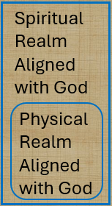

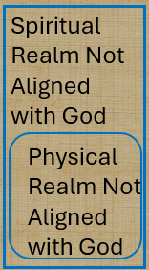
Spiritual Realms (Knowing Theme)
Heard, made known, wisdom, revelation, know Him better, enlightened, know hope, knowledge, insight, discernment, understanding. Made plain
ALIVE
DEAD
¹⁸ being darkened in their understanding, excluded from the life of God because of the ignorance that is in them, because of the hardness of their heart; ¹⁹ and they, having become callous, have given themselves up to indecent behavior for the practice of every kind of impurity with greediness.

Slide 15

Spiritual Realms
Heard, made known, wisdom, revelation, know Him better, enlightened, know hope, knowledge, insight, discernment, understanding. Made plain
ALIVE
DEAD
Islam, Judaism, Atheism, Agnostic,
^{Nothingism (ignoring)}

Slide 16
4 I therefore, the prisoner of the Lord, beseech you that ye walk worthy of the vocation wherewith ye are called,
Epistle | Doctrine | Application
Ephesians | 1-3 | 4-6
Romans | 1-11 | 12-16
Galatians | 1-4 | 5-6
Colossians | 1-2 | 3.4
1 Peter | 1:1 to 2:10 | 2:11 to 5:14
Hebrews | 1:1 top 10:18 | 10:19 to 13:25

Slide 17
Instructions for Christian Living
Take Off | Put On
Old Man | New Man
corrupted by its deceitful desires | new in the attitude of your minds
with regard to your former way of life | created to be like God in true righteousness and holiness
Falsehood | Truth
Anger | Peace
Theft | Generosity

Slide 18
Book of Ephesians Differing Lens
Heavenly Realms
Blessings -- Look at each blessing in Ephesians
Knowledge – Observe references to knowledge Especially in Paul's Prayers
Infinity – Things unfathomable and eternal. God has a multitude of infinite attributes
Once Dead Now Alive. How you once live and how you live now How the world lives and how Christians live
Grace made known and accepted vs. unknow and rejected.
How we should live(walk) , have a new mind, and mature
DOCTRINE
Therefore
APPLICATION

Slide 19
4 I therefore, the prisoner of the Lord, beseech you that ye walk worthy of the vocation wherewith ye are called,
Epistle | Doctrine | Application
Ephesians | 1-3 | 4-6
Romans | 1-11 | 12-16
Galatians | 1-4 | 5-6
Colossians | 1-2 | 3.4
1 Peter | 1:1 to 2:10 | 2:11 to 5:14
Hebrews | 1:1 top 10:18 | 10:19 to 13:25

Slide 20
Book of Ephesians Living as we should
EPH 4:1 As a prisoner for the Lord, then, I urge you to live a life worthy of the calling you have received.
^{COLOSSIANS 1:9} For this reason, since the day we heard about you, we have not stopped praying for you. We continually ask God to fill you with the knowledge of his will through all the wisdom and understanding that the Spirit gives,¹⁰so that you may live a life worthy of the Lord and please him in every way: bearing fruit in every good work, growing in the knowledge of God.

Slide 21
Book of Ephesians Ephesians Living as we should
² Be completely humble and gentle; be patient, bearing with one another in love. ³ Make every effort to keep the unity of the Spirit through the bond of peace.
This chapter has a lot of instructions for Christian living .

Slide 22
Book of Ephesians Maturity and Unity
¹¹ So Christ himself gave the apostles, the prophets, the evangelists, the pastors and teachers, apostles, the prophets, the evangelists, the pastors and teachers,
¹² to equip his people for works of service, so that the body of Christ may be built up ¹³ until we all reach unity in the faith and in the knowledge of the Son of God and become mature, attaining to the whole measure of the fullness of Christ.

Slide 23
Book of Ephesians Maturity
¹⁴ Then we will no longer be infants, tossed back and forth by the waves, and blown here and there by every wind of teaching and by the cunning and craftiness of people in their deceitful scheming.
¹⁵ Instead, speaking the truth in love, we will grow to become in every respect the mature body of him who is the head, that is, Christ. ¹⁶ From him the whole body, joined and held together by every supporting ligament, grows and builds itself up in love, as each part does its work

Slide 24
Book of Ephesians Maturity and Unity
¹⁴ Then we will no longer be infants, tossed back and forth by the waves, and blown here and there by every wind of teaching and by the cunning and craftiness of people in their deceitful scheming.
¹⁵ Instead, speaking the truth in love, we will grow to become in every respect the mature body of him who is the head, that is, Christ. ¹⁶ From him the whole body, joined and held together by every supporting ligament, grows and builds itself up in love, as each part does its work
What is growing?

Slide 25
Book of Hebrews (4) Lack of Maturity
¹¹ We have much to say about this, but it is hard to make it clear to you because you no longer try to understand. ¹² In fact, though by this time you ought to be teachers, you need someone to teach you the elementary truths of God’s word all over again. You need milk, not solid food! ¹³ Anyone who lives on milk, being still an infant, is not acquainted with the teaching about righteousness. ¹⁴ But solid food is for the mature, who by constant use have trained themselves to distinguish good from evil.

Slide 26
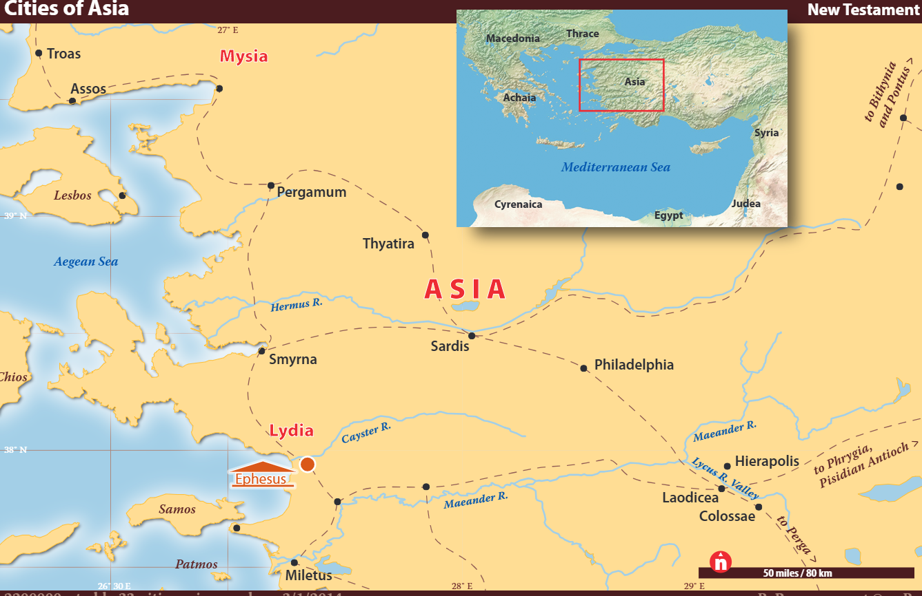
Discuss

Slide 27
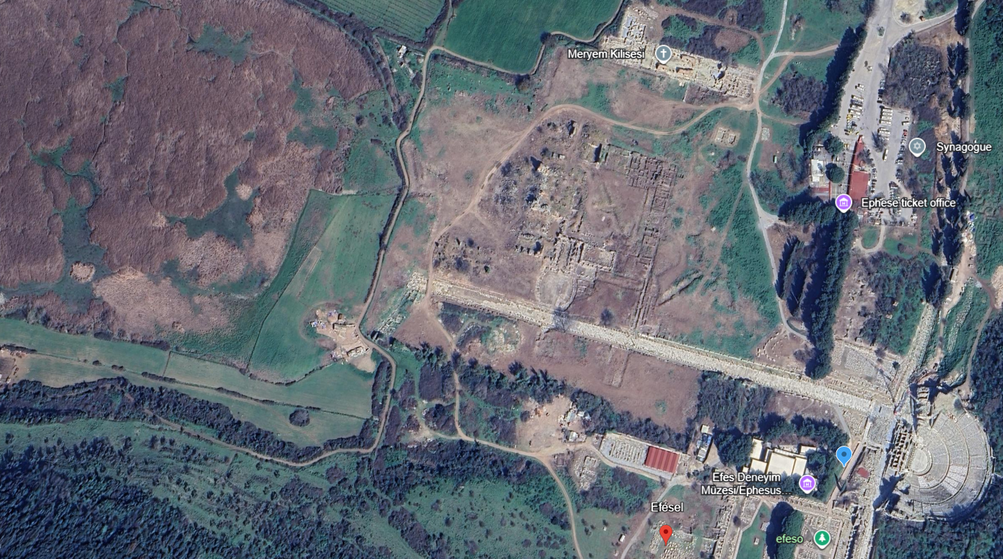
Discuss

Slide 28
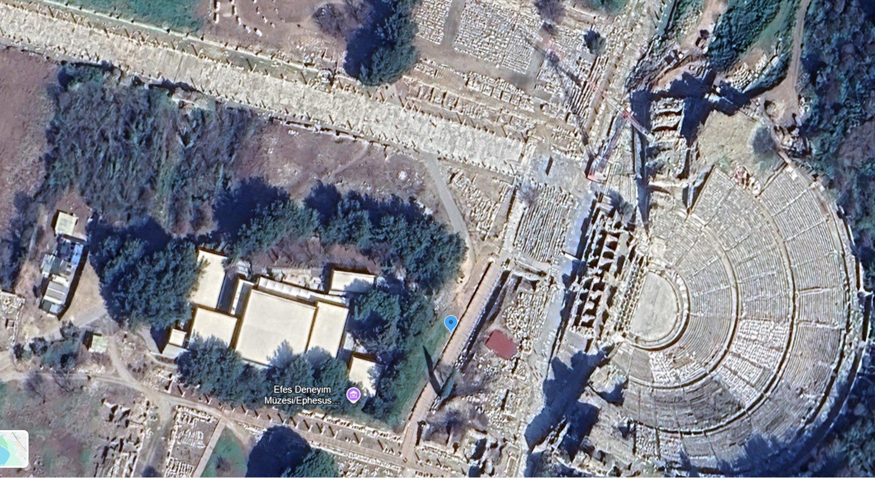
Discuss

Slide 29
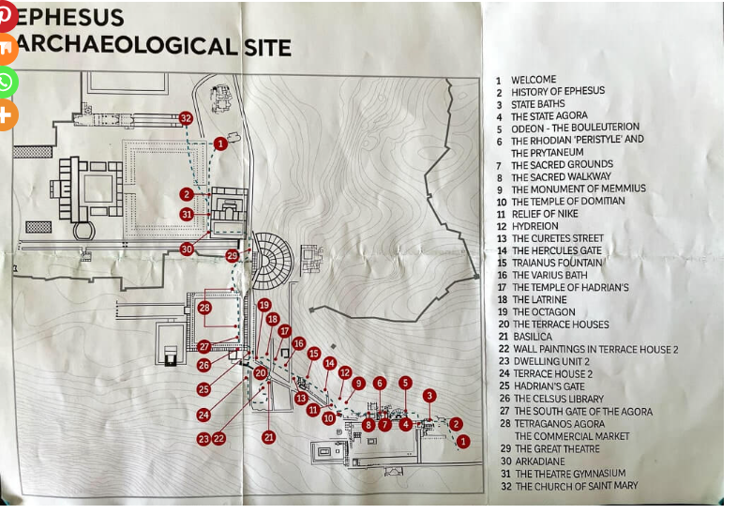

Slide 30
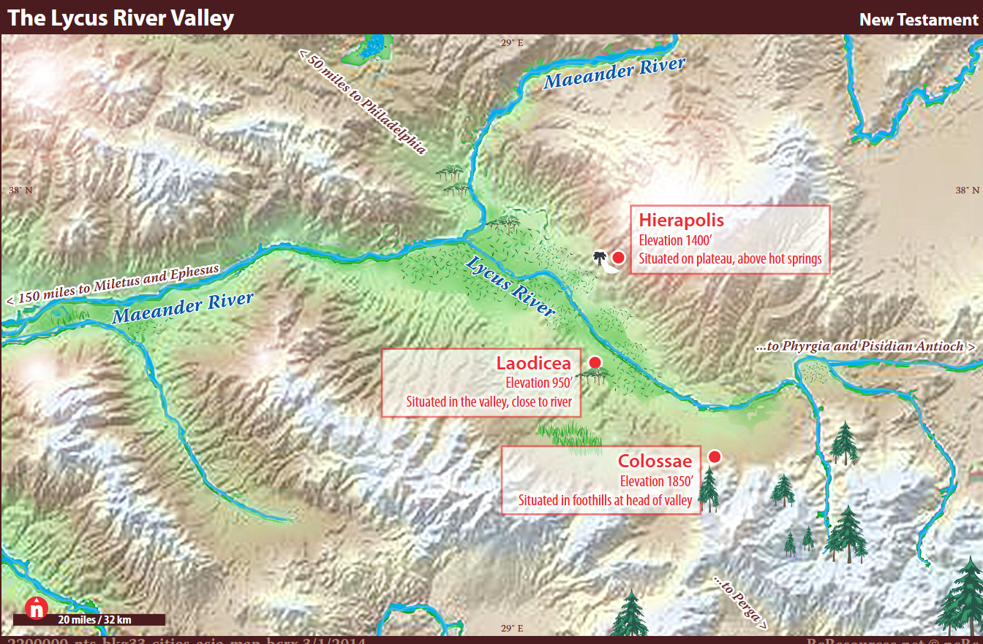

Slide 31
Acts 19 Paul in Ephesus
¹⁶ Then the man who had the evil spirit jumped on them and overpowered them all. He gave them such a beating that they ran out of the house naked and bleeding. ¹⁷ When this became known to the Jews and Greeks living in Ephesus, they were all seized with fear, and the name of the Lord Jesus was held in high honor. ¹⁸ Many of those who believed now came and openly confessed what they had done. ¹⁹ A number who had practiced sorcery brought their scrolls together and burned them publicly. When they calculated the value of the scrolls, the total came to fifty thousand drachmas. ²⁰ In this way the word of the Lord spread widely and grew in power.

Slide 32
Acts 19 Paul in Ephesus
fifty thousand drachmas.
But bullion equivalent calculations do not provide a complete picture of a currency's value. Using a labor-equivalent calculation, a silver drachma (or denarius), which constituted a day's wage for a manual laborer, would be worth approximately the same in modern currency. The United States federal minimum wage's maximum purchasing power was in 1968, when it was $1.60 ($14.47 in 2024), meaning an 8-hour shift paid $12.80 ($115.70 in 2024) Meanwhile, average yearly wages in the United States in 2022 were $77,463 ($83,233 in 2024), meaning a day's wages would be $322.76 ($347.00 in 2024) 50,000 X $200= $10 Millon

Slide 33
Acts 19 Paul in Ephesus
²¹ After all this had happened, Paul decided to go to Jerusalem, passing through Macedonia and Achaia. “After I have been there,” he said, “I must visit Rome also.” ²² He sent two of his helpers, Timothy and Erastus, to Macedonia, while he stayed in the province of Asia a little longer.
The Riot in Ephesus
²³ About that time there arose a great disturbance about the Way. ²⁴ A silversmith named Demetrius, who made silver shrines of Artemis, brought in a lot of business for the craftsmen there.

Slide 34
Acts 19 Paul in Ephesus
. ²⁵ He called them together, along with the workers in related trades, and said: “You know, my friends, that we receive a good income from this business. ²⁶ And you see and hear how this fellow Paul has convinced and led astray large numbers of people here in Ephesus and in practically the whole province of Asia. He says that gods made by human hands are no gods at all. ²⁷ There is danger not only that our trade will lose its good name, but also that the temple of the great goddess Artemis will be discredited; and the goddess herself, who is worshiped throughout the province of Asia and the world, will be robbed of her divine majesty.”

Slide 35
Acts 19 Paul in Ephesus
²⁸ When they heard this, they were furious and began shouting: “Great is Artemis of the Ephesians!” ²⁹ Soon the whole city was in an uproar. The people seized Gaius and Aristarchus, Paul’s traveling companions from Macedonia, and all of them rushed into the theater together. ³⁰ Paul wanted to appear before the crowd, but the disciples would not let him. ³¹ Even some of the officials of the province, friends of Paul, sent him a message begging him not to venture into the theater.

Slide 36
Acts 19 Paul in Ephesus
³² The assembly was in confusion: Some were shouting one thing, some another. Most of the people did not even know why they were there. ³³ The Jews in the crowd pushed Alexander to the front, and they shouted instructions to him. He motioned for silence in order to make a defense before the people. ³⁴ But when they realized he was a Jew, they all shouted in unison for about two hours: “Great is Artemis of the Ephesians!”

Slide 37
Acts 19 Paul in Ephesus
³⁵ The city clerk quieted the crowd and said: “Fellow Ephesians, doesn’t all the world know that the city of Ephesus is the guardian of the temple of the great Artemis and of her image, which fell from heaven? ³⁶ Therefore, since these facts are undeniable, you ought to calm down and not do anything rash. ³⁷ You have brought these men here, though they have neither robbed temples nor blasphemed our goddess. ³⁸ If, then, Demetrius and his fellow craftsmen have a grievance against anybody, the courts are open and there are proconsuls. They can press charges.

Slide 38
Book of Ephesians walk / live worthy of the Lord
EPH 4:1 As a prisoner for the Lord, then, I urge you to live a life worthy of the calling you have received. (NIV)
EPH 4:1 Therefore I, the prisoner of the Lord, implore you to walk in a manner worthy of the calling with which you have been called,(NASB 1995)
EPH 4:1 I therefore, the prisoner of the Lord, beseech you that ye walk worthy of the vocation wherewith ye are called, KJV

Slide 39
Book of Ephesians walk / live worthy of the Lord
EPH 4: ¹⁷ So I tell you this, and insist on it in the Lord, that you must no longer live as the Gentiles do, in the futility of their thinking. (NIV)
EPH 4: ¹⁷So this I say, and affirm together with the Lord, that you walk no longer just as the Gentiles also walk, in the futility of their mind, ¹⁸ being darkened in their understanding,,(NASB 1995)
EPH 4 ¹⁷ This I say therefore, and testify in the Lord, that ye henceforth walk not as other Gentiles walk, in the vanity of their mind, KJV

Slide 40
Book of Colossians walk / live worthy of the Lord
COL 1:9b ask God to fill you with the knowledge of his will through all the wisdom and understanding that the Spirit gives,¹⁰so that you may live a life worthy of the Lord and please him in every way: NIV
COL 1:9b may be filled with the knowledge of His will in all spiritual wisdom and understanding, ¹⁰ so that you will walk in a manner worthy of the Lord, to please Him in all respects, bearing fruit in every good work and increasing in the knowledge of God; NASB 1995
^{COLOSSIANS 1:9b} filled with the knowledge of his will in all wisdom and spiritual understanding; ¹⁰ That ye might walk worthy of the Lord unto all pleasing, being fruitful in every good work, and increasing in the knowledge of God; KJV

Slide 41
Book of 1 Thessalonians walk / live worthy of the Lord
^{2:11} For you know that we dealt with each of you as a father deals with his own children, ¹² encouraging, comforting and urging you to live lives worthy of God, who calls you into his kingdom and glory. NIV
2:12so that you would walk in a manner worthy of the God who calls you into His own kingdom and glory. NASB
^{2:11} As ye know how we exhorted and comforted and charged every one of you, as a father doth his children, ¹² That ye would walk worthy of God, who hath called you unto his kingdom and glory. ¹³ For this cause also thank we God without ceasing, because, when ye received the word of God which ye heard of us, ye received it not as the word of men, but as it is in truth, the word of God, which effectually worketh also in you that believe. KJV

Slide 42
Book of Ephesians walk /live
EPH 4:1 As a prisoner for the Lord, then, I urge you to live a life worthy of the calling you have received. (NIV)
EPH 4:1 Therefore I, the prisoner of the Lord, implore you to walk in a manner worthy of the calling with which you have been called,(NASB 1995)
EPH 4:1 I therefore, the prisoner of the Lord, beseech you that ye walk worthy of the vocation wherewith ye are called, KJV

Slide 43
Book of Ephesians walk /live
Eph 5:8
For ye were sometimes darkness, but now are ye light in the Lord: walk as children of light:
(KJV)
Eph 5:15
See then that ye walk circumspectly, not as fools, but as wise, KJV

Slide 44
Book of Romans walk /live
Rom 8:1There is therefore now no condemnation to them which are in Christ Jesus, who walk not after the flesh, but after the Spirit
Rom 8:4That the righteousness of the law might be fulfilled in us, who walk ^{G4043} not after the flesh, but after the Spirit.
Rom 13:13Let us walk ^{G4043} honestly, as in the day; not in rioting and drunkenness, not in chambering and wantonness, not in strife and envying.

Slide 45
walk /live
1Co 7:17 But as God hath distributed to every man, as the Lord hath called every one, so let him walk. ^{G4043} And so ordain I in all churches
2Co 5:7 (For we walk ^{G4043} by faith, not by sight:)
Phl 3:17 Brethren, be followers together of me, and mark them which walk ^{G4043} so as ye have us for an example.

Slide 46
Book of Ephesians walk /live
EPH 4:1 As a prisoner for the Lord, then, I urge you to live a life worthy of the calling you have received. (NIV)
EPH 4:1 Therefore I, the prisoner of the Lord, implore you to walk in a manner worthy of the calling with which you have been called,(NASB 1995)
EPH 4:1 I therefore, the prisoner of the Lord, beseech you that ye walk worthy of the vocation wherewith ye are called, KJV

Slide 47
Book of Ephesians walk /live
EPH 4:1 As a prisoner for the Lord, then, I urge you to live a life worthy of the calling you have received. (NIV)
EPH 4:1 Therefore I, the prisoner of the Lord, implore you to walk in a manner worthy of the calling with which you have been called,(NASB 1995)
EPH 4:1 I therefore, the prisoner of the Lord, beseech you that ye walk worthy of the vocation wherewith ye are called, KJV

Slide 48
Instructions for Christian Living
Instructions for Christian Living
¹⁷ So I tell you this, and insist on it in the Lord, that you must no longer live as the Gentiles do, in the futility of their thinking. ¹⁸ They are darkened in their understanding and separated from the life of God because of the ignorance that is in them due to the hardening of their hearts. ¹⁹ Having lost all sensitivity, they have given themselves over to sensuality so as to indulge in every kind of impurity, and they are full of greed.

Slide 49
Instructions for Christian Living Newness
²⁰ That, however, is not the way of life you learned ²¹ when you heard about Christ and were taught in him in accordance with the truth that is in Jesus. ²² You were taught, with regard to your former way of life, to put off your old self, which is being corrupted by its deceitful desires; ²³ to be made new in the attitude of your minds; ²⁴ and to put on the new self, created to be like God in true righteousness and holiness.

Slide 50
Instructions for Christian Living
Take Off | Put On
Old Man | New Man
corrupted by its deceitful desires | new in the attitude of your minds
with regard to your former way of life | created to be like God in true righteousness and holiness

Slide 51
to be made new in the attitude of your minds
New καινός kainos new in kind
new
as respects form
recently made, fresh, recent, unused, unworn
as respects substance
of a new kind, unprecedented, novel, uncommon, unheard of

Slide 52
to be made new in the attitude of your minds
New καινός kainos new in kind
G2537 - denotes the new primarily in reference to quality, the fresh, unworn
New νέος neos new in time
G3501 - denotes the new primarily in reference to time, the young, recent

Slide 53
A Living Sacrifice Romans 12 Newness
12 Therefore, I urge you, brothers and sisters, in view of God’s mercy, to offer your bodies as a living sacrifice, holy and pleasing to God—this is your true and proper worship. ² Do not conform to the pattern of this world, but be transformed by the renewing of your mind. Then you will be able to test and approve what God’s will is—his good, pleasing and perfect will.

Slide 54
but be transformed by the renewing of your mind
Renewing ἀνακαίνωσις
a renewal, renovation, complete change for the better

Slide 55
A Living Sacrifice Romans 12 Newness
6 What shall we say, then? Shall we go on sinning so that grace may increase? ² By no means! We are those who have died to sin; how can we live in it any longer? ³ Or don’t you know that all of us who were baptized into Christ Jesus were baptized into his death? ⁴ We were therefore buried with him through baptism into death in order that, just as Christ was raised from the dead through the glory of the Father, we too may live a new life. NIV

Slide 56
A Living Sacrifice Romans 12 Newness
6 What shall we say then? Are we to continue in sin so that grace may increase? ² May it never be! How shall we who died to sin still live in it? ³ Or do you not know that all of us who have been baptized into Christ Jesus have been baptized into His death? ⁴ Therefore we have been buried with Him through baptism into death, so that as Christ was raised from the dead through the glory of the Father, so we too might walk in newness of life. NASB 1995

Slide 57
A Living Sacrifice Romans 12
Humble Service in the Body of Christ
³ For by the grace given me I say to every one of you: Do not think of yourself more highly than you ought, but rather think of yourself with sober judgment, in accordance with the faith God has distributed to each of you. ⁴ For just as each of us has one body with many members, and these members do not all have the same function, ⁵ so in Christ we, though many, form one body, and each member belongs to all the others.

Slide 58
Instructions for Christian Living
²⁵ Therefore each of you must put off falsehood and speak truthfully to your neighbor, for we are all members of one body. ²⁶ “In your anger do not sin”: Do not let the sun go down while you are still angry, ²⁷ and do not give the devil a foothold. ²⁸ Anyone who has been stealing must steal no longer, but must work, doing something useful with their own hands, that they may have something to share with those in need

Slide 59
Instructions for Christian Living
Take Off | Put On
Old Man | New Man
corrupted by its deceitful desires | new in the attitude of your minds
with regard to your former way of life | created to be like God in true righteousness and holiness
Falsehood | Truth
Anger | Peace
Theft | Generosity

Slide 60
²⁹ Do not let any unwholesome talk come out of your mouths, but only what is helpful for building others up according to their needs, that it may benefit those who listen. ³⁰ And do not grieve the Holy Spirit of God, with whom you were sealed for the day of redemption. ³¹ Get rid of all bitterness, rage and anger, brawling and slander, along with every form of malice. ³² Be kind and compassionate to one another, forgiving each other, just as in Christ God forgave you.

Slide 61
Instructions for Christian Living
Take Off | Put On
Old Man | New Man
Unwholesome talk (gossip etc.) | encouragement
bitterness, rage and anger brawling and slander, along with every form of malice | kindness and compassion forgiving

Slide 62
Newness and the Christian Walk
ALIVE
New Man, new in the attitude of your minds, created to be like God in true righteousness and holiness, Truth, Peace, Generosity, encouragement, kindness, compassion, forgiving
DEAD
corrupted by its deceitful desires with regard to your former way of life, Falsehood, Anger, Theft Unwholesome talk, bitterness, rage, anger, brawling, slander, along with every form of malice

Slide 63
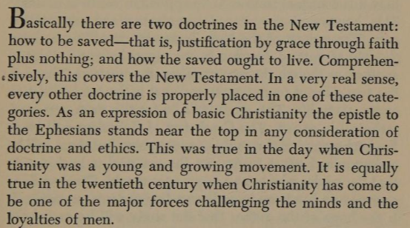
Patterns for Christian Living Ray Summers preface page v

