Slide 1

∞
We are eternal spiritual beings living in a temporary earthly realm.
Goal: Explore the heavenly realms described in Ephesians and review scriptures in light of what we learn.

Slide 2

Heavenly Realms
Ephesians 1:3, 1:20, 2:6, 3:10, 6:12
¹² For our struggle is not against flesh and blood, but against the rulers, against the authorities, against the powers of this dark world and against the spiritual forces of evil in the heavenly realms.
Where are the heavenly (spiritual) realms?
Notes:
Introduction to the Book of Ephesians, using the Western Heights Church of Christ logo. This presentation will delve into the key themes and messages of the Apostle Paul's letter to the Ephesians, exploring its relevance to modern Christian life.

Slide 3

Heavenly Realms
Ephesians 3:10
Heavenly Realm Aligned with God
Heavenly Realm Not Aligned with God
Plots to kill Jesus as a baby and eliminate him with crucifixion
Heavenly Good news
Physical Realm Aligned with God
Physical Realm Not Aligned with God
Notes:
Introduction to the Book of Ephesians, using the Western Heights Church of Christ logo. This presentation will delve into the key themes and messages of the Apostle Paul's letter to the Ephesians, exploring its relevance to modern Christian life.

Slide 4
Heavenly Realm Not Aligned with God
^{Jude 6} And the angels who did not keep their positions of authority but abandoned their proper dwelling—these he has kept in darkness, bound with everlasting chains for judgment on the great Day. ⁷ In a similar way, Sodom and Gomorrah and the surrounding towns gave themselves up to sexual immorality and perversion. They serve as an example of those who suffer the punishment of eternal fire.

Slide 5
Book of Ephesians Differing Lens
Heavenly Realms
Blessings -- Look at each blessing in Ephesians
Knowledge – Observe references to knowledge
Especially in Paul's Prayers
Infinity – Things unfathomable and eternal.
God has a multitude of infinite attributes
Once Dead Now Alive.
How you once live and how you live now
How the world lives and how Christians live
Grace
made known and accepted vs. unknow and rejected.
How we should live(walk) , have a new mind, and mature

Slide 6
Book of Ephesians
Heavenly Realms
The Prayer in Chapter 1, Faith and Grace
Spiritual Tools and Heavenly Armor
Spiritual Blessings in Christ
Made Alive in Christ
The New Spiritual Humanity
The Cornerstone and the New Building
Love that is wide, long, and high. The infinite God
Worthy calling - Unity and oneness _
Futile thinking contrasted with Wisdom and Discretion
Quirky things about Ephesians: The Colossian Heresy, Papyrus 46, No serious issues addressed
Chistian Living Impacting Relationships.
12/7
12/21
12/14
Chapter 1
12/28
01/04
12/28

Slide 7
Example of themes knowing and infinity
^{3:16} I pray that out of his glorious riches he may strengthen you with power through his Spirit in your inner being, ¹⁷ so that Christ may dwell in your hearts through faith. And I pray that you, being rooted and established in love, ¹⁸ may have power, together with all the Lord’s holy people, to grasp how wide and long and high and deep is the love of Christ, ¹⁹ and to know this love that surpasses knowledge—that you may be filled to the measure of all the fullness of God.

Slide 8
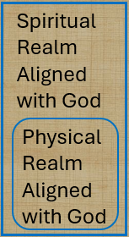

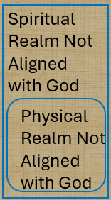
Spiritual Realms (Knowing Theme)
Heard, made known, wisdom, revelation, know Him better, enlightened, know hope, knowledge, insight, discernment, understanding. Made plain
ALIVE
DEAD
¹⁸ being darkened in their understanding, excluded from the life of God because of the ignorance that is in them, because of the hardness of their heart; ¹⁹ and they, having become callous, have given themselves up to indecent behavior for the practice of every kind of impurity with greediness.

Slide 9

Spiritual Realms
Heard, made known, wisdom, revelation, know Him better, enlightened, know hope, knowledge, insight, discernment, understanding. Made plain
ALIVE
DEAD
Islam, Judaism, Atheism, Agnostic,
^{Nothingism (ignoring)}

Slide 10
Patterns for Christian Living
Ray Summers Broadman Press © 1960
Ray Summers makes a distinction between doctrine and application as follows:
Epistle | Doctrine | Application
Ephesians | 1-3 | 4-6
Romans | 1-11 | 12-16
Galatians | 1-4 | 5-6
Colossians | 1-2 | 3.4
1 Peter | 1:1 to 2:10 | 2:11 to 5:14
Hebrews | 1:1 top 10:18 | 10:19 to 13:25

Slide 11
Patterns for Christian Living
Ray Summers Broadman Press © 1960
Ray Summers makes a distinction between doctrine and application as follows:
Epistle | Doctrine | Application
Ephesians | 1-3 | 4-6
Romans | 1-11 | 12-16
Galatians | 1-4 | 5-6
Colossians | 1-2 | 3.4
1 Peter | 1:1 to 2:10 | 2:11 to 5:14
Hebrews | 1:1 top 10:18 | 10:19 to 13:25

Slide 12
4 I therefore, the prisoner of the Lord, beseech you that ye walk worthy of the vocation wherewith ye are called,
Epistle | Doctrine | Application
Ephesians | 1-3 | 4-6
Romans | 1-11 | 12-16
Galatians | 1-4 | 5-6
Colossians | 1-2 | 3.4
1 Peter | 1:1 to 2:10 | 2:11 to 5:14
Hebrews | 1:1 top 10:18 | 10:19 to 13:25

Slide 13
Book of Ephesians Differing Lens
Heavenly Realms
Blessings -- Look at each blessing in Ephesians
Knowledge – Observe references to knowledge
Especially in Paul's Prayers
Infinity – Things unfathomable and eternal.
God has a multitude of infinite attributes
Once Dead Now Alive.
How you once live and how you live now
How the world lives and how Christians live
Grace
made known and accepted vs. unknow and rejected.
How we should live(walk) , have a new mind, and mature
DOCTRINE
Therefore
APPLICATION

Slide 14
WHO WHAT WHEN WHERE WHY

Slide 15
Paul first visited Ephesus briefly at the end of his second missionary journey (around 50-52 AD), returning later for a significant, extended stay of over two years during his third journey (around 52-57 AD), establishing a major Christian center. His initial short visit fulfilled a promise, but his longer stay, where he preached daily in the hall of Tyrannus, established the church and saw widespread conversions

Slide 16
Acts 19 Paul in Ephesus
1 While Apollos was at Corinth, Paul took the road through the interior and arrived at Ephesus. There he found some disciples ² and asked them, “Did you receive the Holy Spirit when you believed?”
They answered, “No, we have not even heard that there is a Holy Spirit.”
³ So Paul asked, “Then what baptism did you receive?”
“John’s baptism,” they replied.
⁴ Paul said, “John’s baptism was a baptism of repentance. He told the people to believe in the one coming after him, that is, in Jesus.” ⁵ On hearing this, they were baptized in the name of the Lord Jesus.

Slide 17
Acts 19 Paul in Ephesus
.⁶ When Paul placed his hands on them, the Holy Spirit came on them, and they spoke in tongues and prophesied. ⁷ There were about twelve men in all.
⁸ Paul entered the synagogue and spoke boldly there for three months, arguing persuasively about the kingdom of God. ⁹ But some of them became obstinate; they refused to believe and publicly maligned the Way. So Paul left them. He took the disciples with him and had discussions daily in the lecture hall of Tyrannus. ¹⁰ This went on for two years, so that all the Jews and Greeks who lived in the province of Asia heard the word of the Lord.

Slide 18
Ephesus the City
Founding & History:
Established by Greek colonists in the 10th century BC, it became part of the Ionian League, flourished under Roman rule (becoming the capital of the Roman province of Asia), and was a crucial port city until the harbor silted up.
Ephesus became capital of the wealthy Roman Province of Asia by 27 BC
During the Roman period it was the third largest city in the empire with Rome and Constantinople being larger. 6thcentury
There was no Constantinople in 60 AD; the city was known as Byzantium then, and its population was small (perhaps 25,000), as Constantinople wasn't founded as the new Roman capital until Constantine the Great established it in 330 AD, growing to hundreds of thousands by the 6th century. The major growth and large populations (400,000+)

Slide 19
Ephesus the City silt issue
Hellenistic Period (334–133 BC): Continuous sedimentation from the Küçük Menderes (Cayster) River began to fill the bay, and human activity (like agriculture) accelerated this process.
Roman Period (c. 1st-3rd Century AD): Despite efforts to dredge the harbor (even under emperors like Nero and Hadrian), silt accumulation worsened, turning the port area into a marsh, causing malaria, and hindering trade.
Late Antiquity (3rd-7th Centuries AD): The harbor became unusable, forcing the city to relocate and diminishing its economic power, with major earthquakes further weakening it.
Byzantine/Ottoman Eras (7th-15th Centuries AD): The city was largely abandoned as the silt rendered the harbor useless, and it was eventually covered by mud and dust

Slide 20
Ephesus the City
Leading trading cities in the Roman World.
Located by the Aegean Sea as a major port.
''the Gate by Which the West Visited the East‘’.
Major center connecting Italy and Greece with Asia Minor.
over 250,000 inhabitants in Ephesus during New testament times
There were three major roads
  one road went south to the Meander Valley,
  another east towards Babylon via Laodicea,
  and a third to the north via Smyrna.

Slide 21
Ephesus Buildings
Great Theatre: A massive structure built in the Hellenistic period and expanded by Romans, holding up to 25,000 people for plays, games, and major public events, including the riot described in Acts 19.
Temple of Artemis (Artemision): Though largely in ruins by the New Testament era, it was a colossal, famous sanctuary that drew pilgrims and was a major economic and religious center.
Library of Celsus: A stunning two-story library built later in the Roman period, showcasing the city's intellectual and architectural wealth. (110 AD)
Public Baths: Large complexes like the Scholastica Baths provided hygiene and social centers for citizens.

Slide 22
Ephesus Buildings
Agoras: The State Agora (political/administrative) and the Commercial Agora (marketplace) were bustling centers of civic life.
Temples: Besides Artemis, there were temples dedicated to Roman emperors, like the Temple of Domitian, and the Temple of the Sebastoi (Imperial Cult).
Terrace Houses: Luxurious multi-story homes for the wealthy, adorned with frescoes and mosaics, showcasing Roman domestic architecture.
Odeion: A smaller covered theater used for concerts and meetings.
Hall Of Tyrannous lectue hall

Slide 23
Ephesus Buildings
Agoras: The State Agora (political/administrative) and the Commercial Agora (marketplace) were bustling centers of civic life.
Temples: Besides Artemis, there were temples dedicated to Roman emperors, like the Temple of Domitian, and the Temple of the Sebastoi (Imperial Cult).
Terrace Houses: Luxurious multi-story homes for the wealthy, adorned with frescoes and mosaics, showcasing Roman domestic architecture.
Odeion: A smaller covered theater used for concerts and meetings.
Hall (school) Of Tyrannus

Slide 24
Hall (School) of Tyrannus
Location: Ephesus, a major city in the Roman province of Asia.
Time Period: Paul taught there daily for two years, around 52-53 AD (or 53-55 AD, depending on the source).
Purpose: It functioned as Paul's teaching center, where he engaged in daily discussions and apologetics, systematically reaching the city and the wider region of Asia Minor with the Christian message.
Outcome: This intensive period of teaching was highly effective; it resulted in "all the residents of Asia [hearing] the word of the Lord, both Jews and Greeks".

Slide 25
About Tyrannus
The precise identity of Tyrannus is uncertain, as the Bible does not provide extensive details. He was likely:
The owner of a lecture hall or school building who rented the space to Paul.
A Greek rhetorician, philosopher, or perhaps a Jewish scholar or rabbi in the city.
It is not clear if Tyrannus was a Christian convert himself, or if the building was simply named after a former, respected owner.
One ancient manuscript suggests Paul used the hall during the hottest hours of the day (from the fifth hour to the tenth, or 11:00 AM to 4:00 PM), allowing him to work at his trade (tentmaking) during the morning and evening hours

Slide 26
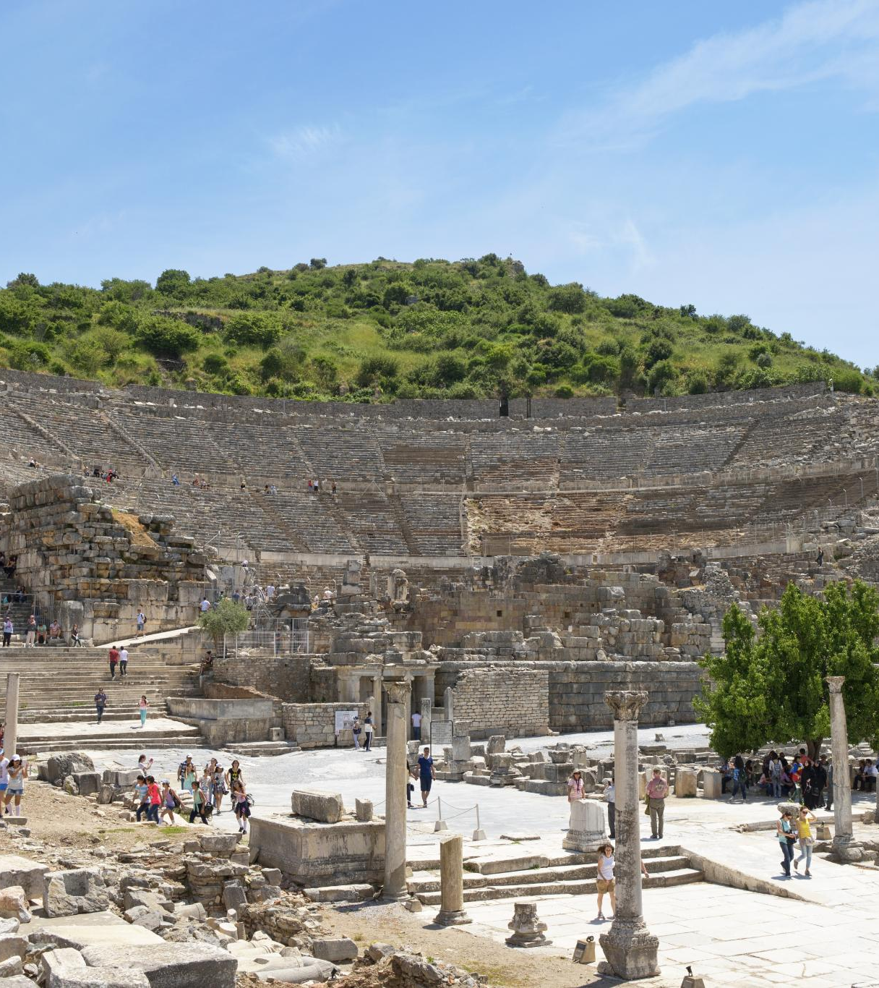
Paul's Teachings in Ephesus
Lecture Hall of Tyrannus
  Paul's teachings in Ephesus primarily occurred in the lecture hall of Tyrannus, where he spent over two years.
  Confrontation at the Theater
  A significant confrontation took place at the theater, where silversmiths rioted against Paul due to the threat his teachings posed to their trade.
  Paul's Missionary Activities
  Paul's missionary activities in Ephesus were impactful, leading to both widespread teachings and significant confrontations.
Notes:
The Apostle Paul did not teach at the theater in Ephesus. Despite spending over two years in Ephesus, his teachings primarily took place in the lecture hall of Tyrannus. However, Paul's missionary activities in the city eventually led to a significant confrontation at the theater, where silversmiths rioted against him due to the threat his teachings posed to their trade.

Slide 27
Paul's Teachings in Ephesus
Notes
The Apostle Paul did not teach at the theater in Ephesus. Despite spending over two years in Ephesus, his teachings primarily took place in the lecture hall of Tyrannus. However, Paul's missionary activities in the city eventually led to a significant confrontation at the theater, where silversmiths rioted against him due to the threat his teachings posed to their trade.
Notes:
The Apostle Paul did not teach at the theater in Ephesus. Despite spending over two years in Ephesus, his teachings primarily took place in the lecture hall of Tyrannus. However, Paul's missionary activities in the city eventually led to a significant confrontation at the theater, where silversmiths rioted against him due to the threat his teachings posed to their trade.

Slide 28
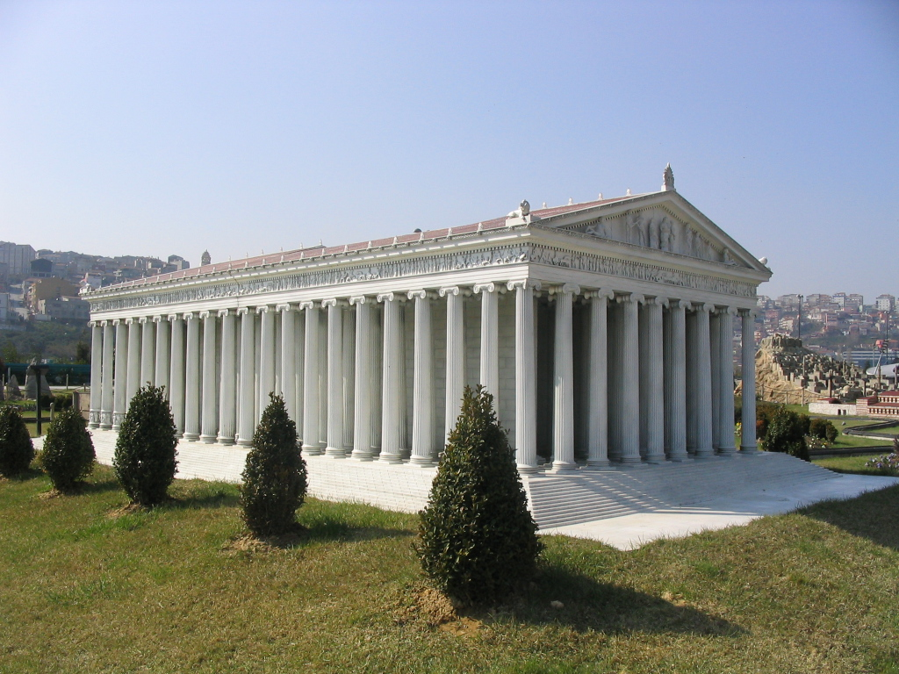
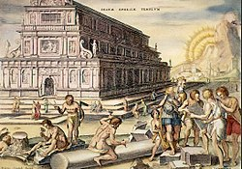
Temple of Artemis
Temples at the site originate as far back as 700 BC. One rendition was destroyed by an arsonist in 356 BC. Alexander offered to pay for the temple's rebuilding; the Ephesians tactfully refused, saying "it would be improper for one god to build a temple to another", and eventually rebuilt it after his death, at their own expense. Work started in 323 BC and continued for many years
Notes:
The Apostle Paul did not teach at the theater in Ephesus. Despite spending over two years in Ephesus, his teachings primarily took place in the lecture hall of Tyrannus. However, Paul's missionary activities in the city eventually led to a significant confrontation at the theater, where silversmiths rioted against him due to the threat his teachings posed to their trade.

Slide 29
Temple of Artemis
The third temple (323 BC) was larger than the second; 137 m (450 ft) long by 69 m (225 ft) wide and 18 m (60 ft) high, with more than 127 columns.
In 268 AD, according to Jordanes,[a raid by the Goths, under their leaders "Respa, Veduc, and Thurar","laid waste many populous cities and set fire to the renowned temple of Diana at Ephesus." The extent and severity of the damage are unknown. Later updates are likely.
Notes:
The Apostle Paul did not teach at the theater in Ephesus. Despite spending over two years in Ephesus, his teachings primarily took place in the lecture hall of Tyrannus. However, Paul's missionary activities in the city eventually led to a significant confrontation at the theater, where silversmiths rioted against him due to the threat his teachings posed to their trade.

Slide 30
Temple of Artemis
A Roman edict of 162 AD acknowledges the importance of Artemesion, the annual Ephesian festival to Artemis, and officially extended it from a few holy days over March–April to a whole month, "one of the largest and most magnificent religious festivals in Ephesus' liturgical calendar.
Pilgrimage to this huge temple was important to the religious life of those in Asia.
Notes:
The Apostle Paul did not teach at the theater in Ephesus. Despite spending over two years in Ephesus, his teachings primarily took place in the lecture hall of Tyrannus. However, Paul's missionary activities in the city eventually led to a significant confrontation at the theater, where silversmiths rioted against him due to the threat his teachings posed to their trade.

Slide 31
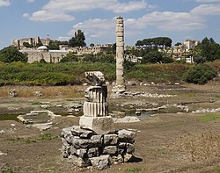
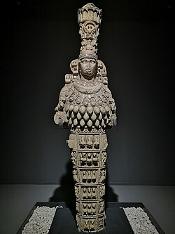
Temple of Artemis
A 2017 photo of the site shows sparse remnants of the site. Statues of Artemus with the large numbers of breast are displayed at the Ephesus Archaeological Museum. This item dated to the first century AD. Artifacts similar to this exist in abundance.
Notes:
The Apostle Paul did not teach at the theater in Ephesus. Despite spending over two years in Ephesus, his teachings primarily took place in the lecture hall of Tyrannus. However, Paul's missionary activities in the city eventually led to a significant confrontation at the theater, where silversmiths rioted against him due to the threat his teachings posed to their trade.

Slide 32
Artemis is not enough.
Artemis served as the god pf fertility for the population of Ephesus and Asia especially for the pilgrims that would travel to the site of the temple. There were many gods that were invoked for differing needs. The people had a fear of evil spirits and mysticism which propelled them into a cycle of seeking out the correct god for each new problem.
Notes:
The Apostle Paul did not teach at the theater in Ephesus. Despite spending over two years in Ephesus, his teachings primarily took place in the lecture hall of Tyrannus. However, Paul's missionary activities in the city eventually led to a significant confrontation at the theater, where silversmiths rioted against him due to the threat his teachings posed to their trade.

Slide 33
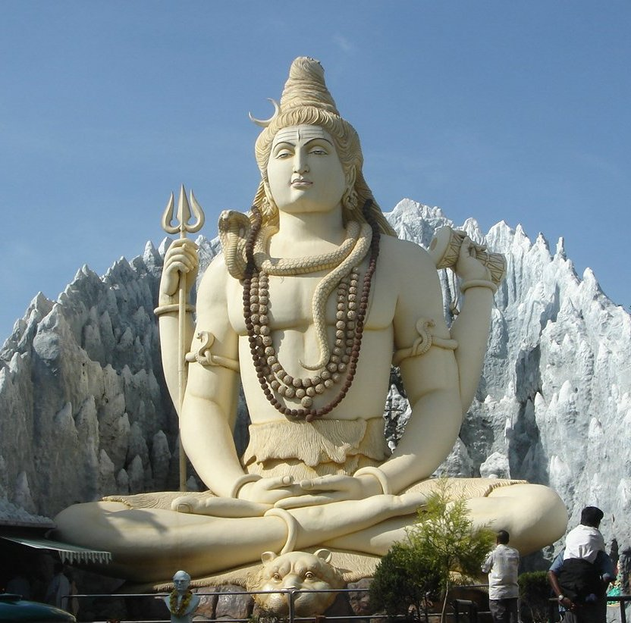
Hinduism one god is not enough.
The Hindu deity concept varies from a personal god as in Yoga school of Hindu philosophy, to thirty-three major deities in the Vedas, to hundreds of deities mentioned in the Puranas of Hinduism
Hindu deities are the gods and goddesses in Hinduism. Deities in Hinduism are as diverse as its traditions, and a Hindu can choose to be polytheistic, pantheistic, monotheistic, monistic, even agnostic, atheistic, or humanist
Notes:
The Apostle Paul did not teach at the theater in Ephesus. Despite spending over two years in Ephesus, his teachings primarily took place in the lecture hall of Tyrannus. However, Paul's missionary activities in the city eventually led to a significant confrontation at the theater, where silversmiths rioted against him due to the threat his teachings posed to their trade.

Slide 34
Hinduism one god is not enough.
More details
This is an image of murti (statue) of Hindu deity Shiva that was created by the sculptor Kashinath. It is 65 feet (20 meters) high, made of concrete and is located at Shivoham Shiva Temple (also known as The Kempfort Shiva Temple, formerly known as the Shiv Mandir), Kemp Fort Mall, Old Airport Road, Ramagiri, Murugeshpalya, Bangalore, Karnataka, India. There is a tunnel like structure underneath the statue where different models of Shiva are kept.
Notes:
The Apostle Paul did not teach at the theater in Ephesus. Despite spending over two years in Ephesus, his teachings primarily took place in the lecture hall of Tyrannus. However, Paul's missionary activities in the city eventually led to a significant confrontation at the theater, where silversmiths rioted against him due to the threat his teachings posed to their trade.

Slide 35
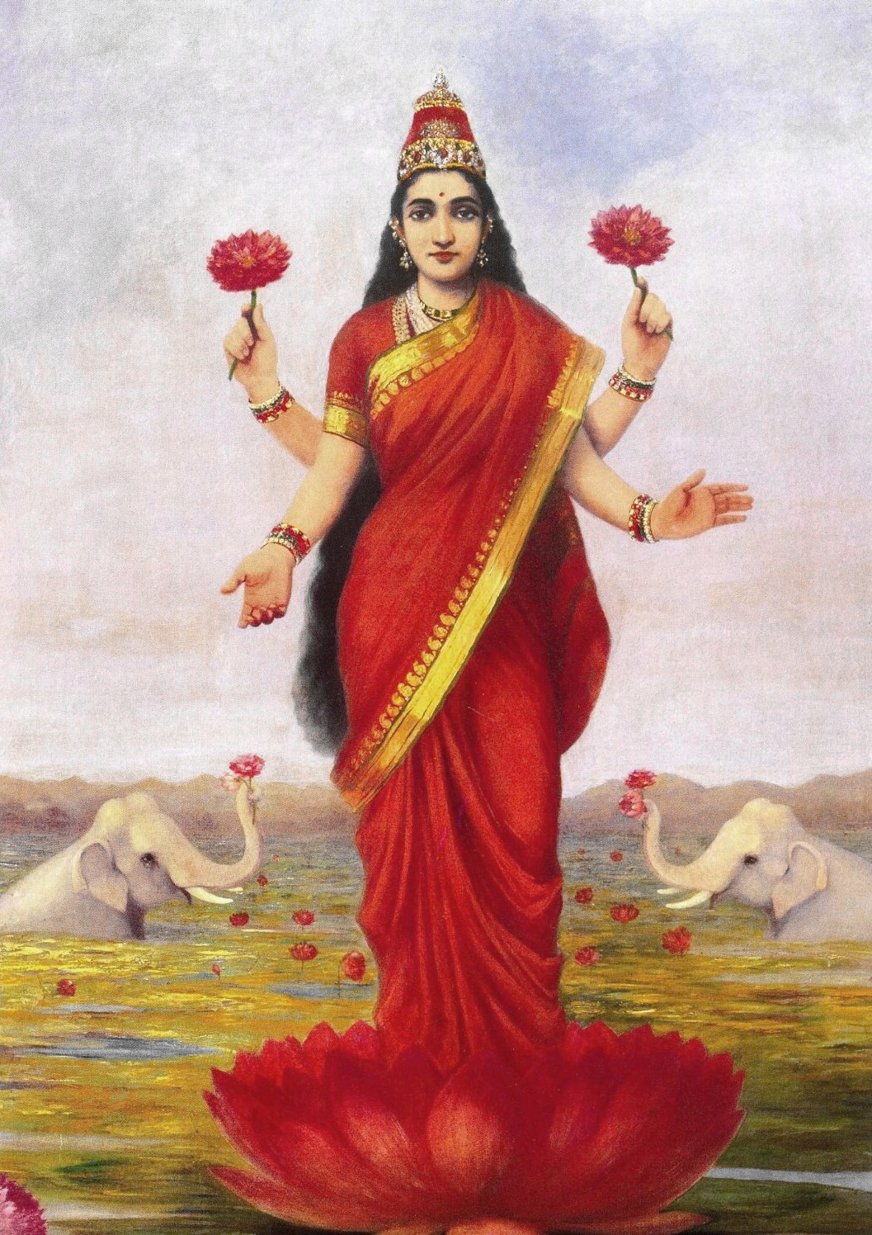
Hinduism one god is not enough.
Goddess Lakshmi standing on a lotus.
Notes:
The Apostle Paul did not teach at the theater in Ephesus. Despite spending over two years in Ephesus, his teachings primarily took place in the lecture hall of Tyrannus. However, Paul's missionary activities in the city eventually led to a significant confrontation at the theater, where silversmiths rioted against him due to the threat his teachings posed to their trade.

Slide 36
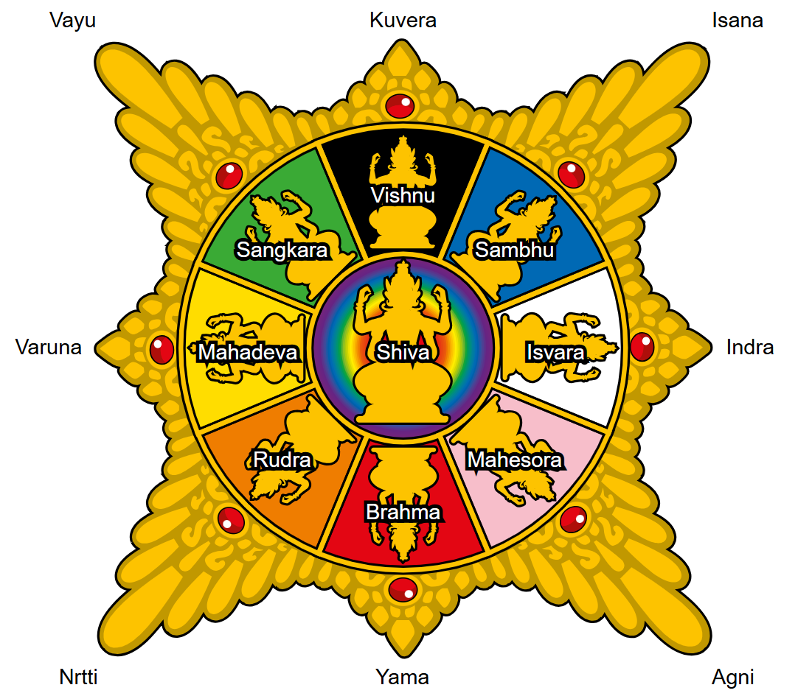
Hinduism one god is not enough.
Gunawan Kartapranata - Own work
Surya Majapahit. "The Sun of Majapahit" is the emblem commonly found in Majapahit ruins. Displaying the image of eight pointed sun rays. The emblem consist of images of 9 Hindu gods and 8 sun rays also symbolize Hindu gods arranged in eight cardinal points. Total 17 Hindu gods represented in Surya Majapahit are: Shiva, Vishnu, Sambhu, Isvara, Mahesora, Brahma, Rudra, Mahadeva, Sangkara, Kuvera, Isana, Indra, Agni, Yama, Nrtti, Varuna and Vayu.
Notes:
The Apostle Paul did not teach at the theater in Ephesus. Despite spending over two years in Ephesus, his teachings primarily took place in the lecture hall of Tyrannus. However, Paul's missionary activities in the city eventually led to a significant confrontation at the theater, where silversmiths rioted against him due to the threat his teachings posed to their trade.

Slide 37
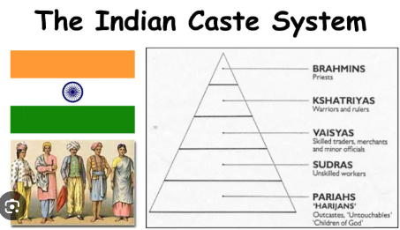

Slide 38
Concept Of God In Hinduism, Brahman, Trinity, 33 Crore Gods
The concept of God in Hinduism is straightforward as well as complex. According to the Puranas, there are 330 million gods, but in practice, Hindus do not worship or even know the names of all gods. It is a general misconception that it is a polytheistic religion, but actually, it is a pluralistic religion. Hinduism believes in only one God but allows its followers to worship the God in many forms such as nature (including trees, sun, idols, animals, etc.) and divine beings (Lord Krishna, Lord Rama, Lord Shiva, Lord Vishnu, etc.) because the world that we see is the manifestation of Him only.
These divine beings are called devas (gods) and devis (goddesses). These celestial beings control forces of nature such as fire, air, wind, etc. They are not to be confused with the One and the Supreme God. God is a different thing from a deity or a god. These words should not be confused with each other.
Notes:
Brahman is the supreme being but cannot be worshipped directly.

Slide 39
4 I therefore, the prisoner of the Lord, beseech you that ye walk worthy of the vocation wherewith ye are called,
Epistle | Doctrine | Application
Ephesians | 1-3 | 4-6
Romans | 1-11 | 12-16
Galatians | 1-4 | 5-6
Colossians | 1-2 | 3.4
1 Peter | 1:1 to 2:10 | 2:11 to 5:14
Hebrews | 1:1 top 10:18 | 10:19 to 13:25

Slide 40
Book of Ephesians Unity
EPH 4:1 As a prisoner for the Lord, then, I urge you to live a life worthy of the calling you have received.
^{COLOSSIANS 1:9} For this reason, since the day we heard about you, we have not stopped praying for you. We continually ask God to fill you with the knowledge of his will through all the wisdom and understanding that the Spirit gives,¹⁰so that you may live a life worthy of the Lord and please him in every way: bearing fruit in every good work, growing in the knowledge of God.

Slide 41
Book of Ephesians Unity
² Be completely humble and gentle; be patient, bearing with one another in love. ³ Make every effort to keep the unity of the Spirit through the bond of peace.
This chapter has a lot of instructions for Christian living .

Slide 42
Book of Ephesians Maturity and Unity
Meekness or gentleness is far from being an easygoing weakness; it is the property of a mind and spirit kept under due control .
F.F Bruce
What is the world view of humble and gentle; be patient?

Slide 43
Book of Ephesians Unity and Maturity
^{Eph4:3} Make every effort to keep the unity of the Spirit through the bond of peace.
“The unity of the Spirit here is a different thing from the statement that there is “one Spirit” in verse 4. The fact that there is one Spirit of God is something which cannot be affected by any endeavor or action of men one way or the other.”
Bruce, F.F.. The Epistle to the Ephesians: A Verse by Verse Exposition (p. 58). Robert Frederick. Kindle Edition.

Slide 44
Book of Ephesians Unity
⁴ There is
one body and
one Spirit, just as you were called to
one hope when you were called;
⁵ one Lord,
one faith,
one baptism;
⁶ one God and Father of all, who is over all and through all and in all.

Slide 45
Book of Ephesians Unity
ONENESS
body
Spirit
hope
Lord
faith
baptism
God
ZERO
ONE
MANY

Slide 46
Book of Ephesians Unity
ONENESS
body
Spirit
hope
Lord
faith
baptism
God
ZERO
ONE
MANY
Time
Judgement

Slide 47
^{EPH4:4} There is one body
The body of Christ, the church) comprising of both Jewish and Gentile believers. The church is not just a local congregation but all Christians.
^{EPH 1:22-23} And God placed all things under his feet and appointed him to be head over everything for the church, which is his body, the fullness of him who fills everything in every way.
^{COL3:15} Let the peace of Christ rule in your hearts, since as members of one body you were called to peace.

Slide 48
^{EPH4:4 4} There is … one Spirit
^{1 Corinthians 12:12} Just as a body, though one, has many parts, but all its many parts form one body, so it is with Christ. ¹³ For we were all baptized by one Spirit so as to form one body—whether Jews or Gentiles, slave or free—and we were all given the one Spirit to drink. ¹⁴ Even so the body is not made up of one part but of many.
^{(Pentecost and Cornelius)}

Slide 49
^{EPH4:4} just as you were called to
one hope when you were called;
– Having the gift grace by way of the cross of Jesus we have a hope of sharing the glory of Christ. Christ’s resurrection has become our resurrection, making us alive and aligned with the will of God having the steadfast hope of eternal life with God and the Son:
^{1 John 3:2} Dear friends, now we are children of God, and what we will be has not yet been made known. But we know that when Christ appears, we shall be like him, for we shall see him as he is.

Slide 50
^{EPH4:3a-4a} There is … one Lord
1 Cor 8:4 So then, about eating food
sacrificed to idols: We know that “An idol is nothing at all in the world” and that “There is no God but one.” ⁵ For even if there are so-called gods, whether in heaven or on earth (as indeed there are many “gods” and many “lords”,) ⁶ yet for us there is but one God, the Father, from whom all things came and for whom we live; and there is but one Lord, Jesus Christ, through whom all things came and through whom we live.

Slide 51
^{EPH4:3a-4a} There is … one Lord
Jude 4 For certain individuals whose condemnation was written about long ago have secretly slipped in among you. They are ungodly people, who pervert the grace of our God into a license for immorality and deny Jesus Christ our only Sovereign and Lord..

Slide 52
^{EPH4:3a-4a} There is … one faith
Jude 3 Dear friends, although I was very eager to write to you about the salvation we share, I felt compelled to write and urge you to contend for the faith that was once for all entrusted to God’s holy people

Slide 53
^{EPH4:3a-4a} There is … one faith
^{Romans 3:29} Or is God the God of Jews only? Is he not the God of Gentiles too? Yes, of Gentiles too, ³⁰ since there is only one God, who will justify the circumcised by faith and the uncircumcised through that same faith. ³¹ Do we, then, nullify the law by this faith? Not at all! Rather, we uphold the law.

Slide 54
^{EPH4:3a-4a} There is … one baptism
Jewish and Gentile believers alike acknowledged one Lord, shared one faith in him, and submitted themselves to one baptism into his name.
Acts 2:38, Romans 6, Jailer, eunuch, Cornelius, Saul.
^{Acts 22:14} “Then he (Ananias) said: ‘The God of our ancestors has chosen you to know his will and to see the Righteous One and to hear words from his mouth. ¹⁵ You will be his witness to all people of what you have seen and heard. ¹⁶ And now what are you waiting for? Get up, be baptized and wash your sins away, calling on his name.’

Slide 55
Book of Ephesians Maturity and Unity
¹¹ So Christ himself gave the apostles, the prophets, the evangelists, the pastors and teachers, apostles, the prophets, the evangelists, the pastors and teachers,
¹² to equip his people for works of service, so that the body of Christ may be built up ¹³ until we all reach unity in the faith and in the knowledge of the Son of God and become mature, attaining to the whole measure of the fullness of Christ.

Slide 56
Book of Ephesians Maturity and Unity
¹¹ And He gave some as apostles, some as prophets, some as evangelists, some as pastors and teachers
¹¹ ¹² for the equipping of the saints for the work of ministry, for the building up of the body of Christ; ¹³ until we all attain to the unity of the faith, and of the ^{[f]}knowledge of the Son of God, to a mature man, to the measure of the stature which belongs to the fullness of Christ. NASB

Slide 57
Book of Ephesians Maturity and Unity
¹¹ So Christ himself gave the apostles, the prophets, the evangelists, the pastors and teachers, apostles, the prophets, the evangelists, the pastors and teachers,
¹² to equip his people for works of service, so that the body of Christ may be built up ¹³ until we all reach unity in the faith and in the knowledge of the Son of God and become mature, attaining to the whole measure of the fullness of Christ.

Slide 58
Book of Ephesians Maturity and Unity
¹⁴ Then we will no longer be infants, tossed back and forth by the waves, and blown here and there by every wind of teaching and by the cunning and craftiness of people in their deceitful scheming.
¹⁵ Instead, speaking the truth in love, we will grow to become in every respect the mature body of him who is the head, that is, Christ. ¹⁶ From him the whole body, joined and held together by every supporting ligament, grows and builds itself up in love, as each part does its work

Slide 59
Book of Ephesians Maturity and Unity
¹⁴ Then we will no longer be infants, tossed back and forth by the waves, and blown here and there by every wind of teaching and by the cunning and craftiness of people in their deceitful scheming.
¹⁵ Instead, speaking the truth in love, we will grow to become in every respect the mature body of him who is the head, that is, Christ. ¹⁶ From him the whole body, joined and held together by every supporting ligament, grows and builds itself up in love, as each part does its work
What is growing?

Slide 60
Book of Hebrews (4) Lack of Maturity
¹¹ We have much to say about this, but it is hard to make it clear to you because you no longer try to understand. ¹² In fact, though by this time you ought to be teachers, you need someone to teach you the elementary truths of God’s word all over again. You need milk, not solid food! ¹³ Anyone who lives on milk, being still an infant, is not acquainted with the teaching about righteousness. ¹⁴ But solid food is for the mature, who by constant use have trained themselves to distinguish good from evil.

Slide 61
Book of Ephesians Maturity and Unity
¹⁴ Then we will no longer be infants, tossed back and forth by the waves, and blown here and there by every wind of teaching and by the cunning and craftiness of people in their deceitful scheming.
¹⁵ Instead, speaking the truth in love, we will grow to become in every respect the mature body of him who is the head, that is, Christ. ¹⁶ From him the whole body, joined and held together by every supporting ligament, grows and builds itself up in love, as each part does its work
Discuss

Slide 62
Book of Ephesians Maturity and Unity
¹⁴ Then we will no longer be infants, tossed back and forth by the waves, and blown here and there by every wind of teaching and by the cunning and craftiness of people in their deceitful scheming.
¹⁵ Instead, speaking the truth in love, we will grow to become in every respect the mature body of him who is the head, that is, Christ. ¹⁶ From him the whole body, joined and held together by every supporting ligament, grows and builds itself up in love, as each part does its work
Discuss

Slide 63
Acts 19 Paul in Ephesus
1 While Apollos was at Corinth, Paul took the road through the interior and arrived at Ephesus. There he found some disciples ² and asked them, “Did you receive the Holy Spirit when you believed?”
They answered, “No, we have not even heard that there is a Holy Spirit.”
³ So Paul asked, “Then what baptism did you receive?”
“John’s baptism,” they replied.
⁴ Paul said, “John’s baptism was a baptism of repentance. He told the people to believe in the one coming after him, that is, in Jesus.” ⁵ On hearing this, they were baptized in the name of the Lord Jesus.

Slide 64
Acts 19 Paul in Ephesus
.⁶ When Paul placed his hands on them, the Holy Spirit came on them, and they spoke in tongues and prophesied. ⁷ There were about twelve men in all.
⁸ Paul entered the synagogue and spoke boldly there for three months, arguing persuasively about the kingdom of God. ⁹ But some of them became obstinate; they refused to believe and publicly maligned the Way. So Paul left them. He took the disciples with him and had discussions daily in the lecture hall of Tyrannus. ¹⁰ This went on for two years, so that all the Jews and Greeks who lived in the province of Asia heard the word of the Lord.

Slide 65
Acts 19 Paul in Ephesus
¹¹ God did extraordinary miracles through Paul, ¹² so that even handkerchiefs and aprons that had touched him were taken to the sick, and their illnesses were cured and the evil spirits left them.
¹³ Some Jews who went around driving out evil spirits tried to invoke the name of the Lord Jesus over those who were demon-possessed. They would say, “In the name of the Jesus whom Paul preaches, I command you to come out.” ¹⁴ Seven sons of Sceva, a Jewish chief priest, were doing this. ¹⁵ One day the evil spirit answered them, “Jesus I know, and Paul I know about, but who are you?”

Slide 66
Acts 19 Paul in Ephesus
¹⁶ Then the man who had the evil spirit jumped on them and overpowered them all. He gave them such a beating that they ran out of the house naked and bleeding. ¹⁷ When this became known to the Jews and Greeks living in Ephesus, they were all seized with fear, and the name of the Lord Jesus was held in high honor. ¹⁸ Many of those who believed now came and openly confessed what they had done. ¹⁹ A number who had practiced sorcery brought their scrolls together and burned them publicly. When they calculated the value of the scrolls, the total came to fifty thousand drachmas. ²⁰ In this way the word of the Lord spread widely and grew in power.

Slide 67
Acts 19 Paul in Ephesus
fifty thousand drachmas.
But bullion equivalent calculations do not provide a complete picture of a currency's value. Using a labor-equivalent calculation, a silver drachma (or denarius), which constituted a day's wage for a manual laborer, would be worth approximately the same in modern currency. The United States federal minimum wage's maximum purchasing power was in 1968, when it was $1.60 ($14.47 in 2024), meaning an 8-hour shift paid $12.80 ($115.70 in 2024) Meanwhile, average yearly wages in the United States in 2022 were $77,463 ($83,233 in 2024), meaning a day's wages would be $322.76 ($347.00 in 2024) 50,000 X $200= $10 Millon

Slide 68
Acts 19 Paul in Ephesus
²¹ After all this had happened, Paul decided to go to Jerusalem, passing through Macedonia and Achaia. “After I have been there,” he said, “I must visit Rome also.” ²² He sent two of his helpers, Timothy and Erastus, to Macedonia, while he stayed in the province of Asia a little longer.
The Riot in Ephesus
²³ About that time there arose a great disturbance about the Way. ²⁴ A silversmith named Demetrius, who made silver shrines of Artemis, brought in a lot of business for the craftsmen there.

Slide 69
Acts 19 Paul in Ephesus
. ²⁵ He called them together, along with the workers in related trades, and said: “You know, my friends, that we receive a good income from this business. ²⁶ And you see and hear how this fellow Paul has convinced and led astray large numbers of people here in Ephesus and in practically the whole province of Asia. He says that gods made by human hands are no gods at all. ²⁷ There is danger not only that our trade will lose its good name, but also that the temple of the great goddess Artemis will be discredited; and the goddess herself, who is worshiped throughout the province of Asia and the world, will be robbed of her divine majesty.”

Slide 70
Acts 19 Paul in Ephesus
²⁸ When they heard this, they were furious and began shouting: “Great is Artemis of the Ephesians!” ²⁹ Soon the whole city was in an uproar. The people seized Gaius and Aristarchus, Paul’s traveling companions from Macedonia, and all of them rushed into the theater together. ³⁰ Paul wanted to appear before the crowd, but the disciples would not let him. ³¹ Even some of the officials of the province, friends of Paul, sent him a message begging him not to venture into the theater.

Slide 71
Acts 19 Paul in Ephesus
³² The assembly was in confusion: Some were shouting one thing, some another. Most of the people did not even know why they were there. ³³ The Jews in the crowd pushed Alexander to the front, and they shouted instructions to him. He motioned for silence in order to make a defense before the people. ³⁴ But when they realized he was a Jew, they all shouted in unison for about two hours: “Great is Artemis of the Ephesians!”

Slide 72
Acts 19 Paul in Ephesus
³⁵ The city clerk quieted the crowd and said: “Fellow Ephesians, doesn’t all the world know that the city of Ephesus is the guardian of the temple of the great Artemis and of her image, which fell from heaven? ³⁶ Therefore, since these facts are undeniable, you ought to calm down and not do anything rash. ³⁷ You have brought these men here, though they have neither robbed temples nor blasphemed our goddess. ³⁸ If, then, Demetrius and his fellow craftsmen have a grievance against anybody, the courts are open and there are proconsuls. They can press charges.

Slide 73
Acts 19 Paul in Ephesus
. ³⁹ If there is anything further you want to bring up, it must be settled in a legal assembly. ⁴⁰ As it is, we are in danger of being charged with rioting because of what happened today. In that case we would not be able to account for this commotion, since there is no reason for it.” ⁴¹ After he had said this, he dismissed the assembly.

