Slide 1

We are eternal spiritual beings living in a temporary earthly realm.
Goal: Explore the heavenly realms described in Ephesians and review scriptures in light of what we learn.

Slide 2

Heavenly Realms
Ephesians 1:3, 1:20, 2:6, 3:10, 6:12
Heavenly Realm Aligned with God
Heavenly Realm Not Aligned with God
God’s Creation
Physical Realm Aligned with God
Physical Realm Not Aligned with God

Slide 3

Physical Realms are subsets of Heavenly Realms
Forgiven Sinners
Sinners
Heavenly Realm Aligned with God
Heavenly Realm Not Aligned with God
Physical Realm Aligned with God
Physical Realm Not Aligned with God
Through grace and the gift of Jesus we are aligned with God.

Slide 4
Ephesians and the terminology heavenly realms
The term “heavenly realms” is used for a single Greek word epouranios (ἐπουρανίοις) . Five times in Ephesians. (NIV)
The second word “realms” (NIV) is added to make a distinction from the dwelling place of God.
Ephesians 6:12 includes spirts not aligned with god in the verse therefore epouranios in this sense is not the dwelling place of God.
KJV uses heavenly places in he first four occurrences, these are aligned with God and uses High places as a distinction for the dwelling place of spirits not aligned with God.
A personal view to describe epouranios as “Spiritual Realms’ will allow heaven to be used as the dwelling place of God.

Slide 5
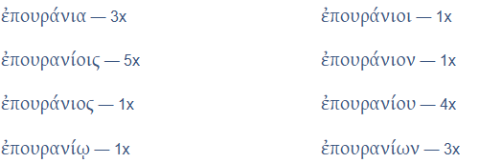
Ephesians and the terminology heavenly realms
Inflections
Ephesians

Slide 6
Physical Realms are subsets of Spiritual Realms
Heavenly Places KJV
High Places KJV
Spiritual
Realm Aligned with God
Spiritual Realm Not Aligned with God
Physical Realm Aligned with God
Physical Realm Not Aligned with God
Through grace and the gift of Jesus we are aligned with God.

Slide 7
Book of Ephesians
Heavenly Realms
The Prayer in Chapter 1, Faith and Grace
Spiritual Tools and Heavenly Armor
Spiritual Blessings in Christ
Made Alive in Christ
The New Spiritual Humanity
The Cornerstone and the New Building
Love that is wide, long, and high. The infinite God
Worthy calling - Unity and oneness _
Futile thinking contrasted with Wisdom and Discretion
Quirky things about Ephesians, The Colossian Heresy, Papyrus 46
Chistian Living Impacting Relationships.
12/7
12/21
12/14
Chapter 1

Slide 8
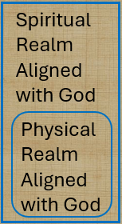
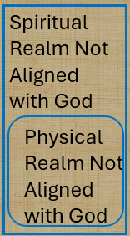
Physical Realms are subsets of Spiritual Realms
Spiritual
Realm Aligned with God
Spiritual
Realm Not Aligned with God
Conceptual
Relational
Physical Realm Aligned with God
Physical Realm Not Aligned with God
Bound by time (also history and geography

Slide 9
Physical Realms are subsets of Spiritual Realms
Spiritual Realm Aligned with God
Spiritual Realm Not Aligned with God
When time is no more the Physical Realms we know about disappear
Physical Realm Aligned with God
Physical Realm Not Aligned with God

Slide 10
I believe in a hill called Mount Calvary
I believe whatever the cost
And when time has surrendered
And Earth is no more
I'll still cling to the old rugged cross

Slide 11

Spiritual Realms
Ephesians 3:10 (conceptually / historically)
Spiritual
Realm Aligned with God
Spiritual
Realm Not Aligned with God
Plots to kill Jesus as a baby and eliminate him with crucifixion
Heavenly Good news
Conceptual and relational change
Physical Realm Aligned with God
Physical Realm Not Aligned with God

Slide 12
Spiritual Realms
BLESSINGS
^{John 3 16}
loved
believes
shall not perish
eternal life
not condemned,
^{Eph 2:4}
love
Mercy
ALIVE
Grace
Raised
^{Eph 2:4}
Seated with Christ
Incomparable riches
kindness
^{John3: 18b}
does not believe
condemned
CURSES
^{Eph 2:1}
DEAD transgressions
sin
worldly
disobedient
^{Eph 2:1}
^{Fleshly}
^{wrath}
Expand lists by inference

Slide 13
What are the blessings mentioned in Ephesians chapter 1.
⁴ For he chose us in him before the creation of the world to be holy and blameless in his sight.

Slide 14
What are the blessings mentioned in Ephesians chapter 1.
⁴ For he chose us in him before the creation of the world to be holy and blameless in his sight.

Slide 15
What are the blessings mentioned in Ephesians chapter 1.
⁵ he predestined us for adoption to sonship through Jesus Christ, in accordance with his pleasure and will— ⁶ to the praise of his glorious grace, which he has freely given us in the One he loves.

Slide 16
What are the blessings mentioned in Ephesians chapter 1.
⁷ In him we have redemption through his blood, the forgiveness of sins, in accordance with the riches of God’s grace ⁸ that he lavished on us. With all wisdom and understanding,

Slide 17
What are the blessings mentioned in Ephesians chapter 1.
⁹ he made known to us the mystery of his will according to his good pleasure, which he purposed in Christ, ¹⁰ to be put into effect when the times reach their fulfillment—to bring unity to all things in heaven and on earth under Christ.

Slide 18
What are the blessings mentioned in Ephesians chapter 1.
¹¹ In him we were also chosen, having been predestined according to the plan of him who works out everything in conformity with the purpose of his will, ¹² in order that we, who were the first to put our hope in Christ, might be for the praise of his glory.

Slide 19
What are the blessings mentioned in Ephesians chapter 1.
¹³ And you also were included in Christ when you heard the message of truth, the gospel of your salvation. When you believed, you were marked in him with a seal, the promised Holy Spirit, ¹⁴ who is a deposit guaranteeing our inheritance until the redemption of those who are God’s possession—to the praise of his glory.

Slide 20
blessings mentioned in the prayer
^{Eph 1:15} For this reason, ever since I heard about your faith in the Lord Jesus and your love for all God’s people, ¹⁶ I have not stopped giving thanks for you, remembering you in my prayers. ¹⁷ I keep asking that the God of our Lord Jesus Christ, the glorious Father, may give you the spirit of wisdom and revelation, so that you may know him better.

Slide 21
blessings mentioned in the prayer
¹⁸ I pray that the eyes of your heart may be enlightened in order that you may know the hope to which he has called you, the riches of his glorious inheritance in his holy people, ¹⁹ and his incomparably great power for us who believe.

Slide 22
blessings mentioned in the prayer
^{19 b} That power is the same as the mighty strength ²⁰ he exerted when he raised Christ from the dead and seated him at his right hand in the heavenly realms, ²¹ far above all rule and authority, power and dominion, and every name that is invoked, not only in the present age but also in the one to come.

Slide 23
blessings mentioned in the prayer
²² And God placed all things under his feet and appointed him to be head over everything for the church, ²³ which is his body, the fullness of him who fills everything in every way

Slide 24
Progressive Actions and prayer detail
REWIND and look at progressive action and the prayer detail

Slide 25
Progressive Actions
¹⁵ For this reason, ever since I heard about your faith in the Lord Jesus and your love for all God’s people, ¹⁶ I have not stopped giving thanks for you, remembering you in my prayers. ¹⁷ I keep asking that the God of our Lord Jesus Christ, the glorious Father, may give you the spirit of wisdom and revelation, so that you may know him better.

Slide 26
Progressive Actions + WHAT IS TO BE KNOWN
¹⁸ I pray that the eyes of your heart may be enlightened in order that you may know: {{the hope to which he has called you, the riches of his glorious inheritance in his holy people, ¹⁹ and his incomparably great power for us who believe.
Notes:
.

Slide 27
WHAT IS TO BE KNOWN
^{19 b} That power is the same as the mighty strength ²⁰ he exerted when he raised Christ from the dead and seated him at his right hand in the heavenly realms, ²¹ far above all rule and authority, power and dominion, and every name that is invoked, not only in the present age but also in the one to come.}}
Notes:
.

Slide 28
WHAT IS TO BE KNOWN
²² And God placed all things under his feet and appointed him to be head over everything for the church, ²³ which is his body, the fullness of him who fills everything in every way}}

Slide 29
Other Ways of saying Giving Thanks
BLESSINGS
^{EPH 1:15-16}
faith
Lord Jesus
Love
God’s people
giving thanks
remembering you in my prayers.
Spirit of wisdom and revelation, so that you may know him
CURSES
Expand list
Attributes of one giving thanks
Notes:
Introduction to the Book of Ephesians, using the Western Heights Church of Christ logo. This presentation will delve into the key themes and messages of the Apostle Paul's letter to the Ephesians, exploring its relevance to modern Christian life.

Slide 30

Paul’s Prayer for the Philippians
^{Philippians 1:9} And this is my prayer: that your love may abound more and more in knowledge and depth of insight, ¹⁰ so that you may be able to discern what is best and may be pure and blameless for the day of Christ, ¹¹ filled with the fruit of righteousness that comes through Jesus Christ—to the glory and praise of God.

Slide 31
Ephesians Chapter 2
Notes:
.

Slide 32
Spiritual Realms
BLESSINGS
Grace
⁴ But because of his great love for us, God, who is rich in mercy, ⁵ made us alive with Christ even when we were dead in transgressions—it is by grace you have been saved. ⁶ And God raised us up with Christ and seated us with him in the heavenly realms in Christ Jesus, ⁷ in order that in the coming ages he might show the incomparable riches of his grace, expressed in his kindness to us in Christ Jesus .
2 As for you, you were dead in your transgressions and sins, ² in which you used to live when you followed the ways of this world and of the ruler of the kingdom of the air, the spirit who is now at work in those who are disobedient. ³ All of us also lived among them at one time, gratifying the cravings of our flesh^{[a]} and following its desires and thoughts. Like the rest, we were by nature deserving of wrath
CURSES
Notes:
Introduction to the Book of Ephesians, using the Western Heights Church of Christ logo. This presentation will delve into the key themes and messages of the Apostle Paul's letter to the Ephesians, exploring its relevance to modern Christian life.

Slide 33
Spiritual Realms
ALIVE
GRACE
DEAD

Slide 34
Spiritual Realms
ALIVE
GRACE
DEAD
The only way to move out of the realm not aligned with God to the Realm aligned with God is through Jesus Christ.

Slide 35
Spiritual Realms
ALIVE
GRACE
DEAD
John 14:6 Jesus said to him, “I am the way, and the truth, and the life; no one comes to the Father except through Me.”

Slide 36
Spiritual Realms
ALIVE
GRACE
DEAD
John 10:9 I am the door (gate) ; if anyone enters through Me, he will be saved, and will go in and out and find pasture.

Slide 37
Did the recipients of Paul’s letter already know about grace?
Why does Paul mention grace again?
How does this grace align with the theme of chapter 1?

Slide 38
Grace Through Faith
^{Ephesians 2:8} For it is by grace you have been saved, through faith—and this is not from yourselves, it is the gift of God—
Notes:
.

Slide 39
Grace in Chapter 3
² Surely you have heard about the administration of God’s grace that was given to me for you, ³ that is, the mystery made known to me by revelation, as I have already written briefly.
Notes:
.

Slide 40
Grace in Chapter 3
⁷ I became a servant of this gospel by the gift of God’s grace given me through the working of his power. ⁸ Although I am less than the least of all the Lord’s people, this grace was given me: to preach to the Gentiles the boundless riches of Christ, ⁹ and to make plain to everyone the administration of this mystery, which for ages past was kept hidden in God, who created all thing
Notes:
.

Slide 41
Faith Chapter 3
¹² In him (Christ) and through faith in him we may approach God with freedom and confidence.
Relational aspect of faith.
Notes:
.

Slide 42

Spiritual Realms
ALIVE
GRACE
DEAD
Without faith the available grace is hidden from the non-believer locking them in a realm not aligned with God

Slide 43

Spiritual Realms
ALIVE
DEAD
^{Eph 4:18} They are darkened in their understanding and separated from the life of God because of the ignorance that is in them due to the hardening of their hearts. ¹⁹ Having lost all sensitivity, they have given themselves over to sensuality so as to indulge in every kind of impurity, and they are full of greed..

Slide 44
Spiritual Realms
ALIVE
DEAD
¹⁸ being darkened in their understanding, excluded from the life of God because of the ignorance that is in them, because of the hardness of their heart; ¹⁹ and they, having become callous, have given themselves up to indecent behavior for the practice of every kind of impurity with greediness.
Even in this terrible state of separation, not aligned with God, Grace can be unveiled and lives changed by the Gospel

Slide 45
Spiritual Realms
DEAD
LOST
CONDEMNED
Even in this terrible state of separation, not aligned with God, Grace can be unveiled and lives changed by the Gospel. The Gospel is the story of Grace

Slide 46
Spiritual Realms
GRACE
ALIVE
FOUND
SAVED
Through Faith
Faith in Jesus allows us to remove the things once
Hiding the Grace and Gospel from us. We are alive!

Slide 47
text

Slide 48
text me

Slide 49
texting

Slide 50
faith

Slide 51
faithing

Slide 52
Faithing
Faith as a verb (via participle)

Slide 53
blessings mentioned in the prayer
¹⁵ For this reason, ever since I heard about your faithing in the Lord Jesus and your love for all God’s people, ¹⁶ I have not stopped giving thanks for you, remembering you in my prayers. ¹⁷ I keep asking that the God of our Lord Jesus Christ, the glorious Father, may give you the spirit of wisdom and revelation, so that you may know him better.

Slide 54
What Has Paul established in chapters 1 and 2 ?
Notes:
.

Slide 55
Impacts of reviewing blessings, ALIVE and Grace?
Notes:
.

Slide 56
Observations
Grace and faith are tightly linked.
The Gospel and grace are tightly linked.
Without faith grace is hidden. Believing is seeing.
Faith can be learned
Counting Blessings, especially Grace, strengthens Faith

Slide 57
Atheist to Believer
C.S. Lewis “Mere Christianity”
Anthony Flew “There Is a God”
Lee Strobel “ The Case for Christ”
Michael Guillen “Believing is Seeing”

Slide 58
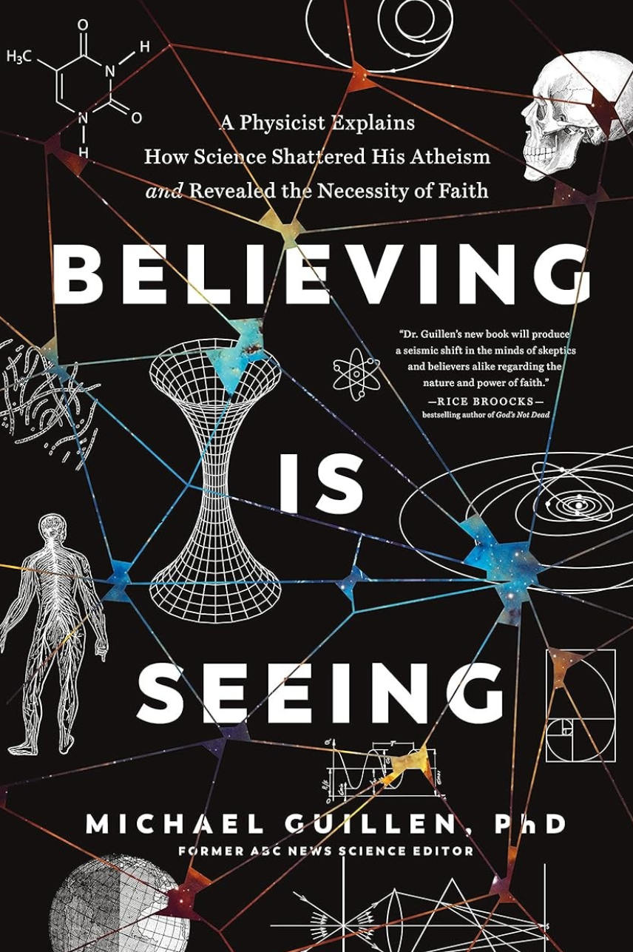
Atheist to Christian _ Michael Guillen
Take a journey with a PHD physicist looking at the world and perceiving that science supports the existence of God. Believing there is a God, he pursued many world religions and found that only Christianity as a suitable choice. Tracing physics from subatomic particles to cosmology he witnesses God.
Numerous bible passages are included at length adding credence to the science and bible connections.

Slide 59
Lessons son file at:
https://www.weldonbeardain.website/ephesians/
Notes:
.

Slide 60
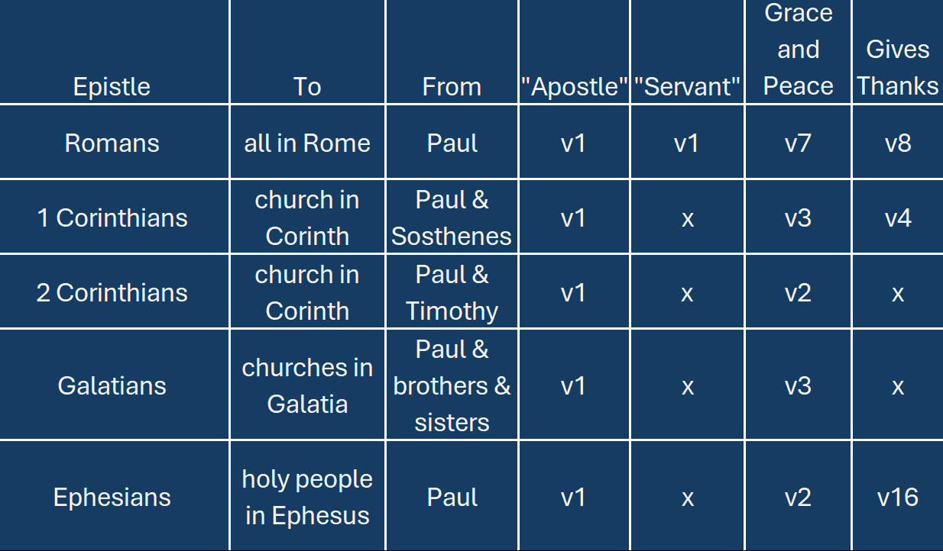
Paul’s Letter Openings
Notes:
Introduction to the Book of Ephesians, using the Western Heights Church of Christ logo. This presentation will delve into the key themes and messages of the Apostle Paul's letter to the Ephesians, exploring its relevance to modern Christian life.

Slide 61
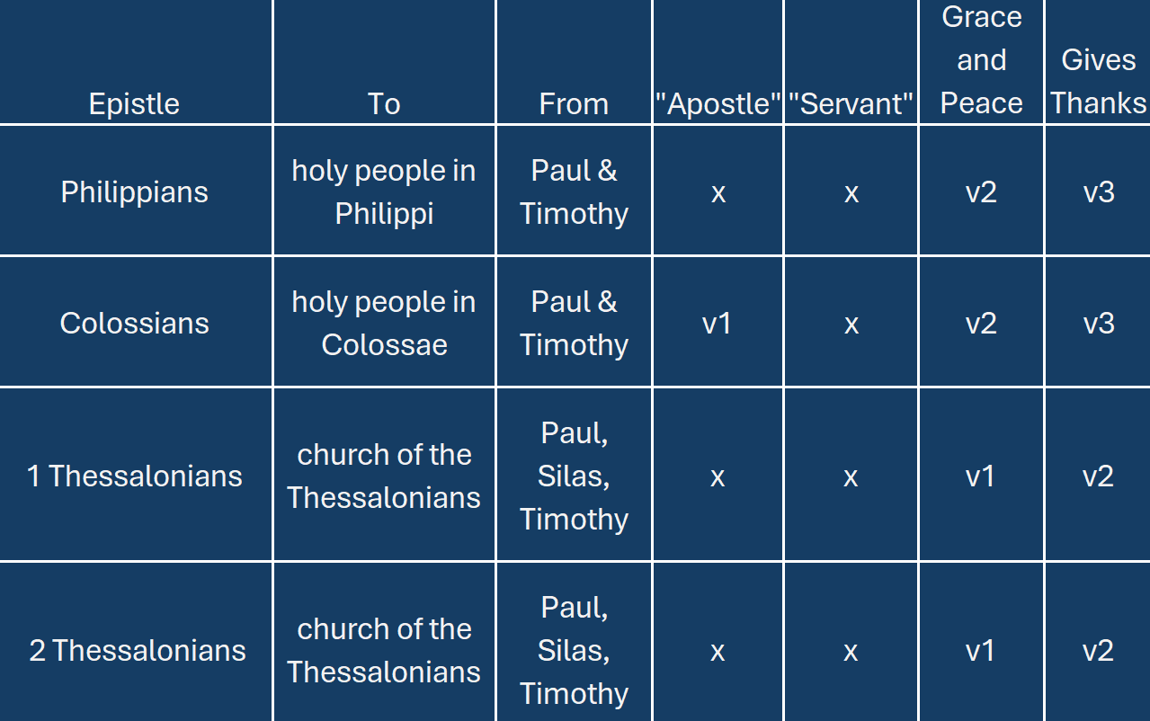
Paul’s Letter Openings
Notes:
.

Slide 62
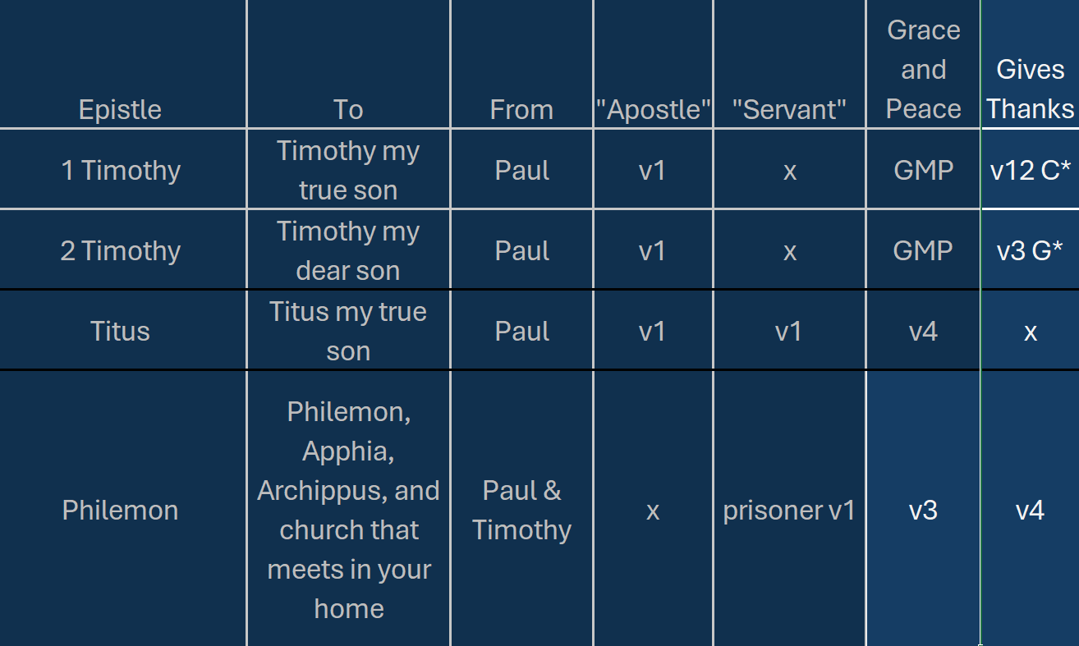
Paul’s Letter Openings

