Slide 1
Book of Ephesians
Book of Ephesians

Slide 2

Book of Ephesians
Key Themes
The Book of Ephesians addresses themes of unity, love, grace, and spiritual growth within the Christian community.
Paul's Message
Paul's letter emphasizes the importance of living a life worthy of the calling received, and the transformative power of God's love and grace.
Modern Relevance
The teachings in Ephesians are relevant to modern Christian life, offering guidance on how to live harmoniously and faithfully in today's world.
Notes:
Introduction to the Book of Ephesians, using the Western Heights Church of Christ logo. This presentation will delve into the key themes and messages of the Apostle Paul's letter to the Ephesians, exploring its relevance to modern Christian life.

Slide 3
Book of Ephesians
Heavenly Realms
The mystery
Spiritual Tools and Heavenly Armor
Spiritual Blessings in Christ
Made Alive in Christ
The New Spiritual Humanity
The Cornerstone and the New Building
Love that is wide, long, and high. The infinite God
Worthy calling - Unity and oneness _
Futile thinking contrasted with Wisdom and Discretion
Quirky things about Ephesians, The Colossian Heresy, Papyrus 46
Chistian Living Impacting Relationships.
Notes:
Introduction to the Book of Ephesians, using the Western Heights Church of Christ logo. This presentation will delve into the key themes and messages of the Apostle Paul's letter to the Ephesians, exploring its relevance to modern Christian life.

Slide 4

Heavenly Realms Ephesians 1:3, 2:6, 3:10, 6:12
Normally Heaven is associated as the dwelling place of God and everything good and perfect.
The first three instances above could be confused with Heaven.
Ephesians 6:12 clearly gives meaning to heavenly realms that Paul is writing about.
Notes:
Introduction to the Book of Ephesians, using the Western Heights Church of Christ logo. This presentation will delve into the key themes and messages of the Apostle Paul's letter to the Ephesians, exploring its relevance to modern Christian life.

Slide 5
Heavenly Realms Ephesians 1:3, 2:6, 3:10, 6:12
Normally Heaven is associated as the dwelling place of God and everything good and perfect.
The first three instances above could be confused with Heaven.
Ephesians 6:12 clearly gives meaning to heavenly realms that Paul is writing about.
¹² For our struggle is not against flesh and blood, but against the rulers, against the authorities, against the powers of this dark world and against the spiritual forces of evil in the heavenly realms.
Notes:
Introduction to the Book of Ephesians, using the Western Heights Church of Christ logo. This presentation will delve into the key themes and messages of the Apostle Paul's letter to the Ephesians, exploring its relevance to modern Christian life.

Slide 6
Heavenly Realms Ephesians 1:3, 2:6, 3:10, 6:12
Normally Heaven is associated as the dwelling place of God and everything good and perfect.
The first three instances above could be confused with Heaven.
Ephesians 6:12 clearly gives meaning to heavenly realms that Paul is writing about.
¹² For our struggle is not against flesh and blood, but against the rulers, against the authorities, against the powers of this dark world and against the spiritual forces of evil in the heavenly realms. Where are the heavenly (spiritual) realms?
Notes:
Introduction to the Book of Ephesians, using the Western Heights Church of Christ logo. This presentation will delve into the key themes and messages of the Apostle Paul's letter to the Ephesians, exploring its relevance to modern Christian life.

Slide 7
Heavenly Realms Ephesians 1:3, 2:6, 3:10, 6:12
Normally Heaven is associated as the dwelling place of God and everything good and perfect.
The first three instances above could be confused with Heaven.
Ephesians 6:12 clearly gives meaning to heavenly realms that Paul is writing about.
¹² For our struggle is not against flesh and blood, but against the rulers, against the authorities, against the powers of this dark world and against the spiritual forces of evil in the heavenly realms. Where are the heavenly (spiritual) realms?
Notes:
Introduction to the Book of Ephesians, using the Western Heights Church of Christ logo. This presentation will delve into the key themes and messages of the Apostle Paul's letter to the Ephesians, exploring its relevance to modern Christian life.

Slide 8
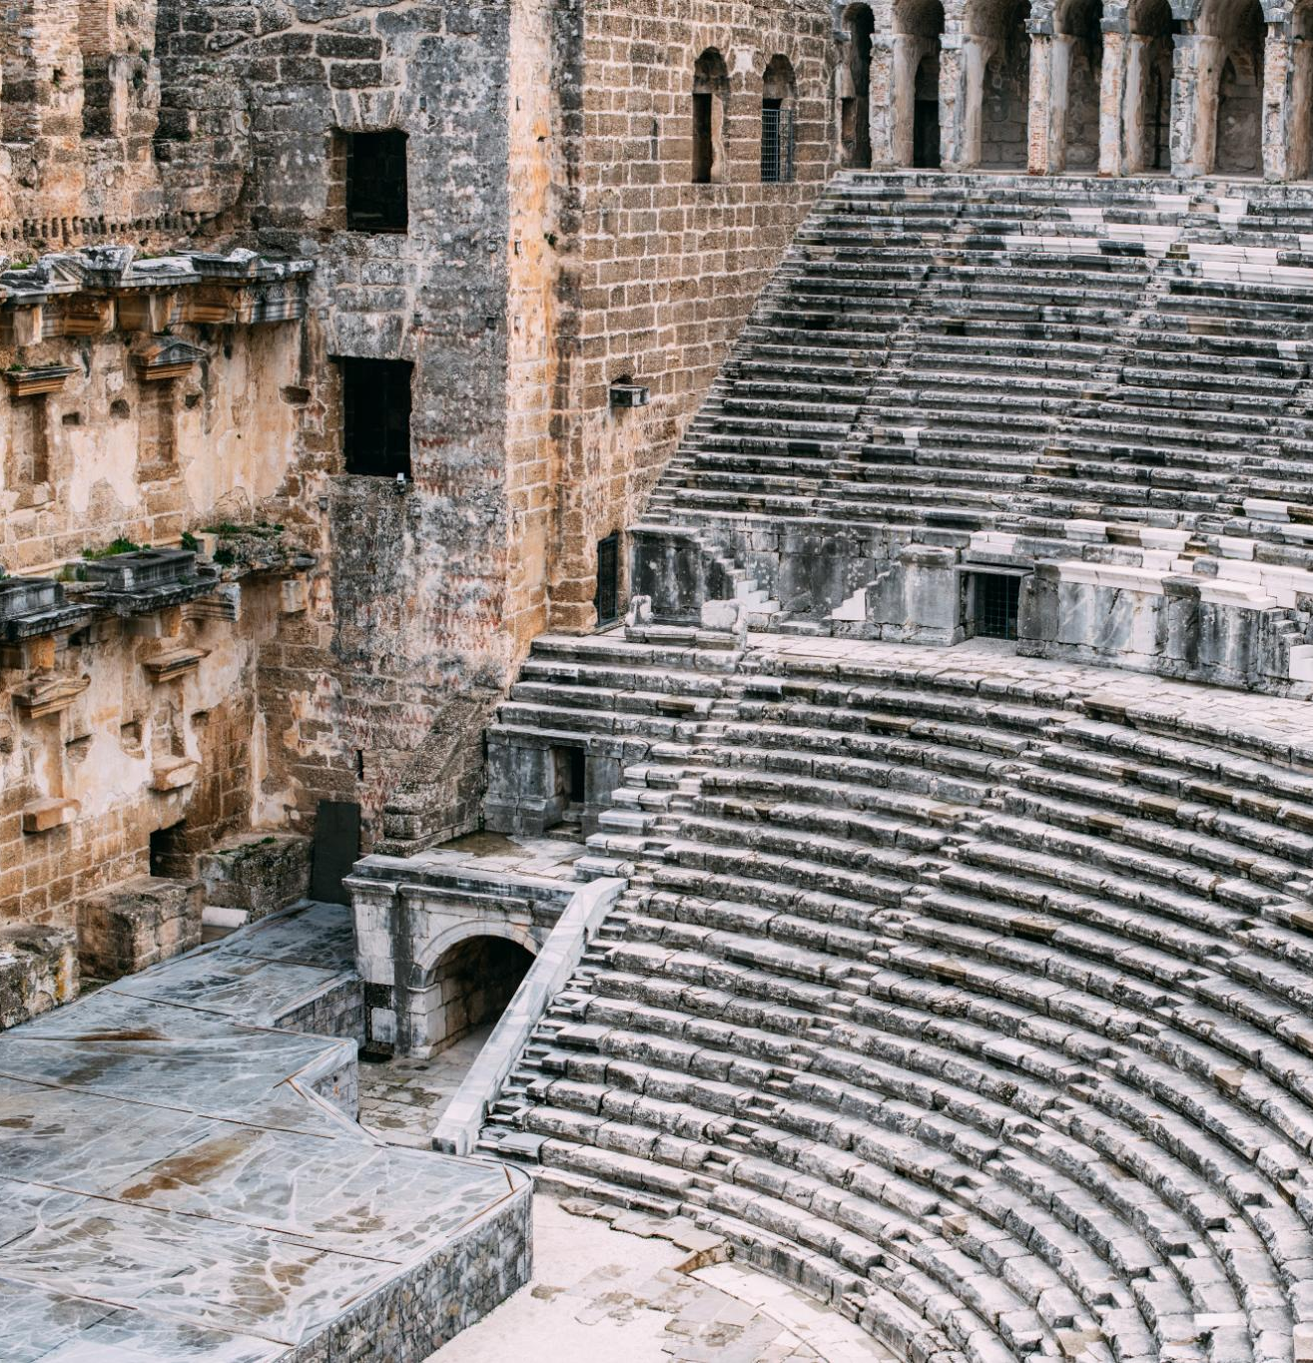
Ephesus Amphitheater 50 CE
Ancient Roman Architecture
The Ephesus amphitheater is an exemplary model of ancient Roman architecture, showcasing remarkable construction techniques and design.
Versatile Venue
The amphitheater was used for gladiatorial games, performances, and public gatherings, making it a central hub for events.
Notes:
The Ephesus Theater, built in the 3rd century BC and expanded during the Roman period, was one of the largest theaters in antiquity. By 50 AD, it had a seating capacity of approximately 25,000 spectators. This grand structure was used for dramatic performances, gladiatorial contests, and public meetings, reflecting the social and cultural significance of theater in ancient times.

Slide 9


Historical Construction
The Ephesus Theater was constructed in the 3rd century BC and later expanded during the Roman period.
Large Seating Capacity
By 50 AD, the theater could seat approximately 25,000 spectators, making it one of the largest of its time.
Notes:
The Ephesus Theater, built in the 3rd century BC and expanded during the Roman period, was one of the largest theaters in antiquity. By 50 AD, it had a seating capacity of approximately 25,000 spectators. This grand structure was used for dramatic performances, gladiatorial contests, and public meetings, reflecting the social and cultural significance of theater in ancient times.

Slide 10

Paul’s Preaching Sparks Uproar
Challenging Artemis Worship
Paul's message questioned the traditional worship of Artemis, shaking the foundation of the city's religious identity.
Impact on Silversmiths’ Trade
Silversmiths profiting from idol-making saw their livelihoods threatened by Paul's teachings, fueling their anger.
Theater Revolt and Uproar
A large, agitated crowd gathered in the city's theater, resulting in a major confrontation and unrest.

Slide 11
Paul’s Preaching Sparks Uproar
Challenging Artemis Worship
Paul's message questioned the traditional worship of Artemis, shaking the foundation of the city's religious identity.
Impact on Silversmiths’ Trade
Silversmiths profiting from idol-making saw their livelihoods threatened by Paul's teachings, fueling their anger.
Theater Revolt and Uproar
A large, agitated crowd gathered in the city's theater, resulting in a major confrontation and unrest.
Notes:
Image source: Microsoft 365 content library In Ephesus, Paul’s bold preaching about Christianity challenged the worship of Artemis, the city’s revered goddess. His message threatened the local silversmiths’ trade, as they profited from making idols. This provoked a massive revolt in the city’s theater, where an angry crowd gathered, leading to a significant confrontation and forcing Paul to leave the region.

Slide 12
Paul’s Preaching Sparks Uproar
Challenging Artemis Worship
Paul's message questioned the traditional worship of Artemis, shaking the foundation of the city's religious identity.
Impact on Silversmiths’ Trade
Silversmiths profiting from idol-making saw their livelihoods threatened by Paul's teachings, fueling their anger.
Theater Revolt and Uproar
A large, agitated crowd gathered in the city's theater, resulting in a major confrontation and unrest.
Notes:
Image source: Microsoft 365 content library In Ephesus, Paul’s bold preaching about Christianity challenged the worship of Artemis, the city’s revered goddess. His message threatened the local silversmiths’ trade, as they profited from making idols. This provoked a massive revolt in the city’s theater, where an angry crowd gathered, leading to a significant confrontation and forcing Paul to leave the region.

Slide 13
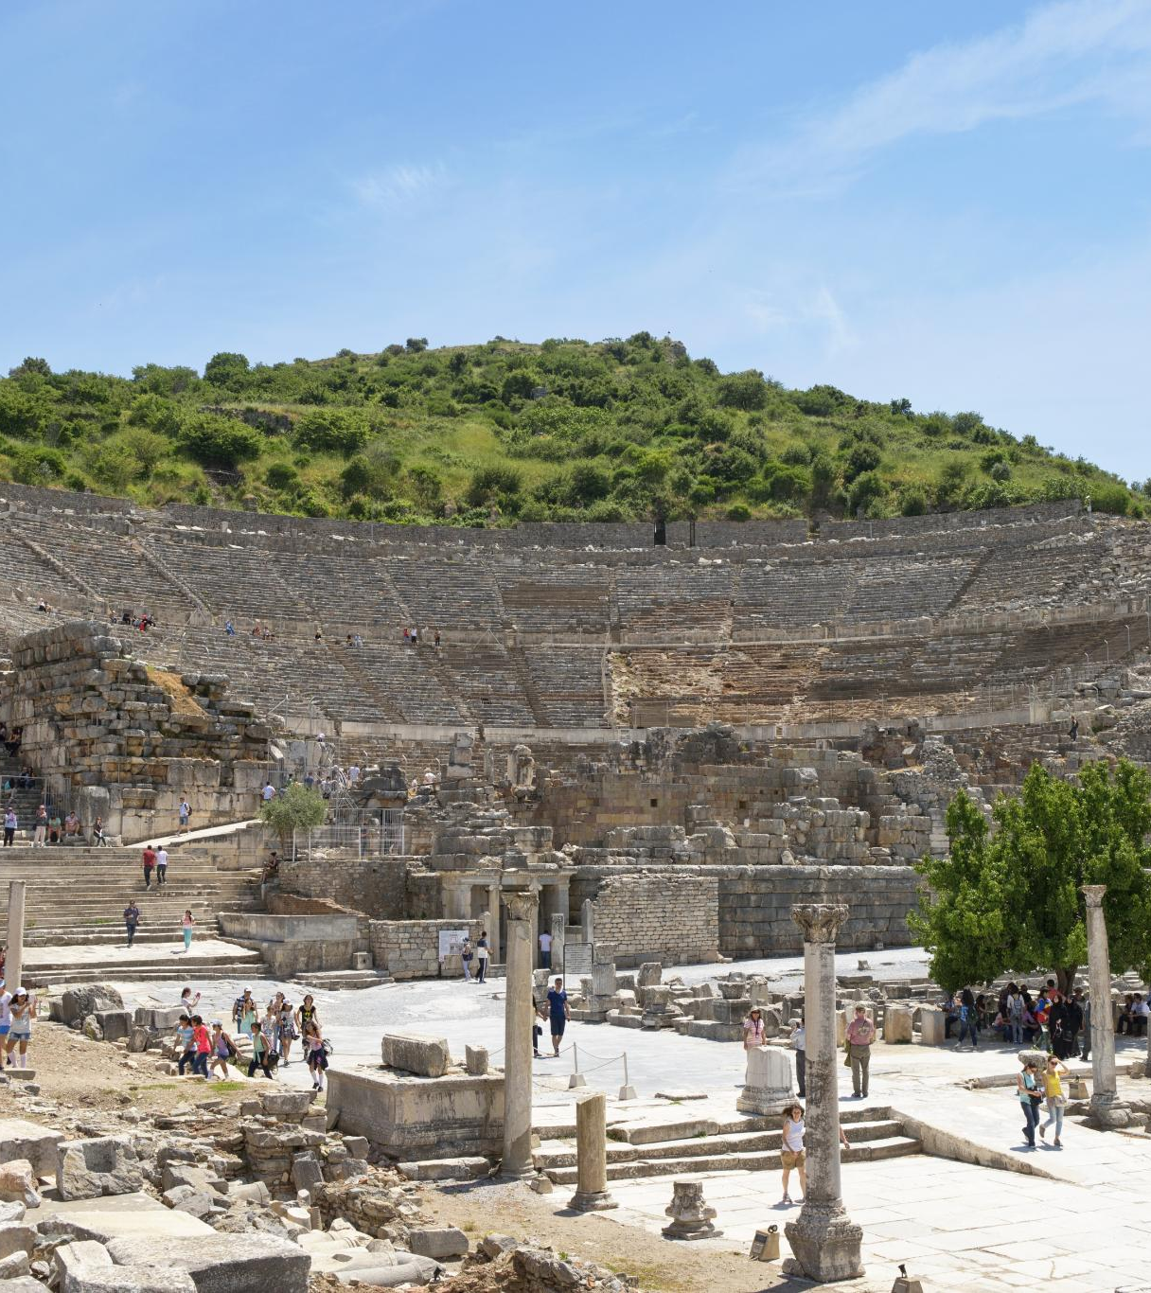
Paul's Teachings in Ephesus
Lecture Hall of Tyrannus
Paul's teachings in Ephesus primarily occurred in the lecture hall of Tyrannus, where he spent over two years.
Confrontation at the Theater
A significant confrontation took place at the theater, where silversmiths rioted against Paul due to the threat his teachings posed to their trade.
Paul's Missionary Activities
Paul's missionary activities in Ephesus were impactful, leading to both widespread teachings and significant confrontations.
Notes:
The Apostle Paul did not teach at the theater in Ephesus. Despite spending over two years in Ephesus, his teachings primarily took place in the lecture hall of Tyrannus. However, Paul's missionary activities in the city eventually led to a significant confrontation at the theater, where silversmiths rioted against him due to the threat his teachings posed to their trade.

Slide 14
Patterns for Christian Living Ray Summers Broadman Press © 1960 preface page v
Basically, there are two doctrines in the New Testament: how to be saved---that is, (1) justification buy grace through faith plus nothing; (2)and how the saved ought to live.
Comprehensively this covers the New Testament in a very real sense, every other doctrine is properly placed in one of these statements.

Slide 15

Patterns for Christian Living Ray Summers Broadman Press © 1960 preface page v
Complete text of commentary at: Ephesians : pattern for Christian living : Summers, Ray : Free Download, Borrow, and Streaming : Internet Archive

Slide 16
Patterns for Christian Living Ray Summers Broadman Press © 1960 preface page v
Basically, there are two doctrines in the New Testament: how to be saved---that is, (1) justification buy grace through faith plus nothing; (2)and how the saved ought to live.
Comprehensively this covers the New Testament in a very real sense, every other doctrine is properly placed in one of these statements.

Slide 17
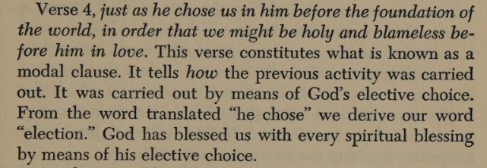
Patterns for Christian Living Ray Summers Broadman Press © 1960 preface page v

Slide 18
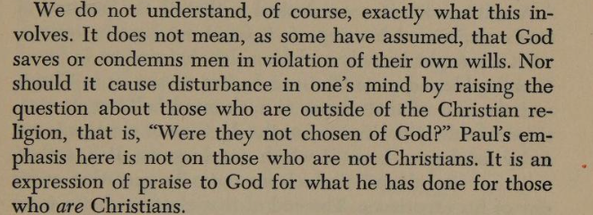
Patterns for Christian Living Ray Summers Broadman Press © 1960 preface page v

Slide 19
Patterns for Christian Living Ray Summers Broadman Press © 1960
Ray Summers makes a distinction between doctrine and application as follows:
Epistle | Doctrine | Application
Ephesians | 1-3 | 4-6
Romans | 1-11 | 12-16
Galatians | 1-4 | 5-6
Colossians | 1-2 | 3.4
1 Peter | 1:1 to 2:10 | 2:11 to 5:14
Hebrews | 1:1 top 10:18 | 10:19 to 13:25

Slide 20

New Testament Commentary Willliam Hendriksen Baker Book Houses © 1967
https://archive.org/details/newtestamentcomm0000hend/page/n282/mode/1up?view=theater
( Calvinist Election)
Contains a Colossians vs Ephesians Comparison (21 pages)

Slide 21
New Testament Commentary Willliam Hendriksen Baker Book Houses © 1967
The good with the questionable
https://archive.org/details/newtestamentcomm0000hend/page/n282/mode/1up?view=theater
( Calvinist Election not good)
Contains a Colossians vs Ephesians Comparison (21 pages) (Helpful)

Slide 22
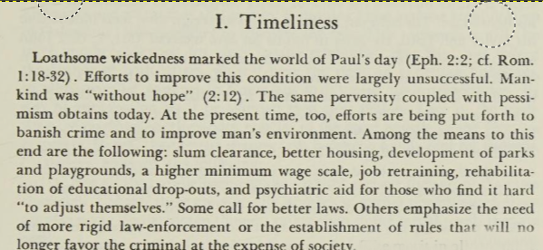
New Testament Commentary Willliam Hendriksen Baker Book Houses © 1967

Slide 23
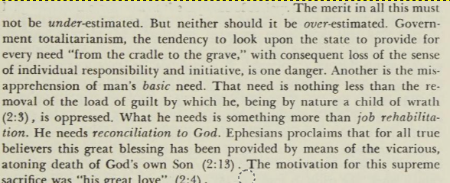
New Testament Commentary Willliam Hendriksen Baker Book Houses © 1967

Slide 24
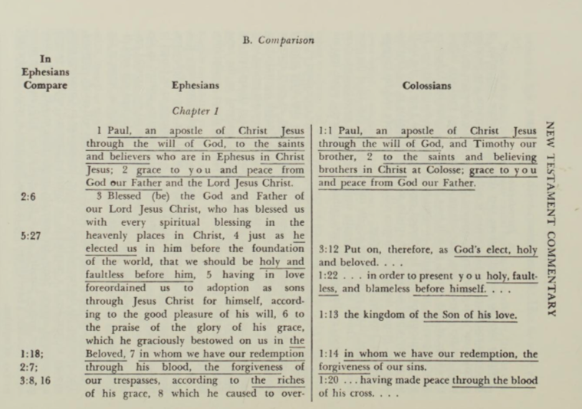
New Testament Commentary Willliam Hendriksen Baker Book Houses © 1967 Approximately 55 verses in Colossians are duplicated in Ephesians

Slide 25
New Testament Commentary Willliam Hendriksen Baker Book Houses © 1967 Approximately 55 verses in Colossians are duplicated in Ephesians

Slide 26
Dystopia : an imagined world or society in which people lead wretched, dehumanized, fearful lives

