Slide 1
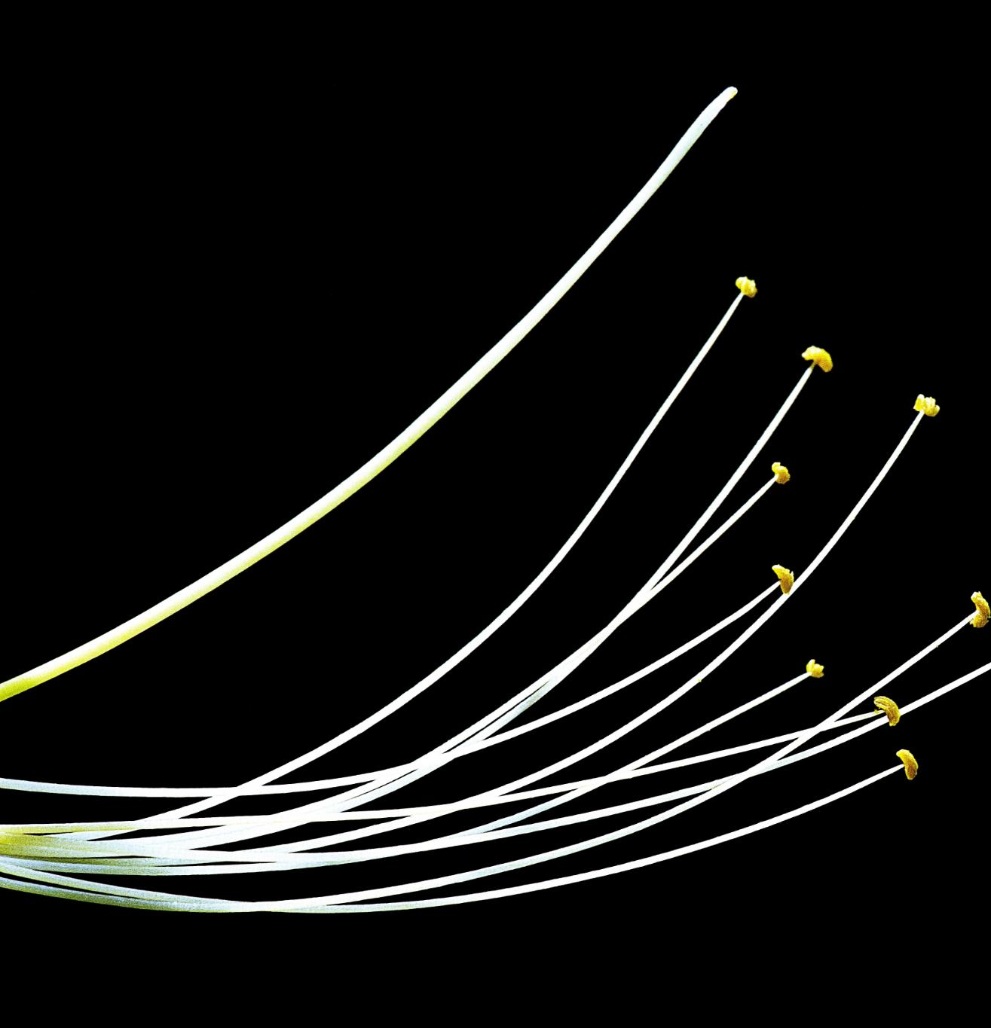
Math Behind Maxwell's Equations
Gauss's Law for Electricity
  This equation relates the electric field to the charge distribution producing it, using the concept of electric flux.
Gauss's Law for Magnetism
  This equation states that the total magnetic flux through a closed surface is zero, implying no magnetic monopoles.
Faraday's Law of Induction
  This law describes how a time-varying magnetic field induces an electric field, fundamental to electromagnetism.
Ampère's Law
  This law relates the magnetic field to the current producing it, including the effects of changing electric fields.
Notes:
Maxwell's equations consist of four fundamental equations that describe the behavior of electric and magnetic fields. They are represented as differential equations: Gauss's law for electricity, Gauss's law for magnetism, Faraday's law of induction, and Ampère's law. These equations use vector calculus, involving divergence and curl operations, to relate electric and magnetic fields to their sources, charge and current distributions.

Slide 2
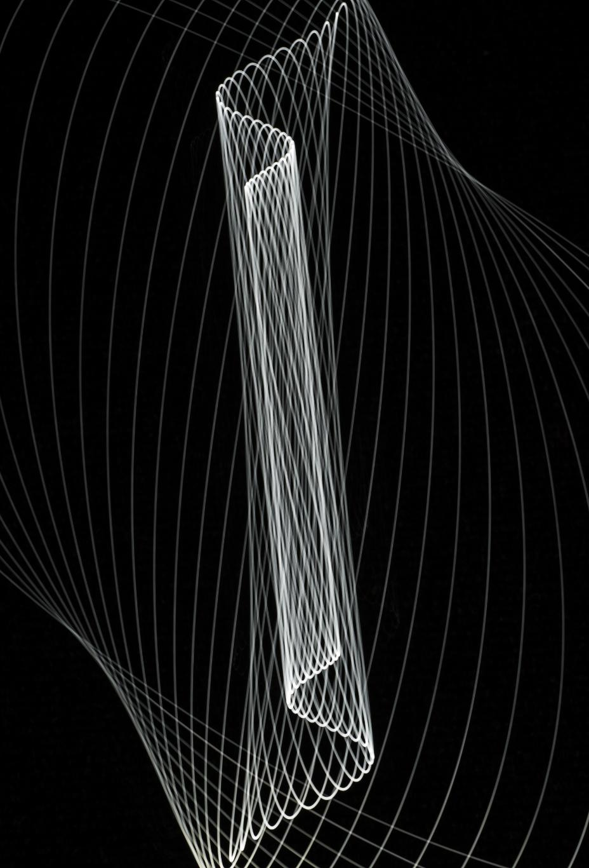
Understanding Divergence
Divergence in Calculus
  Divergence is a vector operator that measures a field's source or sink magnitude at a point.
Scalar Value Representation
  Divergence is a scalar value representing how a vector field spreads out or converges at a point.
Applications in Physics
  Divergence is crucial in fluid dynamics and electromagnetism, describing the behavior of fields and flows.
Notes:
Divergence in calculus refers to a vector operator that measures the magnitude of a field's source or sink at a given point. It is a scalar value representing how much a vector field spreads out from or converges into a point. Divergence is crucial in physics and engineering, particularly in fluid dynamics and electromagnetism, where it helps describe the behavior of fields and flows.

Slide 3
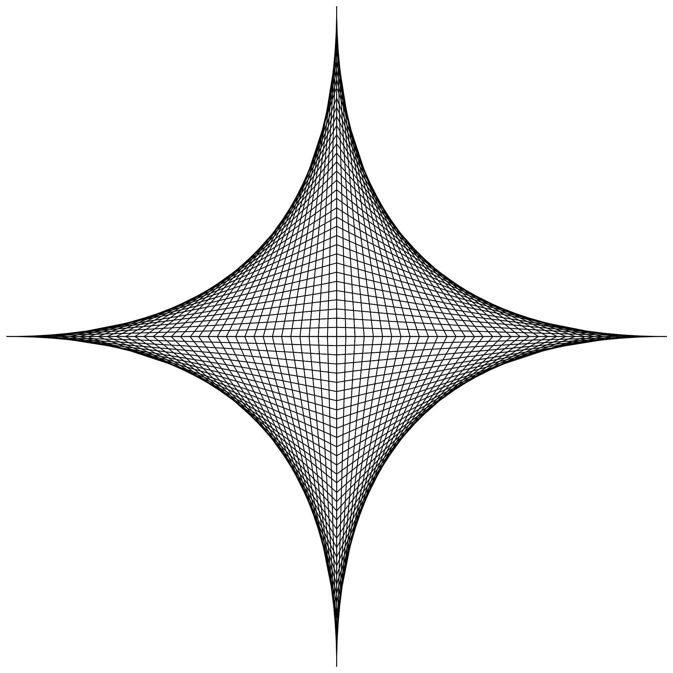
Understanding Curl in Calculus
Definition of Curl
  The curl is a vector operator used to describe the rotation in a vector field, represented by the cross product of the del operator and the vector field.
Applications in Fluid Dynamics
  Curl is essential in fluid dynamics for analyzing rotational patterns and circulation points in fluid flow.
Electromagnetism and Computer Graphics
  Curl is crucial in electromagnetism for understanding magnetic fields, and in computer graphics for simulating rotational movements.
Notes:
The curl is a vector operator that describes the rotation of a vector field in calculus. It is used to analyze the circulation at a point within a field. Mathematically, it is represented by the cross product of the del operator and the vector field. Curl is crucial in fields such as fluid dynamics, electromagnetism, and computer graphics.

Slide 4
Understanding Del Operator
Definition and Symbol
The del operator, symbolized by ∇, denotes the gradient operator in vector calculus. It is essential for various vector field computations.
Gradient Calculation
Using the del operator, the gradient of a scalar field is calculated, indicating how the field changes in different directions.
Divergence and Curl
The del operator is also used to compute the divergence and curl, providing insights into the behavior of vector fields.
Notes:
The del operator, also known as the nabla, is used in vector calculus to denote the gradient operator. It is represented by the symbol ∇. The del operator is used to compute the gradient, divergence, and curl of vector fields. It provides a way to measure how a quantity changes in different directions within a field.

