Slide 1

∞
We are eternal spiritual beings living in a temporary earthly realm.
Goal: Explore the heavenly realms described in Ephesians and review scriptures in light of what we learn.

Slide 2
Book of Ephesians
Heavenly Realms
The Prayer in Chapter 1, Faith and Grace
Spiritual Tools and Heavenly Armor
Spiritual Blessings in Christ
Made Alive in Christ
The New Spiritual Humanity
The Cornerstone and the New Building
Love that is wide, long, and high. The infinite God
Worthy calling - Unity and oneness _
Futile thinking contrasted with Wisdom and Discretion
Quirky things about Ephesians: The Colossian Heresy, Papyrus 46, No serious issues addressed
Chistian Living Impacting Relationships.
12/7
12/21
12/14
Chapter 1
12/28
01/04
12/28

Slide 3
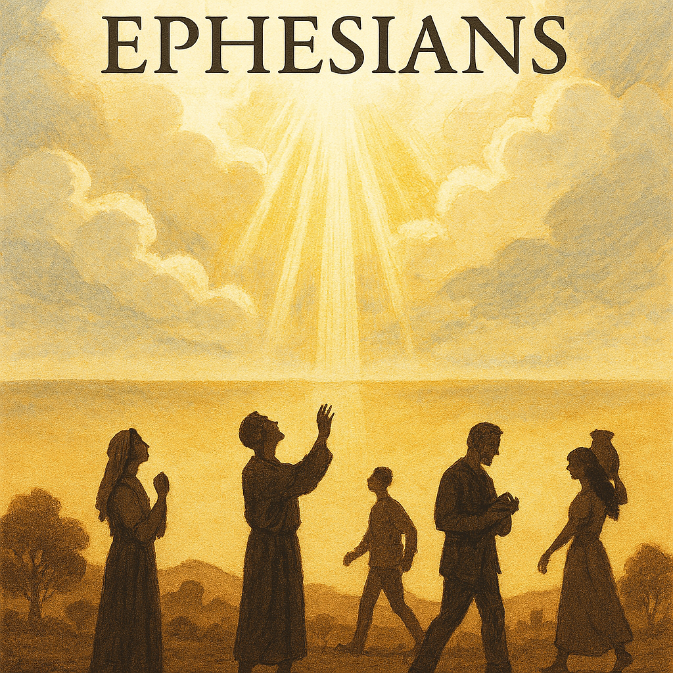
Example of themes knowing and infinity
^{3:16} I pray that out of his glorious riches he may strengthen you with power through his Spirit in your inner being, ¹⁷ so that Christ may dwell in your hearts through faith. And I pray that you, being rooted and established in love, ¹⁸ may have power, together with all the Lord’s holy people, to grasp how wide and long and high and deep is the love of Christ, ¹⁹ and to know this love that surpasses knowledge—that you may be filled to the measure of all the fullness of God.

Slide 4
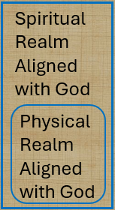


Spiritual Realms
Heard, made known, wisdom, revelation, know Him better, enlightened, know hope, knowledge, insight, discernment, understanding. Made plain
ALIVE
DEAD
¹⁸ being darkened in their understanding, excluded from the life of God because of the ignorance that is in them, because of the hardness of their heart; ¹⁹ and they, having become callous, have given themselves up to indecent behavior for the practice of every kind of impurity with greediness.

Slide 5

Spiritual Realms
Heard, made known, wisdom, revelation, know Him better, enlightened, know hope, knowledge, insight, discernment, understanding. Made plain
ALIVE
DEAD
Islam, Judaism, Atheism, Agnostic,
^{Nothingism (ignoring)}

Slide 6
Patterns for Christian Living Ray Summers Broadman Press © 1960 preface page v
Basically, there are two doctrines in the New Testament: how to be saved---that is, (1) justification buy grace through faith plus nothing; (2)and how the saved ought to live.
Comprehensively this covers the New Testament in a very real sense, every other doctrine is properly placed in one of these statements.

Slide 7

Patterns for Christian Living Ray Summers Broadman Press © 1960 preface page v
Complete text of commentary at: Ephesians : pattern for Christian living : Summers, Ray : Free Download, Borrow, and Streaming : Internet Archive

Slide 8
Patterns for Christian Living Ray Summers Broadman Press © 1960 preface page v
Basically, there are two doctrines in the New Testament: how to be saved---that is, (1) justification buy grace through faith plus nothing; (2)and how the saved ought to live.
Comprehensively this covers the New Testament in a very real sense, every other doctrine is properly placed in one of these statements.

Slide 9
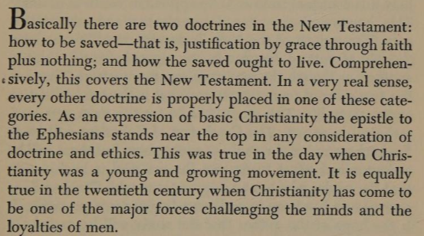
Patterns for Christian Living Ray Summers Broadman Press © 1960 preface page v

Slide 10
Patterns for Christian Living Ray Summers preface page v

Slide 11
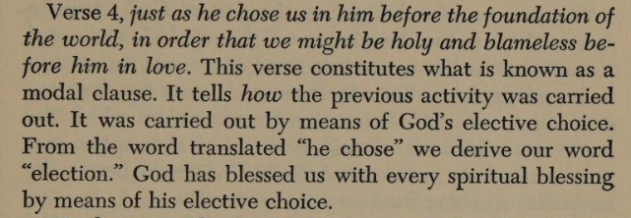
Patterns for Christian Living Ray Summers Broadman Press © 1960 preface page v

Slide 12
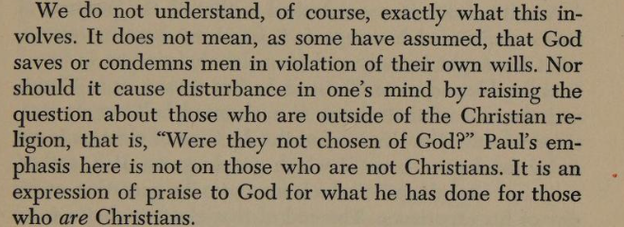
Patterns for Christian Living Ray Summers Broadman Press © 1960 preface page v

Slide 13
Patterns for Christian Living Ray Summers Broadman Press © 1960
Ray Summers makes a distinction between doctrine and application as follows:
Epistle | Doctrine | Application
Ephesians | 1-3 | 4-6
Romans | 1-11 | 12-16
Galatians | 1-4 | 5-6
Colossians | 1-2 | 3.4
1 Peter | 1:1 to 2:10 | 2:11 to 5:14
Hebrews | 1:1 top 10:18 | 10:19 to 13:25

Slide 14

New Testament Commentary Willliam Hendriksen Baker Book Houses © 1967
https://archive.org/details/newtestamentcomm0000hend/page/n282/mode/1up?view=theater
( Calvinist Election)
Contains a Colossians vs Ephesians Comparison (21 pages)

Slide 15
New Testament Commentary Willliam Hendriksen Baker Book Houses © 1967
The good with the questionable
https://archive.org/details/newtestamentcomm0000hend/page/n282/mode/1up?view=theater
( Calvinist Election not good)
Contains a Colossians vs Ephesians Comparison (21 pages) (Helpful)

Slide 16
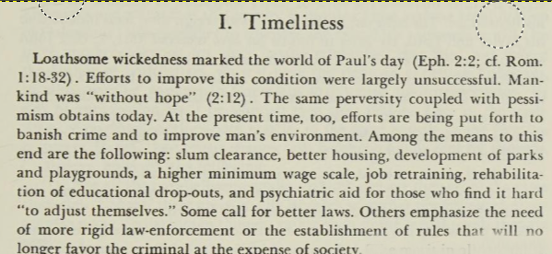
New Testament Commentary Willliam Hendriksen Baker Book Houses © 1967

Slide 17
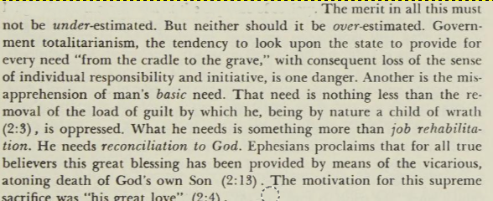
New Testament Commentary Willliam Hendriksen Baker Book Houses © 1967

Slide 18
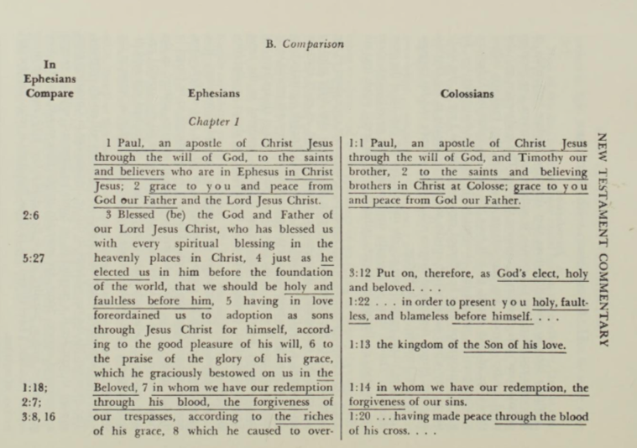
New Testament Commentary Willliam Hendriksen Baker Book Houses © 1967 Approximately 55 verses in Colossians are duplicated in Ephesians

Slide 19
New Testament Commentary Willliam Hendriksen Baker Book Houses © 1967 Approximately 55 verses in Colossians are duplicated in Ephesians

Slide 20
Dystopia : an imagined world or society in which people lead wretched, dehumanized, fearful lives

Slide 21
Book of Ephesians
Book of Ephesians

Slide 22
Book of Ephesians
Key Themes
The Book of Ephesians addresses themes of unity, love, grace, and spiritual growth within the Christian community.
Paul's Message
Paul's letter emphasizes the importance of living a life worthy of the calling received, and the transformative power of God's love and grace.
Modern Relevance
The teachings in Ephesians are relevant to modern Christian life, offering guidance on how to live harmoniously and faithfully in today's world.
Notes:
Introduction to the Book of Ephesians, using the Western Heights Church of Christ logo. This presentation will delve into the key themes and messages of the Apostle Paul's letter to the Ephesians, exploring its relevance to modern Christian life.

