Slide 1

We are eternal spiritual beings living in a temporary earthly realm.
Goal: Explore the heavenly realms described in Ephesians and review scriptures in light of what we learn.

Slide 2

Heavenly Realms Ephesians 1:3, 1:20, 2:6, 3:10, 6:12
Heavenly Realm Aligned with God
Heavenly Realm Not Aligned with God
God’s Creation
Physical Realm Aligned with God
Physical Realm Not Aligned with God

Slide 3

Physical Realms are subsets of Heavenly Realms
Forgiven Sinners
Sinners
Heavenly Realm Aligned with God
Heavenly Realm Not Aligned with God
Physical Realm Aligned with God
Physical Realm Not Aligned with God
Through grace and the gift of Jesus we are aligned with God.

Slide 4
Ephesians and the terminology heavenly realms
The term “heavenly realms” is used for a single Greek word epouranios (ἐπουρανίοις) . Five times in Ephesians. (NIV)
The second word “realms” (NIV) is added to make a distinction from the dwelling place of God.
Ephesians 6:12 includes spirts not aligned with god in the verse therefore epouranios in this sense is not the dwelling place of God.
KJV uses heavenly places in he first four occurrences, these are aligned with God and uses High places as a distinction for the dwelling place of spirits not aligned with God.
A personal view to describe epouranios as “Spiritual Realms’ will allow heaven to be used as the dwelling place of God.

Slide 5
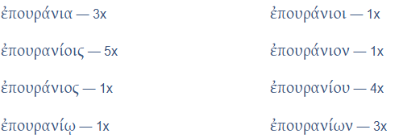
Ephesians and the terminology heavenly realms
Ephesians

Slide 6
Physical Realms are subsets of Spiritual Realms
Heavenly Places KJV
High Places KJV
Spiritual
Realm Aligned with God
Spiritual Realm Not Aligned with God
Physical Realm Aligned with God
Physical Realm Not Aligned with God
Through grace and the gift of Jesus we are aligned with God.

Slide 7
Book of Ephesians
Heavenly Realms
The mystery
Spiritual Tools and Heavenly Armor
Spiritual Blessings in Christ
Made Alive in Christ
The New Spiritual Humanity
The Cornerstone and the New Building
Love that is wide, long, and high. The infinite God
Worthy calling - Unity and oneness _
Futile thinking contrasted with Wisdom and Discretion
Quirky things about Ephesians, The Colossian Heresy, Papyrus 46
Chistian Living Impacting Relationships.
12/7
12/14
Chapter 1

Slide 8
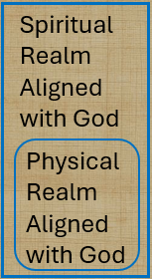

Physical Realms are subsets of Spiritual Realms
Spiritual
Realm Aligned with God
Spiritual
Realm Not Aligned with God
Conceptual
Relational
Physical Realm Aligned with God
Physical Realm Not Aligned with God
Bound by time (also history and geography

Slide 9
Physical Realms are subsets of Heavenly Realms
Heavenly Realm Aligned with God
Heavenly Realm Not Aligned with God
When time is no more the Physical Realms we know about disappear
Physical Realm Aligned with God
Physical Realm Not Aligned with God

Slide 10

Heavenly Realms Ephesians 3:10 (conceptually / historically)
Spiritual
Realm Aligned with God
Spiritual
Realm Not Aligned with God
Plots to kill Jesus as a baby and eliminate him with crucifixion
Heavenly Good news
Conceptual and relational change
Physical Realm Aligned with God
Physical Realm Not Aligned with God

Slide 11
Heavenly Realms
ALIVE
DEAD

Slide 12
Heavenly Realms
BLESSINGS
^{John 3 16}
loved
believes
shall not perish
eternal life
not condemned,
^{Eph 2:4}
love
Mercy
ALIVE
Grace
Raised
^{Eph 2:4}
Seated with Christ
Incomparable riches
kindness
^{John3: 18b}
does not believe
condemned
CURSES
^{Eph 2:1}
DEAD transgressions
sin
worldly
disobedient
^{Eph 2:1}
^{Fleshly}
^{wrath}
Expand lists by inference

Slide 13
What are the blessings mentioned in Ephesians chapter 1.
³ Praise be to the God and Father of our Lord Jesus Christ, who has blessed us in the heavenly realms with every spiritual blessing in Christ

Slide 14
What is the source of our material blessings?
Mitch’s Sermon 12/7/2025

Slide 15
Heavenly Realms Ephesians 1:3
eternal
Heavenly Realm Aligned with God
Heavenly Realm Not Aligned with God
What is the flow of blessings?
Physical Realm Aligned with God
Physical Realm Not Aligned with God
temporary

Slide 16
Heavenly Realms Ephesians 3:10
GOD
Heavenly Realm Aligned with God
Heavenly Realm Not Aligned with God
What is the flow of blessings?
Physical Realm Aligned with God
Physical Realm Not Aligned with God
Notes:
Introduction to the Book of Ephesians, using the Western Heights Church of Christ logo. This presentation will delve into the key themes and messages of the Apostle Paul's letter to the Ephesians, exploring its relevance to modern Christian life.

Slide 17
Class input:
What are the blessings mentioned in Ephesians chapter 1.
Notes:
.

Slide 18
What are the blessings mentioned in Ephesians chapter 1.
⁴ For he chose us in him before the creation of the world to be holy and blameless in his sight.

Slide 19
What are the blessings mentioned in Ephesians chapter 1.
⁴ For he chose us in him before the creation of the world to be holy and blameless in his sight.

Slide 20
What are the blessings mentioned in Ephesians chapter 1.
⁵ he predestined us for adoption to sonship through Jesus Christ, in accordance with his pleasure and will— ⁶ to the praise of his glorious grace, which he has freely given us in the One he loves.

Slide 21
What are the blessings mentioned in Ephesians chapter 1.
⁷ In him we have redemption through his blood, the forgiveness of sins, in accordance with the riches of God’s grace ⁸ that he lavished on us. With all wisdom and understanding,

Slide 22
What are the blessings mentioned in Ephesians chapter 1.
⁹ he made known to us the mystery of his will according to his good pleasure, which he purposed in Christ, ¹⁰ to be put into effect when the times reach their fulfillment—to bring unity to all things in heaven and on earth under Christ.

Slide 23
What are the blessings mentioned in Ephesians chapter 1.
¹¹ In him we were also chosen,^{[e]} having been predestined according to the plan of him who works out everything in conformity with the purpose of his will, ¹² in order that we, who were the first to put our hope in Christ, might be for the praise of his glory.

Slide 24
What are the blessings mentioned in Ephesians chapter 1.
¹³ And you also were included in Christ when you heard the message of truth, the gospel of your salvation. When you believed, you were marked in him with a seal, the promised Holy Spirit, ¹⁴ who is a deposit guaranteeing our inheritance until the redemption of those who are God’s possession—to the praise of his glory.

Slide 25
blessings mentioned in the prayer
¹⁵ For this reason, ever since I heard about your faith in the Lord Jesus and your love for all God’s people, ¹⁶ I have not stopped giving thanks for you, remembering you in my prayers. ¹⁷ I keep asking that the God of our Lord Jesus Christ, the glorious Father, may give you the Spirit (or a spirit)^{[f]} of wisdom and revelation, so that you may know him better.

Slide 26
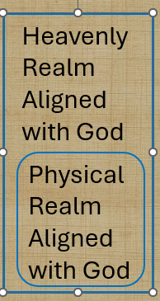
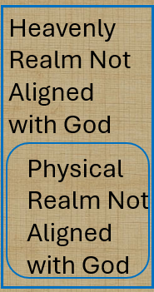
Heavenly Realms
BLESSINGS
^{EPH 1:15-16}
faith
Lord Jesus
Love
God’s people
giving thanks
remembering you in my prayers.
Give you a spirit of wisdom and revelation, so that you may know him
CURSES
Expand list
Notes:
Introduction to the Book of Ephesians, using the Western Heights Church of Christ logo. This presentation will delve into the key themes and messages of the Apostle Paul's letter to the Ephesians, exploring its relevance to modern Christian life.

Slide 27
Other Ways of saying Giving Thanks
BLESSINGS
^{EPH 1:15-16}
faith
Lord Jesus
Love
God’s people
giving thanks
remembering you in my prayers.
Spirit of wisdom and revelation, so that you may know him
CURSES
Expand list
Notes:
Introduction to the Book of Ephesians, using the Western Heights Church of Christ logo. This presentation will delve into the key themes and messages of the Apostle Paul's letter to the Ephesians, exploring its relevance to modern Christian life.

Slide 28
blessings mentioned in the prayer
¹⁸ I pray that the eyes of your heart may be enlightened in order that you may know the hope to which he has called you, the riches of his glorious inheritance in his holy people, ¹⁹ and his incomparably great power for us who believe.

Slide 29
blessings mentioned in the prayer
^{19 b} That power is the same as the mighty strength ²⁰ he exerted when he raised Christ from the dead and seated him at his right hand in the heavenly realms, ²¹ far above all rule and authority, power and dominion, and every name that is invoked, not only in the present age but also in the one to come.

Slide 30
What are the blessings mentioned in Ephesians chapter 1.
^{19 b} That power is the same as the mighty strength ²⁰ he* exerted when he raised Christ from the dead and seated him at his right hand in the heavenly realms, ²¹ far above all rule and authority, power and dominion, and every name that is invoked, not only in the present age but also in the one to come.
* He NASB and ~20 of 60 versions on bible gateway
Notes:
Introduction to the Book of Ephesians, using the Western Heights Church of Christ logo. This presentation will delve into the key themes and messages of the Apostle Paul's letter to the Ephesians, exploring its relevance to modern Christian life.

Slide 31
blessings mentioned in the prayer
²² And God placed all things under his feet and appointed him to be head over everything for the church, ²³ which is his body, the fullness of him who fills everything in every way

Slide 32
Progressive Actions and prayer detail
REWIND and look at progressive action and the prayer detail

Slide 33
Progressive Actions
¹⁵ For this reason, ever since I heard about your faith in the Lord Jesus and your love for all God’s people, ¹⁶ I have not stopped giving thanks for you, remembering you in my prayers. ¹⁷ I keep asking that the God of our Lord Jesus Christ, the glorious Father, may give you the Spirit (or a spirit)^{[f]} of wisdom and revelation, so that you may know him better.

Slide 34
Progressive Actions + WHAT IS TO BE KNOWN
¹⁸ I pray that the eyes of your heart may be enlightened in order that you may know: {{the hope to which he has called you, the riches of his glorious inheritance in his holy people, ¹⁹ and his incomparably great power for us who believe.
Notes:
.

Slide 35
WHAT IS TO BE KNOWN
^{19 b} That power is the same as the mighty strength ²⁰ he exerted when he raised Christ from the dead and seated him at his right hand in the heavenly realms, ²¹ far above all rule and authority, power and dominion, and every name that is invoked, not only in the present age but also in the one to come.
Notes:
.

Slide 36
WHAT IS TO BE KNOWN
²² And God placed all things under his feet and appointed him to be head over everything for the church, ²³ which is his body, the fullness of him who fills everything in every way}}

Slide 37

Paul’s Prayer for the Philippians
^{Philippians 1:9} And this is my prayer: that your love may abound more and more in knowledge and depth of insight, ¹⁰ so that you may be able to discern what is best and may be pure and blameless for the day of Christ, ¹¹ filled with the fruit of righteousness that comes through Jesus Christ—to the glory and praise of God.

Slide 38
Ephesians Chapter 2
https://www.weldonbeardain.website/ephesians/
Notes:
.

Slide 39
Heavenly Realms
BLESSINGS
Grace
⁴ But because of his great love for us, God, who is rich in mercy, ⁵ made us alive with Christ even when we were dead in transgressions—it is by grace you have been saved. ⁶ And God raised us up with Christ and seated us with him in the heavenly realms in Christ Jesus, ⁷ in order that in the coming ages he might show the incomparable riches of his grace, expressed in his kindness to us in Christ Jesus .
2 As for you, you were dead in your transgressions and sins, ² in which you used to live when you followed the ways of this world and of the ruler of the kingdom of the air, the spirit who is now at work in those who are disobedient. ³ All of us also lived among them at one time, gratifying the cravings of our flesh^{[a]} and following its desires and thoughts. Like the rest, we were by nature deserving of wrath
CURSES
Notes:
Introduction to the Book of Ephesians, using the Western Heights Church of Christ logo. This presentation will delve into the key themes and messages of the Apostle Paul's letter to the Ephesians, exploring its relevance to modern Christian life.

Slide 40
Heavenly Realms
ALIVE
GRACE
DEAD

Slide 41
Did the recipients of Paul’s letter already know about grace?
Why does Paul mention grace again?
How does this grace align with the theme of chapter 1?

Slide 42
Grace Through Faith
^{Ephesians 2:8} For it is by grace you have been saved, through faith—and this is not from yourselves, it is the gift of God—
Notes:
.

Slide 43
Grace in Chapter 3
² Surely you have heard about the administration of God’s grace that was given to me for you, ³ that is, the mystery made known to me by revelation, as I have already written briefly.
Notes:
.

Slide 44
Grace in Chapter 3
⁷ I became a servant of this gospel by the gift of God’s grace given me through the working of his power. ⁸ Although I am less than the least of all the Lord’s people, this grace was given me: to preach to the Gentiles the boundless riches of Christ, ⁹ and to make plain to everyone the administration of this mystery, which for ages past was kept hidden in God, who created all thing
Notes:
.

Slide 45
Faith Chapter 3
¹² In him and through faith in him we may approach God with freedom and confidence.
¹¹ This was in accordance with the eternal purpose which He] carried out in Christ Jesus our Lord, ¹² in whom we have boldness and ^{[i]}confident access through faith ^{[j]}in Him.
Notes:
.

Slide 46

Heavenly Realms
ALIVE
GRACE
DEAD
Without faith the available grace is hidden from the non-believer locking them in a realm not aligned with God

Slide 47
Heavenly Realms
ALIVE
GRACE
DEAD
Without faith the available grace is hidden from the non-believer locking them in a realm not aligned with God

Slide 48

Heavenly Realms
ALIVE
DEAD
Without faith the available grace is hidden from the non-believer locking them in a realm not aligned with God

Slide 49

Heavenly Realms
ALIVE
DEAD
¹⁸ being darkened in their understanding, excluded from the life of God because of the ignorance that is in them, because of the hardness of their heart; ¹⁹ and they, having become callous, have given themselves up to indecent behavior for the practice of every kind of impurity with greediness.

Slide 50
Heavenly Realms
ALIVE
DEAD
¹⁸ being darkened in their understanding, excluded from the life of God because of the ignorance that is in them, because of the hardness of their heart; ¹⁹ and they, having become callous, have given themselves up to indecent behavior for the practice of every kind of impurity with greediness.
Even in this terrible state of separation, not aligned with God, Grace can be unveiled and lives changed by the Gospel

Slide 51
Heavenly Realms
ALIVE
DEAD
¹⁸ being darkened in their understanding, excluded from the life of God because of the ignorance that is in them, because of the hardness of their heart; ¹⁹ and they, having become callous, have given themselves up to indecent behavior for the practice of every kind of impurity with greediness.
Even in this terrible state of separation, not aligned with God, Grace can be unveiled and lives changed by the Gospel. The Gospel is the story of Grace

Slide 52
Heavenly Realms
ALIVE
LOST SAVED
DEAD
FOUND CONDEMNED
Even in this terrible state of separation, not aligned with God, Grace can be unveiled and lives changed by the Gospel. The Gospel is the story of Grace

Slide 53
What Has Paul established in chapters 1 and 2 ?
Notes:
.

Slide 54
Impacts of reviewing blessings, ALIVE and Grace?
Notes:
.

Slide 55
Atheist to Believer
C.S. Lewis “Mere Christianity”
Anthony Flew “There Is a God”
Lee Strobel “ The Case for Christ”
Michael Guillen “Believing is Seeing”

Slide 56

Atheist to Christian _ Michael Guillen
Take a journey with a PHD physicist looking at the world and perceiving that science supports the existence of God. Believing there is a God, he pursued many world religions and found that only Christianity as a suitable choice. Tracing physics from subatomic particles to cosmology he witnesses God.
Numerous bible passages are included at length adding credence to the science and bible connections.

Slide 57
Observatons
Grace and faith are tightly linked.
The Gospel and grace are tightly linked.
Without faith grace is hidden. Believing is seeing.
Faith can be learned
Counting Blessings, especially Grace, strengthens Faith

Slide 58
Lessons son file at:
https://www.weldonbeardain.website/ephesians/
Notes:
.

Slide 59
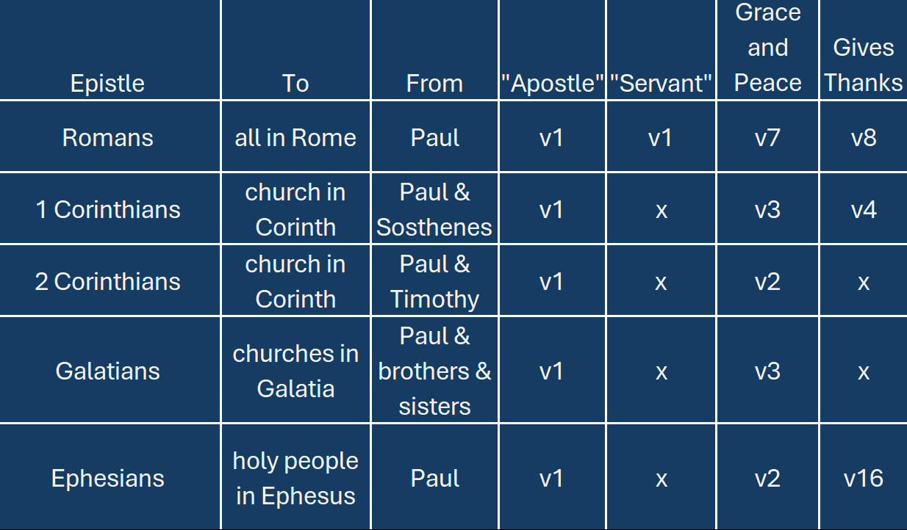
Paul’s Letter Openings
Notes:
Introduction to the Book of Ephesians, using the Western Heights Church of Christ logo. This presentation will delve into the key themes and messages of the Apostle Paul's letter to the Ephesians, exploring its relevance to modern Christian life.

Slide 60
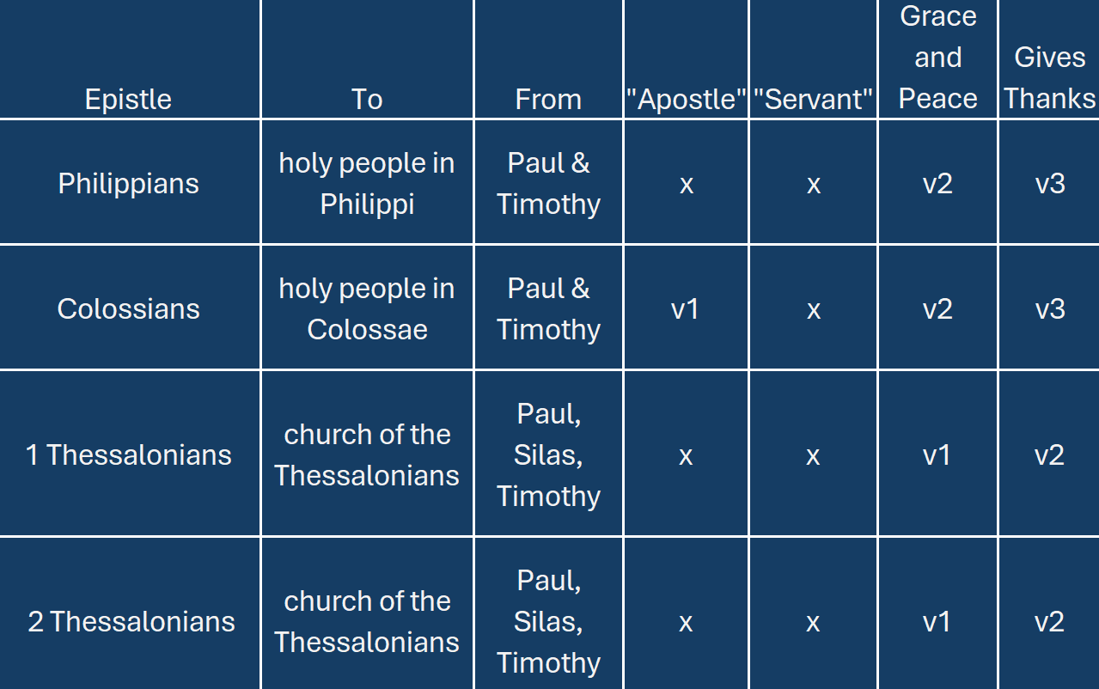
Paul’s Letter Openings
Notes:
.

Slide 61
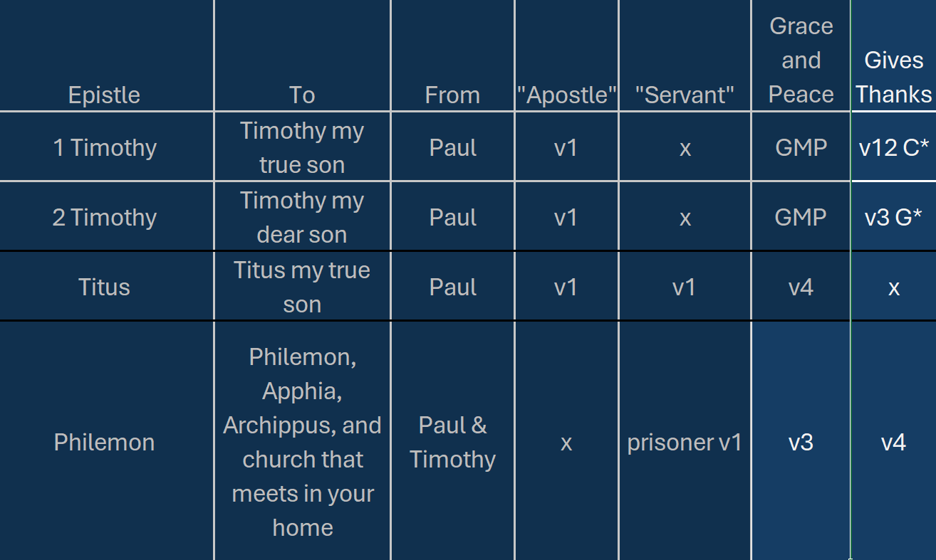
Paul’s Letter Openings

Slide 62


