Slide 1

We are eternal spiritual beings living in a temporary earthly realm.
Goal: Explore the heavenly realms described in Ephesians and review scriptures in light of what we learn.

Slide 2

Heavenly Realms Ephesians 1:3, 1:20, 2:6, 3:10, 6:12
Heavenly Realm Aligned with God
Heavenly Realm Not Aligned with God
God’s Creation
Physical Realm Aligned with God
Physical Realm Not Aligned with God

Slide 3

Physical Realms are subsets of Heavenly Realms
Forgiven Sinners
Sinners
Heavenly Realm Aligned with God
Heavenly Realm Not Aligned with God
Physical Realm Aligned with God
Physical Realm Not Aligned with God
Through grace and the gift of Jesus we are aligned with God.

Slide 4
Book of Ephesians
Heavenly Realms
The mystery
Spiritual Tools and Heavenly Armor
Spiritual Blessings in Christ
Made Alive in Christ
The New Spiritual Humanity
The Cornerstone and the New Building
Love that is wide, long, and high. The infinite God
Worthy calling - Unity and oneness _
Futile thinking contrasted with Wisdom and Discretion
Quirky things about Ephesians, The Colossian Heresy, Papyrus 46
Chistian Living Impacting Relationships.
12/7
12/14
Chapter 1

Slide 5
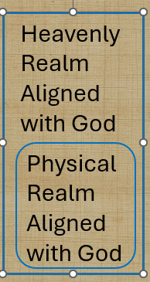
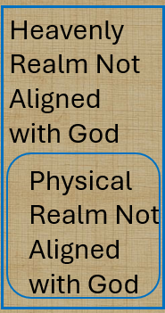
Physical Realms are subsets of Heavenly Realms
Heavenly Realm Aligned with God
Heavenly Realm Not Aligned with God
Conceptual
Relational
Physical Realm Aligned with God
Physical Realm Not Aligned with God
Bound by time (also history and geography

Slide 6
Physical Realms are subsets of Heavenly Realms
Heavenly Realm Aligned with God
Heavenly Realm Not Aligned with God
When time is no more the Physical Realms we know about disappear
Physical Realm Aligned with God
Physical Realm Not Aligned with God

Slide 7

Heavenly Realms Ephesians 3:10 (conceptually / historically)
Heavenly Realm Aligned with God
Heavenly Realm Not Aligned with God
Plots to kill Jesus as a baby and eliminate him with crucifixion
Heavenly Good news
Conceptual and relational change
Physical Realm Aligned with God
Physical Realm Not Aligned with God

Slide 8
Heavenly Realms
ALIVE
DEAD

Slide 9
Heavenly Realms
BLESSINGS
^{John 3 16}
loved
believes
shall not perish
eternal life
not condemned,
^{Eph 2:4}
love
Mercy
ALIVE
Grace
Raised
^{Eph 2:4}
Seated with Christ
Incomparable riches
kindness
^{John3: 18b}
does not believe
condemned
CURSES
^{Eph 2:1}
DEAD transgressions
sin
worldly
disobedient
^{Eph 2:1}
^{Fleshly}
^{wrath}
Expand lists by inference

Slide 10
What are the blessings mentioned in Ephesians chapter 1.
³ Praise be to the God and Father of our Lord Jesus Christ, who has blessed us in the heavenly realms with every spiritual blessing in Christ

Slide 11
What is the source of our material blessings?
Mitch’s Sermon 12/7/2025

Slide 12
Heavenly Realms Ephesians 1:3
eternal
Heavenly Realm Aligned with God
Heavenly Realm Not Aligned with God
What is the flow of blessings?
Physical Realm Aligned with God
Physical Realm Not Aligned with God
temporary

Slide 13
Heavenly Realms Ephesians 3:10
GOD
Heavenly Realm Aligned with God
Heavenly Realm Not Aligned with God
What is the flow of blessings?
Physical Realm Aligned with God
Physical Realm Not Aligned with God
Notes:
Introduction to the Book of Ephesians, using the Western Heights Church of Christ logo. This presentation will delve into the key themes and messages of the Apostle Paul's letter to the Ephesians, exploring its relevance to modern Christian life.

Slide 14
Class input:
What are the blessings mentioned in Ephesians chapter 1.
Notes:
.

Slide 15
What are the blessings mentioned in Ephesians chapter 1.
⁴ For he chose us in him before the creation of the world to be holy and blameless in his sight.

Slide 16
What are the blessings mentioned in Ephesians chapter 1.
⁴ For he chose us in him before the creation of the world to be holy and blameless in his sight.

Slide 17
What are the blessings mentioned in Ephesians chapter 1.
⁵ he predestined us for adoption to sonship through Jesus Christ, in accordance with his pleasure and will— ⁶ to the praise of his glorious grace, which he has freely given us in the One he loves.

Slide 18
What are the blessings mentioned in Ephesians chapter 1.
⁷ In him we have redemption through his blood, the forgiveness of sins, in accordance with the riches of God’s grace ⁸ that he lavished on us. With all wisdom and understanding,

Slide 19
What are the blessings mentioned in Ephesians chapter 1.
⁹ he made known to us the mystery of his will according to his good pleasure, which he purposed in Christ, ¹⁰ to be put into effect when the times reach their fulfillment—to bring unity to all things in heaven and on earth under Christ.

Slide 20
What are the blessings mentioned in Ephesians chapter 1.
¹¹ In him we were also chosen,^{[e]} having been predestined according to the plan of him who works out everything in conformity with the purpose of his will, ¹² in order that we, who were the first to put our hope in Christ, might be for the praise of his glory.

Slide 21
What are the blessings mentioned in Ephesians chapter 1.
¹³ And you also were included in Christ when you heard the message of truth, the gospel of your salvation. When you believed, you were marked in him with a seal, the promised Holy Spirit, ¹⁴ who is a deposit guaranteeing our inheritance until the redemption of those who are God’s possession—to the praise of his glory.

Slide 22
blessings mentioned in the prayer
¹⁵ For this reason, ever since I heard about your faith in the Lord Jesus and your love for all God’s people, ¹⁶ I have not stopped giving thanks for you, remembering you in my prayers. ¹⁷ I keep asking that the God of our Lord Jesus Christ, the glorious Father, may give you the Spirit (or a spirit)^{[f]} of wisdom and revelation, so that you may know him better.

Slide 23
Heavenly Realms
BLESSINGS
^{EPH 1:15-16}
faith
Lord Jesus
Love
God’s people
giving thanks
remembering you in my prayers.
Give you a spirit of wisdom and revelation, so that you may know him
CURSES
Expand list
Notes:
Introduction to the Book of Ephesians, using the Western Heights Church of Christ logo. This presentation will delve into the key themes and messages of the Apostle Paul's letter to the Ephesians, exploring its relevance to modern Christian life.

Slide 24
Other Ways of saying Giving Thanks
BLESSINGS
^{EPH 1:15-16}
faith
Lord Jesus
Love
God’s people
giving thanks
remembering you in my prayers.
Spirit of wisdom and revelation, so that you may know him
CURSES
Expand list
Notes:
Introduction to the Book of Ephesians, using the Western Heights Church of Christ logo. This presentation will delve into the key themes and messages of the Apostle Paul's letter to the Ephesians, exploring its relevance to modern Christian life.

Slide 25
blessings mentioned in the prayer
¹⁸ I pray that the eyes of your heart may be enlightened in order that you may know the hope to which he has called you, the riches of his glorious inheritance in his holy people, ¹⁹ and his incomparably great power for us who believe.

Slide 26
blessings mentioned in the prayer
^{19 b} That power is the same as the mighty strength ²⁰ he exerted when he raised Christ from the dead and seated him at his right hand in the heavenly realms, ²¹ far above all rule and authority, power and dominion, and every name that is invoked, not only in the present age but also in the one to come.

Slide 27
What are the blessings mentioned in Ephesians chapter 1.
^{19 b} That power is the same as the mighty strength ²⁰ he* exerted when he raised Christ from the dead and seated him at his right hand in the heavenly realms, ²¹ far above all rule and authority, power and dominion, and every name that is invoked, not only in the present age but also in the one to come.
* He NASB and ~20 of 60 versions on bible gateway
Notes:
Introduction to the Book of Ephesians, using the Western Heights Church of Christ logo. This presentation will delve into the key themes and messages of the Apostle Paul's letter to the Ephesians, exploring its relevance to modern Christian life.

Slide 28
blessings mentioned in the prayer
²² And God placed all things under his feet and appointed him to be head over everything for the church, ²³ which is his body, the fullness of him who fills everything in every way

Slide 29
Progressive Actions and prayer detail
REWIND and look at progressive action and the prayer detail

Slide 30
Progressive Actions
¹⁵ For this reason, ever since I heard about your faith in the Lord Jesus and your love for all God’s people, ¹⁶ I have not stopped giving thanks for you, remembering you in my prayers. ¹⁷ I keep asking that the God of our Lord Jesus Christ, the glorious Father, may give you the Spirit (or a spirit)^{[f]} of wisdom and revelation, so that you may know him better.

Slide 31
Progressive Actions + WHAT IS TO BE KNOWN
¹⁸ I pray that the eyes of your heart may be enlightened in order that you may know: {{the hope to which he has called you, the riches of his glorious inheritance in his holy people, ¹⁹ and his incomparably great power for us who believe.
Notes:
.

Slide 32
WHAT IS TO BE KNOWN
^{19 b} That power is the same as the mighty strength ²⁰ he exerted when he raised Christ from the dead and seated him at his right hand in the heavenly realms, ²¹ far above all rule and authority, power and dominion, and every name that is invoked, not only in the present age but also in the one to come.
Notes:
.

Slide 33
WHAT IS TO BE KNOWN
²² And God placed all things under his feet and appointed him to be head over everything for the church, ²³ which is his body, the fullness of him who fills everything in every way}}

Slide 34

Paul’s Prayer for the Philippians
^{Philippians 1:9} And this is my prayer: that your love may abound more and more in knowledge and depth of insight, ¹⁰ so that you may be able to discern what is best and may be pure and blameless for the day of Christ, ¹¹ filled with the fruit of righteousness that comes through Jesus Christ—to the glory and praise of God.

Slide 35
Ephesians Chapter 2
https://www.weldonbeardain.website/ephesians/
Notes:
.

Slide 36
Heavenly Realms
BLESSINGS
Grace
⁴ But because of his great love for us, God, who is rich in mercy, ⁵ made us alive with Christ even when we were dead in transgressions—it is by grace you have been saved. ⁶ And God raised us up with Christ and seated us with him in the heavenly realms in Christ Jesus, ⁷ in order that in the coming ages he might show the incomparable riches of his grace, expressed in his kindness to us in Christ Jesus .
2 As for you, you were dead in your transgressions and sins, ² in which you used to live when you followed the ways of this world and of the ruler of the kingdom of the air, the spirit who is now at work in those who are disobedient. ³ All of us also lived among them at one time, gratifying the cravings of our flesh^{[a]} and following its desires and thoughts. Like the rest, we were by nature deserving of wrath
CURSES
Notes:
Introduction to the Book of Ephesians, using the Western Heights Church of Christ logo. This presentation will delve into the key themes and messages of the Apostle Paul's letter to the Ephesians, exploring its relevance to modern Christian life.

Slide 37
Heavenly Realms
ALIVE
GRACE
DEAD

Slide 38
Did the recipients of Paul’s letter already know about grace?
Why does Paul mention grace again?
How does this grace align with the theme of chapter 1?

Slide 39
Grace Through Faith
^{Ephesians 2:8} For it is by grace you have been saved, through faith—and this is not from yourselves, it is the gift of God—
Notes:
.

Slide 40
Grace in Chapter 3
² Surely you have heard about the administration of God’s grace that was given to me for you, ³ that is, the mystery made known to me by revelation, as I have already written briefly.
Notes:
.

Slide 41
Grace in Chapter 3
⁷ I became a servant of this gospel by the gift of God’s grace given me through the working of his power. ⁸ Although I am less than the least of all the Lord’s people, this grace was given me: to preach to the Gentiles the boundless riches of Christ, ⁹ and to make plain to everyone the administration of this mystery, which for ages past was kept hidden in God, who created all thing
Notes:
.

Slide 42
Faith Chapter 3
¹² In him and through faith in him we may approach God with freedom and confidence.
¹¹ This was in accordance with the eternal purpose which He] carried out in Christ Jesus our Lord, ¹² in whom we have boldness and ^{[i]}confident access through faith ^{[j]}in Him.
Notes:
.

Slide 43

Heavenly Realms
ALIVE
GRACE
DEAD
Without faith the available grace is hidden from the non-believer locking them in a realm not aligned with God

Slide 44
Grace Through Faith
^{Ephesians 2:8} For it is by grace you have been saved, through faith—and this is not from yourselves, it is the gift of God—
Notes:
.

Slide 46
Grace and faith are tightly linked
Without faith grace is hidden
Faith can be learned
Counting Blessings, especially Grace, strengthens Faith

Slide 47
https://www.weldonbeardain.website/ephesians/
Notes:
.

Slide 48
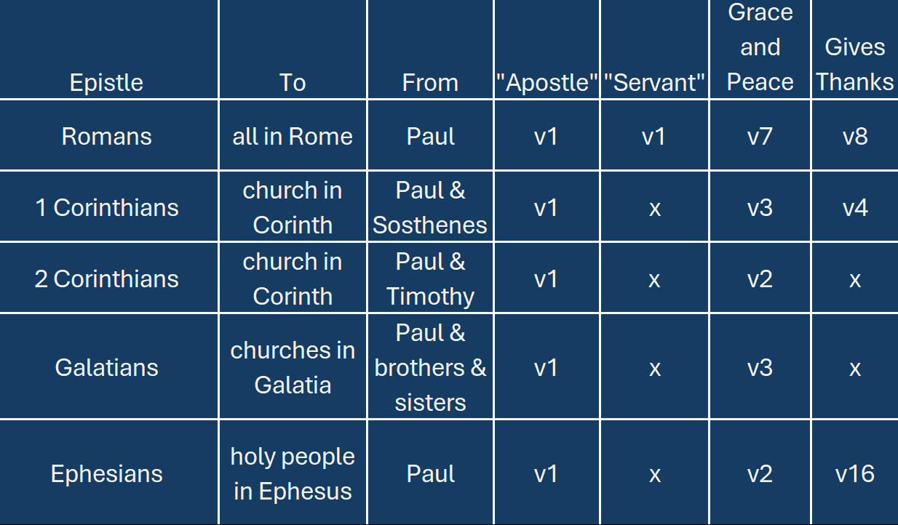
Paul’s Letter Openings
Notes:
Introduction to the Book of Ephesians, using the Western Heights Church of Christ logo. This presentation will delve into the key themes and messages of the Apostle Paul's letter to the Ephesians, exploring its relevance to modern Christian life.

Slide 49
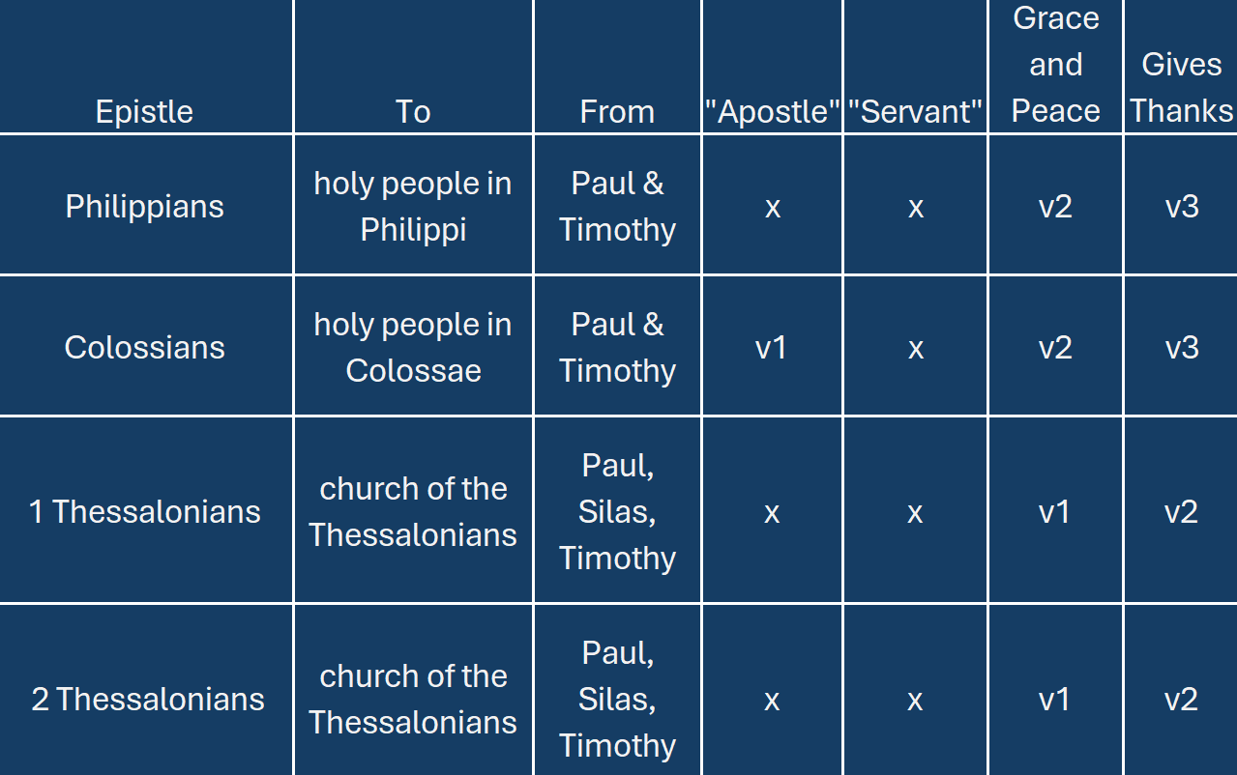
Paul’s Letter Openings
Notes:
.

Slide 50
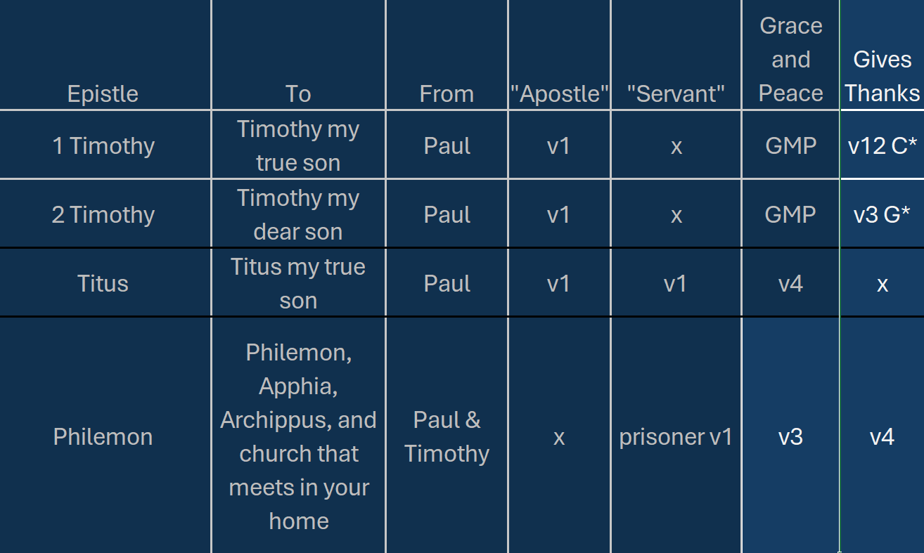
Paul’s Letter Openings

Slide 51


