Slide 1

We are eternal spiritual beings living in a temporary earthly realm.
Goal: Explore the heavenly realms described in Ephesians and review scriptures in light of what we learn.
Notes:
Introduction to the Book of Ephesians, using the Western Heights Church of Christ logo. This presentation will delve into the key themes and messages of the Apostle Paul's letter to the Ephesians, exploring its relevance to modern Christian life.

Slide 2

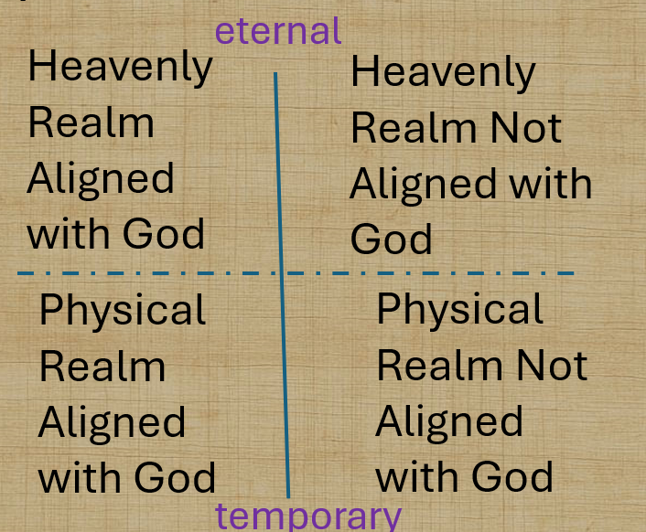
Heavenly Realms

Slide 3

The Armor of God (Panoply)
The Armor of God (Panoply)
belt of truth buckled around your waist
breastplate of righteousness in place
your feet fitted with the readiness that comes from the gospel of peace
shield of faith, with which you can extinguish all the flaming arrows of the evil one
helmet of salvation
and the sword of the Spirit, which is the word of God
Notes:
Introduction to the Book of Ephesians, using the Western Heights Church of Christ logo. This presentation will delve into the key themes and messages of the Apostle Paul's letter to the Ephesians, exploring its relevance to modern Christian life.

Slide 4
Heavenly Realms Ephesians 1:3, 1:20, 2:6, 3:10, 6:12
Heavenly Realm Aligned with God
Heavenly Realm Not Aligned with God
God’s Creation
Physical Realm Aligned with God
Physical Realm Not Aligned with God
Notes:
What is the key takeaway from this slide?​
Copilot said:
Copilot
Key Takeaway from Slide 11
The central message of slide 11 is a comparison of different realms as described in the Book of Ephesians. It highlights four distinct realms:
Heavenly Realm Aligned with God
Heavenly Realm Not Aligned with God
Physical Realm Aligned with God
Physical Realm Not Aligned with God
The slide also references Genesis 1:1 and Genesis 3:15, suggesting a contrast between God's creation and the spiritual realities discussed in Ephesians. The overall takeaway is that Ephesians explores the interaction and distinction between spiritual and physical realms, emphasizing the importance of alignment with God

Slide 5
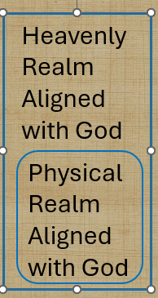
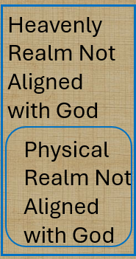
Heavenly Realms Notes
Upon more review it is clear that the model of realms may not show that the realm in which we live, the physical real (to us) , is merely a subset of the much more important spiritual / heavenly realm. We as Christians are citizens of the heavily realm aligned with God. Our sojourn on earth measured in years is absolutely nothing compared to the eternal life gifted to us as believing and accepting Jesus as savior.
Notes:
Introduction to the Book of Ephesians, using the Western Heights Church of Christ logo. This presentation will delve into the key themes and messages of the Apostle Paul's letter to the Ephesians, exploring its relevance to modern Christian life.

Slide 6
Physical Realms are subsets of Heavenly Realms
Heavenly Realm Aligned with God
Heavenly Realm Not Aligned with God
Physical Realm Aligned with God
Physical Realm Not Aligned with God
Notes:
Introduction to the Book of Ephesians, using the Western Heights Church of Christ logo. This presentation will delve into the key themes and messages of the Apostle Paul's letter to the Ephesians, exploring its relevance to modern Christian life.

Slide 7
Book of Ephesians
Review and Work Sheet
Heavenly Realms
The mystery
Spiritual Tools and Heavenly Armor
Spiritual Blessings in Christ
Made Alive in Christ
The New Spiritual Humanity
The Cornerstone and the New Building
Love that is wide, long, and high. The infinite God
Worthy calling - Unity and oneness _
Futile thinking contrasted with Wisdom and Discretion
Quirky things about Ephesians, The Colossian Heresy, Papyrus 46
Chistian Living Impacting Relationships.
Chapter 1
Notes:
Introduction to the Book of Ephesians, using the Western Heights Church of Christ logo. This presentation will delve into the key themes and messages of the Apostle Paul's letter to the Ephesians, exploring its relevance to modern Christian life.

Slide 8
Physical Realms are subsets of Heavenly Realms
Heavenly Realm Aligned with God
Heavenly Realm Not Aligned with God
Conceptual
Relational
Physical Realm Aligned with God
Physical Realm Not Aligned with God
Bound by time (also history and geography
Notes:
Introduction to the Book of Ephesians, using the Western Heights Church of Christ logo. This presentation will delve into the key themes and messages of the Apostle Paul's letter to the Ephesians, exploring its relevance to modern Christian life.

Slide 9

Physical Realms are subsets of Heavenly Realms
Forgiven Sinners
Sinners
Heavenly Realm Aligned with God
Heavenly Realm Not Aligned with God
Physical Realm Aligned with God
Physical Realm Not Aligned with God
Through grace and the gift of Jesus we are aligned with God.
Notes:
Introduction to the Book of Ephesians, using the Western Heights Church of Christ logo. This presentation will delve into the key themes and messages of the Apostle Paul's letter to the Ephesians, exploring its relevance to modern Christian life.

Slide 10
Physical Realms are subsets of Heavenly Realms
Forgiven Sinners
Sinners
^{ACT 13:38} “Therefore, my friends, I want you to know that through Jesus the forgiveness of sins is proclaimed to you. ³⁹ Through him everyone who believes is set free from every sin, a justification you were not able to obtain under the law of Moses.
Notes:
Introduction to the Book of Ephesians, using the Western Heights Church of Christ logo. This presentation will delve into the key themes and messages of the Apostle Paul's letter to the Ephesians, exploring its relevance to modern Christian life.

Slide 11
Physical Realms are subsets of Heavenly Realms
Heavenly Realm Aligned with God
Heavenly Realm Not Aligned with God
When time is no more the Physical Realms we know about disappear
Physical Realm Aligned with God
Physical Realm Not Aligned with God
Notes:
Introduction to the Book of Ephesians, using the Western Heights Church of Christ logo. This presentation will delve into the key themes and messages of the Apostle Paul's letter to the Ephesians, exploring its relevance to modern Christian life.

Slide 12
Heavenly Realms
Review and worksheet
https://www.weldonbeardain.website/ephesians/
Notes:
Introduction to the Book of Ephesians, using the Western Heights Church of Christ logo. This presentation will delve into the key themes and messages of the Apostle Paul's letter to the Ephesians, exploring its relevance to modern Christian life.

Slide 13
Review and worksheet
Ephesians
1:3 What is Coming from the Heavenly Realm?
1:20 What has happened in the Heavenly Realm?
2:6 What has happened to us in the Heavenly Realm?
Notes:
Introduction to the Book of Ephesians, using the Western Heights Church of Christ logo. This presentation will delve into the key themes and messages of the Apostle Paul's letter to the Ephesians, exploring its relevance to modern Christian life.

Slide 14
Review and worksheet
Ephesians
3:10 Who has been put on notice?
Notes:
Introduction to the Book of Ephesians, using the Western Heights Church of Christ logo. This presentation will delve into the key themes and messages of the Apostle Paul's letter to the Ephesians, exploring its relevance to modern Christian life.

Slide 15
3:10 Who has been put on notice?
⁹ and to make plain to everyone the administration of this mystery, which for ages past was kept hidden in God, who created all things. ¹⁰ His intent was that now, through the church, the manifold wisdom of God should be made known to the rulers and authorities in the heavenly realms,
Notes:
Introduction to the Book of Ephesians, using the Western Heights Church of Christ logo. This presentation will delve into the key themes and messages of the Apostle Paul's letter to the Ephesians, exploring its relevance to modern Christian life.

Slide 16
3:10 Who has been put on notice?
⁹ and to make plain to everyone the administration of this mystery, which for ages past was kept hidden in God, who created all things. ¹⁰ His intent was that now, through the church, the manifold wisdom of God should be made known to the rulers and authorities in the heavenly realms,
When was “made plain” happening?
Notes:
Introduction to the Book of Ephesians, using the Western Heights Church of Christ logo. This presentation will delve into the key themes and messages of the Apostle Paul's letter to the Ephesians, exploring its relevance to modern Christian life.

Slide 17
Heavenly Realms Ephesians 3:10 (conceptually / historically)
Heavenly Realm Aligned with God
Heavenly Realm Not Aligned with God
Plots to kill Jesus as a baby and eliminate him with crucifixion
Heavenly Good news
Physical Realm Aligned with God
Physical Realm Not Aligned with God
Notes:
Introduction to the Book of Ephesians, using the Western Heights Church of Christ logo. This presentation will delve into the key themes and messages of the Apostle Paul's letter to the Ephesians, exploring its relevance to modern Christian life.

Slide 18
Heavenly Realms Ephesians 3:10 (conceptually / historically)
Heavenly Realm Aligned with God
Heavenly Realm Not Aligned with God
Plots to kill Jesus as a baby and eliminate him with crucifixion
Heavenly Good news
Conceptual and relational change
Physical Realm Aligned with God
Physical Realm Not Aligned with God
Notes:
Introduction to the Book of Ephesians, using the Western Heights Church of Christ logo. This presentation will delve into the key themes and messages of the Apostle Paul's letter to the Ephesians, exploring its relevance to modern Christian life.

Slide 19
Review and worksheet
Ephesians
6:12 What is happening in the Heavenly Realm?
Notes:
Introduction to the Book of Ephesians, using the Western Heights Church of Christ logo. This presentation will delve into the key themes and messages of the Apostle Paul's letter to the Ephesians, exploring its relevance to modern Christian life.

Slide 20
Heavenly Realms
ALIVE
DEAD
Notes:
Introduction to the Book of Ephesians, using the Western Heights Church of Christ logo. This presentation will delve into the key themes and messages of the Apostle Paul's letter to the Ephesians, exploring its relevance to modern Christian life.

Slide 21
Heavenly Realms
^{Eph 2:4} But because of his great love for us, God, who is rich in mercy, ⁵ made us alive with Christ even when we were dead in transgressions—it is by grace you have been saved. ⁶ And God raised us up with Christ and seated us with him in the heavenly realms in Christ Jesus, ⁷ in order that in the coming ages he might show the incomparable riches of his grace, expressed in his kindness to us in Christ Jesus .
^{Eph 2:1} As for you, you were dead in your transgressions and sins, ² in which you used to live when you followed the ways of this world and of the ruler of the kingdom of the air, the spirit who is now at work in those who are disobedient. ³ All of us also lived among them at one time, gratifying the cravings of our flesh^{[a]} and following its desires and thoughts. Like the rest, we were by nature deserving of wrath
Notes:
Introduction to the Book of Ephesians, using the Western Heights Church of Christ logo. This presentation will delve into the key themes and messages of the Apostle Paul's letter to the Ephesians, exploring its relevance to modern Christian life.

Slide 22
Heavenly Realms
BLESSINGS
⁴ But because of his great love for us, God, who is rich in mercy, ⁵ made us alive with Christ even when we were dead in transgressions—it is by grace you have been saved. ⁶ And God raised us up with Christ and seated us with him in the heavenly realms in Christ Jesus, ⁷ in order that in the coming ages he might show the incomparable riches of his grace, expressed in his kindness to us in Christ Jesus .
2 As for you, you were dead in your transgressions and sins, ² in which you used to live when you followed the ways of this world and of the ruler of the kingdom of the air, the spirit who is now at work in those who are disobedient. ³ All of us also lived among them at one time, gratifying the cravings of our flesh^{[a]} and following its desires and thoughts. Like the rest, we were by nature deserving of wrath
CURSES
Notes:
Introduction to the Book of Ephesians, using the Western Heights Church of Christ logo. This presentation will delve into the key themes and messages of the Apostle Paul's letter to the Ephesians, exploring its relevance to modern Christian life.

Slide 23
Heavenly Realms
^{John 3 16} For God so loved the world that he gave his one and only Son, that whoever believes in him shall not perish but have eternal life. ¹⁷ For God did not send his Son into the world to condemn the world, but to save the world through him. ¹⁸ Whoever believes in him is not condemned,
^{John3: 18b} but whoever does not believe stands condemned already because they have not believed in the name of God’s one and only Son.
Notes:
Introduction to the Book of Ephesians, using the Western Heights Church of Christ logo. This presentation will delve into the key themes and messages of the Apostle Paul's letter to the Ephesians, exploring its relevance to modern Christian life.

Slide 24
Heavenly Realms
^{John 3 16}
loved
believes
shall not perish
eternal life
not condemned,
^{John3: 18b}
does not believe
condemned
Notes:
Introduction to the Book of Ephesians, using the Western Heights Church of Christ logo. This presentation will delve into the key themes and messages of the Apostle Paul's letter to the Ephesians, exploring its relevance to modern Christian life.

Slide 25
Heavenly Realms
^{Eph 2:4} But because of his great love for us, God, who is rich in mercy, ⁵ made us alive with Christ even when we were dead in transgressions—it is by grace you have been saved. ⁶ And God raised us up with Christ and seated us with him in the heavenly realms in Christ Jesus, ⁷ in order that in the coming ages he might show the incomparable riches of his grace, expressed in his kindness to us in Christ Jesus .
^{Eph 2:1} As for you, you were dead in your transgressions and sins, ² in which you used to live when you followed the ways of this world and of the ruler of the kingdom of the air, the spirit who is now at work in those who are disobedient. ³ All of us also lived among them at one time, gratifying the cravings of our flesh^{[a]} and following its desires and thoughts. Like the rest, we were by nature deserving of wrath
Notes:
Introduction to the Book of Ephesians, using the Western Heights Church of Christ logo. This presentation will delve into the key themes and messages of the Apostle Paul's letter to the Ephesians, exploring its relevance to modern Christian life.

Slide 26
Heavenly Realms
^{John 3 16}
loved
believes
shall not perish
eternal life
not condemned,
^{Eph 2:4}
love
Mercy
ALIVE
Grace
Raised
^{Eph 2:4}
Seated with Christ
Incomparable riches
kindness
^{John3: 18b}
does not believe
condemned
^{Eph 2:1}
DEAD transgressions
sin
worldly
disobedient
^{Eph 2:1}
^{Fleshly}
^{wrath}
Notes:
Introduction to the Book of Ephesians, using the Western Heights Church of Christ logo. This presentation will delve into the key themes and messages of the Apostle Paul's letter to the Ephesians, exploring its relevance to modern Christian life.

Slide 27
Heavenly Realms
BLESSINGS
^{John 3 16}
loved
believes
shall not perish
eternal life
not condemned,
^{Eph 2:4}
love
Mercy
ALIVE
Grace
Raised
^{Eph 2:4}
Seated with Christ
Incomparable riches
kindness
^{John3: 18b}
does not believe
condemned
CURSES
^{Eph 2:1}
DEAD transgressions
sin
worldly
disobedient
^{Eph 2:1}
^{Fleshly}
^{wrath}
Expand lists by inference
Notes:
Introduction to the Book of Ephesians, using the Western Heights Church of Christ logo. This presentation will delve into the key themes and messages of the Apostle Paul's letter to the Ephesians, exploring its relevance to modern Christian life.

Slide 28
Heavenly Realms Notes
non –believers remain with wrath.
Major Religions Rejecting Jesus' Divinity
Judaism:
Rejects Jesus as the Messiah and divine, viewing the worship of any person as idolatry, a core tenet of their faith.
Islam:
Considers Jesus (Isa) a revered prophet and the Messiah, born of the Virgin Mary, but not God or the Son of God, emphasizing strict monotheism (Tawhid).
Buddhism & Sikhism:
These traditions focus on different paths to enlightenment; Jesus is seen as a wise teacher or prophet but not central to their theology, with no specific views on his divinity.
Notes:
Introduction to the Book of Ephesians, using the Western Heights Church of Christ logo. This presentation will delve into the key themes and messages of the Apostle Paul's letter to the Ephesians, exploring its relevance to modern Christian life.

Slide 29
Heavenly Realms Notes
non –believers remain with wrath.
Major Religions Rejecting Jesus' Divinity
Hinduism:
Views vary, with some seeing Jesus as a manifestation of a god or a spiritual teacher, but not as the unique, divine Son of God.
Notes:
Introduction to the Book of Ephesians, using the Western Heights Church of Christ logo. This presentation will delve into the key themes and messages of the Apostle Paul's letter to the Ephesians, exploring its relevance to modern Christian life.

Slide 30
Heavenly Realms Notes
non –believers? remain with wrath?
Christian Denominations with Different Views
Jehovah's Witnesses:
Believe Jesus is God's Son, a created being (Archangel Michael), and the Messiah, but not equal to God the Father; worship is directed only to Jehovah.
Unitarianism (Unitarian Christians):
View Jesus as a great spiritual teacher and prophet, but not divine or part of the Trinity, emphasizing the oneness of God.
Mormonism (Latter-day Saints):
Believe Jesus is divine and the Son of God but separate from God the Father, not part of a Trinitarian Godhead.
Notes:
Introduction to the Book of Ephesians, using the Western Heights Church of Christ logo. This presentation will delve into the key themes and messages of the Apostle Paul's letter to the Ephesians, exploring its relevance to modern Christian life.

Slide 31
Songs about Blessings
Notes:
Introduction to the Book of Ephesians, using the Western Heights Church of Christ logo. This presentation will delve into the key themes and messages of the Apostle Paul's letter to the Ephesians, exploring its relevance to modern Christian life.

Slide 32
Songs About Blessings
Count your many Blessings
O Thou Fount of Every Blessing
Notes:
Introduction to the Book of Ephesians, using the Western Heights Church of Christ logo. This presentation will delve into the key themes and messages of the Apostle Paul's letter to the Ephesians, exploring its relevance to modern Christian life.

Slide 33
What is the source of our blessings?
Notes:
Introduction to the Book of Ephesians, using the Western Heights Church of Christ logo. This presentation will delve into the key themes and messages of the Apostle Paul's letter to the Ephesians, exploring its relevance to modern Christian life.

Slide 34
What are the blessings mentioned in Ephesians chapter 1.
³ Praise be to the God and Father of our Lord Jesus Christ, who has blessed us in the heavenly realms with every spiritual blessing in Christ
Notes:
Introduction to the Book of Ephesians, using the Western Heights Church of Christ logo. This presentation will delve into the key themes and messages of the Apostle Paul's letter to the Ephesians, exploring its relevance to modern Christian life.

Slide 35
What is the source of our material blessings?
Mitch’s Sermon 12/7/2025
Notes:
Introduction to the Book of Ephesians, using the Western Heights Church of Christ logo. This presentation will delve into the key themes and messages of the Apostle Paul's letter to the Ephesians, exploring its relevance to modern Christian life.

Slide 36
Heavenly Realms Ephesians 1:3
eternal
Heavenly Realm Aligned with God
Heavenly Realm Not Aligned with God
What is the flow of blessings?
Physical Realm Aligned with God
Physical Realm Not Aligned with God
temporary
Notes:
Introduction to the Book of Ephesians, using the Western Heights Church of Christ logo. This presentation will delve into the key themes and messages of the Apostle Paul's letter to the Ephesians, exploring its relevance to modern Christian life.

Slide 37
Heavenly Realms Ephesians 3:10
GOD
Heavenly Realm Aligned with God
Heavenly Realm Not Aligned with God
What is the flow of blessings?
Physical Realm Aligned with God
Physical Realm Not Aligned with God
Notes:
Introduction to the Book of Ephesians, using the Western Heights Church of Christ logo. This presentation will delve into the key themes and messages of the Apostle Paul's letter to the Ephesians, exploring its relevance to modern Christian life.

Slide 38
Class input:
What are the blessings mentioned in Ephesians chapter 1.
Notes:
Introduction to the Book of Ephesians, using the Western Heights Church of Christ logo. This presentation will delve into the key themes and messages of the Apostle Paul's letter to the Ephesians, exploring its relevance to modern Christian life.

Slide 39
What are the blessings mentioned in Ephesians chapter 1.
⁴ For he chose us in him before the creation of the world to be holy and blameless in his sight.
Notes:
Introduction to the Book of Ephesians, using the Western Heights Church of Christ logo. This presentation will delve into the key themes and messages of the Apostle Paul's letter to the Ephesians, exploring its relevance to modern Christian life.

Slide 40
What are the blessings mentioned in Ephesians chapter 1.
⁴ For he chose us in him before the creation of the world to be holy and blameless in his sight.
Notes:
Introduction to the Book of Ephesians, using the Western Heights Church of Christ logo. This presentation will delve into the key themes and messages of the Apostle Paul's letter to the Ephesians, exploring its relevance to modern Christian life.

Slide 41
What are the blessings mentioned in Ephesians chapter 1.
⁵ he predestined us for adoption to sonship through Jesus Christ, in accordance with his pleasure and will— ⁶ to the praise of his glorious grace, which he has freely given us in the One he loves.
Notes:
Introduction to the Book of Ephesians, using the Western Heights Church of Christ logo. This presentation will delve into the key themes and messages of the Apostle Paul's letter to the Ephesians, exploring its relevance to modern Christian life.

Slide 42
What are the blessings mentioned in Ephesians chapter 1.
⁷ In him we have redemption through his blood, the forgiveness of sins, in accordance with the riches of God’s grace ⁸ that he lavished on us. With all wisdom and understanding,
Notes:
Introduction to the Book of Ephesians, using the Western Heights Church of Christ logo. This presentation will delve into the key themes and messages of the Apostle Paul's letter to the Ephesians, exploring its relevance to modern Christian life.

Slide 43
What are the blessings mentioned in Ephesians chapter 1.
⁹ he made known to us the mystery of his will according to his good pleasure, which he purposed in Christ, ¹⁰ to be put into effect when the times reach their fulfillment—to bring unity to all things in heaven and on earth under Christ.
Notes:
Introduction to the Book of Ephesians, using the Western Heights Church of Christ logo. This presentation will delve into the key themes and messages of the Apostle Paul's letter to the Ephesians, exploring its relevance to modern Christian life.

Slide 44
What are the blessings mentioned in Ephesians chapter 1.
¹¹ In him we were also chosen,^{[e]} having been predestined according to the plan of him who works out everything in conformity with the purpose of his will, ¹² in order that we, who were the first to put our hope in Christ, might be for the praise of his glory.
Notes:
Introduction to the Book of Ephesians, using the Western Heights Church of Christ logo. This presentation will delve into the key themes and messages of the Apostle Paul's letter to the Ephesians, exploring its relevance to modern Christian life.

Slide 45
What are the blessings mentioned in Ephesians chapter 1.
¹³ And you also were included in Christ when you heard the message of truth, the gospel of your salvation. When you believed, you were marked in him with a seal, the promised Holy Spirit, ¹⁴ who is a deposit guaranteeing our inheritance until the redemption of those who are God’s possession—to the praise of his glory.
Notes:
Introduction to the Book of Ephesians, using the Western Heights Church of Christ logo. This presentation will delve into the key themes and messages of the Apostle Paul's letter to the Ephesians, exploring its relevance to modern Christian life.

Slide 46
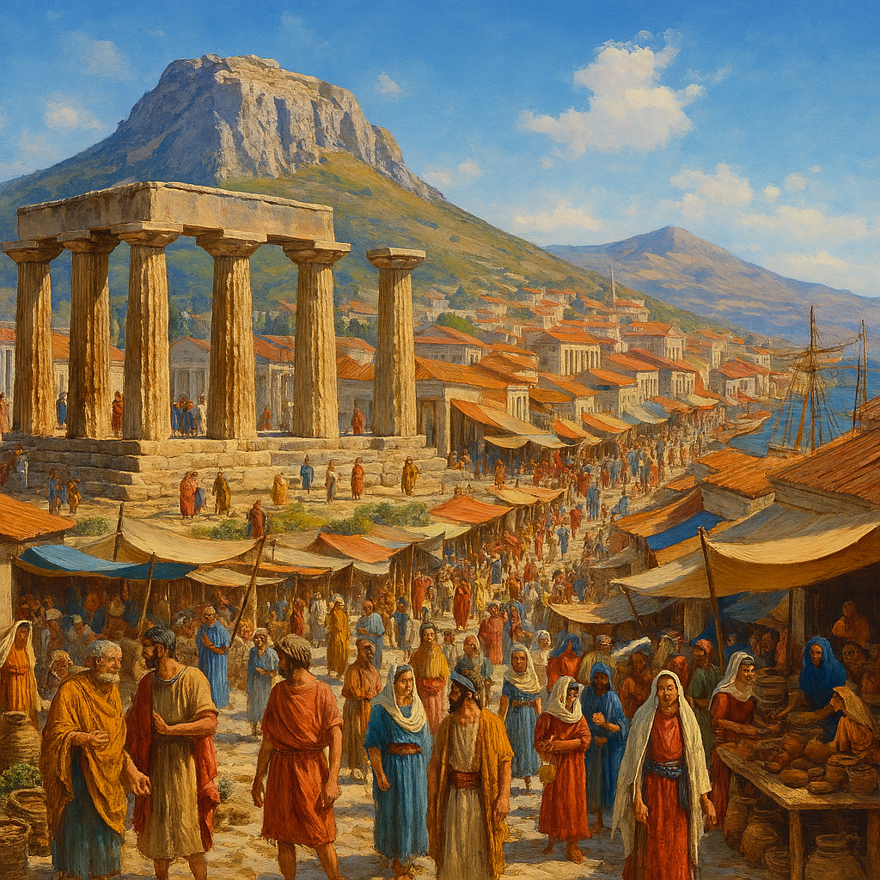
Heavenly Realms 2 Corinthians 5 Our temporal existence
5 For we know that if the earthly tent we live in is destroyed, we have a building from God, an eternal house in heaven, not built by human hands. ² Meanwhile we groan, longing to be clothed instead with our heavenly dwelling, ³ because when we are clothed, we will not be found naked. ⁴ For while we are in this tent, we groan and are burdened, because we do not wish to be unclothed but to be clothed instead with our heavenly dwelling, so that what is mortal may be swallowed up by life. ⁵ Now the one who has fashioned us for this very purpose is God, who has given us the Spirit as a deposit, guaranteeing what is to come..
Notes:
Introduction to the Book of Ephesians, using the Western Heights Church of Christ logo. This presentation will delve into the key themes and messages of the Apostle Paul's letter to the Ephesians, exploring its relevance to modern Christian life.

Slide 47
Heavenly Realms Summary A.I. Generated MUST CHECK
Spiritual and Physical Realms Throughout Ephesians
The presentation repeatedly explores the concept of “heavenly realms” and “spiritual realms,” especially in relation to passages from Ephesians (e.g., Ephesians 1:3, 1:20, 2:6, 3:10, 6:12). These slides discuss how spiritual realities interact with physical life, and how believers are called to align themselves with God in both realms.
Contrast and Interaction
Multiple slides illustrate the difference between realms aligned with God and those not aligned with God, both spiritually and physically. This contrast is used to highlight the ongoing spiritual struggle described by Paul, and the importance of spiritual awareness and readiness (such as putting on the “Armor of God”).

