Slide 1

We are eternal spiritual beings living in a temporary earthly realm.
Goal: Explore the heavenly realms described in Ephesians and review scriptures in light of what we learn.
Notes:
Introduction to the Book of Ephesians, using the Western Heights Church of Christ logo. This presentation will delve into the key themes and messages of the Apostle Paul's letter to the Ephesians, exploring its relevance to modern Christian life.

Slide 2

Heavenly Realms

Slide 3
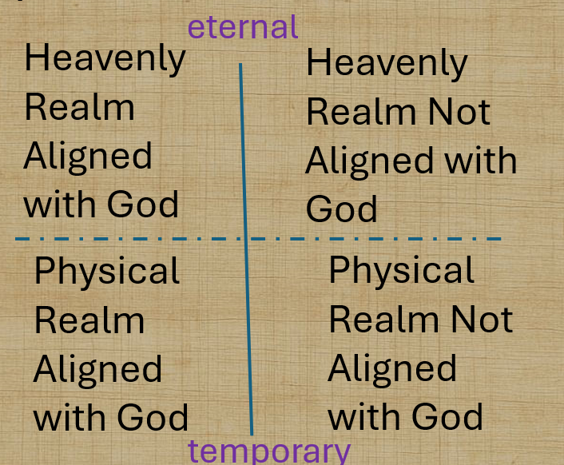
Heavenly Realms

Slide 4
Review and worksheet
Notes:
Introduction to the Book of Ephesians, using the Western Heights Church of Christ logo. This presentation will delve into the key themes and messages of the Apostle Paul's letter to the Ephesians, exploring its relevance to modern Christian life.

Slide 5
Review and worksheet
Ephesians
1:3 What is Coming from the Heavenly Realm?
1:20 What has happened in the Heavenly Realm?
2:6 What has happened to us in the Heavenly Realm?
Notes:
Introduction to the Book of Ephesians, using the Western Heights Church of Christ logo. This presentation will delve into the key themes and messages of the Apostle Paul's letter to the Ephesians, exploring its relevance to modern Christian life.

Slide 6
Review and worksheet
Ephesians
3:10 Who has been put on notice?
Notes:
Introduction to the Book of Ephesians, using the Western Heights Church of Christ logo. This presentation will delve into the key themes and messages of the Apostle Paul's letter to the Ephesians, exploring its relevance to modern Christian life.

Slide 7
3:10 Who has been put on notice?
⁹ and to make plain to everyone the administration of this mystery, which for ages past was kept hidden in God, who created all things. ¹⁰ His intent was that now, through the church, the manifold wisdom of God should be made known to the rulers and authorities in the heavenly realms,
Notes:
Introduction to the Book of Ephesians, using the Western Heights Church of Christ logo. This presentation will delve into the key themes and messages of the Apostle Paul's letter to the Ephesians, exploring its relevance to modern Christian life.

Slide 8

Heavenly Realms
Ephesians 3:10
Heavenly Realm Aligned with God
Heavenly Realm Not Aligned with God
Plots to kill Jesus as a baby and eliminate him with crucifixion
Heavenly Good news
Physical Realm Aligned with God
Physical Realm Not Aligned with God
Notes:
Introduction to the Book of Ephesians, using the Western Heights Church of Christ logo. This presentation will delve into the key themes and messages of the Apostle Paul's letter to the Ephesians, exploring its relevance to modern Christian life.

Slide 9
Review and worksheet
Ephesians
3:10 Who has been put on notice?
6:12 What is happening in the Heavenly Realm?
Notes:
Introduction to the Book of Ephesians, using the Western Heights Church of Christ logo. This presentation will delve into the key themes and messages of the Apostle Paul's letter to the Ephesians, exploring its relevance to modern Christian life.

Slide 10
Book of Ephesians
Heavenly Realms
The mystery
Spiritual Tools and Heavenly Armor
Spiritual Blessings in Christ
Made Alive in Christ
The New Spiritual Humanity
The Cornerstone and the New Building
Love that is wide, long, and high. The infinite God
Worthy calling - Unity and oneness _
Futile thinking contrasted with Wisdom and Discretion
Quirky things about Ephesians, The Colossian Heresy, Papyrus 46
Chistian Living Impacting Relationships.
Notes:
Introduction to the Book of Ephesians, using the Western Heights Church of Christ logo. This presentation will delve into the key themes and messages of the Apostle Paul's letter to the Ephesians, exploring its relevance to modern Christian life.

Slide 11
Songs about Blessings
Notes:
Introduction to the Book of Ephesians, using the Western Heights Church of Christ logo. This presentation will delve into the key themes and messages of the Apostle Paul's letter to the Ephesians, exploring its relevance to modern Christian life.

Slide 12
Songs About Blessings
Count your many Blessings
O Thou Fount of Every Blessing
Notes:
Introduction to the Book of Ephesians, using the Western Heights Church of Christ logo. This presentation will delve into the key themes and messages of the Apostle Paul's letter to the Ephesians, exploring its relevance to modern Christian life.

Slide 13
What is the source of our blessings?
Notes:
Introduction to the Book of Ephesians, using the Western Heights Church of Christ logo. This presentation will delve into the key themes and messages of the Apostle Paul's letter to the Ephesians, exploring its relevance to modern Christian life.

Slide 14
What is the source of our spiritual blessings?
What is the source of our material blessings?
Notes:
Introduction to the Book of Ephesians, using the Western Heights Church of Christ logo. This presentation will delve into the key themes and messages of the Apostle Paul's letter to the Ephesians, exploring its relevance to modern Christian life.

Slide 15
Heavenly Realms
Ephesians 1:3
eternal
Heavenly Realm Aligned with God
Heavenly Realm Not Aligned with God
What is the flow of blessings?
Physical Realm Aligned with God
Physical Realm Not Aligned with God
temporary
Notes:
Introduction to the Book of Ephesians, using the Western Heights Church of Christ logo. This presentation will delve into the key themes and messages of the Apostle Paul's letter to the Ephesians, exploring its relevance to modern Christian life.

Slide 16
Heavenly Realms
Ephesians 3:10
GOD
Heavenly Realm Aligned with God
Heavenly Realm Not Aligned with God
What is the flow of blessings?
Physical Realm Aligned with God
Physical Realm Not Aligned with God
Notes:
Introduction to the Book of Ephesians, using the Western Heights Church of Christ logo. This presentation will delve into the key themes and messages of the Apostle Paul's letter to the Ephesians, exploring its relevance to modern Christian life.

Slide 17
Class input:
What are the blessings mentioned in Ephesians chapter 1.
Notes:
Introduction to the Book of Ephesians, using the Western Heights Church of Christ logo. This presentation will delve into the key themes and messages of the Apostle Paul's letter to the Ephesians, exploring its relevance to modern Christian life.

Slide 18
What are the blessings mentioned in Ephesians chapter 1.
³ Praise be to the God and Father of our Lord Jesus Christ, who has blessed us in the heavenly realms with every spiritual blessing in Christ
Notes:
Introduction to the Book of Ephesians, using the Western Heights Church of Christ logo. This presentation will delve into the key themes and messages of the Apostle Paul's letter to the Ephesians, exploring its relevance to modern Christian life.

Slide 19
What are the blessings mentioned in Ephesians chapter 1.
³ Praise be to the God and Father of our Lord Jesus Christ, who has blessed us in the heavenly realms with every spiritual blessing in Christ
Notes:
Introduction to the Book of Ephesians, using the Western Heights Church of Christ logo. This presentation will delve into the key themes and messages of the Apostle Paul's letter to the Ephesians, exploring its relevance to modern Christian life.

Slide 20
What are the blessings mentioned in Ephesians chapter 1.
⁴ For he chose us in him before the creation of the world to be holy and blameless in his sight.
Notes:
Introduction to the Book of Ephesians, using the Western Heights Church of Christ logo. This presentation will delve into the key themes and messages of the Apostle Paul's letter to the Ephesians, exploring its relevance to modern Christian life.

Slide 21
What are the blessings mentioned in Ephesians chapter 1.
⁵ he predestined us for adoption to sonship through Jesus Christ, in accordance with his pleasure and will
Notes:
Introduction to the Book of Ephesians, using the Western Heights Church of Christ logo. This presentation will delve into the key themes and messages of the Apostle Paul's letter to the Ephesians, exploring its relevance to modern Christian life.

Slide 22
What are the blessings mentioned in Ephesians chapter 1.
⁵ he predestined us for adoption to sonship through Jesus Christ, in accordance with his pleasure and will
Notes:
Introduction to the Book of Ephesians, using the Western Heights Church of Christ logo. This presentation will delve into the key themes and messages of the Apostle Paul's letter to the Ephesians, exploring its relevance to modern Christian life.

Slide 23
Heavenly Realms
Ephesians 1:3, 1:20, 2:6, 3:10, 6:12
Normally Heaven is associated as the dwelling place of God and everything good and perfect.
The first four instances above could be confused with the Heaven we sing about.
Ephesians 6:12 clearly gives meaning to heavenly realms that Paul is writing about.
A.I. Generated Image based
on Input heavenly realms.
Notes:
Introduction to the Book of Ephesians, using the Western Heights Church of Christ logo. This presentation will delve into the key themes and messages of the Apostle Paul's letter to the Ephesians, exploring its relevance to modern Christian life.

Slide 24
Heavenly Realms
Ephesians 1:3, 1:20, 2:6, 3:10, 6:12
¹² For our struggle is not against flesh and blood, but against the rulers, against the authorities, against the powers of this dark world and against the spiritual forces of evil in the heavenly realms.
Where are the heavenly (spiritual) realms?
Notes:
Introduction to the Book of Ephesians, using the Western Heights Church of Christ logo. This presentation will delve into the key themes and messages of the Apostle Paul's letter to the Ephesians, exploring its relevance to modern Christian life.

Slide 25
Heavenly Realms
Ephesians 1:3, 1:20, 2:6, 3:10, 6:12
eternal
Heavenly Realm Aligned with God
Heavenly Realm Not Aligned with God
The dotted line is
Intentional.
As humans we reside in both the physical and
Spiritual realms.
Physical Realm Aligned with God
Physical Realm Not Aligned with God
temporary
Notes:
Introduction to the Book of Ephesians, using the Western Heights Church of Christ logo. This presentation will delve into the key themes and messages of the Apostle Paul's letter to the Ephesians, exploring its relevance to modern Christian life.

Slide 26
Heavenly Realms
Ephesians 1:3, 1:20, 2:6, 3:10, 6:12
Heavenly Realm Aligned with God
Heavenly Realm Not Aligned with God
God’s Creation
Contrast with
Gen 1:1
Gen 3:15
Physical Realm Aligned with God
Physical Realm Not Aligned with God
Notes:
What is the key takeaway from this slide?​
Copilot said:
Copilot
Key Takeaway from Slide 11
The central message of slide 11 is a comparison of different realms as described in the Book of Ephesians. It highlights four distinct realms:
Heavenly Realm Aligned with God
Heavenly Realm Not Aligned with God
Physical Realm Aligned with God
Physical Realm Not Aligned with God
The slide also references Genesis 1:1 and Genesis 3:15, suggesting a contrast between God's creation and the spiritual realities discussed in Ephesians. The overall takeaway is that Ephesians explores the interaction and distinction between spiritual and physical realms, emphasizing the importance of alignment with God

Slide 27
What is the key takeaway from this slide?​
Copilot said:
Key Takeaway from Slide 13
The central message of slide 13 is a comparison of different realms
as described in the Book of Ephesians. It highlights four distinct realms:
Heavenly Realm Aligned with God
Heavenly Realm Not Aligned with God
Physical Realm Aligned with God
Physical Realm Not Aligned with God
The slide also references Genesis 1:1 and Genesis 3:15, suggesting a contrast
between God's creation and the spiritual realities discussed in Ephesians.
The overall takeaway is that Ephesians explores the interaction and distinction
between spiritual and physical realms, emphasizing the importance
of alignment with God
Notes:
What is the key takeaway from this slide?​
Copilot said:
Copilot
Key Takeaway from Slide 11
The central message of slide 11 is a comparison of different realms as described in the Book of Ephesians. It highlights four distinct realms:
Heavenly Realm Aligned with God
Heavenly Realm Not Aligned with God
Physical Realm Aligned with God
Physical Realm Not Aligned with God
The slide also references Genesis 1:1 and Genesis 3:15, suggesting a contrast between God's creation and the spiritual realities discussed in Ephesians. The overall takeaway is that Ephesians explores the interaction and distinction between spiritual and physical realms, emphasizing the importance of alignment with God

Slide 28
Spiritual Realms O.T.
1 Samuel 16:14
¹⁴ Now the Spirit of the Lord had departed from Saul, and an evil spirit from the Lord tormented him.
Notes:
Introduction to the Book of Ephesians, using the Western Heights Church of Christ logo. This presentation will delve into the key themes and messages of the Apostle Paul's letter to the Ephesians, exploring its relevance to modern Christian life.

Slide 29
Spiritual Realms O.T.
1 Kings 11
⁴ As Solomon grew old, his wives turned his heart after other gods, and his heart was not fully devoted to the Lord his God, as the heart of David his father had been. ⁵ He followed Ashtoreth the goddess of the Sidonians, and Molek the detestable god of the Ammonites. ⁶ So Solomon did evil in the eyes of the Lord; he did not follow the Lord completely, as David his father had done.
Notes:
Introduction to the Book of Ephesians, using the Western Heights Church of Christ logo. This presentation will delve into the key themes and messages of the Apostle Paul's letter to the Ephesians, exploring its relevance to modern Christian life.

Slide 30
Heavenly Realms
Ephesians 1:3, 2:6, 3:10, 6:12
Heavenly Realm Aligned with God
Heavenly Realm Not Aligned with God
Realm
Interactions
For Saul
And
Solomon
Physical Realm Aligned with God
Physical Realm Not Aligned with God
Notes:
Introduction to the Book of Ephesians, using the Western Heights Church of Christ logo. This presentation will delve into the key themes and messages of the Apostle Paul's letter to the Ephesians, exploring its relevance to modern Christian life.

Slide 31
Heavenly Realms
Ephesians 1:3, 2:6, 3:10, 6:12
Heavenly Realm Aligned with God
Heavenly Realm Not Aligned with God
New Testament
Is thematic in
contrasting
Between the realms
Physical Realm Aligned with God
Physical Realm Not Aligned with God
Notes:
Introduction to the Book of Ephesians, using the Western Heights Church of Christ logo. This presentation will delve into the key themes and messages of the Apostle Paul's letter to the Ephesians, exploring its relevance to modern Christian life.

Slide 32
Where is Christ Seated?
Notes:
Introduction to the Book of Ephesians, using the Western Heights Church of Christ logo. This presentation will delve into the key themes and messages of the Apostle Paul's letter to the Ephesians, exploring its relevance to modern Christian life.

Slide 33
Where is Christ Seated? Eph 1
^{19b} That power is the same as the mighty strength ²⁰ he exerted when he raised Christ from the dead and seated him at his right hand in the heavenly realms, ²¹ far above all rule and authority, power and dominion, and every name that is invoked, not only in the present age but also in the one to come. ²² And God placed all things under his feet and appointed him to be head over everything for the church, ²³ which is his body, the fullness of him who fills everything in every way.
Notes:
Introduction to the Book of Ephesians, using the Western Heights Church of Christ logo. This presentation will delve into the key themes and messages of the Apostle Paul's letter to the Ephesians, exploring its relevance to modern Christian life.

Slide 34
Where are we?
Notes:
Introduction to the Book of Ephesians, using the Western Heights Church of Christ logo. This presentation will delve into the key themes and messages of the Apostle Paul's letter to the Ephesians, exploring its relevance to modern Christian life.

Slide 35
Where are we? Ephesians 2
⁴ But because of his great love for us, God, who is rich in mercy, ⁵ made us alive with Christ even when we were dead in transgressions—it is by grace you have been saved. ⁶ And God raised us up with Christ and seated us with him in the heavenly realms in Christ Jesus, ⁷ in order that in the coming ages he might show the incomparable riches of his grace, expressed in his kindness to us in Christ Jesus
Notes:
Introduction to the Book of Ephesians, using the Western Heights Church of Christ logo. This presentation will delve into the key themes and messages of the Apostle Paul's letter to the Ephesians, exploring its relevance to modern Christian life.

Slide 36
Spiritual Blessings and tools
Notes:
Introduction to the Book of Ephesians, using the Western Heights Church of Christ logo. This presentation will delve into the key themes and messages of the Apostle Paul's letter to the Ephesians, exploring its relevance to modern Christian life.

Slide 37
The Armor of God (Panoply) Eph 6
¹⁰ Finally, be strong in the Lord and in his mighty power. ¹¹ Put on the full armor of God, so that you can take your stand against the devil’s schemes. ¹² For our struggle is not against flesh and blood, but against the rulers, against the authorities, against the powers of this dark world and against the spiritual forces of evil in the heavenly realms. ¹³ Therefore put on the full armor of God, so that when the day of evil comes, you may be able to stand your ground, and after you have done everything, to stand.
Notes:
Introduction to the Book of Ephesians, using the Western Heights Church of Christ logo. This presentation will delve into the key themes and messages of the Apostle Paul's letter to the Ephesians, exploring its relevance to modern Christian life.

Slide 38
The Armor of God (Panoply) Eph 6
¹⁰ Finally, be strong in the Lord and in his mighty power. ¹¹ Put on the full armor of God, so that you can take your stand against the devil’s schemes. ¹² For our struggle is not against flesh and blood, but against the rulers, against the authorities, against the powers of this dark world and against the spiritual forces of evil in the heavenly realms. ¹³ Therefore put on the full armor of God, so that when the day of evil comes, you may be able to stand your ground, and after you have done everything, to stand.
Notes:
Introduction to the Book of Ephesians, using the Western Heights Church of Christ logo. This presentation will delve into the key themes and messages of the Apostle Paul's letter to the Ephesians, exploring its relevance to modern Christian life.

Slide 39
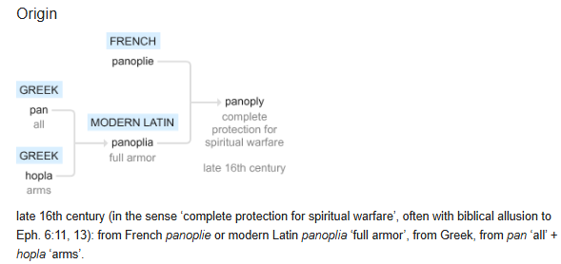
Panoply

Slide 40
The Armor of God (Panoply)
The Armor of God (Panoply)
¹⁴ Stand firm then, with the belt of truth buckled around your waist, with the breastplate of righteousness in place, ¹⁵ and with your feet fitted with the readiness that comes from the gospel of peace. ¹⁶ In addition to all this, take up the shield of faith, with which you can extinguish all the flaming arrows of the evil one. ¹⁷ Take the helmet of salvation and the sword of the Spirit, which is the word of God.
Notes:
Introduction to the Book of Ephesians, using the Western Heights Church of Christ logo. This presentation will delve into the key themes and messages of the Apostle Paul's letter to the Ephesians, exploring its relevance to modern Christian life.

Slide 41
The Armor of God (Panoply)
The Armor of God (Panoply)
belt of truth buckled around your waist
breastplate of righteousness in place
your feet fitted with the readiness that comes from the gospel of peace
shield of faith, with which you can extinguish all the flaming arrows of the evil one
helmet of salvation and the sword of the Spirit, which is the word of God of God.
Why armor?
Offence or Defense?
Notes:
Introduction to the Book of Ephesians, using the Western Heights Church of Christ logo. This presentation will delve into the key themes and messages of the Apostle Paul's letter to the Ephesians, exploring its relevance to modern Christian life.

Slide 42
Posture for battle.
¹⁸ And pray in the Spirit on all occasions with all kinds of prayers and requests. With this in mind, be alert and always keep on praying for all the Lord’s people. ¹⁹ Pray also for me, that whenever I speak, words may be given me so that I will fearlessly make known the mystery of the gospel, ²⁰ for which I am an ambassador in chains. Pray that I may declare it fearlessly, as I should.
Notes:
Introduction to the Book of Ephesians, using the Western Heights Church of Christ logo. This presentation will delve into the key themes and messages of the Apostle Paul's letter to the Ephesians, exploring its relevance to modern Christian life.

Slide 43
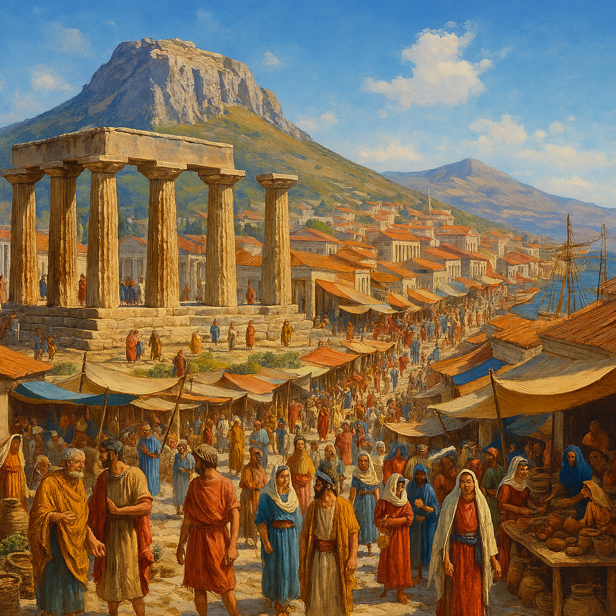
Heavenly Realms
2 Corinthians 5
Our temporal existence
5 For we know that if the earthly tent we live in is destroyed, we have a building from God, an eternal house in heaven, not built by human hands. ² Meanwhile we groan, longing to be clothed instead with our heavenly dwelling, ³ because when we are clothed, we will not be found naked. ⁴ For while we are in this tent, we groan and are burdened, because we do not wish to be unclothed but to be clothed instead with our heavenly dwelling, so that what is mortal may be swallowed up by life. ⁵ Now the one who has fashioned us for this very purpose is God, who has given us the Spirit as a deposit, guaranteeing what is to come..
Notes:
Introduction to the Book of Ephesians, using the Western Heights Church of Christ logo. This presentation will delve into the key themes and messages of the Apostle Paul's letter to the Ephesians, exploring its relevance to modern Christian life.

Slide 44
Heavenly Realms
2 Corinthians 5
Our temporal existence
5 For we know that if the earthly tent we live in is destroyed, we have a building from God, an eternal house in heaven, not built by human hands. ² Meanwhile we groan, longing to be clothed instead with our heavenly dwelling, ³ because when we are clothed, we will not be found naked. ⁴ For while we are in this tent, we groan and are burdened, because we do not wish to be unclothed but to be clothed instead with our heavenly dwelling, so that what is mortal may be swallowed up by life. ⁵ Now the one who has fashioned us for this very purpose is God, who has given us the Spirit as a deposit, guaranteeing what is to come..
Notes:
Introduction to the Book of Ephesians, using the Western Heights Church of Christ logo. This presentation will delve into the key themes and messages of the Apostle Paul's letter to the Ephesians, exploring its relevance to modern Christian life.

Slide 45
Heavenly Realms
Evil Spirts result in Evil Acts
John 3:20 Everyone who does evil hates the light and will not come into the light for fear that their deeds will be exposed.
John 17:15 My prayer is not that you take them out of the world but that you protect them from the evil one.
Romans 2:8 But for those who are self-seeking and who reject the truth and follow evil, there will be wrath and anger.
Romans 1:29-Romans 1:29
They have become filled with every kind of wickedness, evil, greed and depravity. They are full of envy, murder, strife, deceit and malice. They are gossips, slanderers, God-haters, insolent, arrogant and boastful; they invent ways of doing evil; they disobey their parents;
Notes:
Introduction to the Book of Ephesians, using the Western Heights Church of Christ logo. This presentation will delve into the key themes and messages of the Apostle Paul's letter to the Ephesians, exploring its relevance to modern Christian life.

Slide 46
Heavenly Realms
Summary A.I. Generated MUST CHECK
Spiritual and Physical Realms Throughout Ephesians
  The presentation repeatedly explores the concept of “heavenly realms” and “spiritual realms,” especially in relation to passages from Ephesians (e.g., Ephesians 1:3, 1:20, 2:6, 3:10, 6:12). These slides discuss how spiritual realities interact with physical life, and how believers are called to align themselves with God in both realms.
Contrast and Interaction
  Multiple slides illustrate the difference between realms aligned with God and those not aligned with God, both spiritually and physically. This contrast is used to highlight the ongoing spiritual struggle described by Paul, and the importance of spiritual awareness and readiness (such as putting on the “Armor of God”).

Slide 47
Heavenly Realms
Summary A.I. Generated MUST CHECK
Biblical References and Examples
  The presentation draws on Old Testament examples (e.g., Saul, Solomon) and New Testament teachings to show how spiritual forces and choices impact both heavenly and earthly experiences.
Practical Application for Christian Living
  The latter slides connect these spiritual concepts to practical Christian living, emphasizing unity, love, grace, and the transformative power of God’s presence. The distinction between realms serves as a foundation for understanding how Christians are to live out their faith in the world.

Slide 48
Heavenly Realms
Summary A.I. Generated MUST CHECK
Summary:
The theme of contrasting spiritual and physical realms is woven throughout the presentation. It serves as a lens for interpreting Paul’s message in Ephesians, illustrating the believer’s call to live in alignment with God, equipped for spiritual challenges, and grounded in practical faith.

Slide 49
Heavenly Realms
Summary By weldon
Summary:
I had though about making a slide with a lens BEFORE I let Copilot do a summary. It was spooky that my intent of creating a lens of the heavenly realms as a viewpoint for our reexamination of several scriptures. Paul has developed a concept viewpoint that merits our attention. The lens of heavenly realms is important but is not as important of other lens such as the cross, attributes of God and many others. Paul is changing us to keep heaven on our hearts reminding us to focus on alignment with God and aur eternal destiny while identifying the spiritual battle that we face. We are not alone but have blessings and provisions to win the battle of all battles. God be praised for his Gift of Jesus and provision of his Holy Spirit.

Slide 50
Heavenly Realms
Summary A.I. Generated MUST CHECK
I'll try to create that. (note from copilot)
Here’s the concept for your slide image:
Theme: Contrasting spiritual and physical realms, as described in the Book of Ephesians.
Visual Elements:
  A radiant, heavenly realm above, filled with light, clouds, and a sense of divine presence.
  A grounded, earthly realm below, with people living out their faith.
  A subtle dividing line or gradient separating the two realms.
  Rays of light connecting the realms, with figures in the earthly realm looking upward, symbolizing alignment with God.
Tone: Uplifting, spiritual, and suitable for a Christian educational context.
The image will appear below once it’s ready. If you’d like any adjustments or a different style, let me know!
spiritual challenges, and grounded in practical faith.

Slide 51
weldonbeardain.website

