Slide 1

Where is Heaven?
Notes:
Introduction to the Book of Ephesians, using the Western Heights Church of Christ logo. This presentation will delve into the key themes and messages of the Apostle Paul's letter to the Ephesians, exploring its relevance to modern Christian life.

Slide 2
Songs about Heaven
Notes:
Introduction to the Book of Ephesians, using the Western Heights Church of Christ logo. This presentation will delve into the key themes and messages of the Apostle Paul's letter to the Ephesians, exploring its relevance to modern Christian life.

Slide 3
Songs About Heaven
Sing to me of Heaven
When We all get to Heaven
Earth Hold no Treasures
How Beautiful Heaven Must Be
Just over in the Glory Land
There’s a Land Beyond the River
Beulah Land
Beyond the Sunset
Beyond this land of Parting
In the Land of Fadeless Day
Heaven Holds All to Me
Mansions over the Hilltop
I’ll Flay Away
Notes:
Introduction to the Book of Ephesians, using the Western Heights Church of Christ logo. This presentation will delve into the key themes and messages of the Apostle Paul's letter to the Ephesians, exploring its relevance to modern Christian life.

Slide 4
Book of Ephesians
Heavenly Realms
The mystery
Spiritual Tools and Heavenly Armor
Spiritual Blessings in Christ
Made Alive in Christ
The New Spiritual Humanity
The Cornerstone and the New Building
Love that is wide, long, and high. The infinite God
Worthy calling - Unity and oneness _
Futile thinking contrasted with Wisdom and Discretion
Quirky things about Ephesians, The Colossian Heresy, Papyrus 46
Chistian Living Impacting Relationships.
Notes:
Introduction to the Book of Ephesians, using the Western Heights Church of Christ logo. This presentation will delve into the key themes and messages of the Apostle Paul's letter to the Ephesians, exploring its relevance to modern Christian life.

Slide 5

Heavenly Realms Ephesians 1:3, 1:20, 2:6, 3:10, 6:12
Normally Heaven is associated as the dwelling place of God and everything good and perfect.
The first three instances above could be confused with Heaven.
Ephesians 6:12 clearly gives meaning to heavenly realms that Paul is writing about.
Notes:
Introduction to the Book of Ephesians, using the Western Heights Church of Christ logo. This presentation will delve into the key themes and messages of the Apostle Paul's letter to the Ephesians, exploring its relevance to modern Christian life.

Slide 6
Heavenly Realms Ephesians 1:3, 1:20, 2:6, 3:10, 6:12
¹² For our struggle is not against flesh and blood, but against the rulers, against the authorities, against the powers of this dark world and against the spiritual forces of evil in the heavenly realms.
Where are the heavenly (spiritual) realms?
Notes:
Introduction to the Book of Ephesians, using the Western Heights Church of Christ logo. This presentation will delve into the key themes and messages of the Apostle Paul's letter to the Ephesians, exploring its relevance to modern Christian life.

Slide 7
Heavenly Realms Ephesians 1:3, 1:20, 2:6, 3:10, 6:12
Heavenly Realm Aligned with God
Heavenly Realm Not Aligned with God
Physical Realm Aligned with God
Physical Realm Not Aligned with God
Notes:
Introduction to the Book of Ephesians, using the Western Heights Church of Christ logo. This presentation will delve into the key themes and messages of the Apostle Paul's letter to the Ephesians, exploring its relevance to modern Christian life.

Slide 8
Heavenly Realms Ephesians 1:3, 1:20, 2:6, 3:10, 6:12
eternal
Heavenly Realm Aligned with God
Heavenly Realm Not Aligned with God
Physical Realm Aligned with God
Physical Realm Not Aligned with God
temporary
Notes:
Introduction to the Book of Ephesians, using the Western Heights Church of Christ logo. This presentation will delve into the key themes and messages of the Apostle Paul's letter to the Ephesians, exploring its relevance to modern Christian life.

Slide 9
Heavenly Realms Ephesians 1:3, 1:20, 2:6, 3:10, 6:12
eternal
Heavenly Realm Aligned with God
Heavenly Realm Not Aligned with God
Interaction Between Realms
Physical Realm Aligned with God
Physical Realm Not Aligned with God
temporary
Notes:
Introduction to the Book of Ephesians, using the Western Heights Church of Christ logo. This presentation will delve into the key themes and messages of the Apostle Paul's letter to the Ephesians, exploring its relevance to modern Christian life.

Slide 10
Heavenly Realms Ephesians 1:3, 1:20, 2:6, 3:10, 6:12
Heavenly Realm Aligned with God
Heavenly Realm Not Aligned with God
God’s Creation
Contrast with
Gen 1:1
Gen 3:15
Physical Realm Aligned with God
Physical Realm Not Aligned with God
Notes:
What is the key takeaway from this slide?​
Copilot said:
Copilot
Key Takeaway from Slide 11
The central message of slide 11 is a comparison of different realms as described in the Book of Ephesians. It highlights four distinct realms:
Heavenly Realm Aligned with God
Heavenly Realm Not Aligned with God
Physical Realm Aligned with God
Physical Realm Not Aligned with God
The slide also references Genesis 1:1 and Genesis 3:15, suggesting a contrast between God's creation and the spiritual realities discussed in Ephesians. The overall takeaway is that Ephesians explores the interaction and distinction between spiritual and physical realms, emphasizing the importance of alignment with God

Slide 11
What is the key takeaway from this slide?​
Copilot said:
Key Takeaway from Slide 10
The central message of slide 10 is a comparison of different realms
as described in the Book of Ephesians. It highlights four distinct realms:
Heavenly Realm Aligned with God
Heavenly Realm Not Aligned with God
Physical Realm Aligned with God
Physical Realm Not Aligned with God
The slide also references Genesis 1:1 and Genesis 3:15, suggesting a contrast
between God's creation and the spiritual realities discussed in Ephesians.
The overall takeaway is that Ephesians explores the interaction and distinction
between spiritual and physical realms, emphasizing the importance
of alignment with God
Notes:
What is the key takeaway from this slide?​
Copilot said:
Copilot
Key Takeaway from Slide 11
The central message of slide 11 is a comparison of different realms as described in the Book of Ephesians. It highlights four distinct realms:
Heavenly Realm Aligned with God
Heavenly Realm Not Aligned with God
Physical Realm Aligned with God
Physical Realm Not Aligned with God
The slide also references Genesis 1:1 and Genesis 3:15, suggesting a contrast between God's creation and the spiritual realities discussed in Ephesians. The overall takeaway is that Ephesians explores the interaction and distinction between spiritual and physical realms, emphasizing the importance of alignment with God

Slide 12
Spiritual Realms O.T. 1 Samuel 16:14
¹⁴ Now the Spirit of the Lord had departed from Saul, and an evil spirit from the Lord tormented him.
Notes:
Introduction to the Book of Ephesians, using the Western Heights Church of Christ logo. This presentation will delve into the key themes and messages of the Apostle Paul's letter to the Ephesians, exploring its relevance to modern Christian life.

Slide 13
Spiritual Realms O.T. 1 Kings 11
⁴ As Solomon grew old, his wives turned his heart after other gods, and his heart was not fully devoted to the Lord his God, as the heart of David his father had been. ⁵ He followed Ashtoreth the goddess of the Sidonians, and Molek the detestable god of the Ammonites. ⁶ So Solomon did evil in the eyes of the Lord; he did not follow the Lord completely, as David his father had done.
Notes:
Introduction to the Book of Ephesians, using the Western Heights Church of Christ logo. This presentation will delve into the key themes and messages of the Apostle Paul's letter to the Ephesians, exploring its relevance to modern Christian life.

Slide 14
Heavenly Realms Ephesians 1:3, 2:6, 3:10, 6:12
Heavenly Realm Aligned with God
Heavenly Realm Not Aligned with God
Realm
Interactions
For Saul
And
Solomon
Physical Realm Aligned with God
Physical Realm Not Aligned with God
Notes:
Introduction to the Book of Ephesians, using the Western Heights Church of Christ logo. This presentation will delve into the key themes and messages of the Apostle Paul's letter to the Ephesians, exploring its relevance to modern Christian life.

Slide 15
Where is Christ Seated?
Notes:
Introduction to the Book of Ephesians, using the Western Heights Church of Christ logo. This presentation will delve into the key themes and messages of the Apostle Paul's letter to the Ephesians, exploring its relevance to modern Christian life.

Slide 16
Where is Christ Seated?
^{19b} That power is the same as the mighty strength ²⁰ he exerted when he raised Christ from the dead and seated him at his right hand in the heavenly realms, ²¹ far above all rule and authority, power and dominion, and every name that is invoked, not only in the present age but also in the one to come. ²² And God placed all things under his feet and appointed him to be head over everything for the church, ²³ which is his body, the fullness of him who fills everything in every way.
Notes:
Introduction to the Book of Ephesians, using the Western Heights Church of Christ logo. This presentation will delve into the key themes and messages of the Apostle Paul's letter to the Ephesians, exploring its relevance to modern Christian life.

Slide 17
Where are we?
Notes:
Introduction to the Book of Ephesians, using the Western Heights Church of Christ logo. This presentation will delve into the key themes and messages of the Apostle Paul's letter to the Ephesians, exploring its relevance to modern Christian life.

Slide 18
Where are we? Ephesians 2
⁴ But because of his great love for us, God, who is rich in mercy, ⁵ made us alive with Christ even when we were dead in transgressions—it is by grace you have been saved. ⁶ And God raised us up with Christ and seated us with him in the heavenly realms in Christ Jesus, ⁷ in order that in the coming ages he might show the incomparable riches of his grace, expressed in his kindness to us in Christ Jesus
Notes:
Introduction to the Book of Ephesians, using the Western Heights Church of Christ logo. This presentation will delve into the key themes and messages of the Apostle Paul's letter to the Ephesians, exploring its relevance to modern Christian life.

Slide 19
Where are we? Ephesians 2
⁴ But because of his great love for us, God, who is rich in mercy, ⁵ made us alive with Christ even when we were dead in transgressions—it is by grace you have been saved. ⁶ And God raised us up with Christ and seated us with him in the heavenly realms in Christ Jesus, ⁷ in order that in the coming ages he might show the incomparable riches of his grace, expressed in his kindness to us in Christ Jesus
Notes:
Introduction to the Book of Ephesians, using the Western Heights Church of Christ logo. This presentation will delve into the key themes and messages of the Apostle Paul's letter to the Ephesians, exploring its relevance to modern Christian life.

Slide 20
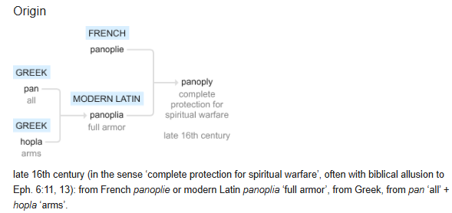
Panoply

Slide 21
The Armor of God (Panoply)
¹⁰ Finally, be strong in the Lord and in his mighty power. ¹¹ Put on the full armor of God, so that you can take your stand against the devil’s schemes. ¹² For our struggle is not against flesh and blood, but against the rulers, against the authorities, against the powers of this dark world and against the spiritual forces of evil in the heavenly realms. ¹³ Therefore put on the full armor of God, so that when the day of evil comes, you may be able to stand your ground, and after you have done everything, to stand.
Notes:
Introduction to the Book of Ephesians, using the Western Heights Church of Christ logo. This presentation will delve into the key themes and messages of the Apostle Paul's letter to the Ephesians, exploring its relevance to modern Christian life.

Slide 22
The Armor of God (Panoply)
The Armor of God (Panoply)
¹⁴ Stand firm then, with the belt of truth buckled around your waist, with the breastplate of righteousness in place, ¹⁵ and with your feet fitted with the readiness that comes from the gospel of peace. ¹⁶ In addition to all this, take up the shield of faith, with which you can extinguish all the flaming arrows of the evil one. ¹⁷ Take the helmet of salvation and the sword of the Spirit, which is the word of God.
Notes:
Introduction to the Book of Ephesians, using the Western Heights Church of Christ logo. This presentation will delve into the key themes and messages of the Apostle Paul's letter to the Ephesians, exploring its relevance to modern Christian life.

Slide 23
The Armor of God (Panoply)
The Armor of God (Panoply)
belt of truth buckled around your waist
breastplate of righteousness in place
your feet fitted with the readiness that comes from the gospel of peace
shield of faith, with which you can extinguish all the flaming arrows of the evil one
helmet of salvation and the sword of the Spirit, which is the word of God of God.
Notes:
Introduction to the Book of Ephesians, using the Western Heights Church of Christ logo. This presentation will delve into the key themes and messages of the Apostle Paul's letter to the Ephesians, exploring its relevance to modern Christian life.

Slide 24
Posture for battle.
¹⁸ And pray in the Spirit on all occasions with all kinds of prayers and requests. With this in mind, be alert and always keep on praying for all the Lord’s people. ¹⁹ Pray also for me, that whenever I speak, words may be given me so that I will fearlessly make known the mystery of the gospel, ²⁰ for which I am an ambassador in chains. Pray that I may declare it fearlessly, as I should.
Notes:
Introduction to the Book of Ephesians, using the Western Heights Church of Christ logo. This presentation will delve into the key themes and messages of the Apostle Paul's letter to the Ephesians, exploring its relevance to modern Christian life.

Slide 25
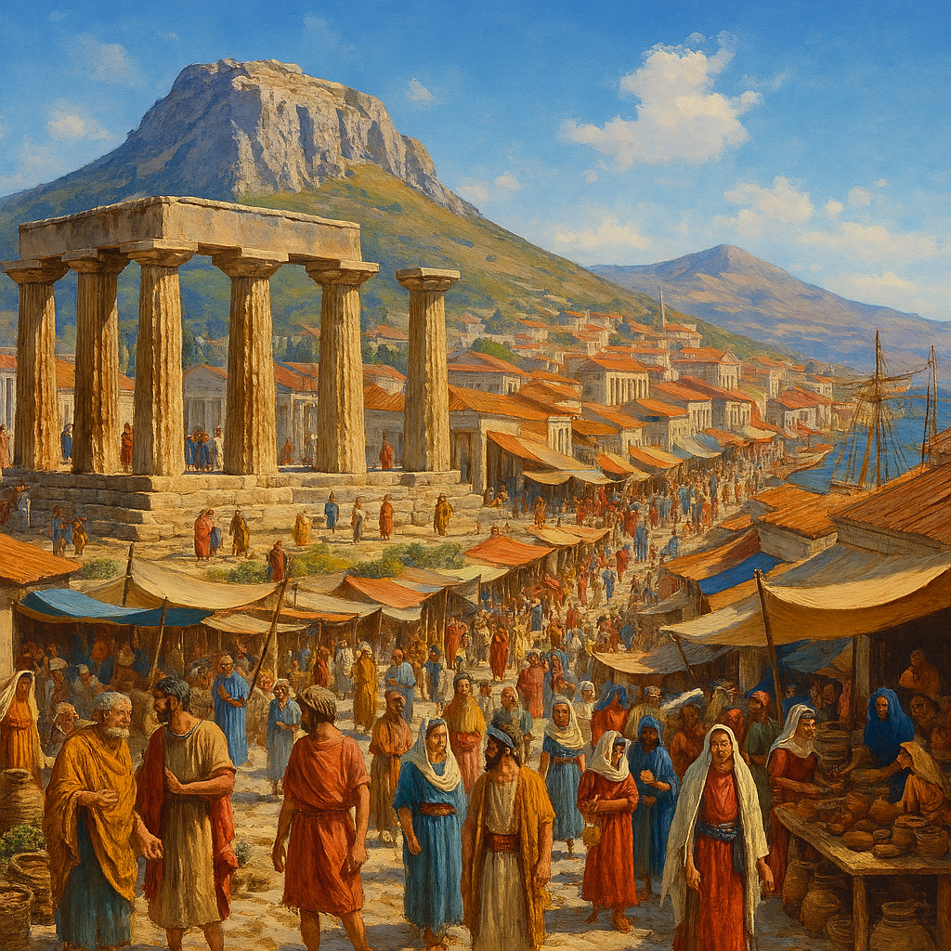
Heavenly Realms 2 Corinthians 5 Our temporal existence
5 For we know that if the earthly tent we live in is destroyed, we have a building from God, an eternal house in heaven, not built by human hands. ² Meanwhile we groan, longing to be clothed instead with our heavenly dwelling, ³ because when we are clothed, we will not be found naked. ⁴ For while we are in this tent, we groan and are burdened, because we do not wish to be unclothed but to be clothed instead with our heavenly dwelling, so that what is mortal may be swallowed up by life. ⁵ Now the one who has fashioned us for this very purpose is God, who has given us the Spirit as a deposit, guaranteeing what is to come..
Notes:
Introduction to the Book of Ephesians, using the Western Heights Church of Christ logo. This presentation will delve into the key themes and messages of the Apostle Paul's letter to the Ephesians, exploring its relevance to modern Christian life.

Slide 26
Heavenly Realms Evil Spirts result in Evil Acts
John 3:20 Everyone who does evil hates the light and will not come into the light for fear that their deeds will be exposed.
John 17:15 My prayer is not that you take them out of the world but that you protect them from the evil one.
Romans 2:8 But for those who are self-seeking and who reject the truth and follow evil, there will be wrath and anger.
Romans 1:29-Romans 1:29
They have become filled with every kind of wickedness, evil, greed and depravity. They are full of envy, murder, strife, deceit and malice. They are gossips, slanderers, God-haters, insolent, arrogant and boastful; they invent ways of doing evil; they disobey their parents;
Notes:
Introduction to the Book of Ephesians, using the Western Heights Church of Christ logo. This presentation will delve into the key themes and messages of the Apostle Paul's letter to the Ephesians, exploring its relevance to modern Christian life.

Slide 27
Heavenly Realms Ephesians 1:3, 1:20, 2:6, 3:10, 6:12
Normally Heaven is associated as the dwelling place of God and everything good and perfect.
The first three instances above could be confused with Heaven.
Ephesians 6:12 clearly gives meaning to heavenly realms that Paul is writing about.
¹² For our struggle is not against flesh and blood, but against the rulers, against the authorities, against the powers of this dark world and against the spiritual forces of evil in the heavenly realms. Where are the heavenly (spiritual) realms?
Notes:
Introduction to the Book of Ephesians, using the Western Heights Church of Christ logo. This presentation will delve into the key themes and messages of the Apostle Paul's letter to the Ephesians, exploring its relevance to modern Christian life.

Slide 28
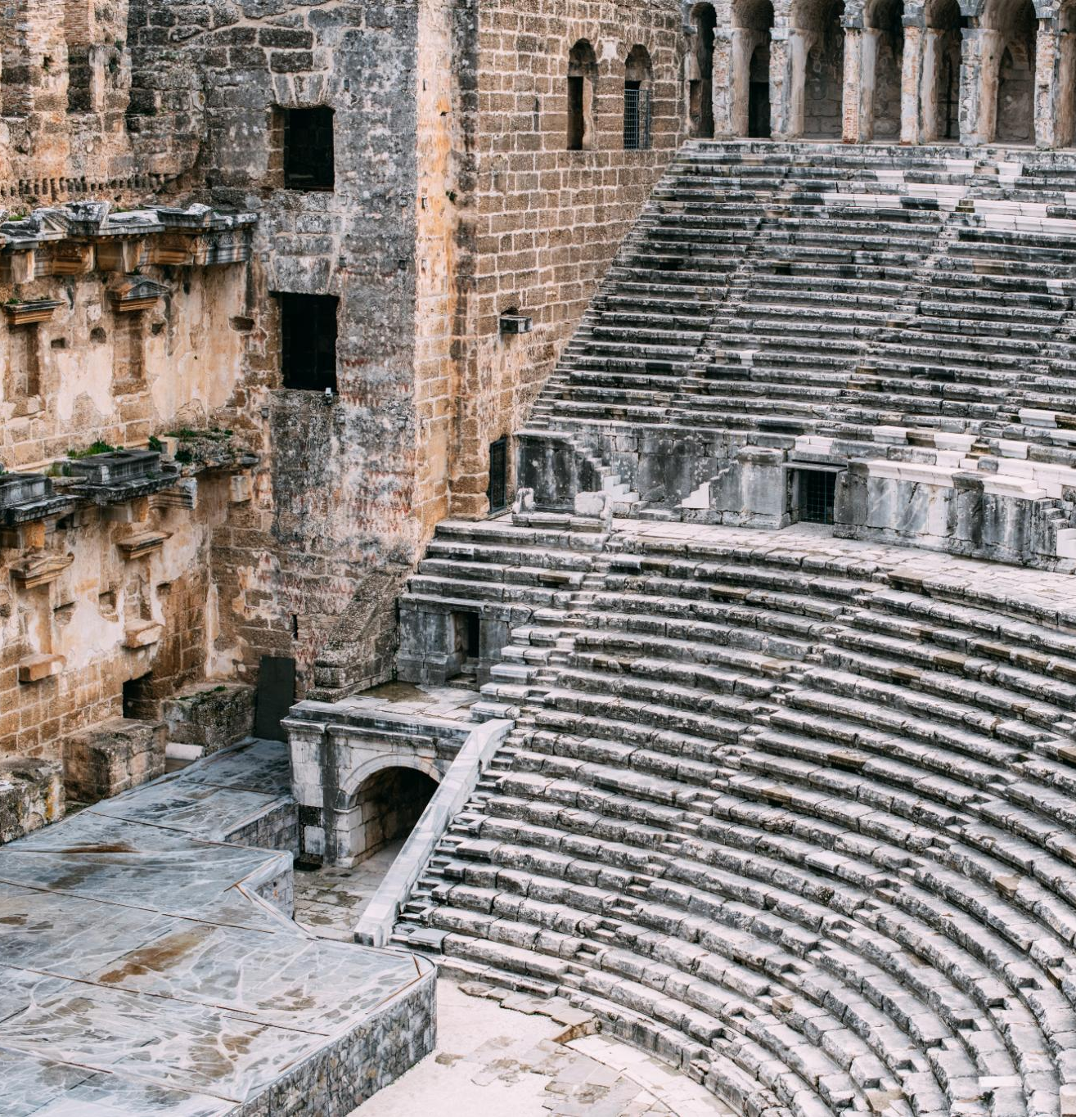
Ephesus Amphitheater 50 CE
Ancient Roman Architecture
The Ephesus amphitheater is an exemplary model of ancient Roman architecture, showcasing remarkable construction techniques and design.
Versatile Venue
The amphitheater was used for gladiatorial games, performances, and public gatherings, making it a central hub for events.
Notes:
The Ephesus Theater, built in the 3rd century BC and expanded during the Roman period, was one of the largest theaters in antiquity. By 50 AD, it had a seating capacity of approximately 25,000 spectators. This grand structure was used for dramatic performances, gladiatorial contests, and public meetings, reflecting the social and cultural significance of theater in ancient times.

Slide 29


Historical Construction
The Ephesus Theater was constructed in the 3rd century BC and later expanded during the Roman period.
Large Seating Capacity
By 50 AD, the theater could seat approximately 25,000 spectators, making it one of the largest of its time.
Notes:
The Ephesus Theater, built in the 3rd century BC and expanded during the Roman period, was one of the largest theaters in antiquity. By 50 AD, it had a seating capacity of approximately 25,000 spectators. This grand structure was used for dramatic performances, gladiatorial contests, and public meetings, reflecting the social and cultural significance of theater in ancient times.

Slide 30

Paul’s Preaching Sparks Uproar
Challenging Artemis Worship
Paul's message questioned the traditional worship of Artemis, shaking the foundation of the city's religious identity.
Impact on Silversmiths’ Trade
Silversmiths profiting from idol-making saw their livelihoods threatened by Paul's teachings, fueling their anger.
Theater Revolt and Uproar
A large, agitated crowd gathered in the city's theater, resulting in a major confrontation and unrest.

Slide 31
Paul’s Preaching Sparks Uproar
Challenging Artemis Worship
Paul's message questioned the traditional worship of Artemis, shaking the foundation of the city's religious identity.
Impact on Silversmiths’ Trade
Silversmiths profiting from idol-making saw their livelihoods threatened by Paul's teachings, fueling their anger.
Theater Revolt and Uproar
A large, agitated crowd gathered in the city's theater, resulting in a major confrontation and unrest.
Notes:
Image source: Microsoft 365 content library In Ephesus, Paul’s bold preaching about Christianity challenged the worship of Artemis, the city’s revered goddess. His message threatened the local silversmiths’ trade, as they profited from making idols. This provoked a massive revolt in the city’s theater, where an angry crowd gathered, leading to a significant confrontation and forcing Paul to leave the region.

Slide 32
Paul’s Preaching Sparks Uproar
Challenging Artemis Worship
Paul's message questioned the traditional worship of Artemis, shaking the foundation of the city's religious identity.
Impact on Silversmiths’ Trade
Silversmiths profiting from idol-making saw their livelihoods threatened by Paul's teachings, fueling their anger.
Theater Revolt and Uproar
A large, agitated crowd gathered in the city's theater, resulting in a major confrontation and unrest.
Notes:
Image source: Microsoft 365 content library In Ephesus, Paul’s bold preaching about Christianity challenged the worship of Artemis, the city’s revered goddess. His message threatened the local silversmiths’ trade, as they profited from making idols. This provoked a massive revolt in the city’s theater, where an angry crowd gathered, leading to a significant confrontation and forcing Paul to leave the region.

Slide 33
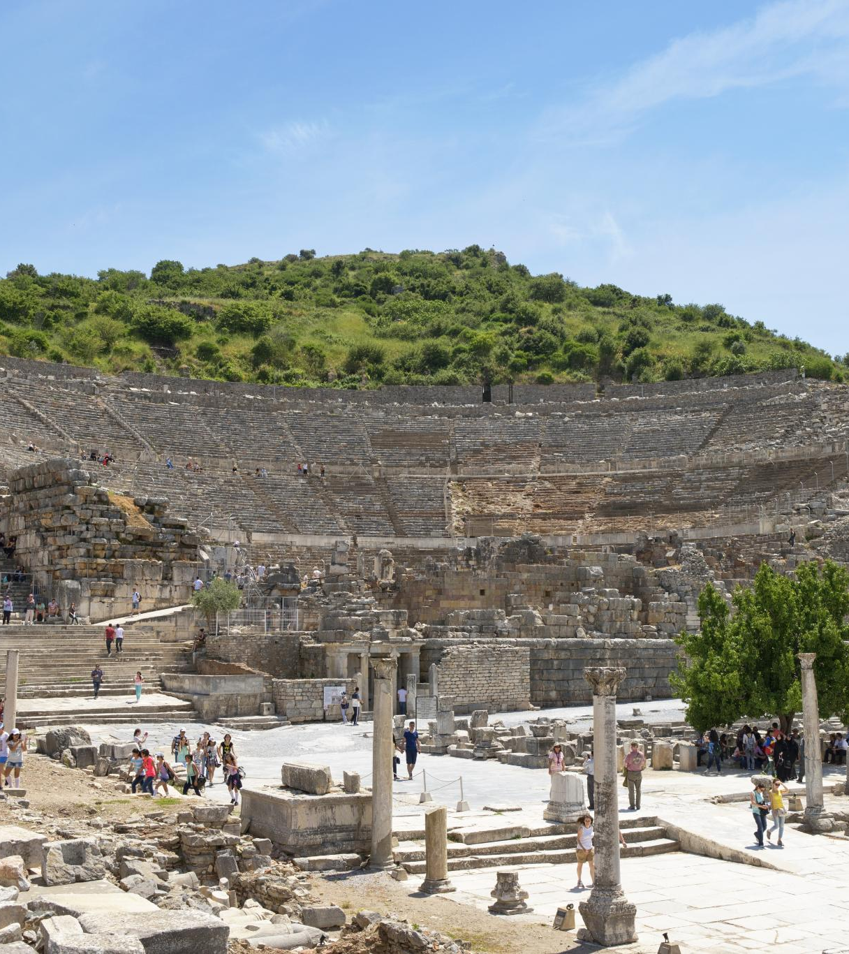
Paul's Teachings in Ephesus
Lecture Hall of Tyrannus
Paul's teachings in Ephesus primarily occurred in the lecture hall of Tyrannus, where he spent over two years.
Confrontation at the Theater
A significant confrontation took place at the theater, where silversmiths rioted against Paul due to the threat his teachings posed to their trade.
Paul's Missionary Activities
Paul's missionary activities in Ephesus were impactful, leading to both widespread teachings and significant confrontations.
Notes:
The Apostle Paul did not teach at the theater in Ephesus. Despite spending over two years in Ephesus, his teachings primarily took place in the lecture hall of Tyrannus. However, Paul's missionary activities in the city eventually led to a significant confrontation at the theater, where silversmiths rioted against him due to the threat his teachings posed to their trade.

Slide 34
Patterns for Christian Living Ray Summers Broadman Press © 1960 preface page v
Basically, there are two doctrines in the New Testament: how to be saved---that is, (1) justification buy grace through faith plus nothing; (2)and how the saved ought to live.
Comprehensively this covers the New Testament in a very real sense, every other doctrine is properly placed in one of these statements.

Slide 35

Patterns for Christian Living Ray Summers Broadman Press © 1960 preface page v
Complete text of commentary at: Ephesians : pattern for Christian living : Summers, Ray : Free Download, Borrow, and Streaming : Internet Archive

Slide 36
Patterns for Christian Living Ray Summers Broadman Press © 1960 preface page v
Basically, there are two doctrines in the New Testament: how to be saved---that is, (1) justification buy grace through faith plus nothing; (2)and how the saved ought to live.
Comprehensively this covers the New Testament in a very real sense, every other doctrine is properly placed in one of these statements.

Slide 37
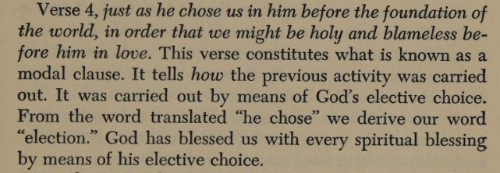
Patterns for Christian Living Ray Summers Broadman Press © 1960 preface page v

Slide 38
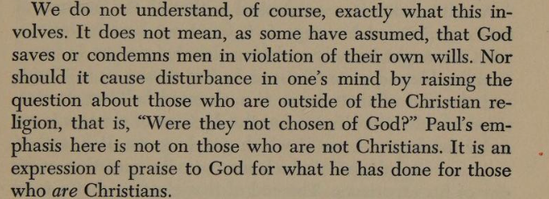
Patterns for Christian Living Ray Summers Broadman Press © 1960 preface page v

Slide 39
Patterns for Christian Living Ray Summers Broadman Press © 1960
Ray Summers makes a distinction between doctrine and application as follows:
Epistle | Doctrine | Application
Ephesians | 1-3 | 4-6
Romans | 1-11 | 12-16
Galatians | 1-4 | 5-6
Colossians | 1-2 | 3.4
1 Peter | 1:1 to 2:10 | 2:11 to 5:14
Hebrews | 1:1 top 10:18 | 10:19 to 13:25

Slide 40

New Testament Commentary Willliam Hendriksen Baker Book Houses © 1967
https://archive.org/details/newtestamentcomm0000hend/page/n282/mode/1up?view=theater
( Calvinist Election)
Contains a Colossians vs Ephesians Comparison (21 pages)

Slide 41
New Testament Commentary Willliam Hendriksen Baker Book Houses © 1967
The good with the questionable
https://archive.org/details/newtestamentcomm0000hend/page/n282/mode/1up?view=theater
( Calvinist Election not good)
Contains a Colossians vs Ephesians Comparison (21 pages) (Helpful)

Slide 42
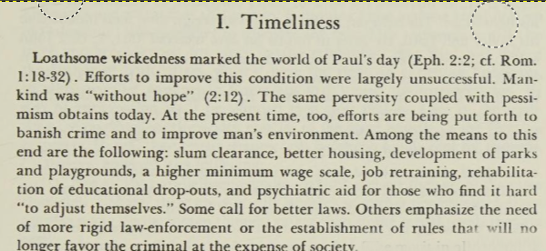
New Testament Commentary Willliam Hendriksen Baker Book Houses © 1967

Slide 43
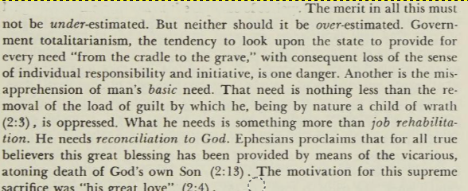
New Testament Commentary Willliam Hendriksen Baker Book Houses © 1967

Slide 44
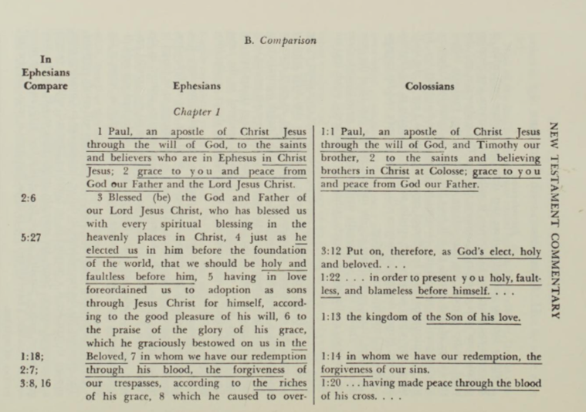
New Testament Commentary Willliam Hendriksen Baker Book Houses © 1967 Approximately 55 verses in Colossians are duplicated in Ephesians

Slide 45
New Testament Commentary Willliam Hendriksen Baker Book Houses © 1967 Approximately 55 verses in Colossians are duplicated in Ephesians

Slide 46
Dystopia : an imagined world or society in which people lead wretched, dehumanized, fearful lives

Slide 47
Book of Ephesians
Book of Ephesians

Slide 48
Book of Ephesians
Key Themes
The Book of Ephesians addresses themes of unity, love, grace, and spiritual growth within the Christian community.
Paul's Message
Paul's letter emphasizes the importance of living a life worthy of the calling received, and the transformative power of God's love and grace.
Modern Relevance
The teachings in Ephesians are relevant to modern Christian life, offering guidance on how to live harmoniously and faithfully in today's world.
Notes:
Introduction to the Book of Ephesians, using the Western Heights Church of Christ logo. This presentation will delve into the key themes and messages of the Apostle Paul's letter to the Ephesians, exploring its relevance to modern Christian life.

Slide 49
Ephesians 1:1
SBL Greek New Testament 2010 Παῦλος ἀπόστολος Χριστοῦ Ἰησοῦ διὰ θελήματος θεοῦ τοῖς ἁγίοις τοῖς οὖσιν [ἐν Ἐφέσῳ] καὶ πιστοῖς ἐν Χριστῷ Ἰησοῦ·
Nestle Greek New Testament 1904 Παῦλος ἀπόστολος Χριστοῦ Ἰησοῦ διὰ θελήματος Θεοῦ τοῖς ἁγίοις τοῖς οὖσιν [ἐν Ἐφέσῳ] καὶ πιστοῖς ἐν Χριστῷ Ἰησοῦ·
Westcott and Hort 1881 ΠΑΥΛΟΣ ἀπόστολος Χριστοῦ Ἰησοῦ διὰ θελήματος θεοῦ τοῖς ἁγίοις τοῖς οὖσιν ἐν Ἐφέσῳ καὶ πιστοῖς ἐν Χριστῷ Ἰησοῦ·
Westcott and Hort / [NA27 variants] ΠΑΥΛΟΣ ἀπόστολος Χριστοῦ Ἰησοῦ διὰ θελήματος θεοῦ τοῖς ἁγίοις τοῖς οὖσιν ἐν Ἐφέσῳ καὶ πιστοῖς ἐν Χριστῷ Ἰησοῦ·
RP Byzantine Majority Text 2005 Παῦλος, ἀπόστολος Ἰησοῦ χριστοῦ διὰ θελήματος θεοῦ, τοῖς ἁγίοις τοῖς οὖσιν ἐν Ἐφέσῳ καὶ πιστοῖς ἐν χριστῷ Ἰησοῦ·
Notes:
Introduction to the Book of Ephesians, using the Western Heights Church of Christ logo. This presentation will delve into the key themes and messages of the Apostle Paul's letter to the Ephesians, exploring its relevance to modern Christian life.

Slide 50
Ephesians 1:1
Greek Orthodox Church 1904 Παῦλος, ἀπόστολος Ἰησοῦ Χριστοῦ διὰ θελήματος Θεοῦ, τοῖς ἁγίοις τοῖς οὖσιν ἐν Ἐφέσῳ καὶ πιστοῖς ἐν Χριστῷ Ἰησοῦ·
Tischendorf 8th Edition Παῦλος ἀπόστολος Χριστός Ἰησοῦς διά θέλημα θεός ὁ ἅγιος ὁ εἰμί ἐν Ἔφεσος καί πιστός ἐν Χριστός Ἰησοῦς
Scrivener's Textus Receptus 1894 Παῦλος, ἀπόστολος Ἰησοῦ Χριστοῦ διὰ θελήματος Θεοῦ, τοῖς ἁγίοις τοῖς οὖσιν ἐν Ἐφέσῳ καὶ πιστοῖς ἐν Χριστῷ Ἰησοῦ·
Stephanus Textus Receptus 1550 Παῦλος ἀπόστολος Ἰησοῦ Χριστοῦ διὰ θελήματος θεοῦ τοῖς ἁγίοις τοῖς οὖσιν ἐν Ἐφέσῳ καὶ πιστοῖς ἐν Χριστῷ Ἰησοῦ
Notes:
Introduction to the Book of Ephesians, using the Western Heights Church of Christ logo. This presentation will delve into the key themes and messages of the Apostle Paul's letter to the Ephesians, exploring its relevance to modern Christian life.

