Slide 1
Book of Ephesians
Book of Ephesians

Slide 2

Book of Ephesians
Key Themes
  The Book of Ephesians addresses themes of unity, love, grace, and spiritual growth within the Christian community.
Paul's Message
  Paul's letter emphasizes the importance of living a life worthy of the calling received, and the transformative power of God's love and grace.
Modern Relevance
  The teachings in Ephesians are relevant to modern Christian life, offering guidance on how to live harmoniously and faithfully in today's world.
Notes:
Introduction to the Book of Ephesians, using the Western Heights Church of Christ logo. This presentation will delve into the key themes and messages of the Apostle Paul's letter to the Ephesians, exploring its relevance to modern Christian life.

Slide 3
Book of Ephesians
Heavenly Realms
The mystery
Spiritual Tools and Heavenly Armor
Spiritual Blessings in Christ
Made Alive in Christ
The New Spiritual Humanity
The Cornerstone and the New Building
Love that is wide, long, and high. The infinite God
Worthy calling - Unity and oneness _
Futile thinking contrasted with Wisdom and Discretion
Quirky things about Ephesians, The Colossian Heresy, Papyrus 46
Chistian Living Impacting Relationships.
Notes:
Introduction to the Book of Ephesians, using the Western Heights Church of Christ logo. This presentation will delve into the key themes and messages of the Apostle Paul's letter to the Ephesians, exploring its relevance to modern Christian life.

Slide 4
Where is Heaven?
Notes:
Introduction to the Book of Ephesians, using the Western Heights Church of Christ logo. This presentation will delve into the key themes and messages of the Apostle Paul's letter to the Ephesians, exploring its relevance to modern Christian life.

Slide 5
Songs about Heaven
Notes:
Introduction to the Book of Ephesians, using the Western Heights Church of Christ logo. This presentation will delve into the key themes and messages of the Apostle Paul's letter to the Ephesians, exploring its relevance to modern Christian life.

Slide 6
Songs About Heaven
Sing to me of Heaven
When We all get to Heaven
Earth Hold no Treasures
How Beautiful Heaven Must Be
Just over in the Glory Land
There’s a Land Beyond the River
Beulah Land
Beyond the Sunset
Beyond this land of Parting
In the Land of Fadeless Day
Notes:
Introduction to the Book of Ephesians, using the Western Heights Church of Christ logo. This presentation will delve into the key themes and messages of the Apostle Paul's letter to the Ephesians, exploring its relevance to modern Christian life.

Slide 7

Heavenly Realms
Ephesians 1:3, 1:20, 2:6, 3:10, 6:12
Normally Heaven is associated as the dwelling place of God and everything good and perfect.
The first three instances above could be confused with Heaven.
Ephesians 6:12 clearly gives meaning to heavenly realms that Paul is writing about.
Notes:
Introduction to the Book of Ephesians, using the Western Heights Church of Christ logo. This presentation will delve into the key themes and messages of the Apostle Paul's letter to the Ephesians, exploring its relevance to modern Christian life.

Slide 8
Heavenly Realms
Ephesians 1:3, 2:6, 3:10, 6:12
Normally Heaven is associated as the dwelling place of God and everything good and perfect.
The first four instances above could be confused with Heaven.
Ephesians 6:12 clearly gives meaning to heavenly realms that Paul is writing about.
¹² For our struggle is not against flesh and blood, but against the rulers, against the authorities, against the powers of this dark world and against the spiritual forces of evil in the heavenly realms.
Notes:
Introduction to the Book of Ephesians, using the Western Heights Church of Christ logo. This presentation will delve into the key themes and messages of the Apostle Paul's letter to the Ephesians, exploring its relevance to modern Christian life.

Slide 9
Heavenly Realms
Ephesians 1:3, 2:6, 3:10, 6:12
Normally Heaven is associated as the dwelling place of God and everything good and perfect.
The first three instances above could be confused with Heaven.
Ephesians 6:12 clearly gives meaning to heavenly realms that Paul is writing about.
¹² For our struggle is not against flesh and blood, but against the rulers, against the authorities, against the powers of this dark world and against the spiritual forces of evil in the heavenly realms. Where are the heavenly (spiritual) realms?
Notes:
Introduction to the Book of Ephesians, using the Western Heights Church of Christ logo. This presentation will delve into the key themes and messages of the Apostle Paul's letter to the Ephesians, exploring its relevance to modern Christian life.

Slide 10
Heavenly Realms
Ephesians 1:3, 2:6, 3:10, 6:12
Heavenly Realm Aligned with God
Heavenly Realm Not Aligned with God
Physical Realm Aligned with God
Physical Realm Not Aligned with God
Notes:
Introduction to the Book of Ephesians, using the Western Heights Church of Christ logo. This presentation will delve into the key themes and messages of the Apostle Paul's letter to the Ephesians, exploring its relevance to modern Christian life.

Slide 11
Heavenly Realms
Ephesians 1:3, 2:6, 3:10, 6:12
eternal
Heavenly Realm Aligned with God
Heavenly Realm Not Aligned with God
Physical Realm Aligned with God
Physical Realm Not Aligned with God
temporary
Notes:
Introduction to the Book of Ephesians, using the Western Heights Church of Christ logo. This presentation will delve into the key themes and messages of the Apostle Paul's letter to the Ephesians, exploring its relevance to modern Christian life.

Slide 12
Heavenly Realms
Ephesians 1:3, 2:6, 3:10, 6:12
Heavenly Realm Aligned with God
Heavenly Realm Not Aligned with God
Contrast with
Gen 1:1
Gen 3:15
Physical Realm Aligned with God
Physical Realm Not Aligned with God
Notes:
Introduction to the Book of Ephesians, using the Western Heights Church of Christ logo. This presentation will delve into the key themes and messages of the Apostle Paul's letter to the Ephesians, exploring its relevance to modern Christian life.

Slide 13
Spiritual Realms O.T.
1 Samuel 16:14
¹⁴ Now the Spirit of the Lord had departed from Saul, and an evil spirit from the Lord tormented him.
Spiritual Realms O.T.
2 Samuel 7:15
¹⁵ But my love will never be taken away from him, as I took it away from Saul, whom I removed from before you.
Notes:
Introduction to the Book of Ephesians, using the Western Heights Church of Christ logo. This presentation will delve into the key themes and messages of the Apostle Paul's letter to the Ephesians, exploring its relevance to modern Christian life.

Slide 14
Spiritual Realms O.T.
1 Kings 11
⁴ As Solomon grew old, his wives turned his heart after other gods, and his heart was not fully devoted to the Lord his God, as the heart of David his father had been. ⁵ He followed Ashtoreth the goddess of the Sidonians, and Molek the detestable god of the Ammonites. ⁶ So Solomon did evil in the eyes of the Lord; he did not follow the Lord completely, as David his father had done.
Notes:
Introduction to the Book of Ephesians, using the Western Heights Church of Christ logo. This presentation will delve into the key themes and messages of the Apostle Paul's letter to the Ephesians, exploring its relevance to modern Christian life.

Slide 15
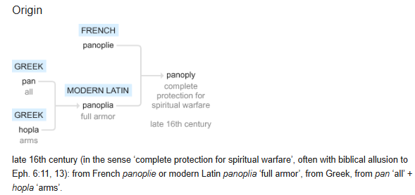
Panoply

Slide 16
The Armor of God (Panoply)
The Armor of God (Panoply)
¹⁰ Finally, be strong in the Lord and in his mighty power. ¹¹ Put on the full armor of God, so that you can take your stand against the devil’s schemes. ¹² For our struggle is not against flesh and blood, but against the rulers, against the authorities, against the powers of this dark world and against the spiritual forces of evil in the heavenly realms. ¹³ Therefore put on the full armor of God, so that when the day of evil comes, you may be able to stand your ground, and after you have done everything, to stand.
Notes:
Introduction to the Book of Ephesians, using the Western Heights Church of Christ logo. This presentation will delve into the key themes and messages of the Apostle Paul's letter to the Ephesians, exploring its relevance to modern Christian life.

Slide 17
The Armor of God (Panoply)
The Armor of God (Panoply)
¹⁴ Stand firm then, with the belt of truth buckled around your waist, with the breastplate of righteousness in place, ¹⁵ and with your feet fitted with the readiness that comes from the gospel of peace. ¹⁶ In addition to all this, take up the shield of faith, with which you can extinguish all the flaming arrows of the evil one. ¹⁷ Take the helmet of salvation and the sword of the Spirit, which is the word of God.
Notes:
Introduction to the Book of Ephesians, using the Western Heights Church of Christ logo. This presentation will delve into the key themes and messages of the Apostle Paul's letter to the Ephesians, exploring its relevance to modern Christian life.

Slide 18
The Armor of God (Panoply)
The Armor of God (Panoply)
belt of truth buckled around your waist
breastplate of righteousness in place
your feet fitted with the readiness that comes from the gospel of peace
shield of faith, with which you can extinguish all the flaming arrows of the evil one
helmet of salvation and the sword of the Spirit, which is the word of God of God.
Notes:
Introduction to the Book of Ephesians, using the Western Heights Church of Christ logo. This presentation will delve into the key themes and messages of the Apostle Paul's letter to the Ephesians, exploring its relevance to modern Christian life.

Slide 19
Posture for battle.
¹⁸ And pray in the Spirit on all occasions with all kinds of prayers and requests. With this in mind, be alert and always keep on praying for all the Lord’s people. ¹⁹ Pray also for me, that whenever I speak, words may be given me so that I will fearlessly make known the mystery of the gospel, ²⁰ for which I am an ambassador in chains. Pray that I may declare it fearlessly, as I should.
Notes:
Introduction to the Book of Ephesians, using the Western Heights Church of Christ logo. This presentation will delve into the key themes and messages of the Apostle Paul's letter to the Ephesians, exploring its relevance to modern Christian life.

Slide 20
Heavenly Realms
2 Corinthians 5
5 For we know that if the earthly tent we live in is destroyed, we have a building from God, an eternal house in heaven, not built by human hands. ² Meanwhile we groan, longing to be clothed instead with our heavenly dwelling, ³ because when we are clothed, we will not be found naked. ⁴ For while we are in this tent, we groan and are burdened, because we do not wish to be unclothed but to be clothed instead with our heavenly dwelling, so that what is mortal may be swallowed up by life. ⁵ Now the one who has fashioned us for this very purpose is God, who has given us the Spirit as a deposit, guaranteeing what is to come..
Notes:
Introduction to the Book of Ephesians, using the Western Heights Church of Christ logo. This presentation will delve into the key themes and messages of the Apostle Paul's letter to the Ephesians, exploring its relevance to modern Christian life.

Slide 21
Heavenly Realms
Evil Spirts result in Evil Acts
John 3:20 Everyone who does evil hates the light and will not come into the light for fear that their deeds will be exposed.
John 17:15 My prayer is not that you take them out of the world but that you protect them from the evil one.
Romans 2:8 But for those who are self-seeking and who reject the truth and follow evil, there will be wrath and anger.
Romans 1:29-Romans 1:29
They have become filled with every kind of wickedness, evil, greed and depravity. They are full of envy, murder, strife, deceit and malice. They are gossips, slanderers, God-haters, insolent, arrogant and boastful; they invent ways of doing evil; they disobey their parents;
Notes:
Introduction to the Book of Ephesians, using the Western Heights Church of Christ logo. This presentation will delve into the key themes and messages of the Apostle Paul's letter to the Ephesians, exploring its relevance to modern Christian life.

Slide 22
Heavenly Realms
Ephesians 1:3, 2:6, 3:10, 6:12
Normally Heaven is associated as the dwelling place of God and everything good and perfect.
The first three instances above could be confused with Heaven.
Ephesians 6:12 clearly gives meaning to heavenly realms that Paul is writing about.
¹² For our struggle is not against flesh and blood, but against the rulers, against the authorities, against the powers of this dark world and against the spiritual forces of evil in the heavenly realms. Where are the heavenly (spiritual) realms?
Notes:
Introduction to the Book of Ephesians, using the Western Heights Church of Christ logo. This presentation will delve into the key themes and messages of the Apostle Paul's letter to the Ephesians, exploring its relevance to modern Christian life.

Slide 23
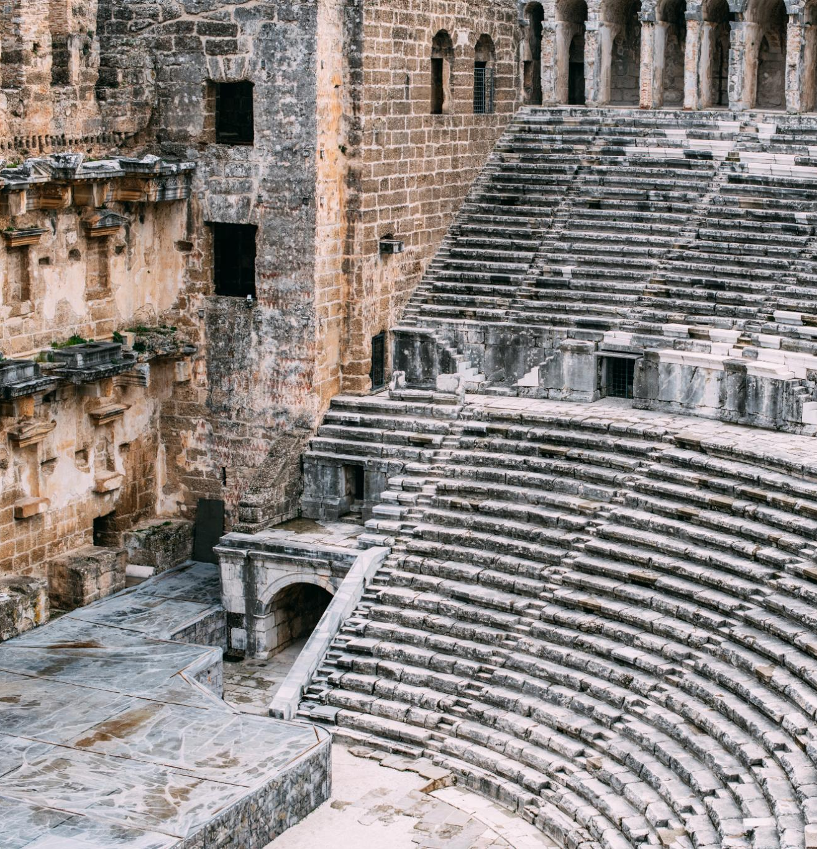
Ephesus Amphitheater 50 CE
Ancient Roman Architecture
  The Ephesus amphitheater is an exemplary model of ancient Roman architecture, showcasing remarkable construction techniques and design.
Versatile Venue
  The amphitheater was used for gladiatorial games, performances, and public gatherings, making it a central hub for events.
Notes:
The Ephesus Theater, built in the 3rd century BC and expanded during the Roman period, was one of the largest theaters in antiquity. By 50 AD, it had a seating capacity of approximately 25,000 spectators. This grand structure was used for dramatic performances, gladiatorial contests, and public meetings, reflecting the social and cultural significance of theater in ancient times.

Slide 24


Historical Construction
  The Ephesus Theater was constructed in the 3rd century BC and later expanded during the Roman period.
Large Seating Capacity
  By 50 AD, the theater could seat approximately 25,000 spectators, making it one of the largest of its time.
Notes:
The Ephesus Theater, built in the 3rd century BC and expanded during the Roman period, was one of the largest theaters in antiquity. By 50 AD, it had a seating capacity of approximately 25,000 spectators. This grand structure was used for dramatic performances, gladiatorial contests, and public meetings, reflecting the social and cultural significance of theater in ancient times.

Slide 25

Paul’s Preaching Sparks Uproar
Challenging Artemis Worship
  Paul's message questioned the traditional worship of Artemis, shaking the foundation of the city's religious identity.
Impact on Silversmiths’ Trade
  Silversmiths profiting from idol-making saw their livelihoods threatened by Paul's teachings, fueling their anger.
Theater Revolt and Uproar
  A large, agitated crowd gathered in the city's theater, resulting in a major confrontation and unrest.

Slide 26
Paul’s Preaching Sparks Uproar
Challenging Artemis Worship
  Paul's message questioned the traditional worship of Artemis, shaking the foundation of the city's religious identity.
Impact on Silversmiths’ Trade
  Silversmiths profiting from idol-making saw their livelihoods threatened by Paul's teachings, fueling their anger.
Theater Revolt and Uproar
  A large, agitated crowd gathered in the city's theater, resulting in a major confrontation and unrest.
Notes:
Image source: Microsoft 365 content library
In Ephesus, Paul’s bold preaching about Christianity challenged the worship of Artemis, the city’s revered goddess. His message threatened the local silversmiths’ trade, as they profited from making idols. This provoked a massive revolt in the city’s theater, where an angry crowd gathered, leading to a significant confrontation and forcing Paul to leave the region.

Slide 27
Paul’s Preaching Sparks Uproar
Challenging Artemis Worship
  Paul's message questioned the traditional worship of Artemis, shaking the foundation of the city's religious identity.
Impact on Silversmiths’ Trade
  Silversmiths profiting from idol-making saw their livelihoods threatened by Paul's teachings, fueling their anger.
Theater Revolt and Uproar
  A large, agitated crowd gathered in the city's theater, resulting in a major confrontation and unrest.
Notes:
Image source: Microsoft 365 content library
In Ephesus, Paul’s bold preaching about Christianity challenged the worship of Artemis, the city’s revered goddess. His message threatened the local silversmiths’ trade, as they profited from making idols. This provoked a massive revolt in the city’s theater, where an angry crowd gathered, leading to a significant confrontation and forcing Paul to leave the region.

Slide 28
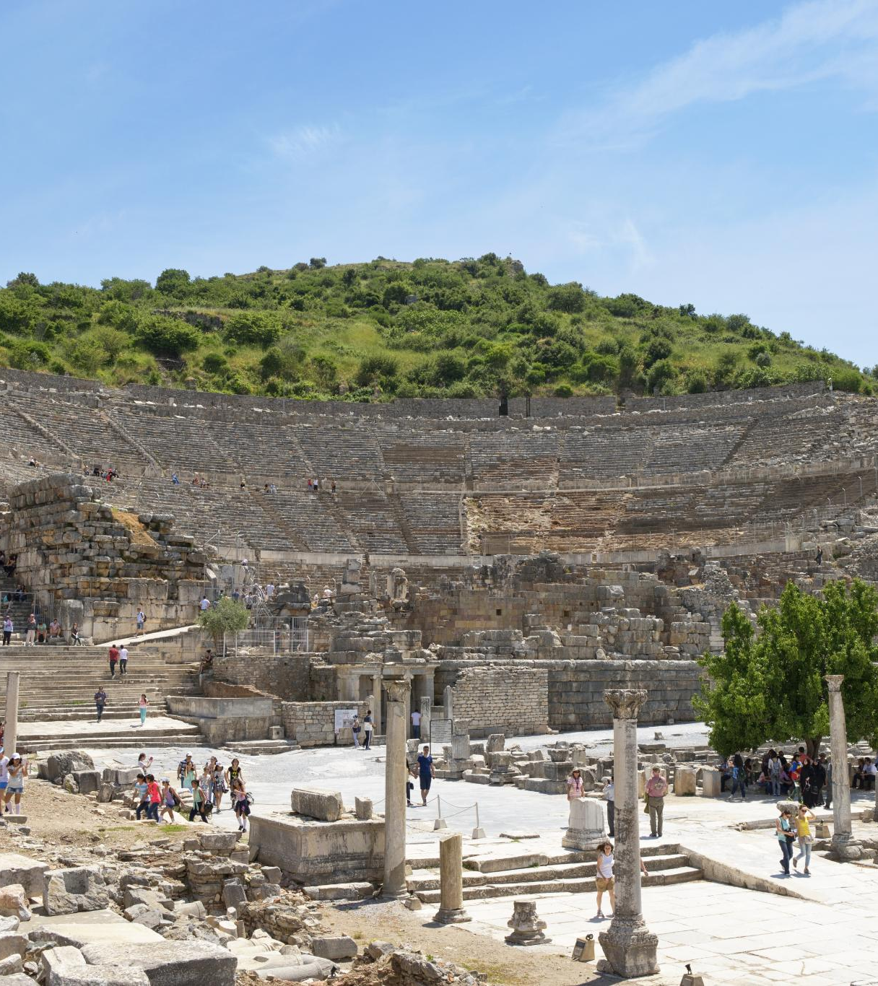
Paul's Teachings in Ephesus
Lecture Hall of Tyrannus
  Paul's teachings in Ephesus primarily occurred in the lecture hall of Tyrannus, where he spent over two years.
Confrontation at the Theater
  A significant confrontation took place at the theater, where silversmiths rioted against Paul due to the threat his teachings posed to their trade.
Paul's Missionary Activities
  Paul's missionary activities in Ephesus were impactful, leading to both widespread teachings and significant confrontations.
Notes:
The Apostle Paul did not teach at the theater in Ephesus. Despite spending over two years in Ephesus, his teachings primarily took place in the lecture hall of Tyrannus. However, Paul's missionary activities in the city eventually led to a significant confrontation at the theater, where silversmiths rioted against him due to the threat his teachings posed to their trade.

Slide 29
Patterns for Christian Living
Ray Summers Broadman Press © 1960 preface page v
Basically, there are two doctrines in the New Testament: how to be saved---that is,
(1) justification buy grace through faith plus nothing;
(2)and how the saved ought to live.
Comprehensively this covers the New Testament in a very real sense, every other doctrine is properly placed in one of these statements.

Slide 30

Patterns for Christian Living
Ray Summers Broadman Press © 1960 preface page v
Complete text of commentary at:
Ephesians : pattern for Christian living : Summers, Ray : Free Download, Borrow, and Streaming : Internet Archive

Slide 31
Patterns for Christian Living
Ray Summers Broadman Press © 1960 preface page v
Basically, there are two doctrines in the New Testament: how to be saved---that is,
(1) justification buy grace through faith plus nothing;
(2)and how the saved ought to live.
Comprehensively this covers the New Testament in a very real sense, every other doctrine is properly placed in one of these statements.

Slide 32
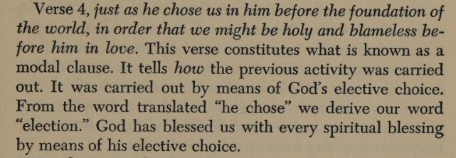
Patterns for Christian Living
Ray Summers Broadman Press © 1960 preface page v

Slide 33
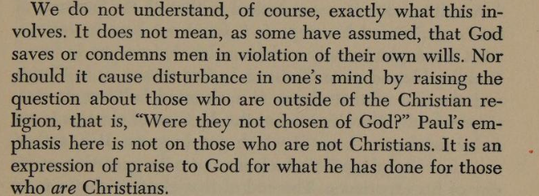
Patterns for Christian Living
Ray Summers Broadman Press © 1960 preface page v

Slide 34
Patterns for Christian Living
Ray Summers Broadman Press © 1960
Ray Summers makes a distinction between doctrine and application as follows:
Epistle | Doctrine | Application
Ephesians | 1-3 | 4-6
Romans | 1-11 | 12-16
Galatians | 1-4 | 5-6
Colossians | 1-2 | 3.4
1 Peter | 1:1 to 2:10 | 2:11 to 5:14
Hebrews | 1:1 top 10:18 | 10:19 to 13:25

Slide 35

New Testament Commentary
Willliam Hendriksen Baker Book Houses © 1967
https://archive.org/details/newtestamentcomm0000hend/page/n282/mode/1up?view=theater
( Calvinist Election)
Contains a Colossians vs Ephesians Comparison (21 pages)

Slide 36
New Testament Commentary
Willliam Hendriksen Baker Book Houses © 1967
The good with the questionable
https://archive.org/details/newtestamentcomm0000hend/page/n282/mode/1up?view=theater
( Calvinist Election not good)
Contains a Colossians vs Ephesians Comparison (21 pages) (Helpful)

Slide 37
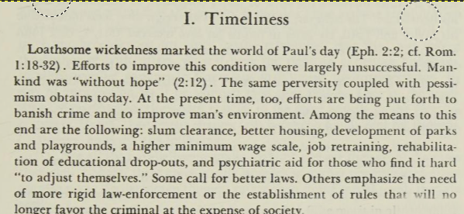
New Testament Commentary
Willliam Hendriksen Baker Book Houses © 1967

Slide 38
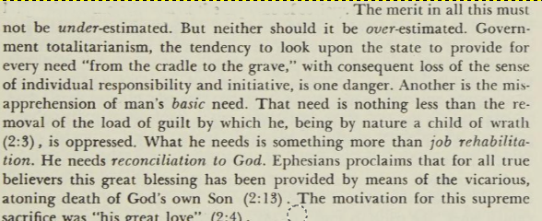
New Testament Commentary
Willliam Hendriksen Baker Book Houses © 1967

Slide 39
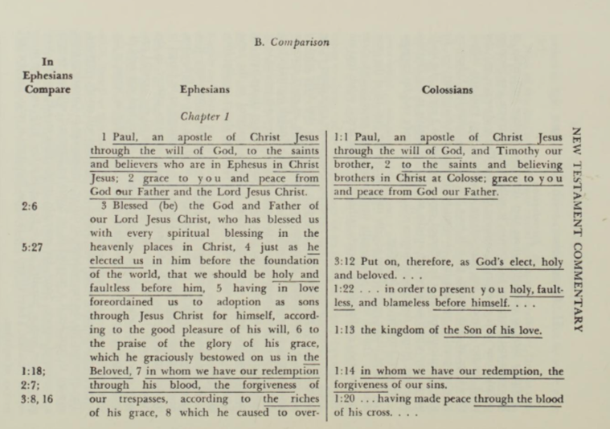
New Testament Commentary
Willliam Hendriksen Baker Book Houses © 1967
Approximately 55 verses in Colossians are duplicated in Ephesians

Slide 40
New Testament Commentary
Willliam Hendriksen Baker Book Houses © 1967
Approximately 55 verses in Colossians are duplicated in Ephesians

Slide 41
Dystopia : an imagined world or society in which people lead wretched, dehumanized, fearful lives

