Slide 1
Book of Ephesians
Book of Ephesians

Slide 2

Book of Ephesians
Key Themes
  The Book of Ephesians addresses themes of unity, love, grace, and spiritual growth within the Christian community.
Paul's Message
  Paul's letter emphasizes the importance of living a life worthy of the calling received, and the transformative power of God's love and grace.
Modern Relevance
  The teachings in Ephesians are relevant to modern Christian life, offering guidance on how to live harmoniously and faithfully in today's world.
Notes:
Introduction to the Book of Ephesians, using the Western Heights Church of Christ logo. This presentation will delve into the key themes and messages of the Apostle Paul's letter to the Ephesians, exploring its relevance to modern Christian life.

Slide 3
Book of Ephesians
Heavenly Realms
The mystery
Spiritual Tools and Heavenly Armor
Spiritual Blessings in Christ
Made Alive in Christ
The New Spiritual Humanity
The Cornerstone and the New Building
Love that is wide, long, and high. The infinite God
Worthy calling - Unity and oneness _
Futile thinking contrasted with Wisdom and Discretion
Quirky things about Ephesians, The Colossian Heresy, Papyrus 46
Chistian Living Impacting Relationships.
Notes:
Introduction to the Book of Ephesians, using the Western Heights Church of Christ logo. This presentation will delve into the key themes and messages of the Apostle Paul's letter to the Ephesians, exploring its relevance to modern Christian life.

Slide 4

Heavenly Realms
Ephesians 1:3, 2:6, 3:10, 6:12
Normally Heaven is associated as the dwelling place of God and everything good and perfect.
The first three instances above could be confused with Heaven.
Ephesians 6:12 clearly gives meaning to heavenly realms that Paul is writing about.
Notes:
Introduction to the Book of Ephesians, using the Western Heights Church of Christ logo. This presentation will delve into the key themes and messages of the Apostle Paul's letter to the Ephesians, exploring its relevance to modern Christian life.

Slide 5
Heavenly Realms
Ephesians 1:3, 2:6, 3:10, 6:12
Normally Heaven is associated as the dwelling place of God and everything good and perfect.
The first three instances above could be confused with Heaven.
Ephesians 6:12 clearly gives meaning to heavenly realms that Paul is writing about.
¹² For our struggle is not against flesh and blood, but against the rulers, against the authorities, against the powers of this dark world and against the spiritual forces of evil in the heavenly realms.
Notes:
Introduction to the Book of Ephesians, using the Western Heights Church of Christ logo. This presentation will delve into the key themes and messages of the Apostle Paul's letter to the Ephesians, exploring its relevance to modern Christian life.

Slide 6
Heavenly Realms
Ephesians 1:3, 2:6, 3:10, 6:12
Normally Heaven is associated as the dwelling place of God and everything good and perfect.
The first three instances above could be confused with Heaven.
Ephesians 6:12 clearly gives meaning to heavenly realms that Paul is writing about.
¹² For our struggle is not against flesh and blood, but against the rulers, against the authorities, against the powers of this dark world and against the spiritual forces of evil in the heavenly realms. Where are the heavenly (spiritual) realms?
Notes:
Introduction to the Book of Ephesians, using the Western Heights Church of Christ logo. This presentation will delve into the key themes and messages of the Apostle Paul's letter to the Ephesians, exploring its relevance to modern Christian life.

Slide 7
Heavenly Realms
Ephesians 1:3, 2:6, 3:10, 6:12
Normally Heaven is associated as the dwelling place of God and everything good and perfect.
The first three instances above could be confused with Heaven.
Ephesians 6:12 clearly gives meaning to heavenly realms that Paul is writing about.
¹² For our struggle is not against flesh and blood, but against the rulers, against the authorities, against the powers of this dark world and against the spiritual forces of evil in the heavenly realms. Where are the heavenly (spiritual) realms?
Notes:
Introduction to the Book of Ephesians, using the Western Heights Church of Christ logo. This presentation will delve into the key themes and messages of the Apostle Paul's letter to the Ephesians, exploring its relevance to modern Christian life.

Slide 8
Heavenly Realms
2 Corinthians 5
5 For we know that if the earthly tent we live in is destroyed, we have a building from God, an eternal house in heaven, not built by human hands. ² Meanwhile we groan, longing to be clothed instead with our heavenly dwelling, ³ because when we are clothed, we will not be found naked. ⁴ For while we are in this tent, we groan and are burdened, because we do not wish to be unclothed but to be clothed instead with our heavenly dwelling, so that what is mortal may be swallowed up by life. ⁵ Now the one who has fashioned us for this very purpose is God, who has given us the Spirit as a deposit, guaranteeing what is to come..
Notes:
Introduction to the Book of Ephesians, using the Western Heights Church of Christ logo. This presentation will delve into the key themes and messages of the Apostle Paul's letter to the Ephesians, exploring its relevance to modern Christian life.

Slide 9
Heavenly Realms
Evil Spirts result in Evil Acts
John 3:20 Everyone who does evil hates the light and will not come into the light for fear that their deeds will be exposed.
John 17:15 My prayer is not that you take them out of the world but that you protect them from the evil one.
Romans 2:8 But for those who are self-seeking and who reject the truth and follow evil, there will be wrath and anger.
Romans 1:29-Romans 1:29
They have become filled with every kind of wickedness, evil, greed and depravity. They are full of envy, murder, strife, deceit and malice. They are gossips, slanderers, God-haters, insolent, arrogant and boastful; they invent ways of doing evil; they disobey their parents;
Notes:
Introduction to the Book of Ephesians, using the Western Heights Church of Christ logo. This presentation will delve into the key themes and messages of the Apostle Paul's letter to the Ephesians, exploring its relevance to modern Christian life.

Slide 10
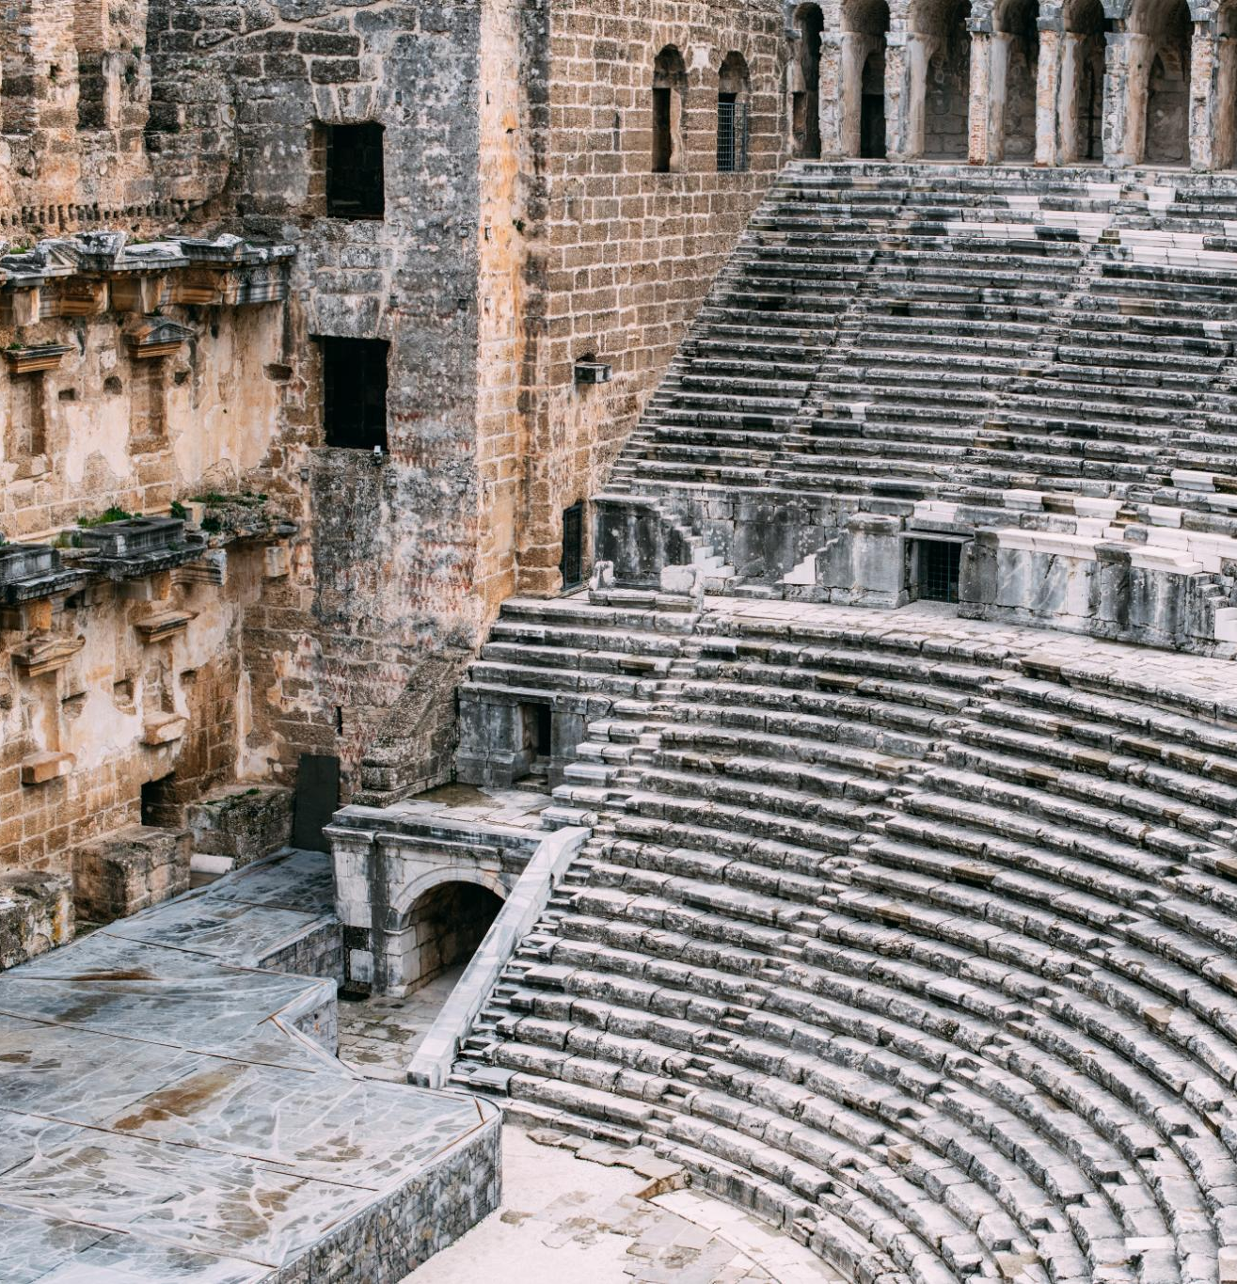
Ephesus Amphitheater 50 CE
Ancient Roman Architecture
  The Ephesus amphitheater is an exemplary model of ancient Roman architecture, showcasing remarkable construction techniques and design.
Versatile Venue
  The amphitheater was used for gladiatorial games, performances, and public gatherings, making it a central hub for events.
Notes:
The Ephesus Theater, built in the 3rd century BC and expanded during the Roman period, was one of the largest theaters in antiquity. By 50 AD, it had a seating capacity of approximately 25,000 spectators. This grand structure was used for dramatic performances, gladiatorial contests, and public meetings, reflecting the social and cultural significance of theater in ancient times.

Slide 11


Historical Construction
  The Ephesus Theater was constructed in the 3rd century BC and later expanded during the Roman period.
Large Seating Capacity
  By 50 AD, the theater could seat approximately 25,000 spectators, making it one of the largest of its time.
Notes:
The Ephesus Theater, built in the 3rd century BC and expanded during the Roman period, was one of the largest theaters in antiquity. By 50 AD, it had a seating capacity of approximately 25,000 spectators. This grand structure was used for dramatic performances, gladiatorial contests, and public meetings, reflecting the social and cultural significance of theater in ancient times.

Slide 12

Paul’s Preaching Sparks Uproar
Challenging Artemis Worship
  Paul's message questioned the traditional worship of Artemis, shaking the foundation of the city's religious identity.
Impact on Silversmiths’ Trade
  Silversmiths profiting from idol-making saw their livelihoods threatened by Paul's teachings, fueling their anger.
Theater Revolt and Uproar
  A large, agitated crowd gathered in the city's theater, resulting in a major confrontation and unrest.

Slide 13
Paul’s Preaching Sparks Uproar
Challenging Artemis Worship
  Paul's message questioned the traditional worship of Artemis, shaking the foundation of the city's religious identity.
Impact on Silversmiths’ Trade
  Silversmiths profiting from idol-making saw their livelihoods threatened by Paul's teachings, fueling their anger.
Theater Revolt and Uproar
  A large, agitated crowd gathered in the city's theater, resulting in a major confrontation and unrest.
Notes:
Image source: Microsoft 365 content library
In Ephesus, Paul’s bold preaching about Christianity challenged the worship of Artemis, the city’s revered goddess. His message threatened the local silversmiths’ trade, as they profited from making idols. This provoked a massive revolt in the city’s theater, where an angry crowd gathered, leading to a significant confrontation and forcing Paul to leave the region.

Slide 14
Paul’s Preaching Sparks Uproar
Challenging Artemis Worship
  Paul's message questioned the traditional worship of Artemis, shaking the foundation of the city's religious identity.
Impact on Silversmiths’ Trade
  Silversmiths profiting from idol-making saw their livelihoods threatened by Paul's teachings, fueling their anger.
Theater Revolt and Uproar
  A large, agitated crowd gathered in the city's theater, resulting in a major confrontation and unrest.
Notes:
Image source: Microsoft 365 content library
In Ephesus, Paul’s bold preaching about Christianity challenged the worship of Artemis, the city’s revered goddess. His message threatened the local silversmiths’ trade, as they profited from making idols. This provoked a massive revolt in the city’s theater, where an angry crowd gathered, leading to a significant confrontation and forcing Paul to leave the region.

Slide 15
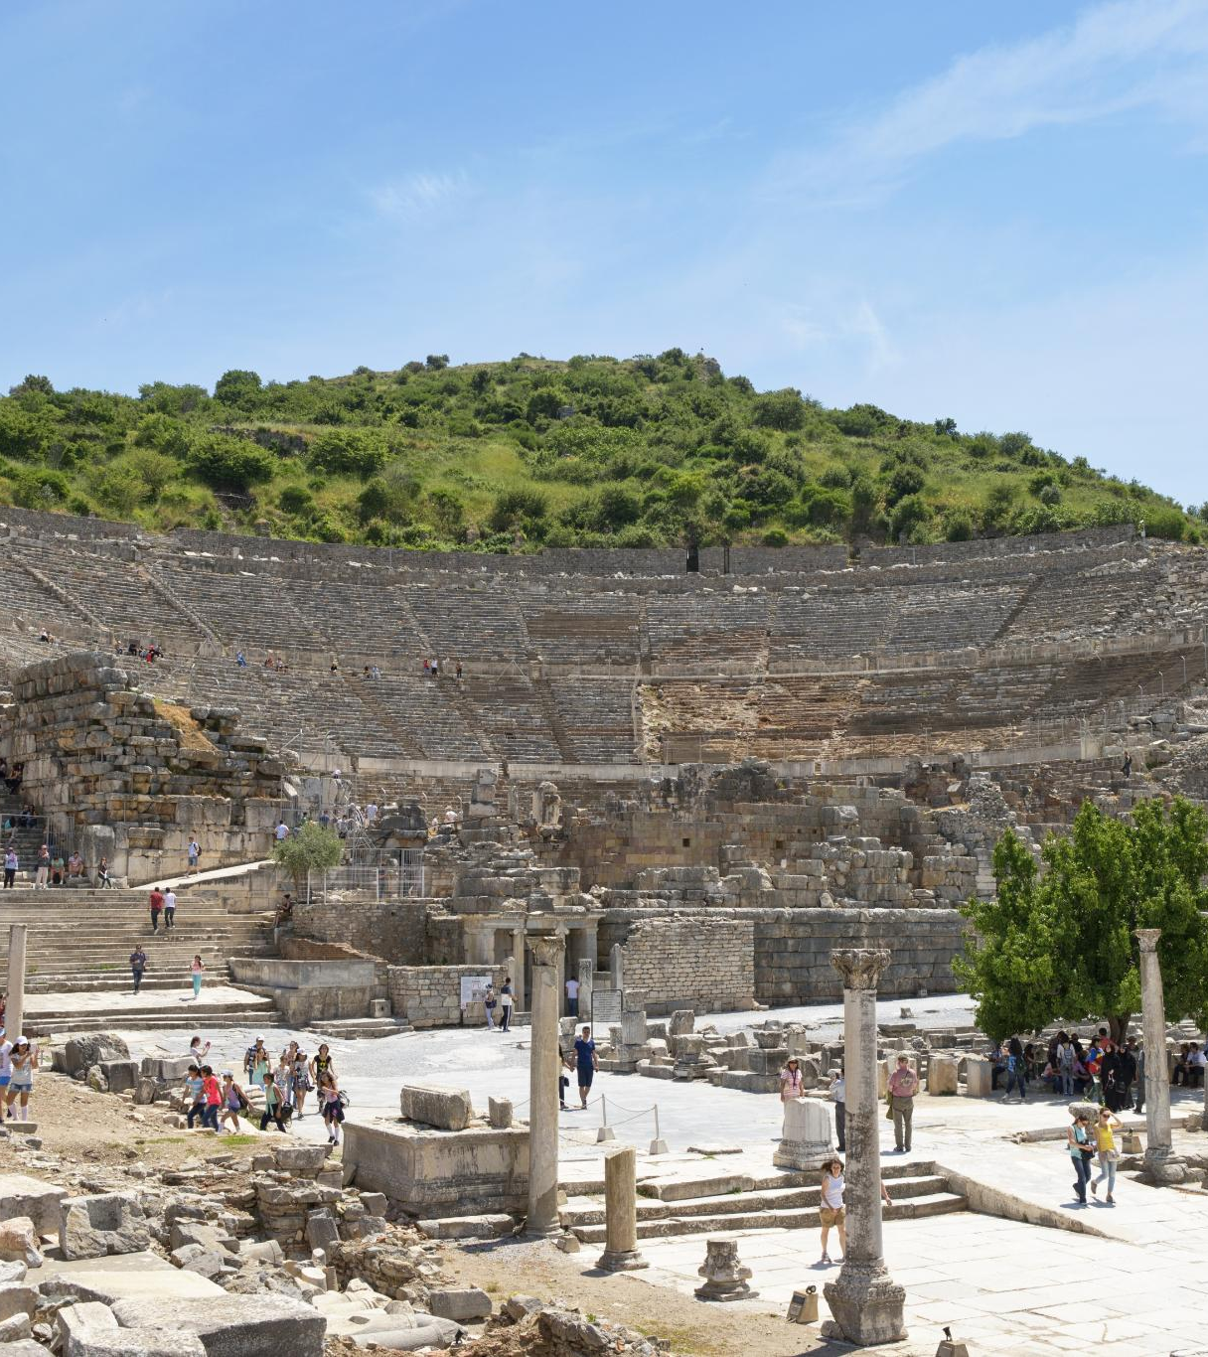
Paul's Teachings in Ephesus
Lecture Hall of Tyrannus
  Paul's teachings in Ephesus primarily occurred in the lecture hall of Tyrannus, where he spent over two years.
Confrontation at the Theater
  A significant confrontation took place at the theater, where silversmiths rioted against Paul due to the threat his teachings posed to their trade.
Paul's Missionary Activities
  Paul's missionary activities in Ephesus were impactful, leading to both widespread teachings and significant confrontations.
Notes:
The Apostle Paul did not teach at the theater in Ephesus. Despite spending over two years in Ephesus, his teachings primarily took place in the lecture hall of Tyrannus. However, Paul's missionary activities in the city eventually led to a significant confrontation at the theater, where silversmiths rioted against him due to the threat his teachings posed to their trade.

Slide 16
Patterns for Christian Living
Ray Summers Broadman Press © 1960 preface page v
Basically, there are two doctrines in the New Testament: how to be saved---that is,
(1) justification buy grace through faith plus nothing;
(2)and how the saved ought to live.
Comprehensively this covers the New Testament in a very real sense, every other doctrine is properly placed in one of these statements.

Slide 17

Patterns for Christian Living
Ray Summers Broadman Press © 1960 preface page v
Complete text of commentary at:
Ephesians : pattern for Christian living : Summers, Ray : Free Download, Borrow, and Streaming : Internet Archive

Slide 18
Patterns for Christian Living
Ray Summers Broadman Press © 1960 preface page v
Basically, there are two doctrines in the New Testament: how to be saved---that is,
(1) justification buy grace through faith plus nothing;
(2)and how the saved ought to live.
Comprehensively this covers the New Testament in a very real sense, every other doctrine is properly placed in one of these statements.

Slide 19
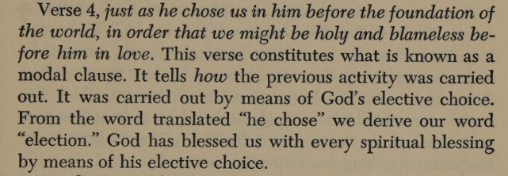
Patterns for Christian Living
Ray Summers Broadman Press © 1960 preface page v

Slide 20
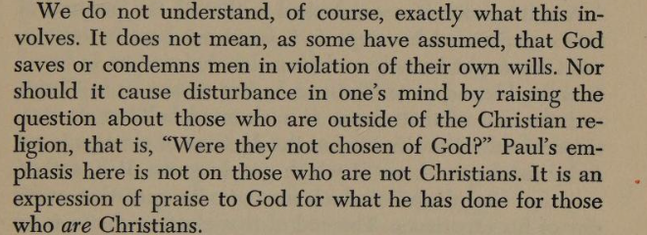
Patterns for Christian Living
Ray Summers Broadman Press © 1960 preface page v

Slide 21
Patterns for Christian Living
Ray Summers Broadman Press © 1960
Ray Summers makes a distinction between doctrine and application as follows:
Epistle | Doctrine | Application
Ephesians | 1-3 | 4-6
Romans | 1-11 | 12-16
Galatians | 1-4 | 5-6
Colossians | 1-2 | 3.4
1 Peter | 1:1 to 2:10 | 2:11 to 5:14
Hebrews | 1:1 top 10:18 | 10:19 to 13:25

Slide 22

New Testament Commentary
Willliam Hendriksen Baker Book Houses © 1967
https://archive.org/details/newtestamentcomm0000hend/page/n282/mode/1up?view=theater
( Calvinist Election)
Contains a Colossians vs Ephesians Comparison (21 pages)

Slide 23
New Testament Commentary
Willliam Hendriksen Baker Book Houses © 1967
The good with the questionable
https://archive.org/details/newtestamentcomm0000hend/page/n282/mode/1up?view=theater
( Calvinist Election not good)
Contains a Colossians vs Ephesians Comparison (21 pages) (Helpful)

Slide 24
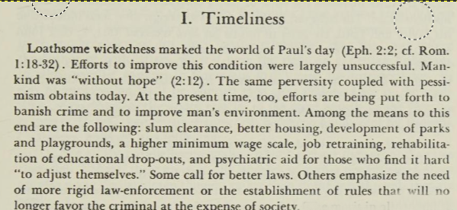
New Testament Commentary
Willliam Hendriksen Baker Book Houses © 1967

Slide 25
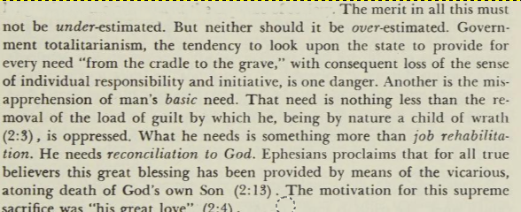
New Testament Commentary
Willliam Hendriksen Baker Book Houses © 1967

Slide 26
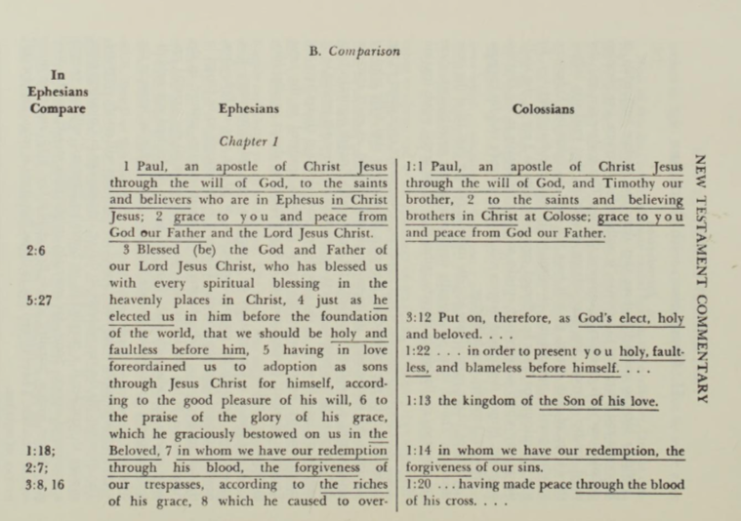
New Testament Commentary
Willliam Hendriksen Baker Book Houses © 1967
Approximately 55 verses in Colossians are duplicated in Ephesians

Slide 27
New Testament Commentary
Willliam Hendriksen Baker Book Houses © 1967
Approximately 55 verses in Colossians are duplicated in Ephesians

Slide 28
Dystopia : an imagined world or society in which people lead wretched, dehumanized, fearful lives

