Slide 2
Acts 19 Paul in Ephesus
1 While Apollos was at Corinth, Paul took the road through the interior and arrived at Ephesus. There he found some disciples ² and asked them, “Did you receive the Holy Spirit when^{[a]} you believed?”
They answered, “No, we have not even heard that there is a Holy Spirit.”
³ So Paul asked, “Then what baptism did you receive?”
“John’s baptism,” they replied.
⁴ Paul said, “John’s baptism was a baptism of repentance. He told the people to believe in the one coming after him, that is, in Jesus.” ⁵ On hearing this, they were baptized in the name of the Lord Jesus.

Slide 3
Epistle to the Ephesians papyri.
Papyrus 46 wiki Papyrus 46 detail
Papyrus 49
Papyrus 92
Papyrus 99

Slide 4
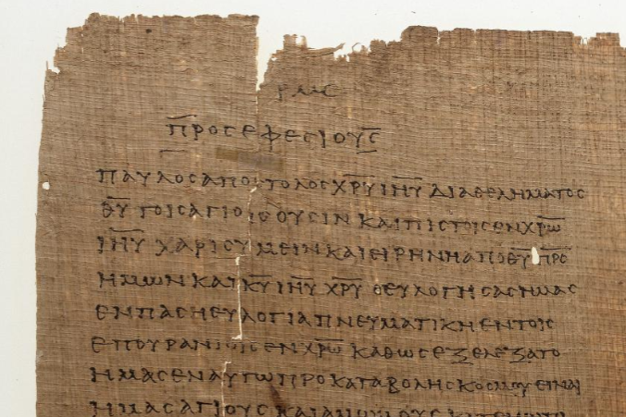

Slide 5
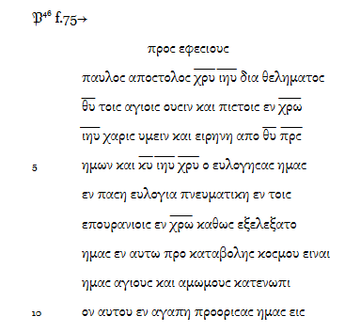
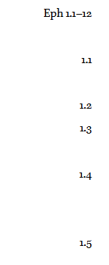


Slide 6
Acts 19 Paul in Ephesus
.⁶ When Paul placed his hands on them, the Holy Spirit came on them, and they spoke in tongues and prophesied. ⁷ There were about twelve men in all.
⁸ Paul entered the synagogue and spoke boldly there for three months, arguing persuasively about the kingdom of God. ⁹ But some of them became obstinate; they refused to believe and publicly maligned the Way. So Paul left them. He took the disciples with him and had discussions daily in the lecture hall of Tyrannus. ¹⁰ This went on for two years, so that all the Jews and Greeks who lived in the province of Asia heard the word of the Lord.

Slide 7
Acts 19 Paul in Ephesus
¹¹ God did extraordinary miracles through Paul, ¹² so that even handkerchiefs and aprons that had touched him were taken to the sick, and their illnesses were cured and the evil spirits left them.
¹³ Some Jews who went around driving out evil spirits tried to invoke the name of the Lord Jesus over those who were demon-possessed. They would say, “In the name of the Jesus whom Paul preaches, I command you to come out.” ¹⁴ Seven sons of Sceva, a Jewish chief priest, were doing this. ¹⁵ One day the evil spirit answered them, “Jesus I know, and Paul I know about, but who are you?” ¹⁶ Then the man who had the evil spirit jumped on them and overpowered them all. He gave them such a beating that they ran out of the house naked and bleeding.

Slide 8
Acts 19 Paul in Ephesus
¹⁷ When this became known to the Jews and Greeks living in Ephesus, they were all seized with fear, and the name of the Lord Jesus was held in high honor. ¹⁸ Many of those who believed now came and openly confessed what they had done. ¹⁹ A number who had practiced sorcery brought their scrolls together and burned them publicly. When they calculated the value of the scrolls, the total came to fifty thousand drachmas.^{[c]} ²⁰ In this way the word of the Lord spread widely and grew in power.
²¹ After all this had happened, Paul decided^{[d]} to go to Jerusalem, passing through Macedonia and Achaia. “After I have been there,” he said, “I must visit Rome also.” ²² He sent two of his helpers, Timothy and Erastus, to Macedonia, while he stayed in the province of Asia a little longer.

Slide 9
Acts 19 Paul in Ephesus
¹⁷ When this became known to the Jews and Greeks living in Ephesus, they were all seized with fear, and the name of the Lord Jesus was held in high honor. ¹⁸ Many of those who believed now came and openly confessed what they had done. ¹⁹ A number who had practiced sorcery brought their scrolls together and burned them publicly. When they calculated the value of the scrolls, the total came to fifty thousand drachmas.^{[c]} ²⁰ In this way the word of the Lord spread widely and grew in power.
²¹ After all this had happened, Paul decided^{[d]} to go to Jerusalem, passing through Macedonia and Achaia. “After I have been there,” he said, “I must visit Rome also.” ²² He sent two of his helpers, Timothy and Erastus, to Macedonia, while he stayed in the province of Asia a little longer.

Slide 10
Acts 19 Paul in Ephesus
The Riot in Ephesus
²³ About that time there arose a great disturbance about the Way. ²⁴ A silversmith named Demetrius, who made silver shrines of Artemis, brought in a lot of business for the craftsmen there. ²⁵ He called them together, along with the workers in related trades, and said: “You know, my friends, that we receive a good income from this business. ²⁶ And you see and hear how this fellow Paul has convinced and led astray large numbers of people here in Ephesus and in practically the whole province of Asia. He says that gods made by human hands are no gods at all. ²⁷ There is danger not only that our trade will lose its good name, but also that the temple of the great goddess Artemis will be discredited; and the goddess herself, who is worshiped throughout the province of Asia and the world, will be robbed of her divine majesty.”
²⁸ When they heard this, they were furious and began shouting: “Great is Artemis of the Ephesians!” ²⁹ Soon the whole city was in an uproar. The people seized Gaius and Aristarchus, Paul’s traveling companions from Macedonia, and all of them rushed into the theater together. ³⁰ Paul wanted to appear before the crowd, but the disciples would not let him. ³¹ Even some of the officials of the province, friends of Paul, sent him a message begging him not to venture into the theater.
³² The assembly was in confusion: Some were shouting one thing, some another. Most of the people did not even know why they were there. ³³ The Jews in the crowd pushed Alexander to the front, and they shouted instructions to him. He motioned for silence in order to make a defense before the people. ³⁴ But when they realized he was a Jew, they all shouted in unison for about two hours: “Great is Artemis of the Ephesians!”
³⁵ The city clerk quieted the crowd and said: “Fellow Ephesians, doesn’t all the world know that the city of Ephesus is the guardian of the temple of the great Artemis and of her image, which fell from heaven? ³⁶ Therefore, since these facts are undeniable, you ought to calm down and not do anything rash. ³⁷ You have brought these men here, though they have neither robbed temples nor blasphemed our goddess. ³⁸ If, then, Demetrius and his fellow craftsmen have a grievance against anybody, the courts are open and there are proconsuls. They can press charges. ³⁹ If there is anything further you want to bring up, it must be settled in a legal assembly. ⁴⁰ As it is, we are in danger of being charged with rioting because of what happened today. In that case we would not be able to account for this commotion, since there is no reason for it.” ⁴¹ After he had said this, he dismissed the assembly.

Slide 11
Acts 19 Paul in Ephesus
²⁷ There is danger not only that our trade will lose its good name, but also that the temple of the great goddess Artemis will be discredited; and the goddess herself, who is worshiped throughout the province of Asia and the world, will be robbed of her divine majesty.”
²⁸ When they heard this, they were furious and began shouting: “Great is Artemis of the Ephesians!” ²⁹ Soon the whole city was in an uproar. The people seized Gaius and Aristarchus, Paul’s traveling companions from Macedonia, and all of them rushed into the theater together. ³⁰ Paul wanted to appear before the crowd, but the disciples would not let him. ³¹ Even some of the officials of the province, friends of Paul, sent him a message begging him not to venture into the theater.

Slide 12
Acts 19 Paul in Ephesus
³² The assembly was in confusion: Some were shouting one thing, some another. Most of the people did not even know why they were there. ³³ The Jews in the crowd pushed Alexander to the front, and they shouted instructions to him. He motioned for silence in order to make a defense before the people. ³⁴ But when they realized he was a Jew, they all shouted in unison for about two hours: “Great is Artemis of the Ephesians!”
³⁵ The city clerk quieted the crowd and said: “Fellow Ephesians, doesn’t all the world know that the city of Ephesus is the guardian of the temple of the great Artemis and of her image, which fell from heaven?

Slide 13
Acts 19 Paul in Ephesus
. ³¹ Even some of the officials of the province, friends of Paul, sent him a message begging him not to venture into the theater.
³² The assembly was in confusion: Some were shouting one thing, some another. Most of the people did not even know why they were there. ³³ The Jews in the crowd pushed Alexander to the front, and they shouted instructions to him. He motioned for silence in order to make a defense before the people. ³⁴ But when they realized he was a Jew, they all shouted in unison for about two hours: “Great is Artemis of the Ephesians!”
³⁵ The city clerk quieted the crowd and said: “Fellow Ephesians, doesn’t all the world know that the city of Ephesus is the guardian of the temple of the great Artemis and of her image, which fell from heaven? ³⁶ Therefore, since these facts are undeniable, you ought to calm down and not do anything rash. ³⁷ You have brought these men here, though they have neither robbed temples nor blasphemed our goddess. ³⁸ If, then, Demetrius and his fellow craftsmen have a grievance against anybody, the courts are open and there are proconsuls. They can press charges. ³⁹ If there is anything further you want to bring up, it must be settled in a legal assembly. ⁴⁰ As it is, we are in danger of being charged with rioting because of what happened today. In that case we would not be able to account for this commotion, since there is no reason for it.” ⁴¹ After he had said this, he dismissed the assembly.

Slide 14
Acts 19 Paul in Ephesus
³⁶ Therefore, since these facts are undeniable, you ought to calm down and not do anything rash. ³⁷ You have brought these men here, though they have neither robbed temples nor blasphemed our goddess. ³⁸ If, then, Demetrius and his fellow craftsmen have a grievance against anybody, the courts are open and there are proconsuls. They can press charges. ³⁹ If there is anything further you want to bring up, it must be settled in a legal assembly. ⁴⁰ As it is, we are in danger of being charged with rioting because of what happened today. In that case we would not be able to account for this commotion, since there is no reason for it.” ⁴¹ After he had said this, he dismissed the assembly.

Slide 16
The "Colossian Heresy"
The "Colossian heresy" refers to a blend of false teachings that the Apostle Paul confronted in his letter to the church in Colossae, likely written around 60 CE. While Paul never names the heresy outright, his warnings in Colossians 2 offer a vivid sketch of its components. (Paul does not state the heresy directly but inference to the issues come from Paul’s comments)
Jewish Legalism: Emphasis on observing dietary laws, festivals, Sabbaths, and other ceremonial practices—Paul counters this in Colossians 2:16–17, saying these were mere shadows of Christ.
Asceticism: Rigorous self-denial and harsh treatment of the body, which Paul critiques as having “an appearance of wisdom” but lacking true spiritual value (Colossians 2:23).

Slide 17
The "Colossian Heresy"
Mysticism and Angel Worship: Some believers were being drawn into mystical experiences and the veneration of angels, which Paul warns against in Colossians 2:18.
Early Gnostic-like Thought: Scholars suggest the heresy included proto-Gnostic ideas—such as secret knowledge (gnosis), the rejection of material creation as evil, and possibly a diminished view of Christ’s humanity.

Slide 18
The "Colossian Heresy"
Early Gnostic-like Thought:
Made need to explain Gnostic thought here.

Slide 19
Acts 19 Paul in Ephesus
. ⁶ When Paul placed his hands on them, the Holy Spirit came on them, and they spoke in tongues^{[b]} and prophesied. ⁷ There were about twelve men in all.
⁸ Paul entered the synagogue and spoke boldly there for three months, arguing persuasively about the kingdom of God. ⁹ But some of them became obstinate; they refused to believe and publicly maligned the Way. So Paul left them. He took the disciples with him and had discussions daily in the lecture hall of Tyrannus. ¹⁰ This went on for two years, so that all the Jews and Greeks who lived in the province of Asia heard the word of the Lord.

Slide 20
Acts 19 Paul in Ephesus
⁹ But some of them became obstinate; they refused to believe and publicly maligned the Way. So Paul left them. He took the disciples with him and had discussions daily in the lecture hall of Tyrannus. ¹⁰ This went on for two years, so that all the Jews and Greeks who lived in the province of Asia heard the word of the Lord.

Slide 21

Book of Ephesians
Key Themes
The Book of Ephesians addresses themes of unity, love, grace, and spiritual growth within the Christian community.
Paul's Message
Paul's letter emphasizes the importance of living a life worthy of the calling received, and the transformative power of God's love and grace.
Modern Relevance
The teachings in Ephesians are relevant to modern Christian life, offering guidance on how to live harmoniously and faithfully in today's world.
Notes:
Introduction to the Book of Ephesians, using the Western Heights Church of Christ logo. This presentation will delve into the key themes and messages of the Apostle Paul's letter to the Ephesians, exploring its relevance to modern Christian life.

Slide 22
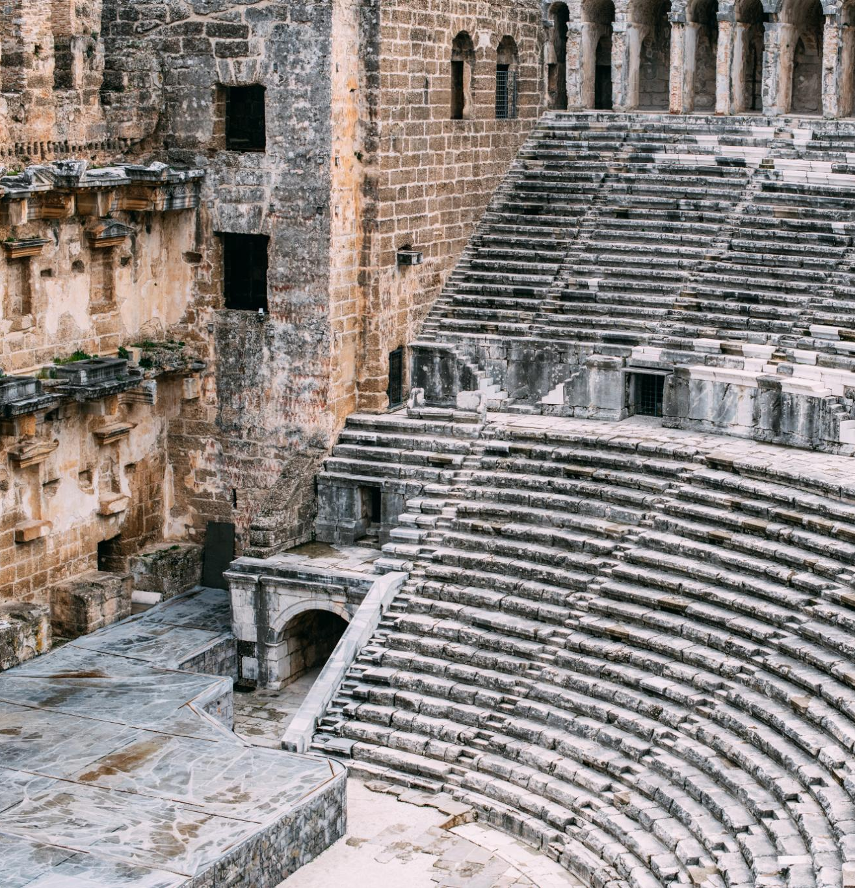
Ephesus Amphitheater 50 CE
Ancient Roman Architecture
The Ephesus amphitheater is an exemplary model of ancient Roman architecture, showcasing remarkable construction techniques and design.
Versatile Venue
The amphitheater was used for gladiatorial games, performances, and public gatherings, making it a central hub for events.
Notes:
The Ephesus Theater, built in the 3rd century BC and expanded during the Roman period, was one of the largest theaters in antiquity. By 50 AD, it had a seating capacity of approximately 25,000 spectators. This grand structure was used for dramatic performances, gladiatorial contests, and public meetings, reflecting the social and cultural significance of theater in ancient times.

Slide 23

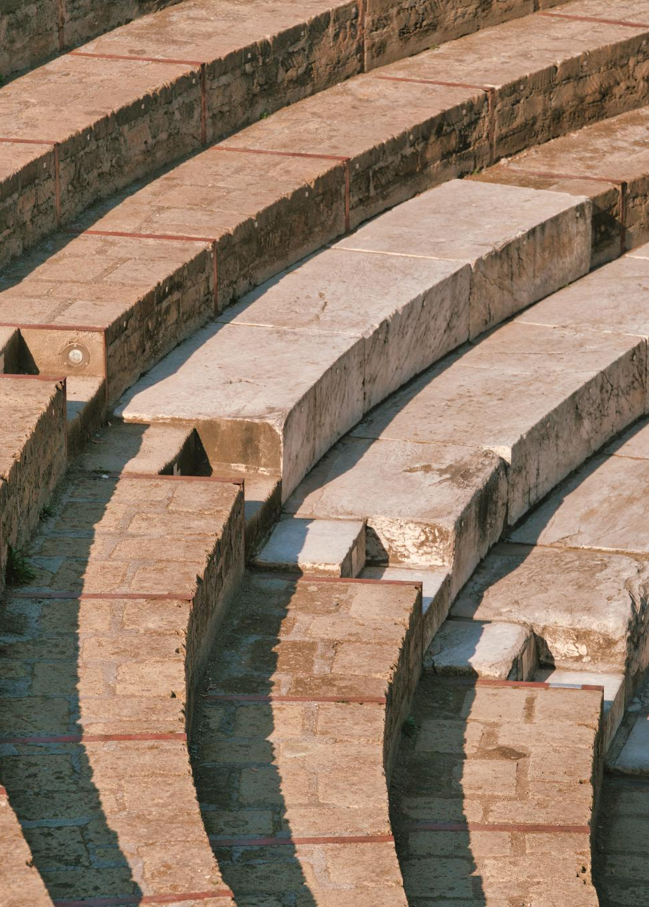
Historical Construction
The Ephesus Theater was constructed in the 3rd century BC and later expanded during the Roman period.
Large Seating Capacity
By 50 AD, the theater could seat approximately 25,000 spectators, making it one of the largest of its time.
Notes:
The Ephesus Theater, built in the 3rd century BC and expanded during the Roman period, was one of the largest theaters in antiquity. By 50 AD, it had a seating capacity of approximately 25,000 spectators. This grand structure was used for dramatic performances, gladiatorial contests, and public meetings, reflecting the social and cultural significance of theater in ancient times.

Slide 24
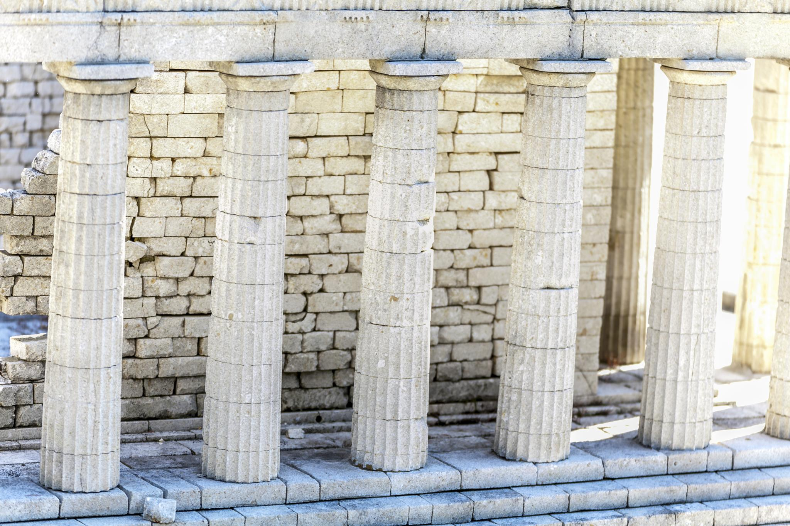
Paul’s Preaching Sparks Uproar
Challenging Artemis Worship
Paul's message questioned the traditional worship of Artemis, shaking the foundation of the city's religious identity.
Impact on Silversmiths’ Trade
Silversmiths profiting from idol-making saw their livelihoods threatened by Paul's teachings, fueling their anger.
Theater Revolt and Uproar
A large, agitated crowd gathered in the city's theater, resulting in a major confrontation and unrest.

Slide 25
Paul’s Preaching Sparks Uproar
Challenging Artemis Worship
Paul's message questioned the traditional worship of Artemis, shaking the foundation of the city's religious identity.
Impact on Silversmiths’ Trade
Silversmiths profiting from idol-making saw their livelihoods threatened by Paul's teachings, fueling their anger.
Theater Revolt and Uproar
A large, agitated crowd gathered in the city's theater, resulting in a major confrontation and unrest.
Notes:
Image source: Microsoft 365 content library In Ephesus, Paul’s bold preaching about Christianity challenged the worship of Artemis, the city’s revered goddess. His message threatened the local silversmiths’ trade, as they profited from making idols. This provoked a massive revolt in the city’s theater, where an angry crowd gathered, leading to a significant confrontation and forcing Paul to leave the region.

Slide 26
Paul’s Preaching Sparks Uproar
Challenging Artemis Worship
Paul's message questioned the traditional worship of Artemis, shaking the foundation of the city's religious identity.
Impact on Silversmiths’ Trade
Silversmiths profiting from idol-making saw their livelihoods threatened by Paul's teachings, fueling their anger.
Theater Revolt and Uproar
A large, agitated crowd gathered in the city's theater, resulting in a major confrontation and unrest.
Notes:
Image source: Microsoft 365 content library In Ephesus, Paul’s bold preaching about Christianity challenged the worship of Artemis, the city’s revered goddess. His message threatened the local silversmiths’ trade, as they profited from making idols. This provoked a massive revolt in the city’s theater, where an angry crowd gathered, leading to a significant confrontation and forcing Paul to leave the region.

Slide 27
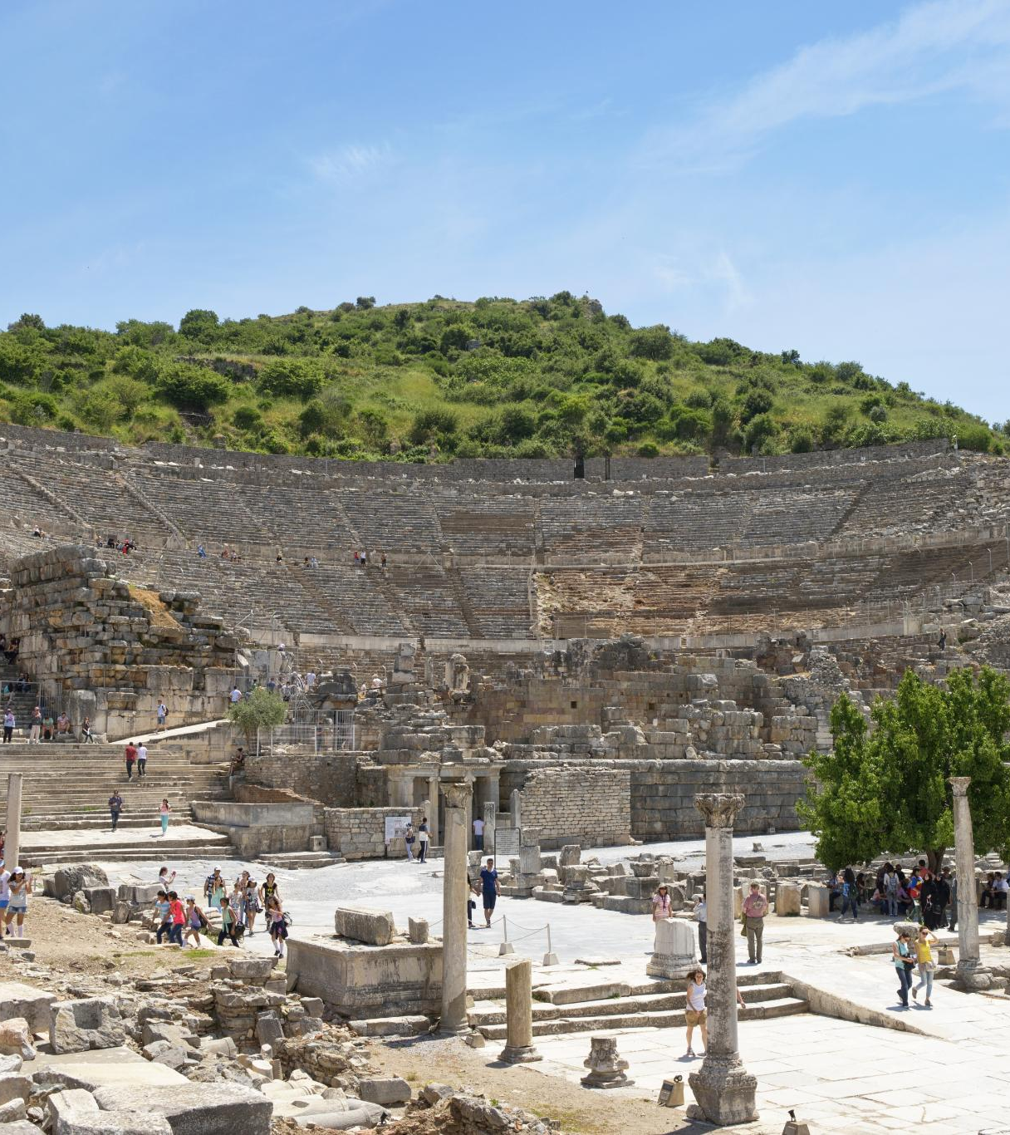
Paul's Teachings in Ephesus
Lecture Hall of Tyrannus
Paul's teachings in Ephesus primarily occurred in the lecture hall of Tyrannus, where he spent over two years.
Confrontation at the Theater
A significant confrontation took place at the theater, where silversmiths rioted against Paul due to the threat his teachings posed to their trade.
Paul's Missionary Activities
Paul's missionary activities in Ephesus were impactful, leading to both widespread teachings and significant confrontations.
Notes:
The Apostle Paul did not teach at the theater in Ephesus. Despite spending over two years in Ephesus, his teachings primarily took place in the lecture hall of Tyrannus. However, Paul's missionary activities in the city eventually led to a significant confrontation at the theater, where silversmiths rioted against him due to the threat his teachings posed to their trade.

