Slide 2

Book of Ephesians
Key Themes
The Book of Ephesians addresses themes of unity, love, grace, and spiritual growth within the Christian community.
Paul's Message
Paul's letter emphasizes the importance of living a life worthy of the calling received, and the transformative power of God's love and grace.
Modern Relevance
The teachings in Ephesians are relevant to modern Christian life, offering guidance on how to live harmoniously and faithfully in today's world.
Notes:
Introduction to the Book of Ephesians, using the Western Heights Church of Christ logo. This presentation will delve into the key themes and messages of the Apostle Paul's letter to the Ephesians, exploring its relevance to modern Christian life.

Slide 3
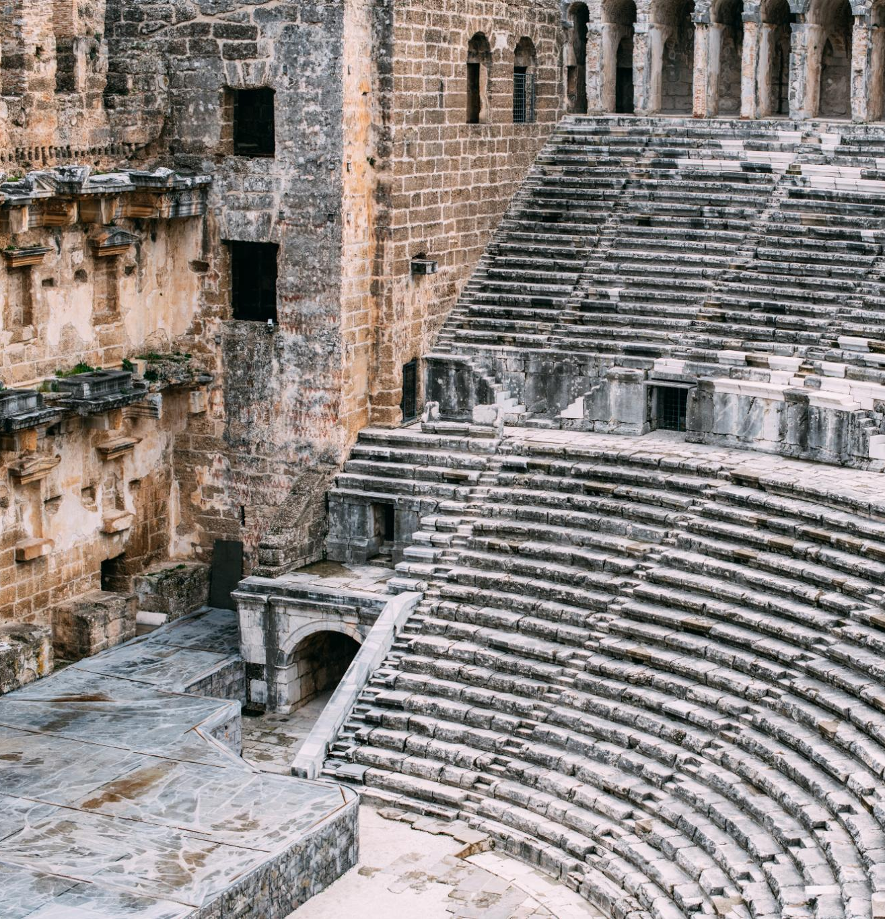
Ephesus Amphitheater 50 CE
Ancient Roman Architecture
The Ephesus amphitheater is an exemplary model of ancient Roman architecture, showcasing remarkable construction techniques and design.
Versatile Venue
The amphitheater was used for gladiatorial games, performances, and public gatherings, making it a central hub for events.
Large Capacity
Accommodating thousands of spectators, the amphitheater's size underscores the advanced engineering and cultural importance of Ephesus.
Notes:
The amphitheater in Ephesus, dating back to 50 CE, is a remarkable structure that showcases ancient Roman architecture. It was used for various events, including gladiatorial games, performances, and public gatherings. The amphitheater could accommodate thousands of spectators, highlighting the advanced engineering and cultural significance of Ephesus during that era.

Slide 4
Ephesus Amphitheater 50 CE
Ancient Roman Architecture
The Ephesus amphitheater is an exemplary model of ancient Roman architecture, showcasing remarkable construction techniques and design.
Versatile Venue
The amphitheater was used for gladiatorial games, performances, and public gatherings, making it a central hub for events.
Notes:
The Ephesus Theater, built in the 3rd century BC and expanded during the Roman period, was one of the largest theaters in antiquity. By 50 AD, it had a seating capacity of approximately 25,000 spectators. This grand structure was used for dramatic performances, gladiatorial contests, and public meetings, reflecting the social and cultural significance of theater in ancient times.

Slide 5
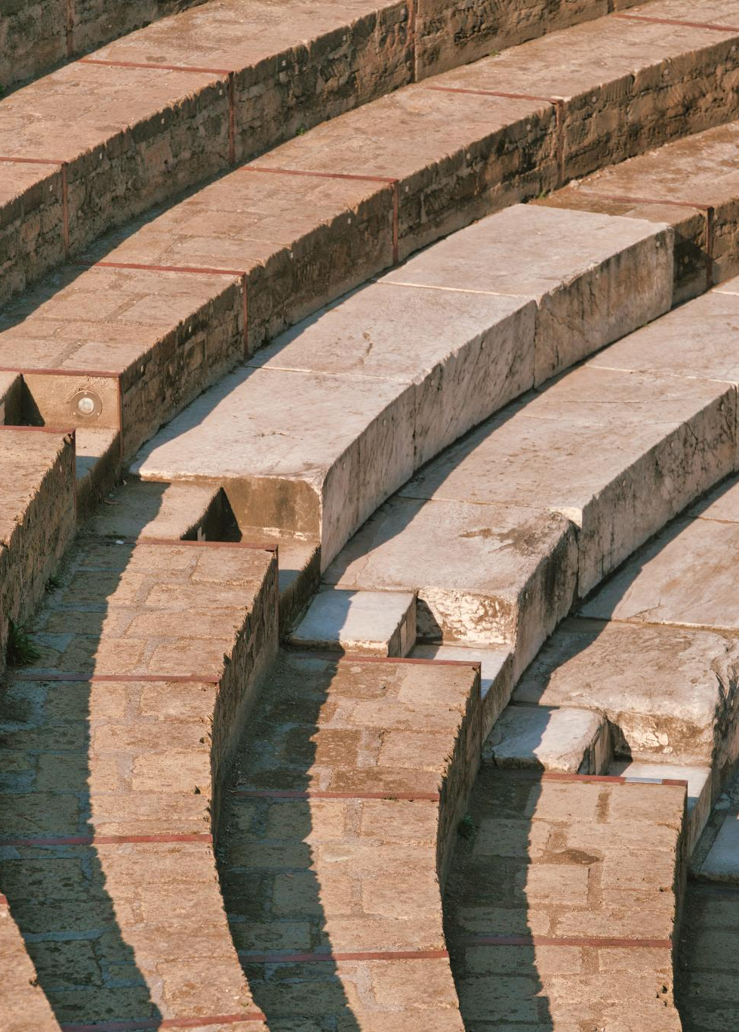
Ephesus Theater Capacity
Historical Construction
The Ephesus Theater was constructed in the 3rd century BC and later expanded during the Roman period.
Large Seating Capacity
By 50 AD, the theater could seat approximately 25,000 spectators, making it one of the largest of its time.
Notes:
The Ephesus Theater, built in the 3rd century BC and expanded during the Roman period, was one of the largest theaters in antiquity. By 50 AD, it had a seating capacity of approximately 25,000 spectators. This grand structure was used for dramatic performances, gladiatorial contests, and public meetings, reflecting the social and cultural significance of theater in ancient times.

Slide 6
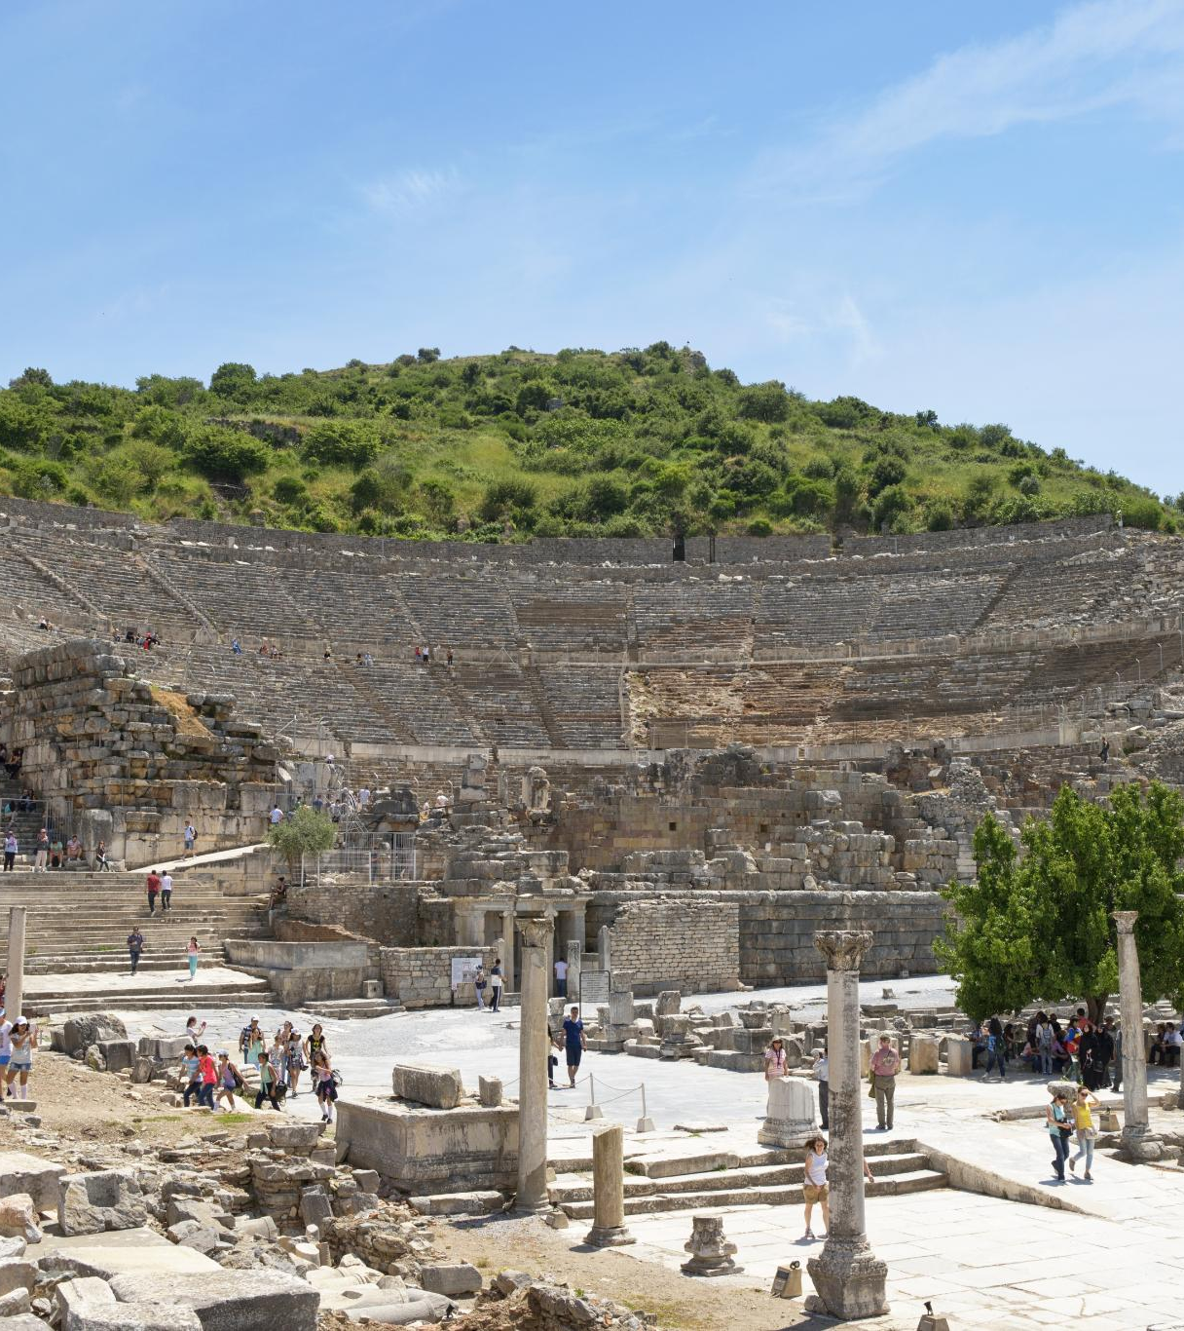
Paul's Teachings in Ephesus
Lecture Hall of Tyrannus
Paul's teachings in Ephesus primarily occurred in the lecture hall of Tyrannus, where he spent over two years.
Confrontation at the Theater
A significant confrontation took place at the theater, where silversmiths rioted against Paul due to the threat his teachings posed to their trade.
Paul's Missionary Activities
Paul's missionary activities in Ephesus were impactful, leading to both widespread teachings and significant confrontations.
Notes:
The Apostle Paul did not teach at the theater in Ephesus. Despite spending over two years in Ephesus, his teachings primarily took place in the lecture hall of Tyrannus. However, Paul's missionary activities in the city eventually led to a significant confrontation at the theater, where silversmiths rioted against him due to the threat his teachings posed to their trade.

