Slide 1
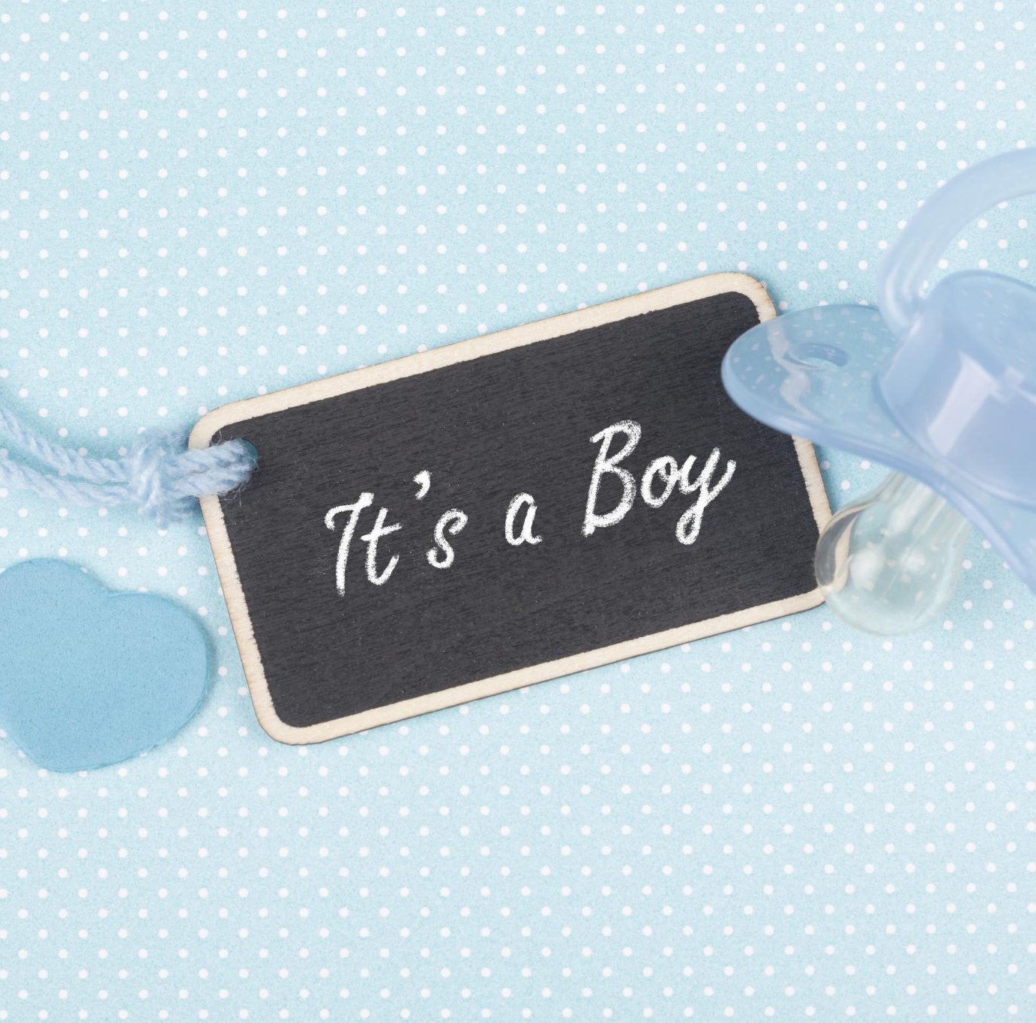
From Grammy and Papa
From Grammy and Papa
Notes:
AI-generated content may be incorrect. --- This presentation focuses on how to create meaningful and memorable baby shower cards. We will explore the significance of these cards, various design options, tips for writing heartfelt messages, and creative ideas to add personal touches. Image source: Microsoft 365 content library

