Slide 1
Distinct Differences Between the Latin Vulgate and the Textus Receptus: Historical and Textual Perspectives
Comparing origins and impacts of two biblical texts
Notes:
AI-generated content may be incorrect. --- This presentation explores the critical distinctions between the Latin Vulgate and the Textus Receptus. We will examine their historical origins, source texts, textual variations, and their profound influence on biblical translations and Christian traditions.

Slide 2
Presentation Agenda
Historical Background and Origins
Source Texts and Language Differences
Textual Variations and Theological Implications
Influence on Later Translations and Christian Traditions
Notes:
We will begin by reviewing the historical background and origins of the Latin Vulgate and the Textus Receptus. Next, we will compare their source texts and language differences. Then, we will analyze key textual variations and theological implications. Finally, we will discuss their influence on later Bible translations and Christian traditions.

Slide 3
Historical Background and Origins
Notes:
Understanding the Latin Vulgate and Textus Receptus starts with their formation contexts and purposes. This development shaped their role in scripture transmission across centuries.

Slide 4
Formation and Purpose of the Latin Vulgate
Translation by St. Jerome
St. Jerome translated the Latin Vulgate in the late 4th century to unify biblical texts into a standardized Latin version.
Standardization of Biblical Texts
The Vulgate unified various Latin biblical texts into one authoritative version used across the Western Church.
Long-lasting Religious Influence
The Latin Vulgate served as the official Bible of the Western Church for over a thousand years.
Notes:
--- The Latin Vulgate, primarily translated by St. Jerome in the late 4th century, aimed to unify and standardize Latin biblical texts. It became the official Bible of the Western Church for over a millennium. Image source: Microsoft 365 content library

Slide 5

Development and Significance of the Textus Receptus
Compilation during Renaissance
The Textus Receptus was compiled in the Renaissance era from a limited number of Byzantine Greek manuscripts.
Greek New Testament Text
It represents a printed edition of the Greek New Testament, foundational for biblical scholarship in early modern Europe. The copy from Erasmus provide both a Greek Compilation and a Latin Translation printed in parallelrl
Influence on Protestant Translations
The Textus Receptus shaped many early Protestant Bible translations, impacting religious texts worldwideThe TR used for the Authorized Version (KJV) was “adjusted” in some small repects.
Notes:
--- The Textus Receptus, compiled during the Renaissance, is a printed Greek New Testament text based on a limited set of Byzantine manuscripts. It influenced many early Protestant Bible translations. Image source: Microsoft 365 content library

Slide 6

Latin Vulgate’s Translation Sources and Methodology
Primary Manuscript Sources
Jerome used Hebrew and Greek manuscripts as main sources to translate the Vulgate Bible into Latin.
Translation Approach
He applied a formal equivalence method focusing on literal and accurate translation of original texts.
Purpose of Translation
The goal was to produce a coherent Latin text for use by the Western Church and its communities.
Notes:
--- Jerome translated the Vulgate mainly from Hebrew and Greek manuscripts available in his time, applying a formal equivalence approach to create a coherent Latin text for the Western Church. Image source: Microsoft 365 content library

Slide 7

Textus Receptus’s Greek Manuscript Traditions
Basis of Textus Receptus
Textus Receptus is founded on a limited number of late Byzantine Greek manuscripts.
Eastern Mediterranean Tradition
The manuscripts reflect the textual tradition common in the Eastern Mediterranean before printing technology.
Notes:
--- The Textus Receptus is based on a handful of late Byzantine Greek manuscripts. It reflects the textual tradition prevalent in the Eastern Mediterranean before the invention of printing. Image source: Microsoft 365 content library

Slide 8

Comparison of Original Languages: Latin Vs. Greek
Latin Vulgate Translation
The Latin Vulgate is a translated version of the Bible into Latin, a language not originally used in biblical texts.
Greek New Testament Originals
The Textus Receptus represents Greek manuscripts, the original language for much of the New Testament writings.
Notes:
--- The Latin Vulgate is a translation into Latin, a language not originally used for the biblical texts, while the Textus Receptus represents the Greek New Testament manuscripts, the original language for much of the New Testament. Image source: Microsoft 365 content library

Slide 9
Textual Variations and Theological Implications
Notes:
Differences in wording and passages between these texts have led to varying interpretations and theological debates over time.

Slide 10
Textual Variations and Theological Implications
Notes:
Differences in wording and passages between these texts have led to varying interpretations and theological debates over time.

Slide 11

Key Differences in Biblical Passages
Textual Variations in Mark
The ending of the Gospel of Mark presents different versions, leading to scholarly debate on its original conclusion.
Comma Johanneum Discrepancy
The Comma Johanneum is a disputed passage with significant doctrinal consequences in biblical interpretation.
Doctrinal Impacts
These textual discrepancies influence theological understanding and interpretations within Christian traditions.
Notes:
--- Notable discrepancies exist in certain passages, such as variations in the ending of Mark and the Comma Johanneum, which have significant textual and doctrinal impact. Image source: Microsoft 365 content library

Slide 12
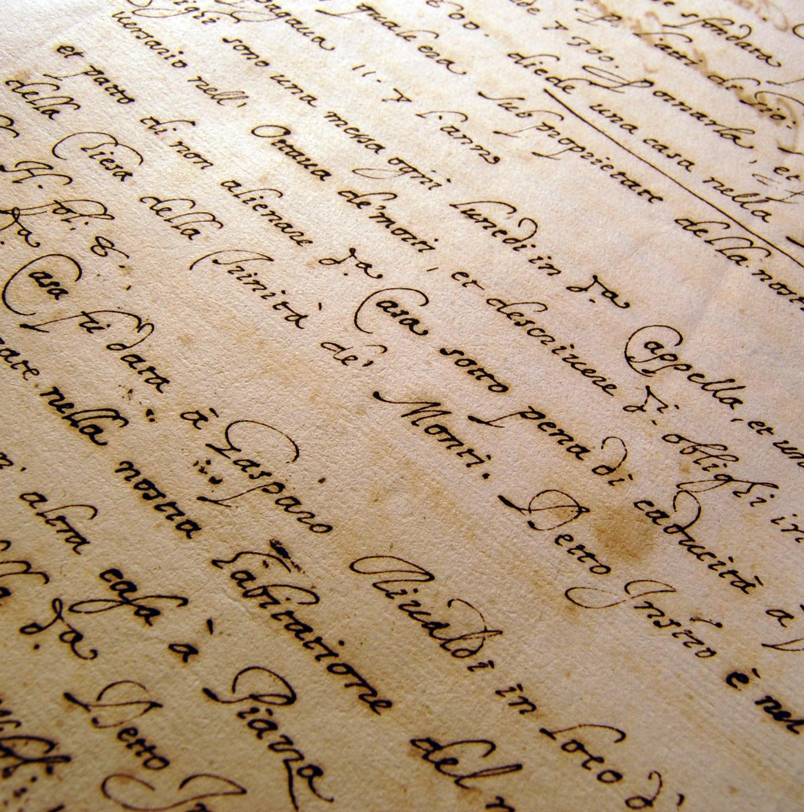
Variations in Wording and Interpretation
Textual Differences Impact
Minor wording changes between Latin Vulgate and Textus Receptus affect scriptural understanding and theological meaning.
Theological Nuance Shifts
Different word choices can subtly shift theological emphasis and interpretation within scripture.
Notes:
--- Subtle differences in wording between the Latin Vulgate and Textus Receptus can influence how scripture is understood, sometimes altering theological emphasis or nuance. Image source: Microsoft 365 content library

Slide 13

Impact on Doctrine and Theological Debate
Textual Differences
Variations in scriptural texts influence theological interpretations and doctrinal formulations across traditions.
Doctrinal Formulations
Differences in text contribute to distinct doctrinal beliefs in Catholic and Protestant traditions.
Theological Debate
Debates over scriptural authority shape ongoing dialogues and divisions within Christianity.
Notes:
--- The textual differences have affected doctrinal formulations, contributing to debates between Catholic and Protestant traditions regarding scriptural authority and interpretation. Image source: Microsoft 365 content library

Slide 14
Influence on Later Translations and Christian Traditions
Notes:
Both texts have left a lasting legacy on Bible translations, worship practices, and scholarly study within various Christian communities.

Slide 15

Role in Catholic and Protestant Bible Versions
Latin Vulgate Influence
The Latin Vulgate was the primary source for Catholic Bible versions, shaping their text and theological interpretations.
Textus Receptus Foundation
The Textus Receptus served as the basis for many early Protestant Bible translations, including the King James Version.
Notes:
--- The Latin Vulgate heavily influenced Catholic Bible versions, while the Textus Receptus was foundational for many early Protestant translations, such as the King James Version. Image source: Microsoft 365 content library

Slide 16

Legacy in Liturgy and Worship
Latin Vulgate Influence
The Latin Vulgate significantly shaped Catholic liturgical texts and prayers lasting centuries.
Textus Receptus Impact
The Textus Receptus influenced Protestant worship and Scripture readings profoundly.
Notes:
--- The Latin Vulgate shaped Catholic liturgical texts and prayers, while the Textus Receptus influenced Protestant worship and Scripture readings. Image source: Microsoft 365 content library

Slide 17

Modern Scholarly Perspectives
Critical Examination of Texts
Modern scholars critically analyze ancient texts to understand their historical significance and context.
Preference for Earlier Manuscripts
Earlier manuscripts are favored due to their proximity to original texts, providing reliable sources for translation.
Use of Broader Textual Evidence
Broader textual evidence from various sources is integrated to enhance accuracy in modern translations.
Notes:
--- Contemporary scholarship critically examines both texts, recognizing their historical importance while favoring earlier manuscripts and broader textual evidence for modern translations. Image source: Microsoft 365 content library

Slide 18
Conclusion
Latin Vulgate Importance
The Latin Vulgate marks a key stage in biblical history, shaping Christian scholarship for centuries.
Textus Receptus Role
Textus Receptus is a crucial Greek text that influenced many later Bible translations and Christian traditions.
Biblical Scholarship Impact
Comparing these texts enhances understanding of biblical transmission and enriches Christian heritage appreciation.
Notes:
The Latin Vulgate and Textus Receptus each represent significant stages in biblical history and transmission. Understanding their differences enriches our appreciation of biblical scholarship and Christian traditions.

