Slide 1
Exploring the English Translation of Mark 16 From the Latin Vulgate
Analyzing history, translation, and theological importance
Notes:
---
This presentation delves into the Latin Vulgate Bible with a special focus on the Gospel of Mark, chapter 16. We will explore the history and significance of the Vulgate, analyze the Gospel of Mark, examine an English translation of Mark 16, and discuss its theological and literary importance.

Slide 2
Agenda Overview
Introduction to the Latin Vulgate Bible
Overview of the Gospel of Mark
English Translation of Mark 16 From the Latin Vulgate
Theological and Literary Significance of Mark 16
Notes:
We will begin with an introduction to the Latin Vulgate Bible and its historical context. Next, we provide an overview of the Gospel of Mark, followed by a detailed look at the English translation of Mark 16 from the Vulgate. Finally, we will explore the theological and literary significance of this chapter.

Slide 3
Introduction to the Latin Vulgate Bible
Notes:
The Latin Vulgate is a cornerstone of Christian biblical tradition. This section covers its historical background, Jerome’s translation approach, and its lasting role in Christianity.

Slide 4

History and Significance of the Latin Vulgate
Emergence in 4th Century
  The Latin Vulgate was created in the late 4th century to unify diverse Latin biblical texts into one authoritative version.
Authoritative Bible Translation
  The Vulgate became the standard scripture for Western Christianity, influencing theology and religious practice for centuries.
Notes:
---
The Latin Vulgate emerged in the late 4th century as the authoritative Latin translation of the Bible. It unified various Latin texts, becoming the standard scripture for Western Christianity for centuries.
Image source: Microsoft 365 content library

Slide 5

Jerome’s Translation Process
Consultation of Manuscripts
  Jerome carefully studied Hebrew and Greek manuscripts to ensure faithful translation into Latin.
Focus on Accuracy and Clarity
  Jerome’s translation emphasized precise and clear language to convey biblical texts effectively.
Creation of the Vulgate
  His work resulted in the Vulgate, the authoritative Latin version of the Bible for centuries.
Notes:
---
Saint Jerome translated the Bible into Latin by consulting Hebrew and Greek manuscripts. His meticulous work aimed for accuracy and clarity, shaping the text known as the Vulgate.
Image source: Microsoft 365 content library

Slide 6

Role of the Vulgate in Christian Tradition
Theological Influence
  The Vulgate shaped Christian theology by providing a consistent biblical text for study and interpretation throughout the Middle Ages.
Liturgical Use
  The Vulgate served as the official Bible in Catholic liturgy, guiding religious ceremonies and worship practices for centuries.
Artistic Impact
  Medieval art was deeply inspired by the Vulgate, influencing religious iconography and manuscript illumination styles.
Notes:
---
The Vulgate influenced theology, liturgy, and art throughout the Middle Ages. It was the official Bible of the Catholic Church until modern translations emerged, maintaining profound spiritual authority.
Image source: Microsoft 365 content library

Slide 7
Overview of the Gospel of Mark
Notes:
The Gospel of Mark is one of the earliest Christian texts. This section explores its authorship, historical context, key themes, and literary style.

Slide 8
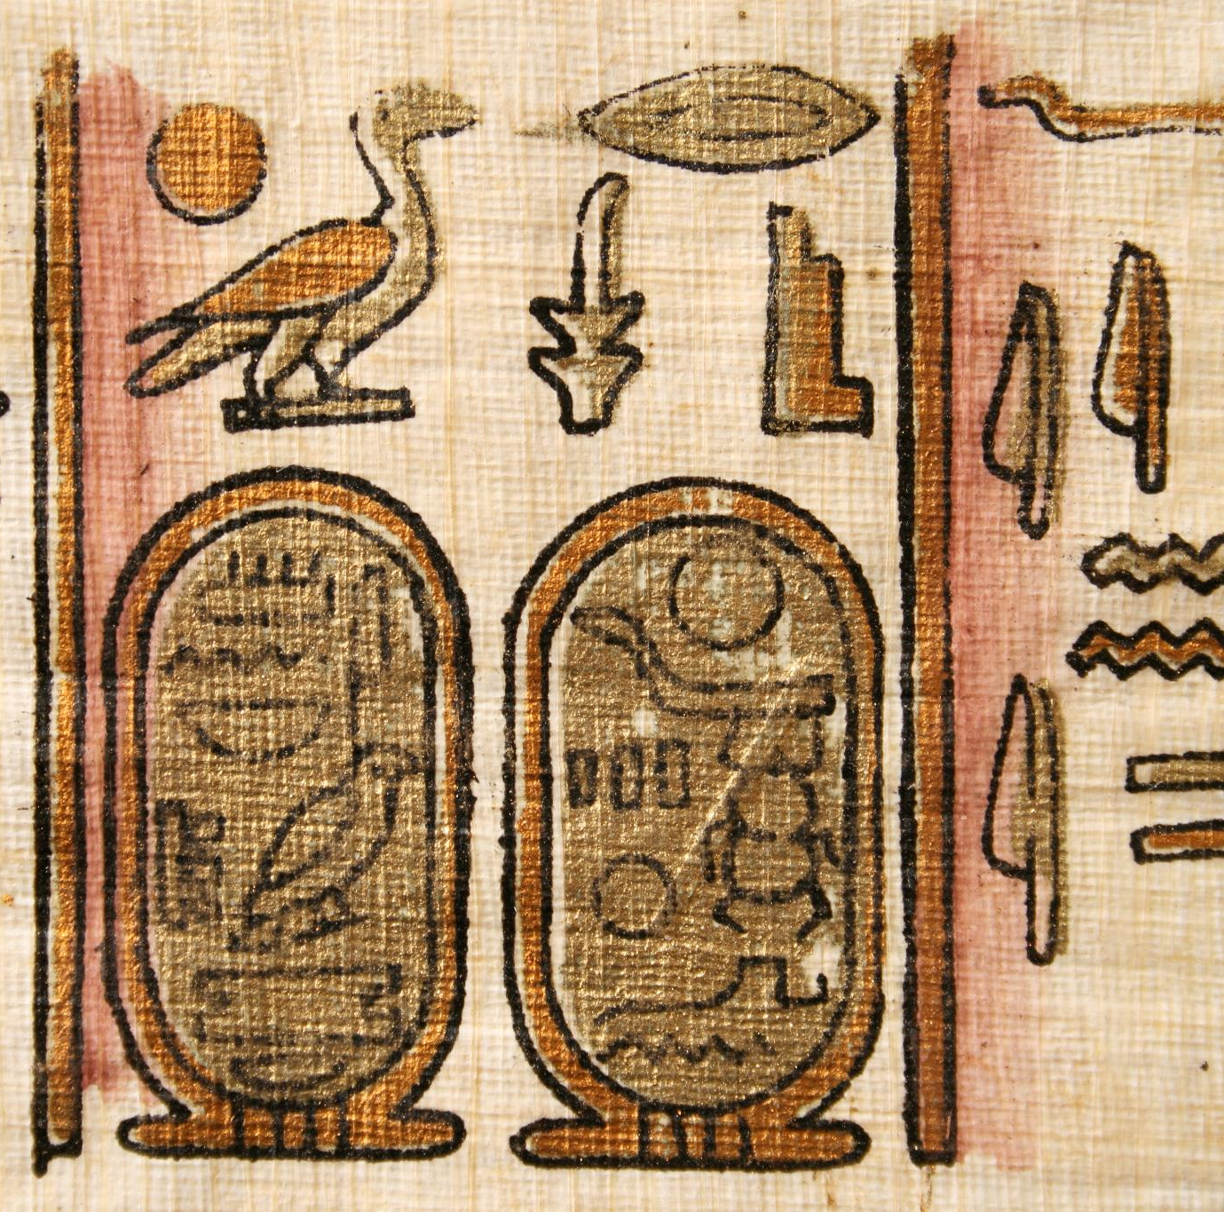
Authorship and Historical Context
Traditional Authorship
  The gospel is traditionally attributed to John Mark, an early Christian follower and companion of apostles.
Historical Setting
  The gospel reflects the experiences of the early Christian community around 70 AD during Roman rule.
Focus on Jesus’ Ministry
  Emphasizes Jesus’ ministry and teachings, highlighting the meaning of discipleship for early Christians.
Notes:
---
Traditionally attributed to John Mark, this gospel reflects the early Christian community’s experiences around 70 AD, emphasizing Jesus’ ministry and the meaning of discipleship.
Image source: Microsoft 365 content library

Slide 9

Key Themes of the Gospel of Mark
Kingdom of God
  Mark emphasizes the coming and reign of the Kingdom of God as central to his message.
Identity of Jesus
  Jesus is portrayed as the Messiah, the anointed one sent to fulfill God’s purpose.
Suffering and Sacrifice
  The gospel highlights Jesus’ suffering as an essential part of his mission and salvation.
Call to Discipleship
  Mark calls followers to faith and discipleship despite challenges and adversity.
Notes:
---
Mark highlights themes like the Kingdom of God, the identity of Jesus as Messiah, suffering, and the call to faith and discipleship in a challenging world.
Image source: Microsoft 365 content library

Slide 10

Structure and Literary Style
Concise Writing
  The gospel uses brief and clear language to present its message efficiently and impactfully.
Fast-paced Narrative
  The gospel employs fast-paced storytelling with action verbs to maintain reader engagement.
Vivid Literary Techniques
  Vivid narrative techniques enhance the gospel's theological themes and reader experience.
Notes:
---
The gospel is concise and fast-paced, using action verbs and vivid narrative techniques to engage readers and convey theological messages effectively.
Image source: Microsoft 365 content library

Slide 11
English Translation of Mark 16 From the Latin Vulgate
Notes:
This section presents a verse-by-verse English rendering of Mark 16 based on the Latin Vulgate, along with a comparison to other translations and discussion of key translation choices.

Slide 12

Verse-by-Verse English Rendering of Mark 16
Careful Translation
  Each verse of Mark 16 is translated meticulously to preserve the original meaning and style from the Latin Vulgate.
Verse-by-Verse Approach
  The translation is presented verse by verse to maintain accuracy and clarity for deeper understanding.
Notes:
---
Here we provide a careful English translation of each verse in Mark 16 from the Latin Vulgate, preserving the original meaning and style as closely as possible.
Image source: Microsoft 365 content library

Slide 13

Comparison with Other English Translations
Translation Differences
  Highlight key textual differences between the Vulgate-based translation and modern English versions such as NIV, KJV, and RSV.
Interpretative Decisions
  Explore how different translators made interpretative choices shaping the meaning and tone of the text.
Textual Nuances
  Examine subtle linguistic and contextual variations that affect understanding across translations.
Notes:
---
We examine differences and similarities between the Vulgate-based translation and versions like the NIV, KJV, and RSV to understand textual nuances and interpretative decisions.
Image source: Microsoft 365 content library

Slide 14

Discussion of Notable Translation Choices or Differences
Longer Ending of Mark
  The rendering of the longer ending of Mark varies among translations, affecting narrative flow and meaning.
Word Choice Impact
  Specific word choices influence theological interpretation, shaping readers' understanding of key concepts.
Notes:
---
This slide highlights significant translation decisions, such as how the longer ending of Mark is rendered and the impact of certain word choices on theological interpretation.
Image source: Microsoft 365 content library

Slide 15
Theological and Literary Significance of Mark 16
Notes:
Mark 16 holds profound theological and literary importance. This section explores its major themes, the longer ending’s role, and implications for Christian faith and practice.

Slide 16

Major Themes in Mark 16
Resurrection Emphasis
  Mark 16 highlights the resurrection as the foundation of Christian belief and hope.
Commissioning Disciples
  The chapter describes Jesus commissioning His disciples to spread the gospel worldwide.
Witness to Faith
  Believers are called to bear witness to their faith through their words and actions.
Promise of Presence
  Jesus promises His continual presence, offering comfort and guidance to followers.
Notes:
---
The chapter emphasizes resurrection, the commissioning of the disciples, witness to faith, and the promise of Jesus’ presence, central to Christian hope and mission.
Image source: Microsoft 365 content library

Slide 17
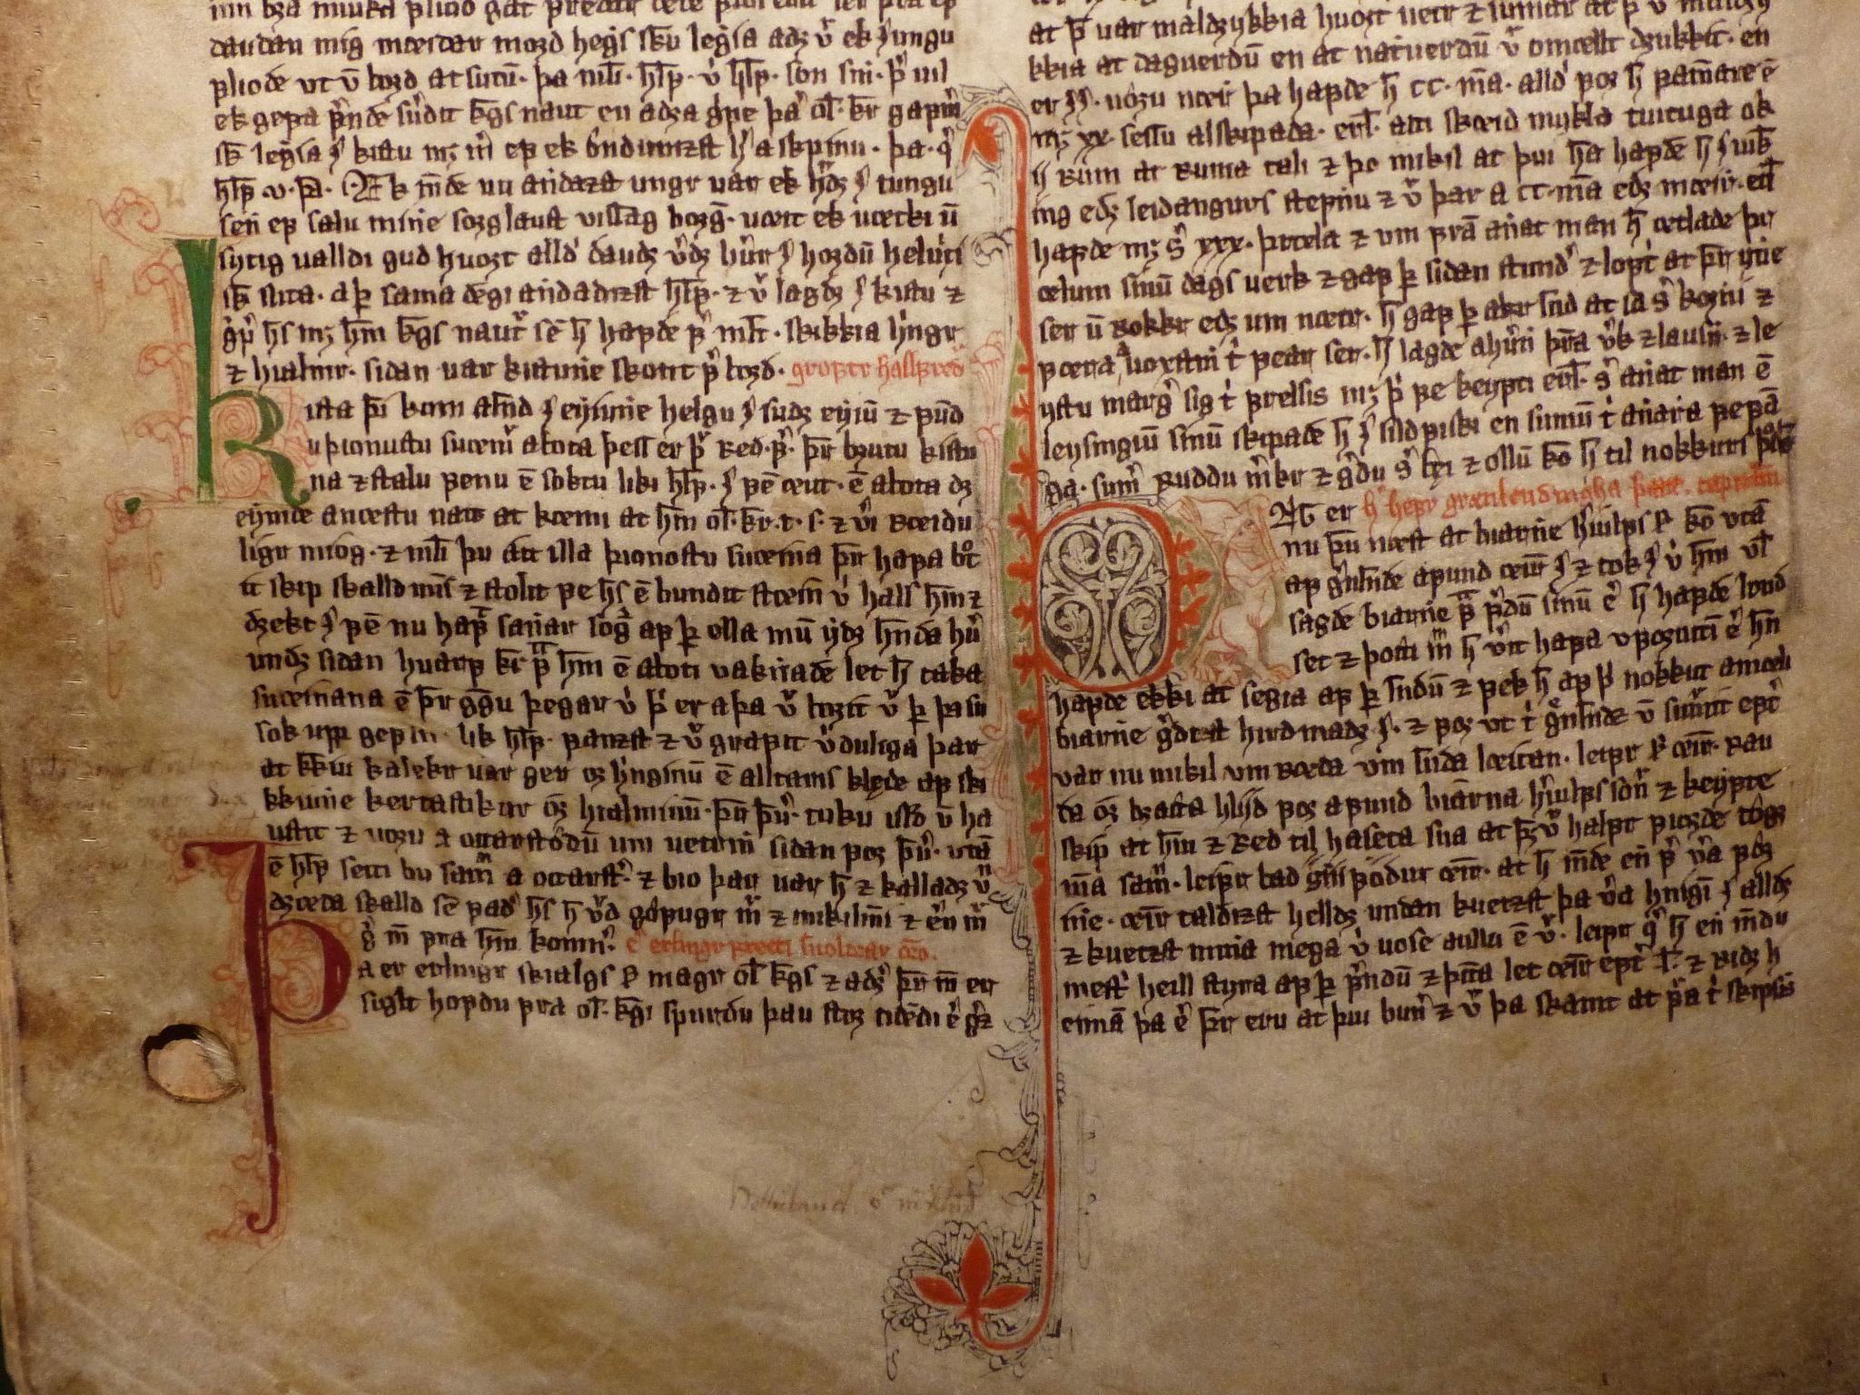
The Longer Ending of Mark and Its Significance
Resurrection Appearances
  The longer ending describes the post-resurrection appearances of Jesus to his followers, affirming his resurrection.
The Great Commission
  It contains the Great Commission, where Jesus commands his disciples to spread the gospel worldwide.
Authenticity Debate
  Scholars have widely debated the authenticity and theological implications of these verses in the Gospel of Mark.
Notes:
---
The longer ending of Mark (verses 9-20) addresses resurrection appearances and the Great Commission. Its authenticity and theological significance have been widely discussed and debated.
Image source: Microsoft 365 content library

Slide 18

Implications for Christian Doctrine and Practice
Doctrine of Resurrection
  Mark 16 reinforces the Christian belief in resurrection, affirming Jesus' victory over death.
Call to Evangelism
  The passage encourages believers to boldly share the message of Jesus and continue His mission globally.
Notes:
---
Mark 16 influences doctrines of resurrection and evangelism. It challenges believers to embrace faith boldly and continue Jesus’ mission in the world today.
Image source: Microsoft 365 content library

Slide 19
Conclusion
Theological Insights
The Latin Vulgate’s translation offers profound theological insights into the Gospel of Mark.
Christian Tradition
The translation deepens the understanding of Christian tradition and its scriptural foundations.
Scholarly and Spiritual Enrichment
Studying the translation enriches both academic scholarship and spiritual perspectives.
Notes:
The Latin Vulgate’s translation of Mark 16 provides rich theological insights and deepens understanding of Christian tradition. Studying its translation enriches both scholarly and spiritual perspectives.

