Slide 2

A tradition
Sometimes during the holidays, I or some family members will attempt to complete a jigsaw puzzle.
Many times this is a collaborative effort. A passer buy my suddenly insert a piece that I have for which I have searched
We are in the 1000 pieces max group but lean toward 500 pices.

Slide 3
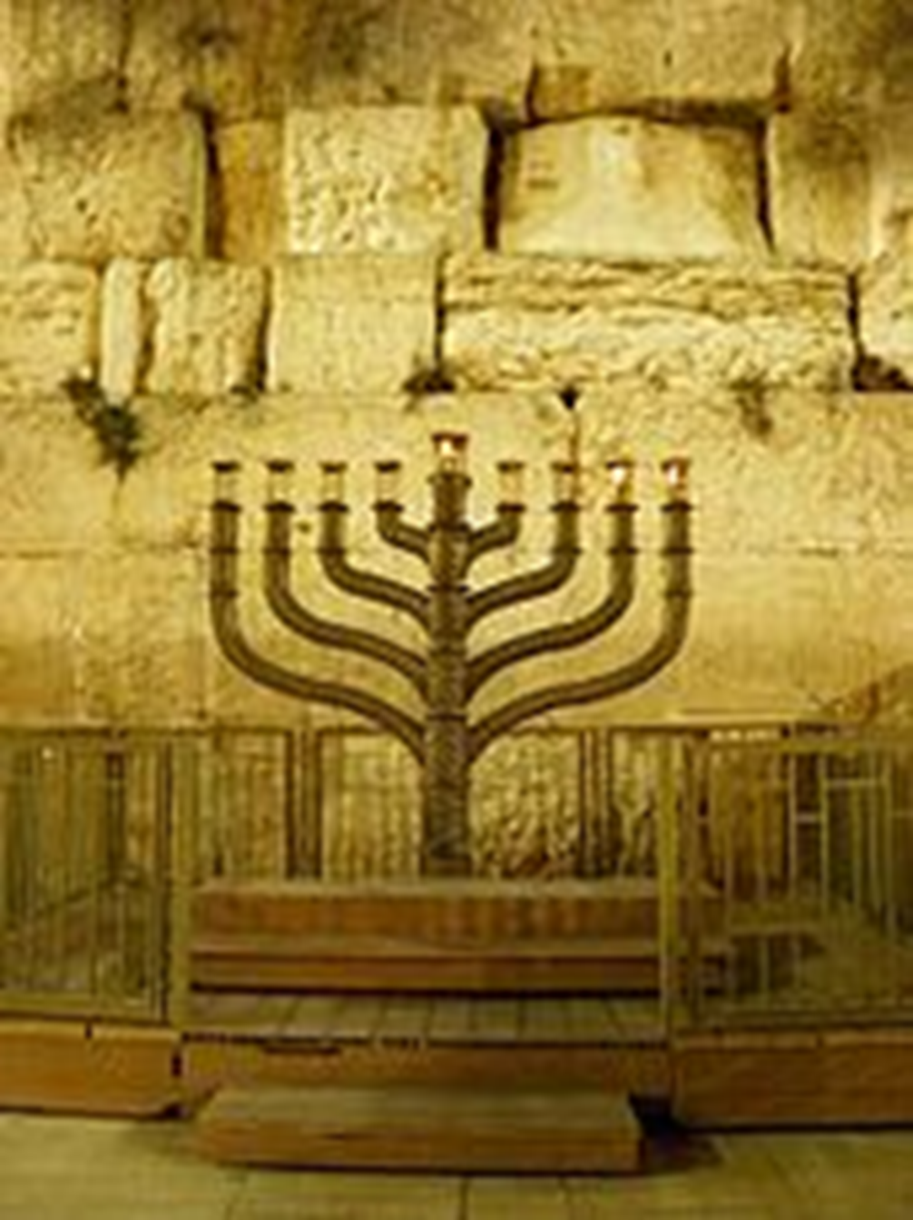

Slide 4
Hanukkah 2024
begins Wednesday, December 25 at sunset
Ends Thursday January 2 at nightfall

Slide 5
Hanukkah 2024
begins Wednesday, December 25 at sunset
Ends Thursday January 2 at nightfall

Slide 7
A spiritual tradition
As a group of classmates and believers we have come together to look at the puzzle in Galatians.
Serval pieces are placed on the table.
The arrangement will take shape for the next few lessons.

Slide 8
Exploring Churches in Galatia
Galatians is written to these churches which have been infiltrated by Judaizing teachers that insist that the new Christians were obligated to observe Jewish laws in order to be in a “correct” relationship with God. Paul’s response is direct and uncompromising as he confronts those adding a burden to those who have been set free

Slide 9
thou-mad’-zo Galatians 1:6
I wonder | DARBY, DRA
TI am marveling | DLNT

Slide 10
thou-mad’-zo Galatians 1:6
I am very surprised | DARBY
Frankly I am stunned. | VOICE
I AM FLABBERGASTED (not in a Good Way) | Weldon B

Slide 11
thou-mad’-zo Galatians 1:6
I am very surprised | DARBY
Frankly I am stunned. | VOICE
I AM FLABBERGASTED (not in a Good Way) | Weldon B

Slide 12
thou-mad’-zo Galatians 1:6
I wonder | DARBY, DRA
TI am marveling | DLNT

Slide 13
thou-mad’-zo Galatians 1:6
I am very surprised | DARBY
Frankly I am stunned. | VOICE
I AM FLABBERGASTED (not in a Good Way) | Weldon B

Slide 14
thou-mad’-zo Galatians 1:6
I am very surprised | DARBY
Frankly I am stunned. | VOICE
I AM FLABBERGASTED (not in a Good Way) | Weldon B

