Slide 1

Exploring Galatia

Slide 2
Acts 13 Pisidian Antioch
The Gospel

Slide 3
Acts 13 Pisidian Antioch
Starting Point – Jewish History
This message of salvation has been sent.
Rulers did not recognize Jesus
Condemning him they fulfilled the words of the prophets.
Pilate has Jesus crucified.
Jesus place in a tomb.
God raises him From the dead. He does not face decay

Slide 4
Exploring Churches in Galatia
In Pisidian Antioch Acts 13
³² “We tell you the good news: What God promised our ancestors ³³ he has fulfilled for us, their children, by raising up Jesus.

Slide 5
Exploring Churches in Galatia
In Pisidian Antioch Acts 13
³⁸ “Therefore, my friends, I want you to know that through Jesus the forgiveness of sins is proclaimed to you.

Slide 6
Exploring Churches in Galatia
In Pisidian Antioch Acts 13
³⁹ Through him everyone who believes is set free from every sin, a justification you were not able to obtain under the law of Moses.

Slide 7
Exploring Churches in Galatia
Good news proclaimed in Galatia and then……

Slide 8
Perplexed Galatians 4
¹⁹ My dear children, for whom I am again in the pains of childbirth until Christ is formed in you, ²⁰ how I wish I could be with you now and change my tone, because I am perplexed about you!

Slide 9
Perplexed Galatians 4
¹⁹ My dear children, for whom I am again in the pains of childbirth until Christ is formed in you, ²⁰ how I wish I could be with you now and change my tone, because I am perplexed about you!
(Be on alert about Paul’s “tone” in Galatians)

Slide 10
Perplexed Galatians 4
Perplexed - ἀπορέω ap-or-eh’-o G639 (4X)
to be without resources, to be in straits, to be left wanting, to be embarrassed, to be in doubt, not to know which way to turn
to be at a loss with one's self, be in doubt
not to know how to decide or what to do, to be perplexed

Slide 11
Perplexed Galatians 4
Perplexed - ἀπορέω ap-or-eh’-o G639
to be without resources, to be in straits, to be left wanting, to be embarrassed, to be in doubt, not to know which way to turn
to be at a loss with one's self, be in doubt
not to know how to decide or what to do, to be perplexed (Paul was decisive in what to do)

Slide 12
Perplexed Galatians 4
Perplexed - ἀπορέω ap-or-eh’-o G639
Paul has a determination to correct the issues in Galatia. As with many churches when Paul sees an issue he addresses the issue.

Slide 13
Fear Galatians 4:11
Do you wish to be enslaved by them all over again? ¹⁰ You are observing special days and months and seasons and years! ¹¹ I fear for you, that somehow I have wasted my efforts on you.

Slide 14
Fear Galatians 4:11
fear - φοβέω fob-eh’-o G5399 (93 X)
to put to flight, to flee
to fear, be afraid
to be struck with fear, to be seized with alarm
of those startled by strange sights or occurrences
of those struck with amazement
to fear, be afraid of one
to fear (i.e. hesitate) to do something (for fear of harm)

Slide 15
Fear Galatians 4:11
Paul had a genuine fear for the churches in Galatia based on their direction and failure to have the saving faith in Christ .

Slide 16
Astonished / Amazed Galatians 1:6
⁶ I am astonished that you are so quickly deserting the one who called you to live in the grace of Christ and are turning to a different gospel— ⁷ which is really no gospel at all. Evidently some people are throwing you into confusion and are trying to pervert the gospel of Christ.

Slide 17
Astonised Galatians 1:6
Astonished - θαυμάζω thou-mad’-zo G2296 (44X)
to wonder, wonder at, marvel
to be wondered at, to be had in admiration

Slide 18
Astonished / Amazed Galatians 1:6
Astonished in a good way..
The gospels use thou-mad’-zo as amazed…
Astonished in a bad way.. Gal 1:6 is an isolated case where thou-mad’-zo is used in a bad way.

Slide 19
Pauls viewpoint
I am perplexed about you.
I am afraid for you
I am astonished by you

Slide 20
Galatians 1 The Gospel
1 Paul, an apostle—sent not from men nor by a man, but by Jesus Christ and God the Father, who raised him from the dead . . . ⁴ who gave himself for our sins to rescue us from the present evil age, according to the will of our God and Father, ⁵ to whom be glory for ever and ever. Amen.

Slide 21
Exploring Churches in Galatia
In Pisidian Antioch Acts 13
³⁹ Through him everyone who believes is set free from every sin, a justification you were not able to obtain under the law of Moses.

Slide 22
A Pauline tradition
As Paul writes 13 letters he is routinely thankful for having been associated with or knowing the recipients.
For Example: ³ I thank my God every time I remember you. Philippians 1:3

Slide 23
A Pauline tradition
³ I thank my God every time I remember you. Philippians 1:3
No thanks in Galatians

Slide 24
Epistle | To | From | "Apostle" | "Servant" | Grace and Peace | Gives Thanks
Romans | all in Rome | Paul | v1 | v1 | v7 | v8
1 Corinthians | church in Corinth | Paul & Sosthenes | v1 | x | v3 | v4
2 Corinthians | church in Corinth | Paul & Timothy | v1 | x | v2 | x
Galatians | churches in Galatia | Paul & brothers & sisters | v1 | x | v3 | x
Ephesians | holy people in Ephesus | Paul | v1 | x | v2 | v16

Slide 25
Epistle | To | From | "Apostle" | "Servant" | Grace and Peace | Gives Thanks
Philippians | holy people in Philippi | Paul & Timothy | x | V1 servants | v2 | v3
Colossians | holy people in Colossae | Paul & Timothy | v1 | x | v2 | v3
1 Thessalonians | church of the Thessalonians | Paul, Silas, Timothy | x | x | v1 | v2
2 Thessalonians | church of the Thessalonians | Paul, Silas, Timothy | x | x | v1 | v2

Slide 26
Epistle | To | From | "Apostle" | "Servant" | Grace and Peace | Gives Thanks
1 Timothy | Timothy my true son | Paul | v1 | x | GMP* | v12 C*
2 Timothy | Timothy my dear son | Paul | v1 | x | GMP* | v3 G*
Titus | Titus my true son | Paul | v1 | v1 | v4 | x
Philemon | Philemon, Apphia, Archippus, and church that meets in your home | Paul & Timothy | x | prisoner v1 | v3 | v4
GMP* Grace Mercy Peace C* Christ G* God

Slide 27
Grace and Peace 1:3
Grace and Peace are used in the introduction of all the Pauline letters.
The letters to Timothy differ slightly as these include Grace, Mercy, and Peace.

Slide 28
Grace and Peace 1:3
Grace – We have been redeemed and brought back into a relationship with God.
We were underserving but the Sacrifice of Jesus and us having faith removes all sin.
For the Judaizers this gift was not enough and their actions could be viewed as an attack on grace.

Slide 29
Grace and Peace 1:3
Peace- shalom aleichem, aleichem shalom.
Peace exchanged as a Hebrew Greeting.
Peace be to you, and to you peace.
This is not a peace ending world conflict but a peace that is between man and God.
Having this type of peace changes everything.
It is well with my soul.

Slide 30
Grace and Peace 1:3
This phrase becomes the sermonette..
As the result of God’s grace we can be at peace with Him.

Slide 31
Grace and Peace 1:3
This phrase becomes the sermonette..
As the result of God’s grace we can be at peace with Him.

Slide 32
Gal 1 Paul defending Apostleship
1 Paul, an apostle—sent not from men nor by a man,
Galatians 1:11-2:10
Galatians 2:11-14 Paul admonishes Peter
Defense is thematic across several epistles
2 Corinthians 11

Slide 33
Galatians 1
³ Grace and peace to you from God our Father and the Lord Jesus Christ, ⁴ who gave himself for our sins to rescue us from the present evil age, according to the will of our God and Father, ⁵ to whom be glory for ever and ever. Amen.

Slide 34
Galatians 1
⁶ …..(you) are turning to a different gospel— ⁷ which is really no gospel at all. Evidently some people are throwing you into confusion and are trying to pervert the gospel of Christ. ⁸ But even if we or an angel from heaven should preach a gospel other than the one we preached to you, let them be under God’s curse!

Slide 35
Galatians 1
⁹ As we have already said, so now I say again: If anybody is preaching to you a gospel other than what you accepted, let them be under God’s curse!
What about Paul’s tone?

Slide 36
Galatians 1
let them be under God’s curse NIV
let him be anathema. ASV
let him be condemned to destruction! AMP
let him be accursed. BRG ESV KJV NKJV
may he be condemned to hell GNT (good news translation)
He is to be accursed NASB NASB1995

Slide 37
Anathema Galatians 4
Anathema - ἀνάθεμα an-ath'-em-ah G331 (6X)
a thing set up or laid by in order to be kept
a thing devoted to God without hope of being redeemed, and if an animal, to be slain; therefore a person or thing doomed to destruction

Slide 38
95 Theses Martin Luther
36 Those who believe that they can be certain of their salvation because they have indulgence letters will be eternally damned, together with their teachers

Slide 39
95 Theses Martin Luther
45 Christians are to be taught that he who sees a needy man and passes him by, yet gives his money for indulgences, does not buy papal indulgences but God's wrath
27 They preach only human doctrines who say that as soon as the money clinks into the money chest, the soul flies out of purgatory.

Slide 40
95 Theses Martin Luther
71 Let him who speaks against the truth concerning papal indulgences be anathema and accursed.
73 Just as the pope justly thunders against those who by any means whatever contrive harm to the sale of indulgences.

Slide 41
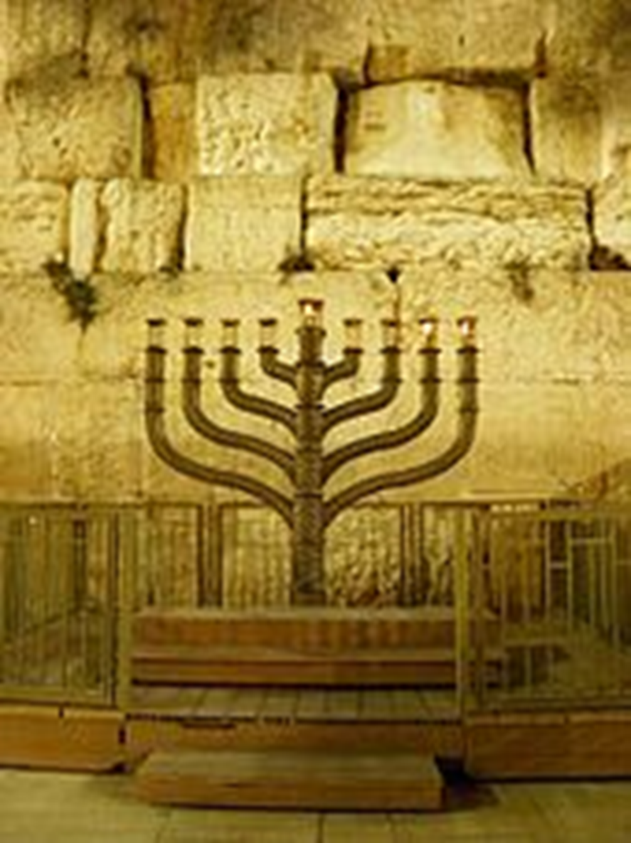

Slide 42
Hanukkah 2024
begins Wednesday, December 25 at sunset
Ends Thursday January 2 at nightfall

Slide 43
The holiday is tied to the historical significance of the Maccabean victory
See 1 Maccabees chapter 4

