Slide 1

Exploring Galatia

Slide 2
Exploring Churches in Galatia
Starting with Paul’s conversion and travels, the first missionary journey will take us to the locale and establishment of the first churches in Galatia. The Judaizing element challenges the sufficiency of Christ leading Paul to write his harshest letter which deals directly with this issue..

Slide 3
Exploring Churches in Galatia
Galatians is written to these churches which have been infiltrated by Judaizing teachers that insist that the new Christians were obligated to observe Jewish laws in order to be in a “correct” relationship with God. Paul’s response is direct and uncompromising as he confronts those adding a burden to those who have been set free

Slide 4
Exploring Churches in Galatia
Our goal for today is a review of lesson 1 and a look at Pauls 1st missionary Journey and the establishment of churches in Galatia.
An exercise of looking at the content of early sermons in Acts may shed light on what was being taught and a guide for our outreach.

Slide 5
Exploring Churches in Galatia
We observed Stephen and his credentials.
He was one of seven to provide food for the widows.
After the apostles had laid hands on these men, Stephen did signs and wonders and proclaimed Christ.

Slide 6
Exploring Churches in Galatia
Stephen was dragged to the Sanhedrin
His speech was direct and clear about the mindset of the group and the were enraged to a murderess fury based on what Stephan had proclaimed. As a result, he was stoned to death.
Saul was in attendance and implicated himself as a supporter to the murder of Stephan.

Slide 7
Exploring Churches in Galatia
Saul a zealous pharisee sought and received letters of authority from the Sanhedrin to jail those who were of “the way”.
On the road to Damascus Saul was confronted by Jesus. Paul saw Jesus and was given instruction to go to Damascus.,

Slide 8
Exploring Churches in Galatia
Ananias was directed by God to meet with Paul at the house of Judas.
Ananias prayed and scales fell from Saul’s eyes and his sight was restored.
Saul was baptized and then then had some food and drink which he had not had for three days.

Slide 9
Exploring Churches in Galatia
Paul preached the Gospel of Jesus Christ in Damascus.
Jews sought to kill Paul based on his teaching,
He escaped Damarcus one night as he was lowered in a basket avoiding the gates.

Slide 10
Exploring Churches in Galatia
Paul spends 3 year in Arabia
Paul preached the Gospel of Jesus Christ in Jerusalem.
Jews sought to kill Paul based on his teaching,
He escaped Jerusalem and made his way to Caesarea then to Tarsus.

Slide 11
Exploring Churches in Galatia
This seemed to be a preach Christ then escape mode.
Acts has the events of Damascus and Jerusalem in sequence with no interlude.
He escaped Jerusalem and made his way to Caesarea then to Tarsus.

Slide 12
Exploring Churches in Galatia
^{ACTS 9}
²⁵ But his followers took him by night and lowered him in a basket through an opening in the wall. (of Damascus)
²⁶ When he came to Jerusalem, he tried to join the disciples, but they were all afraid of him, not believing that he really was a disciple.
Interlude

Slide 13
Exploring Churches in Galatia
^{Galatians 1}
¹⁷ I did not go up to Jerusalem to see those who were apostles before I was, but I went into Arabia. Later I returned to Damascus.
¹⁸ Then after three years, I went up to Jerusalem to get acquainted with Cephas^{[b]} and stayed with him fifteen days. ¹⁹ I saw none of the other apostles—only James, the Lord’s brother.

Slide 14
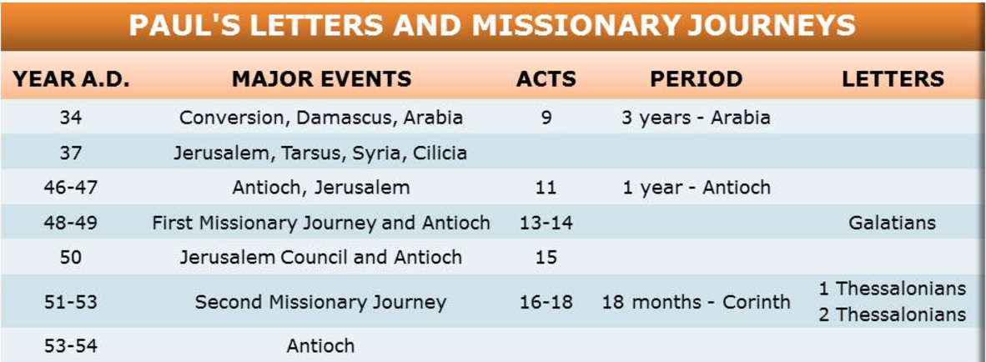

Slide 15
Exploring Churches in Galatia
^{Let’s talk about Barnabas}

Slide 16
Exploring Churches in Galatia
^{Barnabas Acts 4 :}
³⁶ Joseph, a Levite from Cyprus, whom the apostles called Barnabas (which means “son of encouragement”), ³⁷ sold a field he owned and brought the money and put it at the apostles’ feet.

Slide 17
Exploring Churches in Galatia
^{Barnabas Acts 9 :}
²⁶ When he (Saul) came to Jerusalem, he tried to join the disciples, but they were all afraid of him, not believing that he really was a disciple. ²⁷ But Barnabas took him and brought him to the apostles.

Slide 18
Exploring Churches in Galatia
^{Barnabas Acts 9 :}
He told them how Saul on his journey had seen the Lord and that the Lord had spoken to him, and how in Damascus he had preached fearlessly in the name of Jesus. ²⁸ So Saul stayed with them and moved about freely in Jerusalem,.

Slide 19
Exploring Churches in Galatia
^{Barnabas Acts 9 :}
He told them how Saul on his journey had seen the Lord and that the Lord had spoken to him, and how in Damascus he had preached fearlessly in the name of Jesus. ²⁸ So Saul stayed with them and moved about freely in Jerusalem,.

Slide 20
Exploring Churches in Galatia
Acts 9 : Saul’s Jerusalem Escape
²⁹ He talked and debated with the Hellenistic Jews,^{[a]} but they tried to kill him. ³⁰ When the believers learned of this, they took him down to Caesarea and sent him off to Tarsus.

Slide 21
Exploring Churches in Galatia
Acts 11 The Church in Antioch.
¹⁹ Now those who had been scattered by the persecution that broke out when Stephen was killed traveled as far as Phoenicia, Cyprus and Antioch, spreading the word only among Jews. ²⁰ Some of them, however, men from Cyprus and Cyrene, went to Antioch and began to speak to Greeks also, telling them the good news about the Lord Jesus.
Notes:
It’s a story with two side. The devout Jews were in favor of Stephen’s death as a traitor to the Jewish Faith, Those that could see that Jesus was the messiah and the fulfillment of prophecy saw the martyrdom of Stephen as the shedding of innocent blood for the cause of Christ . Jews and Greeks are not races but groups of people that are ideologically different.

Slide 22
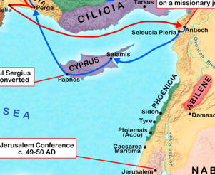

Slide 23
Exploring Churches in Galatia
What had happened to Stephen had a profound impact on the church. What had happened to Abraham Lincoln or John Kenedy or Martin Luther King had a profound impact on the United States . Many of us have a memory or where we were and what we doing with faced with the news. The blood of Jesus on the cross is profound in importance to the martyrs that follow.
Notes:
What had happened to Stephen had a profound impact on the church. What had happened to Abraham Lincoln or John Kenedy or Martin Luther King had a profound impact on the united States . Innocent blood spilled for a worthy cause is met with a visceral response from onlookers that can understand an underlying truth. The blood of Jesus on the cross is profound in importance to the martyrs that follow.

Slide 24
Exploring Churches in Galatia
Acts 11 The Church in Antioch.
²¹ The Lord’s hand was with them, and a great number of people believed and turned to the Lord.
²² News of this reached the church in Jerusalem, and they sent Barnabas to Antioch. ²³ When he arrived and saw what the grace of God had done, he was glad and encouraged them all to remain true to the Lord with all their hearts.

Slide 25
Exploring Churches in Galatia
Acts 11 The Church in Antioch.
²⁵ Then Barnabas went to Tarsus to look for Saul, ²⁶ and when he found him, he brought him to Antioch. So for a whole year Barnabas and Saul met with the church and taught great numbers of people. The disciples were called Christians first at Antioch.

Slide 26
Exploring Churches in Galatia
Acts 11 The Church in Antioch.
. So for a whole year Barnabas and Saul met with the church and taught great numbers of people. The disciples were called Christians first at Antioch.

Slide 27
Exploring Churches in Galatia

Slide 28
Exploring Churches in Galatia
²⁷ During this time some prophets came down from Jerusalem to Antioch. ²⁸ One of them, named Agabus, stood up and through the Spirit predicted that a severe famine would spread over the entire Roman world. (This happened during the reign of Claudius.) .

Slide 29
Exploring Churches in Galatia
²⁹ The disciples, as each one was able, decided to provide help for the brothers and sisters living in Judea. ³⁰ This they did, sending their gift to the elders by Barnabas and Saul.

Slide 30
Exploring Churches in Galatia

Slide 31
Exploring Churches in Galatia
Why would Antioch be a better site for a Church than Jerusalem?

Slide 32
Exploring Churches in Galatia
Why would Antioch be a better site for a Church than Jerusalem?
Distance them selves from the Sanhedrin.
Converting both Jews and Greeks.
Forged a new Identity with the word Christian.

Slide 33
Exploring Churches in Galatia
Paul’s Travel Log Before 1st Missionary Journey.….
Traveled to Damascus saw Jesus .. Converted.
Preached in Damascus Escaped. / Three Years in Arabia.
Taught in Jerusalem escaped vis Caesarea to Taurus.
Barnabas finds Paul Brings him to Antioch
Stay in Antioch for a year.
Paul and Barnabas go to Jerusalem in a relief effort.

Slide 34
Exploring Churches in Galatia
Acts 12 Barnabas and Paul Sent off.
²⁵ When Barnabas and Saul had finished their mission, they returned from^{[a]} Jerusalem, taking with them John, also called Mark.

Slide 35
Exploring Churches in Galatia
Acts 12 Barnabas and Paul Sent off.
²⁵ When Barnabas and Saul had finished their mission, they returned from^{[a]} Jerusalem, taking with them John, also called Mark.

Slide 36
Exploring Churches in Galatia
Acts 13 Barnabas and Paul Sent off.
² While they were worshiping the Lord and fasting, the Holy Spirit said, “Set apart for me Barnabas and Saul for the work to which I have called them.” ³ So after they had fasted and prayed, they placed their hands on them and sent them off.

Slide 37
Exploring Churches in Galatia
The first Missionary Journey….
Acts chapters 13 and 14 will outline Paul’s and Barnabas’s travels of the first missionary journey and the establishment of the churches in Galatia.

Slide 38
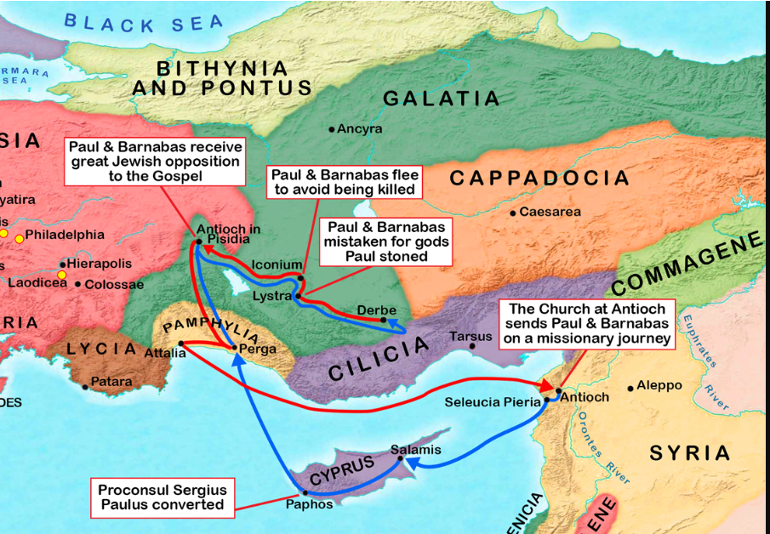

Slide 39
Exploring Churches in Galatia
On Cyprus
⁴ The two of them, sent on their way by the Holy Spirit, went down to Seleucia and sailed from there to Cyprus. ⁵ When they arrived at Salamis, they proclaimed the word of God in the Jewish synagogues. John was with them as their helper.

Slide 40
Exploring Churches in Galatia
On Cyprus Acts 13
⁶ They traveled through the whole island until they came to Paphos. There they met a Jewish sorcerer and false prophet named Bar-Jesus, ⁷ who was an attendant of the proconsul, Sergius Paulus.

Slide 41

Exploring Churches in Galatia
The distance from Salamis to Paphos in Cyprus is approximately 222 kilometers (about 138 miles) by road

Slide 42
Exploring Churches in Galatia
At Paphos Acts 13 : 6-12
Bar-Jesus, was temporarily made blind.
Sergius Paulus saw the miracle and was converted.

Slide 43
Exploring Churches in Galatia
At Paphos Acts 13 : 6-12
Bar-Jesus, was temporarily made blind.
Sergius Paulus saw the miracle and was converted.

Slide 44
Exploring Churches in Galatia
In Pisidian Antioch Acts 13:14
¹³ From Paphos, Paul and his companions sailed to Perga in Pamphylia, where John left them to return to Jerusalem. ¹⁴ From Perga they went on to Pisidian Antioch. On the Sabbath they entered the synagogue and sat down.

Slide 45
Exploring Churches in Galatia
In Pisidian Antioch Acts 13
This Chapter has a sermon from Paul that that brings the Gospel to the people of Galatia.
Track the elements of the Sermon to get an image of what Paul is teaching.

Slide 46
Exploring Churches in Galatia
In Pisidian Antioch Acts 13
¹⁵ After the reading from the Law and the Prophets, the leaders of the synagogue sent word to them, saying, “Brothers, if you have a word of exhortation for the people, please speak.”

Slide 47
Exploring Churches in Galatia
In Pisidian Antioch Acts 13
¹⁶ Standing up, Paul motioned with his hand and said: “Fellow Israelites and you Gentiles who worship God, listen to me!
Inclusive

Slide 48
Exploring Churches in Galatia
In Pisidian Antioch Acts 13
¹⁷ The God of the people of Israel chose our ancestors; he made the people prosper during their stay in Egypt; with mighty power he led them out of that country; ¹⁸ for about forty years he endured their conduct^{[a]} in the wilderness;
Historical

Slide 49
Exploring Churches in Galatia
In Pisidian Antioch Acts 13
¹⁹ and he overthrew seven nations in Canaan, giving their land to his people as their inheritance. ²⁰ All this took about 450 years.
Historical

Slide 50
Exploring Churches in Galatia
In Pisidian Antioch Acts 13
“After this, God gave them judges until the time of Samuel the prophet. ²¹ Then the people asked for a king, and he gave them Saul son of Kish, of the tribe of Benjamin, who ruled forty years.
Historical

Slide 51
Exploring Churches in Galatia
In Pisidian Antioch Acts 13
²² After removing Saul, he made David their king. God testified concerning him: ‘I have found David son of Jesse, a man after my own heart; he will do everything I want him to do.’
Historical

Slide 52
Exploring Churches in Galatia
In Pisidian Antioch Acts 13
²⁶ “Fellow children of Abraham and you God-fearing Gentiles, it is to us that this message of salvation has been sent. ²⁷ The people of Jerusalem and their rulers did not recognize Jesus, yet in condemning him they fulfilled the words of the prophets that are read every Sabbath.
Messianic / Salvation

Slide 53
Exploring Churches in Galatia
In Pisidian Antioch Acts 13
²⁸ Though they found no proper ground for a death sentence, they asked Pilate to have him executed. ²⁹ When they had carried out all that was written about him, they took him down from the cross and laid him in a tomb
Messianic / Christ Crucified / Sacrifice

Slide 54
Exploring Churches in Galatia
In Pisidian Antioch Acts 13
³⁰ But God raised him from the dead, ³¹ and for many days he was seen by those who had traveled with him from Galilee to Jerusalem. They are now his witnesses to our people.
Messianic / Christ Resurrected / Overcomes Death

Slide 55
Exploring Churches in Galatia
In Pisidian Antioch Acts 13
³² “We tell you the good news: What God promised our ancestors ³³ he has fulfilled for us, their children, by raising up Jesus. As it is written in the second Psalm:
“‘You are my son; today I have become your father
Messianic Promise Fulfilled / Christ Resurrected / Fulfills Prophecy

Slide 56
Exploring Churches in Galatia
In Pisidian Antioch Acts 13
³⁴ God raised him from the dead so that he will never be subject to decay. As God has said,
“‘I will give you the holy and sure blessings promised to David.’^{[c]}
Messianic / Christ Resurrected / Overcomes Death

Slide 57
Exploring Churches in Galatia
In Pisidian Antioch Acts 13
³⁵ So it is also stated elsewhere:
“‘You will not let your holy one see decay.’^{[d]}
Messianic / Christ Resurrected / No decay
Pauls explains this in following verses.

Slide 58
Exploring Churches in Galatia
In Pisidian Antioch Acts 13
³⁶ “Now when David had served God’s purpose in his own generation, he fell asleep; he was buried with his ancestors and his body decayed. ³⁷ But the one whom God raised from the dead did not see decay.
Messianic / Christ Resurrected / Explanation of no decay

Slide 59
Exploring Churches in Galatia
In Pisidian Antioch Acts 13
³⁸ “Therefore, my friends, I want you to know that through Jesus the forgiveness of sins is proclaimed to you.
Forgiveness of sins

Slide 60
Exploring Churches in Galatia
In Pisidian Antioch Acts 13
³⁹ Through him everyone who believes is set free from every sin, a justification you were not able to obtain under the law of Moses.

Slide 61
Exploring Churches in Galatia
Galatians

