Slide 1

Exploring Galatia
Perplexed

Slide 2
Exploring Churches in Galatia
Starting with Paul’s conversion and travels, the first missionary journey will take us to the locale and establishment of the first churches in Galatia. The Judaizing element challenges the sufficiency of Christ leading Paul to write his harshest letter which deals directly with this issue..

Slide 3
Exploring Churches in Galatia
Galatians is written to these churches which have been infiltrated by Judaizing teachers that insist that the new Christians were obligated to observe Jewish laws in order to be in a “correct” relationship with God. Paul’s response is direct and uncompromising as he confronts those adding a burden to those who have been set free

Slide 4
Perplexed Galatians 4
¹⁹ My dear children, for whom I am again in the pains of childbirth until Christ is formed in you, ²⁰ how I wish I could be with you now and change my tone, because I am perplexed about you!

Slide 5
Perplexed Galatians 4
Perplexed - ἀπορέω ap-or-eh’-o G639
to be without resources, to be in straits, to be left wanting, to be embarrassed, to be in doubt, not to know which way to turn
to be at a loss with one's self, be in doubt
not to know how to decide or what to do, to be perplexed

Slide 6
Perplexed Galatians 4
Go - πορεύω G4198
to lead over, carry over, transfer
to pursue the journey on which one has entered, to continue on one's journey
to depart from life
to follow one, that is: become his adherent
to lead or order one's life
Notes:
The KJV translates Strong's G4198 in the following manner: go (117x), depart (11x), walk (9x), go (one's) way (8x), miscellaneous (9x).

Slide 7
Perplexed Galatians 4
Go - πορεύω G4198
And they were both righteous before God, walking ^{G4198} in all the commandments and ordinances of the Lord blameless. Luke 1:6
Notes:
The KJV translates Strong's G4198 in the following manner: go (117x), depart (11x), walk (9x), go (one's) way (8x), miscellaneous (9x).

Slide 8
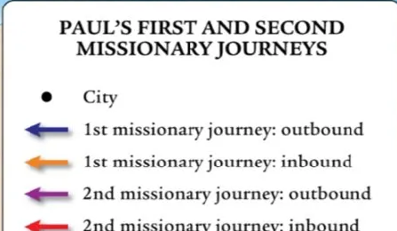

Galatia 1st and 2nd Journeys
Notes:
The KJV translates Strong's G4198 in the following manner: go (117x), depart (11x), walk (9x), go (one's) way (8x), miscellaneous (9x).

Slide 9
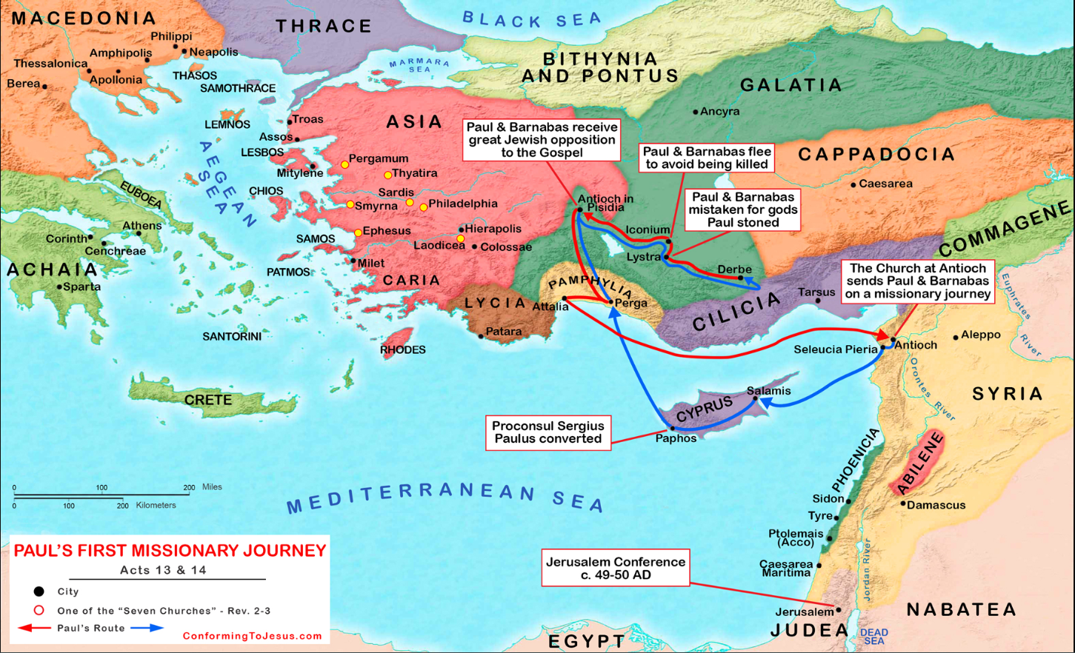

Slide 10
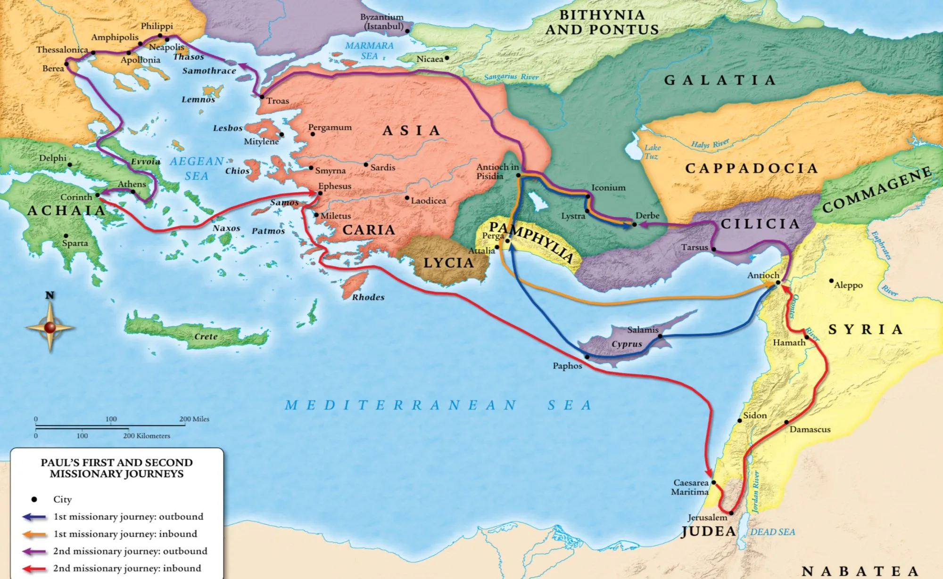
Galatia 1st and 2nd Journeys
Notes:
The KJV translates Strong's G4198 in the following manner: go (117x), depart (11x), walk (9x), go (one's) way (8x), miscellaneous (9x).

Slide 11
Galatia 1st and 2nd Journeys
Notes:
The KJV translates Strong's G4198 in the following manner: go (117x), depart (11x), walk (9x), go (one's) way (8x), miscellaneous (9x).

Slide 12
Galatia 1st and 2nd Journeys
Notes:
The KJV translates Strong's G4198 in the following manner: go (117x), depart (11x), walk (9x), go (one's) way (8x), miscellaneous (9x).

