Slide 1

Exploring Galatia

Slide 2
Exploring Churches in Galatia
Starting with Paul’s conversion and travels, the first missionary journey will take us to the locale and establishment of the first churches in Galatia. The Judaizing element challenges the sufficiency of Christ leading Paul to write his harshest letter which deals directly with this issue..

Slide 3
Exploring Churches in Galatia
Galatians is written to these churches which have been infiltrated by Judaizing teachers that insist that the new Christians were obligated to observe Jewish laws in order to be in a “correct” relationship with God. Paul’s response is direct and uncompromising as he confronts those adding a burden to those who have been set free

Slide 4
Exploring Churches in Galatia
Our goal for today is a review of lesson 1 and a look at Pauls 1st missionary Journey and the establishment of churches in Galatia.
An exercise of looking at the content of early sermons in Acts may shed light on what was being taught and a guide for our outreach.

Slide 5
Exploring Churches in Galatia
We stepped backwards to Stephen and his credentials.
He was one of seven to provide food for the widows.
After the apostles had laid hands on these men, Stephen did signs and wonders and proclaimed Christ.

Slide 6
Exploring Churches in Galatia
Stephen was dragged to the Sanhedrin
His speech was direct and clear about the mindset of the group and the were enraged to a murderess fury based on what Stephan had proclaimed. As a result, he was stoned to death.
Saul was in attendance and implicated himself as a supporter to the murder of Stephan.

Slide 7
Exploring Churches in Galatia
Saul a zealous pharisee sought and received letters of authority from the Sanhedrin to jail those who were of “the way”.
On the road to Damascus Saul was confronted by Jesus. Paul saw Jesus and was given instruction to go to Damascus.,

Slide 8
Exploring Churches in Galatia
Ananias was directed by God to meet with Paul at the house of Judas.
Ananias prayed and scales fell from Saul’s eyes and his sight was restored.
Saul was baptized and then then had some food and drink which he had not had for three days.

Slide 9
Exploring Churches in Galatia
Paul preached the Gospel of Jesus Christ in Damascus.
Jews sought to kill Paul based on his teaching,
He escaped Damarcus one night as he was lowered in a basket avoiding the gates.

Slide 10
Exploring Churches in Galatia
Paul preached the Gospel of Jesus Christ in Jerusalem.
Jews sought to kill Paul based on his teaching,
He escaped Jerusalem and made his way to Caesarea then to Tarsus.

Slide 11
Exploring Churches in Galatia
This seemed to be a preach Christ then escape mode.
Acts has the events of Damascus and Jerusalem in sequence with no interlude.
He escaped Jerusalem and made his way to Caesarea then to Tarsus.

Slide 12
Exploring Churches in Galatia
^{ACTS 9}
⁵ But his followers took him by night and lowered him in a basket through an opening in the wall. (of Damascus)
²⁶ When he came to Jerusalem, he tried to join the disciples, but they were all afraid of him, not believing that he really was a disciple.
Interlude

Slide 13
Exploring Churches in Galatia
^{Galatians 1}
¹⁷ I did not go up to Jerusalem to see those who were apostles before I was, but I went into Arabia. Later I returned to Damascus.
¹⁸ Then after three years, I went up to Jerusalem to get acquainted with Cephas^{[b]} and stayed with him fifteen days. ¹⁹ I saw none of the other apostles—only James, the Lord’s brother.
²⁰ I assure you before God that what I am writing you is no lie.
²¹ Then I went to Syria and Cilicia. ²² I was personally unknown to the churches of Judea that are in Christ. ²³ They only heard the report: “The man who formerly persecuted us is now preaching the faith he once tried to destroy.” ²⁴ And they praised God because of me.

Slide 14
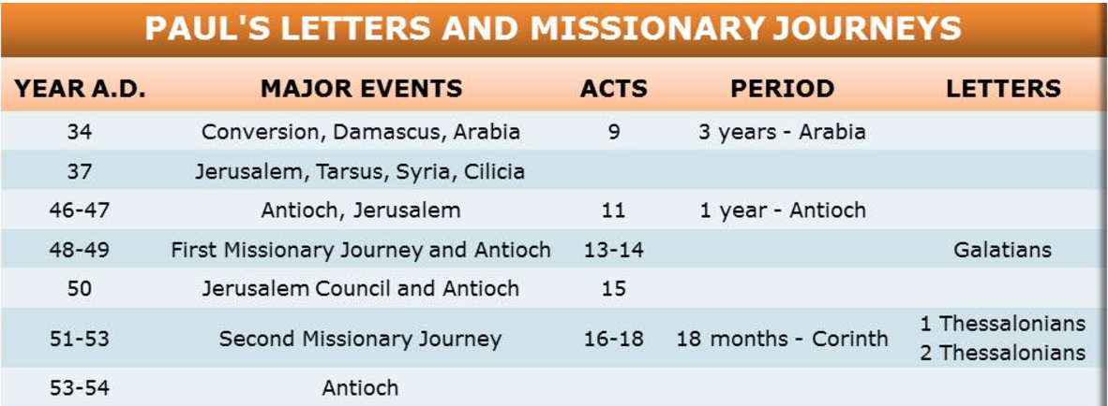

Slide 15
Exploring Churches in Galatia
^{Galatians 1}
²⁰ I assure you before God that what I am writing you is no lie.
²¹ Then I went to Syria and Cilicia. ²² I was personally unknown to the churches of Judea that are in Christ. ²³ They only heard the report: “The man who formerly persecuted us is now preaching the faith he once tried to destroy.” ²⁴ And they praised God because of me.
.

Slide 16
Exploring Churches in Galatia
^{Acts 11 :9 ___}
There is an interleave of the events of Acts 9 and Galatians 1
The events of Paul and Barnabas move forward to Acts 11.
A new person, Barnabas , is influential; in the early church.
He plays a part in the initiation of Missionary Journey 1.

Slide 17
Exploring Churches in Galatia
^{Acts 11 :9 ___}
There is an interleave of the events of Acts 9 and Galatians 1
The events of Paul and Barnabas move forward to Acts 11.
A new person, Barnabas , is influential; in the early church.
He plays a part in the initiation of Missionary Journey 1.

Slide 18
Exploring Churches in Galatia
^{Acts 11}
The Church in Antioch
¹⁹ Now those who had been scattered by the persecution that broke out when Stephen was killed traveled as far as Phoenicia, Cyprus and Antioch, spreading the word only among Jews. ²⁰ Some of them, however, men from Cyprus and Cyrene, went to Antioch and began to speak to Greeks also, telling them the good news about the Lord Jesus.

Slide 19
Exploring Churches in Galatia
Acts 11 The Church in Antioch.
¹⁹ Now those who had been scattered by the persecution that broke out when Stephen was killed traveled as far as Phoenicia, Cyprus and Antioch, spreading the word only among Jews. ²⁰ Some of them, however, men from Cyprus and Cyrene, went to Antioch and began to speak to Greeks also, telling them the good news about the Lord Jesus.
Notes:
It’s a story with two side. The devout Jews were in favor of Stephen’s death as a traitor to the Jewish Faith, Those that could see that Jesus was the messiah and the fulfillment of prophecy saw the martyrdom of Stephen as the shedding of innocent blood for the cause of Christ

Slide 20
Exploring Churches in Galatia
What had happened to Stephen had a profound impact on the church. What had happened to Abraham Lincoln or John Kenedy or Martin Luther King had a profound impact on the United States . Innocent blood spilled for a worthy cause is met with a visceral response from onlookers that can understand an underlying truth. The blood of Jesus on the cross is profound in importance to the martyrs that follow.
Notes:
What had happened to Stephen had a profound impact on the church. What had happened to Abraham Lincoln or John Kenedy or Martin Luther King had a profound impact on the united States . Innocent blood spilled for a worthy cause is met with a visceral response from onlookers that can understand an underlying truth. The blood of Jesus on the cross is profound in importance to the martyrs that follow.

Slide 21
Exploring Churches in Galatia
Acts 11 The Church in Antioch.
²⁴ He was a good man, full of the Holy Spirit and faith, and a great number of people were brought to the Lord.
²⁵ Then Barnabas went to Tarsus to look for Saul,

Slide 22
Exploring Churches in Galatia
Acts 11 The Church in Antioch.
²¹ The Lord’s hand was with them, and a great number of people believed and turned to the Lord.
²² News of this reached the church in Jerusalem, and they sent Barnabas to Antioch. ²³ When he arrived and saw what the grace of God had done, he was glad and encouraged them all to remain true to the Lord with all their hearts.

Slide 23
Exploring Churches in Galatia
Acts 11 The Church in Antioch.
²⁵ Then Barnabas went to Tarsus to look for Saul, ²⁶ and when he found him, he brought him to Antioch. So for a whole year Barnabas and Saul met with the church and taught great numbers of people. The disciples were called Christians first at Antioch.

Slide 24
Exploring Churches in Galatia
Acts 11 The Church in Antioch.
²⁶ and when he found him, he brought him to Antioch. So for a whole year Barnabas and Saul met with the church and taught great numbers of people. The disciples were called Christians first at Antioch.

Slide 25
Exploring Churches in Galatia
²⁷ During this time some prophets came down from Jerusalem to Antioch. ²⁸ One of them, named Agabus, stood up and through the Spirit predicted that a severe famine would spread over the entire Roman world. (This happened during the reign of Claudius.) .

Slide 26
Exploring Churches in Galatia
²⁹ The disciples, as each one was able, decided to provide help for the brothers and sisters living in Judea. ³⁰ This they did, sending their gift to the elders by Barnabas and Saul.

Slide 27
Exploring Churches in Galatia

Slide 28
Exploring Churches in Galatia
Acts 11 The Church in Antioch.
²⁵ Then Barnabas went to Tarsus to look for Saul, ²⁶ and when he found him, he brought him to Antioch. So for a whole year Barnabas and Saul met with the church and taught great numbers of people. The disciples were called Christians first at Antioch.

Slide 29
Exploring Churches in Galatia
Acts 12 Barnabas and Paul Sent off.
²⁵ When Barnabas and Saul had finished their mission, they returned from^{[a]} Jerusalem, taking with them John, also called Mark.

Slide 30
Exploring Churches in Galatia
^{Antioch Recap}
men from Cyprus and Cyrene, went to Antioch and began to speak to Greeks also, telling them the good news about the Lord Jesus.
News of this reached the church in Jerusalem, and they sent Barnabas to Antioch

Slide 31
Exploring Churches in Galatia
^{Antioch Recap}
Then Barnabas went to Tarsus to look for Saul,
. So for a whole year Barnabas and Saul met with the church
When Barnabas and Saul had finished their mission of giving gifts for the famine in Jerusalem, they returned with John, also called Mark.

Slide 32
Exploring Churches in Galatia
The first Missionary Journey….
Acts chapters 13 and 14 will outline Paul’s and Barnabas’s travels of the first missionary journey and the establishment of the churches in Galatia.

Slide 33
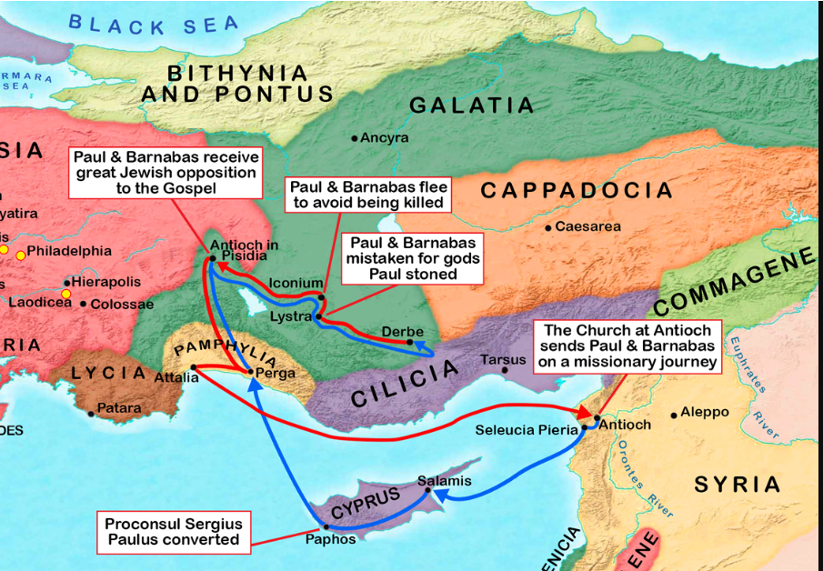

Slide 34
Exploring Churches in Galatia
Paul’s Travel Log Before 1st Missionary
Journey.….
Traveled to Damascus saw Jesus .. Converted.
Preached in Damascus Escaped.
Three Years in Arabia.
Taught in Jerusalem escaped vis Caesarea to Taurus.
Acts chapters 13 and 14 will outline Paul’s and Barnabas’s travels of the first missionary journey and the establishment of the churches in Galatia.

Slide 35
Acts 2
Parthians, and Medes, and Elamites, and the dwellers in Mesopotamia, and in Judaea, and Cappadocia, in Pontus, and Asia,
¹⁰ Phrygia, and Pamphylia, in Egypt, and in the parts of Libya about Cyrene, and strangers of Rome, Jews and proselytes,
¹¹ Cretes and Arabians, we do
.

Slide 36
Exploring Churches in Galatia
Lystra, an ancient city in central Anatolia (modern-day Turkey), was settled around 6 BC when the Roman Empire made it a colony under the name Colonia Iulia Felix Gemina. This was part of Rome's efforts to gain better control over the tribes in the region1

Slide 37
Exploring Churches in Galatia
Iconium, known today as Konya, has a long history of settlement. The earliest known settlement in the area dates back to around 7100 BC with the Neolithic site of Çatalhöyük. This proto-city settlement flourished around 7000 BC and continued until about 5600 BC. The city itself, as Iconium, was later established by the Hittites and became an important city in the region. It was later known as Colonia Iconium during the Roman period

Slide 38
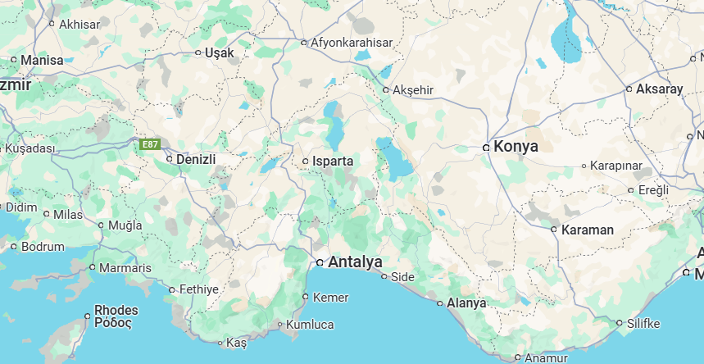

Slide 39
Exploring Churches in Galatia
Derbe, an ancient city in the region of Lycaonia (modern-day Turkey), was settled around 6 BC during the Roman period. It later became part of the Roman province of Galatia

Slide 40
Exploring Churches in Galatia
Antioch in Pisidia, also known as Antiochia in Pisidia, was founded in the last quarter of the 3rd century BC by the Seleucid Dynasty. However, it only gained prominence after it was refounded as a Roman colony by Augustus in 25 BC.

Slide 41
Exploring Churches in Galatia
Augustus (27 BC - 14 AD): The first Roman emperor, who established the Roman Empire and ruled from 27 BC to 14 CE.
Tiberius (14-37 AD): Augustus' stepson and successor, known for his reclusive and paranoid rule.
Caligula (37-41 AD): Known for his eccentric and cruel behavior, his reign was marked by extravagance and tyranny.
Claudius (41-54 AD): Despite being considered an unlikely candidate, he proved to be an effective emperor.
Nero (54-68 AD): Famous for his artistic ambitions and the Great Fire of Rome, his rule ended in rebellion and his suicide.

Slide 42
Exploring Churches in Galatia
Augustus (27 BC - 14 AD
Tiberius (14-37) AD
Caligula (37-41) AD.
Claudius (41-54) AD
Nero (54-68) AD.

Slide 43

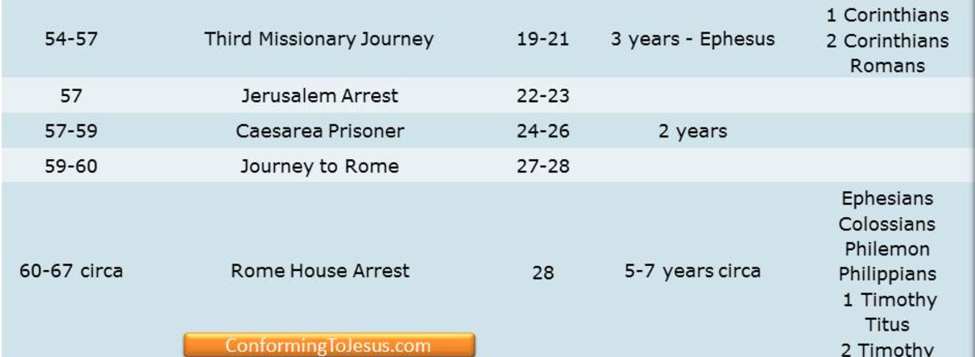

Slide 44
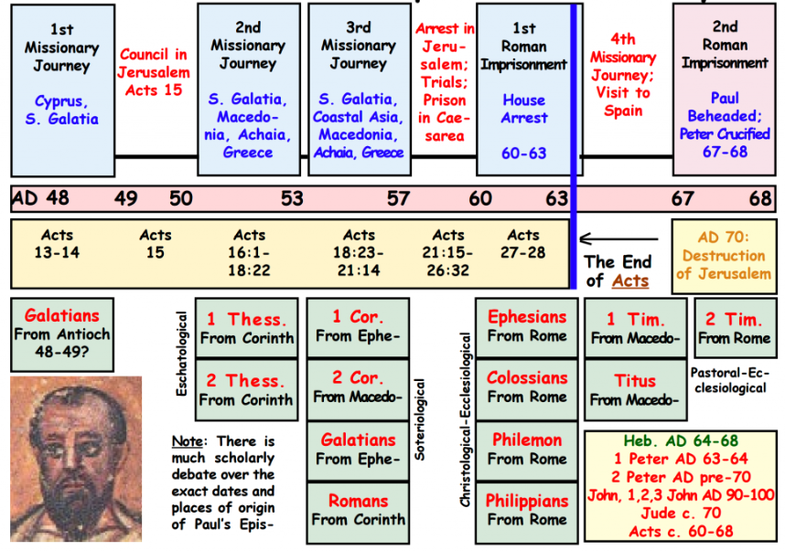

Slide 45
Saul Acts 6 Stephens’s Credentials
⁵ This proposal (choose someone to feed widows) pleased the whole group. They chose Stephen, a man full of faith and of the Holy Spirit; ……….⁶ They presented these men to the apostles, who prayed and laid their hands on them.
….number of disciples in Jerusalem increased rapidly, and a large number of priests became obedient to the faith.

Slide 46
Saul Acts 6 Stephens’s Credentials
⁸ Now Stephen, a man full of God’s grace and power, performed great wonders and signs among the people. ⁹ Opposition arose, however, from members of the Synagogue of the Freedmen (as it was called)—Jews of Cyrene and Alexandria as well as the provinces of Cilicia and Asia—who began to argue with Stephen. ¹⁰ But they could not stand up against the wisdom the Spirit gave him as he spoke.

Slide 47
Saul Acts 7 Stephens’s Lesson
⁵¹ “You stiff-necked people! Your hearts and ears are still uncircumcised. You are just like your ancestors: You always resist the Holy Spirit! ………⁵⁴ When the members of the Sanhedrin heard this, they were furious and gnashed their teeth at him. ⁵⁵ But Stephen, full of the Holy Spirit, looked up to heaven and saw the glory of God, and Jesus standing at the right hand of God. ⁵⁶ “Look,” he said, “I see heaven open and the Son of Man standing at the right hand of God.”

Slide 48
Saul Acts 7 Stephens’s Lesson
⁵¹ “You stiff-necked people! Your hearts and ears are still uncircumcised. You are just like your ancestors: You always resist the Holy Spirit! ………⁵⁴ When the members of the Sanhedrin heard this, they were furious and gnashed their teeth at him. ⁵⁵ But Stephen, full of the Holy Spirit, looked up to heaven and saw the glory of God, and Jesus standing at the right hand of God. ⁵⁶ “Look,” he said, “I see heaven open and the Son of Man standing at the right hand of God.”

Slide 49
Saul Acts 7 Stephens’s Lesson
⁵⁷ At this they covered their ears and, yelling at the top of their voices, they all rushed at him, ⁵⁸ dragged him out of the city and began to stone him. Meanwhile, the witnesses laid their coats at the feet of a young man named Saul.
⁵⁹ While they were stoning him, Stephen prayed, “Lord Jesus, receive my spirit.” ⁶⁰ Then he fell on his knees and cried out, “Lord, do not hold this sin against them.” When he had said this, he fell asleep.

Slide 50
Saul Acts 8 Saul’s zeal against “the way”
8 And Saul approved of their killing him.
The Church Persecuted and Scattered
On that day a great persecution broke out against the church in Jerusalem, and all except the apostles were scattered throughout Judea and Samaria. ² Godly men buried Stephen and mourned deeply for him. ³ But Saul began to destroy the church. Going from house to house, he dragged off both men and women and put them in prison.

Slide 51
Saul Acts 9 Saul’s zeal against “the way”
9 Meanwhile, Saul was still breathing out murderous threats against the Lord’s disciples. He went to the high priest ² and asked him for letters to the synagogues in Damascus, so that if he found any there who belonged to the Way, whether men or women, he might take them as prisoners to Jerusalem.

Slide 52
Saul Acts 8 Saul’s conversion
³ As he neared Damascus on his journey, suddenly a light from heaven flashed around him. ⁴ He fell to the ground and heard a voice say to him, “Saul, Saul, why do you persecute me?”

Slide 53
Saul Acts 8 Saul’s conversion
³ As he neared Damascus on his journey, suddenly a light from heaven flashed around him. ⁴ He fell to the ground and heard a voice say to him, “Saul, Saul, why do you persecute me?”
⁵ “Who are you, Lord?” Saul asked.
“I am Jesus, whom you are persecuting,” he replied. ⁶ “Now get up and go into the city, and you will be told what you must do.”

Slide 54
Saul Acts 9 Saul’s zeal against “the way”
⁷ The men traveling with Saul stood there speechless; they heard the sound but did not see anyone. ⁸ Saul got up from the ground, but when he opened his eyes he could see nothing. So they led him by the hand into Damascus. ⁹ For three days he was blind, and did not eat or drink anything.

Slide 55
Saul Acts 9 Saul’s conversion”
⁷ The men traveling with Saul stood there speechless; they heard the sound but did not see anyone. ⁸ Saul got up from the ground, but when he opened his eyes he could see nothing. So they led him by the hand into Damascus. ⁹ For three days he was blind, and did not eat or drink anything.

Slide 56
Saul Acts 9 Saul’s conversion”
¹⁰ In Damascus there was a disciple named Ananias. The Lord called to him in a vision, “Ananias!”
“Yes, Lord,” he answered.
¹¹ The Lord told him, for a man from Tarsus named Saul, for he is praying “Go to the house of Judas on Straight Street and ask . ¹² In a vision he has seen a man named Ananias come and place his hands on him to restore his sight.”

Slide 57
Saul Acts 9 Saul’s conversion”
¹³ “Lord,” Ananias answered, “I have heard many reports about this man and all the harm he has done to your holy people in Jerusalem. ¹⁴ And he has come here with authority from the chief priests to arrest all who call on your name.”
¹⁵ But the Lord said to Ananias, . “Go! This man is my chosen instrument to proclaim my name to the Gentiles and their kings and to the people of Israel. ¹⁶ I will show him how much he must suffer for my name”

Slide 58
Saul Acts 9 Saul’s conversion”
¹³ “Lord,” Ananias answered, “I have heard many reports about this man and all the harm he has done to your holy people in Jerusalem. ¹⁴ And he has come here with authority from the chief priests to arrest all who call on your name.”
¹⁵ But the Lord said to Ananias, . “Go! This man is my chosen instrument to proclaim my name to the Gentiles and their kings and to the people of Israel. ¹⁶ I will show him how much he must suffer for my name”

Slide 59
Saul Acts 9 Saul’s conversion”
¹⁷ Then Ananias went to the house and entered it. Placing his hands on Saul, he said, “Brother Saul, the Lord—Jesus, who appeared to you on the road as you were coming here—has sent me so that you may see again and be filled with the Holy Spirit.” ¹⁸ Immediately, something like scales fell from Saul’s eyes, and he could see again. He got up and was baptized, ¹⁹ and after taking some food, he regained his strength.

Slide 60
Saul Acts 9 Saul preaching in Damascus
Saul spent several days with the disciples in Damascus. ²⁰ At once he began to preach in the synagogues that Jesus is the Son of God. ²¹ All those who heard him were astonished and asked, “Isn’t he the man who raised havoc in Jerusalem among those who call on this name? And hasn’t he come here to take them as prisoners to the chief priests?” ²² Yet Saul grew more and more powerful and baffled the Jews living in Damascus by proving that Jesus is the Messiah.

Slide 61
Saul Acts 9 Saul escaping Damascus
²³ After many days had gone by, there was a conspiracy among the Jews to kill him, ²⁴ but Saul learned of their plan. Day and night they kept close watch on the city gates in order to kill him. ²⁵ But his followers took him by night and lowered him in a basket through an opening in the wall.

Slide 62
Saul Acts 9 Saul escaping Damascus
²³ After many days had gone by, there was a conspiracy among the Jews to kill him, ²⁴ but Saul learned of their plan. Day and night they kept close watch on the city gates in order to kill him. ²⁵ But his followers took him by night and lowered him in a basket through an opening in the wall.
Special mode of operation--- Preach then Escape

Slide 63
Saul Acts 9 Saul preaching in Jerusalem
²⁶ When he came to Jerusalem, he tried to join the disciples, but they were all afraid of him, not believing that he really was a disciple. ²⁷ But Barnabas took him and brought him to the apostles. He told them how Saul on his journey had seen the Lord and that the Lord had spoken to him, and how in Damascus he had preached fearlessly in the name of Jesus. ²⁸ So Saul stayed with them and moved about freely in Jerusalem, speaking boldly in the name of the Lord. ²⁹ He talked and debated with the Hellenistic Jews (then -→)

Slide 64
Saul Acts 9 Saul escaping Jerusalem
] but they tried to kill him. ³⁰ When the believers learned of this, they took him down to Caesarea and sent him off to Tarsus.
(another escape)

Slide 65
Saul Acts 9 Saul escaping Jerusalem
] but they tried to kill him. ³⁰ When the believers learned of this, they took him down to Caesarea and sent him off to Tarsus.
³¹ Then the church throughout Judea, Galilee and Samaria enjoyed a time of peace and was strengthened. Living in the fear of the Lord and encouraged by the Holy Spirit, it increased in numbers

Slide 66
Miracle | Saint | Place | Passage
1. Crippled man healed | Peter | Jerusalem | Acts 3:1-11
2. Death of Ananias and Sapphira | Peter | Jerusalem | Acts 5:1-10
3. Miraculous deeds | Peter | Jerusalem | Acts 5:12-16
4. Conferred the Holy Spirit | Peter | Samaria | Acts 8:14-17
5. Paul’s Conversion | Paul | Between Jerusalem and Damascus | Acts 9:1-9
6. Aeneas healed of palsy | Peter | Lydda | Acts 9:33-34

Slide 67
Miracle | Saint | Place | Passage
7. Tabitha (Dorcas) raised from the dead | Peter | Joppa | Acts 9:36-41
8. Peter rescued from prison by an angel | Peter | Jerusalem | Acts 12:7-17
9. Herod punished with death | Peter | Jerusalem | Acts 12:21-23
10. Elymas the sorcerer is stricken with blindness | Paul | Paphos | Acts 13:6-11
11. A crippled healed | Paul | Lystra | Acts 14:8-10
12. Exorcism of a demon of divination | Paul | Philippi | Acts 16:16-18

Slide 68
Miracle | Saint | Place | Passage
14. Conferred the Holy Spirit | Paul | Corinth | Acts 19:1-6
15. Many persons healed | Paul | Corinth | Acts 19:11-12
16. Eutychus raised from the dead | Paul | Troas | Acts 20:9-12
17. Viper snake rendered harmless | Paul | Malta | Acts 28:3-6
18. Publius’ father and others healed | Paul | Malta | Acts 28:7-9

Slide 69
Perplexed Galatians 4
¹⁹ My dear children, for whom I am again in the pains of childbirth until Christ is formed in you, ²⁰ how I wish I could be with you now and change my tone, because I am perplexed about you!

Slide 70
Perplexed Galatians 4
Perplexed - ἀπορέω ap-or-eh’-o G639
to be without resources, to be in straits, to be left wanting, to be embarrassed, to be in doubt, not to know which way to turn
to be at a loss with one's self, be in doubt
not to know how to decide or what to do, to be perplexed

Slide 71
Perplexed Galatians 4
Go - πορεύω G4198
to lead over, carry over, transfer
to pursue the journey on which one has entered, to continue on one's journey
to depart from life
to follow one, that is: become his adherent
to lead or order one's life
Notes:
The KJV translates Strong's G4198 in the following manner: go (117x), depart (11x), walk (9x), go (one's) way (8x), miscellaneous (9x).

Slide 72
Perplexed Galatians 4
Go - πορεύω G4198
And they were both righteous before God, walking ^{G4198} in all the commandments and ordinances of the Lord blameless. Luke 1:6
Notes:
The KJV translates Strong's G4198 in the following manner: go (117x), depart (11x), walk (9x), go (one's) way (8x), miscellaneous (9x).

Slide 73
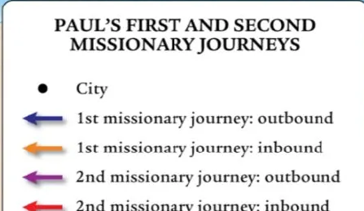

Galatia 1st and 2nd Journeys
Notes:
The KJV translates Strong's G4198 in the following manner: go (117x), depart (11x), walk (9x), go (one's) way (8x), miscellaneous (9x).

Slide 74
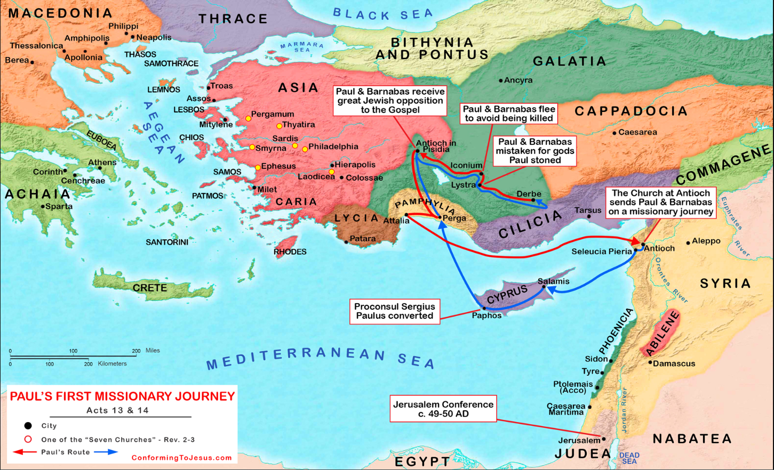

Slide 75
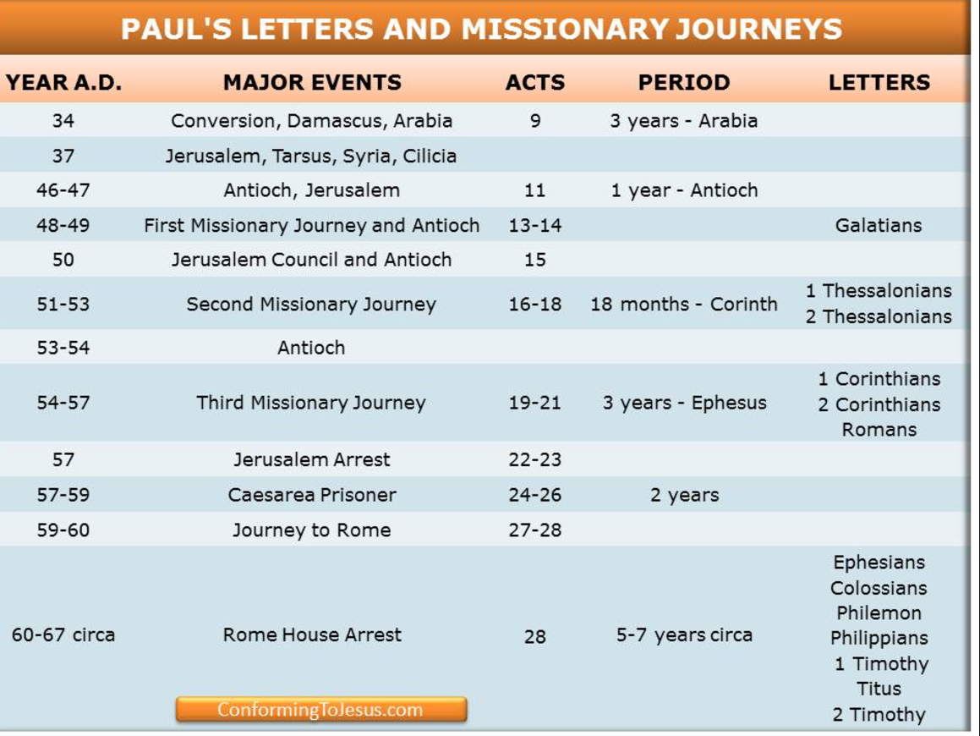

Slide 76
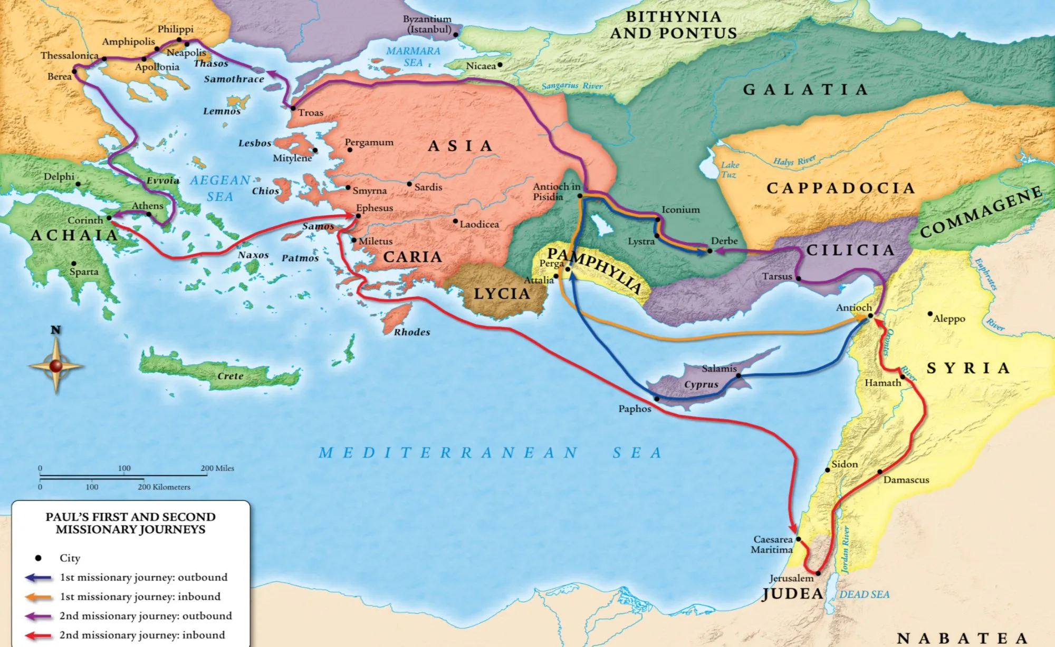
Galatia 1st and 2nd Journeys
Notes:
The KJV translates Strong's G4198 in the following manner: go (117x), depart (11x), walk (9x), go (one's) way (8x), miscellaneous (9x).

Slide 77
Galatia 1st and 2nd Journeys
Notes:
The KJV translates Strong's G4198 in the following manner: go (117x), depart (11x), walk (9x), go (one's) way (8x), miscellaneous (9x).

Slide 78
Galatia 1st and 2nd Journeys
Notes:
The KJV translates Strong's G4198 in the following manner: go (117x), depart (11x), walk (9x), go (one's) way (8x), miscellaneous (9x).

