Slide 1
Commentaries

Slide 2
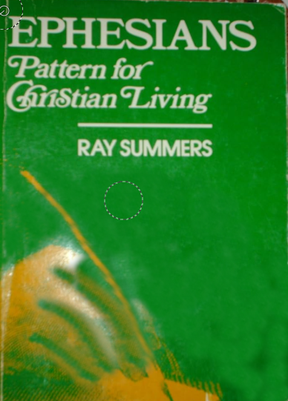
Patterns for Christian Living
Ray Summers Broadman Press © 1960 preface page v
Complete text of commentary at:
Ephesians : pattern for Christian living : Summers, Ray : Free Download, Borrow, and Streaming : Internet Archive

Slide 3
Patterns for Christian Living
Ray Summers Broadman Press © 1960 preface page v
Basically, there are two doctrines in the New Testament: how to be saved---that is,
(1) justification buy grace through faith plus nothing;
(2)and how the saved ought to live.
Comprehensively this covers the New Testament in a very real sense, every other doctrine is properly placed in one of these statements.

Slide 4
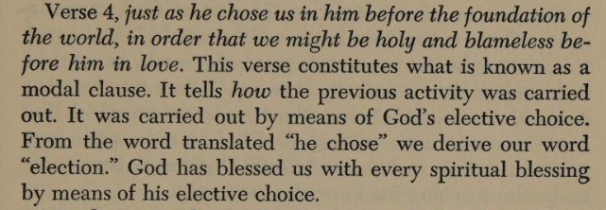
Patterns for Christian Living
Ray Summers Broadman Press © 1960 preface page v

Slide 5
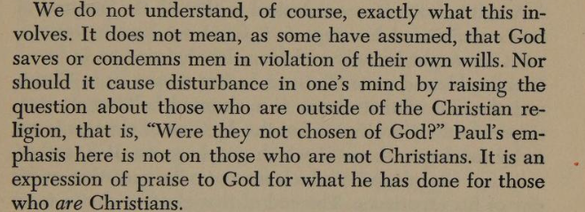
Patterns for Christian Living
Ray Summers Broadman Press © 1960 preface page v

Slide 6
Patterns for Christian Living
Ray Summers Broadman Press © 1960
Ray Summers makes a distinction between doctrine and application as follows:
Epistle | Doctrine | Application
Ephesians | 1-3 | 4-6
Romans | 1-11 | 12-16
Galatians | 1-4 | 5-6
Colossians | 1-2 | 3.4
1 Peter | 1:1 to 2:10 | 2:11 to 5:14
Hebrews | 1:1 top 10:18 | 10:19 to 13:25

Slide 7

New Testament Commentary
Willliam Hendriksen Baker Book Houses © 1967
https://archive.org/details/newtestamentcomm0000hend/page/n282/mode/1up?view=theater
( Calvinist Election)
Contains a Colossians vs Ephesians Comparison (21 pages)

Slide 8
New Testament Commentary
Willliam Hendriksen Baker Book Houses © 1967
The good with the questionable
https://archive.org/details/newtestamentcomm0000hend/page/n282/mode/1up?view=theater
( Calvinist Election not good)
Contains a Colossians vs Ephesians Comparison (21 pages) (Helpful)

Slide 9
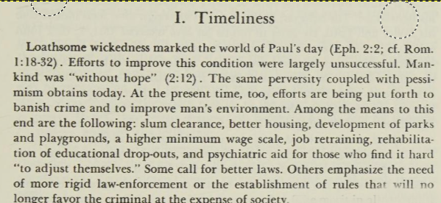
New Testament Commentary
Willliam Hendriksen Baker Book Houses © 1967

Slide 10
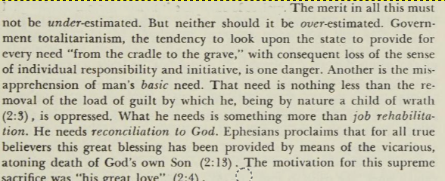
New Testament Commentary
Willliam Hendriksen Baker Book Houses © 1967

Slide 11
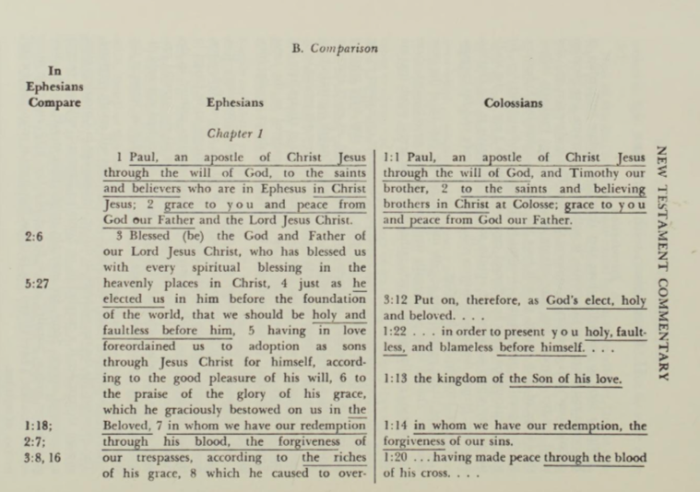
New Testament Commentary
Willliam Hendriksen Baker Book Houses © 1967
Approximately 55 verses in Colossians are duplicated in Ephesians

Slide 12
New Testament Commentary
Willliam Hendriksen Baker Book Houses © 1967
Approximately 55 verses in Colossians are duplicated in Ephesians

Slide 13
Dystopia : an imagined world or society in which people lead wretched, dehumanized, fearful lives
(a word unknown to a west Texas farm boy)

