Slide 1
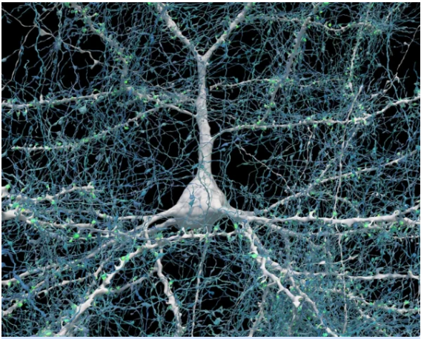
The amazing details of the Human brain
A small 1 mm3 sample from a human brain has been sliced and photographed with fantastic results. The sample has a volume similar a large grain of salt found on those large pretzels sold at fairs, malls or convince stores.

Slide 2
Hunan Brain Sample Details
Sample not a cube but has volume of 1 mm3
The sample is irregular in shape but has a thickness or 170 micrometers a thickness similar to the width of three fine human hairs. (arm hair)​. The sample was sliced in 5300 slices and photographed.
The Photographic data set is 1.4 petabytes. (1,400 trillion bytes)
A person would need the memory of 1400 of the most expensive (1 TB) iPhones to hold the sample data
The human brain is about 1350 cm3
Numbers for the sample could be extrapolated by a factor of 1,350,000 if one were to look at the whole brain. almost 2 billion I-phones to hold the data but it would take close to a 50 to 100 million man years to collect the data.
A single neuron (white) shown with 5,600 of the axons (blue) that connect to it. The synapses that make these connections are shown in green. Credit: Google Research & Lichtman Lab (Harvard University). Renderings by D. Berger (Harvard University)
https://www.hpcwire.com/2024/05/10/harvard-google-use-ai-to-help-produce-astonishing-3d-map-of-brain-tissue/

Slide 3
Hunan Brain Sample Details
Sample not a cube but has volume of 1 mm3
The sample is irregular in shape but has a thickness or 170 micrometers a thickness similar to the width of three fine human hairs. (arm hair)​. The sample was sliced in 5300 slices and photographed.
The Photographic data set is 1.4 petabytes. (1,400 trillion bytes)
A person would need the memory of 1400 of the most expensive (1 TB) iPhones to hold the sample data
The human brain is about 1350 cm3
Numbers for the sample could be extrapolated by a factor of 1,350,000 if one were to look at the whole brain. almost 2 billion I-phones to hold the data but it would take close to a 5 to 10 million man years to collect the data.
A single neuron (white) shown with 5,600 of the axons (blue) that connect to it. The synapses that make these connections are shown in green. Credit: Google Research & Lichtman Lab (Harvard University). Renderings by D. Berger (Harvard University)
https://www.hpcwire.com/2024/05/10/harvard-google-use-ai-to-help-produce-astonishing-3d-map-of-brain-tissue/

Slide 4
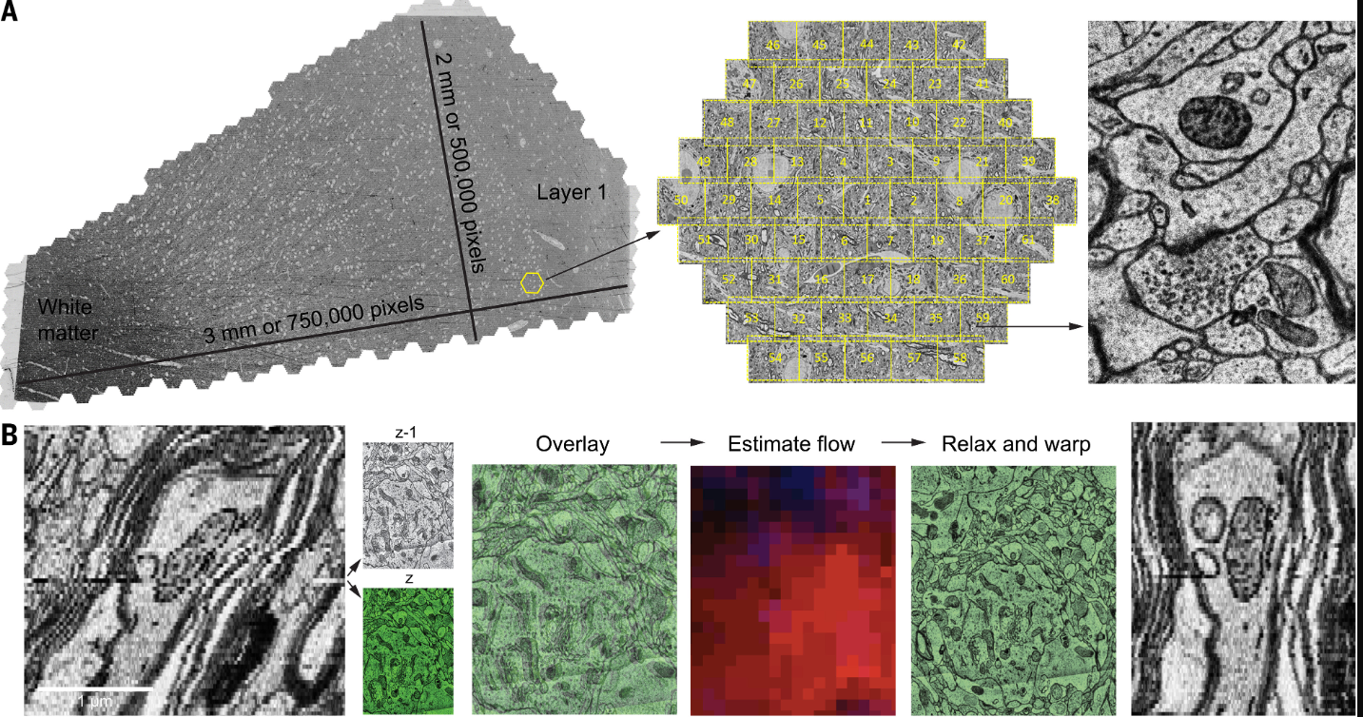

Slide 5
A petavoxel fragment of human cerebral cortex reconstructed at nanoscale resolution
Fig. 1
GO TO FIGURE LOCATION WITHIN THE ARTICLE
Fig. 1. H01 dataset, image acquisition, and alignment.
(A) A fresh human surgical cerebral cortex sample was rapidly preserved, stained, embedded in resin, sectioned at ~33 nm, collected on tape, and imaged using the ATUM–multibeam SEM (ATUM-mSEM) method. The Zeiss mSEM electron microscope uses 61 beams that image a hexagonal area of ~10,000 μm² simultaneously, which allows for large areas to be imaged rapidly. For each section, all of the resulting tiles were then stitched together (left); this section is ~4.5 mm² in area and was imaged with 4 × 4 nm² pixels. Image of synapse is shown at right. Given the necessity of some overlap between the stitched tiles, this single section required the collection of >300 gigabytes of data. (B) Fine-scale alignment with optical flow. Left: an x–y cross-section of the initial coarsely aligned subvolume exhibits drift and jitter. Center: two adjacent XY sections, z (green) and z-1, are overlaid to illustrate their misalignment. Image patch–based cross-correlation computes an x–y flow field between them. Red and blue intensities, which indicate the respective horizontal and vertical flow components, were used to warp one of the sections, improving their alignment (relax and warp overlay). Right: x–z view of the same subvolume with flow realignment applied.
Fig. 1. H01 dataset, image acquisition, and alignment.
(A) A fresh human surgical cerebral cortex sample was rapidly preserved, stained, embedded in resin, sectioned at ~33 nm, collected on tape, and imaged using the ATUM–multibeam SEM (ATUM-mSEM) method. The Zeiss mSEM electron microscope uses 61 beams that image a hexagonal area of ~10,000 μm² simultaneously, which allows for large areas to be imaged rapidly. For each section, all of the resulting tiles were then stitched together (left); this section is ~4.5 mm² in area and was imaged with 4 × 4 nm² pixels. Image of synapse is shown at right. Given the necessity of some overlap between the stitched tiles, this single section required the collection of >300 gigabytes of data. (B) Fine-scale alignment with optical flow. Left: an x–y cross-section of the initial coarsely aligned subvolume exhibits drift and jitter. Center: two adjacent XY sections, z (green) and z-1, are overlaid to illustrate their misalignment. Image patch–based cross-correlation computes an x–y flow field between them. Red and blue intensities, which indicate the respective horizontal and vertical flow components, were used to warp one of the sections, improving their alignment (relax and warp overlay). Right: x–z view of the same subvolume with flow realignment applied.
Aa
A petavoxel fragment of human cerebral cortex reconstructed at nanoscale resolution | Science

Slide 6
Hunan Brain Sample Details
Sample contains 57,000
It contains about 57,000 cells or 77 billion for whole brain,
Sample contains 230 mm of blood vessels.
230 mm is about 9 inches or 191 miles for the brain.
Synapses
Adjusting for the measured false discovery, false-negative, and excitatory or inhibitory misclassification rates, we estimate that the H01 volume contains a total of 102.5 million (67.1%) (137 trillion for entire brain) excitatory synapses and 50.3 million (32.9%) inhibitory synapses.
https://www.hpcwire.com/2024/05/10/harvard-google-use-ai-to-help-produce-astonishing-3d-map-of-brain-tissue/

