Slide 1
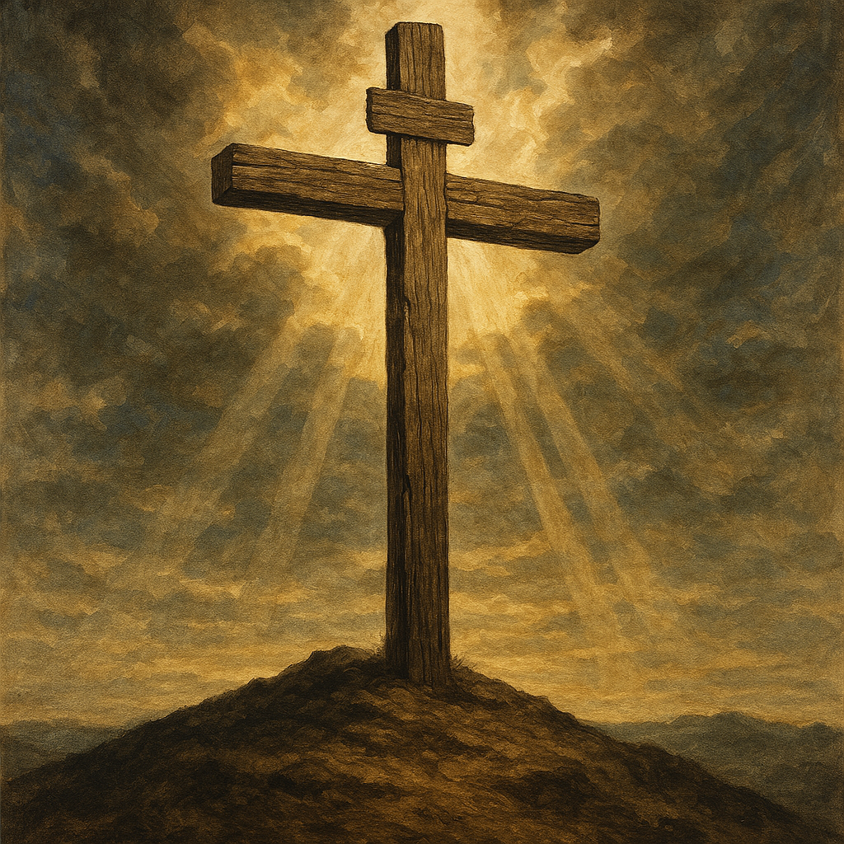
How to Live
Ephesians 5 /6
And the parallels to Colossians

Slide 2
How to Live
Ephesians 5
And the parallels to Colossians
As mentions before approximately 55 verses of Colossians and Ephesians have a similarity.

Slide 3
How to Live
Ephesians 5
And the parallels to Colossians
As mentioned before about 55 verses of Colossians and Ephesians have a connection . Heavenly realms seems to be distinct to Ephesians (or Laodiceans or any church) but does not resonate in Colossians. Many other themes such as Christan living are repeated and resonate between he two letters. Ephesians stands superlative in realms distinctions.

Slide 4
How to Live
Ephesians 5

Slide 5
Ephesians 5 NIV
5 ¹ Follow God’s example, therefore, as dearly loved children ² and walk in the way of love, just as Christ loved us and gave himself up for us as a fragrant offering and sacrifice to God.

Slide 6
Ephesians 5 NASB
5 ¹ Follow God’s example, therefore, as dearly loved children ² and walk in the way of love, just as Christ loved us and gave himself up for us as a fragrant offering and sacrifice to God.
How are we to follow God’s example?

Slide 7
Ephesians 5
5 Therefore be imitators of God, as beloved children; ² and walk in love, just as Christ also loved you and gave Himself up for us, an offering and a sacrifice to God as a fragrant aroma.
How do we imitate God?

Slide 8
Imitators of God
God so loved the world…. John 3:16
While we were still sinners Christ died for us…Rom 5:8
⁸ But God demonstrates his own love for us in this: While we were still sinners, Christ died for us.
We are to share agape love, mercy, grace, forgiveness, redemption, reconciliation, relationship, restoration, fellowship, spiritual blessings, and a peace that surpasses our understanding.

Slide 9
Colossians 3:12
¹² Therefore, as God’s chosen people, holy and dearly loved, clothe yourselves with compassion, kindness, humility, gentleness and patience. ¹³ Bear with each other and forgive one another if any of you has a grievance against someone. Forgive as the Lord forgave you. ¹⁴ And over all these virtues put on love, which binds them all together in perfect unity.
How do we imitate God?

Slide 10
Immorality
Eph 5 ³ But among you there must not be even a hint of sexual immorality, or of any kind of impurity, or of greed, because these are improper for God’s holy people. ⁴ Nor should there be obscenity, foolish talk or coarse joking, which are out of place, but rather thanksgiving.

Slide 11
Immorality
Col 3 ⁵ Put to death, therefore, whatever belongs to your earthly nature: sexual immorality, impurity, lust, evil desires and greed, which is idolatry. ⁶ Because of these, the wrath of God is coming. ⁷ You used to walk in these ways, in the life you once lived. ⁸ But now you must also rid yourselves of all such things as these: anger, rage, malice, slander, and filthy language from your lips. ⁹ Do not lie to each other, since you have taken off your old self with its practices

Slide 12
God’s Wrath Against Sinful Humanity
Rom 1 ¹⁸ The wrath of God is being revealed from heaven against all the godlessness and wickedness of people, who suppress the truth by their wickedness, ¹⁹ since what may be known about God is plain to them, because God has made it plain to them.

Slide 13
God’s Wrath Against Sinful Humanity
Rom 1 ²⁰ For since the creation of the world God’s invisible qualities—his eternal power and divine nature—have been clearly seen, being understood from what has been made, so that people are without excuse.

Slide 14
God’s Wrath Against Sinful Humanity
Rom 1 ²¹ For although they knew God, they neither glorified him as God nor gave thanks to him, but their thinking became futile and their foolish hearts were darkened. ²² Although they claimed to be wise, they became fools ²³ and exchanged the glory of the immortal God for images made to look like a mortal human being and birds and animals and reptiles.

Slide 15
God’s Wrath Against Sinful Humanity
Rom 1 ²⁴ Therefore God gave them over in the sinful desires of their hearts to sexual impurity for the degrading of their bodies with one another. ²⁵ They exchanged the truth about God for a lie, and worshiped and served created things rather than the Creator—who is forever praised. Amen

Slide 16
God’s Wrath Against Sinful Humanity
Rom 1 ²⁶ Because of this, God gave them over to shameful lusts. Even their women exchanged natural sexual relations for unnatural ones. ²⁷ In the same way the men also abandoned natural relations with women and were inflamed with lust for one another. Men committed shameful acts with other men, and received in themselves the due penalty for their error.

Slide 17
God’s Wrath Against Sinful Humanity
Rom 1 ²⁸ Furthermore, just as they did not think it worthwhile to retain the knowledge of God, so God gave them over to a depraved mind, so that they do what ought not to be done. ²⁹ They have become filled with every kind of wickedness, evil, greed and depravity. They are full of envy, murder, strife, deceit and malice. They are gossips, ³⁰ slanderers, God-haters, insolent, arrogant and boastful; they invent ways of doing evil; they disobey their parents.

Slide 18
God’s Wrath Against Sinful Humanity
Rom 1 ³¹ they have no understanding, no fidelity, no love, no mercy. ³² Although they know God’s righteous decree that those who do such things deserve death, they not only continue to do these very things but also approve of those who practice them.

Slide 19
Items of worldliness that violate the covenant
EPH 5 . ⁵ For of this you can be sure: No immoral, impure or greedy person—such a person is an idolater—has any inheritance in the kingdom of Christ and of God. ⁶ Let no one deceive you with empty words, for because of such things God’s wrath comes on those who are disobedient. ⁷ Therefore do not be partners with them.

Slide 20
Children of Light
EPH 5 ⁸ For you were once darkness, but now you are light in the Lord. Live as children of light ⁹ (for the fruit of the light consists in all goodness, righteousness and truth) ¹⁰ and find out what pleases the Lord. ¹¹ Have nothing to do with the fruitless deeds of darkness, but rather expose them.

Slide 21
Children of Light
Col 1 ¹⁰ so that you may live a life worthy of the Lord and please him in every way: bearing fruit in every good work, growing in the knowledge of God, ¹¹ being strengthened with all power according to his glorious might so that you may have great endurance and patience, ¹² and giving joyful thanks to the Father, who has qualified you^{[f]} to share in the inheritance of his holy people in the kingdom of light. ¹³

Slide 22
Children of Light
¹² It is shameful even to mention what the disobedient do in secret. ¹³ But everything exposed by the light becomes visible—and everything that is illuminated becomes a light.

Slide 23
Children of Light
The dead verses alive paradigm has now been exchanged for the darkness verses light. In the beginning light overcame the darkness of chaos Gen 1 while Jesus makes the proclamation the he is the light of the world. John 8. Paul will go on to describe deeds of light verses darkness and our obligation to expose darkness in view of the light.

Slide 24
Children of Light 1 Peter 1:9
⁹ But you are a chosen people, a royal priesthood, a holy nation, God’s special possession, that you may declare the praises of him who called you out of darkness into his wonderful light. ¹⁰ Once you were not a people, but now you are the people of God; once you had not received mercy, but now you have received mercy.

Slide 25
Children of Light 1 Peter 1:9
⁹ But you are a chosen people, a royal priesthood, a holy nation, God’s special possession, that you may declare the praises of him who called you out of darkness into his wonderful light. ¹⁰ Once you were not a people, but now you are the people of God; once you had not received mercy, but now you have received mercy.

Slide 26
John 1 light
“⁴ In him was life, and that life was the light of all mankind. ⁵ The light shines in the darkness, and the darkness has not overcome it
⁹ The true light that gives light to everyone was coming into the world. ¹⁰ He was in the world, and though the world was made through him, the world did not recognize him. ¹¹ He came to that which was his own, but his own did not receive him. ¹² Yet to all who did receive him, to those who believed in his name, he gave the right to become children of God—

Slide 27
John 1 light
“⁴ In him was life, and that life was the light of all mankind. ⁵ The light shines in the darkness, and the darkness has not overcome it
⁹ The true light that gives light to everyone was coming into the world. ¹⁰ He was in the world, and though the world was made through him, the world did not recognize him. ¹¹ He came to that which was his own, but his own did not receive him. ¹² Yet to all who did receive him, to those who believed in his name, he gave the right to become children of God—

Slide 28
John 8 light
¹² When Jesus spoke again to the people, he said, “I am the light of the world. Whoever follows me will never walk in darkness, but will have the light of life.”

Slide 29
Col 1:13 light
¹³ For he has rescued us from the dominion of darkness and brought us into the kingdom of the Son he loves, ¹⁴ in whom we have redemption, the forgiveness of sins.

Slide 30
Time is precious /Encounters are limited
EPH 5 ¹⁶ making the most of every opportunity, because the days are evil. ¹⁷ Therefore do not be foolish, but understand what the Lord’s will is.

Slide 31
Lifestyle Decisions Eph 5:18-20
¹⁸ Do not get drunk on wine, which leads to debauchery. Instead, be filled with the Spirit, ¹⁹ speaking to one another with psalms, hymns, and songs from the Spirit. Sing and make music from your heart to the Lord, ²⁰ always giving thanks to God the Father for everything, in the name of our Lord Jesus Christ

Slide 32
Lifestyle Decisions Col 3:16-17
¹⁶ Let the message of Christ dwell among you richly as you teach and admonish one another with all wisdom through psalms, hymns, and songs from the Spirit, singing to God with gratitude in your hearts. ¹⁷ And whatever you do, whether in word or deed, do it all in the name of the Lord Jesus, giving thanks to God the Father

Slide 33
The small Church
COL 3 ¹⁸ Wives, submit yourselves to your husbands, as is fitting in the Lord.
¹⁹ Husbands, love your wives and do not be harsh with them.
²⁰ Children, obey your parents in everything, for this pleases the Lord.
²¹ Fathers, do not embitter your children, or they will become discouraged.

Slide 34
The small Church
EPH 5 ²² Wives, submit yourselves to your own husbands as you do to the Lord. ²³ For the husband is the head of the wife as Christ is the head of the church, his body, of which he is the Savior. ²⁴ Now as the church submits to Christ, so also wives should submit to their husbands in everything.
Slides / verse order backward by intent.

Slide 35
The small Church
EPH 5 ²⁵ Husbands, love your wives, just as Christ loved the church and gave himself up for her ²⁶ to make her holy, cleansing her by the washing with water through the word, ²⁷ and to present her to himself as a radiant church, without stain or wrinkle or any other blemish, but holy and blameless. ²⁸ In this same way, husbands ought to love their wives as their own bodies. He who loves his wife loves himself.

Slide 36
. ²⁹ After all, no one ever hated their own body, but they feed and care for their body, just as Christ does the church— ³⁰ for we are members of his body. ³¹ “For this reason a man will leave his father and mother and be united to his wife, and the two will become one flesh.” ³² This is a profound mystery—but I am talking about Christ and the church. ³³ However, each one of you also must love his wife as he loves himself, and the wife must respect her husband.

Slide 37
Children
EPH 6 ¹ Children, obey your parents in the Lord, for this is right. ² “Honor your father and mother”—which is the first commandment with a promise— ³ “so that it may go well with you and that you may enjoy long life on the earth.”⁴ Fathers, do not exasperate your children; instead, bring them up in the training and instruction of the Lord.

Slide 38
Slaves
EPH 6 ⁵ Slaves, obey your earthly masters with respect and fear, and with sincerity of heart, just as you would obey Christ. ⁶ Obey them not only to win their favor when their eye is on you, but as slaves of Christ, doing the will of God from your heart. ⁷ Serve wholeheartedly, as if you were serving the Lord, not people, ⁸ because you know that the Lord will reward each one for whatever good they do, whether they are slave or free.
⁹ And masters, treat your slaves in the same way. Do not threaten them, since you know that he who is both their Master and yours is in heaven, and there is no favoritism with him.

Slide 39
Slaves
Col 3 ²² Slaves, obey your earthly masters in everything; and do it, not only when their eye is on you and to curry their favor, but with sincerity of heart and reverence for the Lord. ²³ Whatever you do, work at it with all your heart, as working for the Lord, not for human masters, ²⁴ since you know that you will receive an inheritance from the Lord as a reward. It is the Lord Christ you are serving. ²⁵ Anyone who does wrong will be repaid for their wrongs, and there is no favoritism.

Slide 40
How to Live
Ephesians 5
And the parallels to Colossians

Slide 41
Ephesians 5
5 ¹ Follow God’s example, therefore, as dearly loved children ² and walk in the way of love, just as Christ loved us and gave himself up for us as a fragrant offering and sacrifice to God.
AND WALK IN LOVE

Slide 42
Eph 1:1 Col 1:1
1 Paul, an apostle of Christ Jesus by the will of God,
To God’s holy people in Ephesus,^{[a]} the faithful in Christ Jesus: ² Grace and peace to you from God our Father and the Lord Jesus Christ
,^{[a]}(Ephesians 1:1 Some early manuscripts do not have in Ephesus.)
1 Paul, an apostle of Christ Jesus by the will of God, and Timothy our brother, To God’s holy people in Colossae, the faithful brothers and sisters^{[a]} in Christ:
Grace and peace to you from God our Father.

Slide 43
Eph 1:4 Col 3:12 1:22
⁴ For he chose us in him before the creation of the world to be holy and blameless in his sight. In love
¹² Therefore, as God’s chosen people, holy and dearly loved, clothe yourselves with compassion, kindness, humility, gentleness and patience..
²² But now he has reconciled you by Christ’s physical body through death to present you holy in his sight, without blemish and free from accusation

Slide 44
Eph 1:7 Col 3:14
⁷ In him we have redemption through his blood, the forgiveness of sins, in accordance with the riches of God’s grace
¹³ For he has rescued us from the dominion of darkness and brought us into the kingdom of the Son he loves, ¹⁴ in whom we have redemption, the forgiveness of sins.

Slide 45
Eph 1:8-9 Col 1:9 1:26
⁸ that he lavished on us. With all wisdom and understanding, ⁹ he made known to us the mystery of his will according to his good pleasure, which he purposed in Christ
⁹ For this reason, since the day we heard about you, we have not stopped praying for you. We continually ask God to fill you with the knowledge of his will through all the wisdom and understanding that the Spirit gives,. — ²⁶ the mystery that has been kept hidden for ages and generations, but is now disclosed to the Lord’s people.

Slide 46
How to Live
Ephesians
And other parallels to Colossians

Slide 47
Eph 1:10 Col 1:16
¹⁰ to be put into effect when the times reach their fulfillment—to bring unity to all things in heaven and on earth under Christ.
¹⁶ For in him all things were created: things in heaven and on earth, visible and invisible, whether thrones or powers or rulers or authorities; all things have been created through him and for him

Slide 48
Eph 1:12 Col 1:23
¹¹ In him we were also chosen*, having been predestined according to the plan of him who works out everything in conformity with the purpose of his will, ¹² in order that we, who were the first to put our hope in Christ, might be for the praise of his glory.
*Ephesians 1:11 Or were made heirs
²³ if you continue in your faith, established and firm, and do not move from the hope held out in the gospel.

Slide 49
Ephesians 5
5 ¹ Follow God’s example, therefore, as dearly loved children ² and walk in the way of love, just as Christ loved us and gave himself up for us as a fragrant offering and sacrifice to God.

Slide 50
Ephesians 5
5 ¹ Follow God’s example,
Last week there was a contrast of the NIV to the NASB1995 which follows
5 Therefore be imitators of God.
In my weakness I proposed a list of the attributes of God that need our imitations.
The list has been augmented by Paul’s challenge to the Romans to place others ahead of yourself.
Read the bible and engage with Christins to confirm your list of attributes that imitate God,

Slide 51
Imitators of God
God so loved the world…. John 3:16
While we were still sinners Christ died for us…Rom 5:8
⁸ But God demonstrates his own love for us in this: While we were still sinners, Christ died for us.
We are to share agape love, mercy, grace, forgiveness, redemption, reconciliation, relationship, restoration, fellowship, spiritual blessings, and a peace that surpasses our understanding. We should count others as more important than ourselves.

Slide 52
Imitators of God
God so loved the world…. John 3:16
While we were still sinners Christ died for us…Rom 5:8
⁸ But God demonstrates his own love for us in this: While we were still sinners, Christ died for us.
We are to share agape love, mercy, grace, forgiveness, redemption, reconciliation, relationship, restoration, fellowship, spiritual blessings, and a peace that surpasses our understanding. We should count others as more important than ourselves. Search the scripture and fellowship with true Christians to shape the ways to imitate God.

Slide 53
Ephesians 5
5 ¹ Follow God’s example, therefore, as dearly loved children ² and walk in the way of love, just as Christ loved us and gave himself up for us as a fragrant offering and sacrifice to God.

Slide 54
Romans 8
8 Therefore, there is now no condemnation for those who are in Christ Jesus, ² because through Christ Jesus the law of the Spirit who gives life has set you free from the law of sin and death. ³ For what the law was powerless to do because it was weakened by the flesh, God did by sending his own Son in the likeness of sinful flesh to be a sin offering.

Slide 55
Romans 8
^{3B} And so he condemned sin in the flesh, ⁴ in order that the righteous requirement of the law might be fully met in us, who do not live according to the flesh but according to the Spirit.

Slide 56
Romans 8
^{3B} And so he condemned sin in the flesh, ⁴ in order that the righteous requirement of the law might be fully met in us, who do not live according to the flesh but according to the Spirit.

Slide 57
Ephesians 5
5 ¹ Follow God’s example, therefore, as dearly loved children ² and walk in the way of love, just as Christ loved us and gave himself up for us as a fragrant offering and sacrifice to God.
How are we to follow God’s example?

Slide 58
Ephesians 5
5 Therefore be imitators of God, as beloved children; ² and walk in love, just as Christ also loved you and gave Himself up for us, an offering and a sacrifice to God as a fragrant aroma.
How do we imitate God?

Slide 59
Lifestyle Decisions.
¹⁸ Do not get drunk on wine, which leads to debauchery. Instead, be filled with the Spirit, ¹⁹ speaking to one another with psalms, hymns, and songs from the Spirit. Sing and make music from your heart to the Lord, ²⁰ always giving thanks to God the Father for everything, in the name of our Lord Jesus Christ

Slide 60
Otherness is a realization that others are more important than me. First and foremost this is applicable to our mate, our family, and our brothers and sisters in Christ followed by neighbors then strangers then maybe me.
^{Eph 5 21} Submit to one another out of reverence for Christ.
This is an invocation to Pauls note to the Romans

Slide 61
Love in Action
Romans 12 ⁹ Love must be sincere. Hate what is evil; cling to what is good. ¹⁰ Be devoted to one another in love. Honor one another above yourselves. ¹¹ Never be lacking in zeal, but keep your spiritual fervor, serving the Lord. ¹² Be joyful in hope, patient in affliction, faithful in prayer. ¹³ Share with the Lord’s people who are in need. Practice hospitality.
.

Slide 62
Love in Action
Romans 12 ⁹ Love must be sincere. Hate what is evil; cling to what is good. ¹⁰ Be devoted to one another in love. Honor one another above yourselves. ¹¹ Never be lacking in zeal, but keep your spiritual fervor, serving the Lord. ¹² Be joyful in hope, patient in affliction, faithful in prayer. ¹³ Share with the Lord’s people who are in need. Practice hospitality.
.

Slide 63
The small Church
EPH 5 ²⁵ Husbands, love your wives, just as Christ loved the church and gave himself up for her ²⁶ to make her holy, cleansing her by the washing with water through the word, ²⁷ and to present her to himself as a radiant church, without stain or wrinkle or any other blemish, but holy and blameless. ²⁸ In this same way, husbands ought to love their wives as their own bodies. He who loves his wife loves himself.

Slide 64
The small Church
EPH 5 ²⁵ Husbands, love your wives, just as Christ loved the church and gave himself up for her .
What woman would not desire a man that is sacrificial for her?
Slides backward by intent.

Slide 65
The small Church
EPH 5 ²² Wives, submit yourselves to your own husbands as you do to the Lord. ²³ For the husband is the head of the wife as Christ is the head of the church, his body, of which he is the Savior. ²⁴ Now as the church submits to Christ, so also wives should submit to their husbands in everything.
Slides / verse order backward by intent.

Slide 66
The small Church
EPH 5 ²² Wives, submit yourselves to your own husbands as you do to the Lord. ²³ For the husband is the head of the wife as Christ is the head of the church, his body, of which he is the Savior. ²⁴ Now as the church submits to Christ, so also wives should submit to their husbands in everything.
How is the small church to response the sacrificial?
Slides / verse order backward by intent.

Slide 67
. ²⁹ After all, no one ever hated their own body, but they feed and care for their body, just as Christ does the church— ³⁰ for we are members of his body. ³¹ “For this reason a man will leave his father and mother and be united to his wife, and the two will become one flesh.” ³² This is a profound mystery—but I am talking about Christ and the church. ³³ However, each one of you also must love his wife as he loves himself, and the wife must respect her husband.

