Slide 1
Marcion of Sinope 85-160 A.D
Marcion was a theologian in early Christianity. Marcion preached that God had sent Jesus Christ, who was distinct from the "vengeful" God (Demiurge) who had created the world. He considered himself a follower of Paul the Apostle, whom he believed to have been the only true apostle of Jesus Christ; his doctrine is called Marcionism. Marcion published the earliest record of a canon of New Testament books.
The practice of Marcionism would last hundreds of years.
Some identify Marcion as the first Christian heretic. He was excommunicated in 144.

Slide 2
Demiurge – a subordinate god
Plato used the term in the dialog Timaeus, an exposition of cosmology in which the Demiurge is the agent who takes the preexisting materials of chaos, arranges them according to the models of eternal forms, and produces all the physical things of the world, including human bodies. The Demiurge is sometimes thought of as the Platonic personification of active reason. The term was later adopted by some of the Gnostics, who, in their dualistic worldview, saw the Demiurge as one of the forces of evil, who was responsible for the creation of the despised material world and was wholly alien to the supreme God of goodness.

Slide 3
Docetic
Docetic describes beliefs or teachings, particularly an early Christian heresy, that Jesus Christ only seemed or appeared to be human, rather than having a real physical body, stemming from the Greek word dokein ("to seem"). Docetism suggested Christ's body was an illusion, his life and suffering unreal, because matter was viewed as evil and incompatible with the divine. This view was combated by early apostles and Church Fathers (like John and Ignatius of Antioch) who emphasized Christ's true humanity and full embodiment for salvation.

Slide 4
Justin Martyr, Irenaeus, and Tertullian on Marcion
Key Themes Across All Three Writers
Refutation of Dualism: All three writers reject Marcion’s teaching of two gods and defend the unity of God.
(God of the old testament differs from God of the New Testament)

Slide 5
Justin Martyr, Irenaeus, and Tertullian on Marcion
Key Themes Across All Three Writers
Defense of the Old Testament: They argue for the validity and continuity of the Old Testament as Christian scripture.
Canon Formation: Marcion’s edited canon prompted responses that helped shape the Christian biblical canon.
Polemic Tone: Each writer presents Marcion as a serious threat to orthodox Christianity, often using strong language and detailed argumentation

Slide 6
Tertullian circa 200 Ad on Marcion Adversus Marcionem
Books 1 and 2 refute Marcion's dualism; Book 3 shows that Jesus is the messiah of the Old Testament. Books 4 and 5 discuss Marcion's butchered 'gospel' and 'letters' of Paul.

Slide 7
Tertullian c. 155–220 AD on Marcion Adversus Marcionem c. 200 AD
Chapter VIII. ----Other Proofs from the Same Chapter, that Jesus, Who Preached at Nazareth, and Was Acknowledged by Certain Demons as Christ the Son of God, Was the Creator's Christ. As Occasion Offers, the Docetic Errors of Marcion are Exposed.

Slide 8
𝔓⁴⁶ Papyrus 46
Before 1900 AD only 4 Papyri were known.
There are now 140 papyri. While many are fragmentary pages of only a few verses several have entire new testament books.
In 1930 Chester Beatty acquired 13 papyri (#2 of 13 being 𝔓⁴⁶ )
It contains a large portion of Romans and most of Hebrews, 1 & 2 Corinthians, Ephesians, Galatians, Philippians, Colossians, and portions of1 Thessalonians. (this is also the order within the document)

Slide 9
Greek View Platonic
Demiurge ~ Craftsman
Supreme god
Demiurge
Creator of world from Chaos
Seeds of Gnosticism are related to views of Plato.
Imperfect World mere copies of “forms”

Slide 10
Marcion of Sinope 85-160 A.D
God of the Old Testament
God of the New Testament
Marcion’s docetic view contributes to some forms of Gnosticism
Docetic view of Jesus

Slide 11
Plato’s and Marcion’s dilemma
How does a perfect spiritual entity deal with a flawed mankind?

Slide 12
Plato’s and Marcion’s dilemma
How does a perfect spiritual entity deal with a flawed mankind?
How can a flawed person have a direct relationship with this perfect Creator?

Slide 13
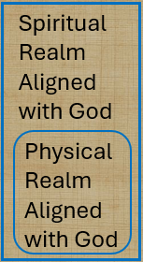
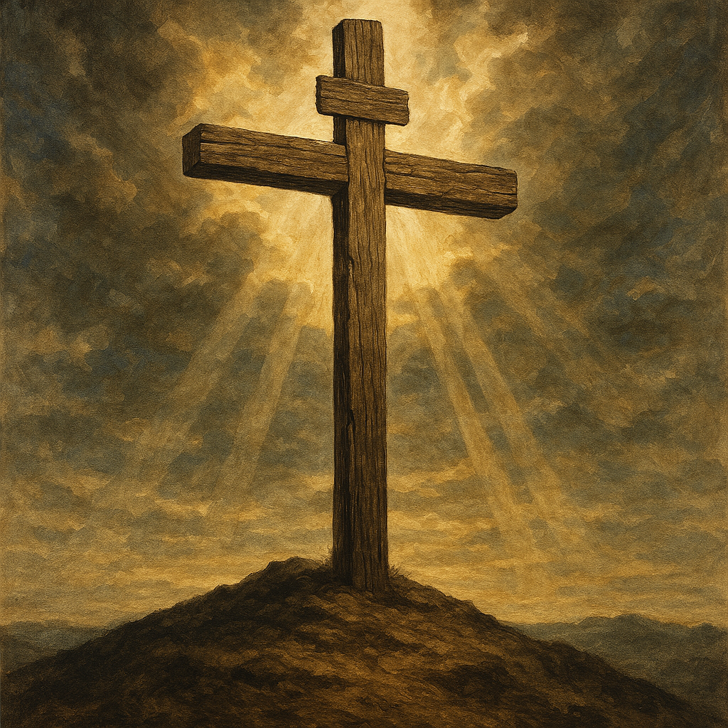
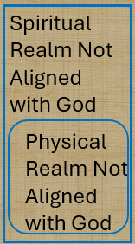
Spiritual Realms
BLESSINGS
^{John 3 16}
loved
believes
shall not perish
eternal life
not condemned,
^{Eph 2:4}
love
Mercy
ALIVE
Grace
Raised
^{Eph 2:4}
Seated with Christ
Incomparable riches
kindness
^{John3: 18b}
does not believe
condemned
CURSES
^{Eph 2:1}
DEAD transgressions
sin
worldly
disobedient
^{Eph 2:1}
^{Fleshly}
^{wrath}
Expand lists by inference

Slide 14

Where are we? Ephesians 2
⁴ But because of his great love for us, God, who is rich in mercy, ⁵ made us alive with Christ even when we were dead in transgressions—it is by grace you have been saved. ⁶ And God raised us up with Christ and seated us with him in the heavenly realms in Christ Jesus, ⁷ in order that in the coming ages he might show the incomparable riches of his grace, expressed in his kindness to us in Christ Jesus
Notes:
Introduction to the Book of Ephesians, using the Western Heights Church of Christ logo. This presentation will delve into the key themes and messages of the Apostle Paul's letter to the Ephesians, exploring its relevance to modern Christian life.

Slide 15
Accessibility
The profound truth that confounded Plato, Marcion, and the emerging Gnostics is that our God though Jesus and the Holy Spirit has granted us 24/7 access to the very throne room of the Creator.
No special or mystic knowledge is required only to learn what Christ has done for us and the grace that comes directly though the sacrifice of Jesus on the cross. Any “mystery” that seemed to been hidden from the prophets is unraveled by the Gospels and the New Testament writers.
God came to us giving us Jesus and he Holy Spirit. Any blockage imagined is nullified buy the provision of the triune completeness clearing any impediment to have a personal communicative relationship with God.

Slide 16
Access granted
1 John 2 ¹ My dear children, I write this to you so that you will not sin. But if anybody does sin, we have an advocate with the Father—Jesus Christ, the Righteous One. ² He is the atoning sacrifice for our sins, and not only for ours but also for the sins of the whole world.

Slide 17
Access granted
Romans 8 ²⁶ In the same way, the Spirit helps us in our weakness. We do not know what we ought to pray for, but the Spirit himself intercedes for us through wordless groans. ²⁷ And he who searches our hearts knows the mind of the Spirit, because the Spirit intercedes for God’s people in accordance with the will of God.

Slide 18
Access granted
Humans have a misguided notion that they are seeking a god.
God came looking for us.

Slide 19
God came looking for us. (very un-gnostic)
God so loved the world…. John 3:16
While we were still sinners Christ died for us…Rom 5:8
⁸ But God demonstrates his own love for us in this: While we were still sinners, Christ died for us.
We are recipients of agape love, mercy, grace, forgiveness, redemption, reconciliation, relationship, restoration, fellowship, spiritual blessings, and a peace that surpasses our understanding.

Slide 20
How to Live
Ephesians 5

Slide 21
Ephesians 5
5 ¹ Follow God’s example, therefore, as dearly loved children ² and walk in the way of love, just as Christ loved us and gave himself up for us as a fragrant offering and sacrifice to God.

Slide 22
Ephesians 5
5 ¹ Follow God’s example, therefore, as dearly loved children ² and walk in the way of love, just as Christ loved us and gave himself up for us as a fragrant offering and sacrifice to God.
How are we to follow God’s example?

Slide 23
Ephesians 5
5 Therefore be imitators of God, as beloved children; ² and walk in love, just as Christ also loved you and gave Himself up for us, an offering and a sacrifice to God as a fragrant aroma.
How do we imitate God?

Slide 24
Imitators of God
God so loved the world…. John 3:16
While we were still sinners Christ died for us…Rom 5:8
⁸ But God demonstrates his own love for us in this: While we were still sinners, Christ died for us.
We are to share agape love, mercy, grace, forgiveness, redemption, reconciliation, relationship, restoration, fellowship, spiritual blessings, and a peace that surpasses our understanding.

Slide 25
Ephesians 5
5 ¹ Follow God’s example, therefore, as dearly loved children ² and walk in the way of love, just as Christ loved us and gave himself up for us as a fragrant offering and sacrifice to God.
Review sacrifice as covered by the Hebrew writer

Slide 26
Hebrews 10 sacrifice
¹¹ Every priest stands daily ministering and offering time after time the same sacrifices, which can never take away sins; ¹² but He, having offered one sacrifice for]sins for all time, sat down at the right hand of God, ¹³ waiting from that time onward until His enemies be made a footstool for His feet. ¹⁴ For by one offering He has perfected for all time those who are sanctified. ¹⁵ And the Holy Spirit also testifies to us; for after saying,

Slide 27
Hebrews 10 sacrifice leading to covenant
¹⁶ “This is the covenant that I will make with them After those days, says the Lord: I will put My laws upon their heart, And on their mind I will write them,” (Jer 31: 33)
He then says,
¹⁷ “And their sins and their lawless deeds I will remember no more. (Jer 31:34 )

Slide 28
Covenant attributes of God(very un-gnostic)
God so loved the world…. John 3:16
While we were still sinners Christ died for us…Rom 5:8
⁸ But God demonstrates his own love for us in this: While we were still sinners, Christ died for us.
Followers are recipients of agape love, mercy, grace, forgiveness, redemption, reconciliation, relationship, restoration, fellowship, spiritual blessings, and a peace that surpasses our understanding.

Slide 29
We are in a covenant relationship with God. Having Christ reminding us of his blood of the covenant is a reminder that sacrifice and covenants are conjoined.

Slide 30
The items of worldliness that violate the covenant
Eph 5 ³ But among you there must not be even a hint of sexual immorality, or of any kind of impurity, or of greed, because these are improper for God’s holy people. ⁴ Nor should there be obscenity, foolish talk or coarse joking, which are out of place, but rather thanksgiving.

Slide 31
Items of worldliness that violate the covenant
EPH 5 . ⁵ For of this you can be sure: No immoral, impure or greedy person—such a person is an idolater—has any inheritance in the kingdom of Christ and of God. ⁶ Let no one deceive you with empty words, for because of such things God’s wrath comes on those who are disobedient. ⁷ Therefore do not be partners with them.

Slide 32
The items of worldliness that violate the covenant
EPH 5 . Therefore do not be partners with them.
Partners ?

Slide 33
Children of Light Contrast of immorality
EPH 5 ⁸ For you were once darkness, but now you are light in the Lord. Live as children of light ⁹ (for the fruit of the light consists in all goodness, righteousness and truth) ¹⁰ and find out what pleases the Lord. ¹¹ Have nothing to do with the fruitless deeds of darkness, but rather expose them. ¹² It is shameful even to mention what the disobedient do in secret. ¹³ But everything exposed by the light becomes visible—and everything that is illuminated becomes a light. ¹⁴ This is why it is said:

Slide 34
Children of Light
The dead verses alive paradigm has now been exchanged for the darkness verses light. In the beginning light overcame the darkness of chaos Gen 1 while Jesus makes the proclamation the he is the light of the world. John 8. Paul will go on to describe deeds of light verses darkness and our obligation to expose darkness in view of the light.
but rather expose them. ¹² It is shameful even to mention what the disobedient do in secret

Slide 35
Greek poetic triplit
“Wake up, sleeper, rise from the dead, and Christ will shine on you.”

Slide 36
represent the general sense of a number of Old Testament passages (cf. Isaiah 26:19; 51:17; 52:1; 60:1; Malachi 4:2), they are not as they stand derived from any single Old Testament context. In Greek they form a metrical triplet, the rhythm of which can easily be reproduced in English, thus: Awake, O thou that sleepest, And from the dead arouse thee, And Christ shall dawn upon thee.
Bruce, F.F.. The Epistle to the Ephesians: A Verse by Verse Exposition (p. 86). Robert Frederick. Kindle Edition.

Slide 37
Time is precious /Encounters are limited
EPH 5 ¹⁶ making the most of every opportunity, because the days are evil. ¹⁷ Therefore do not be foolish, but understand what the Lord’s will is.

Slide 38
Lifestyle Decisions.
¹⁸ Do not get drunk on wine, which leads to debauchery. Instead, be filled with the Spirit, ¹⁹ speaking to one another with psalms, hymns, and songs from the Spirit. Sing and make music from your heart to the Lord, ²⁰ always giving thanks to God the Father for everything, in the name of our Lord Jesus Christ

Slide 39
Otherness is a realization that others are more important than me. First and foremost this is applicable to our mate, our family, and our brothers and sisters in Christ followed by neighbors then strangers then maybe me.
^{Eph 5 21} Submit to one another out of reverence for Christ.
This is an invocation to Pauls note to the Romans

Slide 40
Love in Action
Romans 12 ⁹ Love must be sincere. Hate what is evil; cling to what is good. ¹⁰ Be devoted to one another in love. Honor one another above yourselves. ¹¹ Never be lacking in zeal, but keep your spiritual fervor, serving the Lord. ¹² Be joyful in hope, patient in affliction, faithful in prayer. ¹³ Share with the Lord’s people who are in need. Practice hospitality.
.

Slide 41
Love in Action
Romans 12 ⁹ Love must be sincere. Hate what is evil; cling to what is good. ¹⁰ Be devoted to one another in love. Honor one another above yourselves. ¹¹ Never be lacking in zeal, but keep your spiritual fervor, serving the Lord. ¹² Be joyful in hope, patient in affliction, faithful in prayer. ¹³ Share with the Lord’s people who are in need. Practice hospitality.
.

Slide 42
The small Church
EPH 5 ²⁵ Husbands, love your wives, just as Christ loved the church and gave himself up for her ²⁶ to make her holy, cleansing her by the washing with water through the word, ²⁷ and to present her to himself as a radiant church, without stain or wrinkle or any other blemish, but holy and blameless. ²⁸ In this same way, husbands ought to love their wives as their own bodies. He who loves his wife loves himself.

Slide 43
The small Church
EPH 5 ²⁵ Husbands, love your wives, just as Christ loved the church and gave himself up for her .
What woman would not desire a man that is sacrificial for her?
Slides backward by intent.

Slide 44
The small Church
EPH 5 ²² Wives, submit yourselves to your own husbands as you do to the Lord. ²³ For the husband is the head of the wife as Christ is the head of the church, his body, of which he is the Savior. ²⁴ Now as the church submits to Christ, so also wives should submit to their husbands in everything.
Slides / verse order backward by intent.

Slide 45
The small Church
EPH 5 ²² Wives, submit yourselves to your own husbands as you do to the Lord. ²³ For the husband is the head of the wife as Christ is the head of the church, his body, of which he is the Savior. ²⁴ Now as the church submits to Christ, so also wives should submit to their husbands in everything.
How is the small church to response the sacrificial?
Slides / verse order backward by intent.

Slide 46
. ²⁹ After all, no one ever hated their own body, but they feed and care for their body, just as Christ does the church— ³⁰ for we are members of his body. ³¹ “For this reason a man will leave his father and mother and be united to his wife, and the two will become one flesh.” ³² This is a profound mystery—but I am talking about Christ and the church. ³³ However, each one of you also must love his wife as he loves himself, and the wife must respect her husband.

