Slide 1
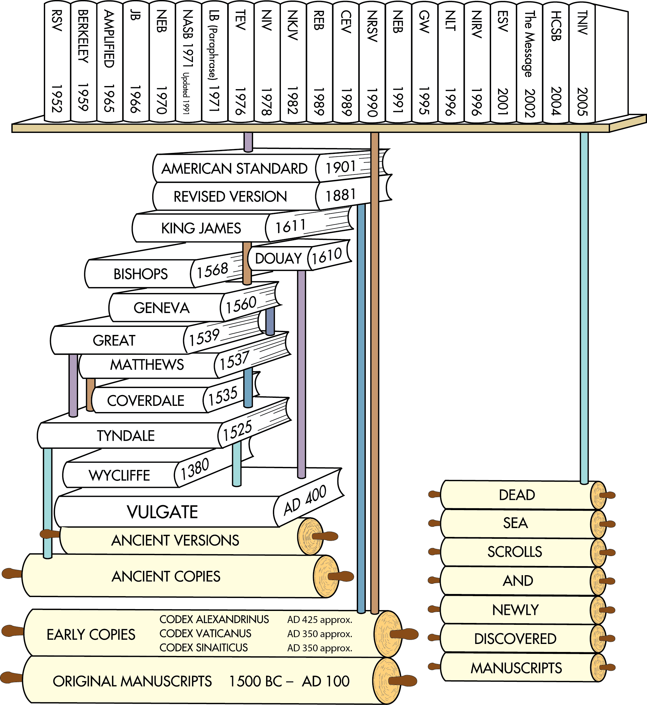
Translations after the discovery of the Dead Sea Scrolls
Translations after earlier ancient manuscripts were discovered in the 1700s and 1800s
English Translations from ancient versions and copies available at that time
Latin Translation
Chart does not include all English translations. Chart idea from Back to the Bible Broadcast, Lincoln NE..

Slide 2
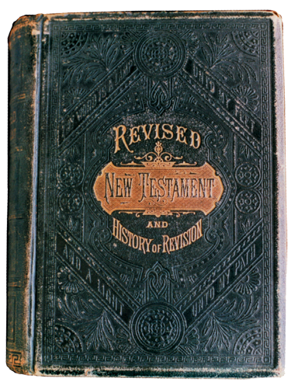
Revised English Version
In 1885, Scholars in England revised the King James Version to reflect the findings from the manuscripts discovered during the two previous centuries.
The Early copies were uncials. Translations prior to the Revised English Version relied on minuscules.
Revised English Version (1885)

Slide 3
Revised Version to American Standard Version
Revised English Version
Their goal was:
to work from more reliable Greek, Hebrew, and Aramaic texts, and
to retranslate words based on new linguistic information about these ancient languages.
The American Standard Version (1901) was the American revision of the English Revised Version.
Revised English Version (1885)
AD 1
500
1000
1500
2000

Slide 4
Revised English Version
Greek Manuscripts Updated
God Gave Instruction to write this down.
“Deuteronomy xxx
The New Testament in the original Greek : Westcott, Brooke Foss, 1825-1901 : Free Download, Borrow, and Streaming : Internet Archive

Slide 5
Textual Criticism 1 John 5:7-8
Information added due to theology

Slide 6
The Woman Taken In Adultery (John 7:53-8:11)
The story of the woman taken in adultery was a problem also in ancient times. Early Christians had trouble with this passage. The forgiveness which Christ gave to the adulteress was contrary to their conviction that the punishment for adultery ought to be very severe. As late as the time of Ambrose (c. 374), bishop of Milan, there were still many Christians who felt such scruples against this portion of John's Gospel. This is clear from the remarks which Ambrose makes in a sermon on David's sin. "In the same way also the Gospel lesson which has been read, may have caused no small offense to the unskilled, in which you have noticed that an adulteress was brought to Christ and dismissed without condemnation.

Slide 8
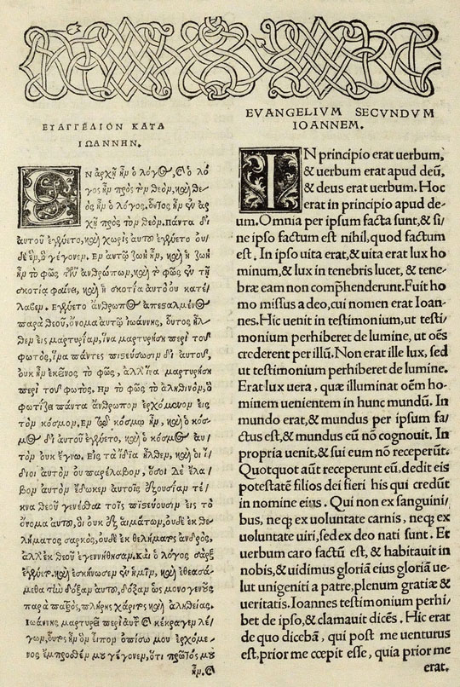
Time Line
Erasmus
Erasmus, a priest and Greek scholar, published a Greek New Testament alongside a corrected Latin translation of the New Testament in 1516.
This text, known as Novum Instrumentum Omne, was the first printed and published Greek New Testament.
Greek New Testament alongside Erasmus’s Latin Translation

Slide 9
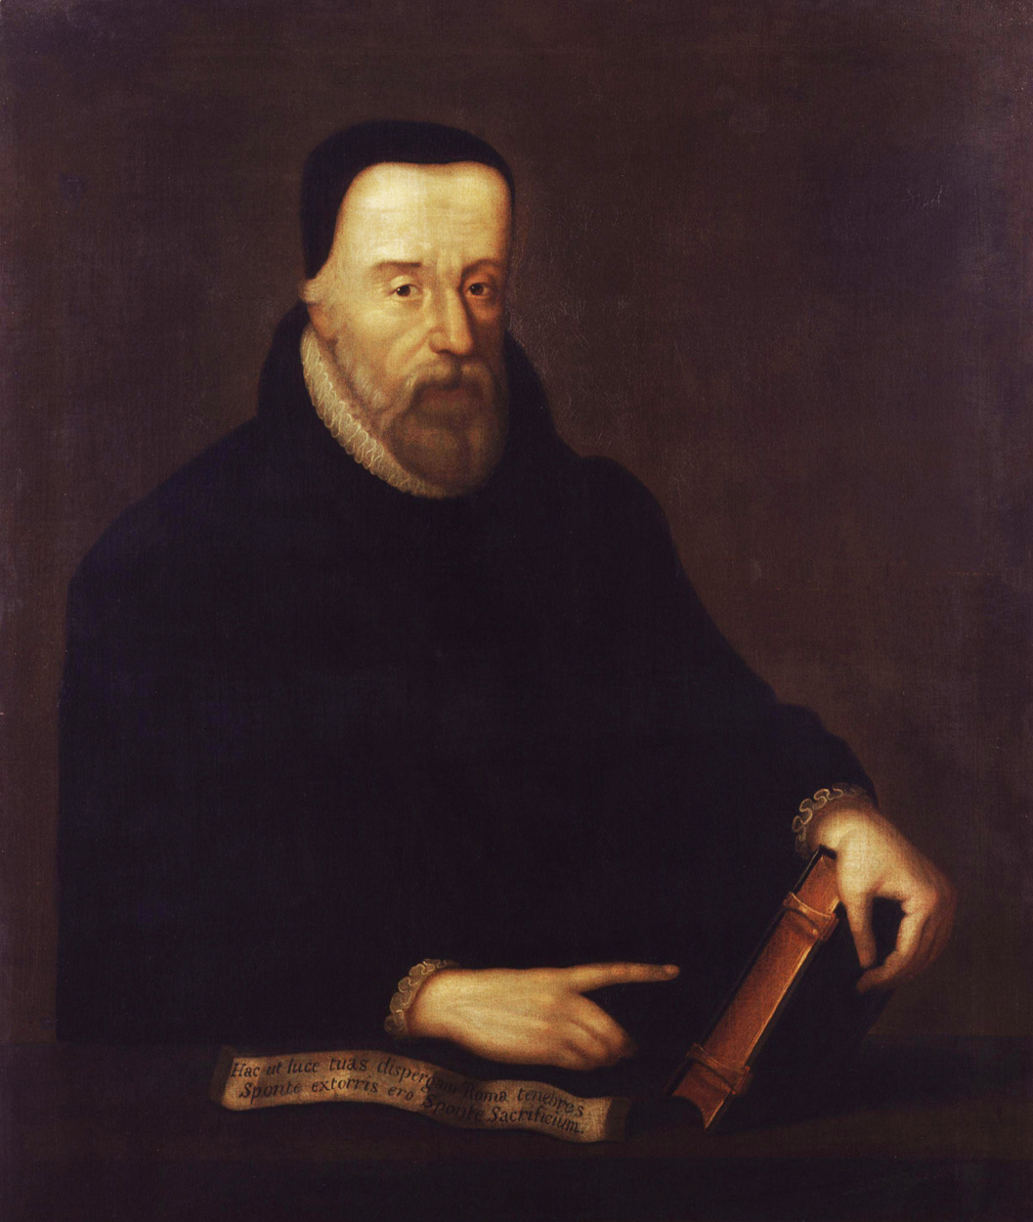
Translators
William Tyndale
William Tyndale was an Oxford scholar and priest.
At dinner, a priest once said to him, “We had better be without God’s law than the pope’s.”
Tyndale retorted, “If God spares my life, I will cause a boy that driveth the plow to know more of the Scripture than you do.”
William Tyndale

Slide 10
Translators
King James Version 1611
The King James Version remained the most popular Bible in English for more than 300 years.
At least two-thirds of the King James Version can be traced back to William Tyndale’s translations.

Slide 11
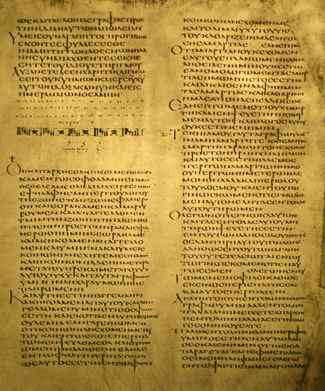
New Material Impacting Translations
Codex Alexandrinus
In 1629, Codex Alexandrinus—a copy of the New Testament from the 400s AD—was made available to Western scholars.
It is one of the earliest and most complete copies of the New Testament.
Portion of 2 Peter and 1 John in Codex Alexandrinus

Slide 12
New Material Impacting Translations
Codex Sinaiticus
In the mid-1800s, the earliest known complete copy of the New Testament—copied in the 300s AD—was found at St. Catherine’s Monastery near Mt. Sinai.
St. Catherine’s Monastery

Slide 13
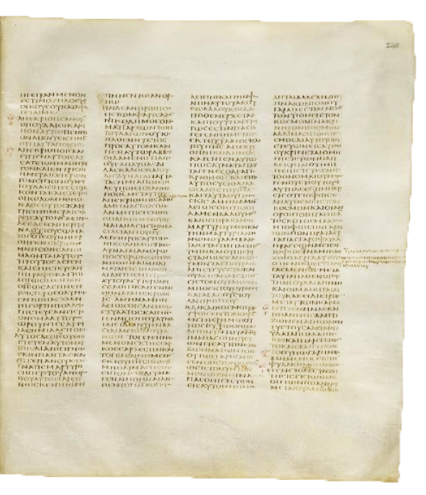
New Material Impacting Translations
Codex Sinaiticus
Carefully copied and corrected, it is one of the most reliable surviving manuscripts of the New Testament.
John 3 in Codex Sinaiticus

Slide 14
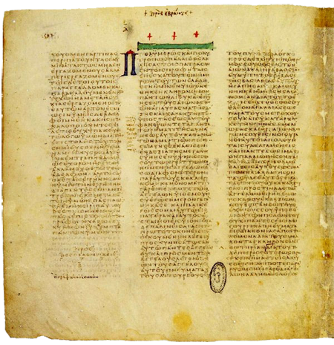
New Material Impacting Translations
Codex Vaticanus
The earliest and probably the most reliable surviving copy of the New Testament was made available to scholars in 1889.
It was probably copied in the early 300s AD and seems to be slightly older than Codex Sinaiticus.
Codex Vaticanus

Slide 15
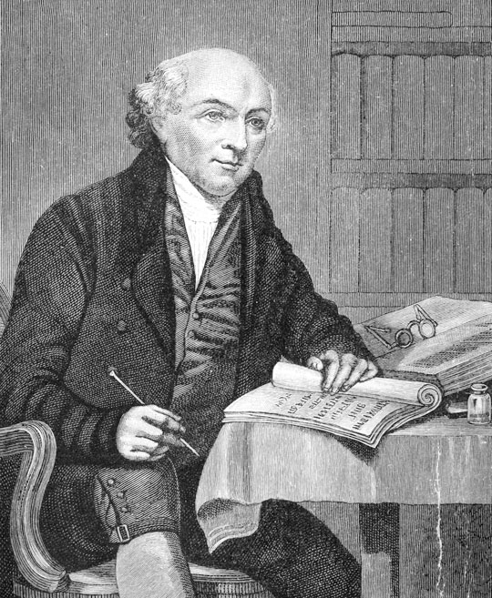
Translators Other Languages
Translations in the 1800s
The missionary movement in the 1800s led to the rapid rise in new Bible translations into other languages.
William Carey, “the father of modern missions,” translated the New Testament into Bengali (1801).
William Carey

Slide 16
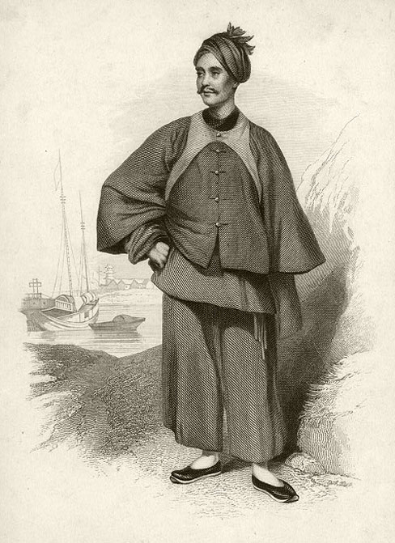
Translators Other Languages
Translations in the 1800s
Missionary Karl Gutzlaff translated portions of the Bible into Thai and Japanese (mid-1800s).
Scottish missionary to China, Robert Morrison, translated the Bible into Chinese (1823).
Karl Gutzlaff

Slide 17
Translators Other Languages
Translations in the 1800s
Native Cherokee speaker, John Arch (Atsi), translated the Gospel of John into Cherokee (1824).
Cherokee pastor, David Brown, translated the New Testament one year later.

Slide 18
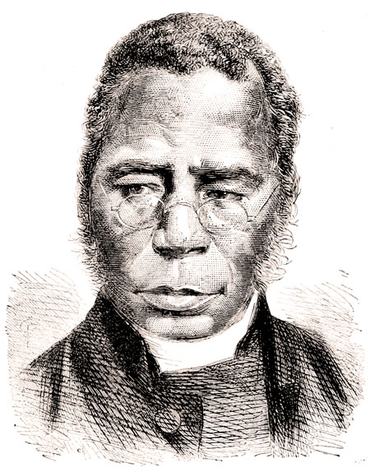
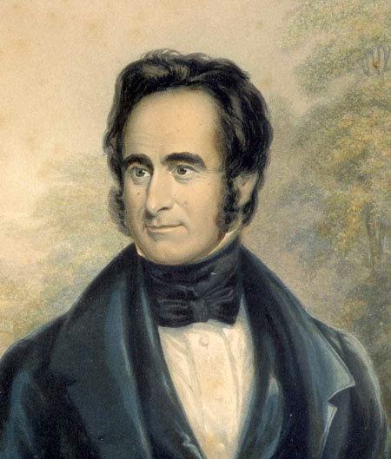
Translators Other Languages
Translations in the 1800s
Former slave born in Yoruba (modern Nigeria), Samuel Ajayi Crowther, translated parts of the New Testament into his native language of Yoruba (1852).
Scottish missionary to Africa, Robert Moffat, translated the Bible into the African language of Tswana (1857).
Samuel Ajayi Crowther
Robert Moffat

Slide 19
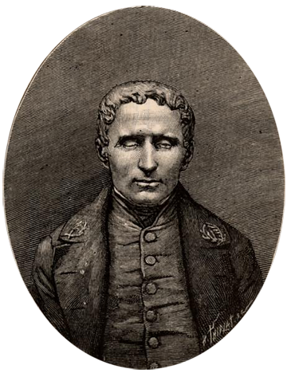
Translators
The Braille Bible
The Universal Braille Press (later Braille Institute of America) published the first complete Braille Bible in 1924.
The Braille Bible filled 21 volumes in the King James Version.
Louis Braille, blind since the age of 3, completed a system for reading at age 15.

Slide 20
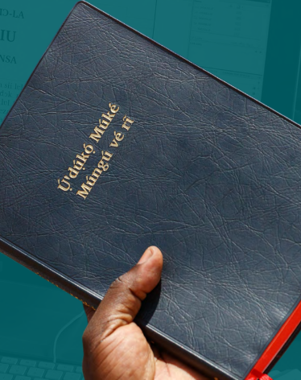
Ongoing Translation
Wycliffe.org
Today at least 2,000 languages are still waiting for a Bible translation to begin
Wycliffe USA is working faster than ever to reach those languages as soon as possible..
1.5 billion people don’t have a full bible in their language. (19% of the world’s population)
128 million do not have any scripture at all.
> 1800 audio versions online
Complete video of bible in sign language.

Slide 21
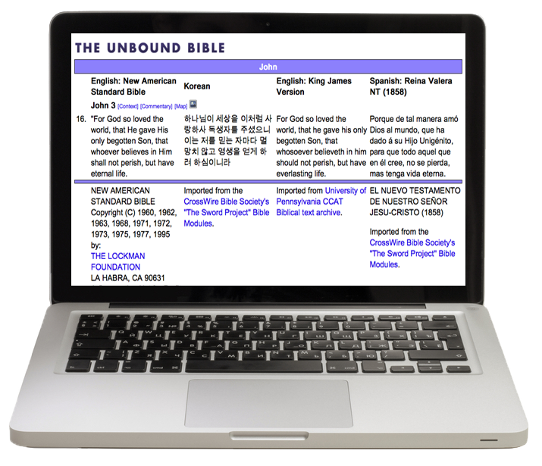
Media and Social Platforms
Today, the Bible comes in many formats and is distributed in all sorts of ways to reach people worldwide with the gospel of Jesus Christ.

Slide 22
English Bible Translations Today

Slide 23
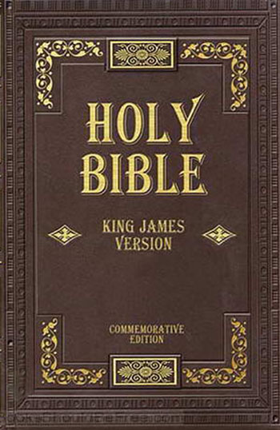
English Bible Translations Today
King James Version (KJV) 1611
1611, current edition 1769
Example: “And he saith unto them, Follow me, and I will make you fishers of men.”—Matthew 4:19

Slide 24
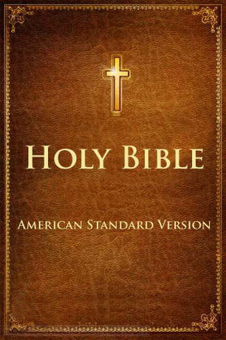
English Bible Translations Today
English Revised Version (ERV)
1885
British revision of the King James Version Using newfound Uncials
American Standard Version (ASV)
1901
American edition of the English Revised Version.

Slide 25
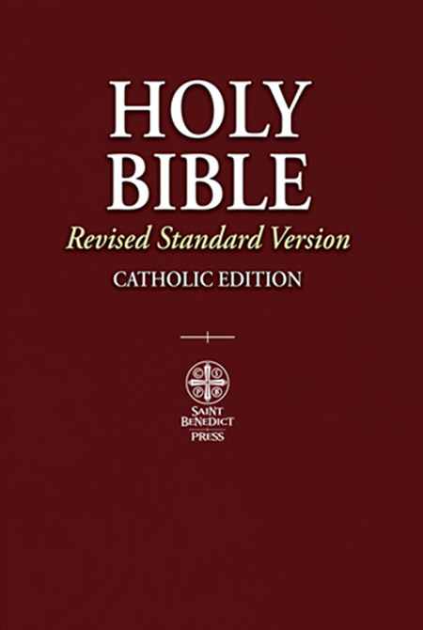
English Bible Translations Today
Revised Standard Version (RSV)
1952
A revision of the American Standard Version (ASV).
New Testament revised again in 1971.

Slide 26
English Bible Translations Today
New American Standard Bible (NASB) 1971, 1995, 2020
Attempts to render grammar and terminology in clear English while preserving literal accuracy of American Standard Version (ASV).

Slide 27
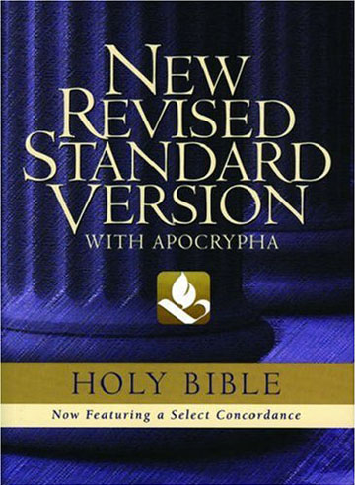
English Bible Translations Today
New Revised Standard Version (NRSV)
1989
Revision of the Revised Standard Version (RSV); intended to be “as literal as possible” and “as free as necessary.”
Gender neutral wording for people.
Example: “And he said to them, ‘Follow me, and I will make you fish for people.’” —Matthew 4:19

Slide 28
English Bible Translations Today
English Standard Version (ESV)
2001
Essentially literal, based on the 1971 RSV with significant corrections and language updates based on the most reliable Greek, Hebrew, and Aramaic texts.
Example: “And he said to them, ‘Follow me, and I will make you fishers of men.’”—Matthew 4:19

Slide 29
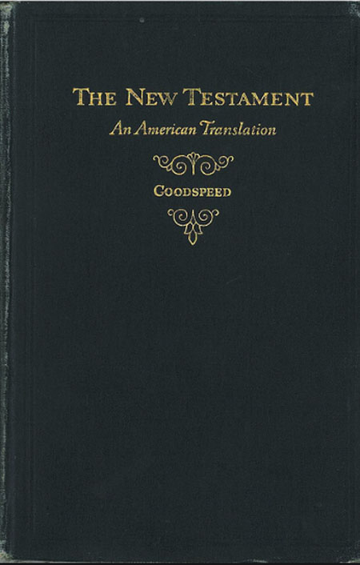
English Bible Translations Today
Smith-Goodspeed, An American Translation 1931
Modern American English translated by:
J. M. Powis Smith (Old Testament)
Edgar J. Goodspeed (New Testament)
Notes:
http://www.bible-researcher.com/goodspeed.html
The translation of the New Testament in this version was conceived by an editor at the University of Chicago Press, who at an academic conference in 1920 had heard Edgar Goodspeed speak about the deficiencies of the already existing modern-speech versions of the New Testament done by Moffatt and Weymouth. The editor (Guy M. Crippen) invited Goodspeed to make a translation to be published by the University Press.
Goodspeed (1871–1962) was at that time a professor of New Testament at the University of Chicago, where he had received a doctorate in Greek in 1898. He was the son of a Baptist minister. Early in his career he had edited some scholarly volumes in which recently discovered papyrus documents were published, but after 1912 he turned to the writing of popular-level books, such as The Story of the New Testament (1916). After the publication of his translation of the New Testament (1923) he continued to write books chiefly for laymen (e.g. The Story of the Old Testament in 1934, The Story of the Bible in 1936, An Introduction to the New Testament in 1937, The Story of the Apocrypha in 1939, How to Read the Bible in 1946). His translation of the New Testament should be seen as part of his continued efforts to provide up-to-date books for the education of laymen.
In his day, Goodspeed would be described as a 'liberal.' His views of the inspiration and authority of the Bible were typical of the liberal wing of Protestantism of the early twentieth century. This may be seen in his Story of the New Testament (1916, revised 1928) and in his Introduction to the New Testament (Chicago, 1937), popular-level books in which he approaches the Bible in the same critical and liberal spirit as did Harry Emerson Fosdick, the most well-known Northern Baptist author of the day (c.f. Fosdick's A Guide to Understanding the Bible, 1938). For example, in his Introduction to the New Testament Goodspeed writes that the Gospel of John "cannot reasonably be considered the original work of a Galilean fishermen ... or the translation of such a work" (p. 326). He maintains that the apostle Paul was the author of the epistle to the Colossians but was not the author of Ephesians. He also concludes that the Pastoral Epistles (1 and 2 Timothy, Titus) were not written by Paul. Against the more radical school of criticism, he argues for the authenticity of 2 Thessalonians, but in a way that is not likely to commend itself to conservatives:

Slide 30
http://www.bible-researcher.com
http://www.bible-researcher.com/goodspeed.html

Slide 31
English Bible Translations Today
J. B. Phillips’ New Testament in Modern English 1958
A paraphrase by J. B. Phillips originally intended for youth.

Slide 32
English Bible Translations Today
Amplified Bible (AMP) 1965
Attempts to express the meaning of the original text through the use of explanatory alternate readings and amplifications.
Example: “For God so greatly loved and dearly prized the world that He [even] gave up His only begotten (unique) Son…”—John 3:16a
1900
1925
1950
1975
2000

Slide 33
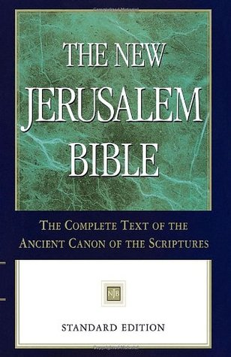
English Bible Translations Today
New Jerusalem Bible (NJB) 1966.1985
1966, updated 1985
Approved by the Roman Catholic Church.
Includes the Apocrypha.

Slide 34
English Bible Translations Today
New English Bible 1970, 1989
Attempts to present the Scriptures in “timeless” modern English.

Slide 35
English Bible Translations Today
New American Bible (NAB)
1970, revised in 1986, 1991
Official translation used in the U.S. Catholic Church Mass.
Includes the Apocrypha.

Slide 36
English Bible Translations Today
The Living Bible (TLB) 1971
Popular paraphrase by Kenneth N. Taylor.
Example: “Because of his kindness, you have been saved through trusting Christ. And even trusting is not of yourselves; it too is a gift from God. Salvation is not a reward for the good we have done, so none of us can take any credit for it.”—Ephesians 2:8–9

Slide 37
English Bible Translations Today
Good News Bible (also Good News Translation; GNT)
1976, revised in 1992
A “common language” Bible, also known as Today’s English Version.

Slide 38
English Bible Translations Today
New International Version (NIV)
1978, revised in 1984, 2011
Seeks to bring modern Bible readers as close as possible to the experience of the first Bible readers.
Currently the best-selling version.

Slide 39
English Bible Translations Today
New King James Version (NKJV) 1982
1982
Derived from the King James Version (KJV).
Modern translation intended to maintain stylistic beauty of the KJV.
New Testament translated from Textus Receptus.

Slide 40
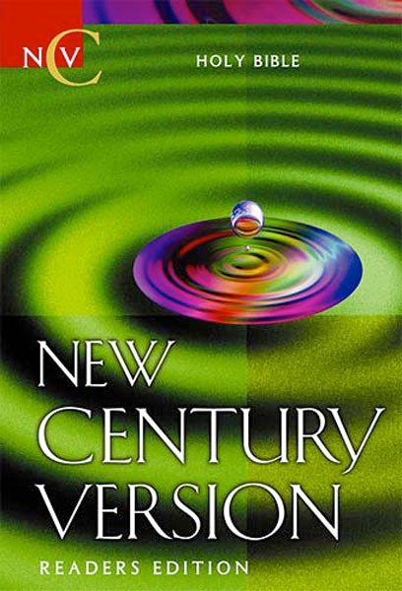
English Bible Translations Today
New Century Version (NCV)
1987
English translation derived from English Version for the Deaf (EVD) and the Easy-to-Read Version (ERV).
Uses modern terms such as measurements and geographic names.

Slide 41
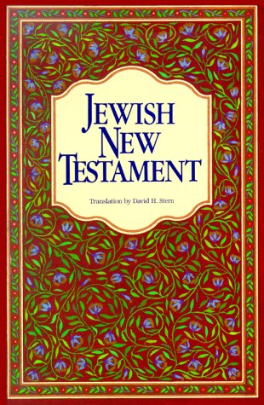
English Bible Translations Today
Jewish New Testament
1989
English translation using traditional Jewish expressions.
Translated by David H. Stern, a Messianic Jew.
Example: “Yeshua said to them, ‘Come after me, and I will make you fishers for men!’”—Matthew 4:19

Slide 42
English Bible Translations Today
Contemporary English Version (CEV) 1995
Intended to be easily read by grade schoolers and second-language English readers.
Example: “God loved the people of this world so much that he gave his only Son, so that everyone who has faith in him will have eternal life and never really die.” —John 3:16

Slide 43
English Bible Translations Today
God’s Word Translation (GW) 1995
Attempts to use “natural equivalents” to translate text into contemporary English.
Example: “God saved you through faith as an act of kindness. You had nothing to do with it. Being saved is a gift from God. It’s not the result of anything you’ve done, so no one can brag about it.”—Ephesians 2:8–9

Slide 44
English Bible Translations Today
New Living Translation (NLT) 1996,2004
A translation in the style of the Living Bible, tries to render entire thoughts—rather than each word—into everyday English.
Easy-to-read modern version.
Example: “For this is how God loved the world: He gave his one and only Son, so that everyone who believes in him will not perish but have eternal life.”—John 3:16

Slide 45
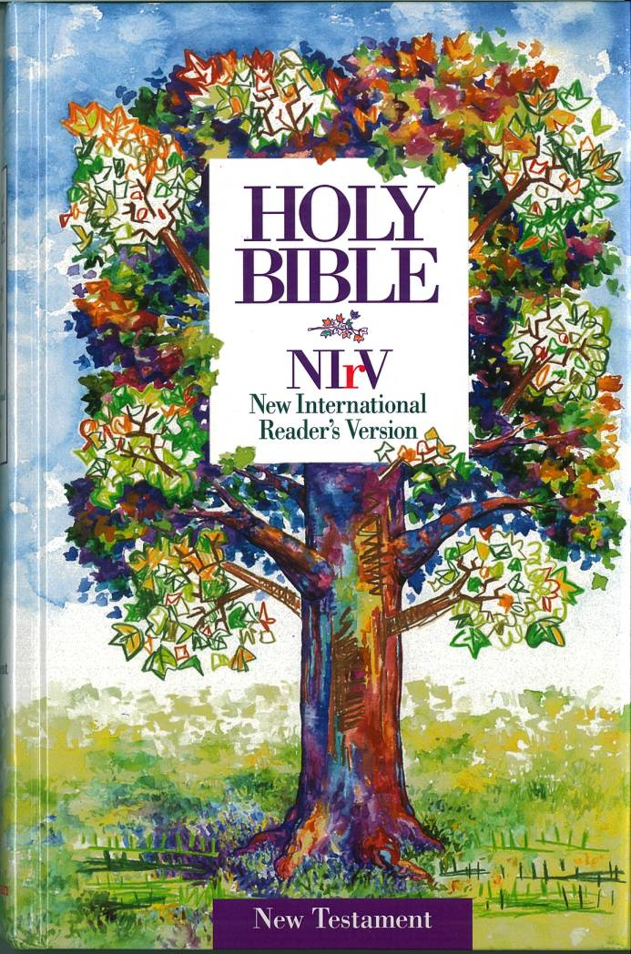
English Bible Translations Today
New International Reader’s Version (NIrV)
1996, revised in 1998
Simple words and short sentences for lower reading levels.
Example: “God’s grace has saved you because of your faith in Christ. Your salvation doesn’t come from anything you do. It is God’s gift.”—Ephesians 2:8

Slide 46
English Bible Translations Today
The Message (MSG)
2002
Paraphrase by Eugene H. Peterson.
Example: “This is how much God loved the world: He gave his Son, his one and only Son. And this is why: so that no one need be destroyed; by believing in him, anyone can have a whole and lasting life.”—John 3:16

Slide 47
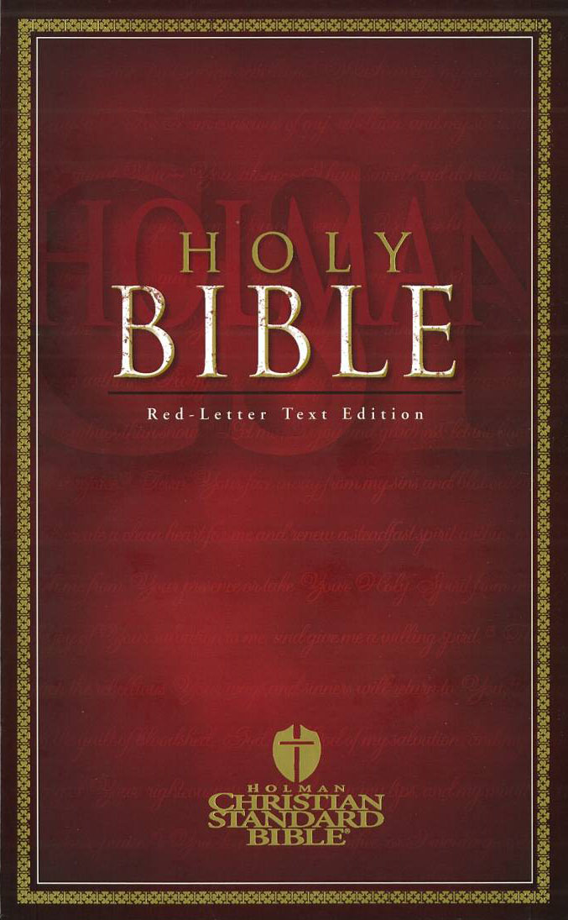
English Bible Translations Today
Holman Christian Standard Bible (HCSB) 2004
Pursues two ideals:
1) Each word must reflect contemporary English.
2) Each word must be faithful to the original languages.
Example: “For God loved the world in this way: He gave His One and Only Son, so that everyone who believes in Him will not perish but have eternal life.” —John 3:16

Slide 48
English Bible Translations Today
Common English Bible (CEB) 2011
Diverse team of translators from 22 faith traditions in American, African, Asian, European, and Latino communities.
Substitutes more natural wordings for traditional biblical terminology.
Example: “‘Come, follow me,’ he said, ‘and I’ll show you how to fish for people.’” —Matthew 4:19

Slide 49
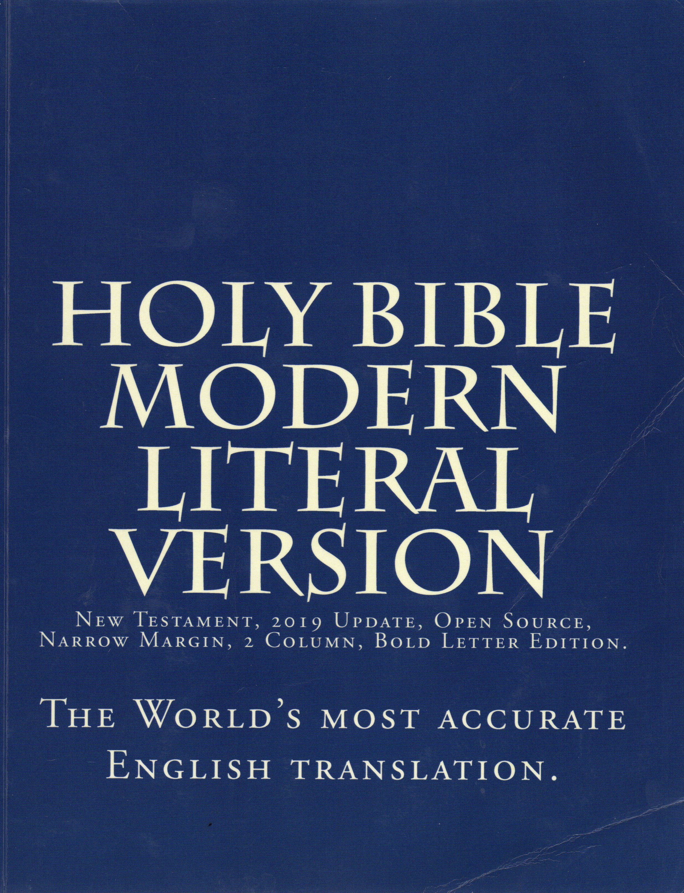
English Bible Translations Today
Holy Bible Modern Literal Translation 2019
Uses a few words as possible for each Greek Word.
Produced as an “Open Source Document’ to be available on the web.
Based on a new Greek Text from Robinson and Pierpont.
Starting Point is a Byzantine majority text with critical comparison to NA 27 and NA 28
Uses a few words as possible for each Greek Word.
https://www.modernliteralversion.org/bibles/MLV/MLVBL.pdf
Notes:
Notes about the Greek Text Used
The New Testament in the Original Greek: Byzantine Textform 2018 Paperback – January 11, 2018
by William G. Pierpont (Author), Maurice A. Robinson (Editor), John Jeffrey Dodson (Contributor)
The present volume displays the Greek New Testament according to its historically dominant transmissional form, known as the Byzantine Textform. In view of the significance of this text throughout the centuries, this compact edition should be of value to student and scholar alike for academic, personal, and ministerial purposes.
Most modern critical editions of the Greek New Testament present an eclectic form of text that primarily represents the localized Alexandrian-based manuscripts. Other available editions exhibit forms of the so-called Textus Receptus or the lectionary-based Patriarchal (Antioniades) version of the Greek Orthodox Church. In contrast, the present edition reflects the regularly utilized consensus found among Greek continuous-text manuscripts that span the extensive geographic realm of the Byzantine Empire throughout at least its thousand-year history.
An apparatus at the foot of the page displays all differences between the Byzantine consensus main text and the Nestle-Aland 27th and 28th editions, as well as differences appearing in the Editio Critica Maior for the book of Acts. Alternative Byzantine readings are noted in a separate apparatus when the primary Textform is significantly divided. The 27 New Testament books are ordered according to early canonical lists, with the General Epistles following Acts, and Hebrews placed between Paul’s letters to churches and to individuals.
The present edition thus provides an affordable Greek New Testament in flexible binding that conveniently fills a particular textual void in relation to research, study, and practical ministry.

Slide 50
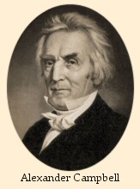
English Bible Translations Historical
Campbell’s New Testament
The Gospels are from a translation by George Campbell (London, 1789), the Epistles from James MacKnight (London, 1795), and the Acts and Revelation from Philip Doddridge’s Family Expositor (London, 1756). In 1818 a London publisher had reprinted these versions together in one volume.
From the 1818 collection Campbell produced updated Editions in 1826, 1828, 1832, 1835.
Included introductory notes and direct rebuttals to Calvinism.
Notes:
https://www.bible-researcher.com/campbell.html
Campbell’s New Testament
Alexander Campbell, ed., The Sacred Writings of the Apostles and Evangelists of Jesus Christ, Commonly Styled The New Testament. Translated from the Original Greek, by Doctors of the Church of Scotland. With Preface George Campbell, James MacKnight, and Philip Doddridge, Ds to the Historical and Epistolary Books; and an Appendix, Containing Critical Notes and Various Translations of Difficult Passages. Buffaloe, Virginia [now Bethany, West Virginia]: Alexander Campbell, 1826. Second edition, 1828. Third edition, 1832. Fourth edition, 1835. Reprinted often, most recently by Gospel Advocate Co. in 1974. Most printings bore the cover title, “The Living Oracles,” and so the version came to be called by that name. For the fourth edition (1835) the title was changed to correct its erroneous assertion that Doddridge was a member of the Church of Scotland, and to indicate that the translations of the three “doctors” had been revised by Alexander Campbell: The Sacred Writings of the Apostles and Evangelists of Jesus Christ, commonly styled the New Testament. Translated from the original Greek by Doctors George Campbell, James MacKnight, and Philip Doddridge. With Prefaces, Various Emendations, and an Appendix. By Alexander Campbell. (Bethany, Virginia: M’Vay & Ewing, 1835).
The Background and Ministry of Alexander Campbell
Alexander Campbell (1788-1866) was born in northern Ireland of Scottish stock, the son of Thomas Campbell, a minister in the Seceder Presbyterian Church of Scotland. He was educated privately by his father. In 1807 his father emigrated to western Pennsylvania in America, and in 1809 Alexander followed him. The Campbells eventually settled in a frontier area, just east of the Ohio River, in the village now known as Bethany in West Virginia.
Before coming to America, the Campbells were associated with a sectarian movement that arose among Presbyterians in their native country. In Scotland the leading figures of this movement were John Glas (1695-1773), Robert Sandeman (1718-71), and James Haldane (1769-1851), and so its adherents were variously called “Glasite,” “Sandemanian,” or “Haldanean.” A number of Scotsmen associated with it, including Sandeman, emigrated to America with the hope that their ideas would find a greater reception among settlers there. It appears that the Campbells came with the same idea.
The Campbells at first associated themselves with Baptists in their area. Alexander displayed unusual talent as a preacher, and spent much of his time travelling about, preaching by invitation in Baptist churches in western Pennsylvania, Virginia, and Ohio. But in his preaching tours he soon began to advocate radical changes in polity and doctrine among the Baptists, along the lines of the Sandemanian movement in Scotland. ¹ Campbell claimed that these reforms were necessary for a “restoration” of ancient Christianity.
Campbell maintained that the office of “pastor” was an unbiblical legacy of sacerdotalism inherited from Catholicism, and that there is no Scriptural warrant for the existence of denominational agencies and mission boards. He also argued that doctrinal standards embodied in the creeds and confessions of the Protestant churches should be abolished, and that the Bible alone should be used to distinguish truth from error. He drew a sharp distinction between the Old Testament and the New, and believed that the New Testament alone should be used to establish doctrine and practices of the church. He maintained that faith in Christ was not a gift from God, and regeneration was not necessary for it, because this saving faith was merely a rational human response to testimony provided in the Bible. It was, in essence, nothing more than intellectual assent to the proposition that “Jesus is the Christ” based upon adequate evidence. He taught that the natural human mind was capable of this faith without a prior work of the Holy Spirit. The biblical teaching regarding the need for Regeneration (“ye must be born again”) was practically nullified by equating Regeneration with post-conversion Baptism. ²
In addition to the Sandemanian influence, Campbell was also much influenced by the writings of Arminian controversialists like Daniel Whitby (1638-1726), and so his theology had much in common with that of the Wesleyans, who were at that time enjoying success among the common people on the American frontier. But unlike Wesley and his followers, whose ministry tended to be constructive and spiritually edifying despite its theological flaws, Campbell was mostly a controversialist, continually engaged in debates, and in general defining himself and his movement negatively, in terms of what he opposed. Most of his followers were not new converts, but persons drawn away from the Baptists, Presbyterians, and Methodists.
His main purpose, as he conceived it, was to attack and discredit all established creeds, and all existing ecclesiastical organizations, so as to clear the way for what he conceived to be a purely “biblical” faith and fellowship. In his polemic against “the teachings of men,” he went so far as to rejected even the ancient ecumenical creeds. When his followers asked if he agreed with the Trinitarian doctrine of the Nicene Creed, he dismissed it as “Calvinistic.” ³
Some of these ideas may be seen as exaggerated versions of ideas that had played a part in the Protestant Reformation. For example, Campbell’s famous slogan, “Where the Scriptures speak, we speak; where the Scriptures are silent, we are silent,” might be construed as a restatement of the Sola Scriptura principle of Luther and Calvin. But the spirit of Campbell’s ideology in this respect differs greatly from that of the magisterial Protestant Reformers. Luther, Calvin, and their followers did insist upon the unique authority of Scripture, but as interpreters of Scripture they did not set themselves against the whole history of the Christian church. They were well-versed in the theological writings of antiquity, and they valued the contributions of celebrated Fathers of the Church such as Athanasius and Augustine. Campbell, on the other hand, showed no respect for the ancient authors, and indeed we find in his writings little indication that he had even studied any of their works.
Aside from theological literature of the age, Campbell’s theology was also influenced by the secular philosophical literature of the so-called “Enlightenment” of the seventeenth and eighteenth centuries. In particular, the influence of the empiricist theory of knowledge developed by John Locke is conspicuous in his teachings regarding the nature of faith ⁴
Campbell’s Edition of the New Testament
Eventually Campbell’s interest in the “restoration” of the “ancient order of things” led him to find fault with the King James Version of the Bible, which in his day was the only version known to most English-speaking Christians. For some time, the more advanced scholars in Great Britain had been pointing out small deficiencies of the version; but, in general, even among the most educated churchmen, the consensus was that the defects were theologically insignificant, and a revision was not necessary. The fact that all the different parties and sects of Protestantism had a common English version was seen as a blessing, and few believed that any revision would prove acceptable to all parties. Albert Barnes, who was a contemporary of Campbell’s, expressed the common opinion:
The friends of this translation have never claimed for it inspiration or infallibility. Yet it is the concurrent testimony of all who are competent to express an opinion, that no translation of the Bible into any language has preserved so faithfully the sense of the original as the English. Phrases there may be, and it is confessed there are, which modern criticism has shown not to express all the meaning of the original; but as a whole, it indubitably stands unrivalled. Nor is it probable that any translation can now supply its place, or improve upon its substantial correctness. The fact that it has for two hundred years poured light into the minds of millions, and guided the steps of generation after generation in the way to heaven, has given to it somewhat of the venerableness which appropriately belongs to a book of God. Successive ages may correct some of its few unimportant errors; may throw light on some of its obscure passages; but to the consummation of all things, it must stand, wherever the English language is spoken, as the purest specimen of its power to give utterance to the meaning of ancient tongues, and of the simple and pure majesty of the language which we speak.
These remarks are made, because it is easy for men who dislike the plain doctrines of the Bible, and for those ignorant of the true history of its translation, to throw out insinuations of its unfaithfulness. From various quarters, from men opposed to the clear doctrines of the Scriptures, are often heard demands for a new translation. We by no means assert the entire infallibility, much less the inspiration, of the English translation of the Bible. Yet of its general faithfulness to the original, there can be no doubt. It would be easy to multiply testimonies of the highest authority to this fact. But the general testimony of the world; the profound regard paid to it by men of the purest character and most extensive learning; the fact that it has warmed the hearts of the pious, ministered to the comforts of the wretched and the dying, and guided the steps of millions to glory, for two hundred years, and now commands the high regard of Christians of so many different denominations, evinces that it is, to no ordinary extent, faithful to the original, and has a claim on the continued regard of coming generations.
It is perfectly clear, also, that it would be impossible now to translate the Scriptures into the English language, under so favorable circumstances as attended the translation in the time of James I. No single set of men could so command the confidence of the Christian world; no convention of those who claim the Christian name could be formed, competent to the task, or if formed, could prosecute the work with harmony; no single denomination could make a translation that would secure the active regard of others. The probability is, therefore, that while the English language is spoken, and as far as it is used, the English Bible will continue to form their faith, and direct their lives; and that the words which now pour light into our minds will continue to illuminate the understandings, and mould the feelings, of unnumbered millions, in their path to immortal life. ⁵
Nevertheless, Campbell (whom Barnes would probably count among the “men who dislike the plain doctrines of the Bible”) charged that the translators of the King James Version had deliberately perverted or obscured the teaching of the Bible in several important ways, so as to give unfair advantage to the proponents of “Calvinism.” And so he was moved to compile and edit a more “perspicuous and correct” translation, on the basis of versions executed by notable scholars of the eighteenth century.
As the title shows, it is a revision of translations of parts of the New Testament done by British scholars. The Gospels are from a translation by George Campbell (London, 1789), the Epistles from James MacKnight (London, 1795), and the Acts and Revelation from Philip Doddridge’s Family Expositor (London, 1756). In 1818 a London publisher had reprinted these versions together in one volume, ⁶ and it was this 1818 edition which Campbell used to produce his own edition in 1826. But Campbell did not merely reprint the versions as he found them. He revised the text, and substituted his own Introduction and explanatory notes for the introductions and notes of the original translators.
In this new edition Campbell naturally took the opportunity to provide Scriptural support for various ideas that he favored. His preface exhibits the belligerence towards “Calvinism” which came to be a hallmark of his movement. In it Campbell tries to establish his claim that the KJV is a Calvinistically biased version by quoting others who had connected some renderings in it with the renderings of an annotated Latin version published in the late sixteenth century by the Calvinist theologian Theodore Beza. But the argument is weak and unconvincing, and only shows the extent to which his own thinking was influenced by Rationalist and Arminian polemical writers of his time.
In this revision Campbell made use of the critical Greek text of Griesbach 1805, but his version does not always follow Griesbach’s text. For example, in Acts 2:30 Griesbach marks the words to kata sarka anastesein ton christon (rendered “according to the flesh, raise up the Messiah” by Doddridge) as spurious, but Campbell omits only the words “according to the flesh” from Doddridge’s version.
To show the extent of the revision in the Gospels, we provide the full text of Matthew 1-7 in parallel columns on another page. For the revision of MacKnight’s Epistles, we give Ephesians 5. For the revision of Doddridge, we give Acts 1-3. In these passages it will be seen that the changes introduced by A. Campbell are mostly stylistic changes, such as any educated man would be inclined to make. Probably the most important changes from a dogmatic standpoint are the substitutions of “immersion” and “immerse” for “baptism” and “baptize,” which are clearly designed to promote Baptist teachings. But the most interesting and questionable renderings of the original translators, which would require expert knowledge to evaluate, are left unchanged.
Sources
1. Editions of Campbell’s New Testament online.
A transcription of the first edition: The Sacred Writings of the Apostles and Evangelists of Jesus Christ, Commonly Styled the New Testament, Translated from the Original Greek, by George Campbell, James Macknight, and Philip Doddridge, Doctors of the Church of Scotland. With Prefaces to the Historical and Epistolary Books; and an Appendix, Containing Critical Notes and Various Translations of Difficult Passages. Printed and Published by Alexr. Campbell. Buffaloe, Brooke County, Virginia. 1826.
Second edition: The Sacred Writings of the Apostles and Evangelists of Jesus Christ, Commonly Styled the New Testament, Translated from the Original Greek, by George Campbell, James Macknight, and Philip Doddridge, Doctors of the Church of Scotland. With Prefaces to the Historical and Epistolary Books; and an Appendix, Containing Critical Notes and Various Translations of Difficult Passages. Second Edition. Printed and Published by Alexander Campbell. Bethany, Brooke County, Virginia. A.D. 1828.
Fourth edition: The Sacred Writings of the Apostles and Evangelists of Jesus Christ, Commonly Styled the New Testament. Translated from the Original Greek by Doctors George Campbell, James MacKnight, and Philip Doddridge. With Prefaces, Various Emendations, and an Appendix. By Alexander Campbell. Fourth Edition. Bethany, Brooke County, Virginia: M’Vay & Ewing (1835). See also a transcription of the text of the fourth edition here.
Reprint of the 4th edition, Cincinnati, Bosworth, 1860, with same title as above, except with the words “stereotyped from the third edition revised.” This is really the fourth edition, but it omits the appendix of various renderings.
2. Campbell’s sources.
The unrevised text of G. Campbell, Macknight and Doddridge: The New Testament, translated from the Original Greek, by G. Campbell, D.D., P. Doddridge, D.D., and J. Macknight, D.D., etc. (London: Wightman and Cramp, 1827).
George Campbell’s ‘Four Gospels’ — George Campbell, The Four Gospels, Translated from the Greek, with Preliminary Dissertations, and Notes Critical and Explanatory. 4 vols. (Boston: W. Wells, 1811): Vol. 1 (dissertations, also here); Vol. 2 (more dissertations); Vol. 3 (translations of the Gospels); Vol. 4 (critical and philological notes, also here). See also the same work reprinted in two volumes of The Works of George Campbell in Six Volumes (London: Tegg, 1840), volume one and two. Also available online is the edition printed in Andover by Gould and Newman (1837), Vol. 1 (containing the dissertations and Matthew, also here); Vol. 2 (Mark, Luke and John, also here). But this Andover edition has many errors.
Macknight on the Epistles. — James Macknight, A New Literal Translation from the Original Greek, of All the Apostolical Epistles; with a Commentary and Notes, Philological, Critical, Explanatory, and Practical; to which is added a History of the Life of the Apostle Paul. New Edition (Philadelphia: Thomas Wardle, 1841).
Doddridge’s Family Expositor, in 6 volumes (1807 reprint): vol. 1 (first part of Gospel harmony); vol. 2 (second part of Gospel harmony); vol. 3 (Acts, also here); vol. 4 (Romans, 1 and 2 Corinthians, also here); vol. 5 (Galatians to Philemon); vol. 6 (Hebrews to Revelation, also here).
3. Secondary literature about Campbell.
Nearly all the literature about Campbell and his early followers has been written by later adherents of the “Restoration” movement, and so it must be read critically with this in mind. The idea that the teachings of Campbell and his followers sprung directly from the canonical Scriptures without any controlling influence from other quarters is an important element in the ideology of the sect. Campbell’s debt to other primitivist sectarians of his day, and to eighteenth-century theological writers who contributed to his thinking (viz., Sandeman and his followers, Arminians such as Whitby, and empiricist philosophers such as John Locke) is usually minimized if not denied by his admirers. In this list of titles, only the first work listed (by Whitsitt) was written by a scholar outside the Restoration Movement.
William H. Whitsitt, Origin of the Disciples of Christ (Campbellites): A Contribution to the Centennial Anniversary of the Birth of Alexander Campbell (New York: A. C. Armstrong and Son, 1888).
Errett Gates, The Early Relation and Separation of Baptists and Disciples. Chicago: R.R. Donnelley and Sons, 1904.
Hiram Van Kirk, A History of the Theology of the Disciples of Christ. St. Louis: Christian Publishing Co., 1907.
Cecil K. Thomas, Alexander Campbell and his New Version. St. Louis, Missouri: Bethany Press, 1958.
Gary Holloway, “Alexander Campbell as a Publisher,” Restoration Quarterly 37 (January 1995), pp. 28-35
Frank Pack, “Alexander Campbell the Scholar,” Restoration Quarterly 30 (1988) 149-50.
James M. Seale, ed., Lectures in Honor of the Alexander Campbell Bicentennial, 1788-1988. Nashville, Tennessee: Disciples of Christ Historical Society, 1988.
Jesse R. Kellems, Alexander Campbell and the Disciples. New York: Richard R. Smith, 1930.
Robert Richardson, Memoirs of Alexander Campbell. 2 Volumes. Philadelphia: J.B. Lippincott, 1868.
4. Secondary literature by Campbell
Alexander Campbell, “Historical Sketch of the Origin and Progress of the New Translation,” Millennial Harbinger 3 (1832), pp. 268-274.
Alexander Campbell, A Connected View of the Principles and Rules by which the Living Oracles May be Intelligibly and Certainly Interpreted: Of the Foundation on which All Christians May Form One Communion: and of the Capital Positions Sustained in the Attempt to Restore the Original Gospel and Order of Things. Bethany, Va.: M’Vay and Ewing, 1835.
NOTES
1. For a full discussion of the Scottish sectarian sources of Campbell’s theology by an American Baptist, see William H. Whitsitt, Origin of the Disciples of Christ (Campbellites): A Contribution to the Centennial Anniversary of the Birth of Alexander Campbell (New York: A. C. Armstrong and Son, 1888). Campbell’s debt to these Scottish sectarians was often noticed by critics in his lifetime, but Campbell was apparently unconscious of the extent of it, and he professed to be an entirely independent thinker. Thus in 1826 when a correspondent wrote to him, “So far as I can judge by your writings and preaching, you are substantially a Sandemanian or Haldanian,” in his reply he would not acknowledge any special or substantial debt, and professed, “I have endeavoured to read the scriptures as though no one had read them before me; and I am as much on my guard against reading them to-day, through the medium of my own views yesterday, or a week ago, as I am against being influenced by any foreign name, authority, or system whatever.” (“Reply” to a letter from Robert B. Semple of Virginia, published in The Christian Baptist, vol. 3 [April 3, 1826], p. 204.) Likewise several Campbellite historians have downplayed the influences on Campbell, and have tried to portray him as an independent thinker; but, as one of them admits, the influence of the “Scotch Independents” on Campbell is “patent to every observer” (Hiram Van Kirk, A History of the Theology of the Disciples of Christ [St. Louis: Christian Publishing Co., 1907], p. 78). Nathan Hatch’s book The Democratization of American Christianity (1989) describes very well the individualistic and egalitarian milieu of the American frontier culture that was so receptive to Campbell’s views, but his statement that “Whatever Alexander Campbell may have brought to America of his Scottish and Presbyterian heritage, he discarded much of it for an explicitly American theology” (p. 71) is very misleading.
2. This rationalistic teaching about faith is certainly not derived from the Bible, in which faith is inseparable from faithfulness, and in which saving faith is presented not as a mere assent to propositions about Christ, but as a lively faith in Christ (i.e. trusting in God’s mercy through Christ), which also involves a mystical union with Christ (see Galatians 2:20). For this reason, Protestant theologians have generally insisted that saving faith involves much more than knowledge. For example, the Lutheran theologian Hans Martensen writes, “Justifying Faith, as the teachers of the Evangelical Church have specially insisted, is not only an assent of the understanding, but trust; a confidence of the heart, a trustful appropriation of the article of the forgiveness of sins, a heartfelt certitude that the Son of God died not only for all, but for me (Gal. ii. 20), the individual;—a faith which, as it is the personal act of the man who ventures to appropriate the redemption provided for the world, is, strictly speaking, the gift of the Spirit of God, the heart of man being in itself too weak for this infinite trust. This believing appropriation of the crucified Saviour brings with it actual fellowship of life with the risen Saviour in His Church: a fellowship in which the believer possesses the righteousness of Christ, not only outwardly, but inwardly, as a creative principle for a new development of life. Christ dwells in the heart of the man by faith, yea, faith is itself the living bond, the secret point of union between Christ and the individual soul (unio mystica) (Gal ii. 20).” (Christian Dogmatics: A Compendium of the Doctrines of Christianity, by Hans Martensen, translated into English by William Urwick [Edinburgh: T. & T. Clark, 1874], p. 391).
3. Alexander Campbell, “The Trinitarian System,” The Christian Baptist, vol. 4, no. 10 (May 1827), pp. 231, 233. While Campbell several times declared that he believed in the divinity and eternity of Christ, and protested against being called anti-trinitarian, his declarations on the subject consistently indicate a kind of naive Sabellianism, and he welcomed into his fellowship the followers of Barton Stone, whose teaching was explicitly anti-trinitarian. Campbell’s position on the Trinity, if not definitely heretical, was dangerously vague and minimalist.
4. John Locke (1632-1704) in his Essay Concerning Human Understanding (1690) “defined faith in purely intellectual, and indeed propositional, terms as ‘the assent to any proposition, not thus made out by the deductions of reason, but upon the credit of the proposer, as coming from God, in some extraordinary way of communication,’ that is to say, by revelation (IV.18.2). Looking on faith as a form of knowledge inferior to reason, Locke recommended great caution in the acceptance of purported revelations. No proposition, he contended, should be entertained ‘with greater assurance than the proofs it is built upon will warrant’ (IV.19.1) ... In The Reasonableness of Christianity as Delivered by the Scriptures (1695) Locke relied principally on biblical prophecies and miracles to accredit Christ as God’s messenger.” (Avery Dulles, The Assurance of Things Hoped for: A Theology of Christian Faith [New York: Oxford University Press, 1997], p. 66.) On the various ways in which Campbell was influenced by Locke, see chapter 3 of Hiram Van Kirk’s History of the Theology of the Disciples of Christ (St. Louis: Christian Publishing Co., 1907). Locke’s influence on Campbell’s understanding of faith was even noted by one of his long-time companions in ministry, Robert Richardson, who complained of it in a private letter: “The philosophy of Locke with which Bro. Campbell’s mind was deeply imbued in youth has insidiously mingled itself with almost all the great points in the reformation and has been all the while like an iceberg in the way--chilling the heart and benumbing the hands, and impeding all progress in the right direction.” (Letter to Isaac Errett, written from Bethphage, July 16, 1857, as quoted by Cloyd Goodnight and Dwight E. Stevenson, Home to Bethphage: A Biography of Robert Richardson [St. Louis, MO: Christian Board of Publication, 1949], p. 122).
5. Notes, Explanatory and Practical, on the Gospels: Designed for Sunday School Teachers and Bible Classes, by Albert Barnes, 6th ed. (New York: Leavitt, Lord, & Co., 1835), pp. xi-xii. This was also the common opinion of the best educated men in England up until about 1860. In 1843 James Goodwin of Cambridge University wrote: “What is the result of our reading any other versions of more recent or modern date? The feeling with which we must rise from the careful perusal of them is no other than that of increased admiration at the faithfulness, accuracy, and beauty of the authorized version of the Holy Scriptures, which it is our happiness to possess. True it is that, since the time when it was made, the field of classical learning has been widely extended; the facilities of acquiring it greatly increased; and scholars have arisen from time to time, who, building on the foundations which others before them have laid, have consequently risen to a greater eminence on the steep hill of knowledge. True likewise it is that such men have here and there noted in our authorized version a few trifling errors, and suggested a few unimportant improvements, if such indeed they may be called. But the sum of their most critical investigations has been this, that it is altogether free from any important error; for general accuracy and faithfulness, unrivalled.... in the authorized version of the Old and New Testaments, we have all received from our fathers an unmixed fountain of living waters, which it is our duty to suffer to flow on, undefiled and pure, to our children.” (The Gospel According to Saint Matthew .... Translated into English from the Greek, with Original Notes, by Sir John Cheke ... [with] an Introductory Account of the Nature and Object of the Translation, by James Goodwin [Cambridge, 1843], pp. 22-24.)
6. The New Testament Translated from the Original Greek, by G. Campbell, P. Doddridge and J. MacKnight. London: John Lepard, 1818. The volume sold well, and came to be known as “Lepard’s Testament.” A volume containing the same text was also printed in London by Wightman and Cramp in 1827. Campbell describes the edition of 1818 and the conception of his edition in an “Historical Sketch of the Origin and Progress of the New Translation” published in the Millennial Harbinger 3 (1832), pp. 268-274.

Slide 51
English Bible Translations Today
Ephesians 2:8 – 2:9 MLV
2:8 For* you* are saved by the grace through the faith, and this thing, the gift of God, is not from you, 2:9 not from works, in-order-that not anyone should boast.
Ephesians 2:8 – 2:9 NIV
For it is by grace you have been saved, through faith—and this is not from yourselves, it is the gift of God—not by works, so that no one can boast.
Notes:
Notes about the Greek Text Used
The New Testament in the Original Greek: Byzantine Textform 2018 Paperback – January 11, 2018
by William G. Pierpont (Author), Maurice A. Robinson (Editor), John Jeffrey Dodson (Contributor)
The present volume displays the Greek New Testament according to its historically dominant transmissional form, known as the Byzantine Textform. In view of the significance of this text throughout the centuries, this compact edition should be of value to student and scholar alike for academic, personal, and ministerial purposes.
Most modern critical editions of the Greek New Testament present an eclectic form of text that primarily represents the localized Alexandrian-based manuscripts. Other available editions exhibit forms of the so-called Textus Receptus or the lectionary-based Patriarchal (Antioniades) version of the Greek Orthodox Church. In contrast, the present edition reflects the regularly utilized consensus found among Greek continuous-text manuscripts that span the extensive geographic realm of the Byzantine Empire throughout at least its thousand-year history.
An apparatus at the foot of the page displays all differences between the Byzantine consensus main text and the Nestle-Aland 27th and 28th editions, as well as differences appearing in the Editio Critica Maior for the book of Acts. Alternative Byzantine readings are noted in a separate apparatus when the primary Textform is significantly divided. The 27 New Testament books are ordered according to early canonical lists, with the General Epistles following Acts, and Hebrews placed between Paul’s letters to churches and to individuals.
The present edition thus provides an affordable Greek New Testament in flexible binding that conveniently fills a particular textual void in relation to research, study, and practical ministry.

Slide 52
English Bible Translations Today
Ephesians 2:8 – 2:9 NLT
God saved you by his grace when you believed. And you can’t take credit for this; it is a gift from God. Salvation is not a reward for the good things we have done, so none of us can boast about it.
Ephesians 2:8 – 2:9 NASB20
For by grace, you have been saved through faith; and this is not of yourselves, it is the gift of God; not a result of works, so that no one may boast
Notes:
Notes about the Greek Text Used
The New Testament in the Original Greek: Byzantine Textform 2018 Paperback – January 11, 2018
by William G. Pierpont (Author), Maurice A. Robinson (Editor), John Jeffrey Dodson (Contributor)
The present volume displays the Greek New Testament according to its historically dominant transmissional form, known as the Byzantine Textform. In view of the significance of this text throughout the centuries, this compact edition should be of value to student and scholar alike for academic, personal, and ministerial purposes.
Most modern critical editions of the Greek New Testament present an eclectic form of text that primarily represents the localized Alexandrian-based manuscripts. Other available editions exhibit forms of the so-called Textus Receptus or the lectionary-based Patriarchal (Antioniades) version of the Greek Orthodox Church. In contrast, the present edition reflects the regularly utilized consensus found among Greek continuous-text manuscripts that span the extensive geographic realm of the Byzantine Empire throughout at least its thousand-year history.
An apparatus at the foot of the page displays all differences between the Byzantine consensus main text and the Nestle-Aland 27th and 28th editions, as well as differences appearing in the Editio Critica Maior for the book of Acts. Alternative Byzantine readings are noted in a separate apparatus when the primary Textform is significantly divided. The 27 New Testament books are ordered according to early canonical lists, with the General Epistles following Acts, and Hebrews placed between Paul’s letters to churches and to individuals.
The present edition thus provides an affordable Greek New Testament in flexible binding that conveniently fills a particular textual void in relation to research, study, and practical ministry.

Slide 53
English Bible Translations Today
Ephesians 2:8 – 2:9 Living Bible
⁸ Because of his kindness, you have been saved through trusting Christ. And even trusting is not of yourselves;^{[b]} it too is a gift from God. ⁹ Salvation is not a reward for the good we have done, so none of us can take any credit for it.
^{b]} Ephesians 2:8 And even trusting is not of yourselves, or “Salvation is not of yourselves.
Notes:
Notes about the Greek Text Used
The New Testament in the Original Greek: Byzantine Textform 2018 Paperback – January 11, 2018
by William G. Pierpont (Author), Maurice A. Robinson (Editor), John Jeffrey Dodson (Contributor)
The present volume displays the Greek New Testament according to its historically dominant transmissional form, known as the Byzantine Textform. In view of the significance of this text throughout the centuries, this compact edition should be of value to student and scholar alike for academic, personal, and ministerial purposes.
Most modern critical editions of the Greek New Testament present an eclectic form of text that primarily represents the localized Alexandrian-based manuscripts. Other available editions exhibit forms of the so-called Textus Receptus or the lectionary-based Patriarchal (Antioniades) version of the Greek Orthodox Church. In contrast, the present edition reflects the regularly utilized consensus found among Greek continuous-text manuscripts that span the extensive geographic realm of the Byzantine Empire throughout at least its thousand-year history.
An apparatus at the foot of the page displays all differences between the Byzantine consensus main text and the Nestle-Aland 27th and 28th editions, as well as differences appearing in the Editio Critica Maior for the book of Acts. Alternative Byzantine readings are noted in a separate apparatus when the primary Textform is significantly divided. The 27 New Testament books are ordered according to early canonical lists, with the General Epistles following Acts, and Hebrews placed between Paul’s letters to churches and to individuals.
The present edition thus provides an affordable Greek New Testament in flexible binding that conveniently fills a particular textual void in relation to research, study, and practical ministry.

Slide 54
English Bible Translations Today
Philippians 1:3-5 MLV
I am giving-thanks to my God upon every remembrance of you , 1:4 always in my every supplication on behalf of all of you , making the supplication with joy, 1:5 upon your fellowship in the good-news from the first day till now.
2:8 – 2:9 NASB95
³ I thank my God in all my remembrance of you, ⁴ always offering prayer with joy in my every prayer for you all, ⁵ in view of your ^{[c]}participation in the gospel from the first day until now.
^{[c] Sharing the Gospel}
Notes:
Notes about the Greek Text Used
The New Testament in the Original Greek: Byzantine Textform 2018 Paperback – January 11, 2018
by William G. Pierpont (Author), Maurice A. Robinson (Editor), John Jeffrey Dodson (Contributor)
The present volume displays the Greek New Testament according to its historically dominant transmissional form, known as the Byzantine Textform. In view of the significance of this text throughout the centuries, this compact edition should be of value to student and scholar alike for academic, personal, and ministerial purposes.
Most modern critical editions of the Greek New Testament present an eclectic form of text that primarily represents the localized Alexandrian-based manuscripts. Other available editions exhibit forms of the so-called Textus Receptus or the lectionary-based Patriarchal (Antioniades) version of the Greek Orthodox Church. In contrast, the present edition reflects the regularly utilized consensus found among Greek continuous-text manuscripts that span the extensive geographic realm of the Byzantine Empire throughout at least its thousand-year history.
An apparatus at the foot of the page displays all differences between the Byzantine consensus main text and the Nestle-Aland 27th and 28th editions, as well as differences appearing in the Editio Critica Maior for the book of Acts. Alternative Byzantine readings are noted in a separate apparatus when the primary Textform is significantly divided. The 27 New Testament books are ordered according to early canonical lists, with the General Epistles following Acts, and Hebrews placed between Paul’s letters to churches and to individuals.
The present edition thus provides an affordable Greek New Testament in flexible binding that conveniently fills a particular textual void in relation to research, study, and practical ministry.

Slide 55
English Bible Translations Today
Philippian 2:8 – 2:9 NLT
³ Every time I think of you, I give thanks to my God. ⁴ Whenever I pray, I make my requests for all of you with joy, ⁵ for you have been my partners in spreading the Good News about Christ from the time you first heard it until now.
Notes:
Notes about the Greek Text Used
The New Testament in the Original Greek: Byzantine Textform 2018 Paperback – January 11, 2018
by William G. Pierpont (Author), Maurice A. Robinson (Editor), John Jeffrey Dodson (Contributor)
The present volume displays the Greek New Testament according to its historically dominant transmissional form, known as the Byzantine Textform. In view of the significance of this text throughout the centuries, this compact edition should be of value to student and scholar alike for academic, personal, and ministerial purposes.
Most modern critical editions of the Greek New Testament present an eclectic form of text that primarily represents the localized Alexandrian-based manuscripts. Other available editions exhibit forms of the so-called Textus Receptus or the lectionary-based Patriarchal (Antioniades) version of the Greek Orthodox Church. In contrast, the present edition reflects the regularly utilized consensus found among Greek continuous-text manuscripts that span the extensive geographic realm of the Byzantine Empire throughout at least its thousand-year history.
An apparatus at the foot of the page displays all differences between the Byzantine consensus main text and the Nestle-Aland 27th and 28th editions, as well as differences appearing in the Editio Critica Maior for the book of Acts. Alternative Byzantine readings are noted in a separate apparatus when the primary Textform is significantly divided. The 27 New Testament books are ordered according to early canonical lists, with the General Epistles following Acts, and Hebrews placed between Paul’s letters to churches and to individuals.
The present edition thus provides an affordable Greek New Testament in flexible binding that conveniently fills a particular textual void in relation to research, study, and practical ministry.

Slide 56
English Bible Translations Today
PHILIPPIANS 3:18
NIV
For, as I have often told you before and now tell you again even with tears, many live as enemies of the cross of Christ
NLT
For I have told you often before, and I say it again with tears in my eyes, that there are many whose conduct shows they are really enemies of the cross of Christ.
Notes:
Notes about the Greek Text Used
The New Testament in the Original Greek: Byzantine Textform 2018 Paperback – January 11, 2018
by William G. Pierpont (Author), Maurice A. Robinson (Editor), John Jeffrey Dodson (Contributor)
The present volume displays the Greek New Testament according to its historically dominant transmissional form, known as the Byzantine Textform. In view of the significance of this text throughout the centuries, this compact edition should be of value to student and scholar alike for academic, personal, and ministerial purposes.
Most modern critical editions of the Greek New Testament present an eclectic form of text that primarily represents the localized Alexandrian-based manuscripts. Other available editions exhibit forms of the so-called Textus Receptus or the lectionary-based Patriarchal (Antioniades) version of the Greek Orthodox Church. In contrast, the present edition reflects the regularly utilized consensus found among Greek continuous-text manuscripts that span the extensive geographic realm of the Byzantine Empire throughout at least its thousand-year history.
An apparatus at the foot of the page displays all differences between the Byzantine consensus main text and the Nestle-Aland 27th and 28th editions, as well as differences appearing in the Editio Critica Maior for the book of Acts. Alternative Byzantine readings are noted in a separate apparatus when the primary Textform is significantly divided. The 27 New Testament books are ordered according to early canonical lists, with the General Epistles following Acts, and Hebrews placed between Paul’s letters to churches and to individuals.
The present edition thus provides an affordable Greek New Testament in flexible binding that conveniently fills a particular textual void in relation to research, study, and practical ministry.

Slide 57
English Bible Translations Today
Holy Bible Modern Literal Translation 2019
PHILIPPIANS 3:18
KJ21
(For many walk, of whom I have told you often and now tell you even with weeping, as the enemies of the cross of Christ.
MOUNCE
For many are living (I have often told you about them but now tell you even with tears) as enemies of the cross of Christ.
3:18 For* many are walking (of whom I was speaking to you° often about them; now I am also saying again to you° , weeping), who are the enemies of the cross of Christ,

Slide 58
English Bible Translations Today
Holy Bible Modern Literal Translation 2019
PHILIPPIANS 3:18
AMP
For there are many, of whom I have often told you, and now tell you even with tears, who live as enemies of the cross of Christ [rejecting and opposing His way of salvation],

Slide 59
English Bible Translations Today
Holy Bible Modern Literal Translation 2019
PHILIPPIANS 3:18
PHILLIPS
For there are many, of whom I have told you before and tell you again now, even with tears, that they are the enemies of the cross of Christ.

Slide 60
English Bible Translations Today
Holy Bible Modern Literal Translation 2019
PHILIPPIANS 3:18
PHILLIPS
For there are many, of whom I have told you before and tell you again now, even with tears, that they are the enemies of the cross of Christ.

Slide 61
English Bible Translations Today
Holy Bible Modern Literal Translation 2019
PHILIPPIANS 3:18
PHILLIPS
For there are many, of whom I have told you before and tell you again now, even with tears, that they are the enemies of the cross of Christ.

Slide 62
English Bible Translations Today
Holy Bible Modern Literal Translation 2019
PHILIPPIANS 3:17-19 (intermingled)
MSG
Stick with me, friends. Keep track of those you see running this same course, headed for this same goal. There are many out there taking other paths, choosing other goals, and trying to get you to go along with them. I’ve warned you of them many times; sadly, I’m having to do it again. All they want is easy street. They hate Christ’s Cross. But easy street is a dead-end street. Those who live there make their bellies their gods; belches are their praise; all they can think of is their appetites
.

Slide 63
https://www.biblegateway.com/
Search on a word
Filter to a book
Find the verse on interest
Click other Translations --- ~ apx 60

Slide 64
Interesting Articles From Bryan Boatman
Controversial with some open-ended arguments ..
http://bbcbeeville.org/2019/08/history-of-the-english-bible-lollard-bibles/
August 11, 2019
http://bbcbeeville.org/2019/08/a-history-of-the-english-bible-william-tyndale/
August 25, 2019
http://bbcbeeville.org/2019/08/history-of-the-english-bible-geneva/
September 1, 2019
http://bbcbeeville.org/2019/09/a-history-of-the-english-bible-king-james/
September 8, 2019
http://bbcbeeville.org/2019/09/a-history-of-the-english-bible-westcott/

Slide 65
How We Got the Bible PowerPoint®
© 2015 RW Research, Inc.
All rights reserved. No part of this publication may be reproduced, stored in a retrieval system or transmitted in any form or by any means—for example, electronic, photocopy, recording—without prior written permission of the publisher.
Image Credits: Shutterstock.com; Bible Translation Sources Chart idea and dates courtesy of Back to the Bible Broadcast, Lincoln NE, used by permission.
Special Thanks to Timothy Paul Jones, PhD; Philip W. Comfort, PhD; Errol F. Rhodes; John McRay, PhD; Lawrence Scrivani; and Michael Cochrane, MA.
Trademarks: Any trademarked symbols included in this teaching presentation belong to the organizations identified. Rose Publishing is a Christian organization and not affiliated with any of the organizations with trademarked symbols. The symbols and photos used in this presentation fall under the U.S.A. Copyright Law, Title 17, Section 107.
Rose Publishing
P. O. Box 3473, Peabody, Massachusetts 01961-3473 U.S.A. www.hendricksonrose.com

