Slide 1
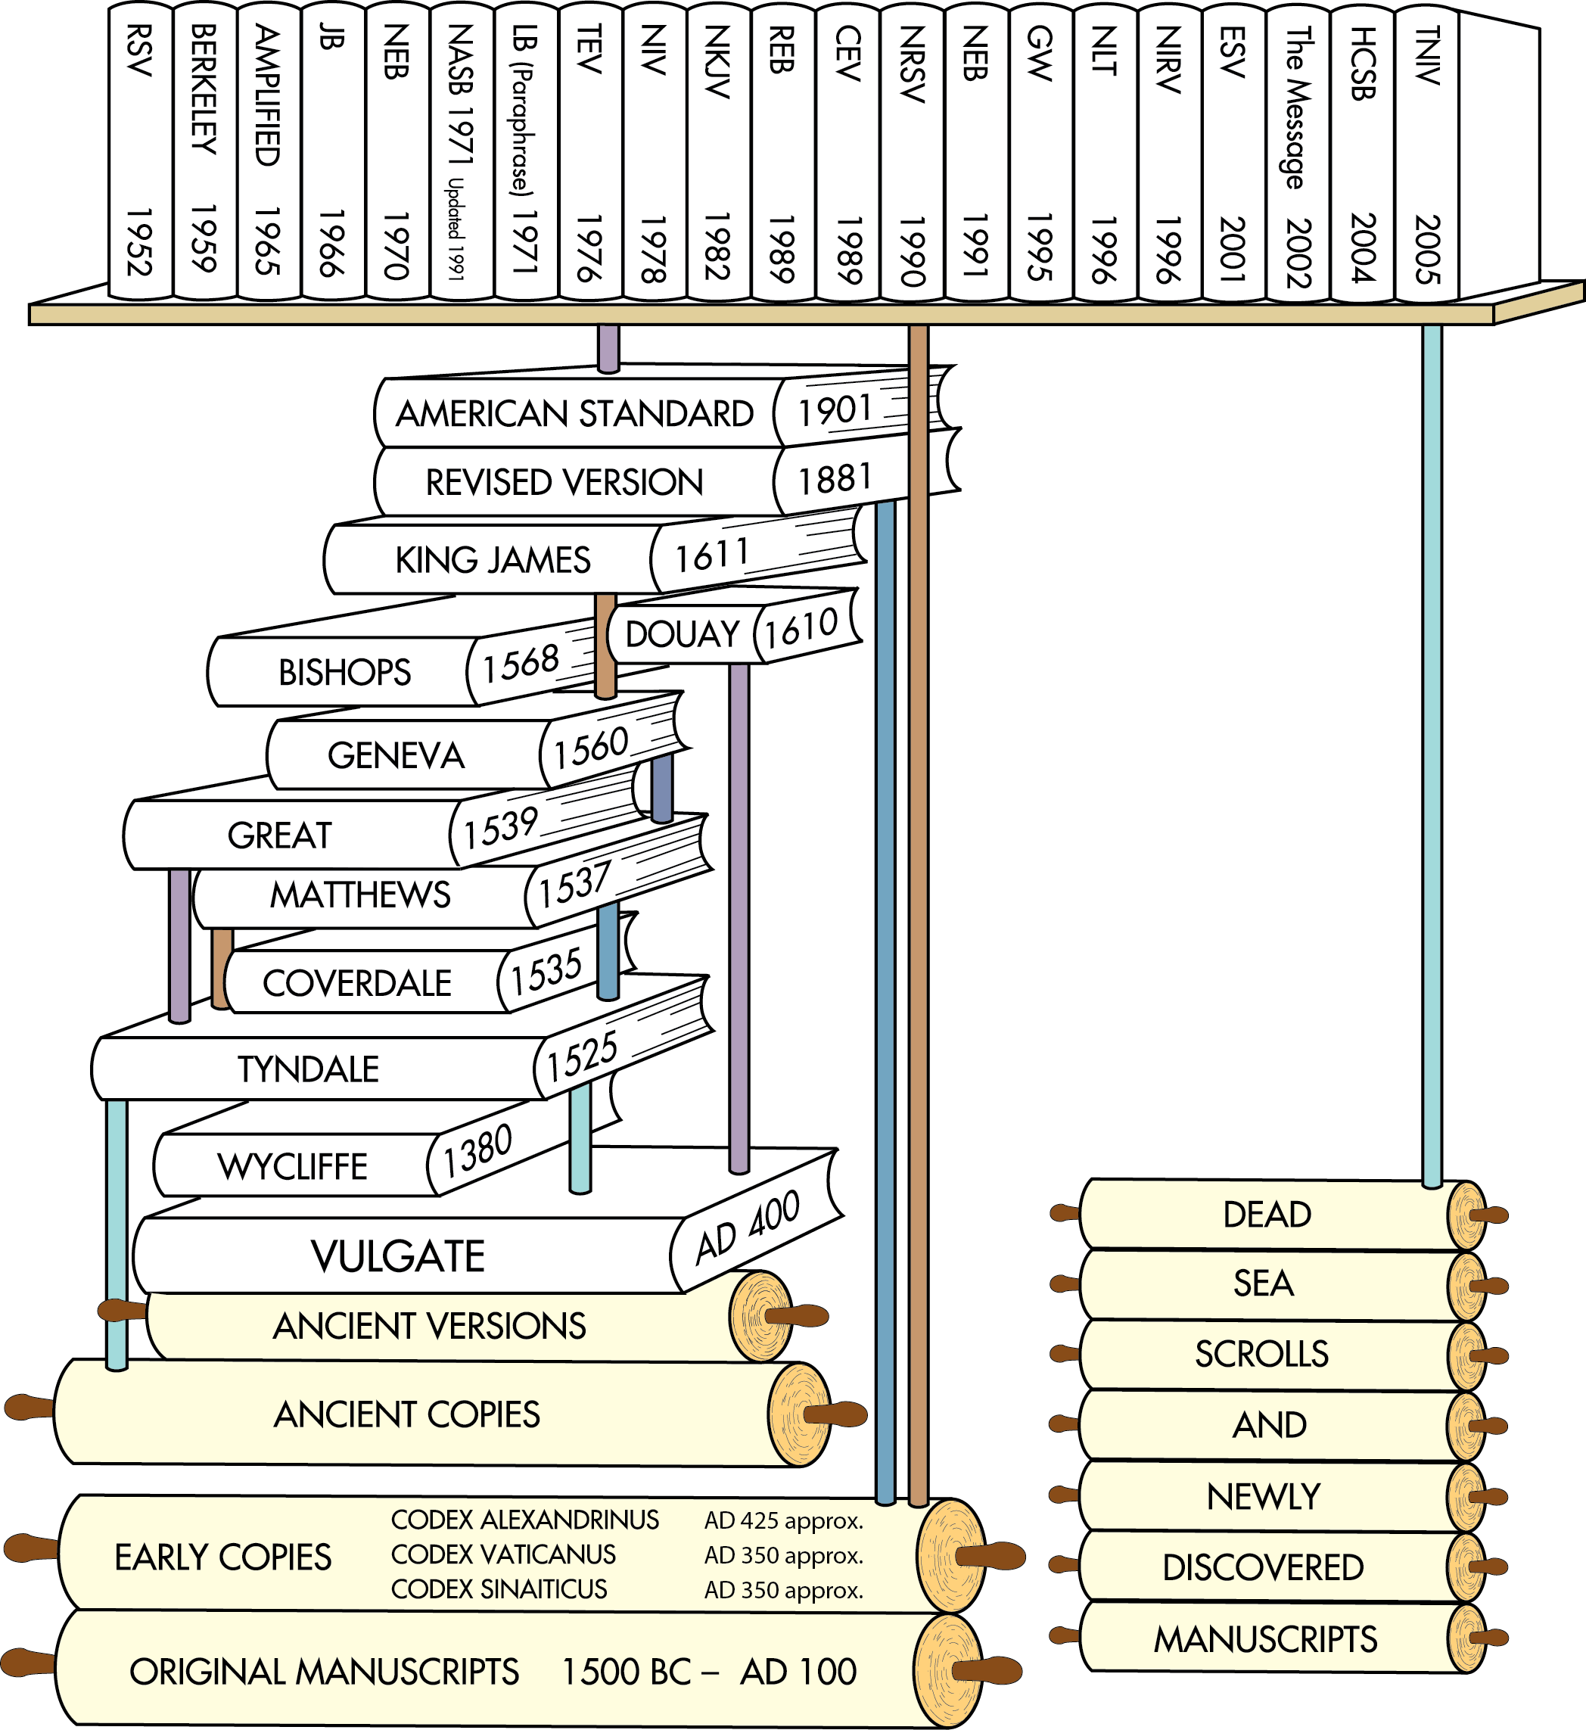
Translations after the discovery of the Dead Sea Scrolls
Translations after earlier ancient manuscripts were discovered in the 1700s and 1800s
English Translations from ancient versions and copies available at that time
Latin Translation
Chart does not include all English translations. Chart idea from Back to the Bible Broadcast, Lincoln NE..

Slide 2
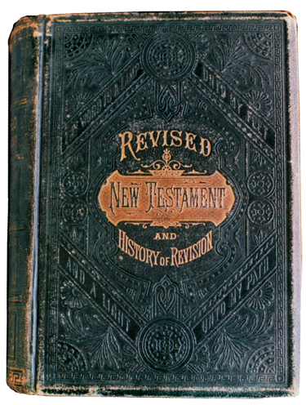

Revised English Version
  In 1885, Scholars in England revised the King James Version to reflect the findings from the manuscripts discovered during the two previous centuries.
  The Early copies were uncials.
  Translations prior to the Revised English Version relied on miniscules.
Revised English Version (1885)
AD 1
500
1000
1500
2000

Slide 3
Revised Version to American Standard Version
Revised English Version
  Their goal was:
    to work from more reliable Greek, Hebrew, and Aramaic texts, and
    to retranslate words based on new linguistic information about these ancient languages.
  The American Standard Version (1901) was the American revision of the English Revised Version.
Revised English Version (1885)
AD 1
500
1000
1500
2000

Slide 4
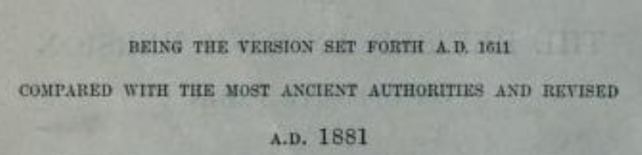

Revised English Version
Greek Manuscripts Updated
God Gave Instruction to write this down.
  “Deuteronomy xxx
  The New Testament in the original Greek : Westcott, Brooke Foss, 1825-1901 : Free Download, Borrow, and Streaming : Internet Archive

Slide 5
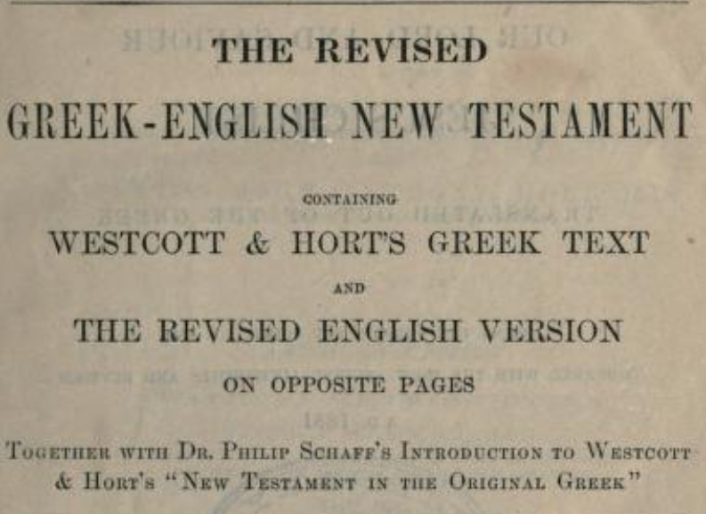
Greek Manuscript beside Revised Version

Slide 6
Greek Manuscript beside Revised Version
What Impact does the English Revised Version Have on the World?

Slide 7
Greek Manuscript beside Revised Version
What Impact does the English Revised Version Have on the World?
Does a discussion of Uncials ensue?

Slide 8
Greek Manuscript beside Revised Version
What Impact does the English Revised Version Have on the World?
Does a discussion of Uncials ensue?
What was the KJV based on?

Slide 9
Greek Manuscript beside Revised Version
What Impact does the English Revised Version Have on the World?
Does a discussion of Uncials ensue?
Are more people/scholars exposed to textual criticism?

Slide 10
Word of the day
PALIMPSEST (Pal-IMP-SEST)
Erasing and reusing a parchment.
ORIGIN OF PALIMPSEST
First recorded in 1655–65; from Latin palimpsēstus,
from Greek palímpsēstos “rubbed again”
(pálin “again” + psēstós “scraped,
rubbed,” past participle of psân “to rub smooth”)
List of New Testament uncials - Wikipedia
Menu

Slide 11
04 = Palimpsest 06= Greek Latin parallel

Slide 12
How do we weigh ancient texts?

Slide 13
How do we weigh ancient texts?
Is there a pecking order?

Slide 14
Textual Criticism
  Goal is to restore the original autographs
  Karl Lachmann (1793-1851) broke with the Textus Receptus in 1831
  Lachmann's own, and that of his younger contemporary Tregelles) are now almost completely obscure.
  Tischendorf Editio octava critica maior (1869-1872), which remains unsurpassed as a complete edition of the New Testament text.
  Note the octava is the eight edition.

Slide 15
Textual Criticism
Gal 1:4 KJV
Who gave himself for our sins, that he might deliver us
from this present evil world, according
to the will of God and our Father:
  The Apparatus. Tischendorf's apparatus was, in its time, comprehensive, and it remains the most complete available.
Gal 1:4 the apparatus reads:
  περι cum *ADEFGKLP al⁵⁰ fere syr^{p} Or^{1,238} etc ...
  (= Gb Sz) υπερ cum ^{c}B 17. 67** al sat mu Ign^{intpol314} al

Slide 16
Textual Criticism
  Brook Wescott and Anthony Hort published he New Testament in the Original Greek; an Introduction [and] Appendix, authored by Hort, appeared in 1882 (revised edition by F. C. Burkitt in 1892)
  Follows B (Codex Alexandrinus) very closely.
  The Greek WH text does not have an adequate textual Apparatus.

Slide 17
Majority Text of Hodges and Farstad
  Unlike most critical editions, that of Hodges and Farstad does not attempt to reconstruct the original text on the basis primarily of the earliest manuscripts. Rather, it assumes that the Byzantine Majority text is the original text, and reconstructs this text. the most part, this is done by "counting noses" -- looking for the reading which has the highest number of supporters (which in the gospels often becomes a matter of printing the reading of K^{x})

Slide 18
Textual Criticism finds little support for this verse
^{John 5:4 KJV}
For an angel went down at a certain season into the pool, and troubled the water: whosoever then first after the troubling of the water stepped in was made whole of whatsoever disease he had.
(does it change the miracle?)
Why the textual change ?

Slide 19
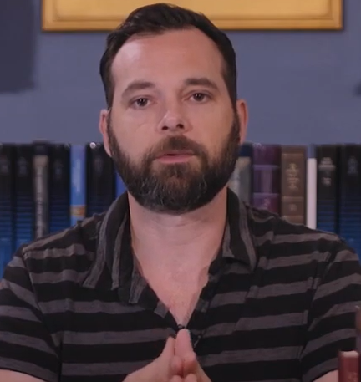
Textual Criticism Information
The Material that follows is from
Sean Finnegan
A modern look at textual criticism.
The problems and issues are old. He provides the YouTube look.
(32) 11 Two Corrected Bible Corruptions (1 Timothy 3.16, 1 John 5.7) - YouTube

Slide 20
Textual Criticism Sample 7: Colossians 2
Edition | Variants in Apparatus
Bover | 14 showing MS support; 2 more where only editors cited
Hodges & Farstad | 8 MT variants; 14 MT vs. UBS variants
Merk | 37 (+36 in the Latin parallel)
Nestle ed. 13 | 31
Nestle-Aland ed. 25 | 31
Nestle-Aland ed. | 31
Souter | 14
Tasker | None
Tischendorf | 98
UBS Ed. 3 | 6
UBS Ed. 4 | 7
Westcott & Hort | 9 with marginal variants (3 being primitive errors), 0 "noteworthy rejected"

Slide 21
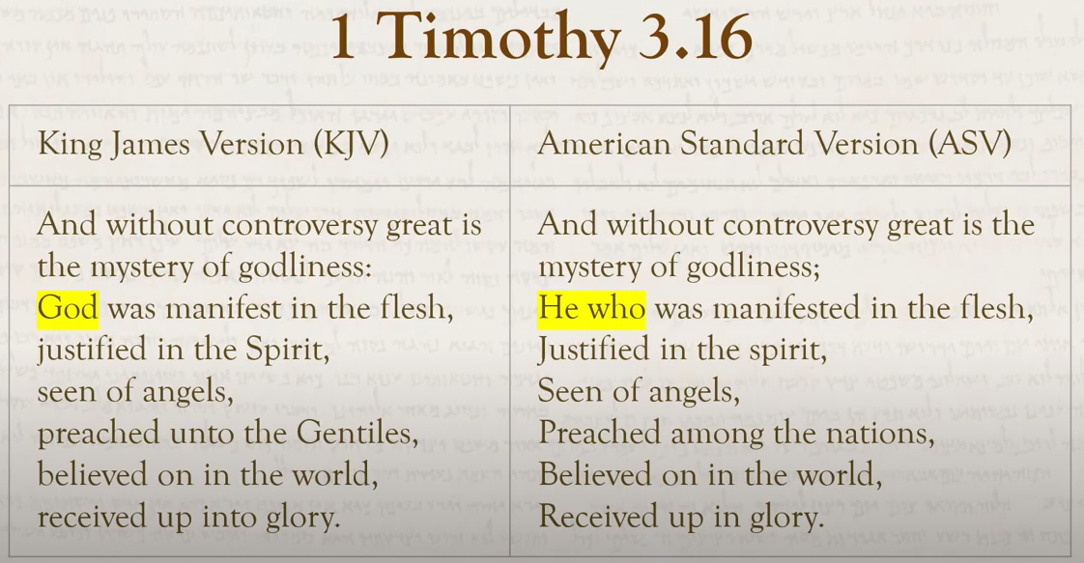
Textual Criticism Information

Slide 22
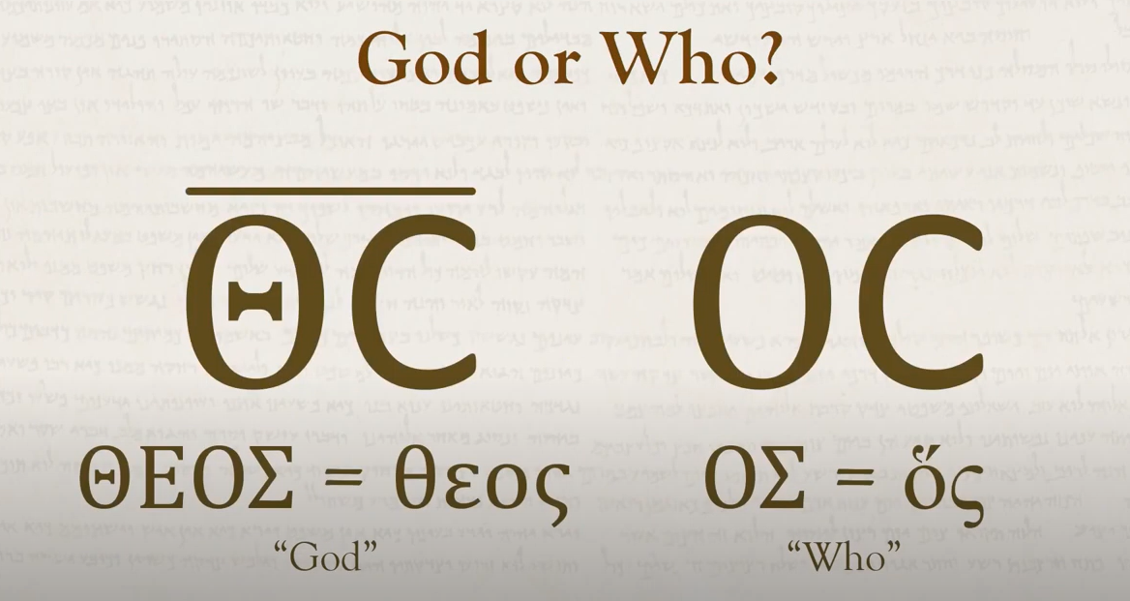
Textual Criticism Information

Slide 23
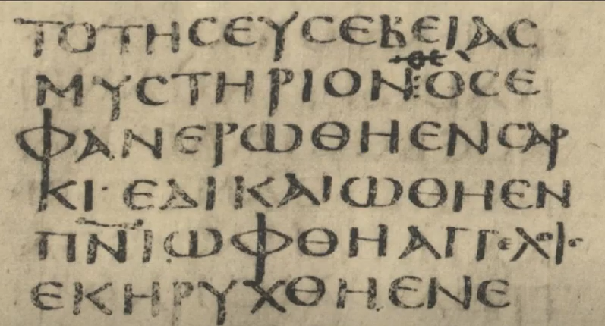

Textual Criticism Information

Slide 24
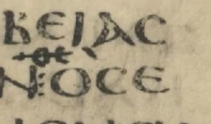
Textual Criticism Information

Slide 25
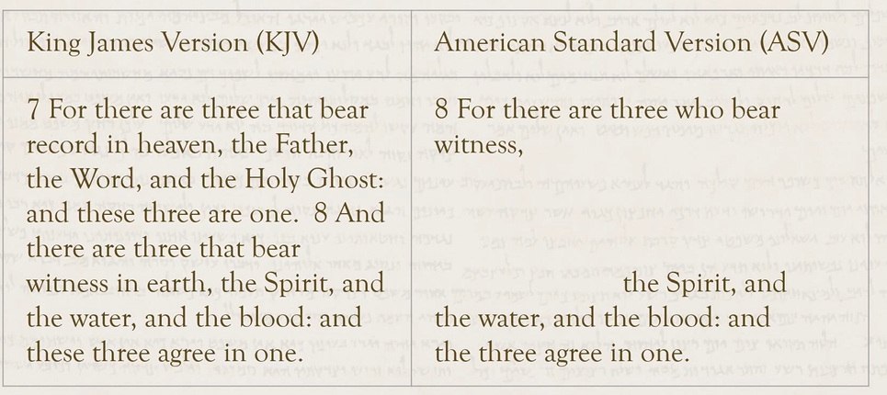
1 John 5:7-8

Slide 26
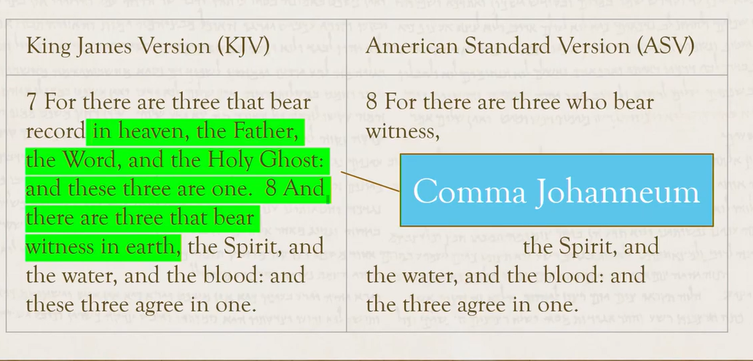
1 John 5:7-8

Slide 27
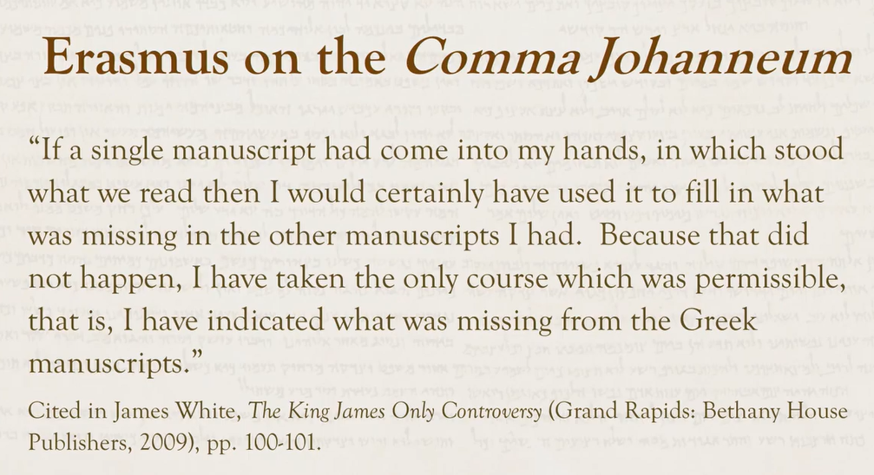

Slide 28
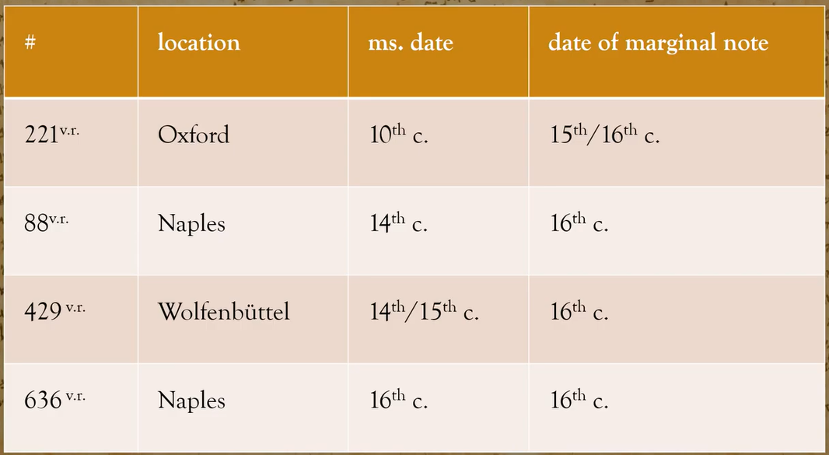
Comma Johanneum included in margin by later scribes

Slide 29
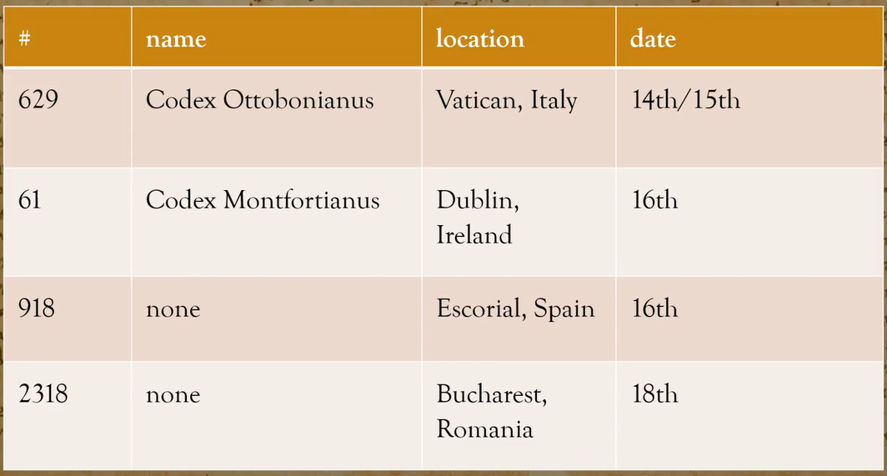
Comma Johanneum included in these manuscripts

Slide 30
How does one view the relationship of the Father Son and Holy Spirit without the Comma Johanneum?

Slide 31
Some websites refer to the Codes Vaticanus as not acceptable as it is a work of the Roman Catholic Church.
Comments?

Slide 32
Major Greek Texts
ERASMUS
KJV
Polyglot
TR
Nestle
Kurt Aland
NA26
Nestle
UBS
NA28
WH
NA27
Majority Texts

Slide 33
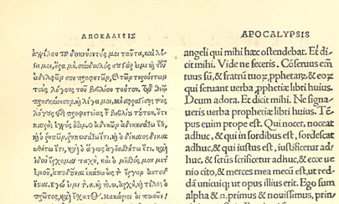
Erasmus

Slide 34
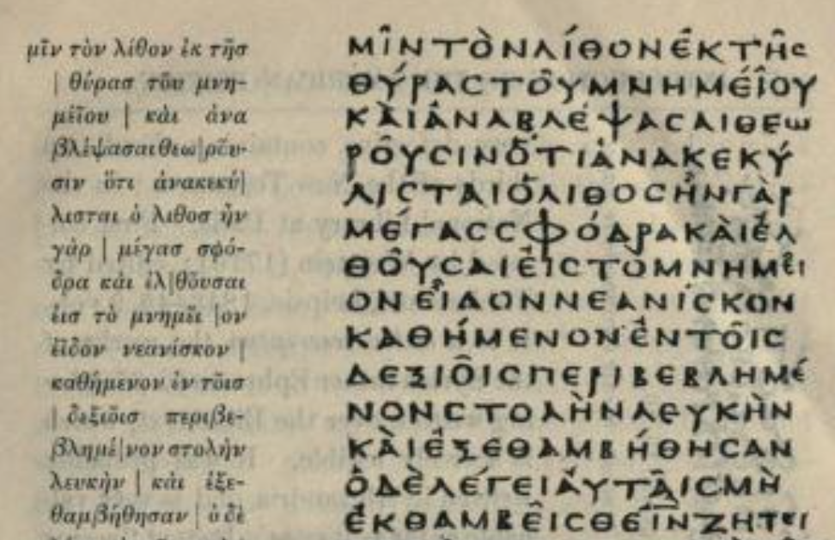
Codex Sinaiticus
Notes:
The New Testament in the original Greek : Westcott, Brooke Foss, 1825-1901 : Free Download, Borrow, and Streaming : Internet Archive
View of photocopy 31

Slide 35
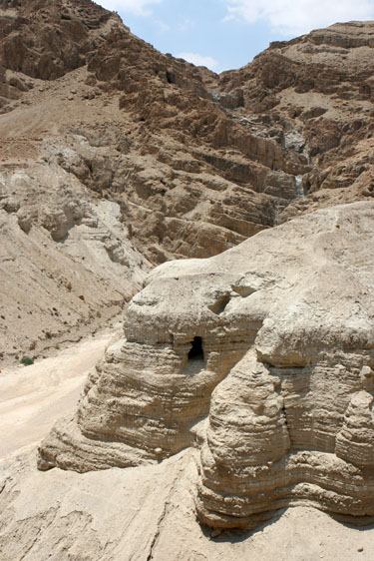
10 Key Points
8
8. The Dead Sea Scrolls confirmed the reliability of the Old Testament.
  The discovery of scrolls in 1947 near the Dead Sea confirmed the reliability of the methods used to preserve the Old Testament text.
A cave where Dead Sea Scrolls were found

Slide 36
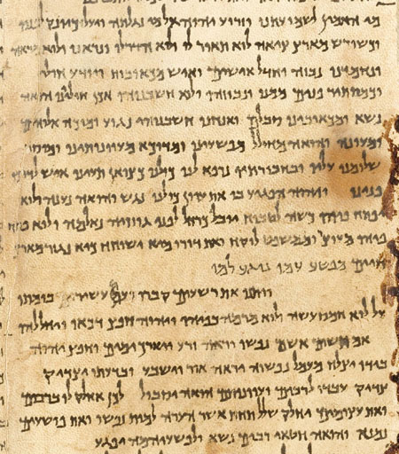
10 Key Points
  The scroll of Isaiah was nearly identical to manuscripts that were copied 1,000 years later.
  Other scrolls revealed many copying variants, but none affect anything we believe about God or about his work in the world.
Portion of the Isaiah Scroll

Slide 37
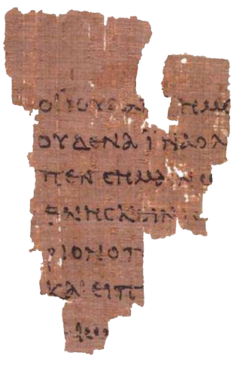
10 Key Points
Papyrus
  One of the oldest New Testament fragments (P52) that survives today was copied in Greek on a papyrus codex.
  It is from John 18 and was written sometime between AD 90 and 150.
Ryland’s Library Papyrus P52

Slide 38
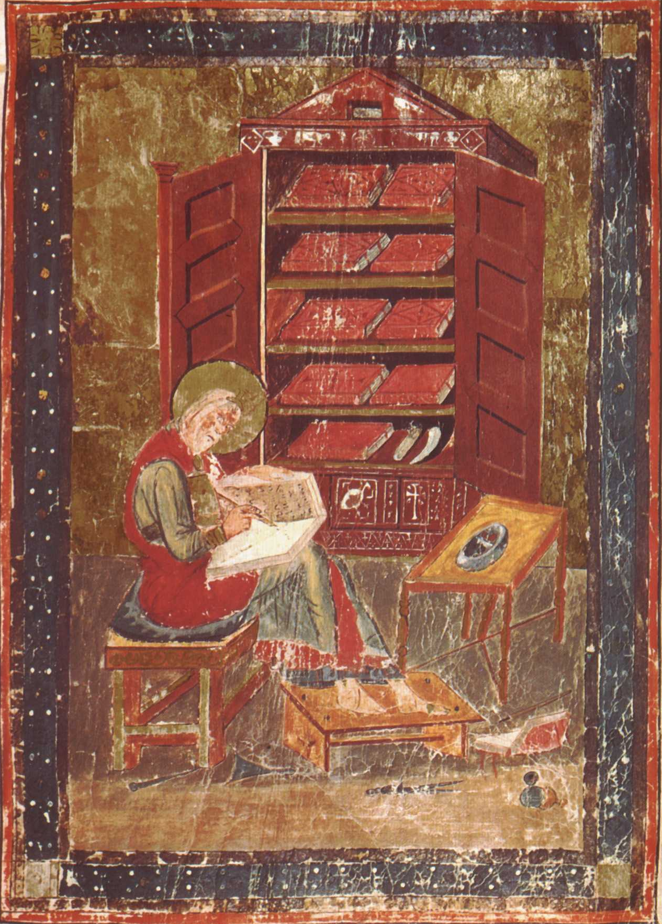
10 Key Points
Codex
  A “codex” is a bound volume made from sheets folded and sewn together, sometimes with a cover.
  Christians began using them instead of scrolls no later than the early 100s AD.

Slide 39

10 Key Points
Animal Skins
  Fine quality animal skins were used for over 1,000 years to make copies of the Bible, AD 300–1400.
    Parchment: scraped and stretched skin, usually from calves, sheep, or goats
    Vellum: higher quality parchment, usually calfskin, rubbed with pumice and treated with chalk

Slide 40
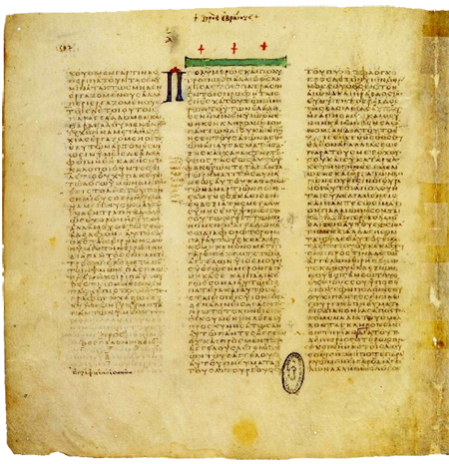
10 Key Points
Vellum
  Two of the oldest vellum copies of the New Testament that exist today are:
    Codex Vaticanus, which was copied in the early 300s AD.
    Codex Sinaiticus, which was copied in the mid 300s AD.
Codex Vaticanus

Slide 41
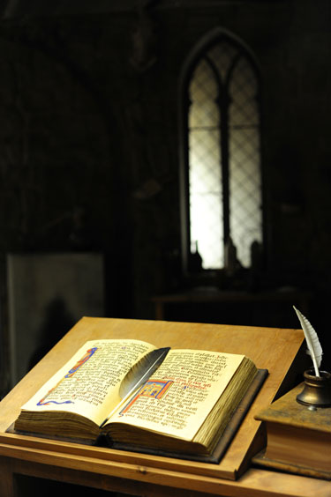
10 Key Points
Vellum
  Wycliffe Bibles were copied by hand on vellum in the 1300s–1400s.
  Each copy took months to produce and cost six months’ wages or more.

Slide 42
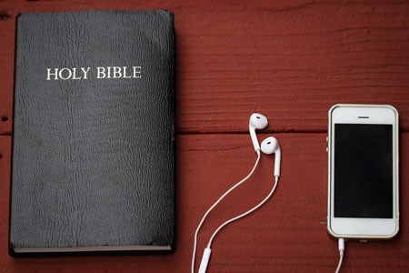
10 Key Points
  The Bible is now printed on paper and comes in many digital formats, in many versions and languages.
Menu

Slide 43
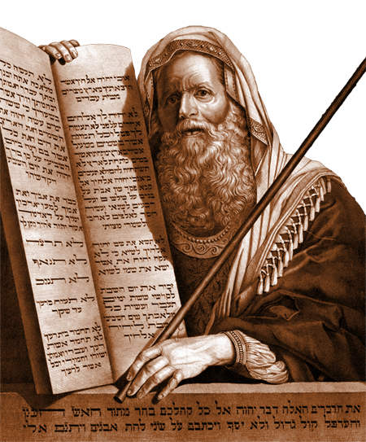
Time Line
Old Testament
  Old Testament events were written down in Hebrew (some portions in Aramaic) over centuries.
  In Exodus, the Lord tells Moses to write in a book (Exodus 17:14; 24:4, 7).
2000 BC
1500 BC
1000 BC
500 BC
AD 1

Slide 44
Time Line
Old Testament
  Other Old Testament writers, inspired by God, include leaders, kings, and prophets.
2000 BC
1500 BC
1000 BC
500 BC
AD 1

Slide 45
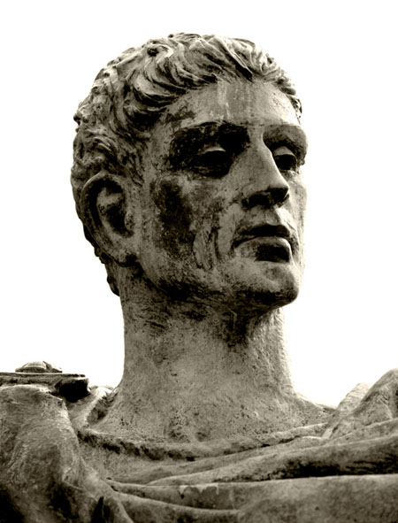
Time Line
Books of the New Testament
  The books of the New Testament had already circulated throughout the known world by the time the Emperor Constantine allowed Christians to practice their religion freely in AD 313.
  Emperor Constantine had no impact or influence on which books became part of the Bible.
Emperor Constantine
AD 1
500
1000
1500
2000

Slide 46
Time Line
Books of the New Testament
  By the 400s AD, a consensus had emerged throughout the churches:
    27 books could be traced to the testimony of apostolic eyewitnesses and their close associates.
  This consensus was confirmed by:
    Church fathers such as Athanasius, Jerome, and Augustine.
    Three church councils, including the Synod of Carthage in AD 397.
AD 1
500
1000
1500
2000

Slide 47
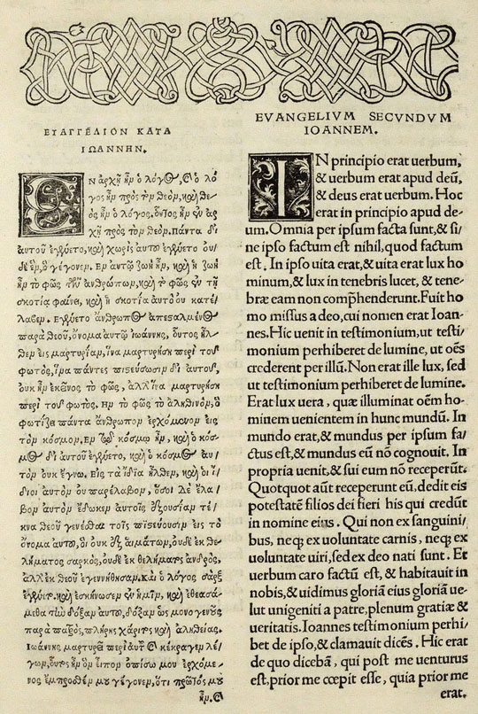
Time Line
Erasmus
  Erasmus, a priest and Greek scholar, published a Greek New Testament alongside a corrected Latin translation of the New Testament in 1516.
  This text, known as Novum Instrumentum Omne, was the first printed and published Greek New Testament.
Greek New Testament alongside Erasmus’s Latin Translation
AD 1
500
1000
1500
2000

Slide 48
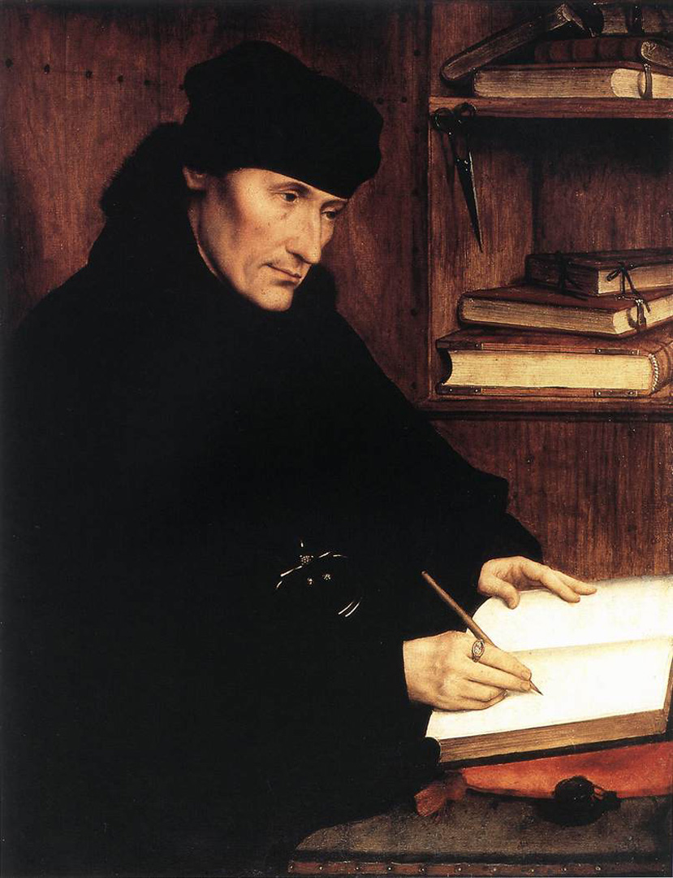
Time Line
Erasmus
  Greek New Testaments that were based on Erasmus’s work were used later by:
    Martin Luther
    William Tyndale
    Translators of the King James Version
Erasmus
AD 1
500
1000
1500
2000

Slide 49
Time Line
Erasmus
  These Greek New Testaments became known in 1633 as Textus Receptus (“Received Text”).
Erasmus
AD 1
500
1000
1500
2000

Slide 50
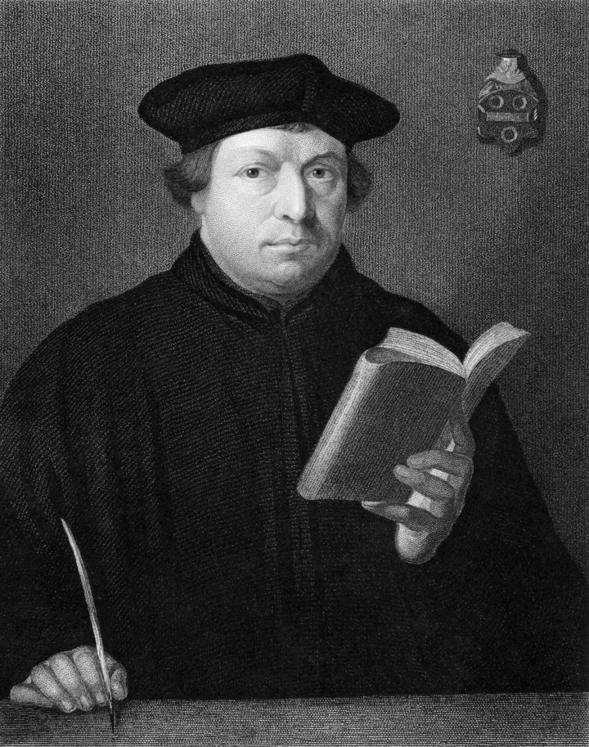
Time Line
Martin Luther
  A monk named Martin Luther came to believe that righteousness comes by faith alone (Romans 1:17).
  Luther clashed with church authorities and helped to launch the Protestant Reformation.
Martin Luther
AD 1
500
1000
1500
2000

Slide 51
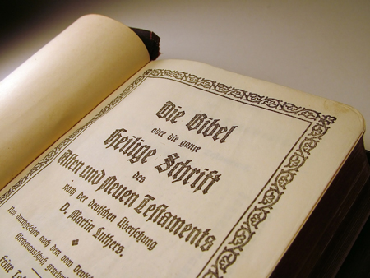
Time Line
Martin Luther
  In hiding, Luther used Erasmus’s Greek text to translate the New Testament into German.
  He completed his translation in 1522.
Luther’s German Translation
AD 1
500
1000
1500
2000

Slide 52
Time Line
Martin Luther
  His vibrant and easily-understood translation helped to standardize the German language.
Luther’s German Translation
AD 1
500
1000
1500
2000

Slide 53
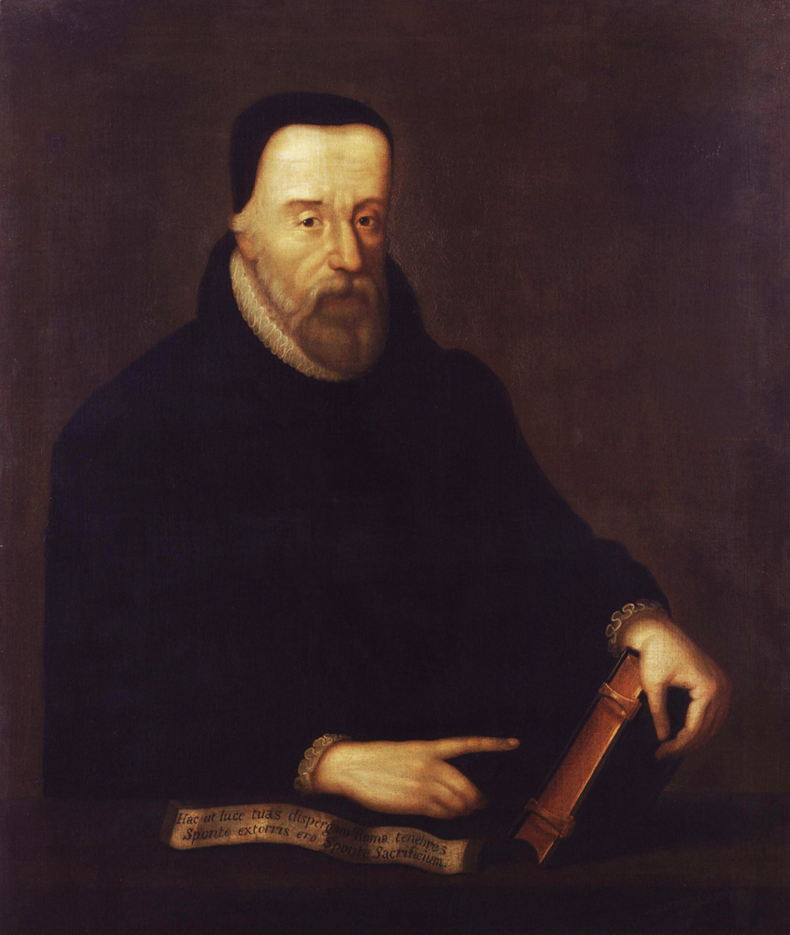
Time Line
William Tyndale
  William Tyndale was an Oxford scholar and priest.
  At dinner, a priest once said to him, “We had better be without God’s law than the pope’s.”
  Tyndale retorted, “If God spares my life, I will cause a boy that driveth the plow to know more of the Scripture than you do.”
William Tyndale
AD 1
500
1000
1500
2000

Slide 54
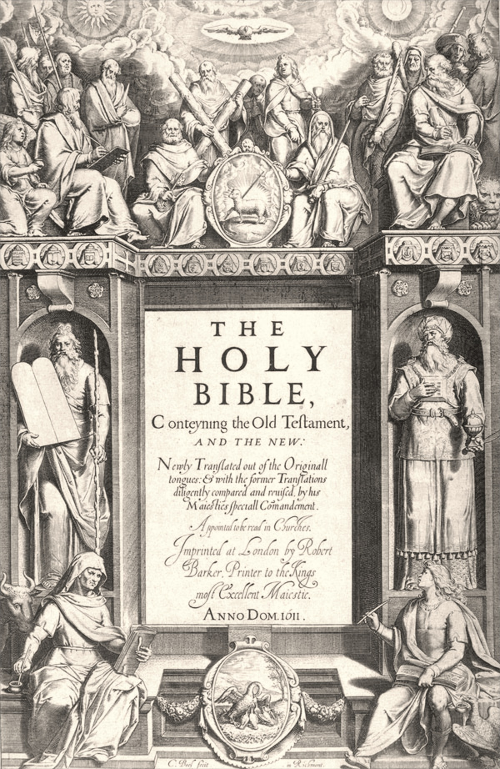
Time Line
King James Version
  King James commissioned 54 scholars to produce a Bible that did not include theological or political notes, like the Geneva Bible did.
  Organized into six teams, they used:
    Earlier English translations.
    Greek New Testaments based on Erasmus’s text.
    Hebrew and Aramaic texts.
Title page of the King James Version
AD 1
500
1000
1500
2000

Slide 55
Time Line
King James Version
  The new version was completed in 1609 and published in 1611.
  The King James Version is also known as “the Authorized Version.”
  It was revised several times. The edition most often used today is the 1769 revision.
Title page of the King James Version
AD 1
500
1000
1500
2000

Slide 56
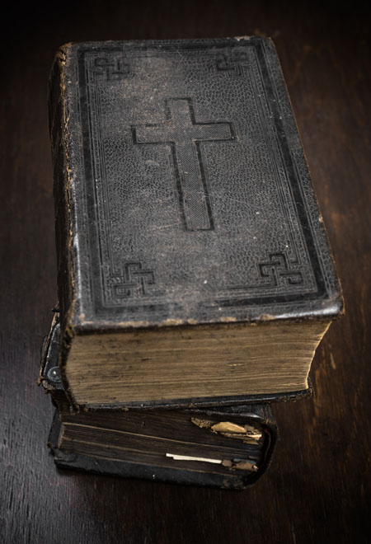
Time Line
King James Version
  The King James Version remained the most popular Bible in English for more than 300 years.
  At least two-thirds of the King James Version can be traced back to William Tyndale’s translations.
AD 1
500
1000
1500
2000

Slide 57
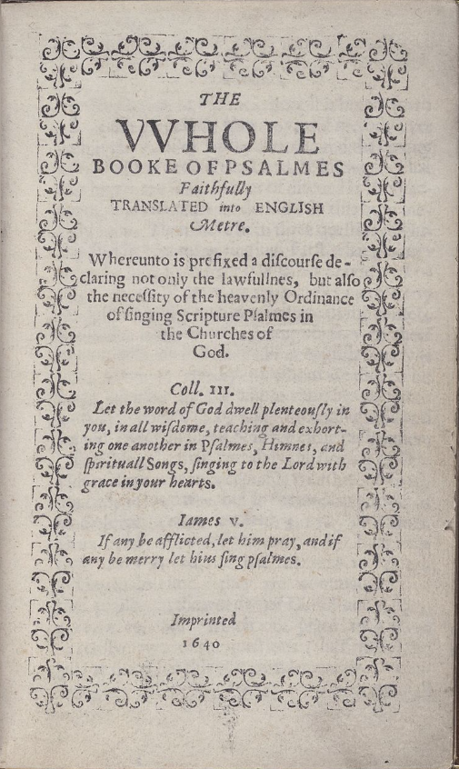
Time Line
Other Translations
  The Bay Hymnal was a new translation of the PSALMS from Hebrew.
  The early residents of the Massachusetts Bay Colony brought with them several books of psalms: the Ainsworth Psalter (1612), compiled by Henry Ainsworth for use by Puritan "separatists" in Holland; the Ravenscroft Psalter (1621); and the Sternhold and Hopkins Psalter (1562), of which there were several editions
Bay Hymnal (1640)
AD 1
500
1000
1500
2000

Slide 58
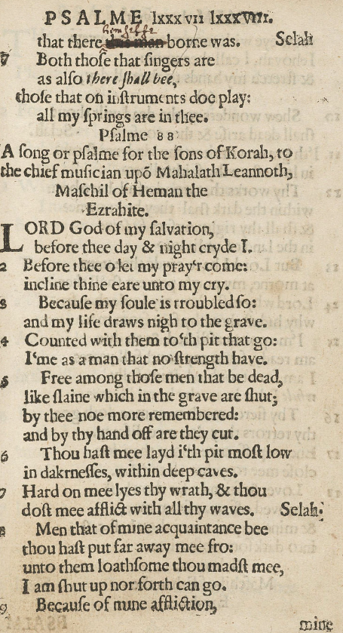
Time Line
Other Translations
  Evidently they were dissatisfied with the translations from Hebrew in these several psalters and wished for some that were closer to the original. They hired "thirty pious and learned Ministers", including Richard Mather, Thomas Mayhew, and John Eliot,^{[9]} to undertake a new translation, which they presented here
Bay Hymnal (1640)
AD 1
500
1000
1500
2000

Slide 59
Time Line
Bay Hymnal 1640
  The first printing was the third product of the Stephen Day (sometimes spelled Daye) press, and consisted of a 148 small quarto leaves, including a 12-page preface, "The Psalmes in Metre", "As with subsequent editions of the book, Day printed the book for sale by the first bookseller in British America, Hezekiah Usher, whose shop at that time was also located in Cambridge, Massachusetts.^{[11]} An estimated 1,700 copies of the first edition were printed.
  3rd Ed 1651 d The Psalms, hymns and spiritual songs of the Old and New Testament, faithfully translated into English metre
  9th Ed 1698 Contained music with 13 tunes from John Playford's A Breefe Introduction to the Skill of Musick (London, 1654)
AD 1
500
1000
1500
2000

Slide 60
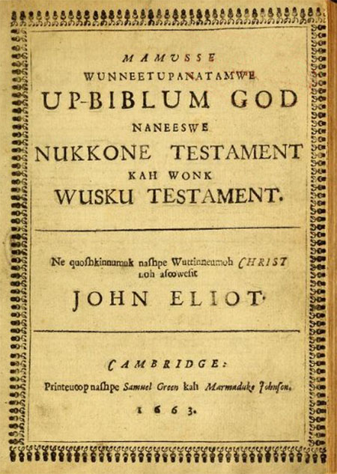
Time Line
Other Translations
  Puritan John Eliot, “the apostle to the Indians,” translated the Bible into the language of Native Americans in Massachusetts (1663).
  A Dutch Reformed pastor, Joao Ferreira de Almeida, finished the the first Portuguese translation of the New Testament (1676).
Eliot’s translation (1663)
AD 1
500
1000
1500
2000

Slide 61
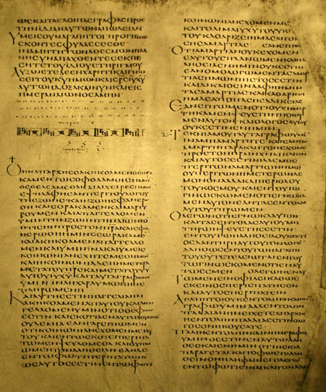
Time Line
Codex Alexandrinus
  In 1629, Codex Alexandrinus—a copy of the New Testament from the 400s AD—was made available to Western scholars.
  It is one of the earliest and most complete copies of the New Testament.
Portion of 2 Peter and 1 John in Codex Alexandrinus
AD 1
500
1000
1500
2000

Slide 62
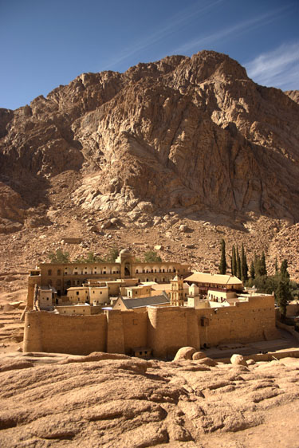
Time Line
Codex Sinaiticus
  In the mid-1800s, the earliest known complete copy of the New Testament—copied in the 300s AD—was found at St. Catherine’s Monastery near Mt. Sinai.
St. Catherine’s Monastery
AD 1
500
1000
1500
2000

Slide 63
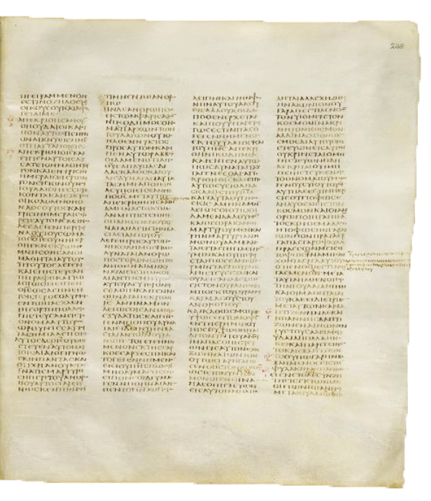
Time Line
Codex Sinaiticus
  Carefully copied and corrected, it is one of the most reliable surviving manuscripts of the New Testament.
John 3 in Codex Sinaiticus
AD 1
500
1000
1500
2000

Slide 64
Time Line
Codex Vaticanus
  The earliest and probably the most reliable surviving copy of the New Testament was made available to scholars in 1889.
  It was probably copied in the early 300s AD and seems to be slightly older than Codex Sinaiticus.
Codex Vaticanus
AD 1
500
1000
1500
2000

Slide 65
Time Line
Codex (book)
  A codex is another name for a book. These were leaves or pages bond together as a book made from vellum. Animal skins
Uncials (capital Letters)
  Many of the earliest manuscripts that have been discovered are written in uncials (all Greek capital letters) with no space between words.
Codex Vaticanus
Last Verses of Luke
Green Line Begins John
AD 1
500
1000
1500
2000

Slide 66
Modern Greek to Uncials
John 1:1 modern Greek Text
Ἐν ἀρχῇ ἦν ὁ λόγος, καὶ ὁ λόγος ἦν πρὸς τὸν θεόν, καὶ θεὸς ἦν ὁ λόγος.
AD 1
500
1000
1500
2000

Slide 67
Modern Greek to Uncials
Changing to all Caps… Diacritical marks are Unicode (computer font) limited.
ἘΝ ἈΡΧἮ ἮΝ Ὁ ΛὌΓΟΣ, ΚΑἺ Ὁ ΛὌΓΟΣ ἮΝ (etc)
John 1:1 modern Greek Text
Ἐν ἀρχῇ ἦν ὁ λόγος, καὶ ὁ λόγος ἦν πρὸς τὸν θεόν, καὶ θεὸς ἦν ὁ λόγος.
AD 1
500
1000
1500
2000

Slide 68
Modern Greek to Uncials
EΝ AΡΧH HΝ O ΛOΓΟΣ ΚΑI O ΛOΓΟΣ HΝ ΠΡOΣ ΤOΝ ΘΕOΝ ΚΑI ΘΕOΣ HΝ O ΛOΓΟΣ
John 1:1 modern Greek Text
Ἐν ἀρχῇ ἦν ὁ λόγος, καὶ ὁ λόγος ἦν πρὸς τὸν θεόν, καὶ θεὸς ἦν ὁ λόγος.
AD 1
500
1000
1500
2000

Slide 69
Modern Greek to Uncials
Uncials
EΝAΡΧHHΝOΛOΓΟΣΚΑIOΛOΓΟΣHΝΠΡOΣ ΤOΝΘΕOΝΚΑIΘΕOΣHΝOΛOΓΟΣ
EΝ AΡΧH HΝ O ΛOΓΟΣ ΚΑI O ΛOΓΟΣ HΝ ΠΡOΣ ΤOΝ ΘΕOΝ ΚΑI ΘΕOΣ HΝ O ΛOΓΟΣ
John 1:1 modern Greek Text
Ἐν ἀρχῇ ἦν ὁ λόγος, καὶ ὁ λόγος ἦν πρὸς τὸν θεόν, καὶ θεὸς ἦν ὁ λόγος.
AD 1
500
1000
1500
2000

Slide 70
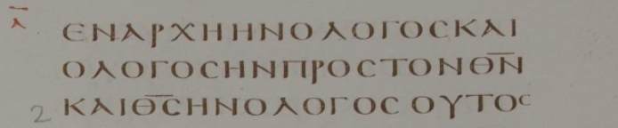
Modern Greek to Uncials
Codex Vat
EΝAΡΧHHΝOΛOΓΟΣΚΑI
OΛOΓΟΣHΝΠΡOΣΤOΝΘΝ
ΚΑIΘΣHΝOΛOΓΟΣ
AD 1
500
1000
1500
2000

Slide 71
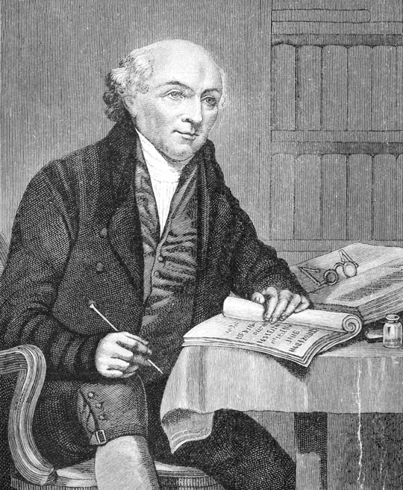
Time Line
Translations in the 1800s
  The missionary movement in the 1800s led to the rapid rise in new Bible translations into other languages.
  William Carey, “the father of modern missions,” translated the New Testament into Bengali (1801).
William Carey
AD 1
500
1000
1500
2000

Slide 72
Time Line
Translations in the 1800s
  Carey and his partners directed the translation of the Bible into more than 40 Indian languages and dialects.
William Carey
AD 1
500
1000
1500
2000

Slide 73
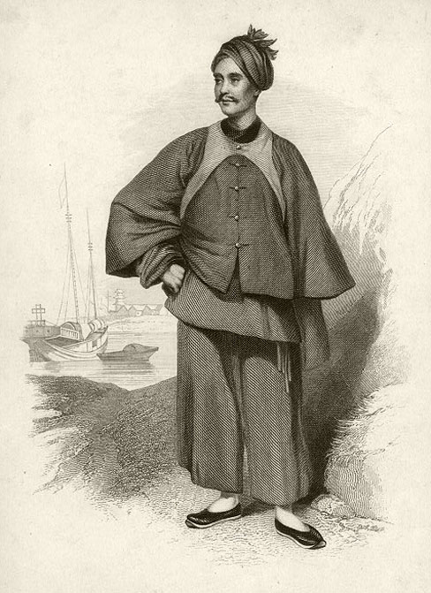
Time Line
Translations in the 1800s
  Missionary Karl Gutzlaff translated portions of the Bible into Thai and Japanese (mid-1800s).
  Scottish missionary to China, Robert Morrison, translated the Bible into Chinese (1823).
Karl Gutzlaff
AD 1
500
1000
1500
2000

Slide 74
Time Line
Translations in the 1800s
  Native Cherokee speaker, John Arch (Atsi), translated the Gospel of John into Cherokee (1824).
  Cherokee pastor, David Brown, translated the New Testament one year later.
AD 1
500
1000
1500
2000

Slide 75
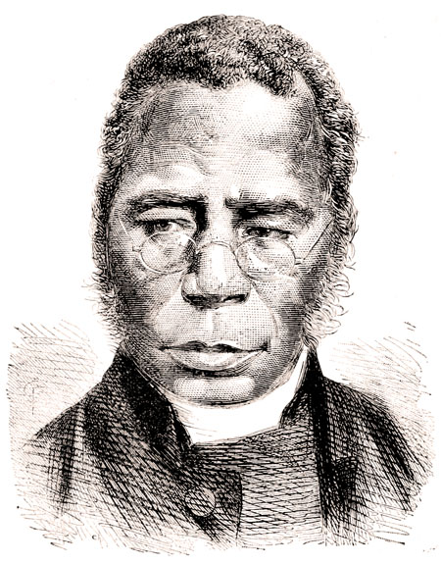
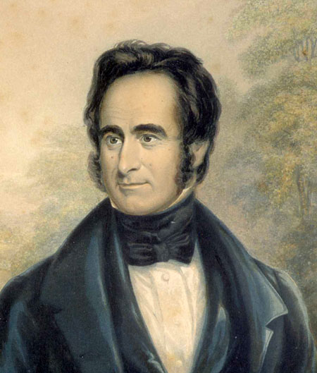
Time Line
Translations in the 1800s
  Former slave born in Yoruba (modern Nigeria), Samuel Ajayi Crowther, translated parts of the New Testament into his native language of Yoruba (1852).
  Scottish missionary to Africa, Robert Moffat, translated the Bible into the African language of Tswana (1857).
Samuel Ajayi Crowther
Robert Moffat
AD 1
500
1000
1500
2000

Slide 76

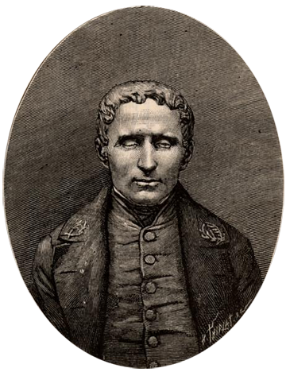
Time Line
The Braille Bible
  The Universal Braille Press (later Braille Institute of America) published the first complete Braille Bible in 1924.
  The Braille Bible filled 21 volumes in the King James Version.
Louis Braille, blind since the age of 3, completed a system for reading at age 15.
AD 1
500
1000
1500
2000

Slide 77
Time Line
The Dead Sea Scrolls
  Scrolls were discovered in 1947 in caves along the Dead Sea.
  They contained some of the oldest known copies of portions of the Old Testament.
  These copies were made between 100 BC and AD 100.
A cave where Dead Sea Scrolls were found
AD 1
500
1000
1500
2000

Slide 78
Time Line
The Dead Sea Scrolls
  A scroll of Isaiah from the Dead Sea Scrolls is the oldest complete manuscript of any book of the Bible copied before the time of Christ.
  It is remarkably close to the modern Hebrew text, with most of the variants being nothing more than differences in spelling.
Portion of the Isaiah Scroll
AD 1
500
1000
1500
2000

Slide 79
Time Line
The Dead Sea Scrolls
  The scrolls provide confirmation that the methods used to preserve the Masoretic Text were effective.
Other Discoveries
  During the 1900s, more than 100 New Testament manuscripts were found in Egypt.
Portion of the Isaiah Scroll
AD 1
500
1000
1500
2000

Slide 80
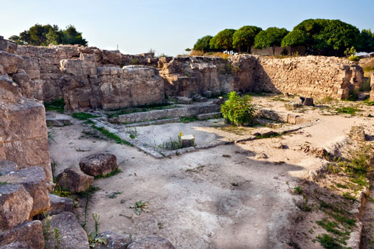
Time Line
Ugaritic
  Excavations of the ancient city of Ugarit (in northern Syria today) led to the discovery of a previously unknown language: Ugaritic.
  Ugaritic is an ancient Semitic language similar to Hebrew.
Ugarit Excavations
AD 1
500
1000
1500
2000

Slide 81
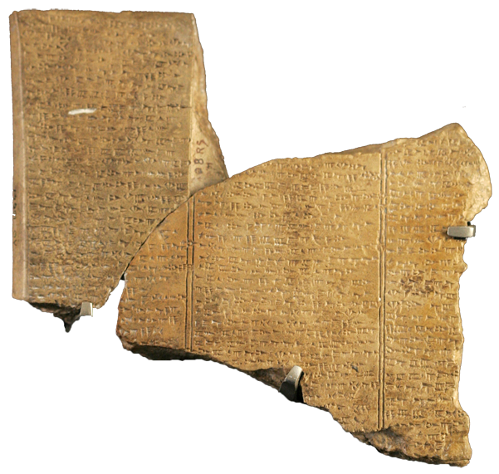
Time Line
Ugaritic
  In the 1960s, the first Ugaritic Grammar was published.
  This has helped scholars understand Hebrew vocabulary and poetry.
Poem in Ugaritic
AD 1
500
1000
1500
2000

Slide 82




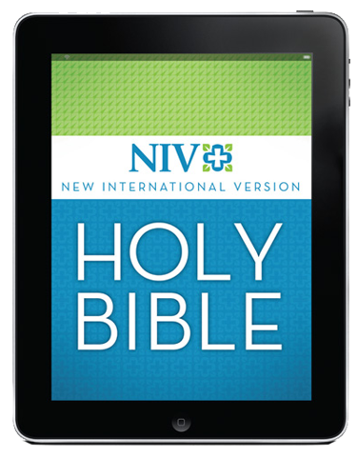
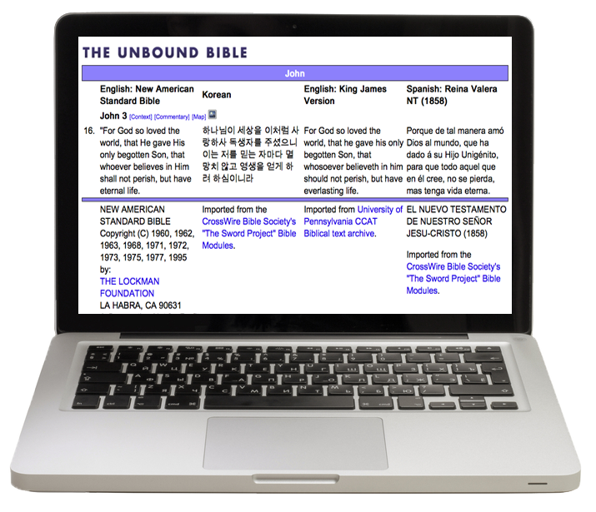
Time Line
  Today, the Bible comes in many formats and is distributed in all sorts of ways to reach people worldwide with the gospel of Jesus Christ.
Menu
AD 1
500
1000
1500
2000

Slide 83
English Bible Translations Today
Menu

Slide 84
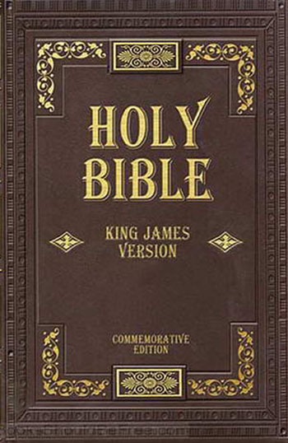
Translations Today
King James Version (KJV)
  1611, current edition 1769
  Example: “And he saith unto them, Follow me, and I will make you fishers of men.”—Matthew 4:19
1611
1900
1925
1950
1975
2000

Slide 85
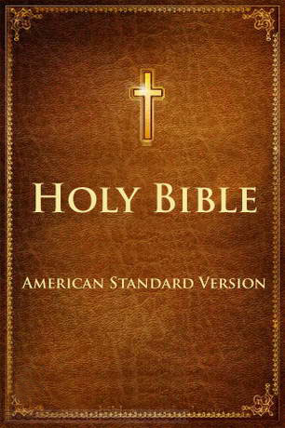
Translations Today
English Revised Version (ERV)
  1885
  British revision of the King James Version.
American Standard Version (ASV)
  1901
  American edition of the English Revised Version.
1900
1925
1950
1975
2000

Slide 86

Translations Today
Smith-Goodspeed, An American Translation
  1931
  Modern American English translated by:
    J. M. Powis Smith (Old Testament)
    Edgar J. Goodspeed (New Testament)
1900
1925
1950
1975
2000

Slide 87

Translations Today
Revised Standard Version (RSV)
  1952
  A revision of the American Standard Version (ASV).
  New Testament revised again in 1971.
1900
1925
1950
1975
2000

Slide 88

Translations Today
J. B. Phillips’ New Testament in Modern English
  1958
  A paraphrase by J. B. Phillips originally intended for youth.
1900
1925
1950
1975
2000

Slide 89

Translations Today
Amplified Bible (AMP)
  1965
  Attempts to express the meaning of the original text through the use of explanatory alternate readings and amplifications.
    Example: “For God so greatly loved and dearly prized the world that He [even] gave up His only begotten (unique) Son…”—John 3:16a
1900
1925
1950
1975
2000

Slide 90

Translations Today
New Jerusalem Bible (NJB)
  1966, updated 1985
  Approved by the Roman Catholic Church.
  Includes the Apocrypha.
1900
1925
1950
1975
2000

Slide 91

Translations Today
New English Bible
  1970, revised in 1989
  Attempts to present the Scriptures in “timeless” modern English.
1900
1925
1950
1975
2000

Slide 92

Translations Today
New American Bible (NAB)
  1970, revised in 1986, 1991
  Official translation used in the U.S. Catholic Church Mass.
  Includes the Apocrypha.
1900
1925
1950
1975
2000

Slide 93

Translations Today
New American Standard Bible (NASB)
  1971, revised in 1995
  Attempts to render grammar and terminology in clear English while preserving literal accuracy of American Standard Version (ASV).
1900
1925
1950
1975
2000

Slide 94

Translations Today
The Living Bible (TLB)
  1971
  Popular paraphrase by Kenneth N. Taylor.
    Example: “Because of his kindness, you have been saved through trusting Christ. And even trusting is not of yourselves; it too is a gift from God. Salvation is not a reward for the good we have done, so none of us can take any credit for it.”—Ephesians 2:8–9
1900
1925
1950
1975
2000

Slide 95

Translations Today
Good News Bible (also Good News Translation; GNT)
  1976, revised in 1992
  A “common language” Bible, also known as Today’s English Version.
1900
1925
1950
1975
2000

Slide 96

Translations Today
New International Version (NIV)
  1978, revised in 1984, 2011
  Seeks to bring modern Bible readers as close as possible to the experience of the first Bible readers.
  Currently the best-selling version.
1900
1925
1950
1975
2000

Slide 97

Translations Today
New King James Version (NKJV)
  1982
  Derived from the King James Version (KJV).
  Modern translation intended to maintain stylistic beauty of the KJV.
  New Testament translated from Textus Receptus.
1900
1925
1950
1975
2000

Slide 98

Translations Today
New Century Version (NCV)
  1987
  English translation derived from English Version for the Deaf (EVD) and the Easy-to-Read Version (ERV).
  Uses modern terms such as measurements and geographic names.
1900
1925
1950
1975
2000

Slide 99

Translations Today
Jewish New Testament
  1989
  English translation using traditional Jewish expressions.
  Translated by David H. Stern, a Messianic Jew.
    Example: “Yeshua said to them, ‘Come after me, and I will make you fishers for men!’”—Matthew 4:19
1900
1925
1950
1975
2000

Slide 100

Translations Today
New Revised Standard Version (NRSV)
  1989
  Revision of the Revised Standard Version (RSV); intended to be “as literal as possible” and “as free as necessary.”
  Gender neutral wording for people.
    Example: “And he said to them, ‘Follow me, and I will make you fish for people.’”
    —Matthew 4:19
1900
1925
1950
1975
2000

Slide 101

Translations Today
Contemporary English Version (CEV)
  1995
  Intended to be easily read by grade schoolers and second-language English readers.
    Example: “God loved the people of this world so much that he gave his only Son, so that everyone who has faith in him will have eternal life and never really die.”
    —John 3:16
1900
1925
1950
1975
2000

Slide 102

Translations Today
God’s Word Translation (GW)
  1995
  Attempts to use “natural equivalents” to translate text into contemporary English.
    Example: “God saved you through faith as an act of kindness. You had nothing to do with it. Being saved is a gift from God. It’s not the result of anything you’ve done, so no one can brag about it.”—Ephesians 2:8–9
1900
1925
1950
1975
2000

Slide 103

Translations Today
New Living Translation (NLT)
  1996, revised in 2004
  A translation in the style of the Living Bible, tries to render entire thoughts—rather than each word—into everyday English.
  Easy-to-read modern version.
    Example: “For this is how God loved the world: He gave his one and only Son, so that everyone who believes in him will not perish but have eternal life.”—John 3:16
1900
1925
1950
1975
2000

Slide 104

Translations Today
New International Reader’s Version (NIrV)
  1996, revised in 1998
  Simple words and short sentences for lower reading levels.
    Example: “God’s grace has saved you because of your faith in Christ. Your salvation doesn’t come from anything you do. It is God’s gift.”—Ephesians 2:8
1900
1925
1950
1975
2000

Slide 105

Translations Today
English Standard Version (ESV)
  2001
  Essentially literal, based on the 1971 RSV with significant corrections and language updates based on the most reliable Greek, Hebrew, and Aramaic texts.
    Example: “And he said to them, ‘Follow me, and I will make you fishers of men.’”—Matthew 4:19
1900
1925
1950
1975
2000

Slide 106

Translations Today
The Message (MSG)
  2002
  Paraphrase by Eugene H. Peterson.
    Example: “This is how much God loved the world: He gave his Son, his one and only Son. And this is why: so that no one need be destroyed; by believing in him, anyone can have a whole and lasting life.”—John 3:16
1900
1925
1950
1975
2000

Slide 107

Translations Today
Holman Christian Standard Bible (HCSB)
  2004
  Pursues two ideals:
    1) Each word must reflect contemporary English.
    2) Each word must be faithful to the
    original languages.
    Example: “For God loved the world in
    this way: He gave His One and Only
    Son, so that everyone who believes in Him will not perish but have eternal life.”
    —John 3:16
1900
1925
1950
1975
2000

Slide 108

Translations Today
Common English Bible (CEB)
  2011
  Diverse team of translators from 22 faith traditions in American, African, Asian, European, and Latino communities.
  Substitutes more natural wordings for traditional biblical terminology.
    Example: “‘Come, follow me,’ he said, ‘and I’ll show you how to fish for people.’”
    —Matthew 4:19
1900
1925
1950
1975
2000

Slide 109

Translations Today
  Holy Bible Modern Literal Translation
  2019
  Follows the majority text without regard to NA26 or TR.
  Uses a few words as possible for each Greek Word.
  Produced as an “Open Source Document’ to be available on the web.
1900
1925
1950
1975
2000

Slide 110
Translations after the discovery of the Dead Sea Scrolls
Translations after earlier ancient manuscripts were discovered in the 1700s and 1800s
Translations from ancient versions and copies available at that time
Menu
Chart does not include all English translations. Chart idea and dates courtesy of Back to the Bible Broadcast, Lincoln NE. Used by Permission.

Slide 111
Translations after the discovery of the Dead Sea Scrolls
Translations after earlier ancient manuscripts were discovered in the 1700s and 1800s
Translations from ancient versions and copies available at that time
Chart does not include all English translations. Chart idea and dates courtesy of Back to the Bible Broadcast, Lincoln NE..

Slide 112
Interesting Articles From Bryan Boatman
Controversial with some open-ended arguments ..
http://bbcbeeville.org/2019/08/history-of-the-english-bible-lollard-bibles/
August 11, 2019
http://bbcbeeville.org/2019/08/a-history-of-the-english-bible-william-tyndale/
August 25, 2019
http://bbcbeeville.org/2019/08/history-of-the-english-bible-geneva/
September 1, 2019
http://bbcbeeville.org/2019/09/a-history-of-the-english-bible-king-james/
September 8, 2019
http://bbcbeeville.org/2019/09/a-history-of-the-english-bible-westcott/

Slide 113

How We Got the Bible PowerPoint®
© 2015 RW Research, Inc.
All rights reserved. No part of this publication may be reproduced, stored in a retrieval system or transmitted in any form or by any means—for example, electronic, photocopy, recording—without prior written permission of the publisher.
Image Credits: Shutterstock.com; Bible Translation Sources Chart idea and dates courtesy of Back to the Bible Broadcast, Lincoln NE, used by permission.
Special Thanks to Timothy Paul Jones, PhD; Philip W. Comfort, PhD; Errol F. Rhodes; John McRay, PhD; Lawrence Scrivani; and Michael Cochrane, MA.
Trademarks: Any trademarked symbols included in this teaching presentation belong to the organizations identified. Rose Publishing is a Christian organization and not affiliated with any of the organizations with trademarked symbols. The symbols and photos used in this presentation fall under the U.S.A. Copyright Law, Title 17, Section 107.
Rose Publishing
P. O. Box 3473, Peabody, Massachusetts 01961-3473 U.S.A.
www.hendricksonrose.com

