Slide 1
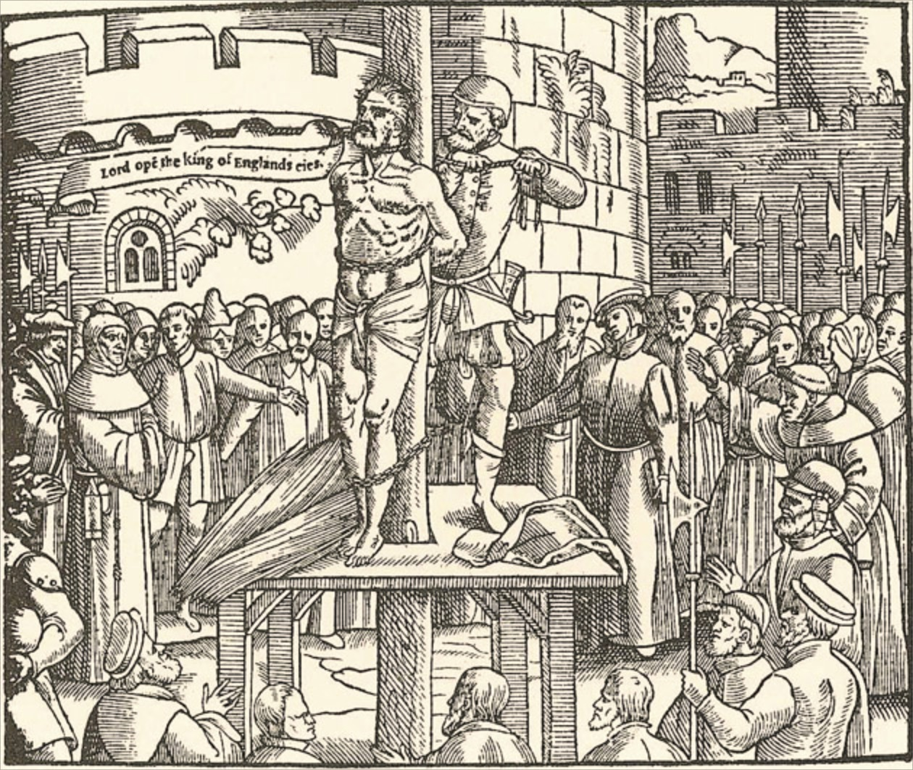
William Tyndale
42
AD 1
500
1000
1500
2000

Slide 2
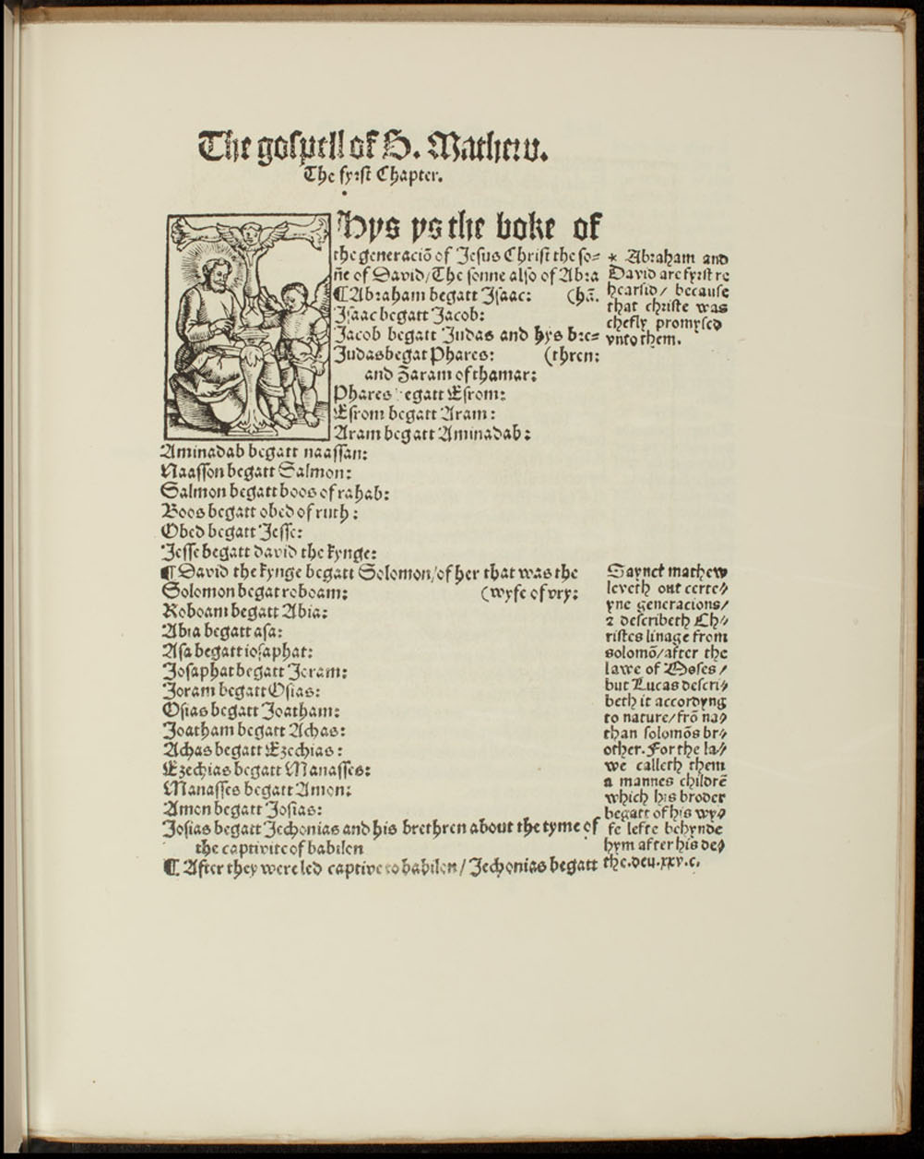
William Tyndale Legacy
William Tyndale
Tyndale is known as the “Father of the English Bible.”
His translation has influenced almost every English translation of the Bible.
Much of the style and vocabulary we know as “biblical English” is traceable to his work.
Page from the Tyndale Bible
AD 1
500
1000
1500
2000

Slide 3
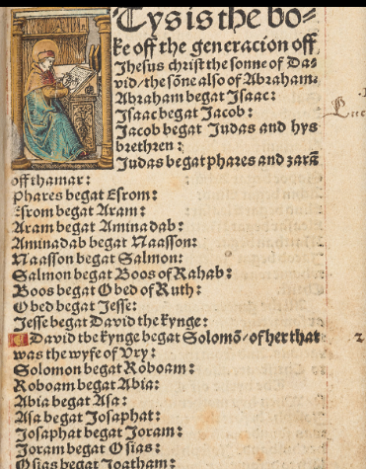
William Tyndale Legacy
William Tyndale’s Translation
Matthew
William Tyndale's New Testament | The British Library (bl.uk)
The copy is in the British Museum.
It had belonged to Anne Boleyn.
Page from the Tyndale Bible
AD 1
500
1000
1500
2000

Slide 4
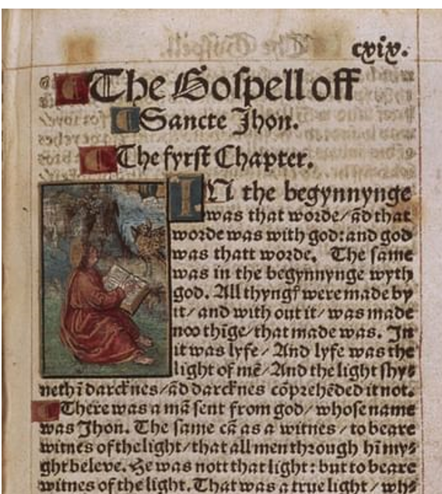
William Tyndale Legacy
William Tyndale’s Translation
John from the British Library copy
Page from the Tyndale Bible
AD 1
500
1000
1500
2000

Slide 5
William Tyndale Legacy
Words
Scapegoat, Passover, Jehovah
Overseer instead of bishop, repentance instead of do penance
Constructs
“eat, drink and be merry”
“the spirit is willing”
“fight the good fight”
Congregation audience, gathering, assembly, crowd, throng, host, mass
Church adjective -- ecclesiastical, clerical, religious, priestly, apostolic, papal
Church noun -- minister, cathedral, basilica, house of worship, place of worship
AD 1
500
1000
1500
2000

Slide 6
William Tyndale Legacy
William Tyndale’s Bible Translation
First English translation to use Jehovah ("Iehouah") as God's name as preferred by English Protestant Reformers.
Used the word congregation to translate ekklēsia to differentiate from the baggage imposed by the word church.
Page from the Tyndale Bible
AD 1
500
1000
1500
2000

Slide 7
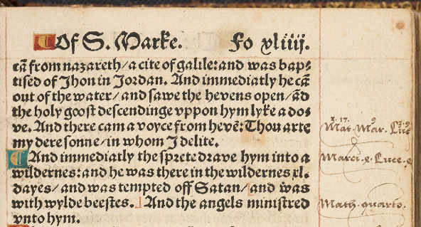
William Tyndale Lagacy
16 to 20 thousand copies made there way to England.
The “church” purchased many copies and burned them.
The second edition eliminated marginal notes making it smaller (pocket size)
AD 1
500
1000
1500
2000

Slide 8
William Tyndale Lagacy
The Catholic Churches rejection was there were over 2000 “errors” in Tyndale's version.
AD 1
500
1000
1500
2000

Slide 9
William Tyndale
Ekklēsia ἐκκλησία is translated congregation by Tyndale
(77 “errors”)
First From a compound of ἐκ (G1537) and a derivative of καλέω (G2564)
ἐκ translated as of (366x), from (181x), out of (162x), by (55x), on (34x), with (25x), miscellaneous (98x)
καλέω translated call (125x), bid (16x), be so named (1x), named (with G3686) (1x), miscellaneous (3x)..
Congregation audience, gathering, assembly, crowd, throng, host, mass (synonyms form Microsoft word)
AD 1
500
1000
1500
2000

Slide 10
William Tyndale
Contrast of synonyms from Microsoft Word Thesaurus
Congregation audience, gathering, assembly, crowd, throng, host, mass
Church adjective -- ecclesiastical, clerical, religious, priestly, apostolic, papal
Church noun -- minister, cathedral, basilica, house of worship, place of worship
AD 1
500
1000
1500
2000

Slide 11
William Tyndale Legacy
Open the King of England's eyes
In short order of about 10 months English Translations of the Bible were Authorized by Henry VIII.
The king’s separation from Rome left him in a void of church leadership that needed to be filled. (wkb)
Age 42 Tyndale October 6, 1536
Strangled and burned
AD 1
500
1000
1500
2000

Slide 12
Tyndale Legacy

Slide 13
English Monarchs
Henry VIII 22 April 1509 – 28 January 1547 (37 years, 282 days).
John Fryth killed 4 July 1533 by Thomas More
On 14 May 1535 John Houghton, Robert Lawrence and Augustine Webster were executed together with fifteen other monks.
Killed Thomas More 6 July 1535
John Fisher
Thomas Cromwell (1485-1540) Issue over Henry VIII 4th wife Anne of Cleves
57,000 people executed under his reign. Promoted publication of the Great Bible
AD 1
500
1000
1500
2000
Notes:
The killer king: How many people did Henry VIII execute? | Sky HISTORY TV Channel
THE KILLER KING: HOW MANY PEOPLE DID HENRY VIII EXECUTE?
Tudor HistoryKings and Queens
Henry VIII (1491 – 1547) is perhaps the most well known of all England’s monarchs, notably for the fact that he had six wives and beheaded two of them. Besides presiding over sweeping changes that brought the nation into the Protestant Reformation and changed England’s faith, the infamous monarch, ridiculed for his obesity, was also subject to raging mood swings and paranoia. It is estimated that during his 36 years of rule over England he executed up to 57,000 people, many of whom were either members of the clergy or ordinary citizens and nobles who had taken part in uprisings and protests up and down the country.
Victims of Henry VIII’s turbulent reign, who were either executed by him or killed in his name, fell into three principal categories - Heresy, Treason and Denial of his Royal Supremacy as Head of the English Church.
READ MORE ABOUT: TUDOR HISTORY
The lives of Henry VII and Henry VIII: Never the twain shall meet
by Richard Bevan
Simply broadcasting or discussing an opinion against the paranoid king could put even the most influential of citizens, including nobility in the Tower of London. Worse fates were to await those who he believed were against him; for if someone dared to be against Henry, they were also against God. Such an offence was dealt with by the relatively humane swift swing of the axe. But for those accused of heresy, witchcraft and treason a far worse fate was in store for condemned victims through the barbaric acts of being burned at the stake or hanged, drawn and quartered. It is interesting to note that members of aristocracy and gentry could not be legally tortured unlike commoners.
What if Germany had won WW1? Game simulates historical scenariosHistorical Strategy GamePlay Now
Would your strategy save the US? This game simulates contemporary conflictsPolitics SimulationPlay Now
by Taboola
Sponsored Links
The following victims of Henry’s displeasure and rage represent only a small proportion of executions which increased in volume during and after the English Reformation. Whether these unfortunates were once adored royal wives, close friends, respected advisors or simply perceived as enemies of the state, they all contribute to a tally of death that makes Henry VIII the most prolific serial killer England has known.
READ MORE ABOUT: BRITISH HISTORY
8 people executed for high treason in the UK
THE ROYAL KILLINGS
Queen Anne Boleyn (1501-1536)
Anne Boleyn was King Henry’s second and possibly most infamous wife for whom the King changed England’s religion and separated from the Church of Rome to marry and sire a much longed-for male heir with. Having failed in delivering a son Anne found herself in the midst of a conspiracy concocted by Henry’s advisor Thomas Cromwell and accused of infidelity with five men including her own brother George Boleyn (Viscount Rochford) and sentenced to death. Anne was famously dispatched by a French swordsman while her brother and the four other accused, Sir William Brereton, musician Mark Smeaton, Henry Norris and Sir Francis Weston, were beheaded by the axe on Tower Hill on the 17 May 1536.
READ MORE ABOUT: TUDOR HISTORY
Guilty or innocent?: The crimes of Anne Boleyn
by Jo Rowan
Only Smeaton, being a commoner, was tortured and his false confession used to condemn the Queen. All accused were believed to have been innocent of the charges. Anne was executed in a private setting in the Tower of London on the 19th May 1536.
George Boleyn (Viscount Rochford) (1503-1536)
Queen Anne’s younger brother, who according to his arrest along with four other accused men was accused of incestuous relations with his sister. Although it is known that George was a sexual libertine there is no evidence he had relations with Anne.
George and Anne were close and affectionate to each other unlike the Queen’s relationship with her sister Mary (former mistress of Henry VIII) which was strained. There is evidence to suggest that George, who became Viscount Rochford and rose to a high position in the court, may have been betrayed by his wife, Jane Parker (sister-in-law to Anne) who contributed testimonies to the trial of Anne, alleging intimate indiscretions with George.
Some historians claim that Rochford was actually homosexual or bisexual and had relations with some of the defendants such as musician Mark Smeaton. The former Viscount of Rochford and Anne’s much-loved brother was executed on Tower Hill on 17 May 1536 along with the four other accused men. Rochford’s last words mainly promoted his new Protestant faith.
READ MORE ABOUT: KINGS AND QUEENS
The Rise and Fall of the Boleyns
by Richard Bevan
Jane Boleyn (nee Parker) Viscountess Rochford (1505-1542)
If ever there was an ironic twist to the litany of victims of Henry VIII, the journey of Lady Jane Parker who may have wilfully contributed to accusations of sexual misconduct between her husband (George Boleyn) and Queen Anne Boleyn, is a potent example.
Whether Parker had intended to harm her husband and Queen Anne is still a case of conjecture but seven years after Anne Boleyn was beheaded, Parker was herself executed for her explicit involvement in acting as ‘agent’ in arranging and assisting Queen Catherine Howard’s secret assignations with Thomas Culpepper. Parker became the third Boleyn member to lose her head. She was executed on the same day as Queen Catherine, directly after on the same scaffold. Both bodies were buried in an unmarked grave in the Tower grounds.
READ MORE ABOUT: TUDOR HISTORY
The cuckold king: Did Catherine Howard cheat on Henry VIII?
by Richard Bevan
Queen Catherine Howard (1523-1541)
Unlike Anne Boleyn, young Catherine lacked her older cousin’s prestigious education, experience and social skills. But she possessed what the ageing and obese King Henry most desired, youth, a girlish nature and disposition to submissiveness. Catherine was about 17 when she married the 49- year-old monarch days after Henry had obtained an annulment from Anne of Cleves.
Catherine’s immaturity and desperation to become pregnant may have encouraged her to be coerced into an ongoing affair with a handsome courtier Thomas Culpepper, who was a distant cousin of both Boleyn and Howard. But it was to be her less than chaste past that caught up with the naive teenager with revelations that she had sexual relations at fifteen with an older predatory rake, Francis Dereham. During Catherine’s interrogation, it was the discovery of a ‘precontract’ of marriage to Dereham that sealed her fate as it was a treasonable offence to knowingly conceal sexual history before marriage to the King.
READ MORE ABOUT: TUDOR HISTORY
That takes guts: 7 gory execution methods from Tudor England
by James Brigden
Under the ‘bill of attainder’ Catherine was sentenced to death with no formal trial. It is rumoured that on being first arrested the hysterical Catherine was dragged screaming down a corridor at Hampton Court. Incarcerated at Syon Abbey in Isleworth, Middlesex during a bitterly cold winter she was later transported to the Tower down the Thames and beheaded on Tower Green, on the same spot as her unfortunate cousin Anne Boleyn. Legend has it that the tragic young teenage Queen requested the executioner’s block in her cell so she could practice her last moments of living with poise and dignity.
Francis Dereham (1506- 1541) & Thomas Culpepper (1514-1541)
The opportunist and social-climbing Francis Dereham had not continued sexual relations with Catherine Howard while she was Queen in his role at court as Gentleman Usher of the Queen’s Chamber. However it was his confession under torture that she was having relations with his rival, Thomas Culpepper, that led to both young men being arrested and sentenced to death.
'IN HENRY’S EYES, DEREHAM HAD ‘SPOILED’ THE ILL-FATED QUEEN'
Bizarrely and possibly reflecting Henry’s perverse egotism, the enraged King decided on bestowing a more brutal execution for Dereham. In Henry’s eyes, Dereham had ‘spoiled’ the ill-fated Queen, whom the King had believed was a virgin on their wedding night. Both accused men were executed together on the scaffold at Tyburn with Dereham suffering the cruellest and most painful fate of being hanged, disembowelled alive and his body quartered. Culpepper, who in an act of cowardly self-preservation blamed the Queen for their sexual assignations, got off lightly due to his closeness to the King with a swift blow of the axe. Both ‘traitors’ heads were put on spikes on Tower Bridge.
READ MORE ABOUT: KINGS AND QUEENS
Who was Henry VIII's most unfortunate wife?
by Richard Bevan
KING HENRY’S RIGHT HAND MEN
Two of Henry's closest advisors and who died on his orders were Sir Thomas More and Thomas Cromwell, the latter ironically helping to seal the fate of More, was himself executed by Henry for treason. Both men’s fates were associated with King Henry’s matrimonial affairs that stemmed from one simple obsession – the need for a male heir.
Sir Thomas More (1478-1535)
Sir Thomas More was an English lawyer, author, statesman and close friend and advisor to Henry VIII. His downfall from high office was due to his opposition of the annulment of the King’s marriage to Catherine of Aragon, and also his opposition to Henry's break from the Catholic Church that was headed by the Pope in Rome.
'I DIE THE KING’S GOOD SERVANT, AND GOD’S FIRST’
More was canonised by Pope Pius XI in 1935 as a martyr. Having refused to attend the coronation of Henry’s new wife Anne Boleyn he was later accused of treason mainly through his association with other known ‘heretics’ such as the infamous Elizabeth Barton (the Nun of Kent) who had prophesied that the king would die if he married Anne Boleyn. More also refused to acknowledge Henry as Supreme Head of the Church of England. Unlike many other victims of Henry, More was offered many opportunities to sign an Oath and save him from execution. He is alleged to have said on the scaffold 'I die the King’s good servant, and God’s first’ before he was beheaded.
Thomas Cromwell (1485-1540)
The ‘upstart’ Cromwell, uncharacteristically came from a trade background unlike the most powerful men in the court who descended from nobility, was an English lawyer and chief minister to King Henry. Never short of enemies or cynics who despised his lowly background, Cromwell was instrumental in attaining the divorce King Henry needed to marry Anne Boleyn.
It was a campaign of high risk that saw Europe’s religion turned on its head. Unfortunately for the much admired and trusted Cromwell his own head was to be the price when he displeased the King over the debacle of Henry’s fourth wife, Anne of Cleves. For Henry disliked Anne intensely and blamed Cromwell for the embarrassment. The once-powerful Chief Minister was arraigned under a bill of attainder, accused of treason and sentenced to death without trial. He was executed on Tower Hill in 1540 and his head placed on a spike on London Bridge.
READ MORE ABOUT: BRITISH HISTORY
The history of the English Reformation
by Richard Bevan
KILLING HERETICS
Being accused of conspiring with the devil through witchcraft or practising incantations was one way people found themselves in Henry's crosshairs. The fate facing those accused of heresy was arrest and a hideous death either by being burned at the stake or through public hanging.
Elizabeth Barton
Elizabeth Barton became famous throughout the land at the time of King Henry's reign. Yet as a self-proclaimed teller of divine revelations, she managed to escape the usual grisly fate of being burnt at the stake As a 19-year-old domestic servant, Barton first predicted the death of a child in the household where she worked and went on to make more prophecies that appeared to come true.
Bestowed with several monikers such as the Nun of Kent and The Mad Maid of Kent, Barton’s reputation soon reached the ears of King Henry’s court after she had become a nun. Investigated by the Catholic church to check Barton was not offending their teachings, her fame increased by the time she met Cardinal Wolsey. Through Wolsey, Barton had meetings with King Henry himself whom she impressed with her revelations that suited his own beliefs and politics.
READ MORE ABOUT: TUDOR HISTORY
Witchcraft in the times of Henry VIII and beyond
by Richard Bevan
However, this brief moment of royal patronage changed drastically when Barton became outspoken against Henry’s intention to obtain an annulment for his marriage to Catherine of Aragon. When Barton prophesied that the King would die within a few months if he married Anne Boleyn events turned against the outspoken nun who found herself arrested for treason.
Forced to confess that her revelations were fabrications Barton was found guilty of false prophecies and for being involved in a conspiracy to kill the King. Barton was 28 years of age when she was hanged at Tyburn on 20 April 1534.
Anne Askew (1521-1546)
Askew is a woman who is remembered for taking a stand against the church's oppression and who actively fought and challenged male control. She also became the first Englishwoman to demand a divorce on spiritual grounds. Condemned as a heretic Askew was tortured in the Tower of London on the rack. Apart from Margaret Cheyne who was burned at the stake for high treason in 1537 under Henry’s reign, Askew is only the second woman on record known to have received such barbaric cruelty in the Tower.
Today she is lauded as a martyr for the Protestant faith.
While held in the Tower, the condemned Askew was stretched on the rack to reveal names of fellow Protestant preachers after she had been arrested for acting as a ‘gospeller’ of the new faith (Protestant) in the streets of London. Caught up in the struggle between religious traditionalists (Catholics) and reformers (Protestants) Henry had outlawed the word of evangelicals due to the possibility of an alliance with the Catholic Emperor Charles V. The search was on for high ranking Protestant preachers which Askew was believed to know.
Asked to reveal her sources, Askew was placed on the infamous rack and tortured twice. The second time was so brutal where her body was raised five inches off the rack table that her shoulders and hips were pulled from their sockets and her elbows and knees were dislocated. Her screams could be heard outside the White Tower where she was being held. Despite the excruciating pain, which caused her to faint, she remained silent and refused to give names.
READ MORE ABOUT: MEDIEVAL HISTORY
The law is an ass: 8 famous animal trials from history
by James Brigden
On 16 July 1546 Askew, together with three men condemned as heretics, were taken to Smithfield in London to be burned at the stake. Due to her painful injuries and being unable to walk, Askew was carried in a chair to the stake where she was dragged to a seat and chained to the post.
Compassionate sympathisers had managed to sneak pouches of gunpowder to the prisoners to alleviate their suffering. Documents of the heinous spectacle note how the public admired Askew’s bravery as the flames leapt to her chest. An explosion of fire killed all five condemned in a matter of seconds.
Mabel Brigge (1506-1536)
Mabel Brigge was a widow from Yorkshire who worked as a servant in a number of households. She had a habit of fasting which was often associated with spiritual and pagan rituals. But in the case of Brigge her fasts were believed to be a way to cast spells for other people. Brigge’s crime was performing a ‘black fast’ which involved avoiding milk and meat for three days as part of a pact requested by another woman, Isobel Buck, to recover some money the latter had lost.
Brigge’s employers John and Agnes Lokkar reported Brigge to the authorities after she had revealed she had carried out a similar fast to kill a man who was found dead with a broken neck. The Lokkars believed Brigge was practising witchcraft and using the black fast to kill both Henry VIII and his right-hand advisor the Duke of Norfolk. Brigge and Buck were arrested and tried at York and both found guilty resulting in Brigge being executed on 7 April, 1538.
READ MORE ABOUT: MEDIEVAL HISTORY
Execution in the Middle Ages
EXECUTIONS FOR REFUSING THE OATH OF SUPREMACY
Carthusian Monks
During the Reformation, there were some monks who refused to comply with Henry VIII’s Act of Supremacy and executed for maintaining their allegiance to the Pope. The Houses of the Carthusian monks was such an order and which paid a heavy price for all ten of their monasteries in the British Isles. The Order founded in 1054 by St Bruno was systematically persecuted and banned. Many of its monks (also known as hermits) who refused to sign the Oath of Supremacy (accepting Henry as the Head of the English Church) were tortured, burned at the stake and left to starve to death in cells.
One of the most barbaric examples of annihilation was at the London Charterhouse (today in Charterhouse Square) where most members of the house were arrested, interrogated and when found guilty left to face agonising deaths. Monks were disembowelled while still alive, beheaded and quartered with the body being hacked into four pieces. Arrests and executions took place in four main stages targeting Charterhouses between 1535 -37.
READ MORE ABOUT: MEDIEVAL HISTORY
Torture in the Middle Ages
Hanged in chains
On 14 May 1535 three leading Carthusians; Doms John Houghton, Robert Lawrence and Augustine Webster from the houses of Beavale and Axholme were executed together with fifteen other monks. The merciless authorities then turned to monks at the London house who, after their arrest and interrogation, were painfully held hanging from chains in prison for thirteen days before being hanged at Tyburn.
Other condemned monks from Charterhouse of St Michael in Hull, Yorkshire, were found guilty on trumped-up charges of treason and were hanged in chains on York’s battlements until dead. One monk, Sebastian Newdigate, was a friend of the King who visited the monk twice in prison to try and persuade him to renounce his faith and accept the Oath, but all in vain. The remaining twenty hermits and lay brothers at London Charterhouse were arrested and taken to Newgate prison in May 1535. Chained standing to posts they were left to starve to death.
John Fisher
Fisher, a Catholic Bishop and cardinal who was arrested and condemned for treason, is a reminder of how even the most high ranking of clergy in the country was fair game in Henry’s merciless quest to silence dissenters. The theologian who later became Bishop of Rochester and served as Chancellor of the University of Cambridge was possibly targeted by Henry, not just because Fisher refused to accept the King as the Supreme Head of the English Church, but also because the Yorkshire born cleric had passionately supported Henry’s first wife Catherine of Aragon during the King’s attempt to attain an annulment. Fisher controversially declared during court proceedings at the time that he was prepared to die in his defence of the ‘indissolubility of marriage’. Henry had a long memory.
READ MORE ABOUT: ANCIENT HISTORY
Weirdest laws in history
by BP Perry
A staunch supporter of the Pope and the Catholic Church when Fisher and other bishops appealed to the Holy See after encroachments on the Catholic Church, Henry had them arrested on the basis that such appeals were forbidden. A brief imprisonment was followed by Fisher’s re-arrest for treason for refusing to accept Henry as the Supreme Head of the Church of England.
Fisher was tried by a court of seventeen which included Henry’s right-hand man, Thomas Cromwell, and Anne Boleyn’s father Thomas Boleyn. Because Fisher was deprived of his status as Bishop of Rochester he was tried as a commoner and feared the worst kind of execution. Public outcry resulted in the original sentence of hanging, drawing and quartering to a more humane beheading on the scaffold. At Tower Hill on 22 June 1535 Fisher faced his execution with impressive calm and dignity although his headless body was stripped and left naked on the scaffold before being thrown into a rough grave. His head was placed on a pole on London Bridge.
READ MORE ABOUT: TUDOR HISTORY
The Mary Rose: Tudor battleship
by Sky HISTORY
The Pilgrimage of Grace executions
Led by London lawyer Robert Aske the ‘Pilgrimage of Grace’ uprising which began in Yorkshire and spread to Cumberland, Northumberland and Lancashire was the most serious of rebellions during Henry’s reign. It was a spontaneous mass protest and rebellion against the policies of the Crown associated with Henry’s advisor Thomas Cromwell.
The rebellion was initiated after a poor harvest in 1535 led to high food prices. Due to King Henry’s Reformation which saw many monasteries dissolved, the poor were unable to turn to them for food and shelter. The rebellion also involved a religious and political angle in that many people who had loved Queen Catherine were appalled by the King’s divorce and his marriage to Anne Boleyn while also seeing their Catholic faith betrayed by new Protestant doctrines.
Aske’s rebellion was viewed as a serious threat to the Crown as the barrister assembled between 30-40,000 people and occupied York. The Duke of Norfolk was assigned the task to quell both the Pilgrimage of Grace rebellion and a new rising called Bigod’s Rebellion led by one Sir Francis Bigod.
Despite pardons from Norfolk being reneged by Henry the Duke was able to put down the rebellions leading to the arrests of Aske and Bigod. Two hundred and sixteen rebels were executed which included lords, knights and abbots. Bigod was hanged at Tyburn while Aske suffered the crueller fate of being hanged in chains at Clifford’s Tower in York. In one case the rebel Sir Nicholas Tempest was hanged, drawn, and quartered while his wife Margaret Stafford suffered being burnt at the stake.
READ MORE ABOUT: MEDIEVAL HISTORY
8 Famous Botched Executions
Margaret Pole, Countess of Surrey (1473 – 1541)
Beatified as a martyr for the Catholic Church, Margaret Pole’s treatment by Henry VIII was particularly cruel, particularly in light of the Countess of Surrey’s advancing age. A peeress in her own right she had been left a little land by her husband and raised five surviving children. Margaret became a lady-in-waiting to Catherine of Aragon, Henry VIII’s first wife. Later she devoted her third son Reginald Pole to the Church where he became the Archbishop of Canterbury. By 1538 the Countess had become one of the richest women in the country due to her handling of her lands.
Despite Margaret’s high standing at court, she fell out of favour with King Henry when he married Anne Boleyn. After Henry declared his first daughter Lady Mary a bastard, Margaret, a supporter of Mary refused to hand over the young lady’s jewels and gold plate. She was only allowed to return to court after Boleyn had been executed.
Responsibility for the Countess's downfall lay with her sons Reginald and Geoffrey. Reginald Pole had been suggested as a future husband for Lady Mary by the King's enemies and he was linked to the Pilgrimage of Grace rebels who planned to move on London and install a Catholic government. Reginald’s brother Geoffrey Pole was arrested in association with plots against the King which led to the Countess herself being imprisoned, as it was assumed she supported her sons’ treasonable activities. The Countess was incarcerated in the Tower of London for two years but in what could be considered salubrious surroundings compared to most prisoners cells.
READ MORE ABOUT: TUDOR HISTORY
What if Lady Jane Grey had kept the throne?
On the 27 May 1541 the now 67-year-old Countess was told she was to be executed within the hour. In what has become as one of the most infamous of executions of a noblewoman, the baffled Margaret was led to a corner of the Tower where, instead of a scaffold, the executioner’s wooden block, raised a few inches from the ground awaited the terrified woman. Refusing to lay her head on the block she is alleged to have challenged the executioner to ‘take it as he could’.
As described in Burke’s Peerage, the killing was carried out by a 'blundering youth' rather than a skilled executioner who hacked at the Countess’ head and shoulders to pieces while she had tried to escape. One account which may be apocryphal described the axeman chasing the distraught Countess before striking her. Buried in the chapel of St Peter and Vincula within the Tower, Margaret Pole was beatified by Pope Leo XIII on 29 December 1886.
THE LAST EXECUTION BY KING HENRY
Henry Howard, Earl of Surrey (1517 – 1547)
The nobleman, soldier and founder of English Renaissance poetry was a first cousin of both Queen Anne Boleyn and Queen Catherine Howard and followed them in their tragic footsteps to the block. The son of Thomas Howard, the Duke of Norfolk who was also the queen's uncle, young Henry Howard, Earl of Surrey, was also known to be quarrelsome and possessing of a violent temper.
Surrey’s reckless behaviour including illegally quartering the royal arms, -- altering his coat of arms without the King's permissions - and encouraging his own sister Mary to seduce the aged King Henry to become his mistress. It was speculated that Surrey was plotting to the take the crown from the King’s own son, the future Edward VI
Together with Surrey, the enraged king also had his father the Duke of Norfolk arrested and imprisoned on charges of treason. On 19 January 1547 the Earl of Surrey was beheaded on Tower Hill days before the planned execution of his father the once trusted right-hand man to Henry who was spared death due to the king own death.
Written by:
RICHARD BEVAN
Richard Bevan is an MA Screenwriter/playwright and freelance writer specialising in history and crime investigation writing. He is currently contributing to Sky HISTORY channel. Represented by WGM Atlantic agency.

Slide 14
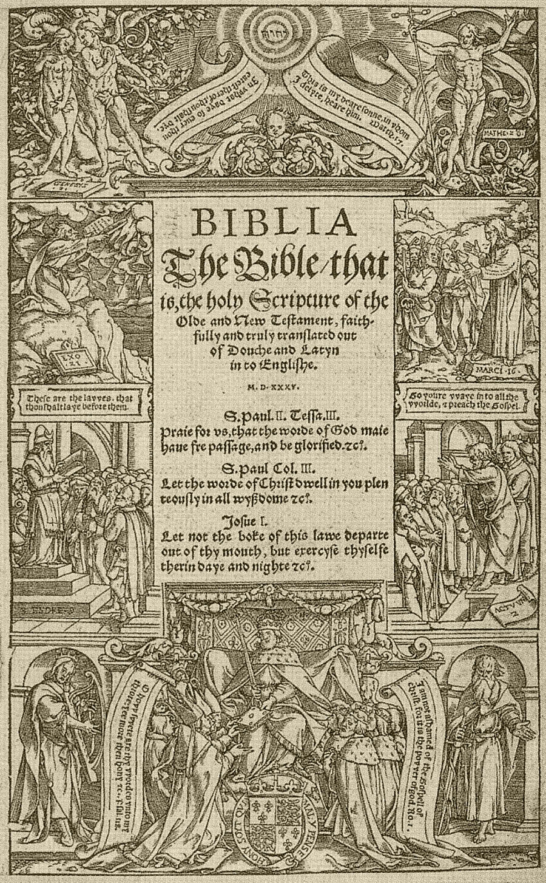
Miles Coverdale
Probably met Thomas Cromwell some time before 1527
From 1528 to 1535 Coverdale spent most of his time in continental Europe, mainly in Antwerp (1st exile) (Tyndale connection probable)
Title Page of the Coverdale Bible
AD 1
500
1000
1500
2000
Notes:
Francis Fry – Wikipedia
Myles Coverdale
13 languages
Article
Talk
Read
Edit
View history
From Wikipedia, the free encyclopedia
For the Australian cricketer, see Miles Coverdale (cricketer).
The Right Reverend
Myles Coverdale
Bishop of ExeterChurchChurch of EnglandSeeExeterInstalled1551Term ended1553PredecessorJohn VeseySuccessorJohn VeseyOrdersConsecration30 August 1551 by Thomas CranmerPersonal detailsBornc. 1488 Yorkshire, England
Died20 January 1569 (aged 80-81) London, EnglandBuriedChurch of St Bartholomew-by-the-Exchange, then St Magnus-the-Martyr, both in the City of LondonDenominationCatholicism; later an early Anglican reformer and regarded as "proto-Puritan" in his later life.
Arms of Myles Coverdale: Quarterly per fess indented gules and or, in chief a rose between two fleurs-de-lys in base a fleur-de-lys between two roses all counter-changed^{[1]}
Myles Coverdale, first name also spelt Miles (1488 – 20 January 1569), was an English ecclesiastical reformer chiefly known as a Bible translator, preacher and, briefly, Bishop of Exeter (1551–1553).^{[2]} In 1535, Coverdale produced the first complete printed translation of the Bible into English.^{[3]} His theological development is a paradigm of the progress of the English Reformation from 1530 to 1552. By the time of his death, he had transitioned into an early Puritan, affiliated to Calvin, yet still advocating the teachings of Augustine.
Life to end of 1528[edit]
Regarding his probable birth county, Daniell cites John Bale, author of a sixteenth-century scriptorium, giving it as Yorkshire.^{[2][note 1]} His birth date is generally regarded as 1488.
Coverdale studied philosophy and theology at Cambridge, becoming bachelor of canon law in 1513.^{[2][note 2]} In 1514 John Underwood, a suffragan bishop and archdeacon of Norfolk, ordained him priest in Norwich. He entered the house of the Augustinian friars in Cambridge, where Robert Barnes had returned from Louvain to become its prior. This is thought to have been about 1520–1525.^{[2]} According to Trueman,^{[4]} Barnes returned to Cambridge in the early to mid-1520s.^{[note 3]} At Louvain Barnes had studied under Erasmus and had developed humanist sympathies. In Cambridge, he read aloud to his students from St. Paul's epistles in translation and taught from classical authors.^{[2]} This undoubtedly influenced them towards Reform. In February 1526, Coverdale was part of a group of friars that travelled from Cambridge to London to present the defence of their superior, after Barnes was summoned before Cardinal Wolsey.^{[2][4]} Barnes had been arrested as a heretic after being accused of preaching Lutheran views in the church of St Edward King and Martyr, Cambridge on Christmas Eve. Coverdale is said to have acted as Barnes' secretary during the trial.^{[5]} By the standards of the time, Barnes received relatively lenient treatment, being made to do public penance by carrying a faggot to St Paul's Cross.^{[4]} However on 10 June 1539, Parliament passed the Act of Six Articles, marking a turning point in the progress of radical protestantism.^{[6]: 423–424} Barnes was burned at the stake on 30 July 1540, at Smithfield, along with two other reformers. Also executed that day were three Roman Catholics, who were hanged, drawn and quartered.^{[4]}
Coverdale probably met Thomas Cromwell some time before 1527. A letter survives showing that later, in 1531, he wrote to Cromwell, requesting his guidance on his behaviour and preaching; also stating his need for books.^{[2]} By Lent 1528, he had left the Augustinians and, wearing simple garments, was preaching in Essex against transubstantiation, the veneration of sacred images, and Confession to a Priest. At that date, such views were very dangerous, for the future course of the religious revolution that began during the reign of Henry VIII was as yet very uncertain. Reforms, both of the forms proposed by Lollardy, and those preached by Luther, were being pursued by a vigorous campaign against heresy.^{[6]: 379–380} Consequently, towards the end of 1528, Coverdale fled from England to the Continent.^{[2]}
First exile, 1528[edit]
From 1528 to 1535 Coverdale spent most of his time in continental Europe, mainly in Antwerp. Celia Hughes believes that upon arriving there, he rendered considerable assistance to William Tyndale in his revisions and partial completion of his English versions of the Bible.^{[7]: 100 [note 4]} In 1531, Tyndale spoke to Stephen Vaughan of his poverty and the hardships of exile, although he was relatively safe in the English House in Antwerp, where the inhabitants supposedly enjoyed diplomatic immunity.^{[8]} However, in the spring of 1535 a "debauched and villainous young Englishman wanting money" named Henry Phillips insinuated himself into Tyndale's trust. Phillips had gambled away money from his father and had fled abroad. He promised the authorities of the Holy Roman Emperor that he would betray Tyndale for cash. On the morning of 21 May 1535, having arranged for the imperial officers to be ready, Phillips tricked Tyndale into leaving the English House, whereupon he was immediately seized. Tyndale languished in prison throughout the remainder of 1535 and despite attempts to have him released, organised by Cromwell through Thomas Poyntz at the English House, Tyndale was strangled and burned at the stake in October 1536. Meanwhile Coverdale continued his work alone to produce what became the first complete English Bible in print, namely the Coverdale Bible. Not yet proficient in Hebrew or Greek, he used Latin, English and German sources plus the translations of Tyndale himself.
Coverdale's translation of the Bible, 1535[edit]
In 1534 Canterbury Convocation petitioned Henry VIII that the whole Bible might be translated into English. Consequently, in 1535, Coverdale dedicated this complete Bible to the King.^{[9]: 201} After much scholarly debate, it is now considered very probable that the place of printing of the Coverdale Bible was Antwerp.^{[2][10]} The printing was financed by Jacobus van Meteren. The printing of the first edition was finished on 4 October 1535.^{[note 5]} Coverdale based the text in part on Tyndale's translation of the New Testament (following Tyndale's November 1534 Antwerp edition) and of those books which were translated by Tyndale: the Pentateuch, and the Book of Jonah. Other Old Testament books he translated from the German of Luther and others.^{[note 6]} Based on Coverdale's translation of the Book of Psalms in his 1535 Bible, his later Psalter has remained in use in the 1662 Book of Common Prayer to the present day, and is retained with various minor corrections in the 1926 Irish Book of Common Prayer, the 1928 US Episcopal Book of Common Prayer, and the 1962 Canadian Book of Common Prayer, etc.^{[note 7]}
Further translations, 1537–1539[edit]
In 1537 the Matthew Bible was printed, also in Antwerp, at the expense of Richard Grafton and Edward Whitchurch who issued it in London.^{[9]: 1058} It comprised Tyndale's Pentateuch; a version of Joshua 2 and Chronicles translated from the Hebrew, probably by Tyndale and not previously published; the remainder of the Old Testament from Coverdale; Tyndale's New Testament from 1535. It was dedicated to Henry VIII who licensed it for general reading. "Thomas Matthew", the supposed editor, was an alias for John Rogers.
The Matthew Bible was theologically controversial.^{[11]} Furthermore it bore evidence of its origin from Tyndale. If Henry VIII had become aware of this, the position of Cromwell and Cranmer would have been precarious. Consequently in 1538 Coverdale was sent to Paris by Cromwell to superintend the printing of the planned "Great Bible".^{[note 8]} François Regnault, who had supplied all English service books from 1519 to 1534, was selected as the printer because his typography was more sumptuous than that available in England.^{[2]} According to Kenyon, the assent of the French king was obtained.^{[11]} In May 1538 printing began. Nevertheless, a coalition of English bishops together with French theologians at the Sorbonne interfered with the operations and the Pope issued an edict that the English Bibles should be burned and the presses stopped. Some completed sheets were seized, but Coverdale rescued others, together with the type, transferring them to London.^{[note 9]} Ultimately, the work was completed in London by Grafton and Whitchurch.^{[note 10]}
Also in 1538, editions were published, both in Paris and in London, of a diglot (dual-language) New Testament. In this, Coverdale compared the Latin Vulgate text with his own English translation, in parallel columns on each page.^{[12][13][note 11]}
An injunction was issued by Cromwell in September 1538, strengthening an earlier one that had been issued but widely ignored in 1536. This second injunction firmly declared opposition to "pilgrimages, feigned relics, or images, or any such superstitions" whilst correspondingly placing heavy emphasis on scripture as "the very lively word of God". Coverdale’s Great Bible was now almost ready for circulation and the injunction called for the use of "one book of the whole Bible of the largest volume" in every English church.^{[14][15]} However at the time insufficient Great Bibles were actually printed in London so an edition of the Matthew Bible that had been re-edited by Coverdale started to be used.^{[note 12]} The laity were also intended to learn other core items of worship in English, including the Creed, the Lord's Prayer and the Ten Commandments.^{[6]: 406}
In February 1539, Coverdale was in Newbury communicating with Thomas Cromwell.^{[16]} The printing of the London edition of the Great Bible was in progress.^{[2]} It was finally published in April of the same year.^{[17]} John Winchcombe, son of "Jack O'Newbury", a famous clothier, served as a confidential messenger to Coverdale who was performing an ecclesiastical visitation. Coverdale commended Winchcombe for his true heart towards the King's Highness and in 1540, Henry VIII granted to Winchcombe the manor of Bucklebury, a former demesne of Reading Abbey.^{[18]} Also from Newbury, Coverdale reported to Cromwell via Winchcombe about breaches in the king's laws against papism, sought out churches in the district where the sanctity of Becket was still maintained, and arranged to burn primers and other church books which had not been altered to match the king's proceedings.
Sometime between 1535 and 1540 (the exact dates being uncertain), separate printings were made of Coverdale's translations into English of the psalms. These first versions of his psalm renditions were based mainly or completely upon his translation of the Book of Psalms in the 1535 Coverdale Bible.
In the final years of the decade, the conservative clerics, led by Stephen Gardiner, bishop of Winchester, were rapidly recovering their power and influence, opposing Cromwell's policies.^{[2]} On 28 June 1539 the Act of Six Articles became law, ending official tolerance of religious reform. Cromwell was executed on 28 July 1540.^{[14]} This was close to the date of the burning of Coverdale's Augustinian mentor Robert Barnes. Cromwell had protected Coverdale since at least 1527 and the latter was obliged to seek refuge again.
Second exile, 1540–1547[edit]
In April 1540 there was a second edition of the Great Bible, this time with a prologue by the Archbishop of Canterbury, Thomas Cranmer. For this reason, the Great Bible is sometimes known as Cranmer’s Bible although he had no part in its translation. According to Kenyon,^{[11]} there were seven editions in total, up until the end of 1541, with the later versions including some revisions.
Before leaving England, Coverdale married Elizabeth Macheson (d. 1565), a Scotswoman of noble family who had come to England with her sister and brother-in-law as religious exiles from Scotland.^{[2]} They went first to Strasbourg, where they remained for about three years. He translated books from Latin and German and wrote an important defence of Barnes. This is regarded as his most significant reforming statement apart from his Bible prefaces. He received the degree of DTh from Tübingen and visited Denmark, where he wrote reforming tracts. In Strasbourg he befriended Conrad Hubert, Martin Bucer's secretary and a preacher at the church of St Thomas. Hubert was a native of Bergzabern (now Bad Bergzabern) in the duchy of Palatine Zweibrücken. In September 1543, on the recommendation of Hubert, Coverdale became assistant minister in Bergzabern as well as schoolmaster in the town's grammar school. During this period, he opposed Martin Luther's attack on the Reformed view of the Lord's Supper. He also began to learn Hebrew, becoming competent in the language, as had been Tyndale.^{[2]}
Return to England, 1548[edit]
Exeter Cathedral - West Window
Edward VI (1547–53) was only 9 years old^{[19]} when he succeeded his father on 28 January 1547. For most of his reign he was being educated, whilst his uncle, Edward Seymour, 1st Earl of Hertford, acted as Lord Protector of the Realm and Governor of the King's Person. Immediately upon receiving these appointments he became Duke of Somerset. Coverdale did not immediately return to England, although the prospects looked better for him. Religious policy followed that of the chief ministers and during Edward's reign this moved towards Protestantism. However in March 1548 he wrote to John Calvin that he was now returning, after eight years of exile for his faith. He was well received at the court of the new monarch. He became a royal chaplain in Windsor, and was appointed almoner to the queen dowager, Catherine Parr. At Parr's funeral in September 1548, Coverdale delivered what would later be said to have been his "1st Protestant sermon".^{[20]}
On 10 June 1549, the Prayer Book Rebellion broke out in Devon and Cornwall. There, Coverdale was directly involved in preaching and pacification attempts.^{[2]} Recognising the continuing unpopularity of the Book of Common Prayer in such areas, the Act of Uniformity had been introduced, making the Latin liturgical rites unlawful from Whitsunday 1549 onward. The west-country rebels complained that the new English liturgy was "but lyke a Christmas game" – men and women should form separate files to receive communion, reminding them of country dancing.^{[21]} The direct spark of rebellion occurred at Sampford Courtenay where, in attempting to enforce the orders, an altercation led to a death, with a proponent of the changes being run through with a pitchfork.^{[22]} Unrest was said also to have been fuelled by several years of increasing social dissatisfaction.^{[23]} Lord John Russell, 1st Earl of Bedford was sent by the Lord Protector to put down the rapidly spreading rebellion and Coverdale accompanied him as chaplain.^{[note 13]} The Battle of Sampford Courtenay effectively ended the rebellion by the end of August. However Coverdale remained in Devon for several more months, helping to pacify the people and doing the work that properly belonged to the Bishop of Exeter. The incumbent, John Vesey, was eighty-six, and had not stirred from Sutton Coldfield in Warwickshire, his birthplace and long-term residence.
Bishop of Exeter, 1551[edit]
Coverdale spent Easter 1551 in Oxford with the Florentine-born Augustinian reformer Peter Martyr Vermigli. At that time, Martyr was Regius Professor of divinity, belonging to Magdalen College.^{[9]: 1267} He had been assisting Cranmer with a revision of the Anglican prayer book.^{[2]} Coverdale attended Martyr's lectures on the Epistle to the Romans and Martyr called him a "a good man who in former years acted as parish minister in Germany" who now "labours greatly in Devon in preaching and explaining the Scriptures". He predicted that Coverdale would become Bishop of Exeter and this took place on 14 August 1551 when John Vesey was ejected from his see.^{[2]}
Third exile, 1553–1559[edit]
Edward VI died of tuberculosis on 6 July 1553.^{[19]} Shortly before, he had attempted to deter a Roman Catholic revival by switching the succession from Mary daughter of Henry VIII and Catherine of Aragon to Lady Jane Grey. However his settlement of the succession lasted barely a fortnight. After a brief struggle between the opposing factions, Mary was proclaimed Queen of England on 19 July.^{[note 14]} The renewed danger to reformers such as Coverdale was obvious.^{[2]} He was summoned almost immediately to appear before the Privy Council and on 1 September he was placed under house arrest in Exeter.^{[note 15]} On 18 September, he was ejected from his see and Vesey, now ninety and still in Warwickshire, was reinstated. Following an intervention by his brother-in-law, chaplain to King Christian III of Denmark-Norway, Coverdale and his wife were permitted to leave for that country. They then went on to Wesel, and finally back to Bergzabern.
On 24 October 1558, Coverdale received leave to settle in Geneva.^{[24][2]} Commenting on his contribution to the Geneva Bible (the exact details of which are scarce), Daniell says: "Although his Hebrew, and ... now his Greek, could not match the local scholars' skills, Coverdale would no doubt have special things to offer as one who nearly two dozen years before had first translated the whole Bible ... the only Englishman to have done so, and then revised it under royal authority for the successive editions of the Great Bible." On 29 November 1558 Coverdale was godfather to John Knox's son. On 16 December he became an elder of the English church in Geneva, and participated in a reconciling letter from its leaders to other English churches on the continent.^{[citation needed]}
London, 1559–1569[edit]
In August 1559, Coverdale and his family returned to London, where they lodged with the Duchess of Suffolk, whom they had known at Wesel.^{[2]} He was appointed as preacher and tutor to her children. He wrote to William Cole in Geneva, saying that the duchess had "like us, the greatest abhorrence of the ceremonies" (meaning the increasing reversion to the use of vestments).^{[note 16]}
His stance on vestments was one of the reasons why he was not reinstated to his bishopric. However Hughes believes that it is likely that in his own opinion, he felt too elderly to undertake the responsibility properly.^{[7]} From 1564 to 1566, he was rector of St Magnus the Martyr in the City of London near London Bridge. Coverdale’s first wife, Elizabeth, died early in September 1565, and was buried in St Michael Paternoster Royal, City of London, on the 8th. On 7 April 1566 he married his second wife, Katherine, at the same church.^{[2]} After the summer of 1566, when he had resigned his last living at St Magnus, Coverdale became popular in early Puritan circles, because of his quiet but firm stance against ceremonies and elaborate clerical dress.^{[7]} Due to his opposition to official church practices, he died in poverty aged 80 or 81 on 20 January 1569, in London and was buried at St Bartholomew-by-the-Exchange with a multitude of mourners present.^{[25]} When that church was demolished in 1840 to make way for the new Royal Exchange, his remains were moved to St Magnus, where there is a tablet in his memory on the east wall, close to the altar.^{[2]} Coverdale left no will and on 23 January 1569 letters of administration were granted to his second wife, Katherine. Daniell says that it appears that he has no living descendants.^{[citation needed]}
Legacy[edit]
Coverdale's legacy has been far-reaching, especially that of his first complete English Bible of 1535. For the 400th anniversary of the Authorised King James Bible, in 2011, the Church of England issued a resolution, which was endorsed by the General Synod.^{[26]} Starting with the Coverdale Bible, the text included a brief description of the continuing significance of the Authorised King James Bible (1611) and its immediate antecedents:
The Coverdale Bible (1535)
The Matthew Bible (1537)
The Great Bible (1539)
The Geneva Bible (1557, the New Testament; 1560, the whole Bible)
The Bishops' Bible (1568)
The Rheims-Douai Bible (1582, the New Testament; 1609-1610, the whole Bible)
The Authorised King James Bible (1611)
As indicated above, Coverdale was involved with the first four of the above. He was partially responsible for Matthew's Bible.^{[2][note 17]} In addition to those mentioned above, he produced a diglot New Testament in 1538.^{[7]: 101} He was extensively involved with editing and producing the Great Bible. He was also part of the group of "Geneva Exiles" who produced the Geneva Bible^{[2]} – the edition preferred, some ninety-five years later, by Oliver Cromwell's army and his Parliamentarians.
Fragment of Miles Coverdale's Goostly Psalmes and Spirituall Songes in the Bodleian Library, Oxford
Coverdale's translation of the Psalms (based on Luther's version and the Latin Vulgate) have a particular importance in the history of the English Bible.^{[27]} His translation is still used in the Anglican Book of Common Prayer.^{[9]} It is the most familiar translation for many in the Anglican Communion worldwide, particularly those in collegiate and cathedral churches.^{[28]} Many musical settings of the psalms also make use of the Coverdale translation. For example Coverdale's renderings are used in Handel's Messiah, based on the Prayer Book Psalter rather than the King James Bible version. His translation of the Roman Canon is still used in some Anglican and Anglican Use Roman Catholic churches. Less well known is Coverdale’s early involvement in hymn books. Celia Hughes believes that in the days of renewed biblical suppression after 1543, the most important work of Coverdale, apart from his principal Bible translation, was his Ghostly Psalms and Spiritual Songs .^{[7]} This she calls "the first English hymn book" and "the only one until the publication of the collection by Sternhold and Hopkins." (This was more than twenty years later). The undated print probably was done parallel to his Bible translation in 1535.^{[29]} Coverdale’s first three hymns are based on the Latin Veni Creator Spiritus, preceding its other English translations such as that of 1625 by Bishop J. Cosin by more than ninety years.^{[note 18]} However, the majority of the hymns are based on the Protestant hymnbooks from Germany, particularly Johann Walter's settings of Martin Luther's hymns such as Ein feste Burg. Coverdale intended his "godly songs" for "our young men ... and our women spinning at the wheels." Thus Hughes argues that he realised that for the less-privileged, his scriptural teaching could be learnt and retained more readily by song rather than by direct access to the Bible, which could often be prohibited. However, his hymnbook also ended up on the list of forbidden books in 1539, and only one complete copy of it survives which is today held in Queen's College, Oxford.[1] Two fragments survived as binding material and are now in the Bodleian Library, Oxford, and in the Beinecke Library at Yale.^{[citation needed]}
Miles Coverdale was a man who was loved all his life for that ‘singular uprightness’ recorded on his tomb. He was always in demand as a preacher of the gospel. He was an assiduous bishop. He pressed forward with great work in the face of the complexities and adversities produced by official policies. His gift to posterity has been from his scholarship as a translator; from his steadily developing sense of English rhythms, spoken and sung; and from his incalculable shaping of the nation's moral and religious sense through the reading aloud in every parish from his ‘Bible of the largest size’.
David Daniell, ‘Coverdale, Miles (1488–1569)’, Oxford Dictionary of National Biography, Oxford University Press, 2004; online edn, October 2009 accessed 15 February 2015.
Coverdale is honoured, together with William Tyndale, with a feast day on the liturgical calendar of the Episcopal Church (USA) on 6 October. His extensive contacts with English and Continental Reformers was integral to the development of successive versions of the Bible in the English language.^{[citation needed]}
Works[edit]
Remains of Myles Coverdale: Containing Prologues to the Translation of the Bible, Treatise on Death, Hope of the Faithful, Exhortation to the Carrying of Christ's Cross, Exposition Upon the Twenty-Second Psalm, Confutation of the Treatise of John Standish, Defence of a Certain Poor Christian Man, Letters, Ghostly Psalms and Spiritual Songs. (1846)
Writings and Translations of Myles Coverdale: The Old Faith, A Spiritual and Most Precious Pearl, Fruitful Lessons, A Treatise on the Lord's Supper, Order of the Church in Denmark, Abridgment of the Enchiridion of Erasmus (1844)
Memorials Of The Right Reverend Father In God Myles Coverdale, Sometime Lord Bishop Of Exeter; Who First Translated The Whole Bible Into English: Together With Divers Matters Relating To The Promulgation Of The Bible, In The Reign Of Henry The Eighth (1838)
The Letters Of The Martyrs: Collected And Published In 1564 With A Preface By Miles Coverdale (1838)
See also[edit]
Saints portal
Christianity portal
Psalms
Timeline of the English Reformation
Censorship of the Bible § England
Notes[edit]
^ According to a bronze plaque on the wall of the former York Minster library, he was believed to have been born in York circa 1488. Anon. (4 September 2014). "Bronze commemorative plaque on wall of former York Minster Library". Retrieved 15 February 2015. However, the exact birth location of York does not appear to be corroborated. An older source (Berkshire History – based on Article of 1903) even suggests his birthplace as Coverdale, a hamlet in North Yorkshire, but neither is this elsewhere substantiated. Daniell says that no details are known of his parentage or early education, so simply Yorkshire is the safest conclusion.
^ Daniell states "BCL according to Cooper, BTh according to Foxe." At the time, such students had to gain proficiency in both subjects.
^ But Trueman also says that Barnes was incorporated BTh in Cambridge university in 1522-3, followed in 1523 by the award of a DTh., so Barnes' return from Louvain was probably in about 1522.
^ Hughes cites four twentieth century authors in support of this view, having said that some older biographers discount the suggestion. Daniell states firmly that Coverdale and Rodgers were with Tyndale in Antwerp in 1534, whilst discounting the account of Foxe (1563) that Coverdale travelled to Hamburg to assist Tyndale in planned printing work.
^ The colophon of the bible itself states this exact date.
^ In his dedication to King Henry, Coverdale explains that he has ‘with a clear conscience purely and faithfully translated this out of five sundry interpreters’. Daniell explains that this means Tyndale, Luther, the Vulgate, the Zürich Bible, and Pagninus's Latin translation of the Hebrew.
^ The following is Guido Latré's citation for: ... it was Coverdale's glory to produce the first printed English Bible, and to leave to posterity a permanent memorial of his genius in that most musical version of the Psalter which passed into the Book of Common Prayer, and has endeared itself to generations of Englishmen. Darlow,T.H. & Moule,H.F., Historical Catalogue of the printed Editions of Holy Scripture in the Library of the British and Foreign Bible Society, 2 vols., London and New York, 1963 (1st ed. 1903) p.6
^ The description ‘Great Bible’ is justified, since it measured 337 mm by 235 mm.
^ A further detail, possibly apocryphal, is that additional sheets were re-purchased as waste paper from a tradesman to whom they had been sold. Foxe (1563) wrote that they had been proffered as hat linings
^ A special copy on vellum, with illuminations, was prepared for Cromwell himself, and is now in the library of St. John’s College, Cambridge.
^ General Note (by Bodleian Library): English and Latin in parallel columns; the calendar is printed partly in red; this edition repudiated by Coverdale on account of the faulty printing.
^ Rychard Grafton and Edward Whitchurch finally printed the London large folio edition of the Great Bible in 1539. Coverdale compiled it, based largely on the 1537 Matthew’s Bible, which had been printed in Antwerp from translations by Tyndale and Coverdale.
^ A later writer recalled that ‘none of the clergy were ready to risk life with Russell's expedition but old Father Coverdale’ (A Brieff Discours, cited by Daniell, p. 232). On the field at Woodbury Windmill, Coverdale ‘caused general thanksgiving to be made unto God’ (Mozley – see Daniell, 15).
^ Her reign was dated from 24 July.
^ In November 1553 and April 1554 both Peter Martyr and the king of Denmark refer to him as having been a prisoner.
^ Daniell cites Mozley, 23, in support of this detail, which is useful in illustrating how, by that time, Coverdale's theology had developed beyond the accepted mainstream of the Elizabethan reforms.
^ According to Daniell, the second half of the Old Testament of the Matthew's Bible was Coverdale's translation.
^ Still used as Hymn No. 153 of the English Hymnal – "Come Holy Ghost, our souls inspire, ..." (NEH No. 138) with English words by Bishop Cosin, music by Thomas Tallis. See The English Hymnal – With Tunes, First ed. Ralph Vaughan Williams, London: Oxford University Press, 1906.
References[edit]
^ George Oliver, Lives of the Bishops of Exeter, p.272
^ Jump up to:ª ^{b} ^{c} ^{d} ^{e} ^{f} ^{g} ^{h} ^{i} ^{j} ^{k} ^{l} ^{m} ^{n} º ^{p} ^{q} ^{r} ^{s} ^{t} ^{u} ^{v} ^{w} ^{x} Daniell, David (2004). "Coverdale, Miles (1488–1569)". Oxford Dictionary of National Biography (online ed.). Oxford University Press. doi:10.1093/ref:odnb/6486. Retrieved 17 February 2015. (Subscription or UK public library membership required.)
^ Anon. "Early Printed Bibles – in English – 1535–1610". British Library – Help for Researchers – Coverdale Bible. The British Library Board. Retrieved 4 March 2015.
^ Jump up to:ª ^{b} ^{c} ^{d} Trueman, Carl R. (2004). "Barnes, Robert (c.1495–1540)". Oxford Dictionary of National Biography (online ed.). Oxford University Press. doi:10.1093/ref:odnb/1472. Retrieved 1 April 2015. (Subscription or UK public library membership required.)
^ Salzman, L.F. (ed.). "'Friaries: Austin friars, Cambridge.' A History of the County of Cambridge and the Isle of Ely: Volume 2 pp287-290". British History online. London: Victoria County History, 1948. Retrieved 2 April 2015.
^ Jump up to:ª ^{b} ^{c} Duffy, Eamon. (1992). The Stripping of the Altars. New Haven & London: Yale University Press. ISBN 0-300-05342-8.
^ Jump up to:ª ^{b} ^{c} ^{d} ^{e} Hughes, Celia (1982). "Coverdale's alter ego" (PDF). Bulletin of the John Rylands Library. Manchester, UK: John Rylands University Library. 65 (1): 100–124. ISSN 0301-102X. Retrieved 29 March 2015.
^ Daniell, David (2004). "Tyndale, William (c.1494–1536)". Oxford Dictionary of National Biography (online ed.). Oxford University Press. doi:10.1093/ref:odnb/27947. Retrieved 11 April 2015. (Subscription or UK public library membership required.)
^ Jump up to:ª ^{b} ^{c} ^{d} Cross 1st ed., F.L.; Livingstone 3rd. ed., E.A. (2006). Article title: Bible, English versions The Oxford Dictionary of the Christian Church (3rd rev. ed.). Oxford University Press. ISBN 0-19-211655-X. {{cite book}}: |last1= has generic name (help)
^ Latré, Guido. "The Place of Printing of the Coverdale Bible". Tyndale org. K. U. Leuven and Université Catholique de Louvain, Belgium, 2000. Retrieved 7 April 2015.
^ Jump up to:ª ^{b} ^{c} Kenyon, Sir Frederic G. "The Great Bible (1539–1541) – from Dictionary of the Bible". Charles Scribner’s Sons, New York, 1909. Retrieved 14 March 2015.
^ Anon. "English Short Title Catalogue – New Testament, Latin, Coverdale, 1538. Original title – The New Testamen [sic] both in Latin and English after the vulgare texte, which is red in the churche translated and corrected by Myles Couerdale". British Library. British Library Board – Original publishers: Paris :Fraunces Regnault ..., prynted for Richard Grafton and Edward Whitchurch cytezens of London, M.ccccc.xxxviii [1538] in Nouembre. Cum gratia & priuilegio regis. Retrieved 16 March 2015.
^ Coverdale, Myles. "The newe testamente [electronic resource] : both Latine and Englyshe ech correspondent to the other after the vulgare texte, communely called S. Ieroms. Faythfully translated by Myles Couerdale. Anno. M.CCCCC.XXXVIII. Coverdale, Miles". SOLO – Search Oxford Libraries Online. Printed in Southwarke : By Iames Nicholson. Set forth wyth the Kynges moost gracious licence, 1538. Retrieved 14 April 2015.
^ Jump up to:ª ^{b} Leithead, Howard (2004). "Oxford DNB Article: Cromwell,Thomas". Oxford Dictionary of National Biography (online ed.). Oxford University Press. doi:10.1093/ref:odnb/6769. Retrieved 5 March 2015. (Subscription or UK public library membership required.)
^ Rex, Richard, "The Crisis of Obedience: God’s Word and Henry’s Reformation", The Historical Journal, V. 39, no. 4, December 1996, pp. 893–4.
^ King, Richard John. "Berkshire History: Biographies: Miles Coverdale (1488–1569)". Berkshire History. David Nash Ford. Archived from the original on 5 November 2012. Retrieved 5 March 2015.
^ Anon. "English Short Title Catalogue – Full View of Record – Uniform title – English Great Bible". British Library. British Library Board – Original publisher Rychard Grafton and Edward Whitchurch, Cum priuilegio ad imprimendum solum, April 1539. Retrieved 16 March 2015.
^ Ditchfield, P H; Page, W. "'Parishes: Bucklebury.' A History of the County of Berkshire: Volume 3, pp291 – 296". British History Online. London: Victoria County History, 1923. Retrieved 10 March 2015.
^ Jump up to:ª ^{b} Cannon, John (2009). A Dictionary of British History. Oxford University Press. ISBN 9780191726514. (entry Edward VI).
^ Murray, John (1872). A Handbook for Travellers in Gloucestershire, Worcestershire, and Herefordshire. Gloucestershire: J Murray. pp. 162–163.
^ Eamon Duffy, The voices of Morebath: reformation and rebellion in an English village, New Haven, Conn.: Yale University Press, p. 133.
^ The Church of England – A Christian presence in every community. "A Church Near You". St Andrew, Sampford Courtenay. © 2015 Archbishops' Council. Retrieved 7 May 2015.
^ Somerset to Sir Philip Hobby, 24 August 1549. In: Gilbert Burnet, The history of the Reformation of the Church of England, ed. Nicholas Pocock, Oxford: Clarendon Press, 1865, vol. V., pp. 250–151. Cited in: Roger B. Manning, "Violence and social conflict in mid-Tudor rebellions," Journal of British Studies, vol. 16, 1977, pp. 18–40 (here p. 28)
^ Daniell, David (2004). "Coverdale, Miles (1488–1569), Bible translator and bishop of Exeter". Oxford Dictionary of National Biography (online ed.). Oxford University Press. doi:10.1093/ref:odnb/6486. ISBN 978-0-19-861412-8. (Subscription or UK public library membership required.)
^ Bobrick, Benson. (2001). Wide as the Waters: the story of the English Bible and the revolution it inspired. New York: Simon & Schuster. ISBN 0-684-84747-7. p. 180.
^ Anon. "Diocesan Synod Motion – Confidence in The Bible – 11/04/2011" (PDF). Church of England. Church of England General Synod. Archived (PDF) from the original on 2 April 2015. Retrieved 28 February 2015.
^ Marlowe, Michael D. "Coverdale's Psalms". Bible Research – Internet Resources for Students of Scripture Online since February 2001. Michael D. Marlowe, 2001 – 2012. Retrieved 20 April 2015.
^ Peterson W S and Macys V. "Psalms – The Coverdale translation" (PDF). Little Gidding: English Spiritual Traditions – 2000. Authors. Archived from the original (PDF) on 18 February 2015. Retrieved 13 March 2015.
^ Leaver, Robin A. (1982). "A Newly-Discovered Fragment of Coverdale's Goostly Psalmes". Jahrbuch für Liturgik und Hymnologie. 26: 130–150.
External links[edit]
Stephen, Leslie, ed. (1887). "Coverdale, Miles" . Dictionary of National Biography. Vol. 12. London: Smith, Elder & Co.
Pollard, Albert Frederick (1911). "Coverdale, Miles" . In Chisholm, Hugh (ed.). Encyclopædia Britannica. Vol. 7 (11th ed.). Cambridge University Press. pp. 343–344.
Coverdale Bible online
Myles Coverdale at Find a Grave
Royal Berkshire History: Miles Coverdale (1488–1569)
Works by Myles Coverdale at Post-Reformation Digital Library

Slide 15
Coverdale Bible
This Bible was completed by Miles Coverdale while Tyndale was in prison in Villvorde (1535).
It was based on Tyndale’s work. The last half of the Old testament was translated from Martin Luther’s German Bible.
It was dedicated to Anne Boleyn, one of King Henry VIII’s wives.
Dedication page seemed to be changed to Jane Seymour in later additions
Title Page of the Coverdale Bible
AD 1
500
1000
1500
2000
Notes:
Francis Fry – Wikipedia
Myles Coverdale
13 languages
Article
Talk
Read
Edit
View history
From Wikipedia, the free encyclopedia
For the Australian cricketer, see Miles Coverdale (cricketer).
The Right Reverend
Myles Coverdale
Bishop of ExeterChurchChurch of EnglandSeeExeterInstalled1551Term ended1553PredecessorJohn VeseySuccessorJohn VeseyOrdersConsecration30 August 1551 by Thomas CranmerPersonal detailsBornc. 1488 Yorkshire, England
Died20 January 1569 (aged 80-81) London, EnglandBuriedChurch of St Bartholomew-by-the-Exchange, then St Magnus-the-Martyr, both in the City of LondonDenominationCatholicism; later an early Anglican reformer and regarded as "proto-Puritan" in his later life.
Arms of Myles Coverdale: Quarterly per fess indented gules and or, in chief a rose between two fleurs-de-lys in base a fleur-de-lys between two roses all counter-changed^{[1]}
Myles Coverdale, first name also spelt Miles (1488 – 20 January 1569), was an English ecclesiastical reformer chiefly known as a Bible translator, preacher and, briefly, Bishop of Exeter (1551–1553).^{[2]} In 1535, Coverdale produced the first complete printed translation of the Bible into English.^{[3]} His theological development is a paradigm of the progress of the English Reformation from 1530 to 1552. By the time of his death, he had transitioned into an early Puritan, affiliated to Calvin, yet still advocating the teachings of Augustine.
Life to end of 1528[edit]
Regarding his probable birth county, Daniell cites John Bale, author of a sixteenth-century scriptorium, giving it as Yorkshire.^{[2][note 1]} His birth date is generally regarded as 1488.
Coverdale studied philosophy and theology at Cambridge, becoming bachelor of canon law in 1513.^{[2][note 2]} In 1514 John Underwood, a suffragan bishop and archdeacon of Norfolk, ordained him priest in Norwich. He entered the house of the Augustinian friars in Cambridge, where Robert Barnes had returned from Louvain to become its prior. This is thought to have been about 1520–1525.^{[2]} According to Trueman,^{[4]} Barnes returned to Cambridge in the early to mid-1520s.^{[note 3]} At Louvain Barnes had studied under Erasmus and had developed humanist sympathies. In Cambridge, he read aloud to his students from St. Paul's epistles in translation and taught from classical authors.^{[2]} This undoubtedly influenced them towards Reform. In February 1526, Coverdale was part of a group of friars that travelled from Cambridge to London to present the defence of their superior, after Barnes was summoned before Cardinal Wolsey.^{[2][4]} Barnes had been arrested as a heretic after being accused of preaching Lutheran views in the church of St Edward King and Martyr, Cambridge on Christmas Eve. Coverdale is said to have acted as Barnes' secretary during the trial.^{[5]} By the standards of the time, Barnes received relatively lenient treatment, being made to do public penance by carrying a faggot to St Paul's Cross.^{[4]} However on 10 June 1539, Parliament passed the Act of Six Articles, marking a turning point in the progress of radical protestantism.^{[6]: 423–424} Barnes was burned at the stake on 30 July 1540, at Smithfield, along with two other reformers. Also executed that day were three Roman Catholics, who were hanged, drawn and quartered.^{[4]}
Coverdale probably met Thomas Cromwell some time before 1527. A letter survives showing that later, in 1531, he wrote to Cromwell, requesting his guidance on his behaviour and preaching; also stating his need for books.^{[2]} By Lent 1528, he had left the Augustinians and, wearing simple garments, was preaching in Essex against transubstantiation, the veneration of sacred images, and Confession to a Priest. At that date, such views were very dangerous, for the future course of the religious revolution that began during the reign of Henry VIII was as yet very uncertain. Reforms, both of the forms proposed by Lollardy, and those preached by Luther, were being pursued by a vigorous campaign against heresy.^{[6]: 379–380} Consequently, towards the end of 1528, Coverdale fled from England to the Continent.^{[2]}
First exile, 1528[edit]
From 1528 to 1535 Coverdale spent most of his time in continental Europe, mainly in Antwerp. Celia Hughes believes that upon arriving there, he rendered considerable assistance to William Tyndale in his revisions and partial completion of his English versions of the Bible.^{[7]: 100 [note 4]} In 1531, Tyndale spoke to Stephen Vaughan of his poverty and the hardships of exile, although he was relatively safe in the English House in Antwerp, where the inhabitants supposedly enjoyed diplomatic immunity.^{[8]} However, in the spring of 1535 a "debauched and villainous young Englishman wanting money" named Henry Phillips insinuated himself into Tyndale's trust. Phillips had gambled away money from his father and had fled abroad. He promised the authorities of the Holy Roman Emperor that he would betray Tyndale for cash. On the morning of 21 May 1535, having arranged for the imperial officers to be ready, Phillips tricked Tyndale into leaving the English House, whereupon he was immediately seized. Tyndale languished in prison throughout the remainder of 1535 and despite attempts to have him released, organised by Cromwell through Thomas Poyntz at the English House, Tyndale was strangled and burned at the stake in October 1536. Meanwhile Coverdale continued his work alone to produce what became the first complete English Bible in print, namely the Coverdale Bible. Not yet proficient in Hebrew or Greek, he used Latin, English and German sources plus the translations of Tyndale himself.
Coverdale's translation of the Bible, 1535[edit]
In 1534 Canterbury Convocation petitioned Henry VIII that the whole Bible might be translated into English. Consequently, in 1535, Coverdale dedicated this complete Bible to the King.^{[9]: 201} After much scholarly debate, it is now considered very probable that the place of printing of the Coverdale Bible was Antwerp.^{[2][10]} The printing was financed by Jacobus van Meteren. The printing of the first edition was finished on 4 October 1535.^{[note 5]} Coverdale based the text in part on Tyndale's translation of the New Testament (following Tyndale's November 1534 Antwerp edition) and of those books which were translated by Tyndale: the Pentateuch, and the Book of Jonah. Other Old Testament books he translated from the German of Luther and others.^{[note 6]} Based on Coverdale's translation of the Book of Psalms in his 1535 Bible, his later Psalter has remained in use in the 1662 Book of Common Prayer to the present day, and is retained with various minor corrections in the 1926 Irish Book of Common Prayer, the 1928 US Episcopal Book of Common Prayer, and the 1962 Canadian Book of Common Prayer, etc.^{[note 7]}
Further translations, 1537–1539[edit]
In 1537 the Matthew Bible was printed, also in Antwerp, at the expense of Richard Grafton and Edward Whitchurch who issued it in London.^{[9]: 1058} It comprised Tyndale's Pentateuch; a version of Joshua 2 and Chronicles translated from the Hebrew, probably by Tyndale and not previously published; the remainder of the Old Testament from Coverdale; Tyndale's New Testament from 1535. It was dedicated to Henry VIII who licensed it for general reading. "Thomas Matthew", the supposed editor, was an alias for John Rogers.
The Matthew Bible was theologically controversial.^{[11]} Furthermore it bore evidence of its origin from Tyndale. If Henry VIII had become aware of this, the position of Cromwell and Cranmer would have been precarious. Consequently in 1538 Coverdale was sent to Paris by Cromwell to superintend the printing of the planned "Great Bible".^{[note 8]} François Regnault, who had supplied all English service books from 1519 to 1534, was selected as the printer because his typography was more sumptuous than that available in England.^{[2]} According to Kenyon, the assent of the French king was obtained.^{[11]} In May 1538 printing began. Nevertheless, a coalition of English bishops together with French theologians at the Sorbonne interfered with the operations and the Pope issued an edict that the English Bibles should be burned and the presses stopped. Some completed sheets were seized, but Coverdale rescued others, together with the type, transferring them to London.^{[note 9]} Ultimately, the work was completed in London by Grafton and Whitchurch.^{[note 10]}
Also in 1538, editions were published, both in Paris and in London, of a diglot (dual-language) New Testament. In this, Coverdale compared the Latin Vulgate text with his own English translation, in parallel columns on each page.^{[12][13][note 11]}
An injunction was issued by Cromwell in September 1538, strengthening an earlier one that had been issued but widely ignored in 1536. This second injunction firmly declared opposition to "pilgrimages, feigned relics, or images, or any such superstitions" whilst correspondingly placing heavy emphasis on scripture as "the very lively word of God". Coverdale’s Great Bible was now almost ready for circulation and the injunction called for the use of "one book of the whole Bible of the largest volume" in every English church.^{[14][15]} However at the time insufficient Great Bibles were actually printed in London so an edition of the Matthew Bible that had been re-edited by Coverdale started to be used.^{[note 12]} The laity were also intended to learn other core items of worship in English, including the Creed, the Lord's Prayer and the Ten Commandments.^{[6]: 406}
In February 1539, Coverdale was in Newbury communicating with Thomas Cromwell.^{[16]} The printing of the London edition of the Great Bible was in progress.^{[2]} It was finally published in April of the same year.^{[17]} John Winchcombe, son of "Jack O'Newbury", a famous clothier, served as a confidential messenger to Coverdale who was performing an ecclesiastical visitation. Coverdale commended Winchcombe for his true heart towards the King's Highness and in 1540, Henry VIII granted to Winchcombe the manor of Bucklebury, a former demesne of Reading Abbey.^{[18]} Also from Newbury, Coverdale reported to Cromwell via Winchcombe about breaches in the king's laws against papism, sought out churches in the district where the sanctity of Becket was still maintained, and arranged to burn primers and other church books which had not been altered to match the king's proceedings.
Sometime between 1535 and 1540 (the exact dates being uncertain), separate printings were made of Coverdale's translations into English of the psalms. These first versions of his psalm renditions were based mainly or completely upon his translation of the Book of Psalms in the 1535 Coverdale Bible.
In the final years of the decade, the conservative clerics, led by Stephen Gardiner, bishop of Winchester, were rapidly recovering their power and influence, opposing Cromwell's policies.^{[2]} On 28 June 1539 the Act of Six Articles became law, ending official tolerance of religious reform. Cromwell was executed on 28 July 1540.^{[14]} This was close to the date of the burning of Coverdale's Augustinian mentor Robert Barnes. Cromwell had protected Coverdale since at least 1527 and the latter was obliged to seek refuge again.
Second exile, 1540–1547[edit]
In April 1540 there was a second edition of the Great Bible, this time with a prologue by the Archbishop of Canterbury, Thomas Cranmer. For this reason, the Great Bible is sometimes known as Cranmer’s Bible although he had no part in its translation. According to Kenyon,^{[11]} there were seven editions in total, up until the end of 1541, with the later versions including some revisions.
Before leaving England, Coverdale married Elizabeth Macheson (d. 1565), a Scotswoman of noble family who had come to England with her sister and brother-in-law as religious exiles from Scotland.^{[2]} They went first to Strasbourg, where they remained for about three years. He translated books from Latin and German and wrote an important defence of Barnes. This is regarded as his most significant reforming statement apart from his Bible prefaces. He received the degree of DTh from Tübingen and visited Denmark, where he wrote reforming tracts. In Strasbourg he befriended Conrad Hubert, Martin Bucer's secretary and a preacher at the church of St Thomas. Hubert was a native of Bergzabern (now Bad Bergzabern) in the duchy of Palatine Zweibrücken. In September 1543, on the recommendation of Hubert, Coverdale became assistant minister in Bergzabern as well as schoolmaster in the town's grammar school. During this period, he opposed Martin Luther's attack on the Reformed view of the Lord's Supper. He also began to learn Hebrew, becoming competent in the language, as had been Tyndale.^{[2]}
Return to England, 1548[edit]
Exeter Cathedral - West Window
Edward VI (1547–53) was only 9 years old^{[19]} when he succeeded his father on 28 January 1547. For most of his reign he was being educated, whilst his uncle, Edward Seymour, 1st Earl of Hertford, acted as Lord Protector of the Realm and Governor of the King's Person. Immediately upon receiving these appointments he became Duke of Somerset. Coverdale did not immediately return to England, although the prospects looked better for him. Religious policy followed that of the chief ministers and during Edward's reign this moved towards Protestantism. However in March 1548 he wrote to John Calvin that he was now returning, after eight years of exile for his faith. He was well received at the court of the new monarch. He became a royal chaplain in Windsor, and was appointed almoner to the queen dowager, Catherine Parr. At Parr's funeral in September 1548, Coverdale delivered what would later be said to have been his "1st Protestant sermon".^{[20]}
On 10 June 1549, the Prayer Book Rebellion broke out in Devon and Cornwall. There, Coverdale was directly involved in preaching and pacification attempts.^{[2]} Recognising the continuing unpopularity of the Book of Common Prayer in such areas, the Act of Uniformity had been introduced, making the Latin liturgical rites unlawful from Whitsunday 1549 onward. The west-country rebels complained that the new English liturgy was "but lyke a Christmas game" – men and women should form separate files to receive communion, reminding them of country dancing.^{[21]} The direct spark of rebellion occurred at Sampford Courtenay where, in attempting to enforce the orders, an altercation led to a death, with a proponent of the changes being run through with a pitchfork.^{[22]} Unrest was said also to have been fuelled by several years of increasing social dissatisfaction.^{[23]} Lord John Russell, 1st Earl of Bedford was sent by the Lord Protector to put down the rapidly spreading rebellion and Coverdale accompanied him as chaplain.^{[note 13]} The Battle of Sampford Courtenay effectively ended the rebellion by the end of August. However Coverdale remained in Devon for several more months, helping to pacify the people and doing the work that properly belonged to the Bishop of Exeter. The incumbent, John Vesey, was eighty-six, and had not stirred from Sutton Coldfield in Warwickshire, his birthplace and long-term residence.
Bishop of Exeter, 1551[edit]
Coverdale spent Easter 1551 in Oxford with the Florentine-born Augustinian reformer Peter Martyr Vermigli. At that time, Martyr was Regius Professor of divinity, belonging to Magdalen College.^{[9]: 1267} He had been assisting Cranmer with a revision of the Anglican prayer book.^{[2]} Coverdale attended Martyr's lectures on the Epistle to the Romans and Martyr called him a "a good man who in former years acted as parish minister in Germany" who now "labours greatly in Devon in preaching and explaining the Scriptures". He predicted that Coverdale would become Bishop of Exeter and this took place on 14 August 1551 when John Vesey was ejected from his see.^{[2]}
Third exile, 1553–1559[edit]
Edward VI died of tuberculosis on 6 July 1553.^{[19]} Shortly before, he had attempted to deter a Roman Catholic revival by switching the succession from Mary daughter of Henry VIII and Catherine of Aragon to Lady Jane Grey. However his settlement of the succession lasted barely a fortnight. After a brief struggle between the opposing factions, Mary was proclaimed Queen of England on 19 July.^{[note 14]} The renewed danger to reformers such as Coverdale was obvious.^{[2]} He was summoned almost immediately to appear before the Privy Council and on 1 September he was placed under house arrest in Exeter.^{[note 15]} On 18 September, he was ejected from his see and Vesey, now ninety and still in Warwickshire, was reinstated. Following an intervention by his brother-in-law, chaplain to King Christian III of Denmark-Norway, Coverdale and his wife were permitted to leave for that country. They then went on to Wesel, and finally back to Bergzabern.
On 24 October 1558, Coverdale received leave to settle in Geneva.^{[24][2]} Commenting on his contribution to the Geneva Bible (the exact details of which are scarce), Daniell says: "Although his Hebrew, and ... now his Greek, could not match the local scholars' skills, Coverdale would no doubt have special things to offer as one who nearly two dozen years before had first translated the whole Bible ... the only Englishman to have done so, and then revised it under royal authority for the successive editions of the Great Bible." On 29 November 1558 Coverdale was godfather to John Knox's son. On 16 December he became an elder of the English church in Geneva, and participated in a reconciling letter from its leaders to other English churches on the continent.^{[citation needed]}
London, 1559–1569[edit]
In August 1559, Coverdale and his family returned to London, where they lodged with the Duchess of Suffolk, whom they had known at Wesel.^{[2]} He was appointed as preacher and tutor to her children. He wrote to William Cole in Geneva, saying that the duchess had "like us, the greatest abhorrence of the ceremonies" (meaning the increasing reversion to the use of vestments).^{[note 16]}
His stance on vestments was one of the reasons why he was not reinstated to his bishopric. However Hughes believes that it is likely that in his own opinion, he felt too elderly to undertake the responsibility properly.^{[7]} From 1564 to 1566, he was rector of St Magnus the Martyr in the City of London near London Bridge. Coverdale’s first wife, Elizabeth, died early in September 1565, and was buried in St Michael Paternoster Royal, City of London, on the 8th. On 7 April 1566 he married his second wife, Katherine, at the same church.^{[2]} After the summer of 1566, when he had resigned his last living at St Magnus, Coverdale became popular in early Puritan circles, because of his quiet but firm stance against ceremonies and elaborate clerical dress.^{[7]} Due to his opposition to official church practices, he died in poverty aged 80 or 81 on 20 January 1569, in London and was buried at St Bartholomew-by-the-Exchange with a multitude of mourners present.^{[25]} When that church was demolished in 1840 to make way for the new Royal Exchange, his remains were moved to St Magnus, where there is a tablet in his memory on the east wall, close to the altar.^{[2]} Coverdale left no will and on 23 January 1569 letters of administration were granted to his second wife, Katherine. Daniell says that it appears that he has no living descendants.^{[citation needed]}
Legacy[edit]
Coverdale's legacy has been far-reaching, especially that of his first complete English Bible of 1535. For the 400th anniversary of the Authorised King James Bible, in 2011, the Church of England issued a resolution, which was endorsed by the General Synod.^{[26]} Starting with the Coverdale Bible, the text included a brief description of the continuing significance of the Authorised King James Bible (1611) and its immediate antecedents:
The Coverdale Bible (1535)
The Matthew Bible (1537)
The Great Bible (1539)
The Geneva Bible (1557, the New Testament; 1560, the whole Bible)
The Bishops' Bible (1568)
The Rheims-Douai Bible (1582, the New Testament; 1609-1610, the whole Bible)
The Authorised King James Bible (1611)
As indicated above, Coverdale was involved with the first four of the above. He was partially responsible for Matthew's Bible.^{[2][note 17]} In addition to those mentioned above, he produced a diglot New Testament in 1538.^{[7]: 101} He was extensively involved with editing and producing the Great Bible. He was also part of the group of "Geneva Exiles" who produced the Geneva Bible^{[2]} – the edition preferred, some ninety-five years later, by Oliver Cromwell's army and his Parliamentarians.
Fragment of Miles Coverdale's Goostly Psalmes and Spirituall Songes in the Bodleian Library, Oxford
Coverdale's translation of the Psalms (based on Luther's version and the Latin Vulgate) have a particular importance in the history of the English Bible.^{[27]} His translation is still used in the Anglican Book of Common Prayer.^{[9]} It is the most familiar translation for many in the Anglican Communion worldwide, particularly those in collegiate and cathedral churches.^{[28]} Many musical settings of the psalms also make use of the Coverdale translation. For example Coverdale's renderings are used in Handel's Messiah, based on the Prayer Book Psalter rather than the King James Bible version. His translation of the Roman Canon is still used in some Anglican and Anglican Use Roman Catholic churches. Less well known is Coverdale’s early involvement in hymn books. Celia Hughes believes that in the days of renewed biblical suppression after 1543, the most important work of Coverdale, apart from his principal Bible translation, was his Ghostly Psalms and Spiritual Songs .^{[7]} This she calls "the first English hymn book" and "the only one until the publication of the collection by Sternhold and Hopkins." (This was more than twenty years later). The undated print probably was done parallel to his Bible translation in 1535.^{[29]} Coverdale’s first three hymns are based on the Latin Veni Creator Spiritus, preceding its other English translations such as that of 1625 by Bishop J. Cosin by more than ninety years.^{[note 18]} However, the majority of the hymns are based on the Protestant hymnbooks from Germany, particularly Johann Walter's settings of Martin Luther's hymns such as Ein feste Burg. Coverdale intended his "godly songs" for "our young men ... and our women spinning at the wheels." Thus Hughes argues that he realised that for the less-privileged, his scriptural teaching could be learnt and retained more readily by song rather than by direct access to the Bible, which could often be prohibited. However, his hymnbook also ended up on the list of forbidden books in 1539, and only one complete copy of it survives which is today held in Queen's College, Oxford.[1] Two fragments survived as binding material and are now in the Bodleian Library, Oxford, and in the Beinecke Library at Yale.^{[citation needed]}
Miles Coverdale was a man who was loved all his life for that ‘singular uprightness’ recorded on his tomb. He was always in demand as a preacher of the gospel. He was an assiduous bishop. He pressed forward with great work in the face of the complexities and adversities produced by official policies. His gift to posterity has been from his scholarship as a translator; from his steadily developing sense of English rhythms, spoken and sung; and from his incalculable shaping of the nation's moral and religious sense through the reading aloud in every parish from his ‘Bible of the largest size’.
David Daniell, ‘Coverdale, Miles (1488–1569)’, Oxford Dictionary of National Biography, Oxford University Press, 2004; online edn, October 2009 accessed 15 February 2015.
Coverdale is honoured, together with William Tyndale, with a feast day on the liturgical calendar of the Episcopal Church (USA) on 6 October. His extensive contacts with English and Continental Reformers was integral to the development of successive versions of the Bible in the English language.^{[citation needed]}
Works[edit]
Remains of Myles Coverdale: Containing Prologues to the Translation of the Bible, Treatise on Death, Hope of the Faithful, Exhortation to the Carrying of Christ's Cross, Exposition Upon the Twenty-Second Psalm, Confutation of the Treatise of John Standish, Defence of a Certain Poor Christian Man, Letters, Ghostly Psalms and Spiritual Songs. (1846)
Writings and Translations of Myles Coverdale: The Old Faith, A Spiritual and Most Precious Pearl, Fruitful Lessons, A Treatise on the Lord's Supper, Order of the Church in Denmark, Abridgment of the Enchiridion of Erasmus (1844)
Memorials Of The Right Reverend Father In God Myles Coverdale, Sometime Lord Bishop Of Exeter; Who First Translated The Whole Bible Into English: Together With Divers Matters Relating To The Promulgation Of The Bible, In The Reign Of Henry The Eighth (1838)
The Letters Of The Martyrs: Collected And Published In 1564 With A Preface By Miles Coverdale (1838)
See also[edit]
Saints portal
Christianity portal
Psalms
Timeline of the English Reformation
Censorship of the Bible § England
Notes[edit]
^ According to a bronze plaque on the wall of the former York Minster library, he was believed to have been born in York circa 1488. Anon. (4 September 2014). "Bronze commemorative plaque on wall of former York Minster Library". Retrieved 15 February 2015. However, the exact birth location of York does not appear to be corroborated. An older source (Berkshire History – based on Article of 1903) even suggests his birthplace as Coverdale, a hamlet in North Yorkshire, but neither is this elsewhere substantiated. Daniell says that no details are known of his parentage or early education, so simply Yorkshire is the safest conclusion.
^ Daniell states "BCL according to Cooper, BTh according to Foxe." At the time, such students had to gain proficiency in both subjects.
^ But Trueman also says that Barnes was incorporated BTh in Cambridge university in 1522-3, followed in 1523 by the award of a DTh., so Barnes' return from Louvain was probably in about 1522.
^ Hughes cites four twentieth century authors in support of this view, having said that some older biographers discount the suggestion. Daniell states firmly that Coverdale and Rodgers were with Tyndale in Antwerp in 1534, whilst discounting the account of Foxe (1563) that Coverdale travelled to Hamburg to assist Tyndale in planned printing work.
^ The colophon of the bible itself states this exact date.
^ In his dedication to King Henry, Coverdale explains that he has ‘with a clear conscience purely and faithfully translated this out of five sundry interpreters’. Daniell explains that this means Tyndale, Luther, the Vulgate, the Zürich Bible, and Pagninus's Latin translation of the Hebrew.
^ The following is Guido Latré's citation for: ... it was Coverdale's glory to produce the first printed English Bible, and to leave to posterity a permanent memorial of his genius in that most musical version of the Psalter which passed into the Book of Common Prayer, and has endeared itself to generations of Englishmen. Darlow,T.H. & Moule,H.F., Historical Catalogue of the printed Editions of Holy Scripture in the Library of the British and Foreign Bible Society, 2 vols., London and New York, 1963 (1st ed. 1903) p.6
^ The description ‘Great Bible’ is justified, since it measured 337 mm by 235 mm.
^ A further detail, possibly apocryphal, is that additional sheets were re-purchased as waste paper from a tradesman to whom they had been sold. Foxe (1563) wrote that they had been proffered as hat linings
^ A special copy on vellum, with illuminations, was prepared for Cromwell himself, and is now in the library of St. John’s College, Cambridge.
^ General Note (by Bodleian Library): English and Latin in parallel columns; the calendar is printed partly in red; this edition repudiated by Coverdale on account of the faulty printing.
^ Rychard Grafton and Edward Whitchurch finally printed the London large folio edition of the Great Bible in 1539. Coverdale compiled it, based largely on the 1537 Matthew’s Bible, which had been printed in Antwerp from translations by Tyndale and Coverdale.
^ A later writer recalled that ‘none of the clergy were ready to risk life with Russell's expedition but old Father Coverdale’ (A Brieff Discours, cited by Daniell, p. 232). On the field at Woodbury Windmill, Coverdale ‘caused general thanksgiving to be made unto God’ (Mozley – see Daniell, 15).
^ Her reign was dated from 24 July.
^ In November 1553 and April 1554 both Peter Martyr and the king of Denmark refer to him as having been a prisoner.
^ Daniell cites Mozley, 23, in support of this detail, which is useful in illustrating how, by that time, Coverdale's theology had developed beyond the accepted mainstream of the Elizabethan reforms.
^ According to Daniell, the second half of the Old Testament of the Matthew's Bible was Coverdale's translation.
^ Still used as Hymn No. 153 of the English Hymnal – "Come Holy Ghost, our souls inspire, ..." (NEH No. 138) with English words by Bishop Cosin, music by Thomas Tallis. See The English Hymnal – With Tunes, First ed. Ralph Vaughan Williams, London: Oxford University Press, 1906.
References[edit]
^ George Oliver, Lives of the Bishops of Exeter, p.272
^ Jump up to:ª ^{b} ^{c} ^{d} ^{e} ^{f} ^{g} ^{h} ^{i} ^{j} ^{k} ^{l} ^{m} ^{n} º ^{p} ^{q} ^{r} ^{s} ^{t} ^{u} ^{v} ^{w} ^{x} Daniell, David (2004). "Coverdale, Miles (1488–1569)". Oxford Dictionary of National Biography (online ed.). Oxford University Press. doi:10.1093/ref:odnb/6486. Retrieved 17 February 2015. (Subscription or UK public library membership required.)
^ Anon. "Early Printed Bibles – in English – 1535–1610". British Library – Help for Researchers – Coverdale Bible. The British Library Board. Retrieved 4 March 2015.
^ Jump up to:ª ^{b} ^{c} ^{d} Trueman, Carl R. (2004). "Barnes, Robert (c.1495–1540)". Oxford Dictionary of National Biography (online ed.). Oxford University Press. doi:10.1093/ref:odnb/1472. Retrieved 1 April 2015. (Subscription or UK public library membership required.)
^ Salzman, L.F. (ed.). "'Friaries: Austin friars, Cambridge.' A History of the County of Cambridge and the Isle of Ely: Volume 2 pp287-290". British History online. London: Victoria County History, 1948. Retrieved 2 April 2015.
^ Jump up to:ª ^{b} ^{c} Duffy, Eamon. (1992). The Stripping of the Altars. New Haven & London: Yale University Press. ISBN 0-300-05342-8.
^ Jump up to:ª ^{b} ^{c} ^{d} ^{e} Hughes, Celia (1982). "Coverdale's alter ego" (PDF). Bulletin of the John Rylands Library. Manchester, UK: John Rylands University Library. 65 (1): 100–124. ISSN 0301-102X. Retrieved 29 March 2015.
^ Daniell, David (2004). "Tyndale, William (c.1494–1536)". Oxford Dictionary of National Biography (online ed.). Oxford University Press. doi:10.1093/ref:odnb/27947. Retrieved 11 April 2015. (Subscription or UK public library membership required.)
^ Jump up to:ª ^{b} ^{c} ^{d} Cross 1st ed., F.L.; Livingstone 3rd. ed., E.A. (2006). Article title: Bible, English versions The Oxford Dictionary of the Christian Church (3rd rev. ed.). Oxford University Press. ISBN 0-19-211655-X. {{cite book}}: |last1= has generic name (help)
^ Latré, Guido. "The Place of Printing of the Coverdale Bible". Tyndale org. K. U. Leuven and Université Catholique de Louvain, Belgium, 2000. Retrieved 7 April 2015.
^ Jump up to:ª ^{b} ^{c} Kenyon, Sir Frederic G. "The Great Bible (1539–1541) – from Dictionary of the Bible". Charles Scribner’s Sons, New York, 1909. Retrieved 14 March 2015.
^ Anon. "English Short Title Catalogue – New Testament, Latin, Coverdale, 1538. Original title – The New Testamen [sic] both in Latin and English after the vulgare texte, which is red in the churche translated and corrected by Myles Couerdale". British Library. British Library Board – Original publishers: Paris :Fraunces Regnault ..., prynted for Richard Grafton and Edward Whitchurch cytezens of London, M.ccccc.xxxviii [1538] in Nouembre. Cum gratia & priuilegio regis. Retrieved 16 March 2015.
^ Coverdale, Myles. "The newe testamente [electronic resource] : both Latine and Englyshe ech correspondent to the other after the vulgare texte, communely called S. Ieroms. Faythfully translated by Myles Couerdale. Anno. M.CCCCC.XXXVIII. Coverdale, Miles". SOLO – Search Oxford Libraries Online. Printed in Southwarke : By Iames Nicholson. Set forth wyth the Kynges moost gracious licence, 1538. Retrieved 14 April 2015.
^ Jump up to:ª ^{b} Leithead, Howard (2004). "Oxford DNB Article: Cromwell,Thomas". Oxford Dictionary of National Biography (online ed.). Oxford University Press. doi:10.1093/ref:odnb/6769. Retrieved 5 March 2015. (Subscription or UK public library membership required.)
^ Rex, Richard, "The Crisis of Obedience: God’s Word and Henry’s Reformation", The Historical Journal, V. 39, no. 4, December 1996, pp. 893–4.
^ King, Richard John. "Berkshire History: Biographies: Miles Coverdale (1488–1569)". Berkshire History. David Nash Ford. Archived from the original on 5 November 2012. Retrieved 5 March 2015.
^ Anon. "English Short Title Catalogue – Full View of Record – Uniform title – English Great Bible". British Library. British Library Board – Original publisher Rychard Grafton and Edward Whitchurch, Cum priuilegio ad imprimendum solum, April 1539. Retrieved 16 March 2015.
^ Ditchfield, P H; Page, W. "'Parishes: Bucklebury.' A History of the County of Berkshire: Volume 3, pp291 – 296". British History Online. London: Victoria County History, 1923. Retrieved 10 March 2015.
^ Jump up to:ª ^{b} Cannon, John (2009). A Dictionary of British History. Oxford University Press. ISBN 9780191726514. (entry Edward VI).
^ Murray, John (1872). A Handbook for Travellers in Gloucestershire, Worcestershire, and Herefordshire. Gloucestershire: J Murray. pp. 162–163.
^ Eamon Duffy, The voices of Morebath: reformation and rebellion in an English village, New Haven, Conn.: Yale University Press, p. 133.
^ The Church of England – A Christian presence in every community. "A Church Near You". St Andrew, Sampford Courtenay. © 2015 Archbishops' Council. Retrieved 7 May 2015.
^ Somerset to Sir Philip Hobby, 24 August 1549. In: Gilbert Burnet, The history of the Reformation of the Church of England, ed. Nicholas Pocock, Oxford: Clarendon Press, 1865, vol. V., pp. 250–151. Cited in: Roger B. Manning, "Violence and social conflict in mid-Tudor rebellions," Journal of British Studies, vol. 16, 1977, pp. 18–40 (here p. 28)
^ Daniell, David (2004). "Coverdale, Miles (1488–1569), Bible translator and bishop of Exeter". Oxford Dictionary of National Biography (online ed.). Oxford University Press. doi:10.1093/ref:odnb/6486. ISBN 978-0-19-861412-8. (Subscription or UK public library membership required.)
^ Bobrick, Benson. (2001). Wide as the Waters: the story of the English Bible and the revolution it inspired. New York: Simon & Schuster. ISBN 0-684-84747-7. p. 180.
^ Anon. "Diocesan Synod Motion – Confidence in The Bible – 11/04/2011" (PDF). Church of England. Church of England General Synod. Archived (PDF) from the original on 2 April 2015. Retrieved 28 February 2015.
^ Marlowe, Michael D. "Coverdale's Psalms". Bible Research – Internet Resources for Students of Scripture Online since February 2001. Michael D. Marlowe, 2001 – 2012. Retrieved 20 April 2015.
^ Peterson W S and Macys V. "Psalms – The Coverdale translation" (PDF). Little Gidding: English Spiritual Traditions – 2000. Authors. Archived from the original (PDF) on 18 February 2015. Retrieved 13 March 2015.
^ Leaver, Robin A. (1982). "A Newly-Discovered Fragment of Coverdale's Goostly Psalmes". Jahrbuch für Liturgik und Hymnologie. 26: 130–150.
External links[edit]
Stephen, Leslie, ed. (1887). "Coverdale, Miles" . Dictionary of National Biography. Vol. 12. London: Smith, Elder & Co.
Pollard, Albert Frederick (1911). "Coverdale, Miles" . In Chisholm, Hugh (ed.). Encyclopædia Britannica. Vol. 7 (11th ed.). Cambridge University Press. pp. 343–344.
Coverdale Bible online
Myles Coverdale at Find a Grave
Royal Berkshire History: Miles Coverdale (1488–1569)
Works by Myles Coverdale at Post-Reformation Digital Library

Slide 16
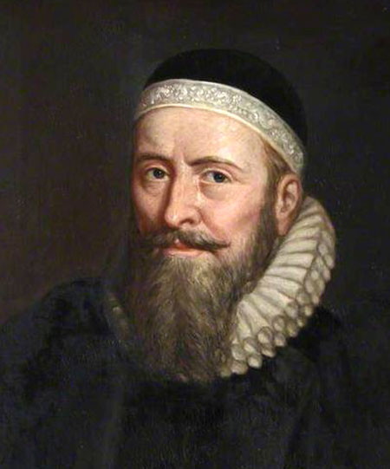
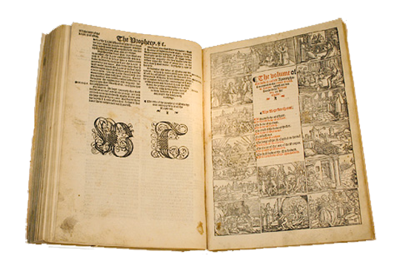
John Rogers
In 1534, Rogers went to Antwerp as chaplain to the English merchants of the Company of the Merchant Adventurers.
Here he met William Tyndale, under whose influence he abandoned the Roman Catholic faith,
John Rogers
The Matthew’s Bible
AD 1
500
1000
1500
2000
Notes:
https://en.wikipedia.org/wiki/New_Testament

Slide 17
The Matthew’s Bible
The year after Tyndale died, John Rogers published an English Bible under the pen name “Thomas Matthew.”
The New Testament was essentially Tyndale’s 2rd edition.
Included Tyndale's Old Testament through Chronicles.
Used Coverdale’s past Chronicles OT from German.
It was the first English Bible printed with the king’s permission (1537).
John Rogers
The Matthew’s Bible
AD 1
500
1000
1500
2000
Notes:
https://en.wikipedia.org/wiki/New_Testament

Slide 18
John Rogers (a.k.a Thomas Matthew) tribute to Tyndale
Between the Old and New Testament the 2 ½” letters WT appear as a tribute to
Tyndale in the Matthews Bible
The Matthew’s Bible
AD 1
500
1000
1500
2000

Slide 19
John Rogers (a.k.a Thomas Matthew) tribute to Tyndale
The Matthew’s Bible
God had answered William Tyndale’s dying plea to “open the King of England’s eyes.”
1500 copies printed in Antrep.
John Rogers
The Matthew’s Bible
AD 1
500
1000
1500
2000

Slide 20
John Rogers
Rogers matriculated at the University of Wittenberg on 25 November 1540, where he remained for three years, becoming a close friend of Philipp Melanchthon and other leading figures of the early Protestant Reformation
Rogers returned to England in 1548
John Rogers
The Matthew’s Bible
AD 1
500
1000
1500
2000
Notes:
https://en.wikipedia.org/wiki/New_Testament

Slide 21
The Coverdale Bible
This was the first complete Bible to be printed on a printing press in English. (Antwrep)
The later editions published in 1537 were the first complete Bibles printed in England.
Title Page of the Coverdale Bible
AD 1
500
1000
1500
2000

Slide 22
Coverdale Bible Reviewed
Francis Fry 1803–1886 an English businessman and biographer reprinted Tyndale work and studied the histories of many bible translations.
In 1867 Fry did a work about the origins of the Cloverdale Bible. From my copy (wkb) it seems that Coverdale has claims to having made a “translation” while in fact is a construct of Tyndale's work and a ¾ portion of the old testament coming form Luther's German text.
Cloverdale versions were accepted with later editions printed in England
Title Page of the Coverdale Bible
AD 1
500
1000
1500
2000
Notes:
Myles Coverdale - Wikipedia
Francis Fry - Wikipedia
Francis Fry
2 languages
Article
Talk
Read
Edit
View history
From Wikipedia, the free encyclopedia
Francis Fry
Francis Fry (1803–1886), was an English businessman and bibliographer.
Life[edit]
Fry was born at Westbury-on-Trym, near Bristol, on 28 October 1803, the second son of Joseph Storrs Fry. He was educated at a large school at Fishponds, in the neighbourhood of Frenchay, kept by a Quaker named Joel Lean, and began business training at Croydon.
From his twentieth year to middle age he devoted himself to the rapidly increasing business of the firm of J. S. Fry & Sons, cocoa and chocolate manufacturers, at Bristol, in which he was later a partner. He took a part in the introduction of railways in the west of England, and was a member of the board of the Bristol and Gloucester Railway, which held its first sitting 11 July 1839, retaining his position during various amalgamations of the line until its union with the Midland Railway. He was also a director of the Bristol and Exeter Railway, the South Devon Railway, and other companies. He took a major share in managing the Bristol Waterworks (1846) until his death.
In 1839 he moved to Cotham, Bristol, and built a house close to the old Tower. With William Forster, father of William Edward Forster, and Robert Alsop, he visited Northern Italy in 1850, as a deputation from the Society of Friends to various crowned heads, asking for their support in the abolition of slavery.^{[1]} In 1852 he made proposals to the railway companies for a general parcel service throughout the United Kingdom.
He was a member of the committee of the Bristol Philosophical Society, as well as of the Bristol Museum and Library. He took an interest in other associations for social improvement. He died 12 November 1886, soon after the completion of his eighty-third year and was buried in the Friends' graveyard at King's Weston, near Bristol.
Collector[edit]
Books and china formed his chief study. His collection of specimens produced at the Bristol factory between 1768 and 1781 was particularly complete. Many examples were described by Hugh Owen^{[2]} His collection of bibles and testaments numbered nearly thirteen hundred, chiefly English, especially editions of the versions of Tyndale, Coverdale, and Cranmer, but with a number of first editions in other languages.
Bibliographer and editor[edit]
He catalogued the library of the Monthly Meeting at Bristol in 1860. On a visit to Germany, a discovery made by Fry at Munich, about books printed at Worms by Peter Schöffer the younger, enabled him to decide that William Tyndale's first English New Testament came from Schöffer's press. Two years later Fry produced his facsimile reprint, by means of tracing and lithography, of Tyndale's New Testament (1525 or 1526), the first complete edition printed in English, from the only perfect copy known at the time, later in the Baptist College, Bristol.
In the same year he edited a facsimile reprint of the pamphlet known as The Souldiers Pocket Bible, distributed to Oliver Cromwell's army, and discovered by George Livermore of Boston, who had himself reprinted it the previous year. Several editions were circulated among the soldiers during the American Civil War. The altered and enlarged edition, The Christian Soldier's Penny Bible (1693), was also facsimiled and edited by Fry.
In 1863 he issued a couple of small rare pieces illustrative of Tyndale's version, and in 1865 published his bibliographical treatise on the Great Bible of 1539, the six editions of Cranmer's Bible of 1540 and 1541, and the five editions of the Authorised Version. Fry visited private and public libraries to collate different copies of these bibles. This work was followed by his account of Miles Coverdale's translation of the Scriptures, and his description of forty editions of Tyndale's version, most of them having variants.
Works[edit]
‘A Catalogue of Books in the Library belonging to the Monthly Meeting in Bristol,’ 3rd edit. Bristol, 1860.
‘The First New Testament printed in the English Language (1525 or 1526), translated from the Greek by William Tyndale, reproduced in facsimile, with an Introduction,’ Bristol, 1862.
‘The Souldiers Pocket Bible, printed at London by G. B. and R. W. for G. C. 1643, reproduced in facsimile, with an Introduction,’ London, 1862, (this consists of texts of Scripture, chiefly from the Geneva version, with special applications).
‘The Christian Soldiers Penny Bible, London, printed by R. Smith for Sam. Wade, 1693, reproduced in facsimile with an Introductory Note,’ London, 1862 (the previous work altered, with the texts from the authorised version somewhat incorrectly quoted).
‘A proper Dyaloge betwene a gentillman and a husbandman eche complaynynge to other their miserable calamite through the ambicion of clergye with a compendious olde treatyse shewynge howe that we ought to have the Scripture in Englysshe, Hans Luft, 1530, reproduced in facsimile, with an Introduction,’ London, 1863.
‘The prophete Jonas, with an Introduction by Wm. Tyndale, reproduced in facsimile, to which is added Coverdale's version of Jonah, with an Introduction,’ London, 1863, (these two works reproduced from unique copies in the library of Lord Arthur Hervey).
‘The Standard Edition of the English New Testament of the Genevan Version,’ London, 1864, (reprinted from the 'Journal of Sacred Literature,’ July 1864).
‘A Description of the Great Bible, 1539, and the six editions of Cranmer's Bible, 1540 and 1541, printed by Grafton and Whitchurch; also of the editions in large folio of the Authorised Version printed in 1611, 1613, 1617, 1634, 1640; illustrated with titles and with passages from the editions, the genealogies and the maps, copied in facsimile, also with an identification of every leaf of the first seven and of many leaves of the other editions, on fifty-one plates, together with an original leaf of each of the editions described,’ London, 1865, folio. *‘The Bible by Coverdale, 1535, remarks on the titles, the year of publication, &c., with facsimiles,’ London, 1867.
‘A List of most of the Words noticed exhibiting the peculiar orthography used in Tindale's New Testament,’ Bristol, 1871, (single sheet, circulated to inquire as to the edition 'finished in 1535').
‘A Bibliographical Description of the Editions of the New Testament, Tyndale's Version in English, with numerous readings, comparisons of texts, and historical notices, the notes in full from the edition of November 1534, an account of two octavo editions of the New Testament of the Bishop's version, without numbers to the verses, illustrated with 73 plates,’ London, 1878.
‘Description of a Title-page of a New Testament dated anno 1532,’ Bristol, 1885, (with facsimile of title-page, two leaves).
Family[edit]
In 1833 he married Matilda, only daughter of Daniel and Anne Penrose, of Brittas, County Wicklow.
References[edit]
^ B. Seebohm, Memoirs of William Forster, 1865, ii. 284
^ Two Centuries of Ceramic Art in Bristol, 1873, pp. 78–9, 97, 243, &c.
This article incorporates text from a publication now in the public domain: "Fry, Francis". Dictionary of National Biography. London: Smith, Elder & Co. 1885–1900.

Slide 23
Myles Coverdale
Coverdale back in England
Orders of Consecration 30 August 1551 by Thomas Cranmer
Title Page of the Coverdale Bible
AD 1
500
1000
1500
2000
Notes:
Francis Fry – Wikipedia
Myles Coverdale
13 languages
Article
Talk
Read
Edit
View history
From Wikipedia, the free encyclopedia
For the Australian cricketer, see Miles Coverdale (cricketer).
The Right Reverend
Myles Coverdale
Bishop of ExeterChurchChurch of EnglandSeeExeterInstalled1551Term ended1553PredecessorJohn VeseySuccessorJohn VeseyOrdersConsecration30 August 1551 by Thomas CranmerPersonal detailsBornc. 1488 Yorkshire, England
Died20 January 1569 (aged 80-81) London, EnglandBuriedChurch of St Bartholomew-by-the-Exchange, then St Magnus-the-Martyr, both in the City of LondonDenominationCatholicism; later an early Anglican reformer and regarded as "proto-Puritan" in his later life.
Arms of Myles Coverdale: Quarterly per fess indented gules and or, in chief a rose between two fleurs-de-lys in base a fleur-de-lys between two roses all counter-changed^{[1]}
Myles Coverdale, first name also spelt Miles (1488 – 20 January 1569), was an English ecclesiastical reformer chiefly known as a Bible translator, preacher and, briefly, Bishop of Exeter (1551–1553).^{[2]} In 1535, Coverdale produced the first complete printed translation of the Bible into English.^{[3]} His theological development is a paradigm of the progress of the English Reformation from 1530 to 1552. By the time of his death, he had transitioned into an early Puritan, affiliated to Calvin, yet still advocating the teachings of Augustine.
Life to end of 1528[edit]
Regarding his probable birth county, Daniell cites John Bale, author of a sixteenth-century scriptorium, giving it as Yorkshire.^{[2][note 1]} His birth date is generally regarded as 1488.
Coverdale studied philosophy and theology at Cambridge, becoming bachelor of canon law in 1513.^{[2][note 2]} In 1514 John Underwood, a suffragan bishop and archdeacon of Norfolk, ordained him priest in Norwich. He entered the house of the Augustinian friars in Cambridge, where Robert Barnes had returned from Louvain to become its prior. This is thought to have been about 1520–1525.^{[2]} According to Trueman,^{[4]} Barnes returned to Cambridge in the early to mid-1520s.^{[note 3]} At Louvain Barnes had studied under Erasmus and had developed humanist sympathies. In Cambridge, he read aloud to his students from St. Paul's epistles in translation and taught from classical authors.^{[2]} This undoubtedly influenced them towards Reform. In February 1526, Coverdale was part of a group of friars that travelled from Cambridge to London to present the defence of their superior, after Barnes was summoned before Cardinal Wolsey.^{[2][4]} Barnes had been arrested as a heretic after being accused of preaching Lutheran views in the church of St Edward King and Martyr, Cambridge on Christmas Eve. Coverdale is said to have acted as Barnes' secretary during the trial.^{[5]} By the standards of the time, Barnes received relatively lenient treatment, being made to do public penance by carrying a faggot to St Paul's Cross.^{[4]} However on 10 June 1539, Parliament passed the Act of Six Articles, marking a turning point in the progress of radical protestantism.^{[6]: 423–424} Barnes was burned at the stake on 30 July 1540, at Smithfield, along with two other reformers. Also executed that day were three Roman Catholics, who were hanged, drawn and quartered.^{[4]}
Coverdale probably met Thomas Cromwell some time before 1527. A letter survives showing that later, in 1531, he wrote to Cromwell, requesting his guidance on his behaviour and preaching; also stating his need for books.^{[2]} By Lent 1528, he had left the Augustinians and, wearing simple garments, was preaching in Essex against transubstantiation, the veneration of sacred images, and Confession to a Priest. At that date, such views were very dangerous, for the future course of the religious revolution that began during the reign of Henry VIII was as yet very uncertain. Reforms, both of the forms proposed by Lollardy, and those preached by Luther, were being pursued by a vigorous campaign against heresy.^{[6]: 379–380} Consequently, towards the end of 1528, Coverdale fled from England to the Continent.^{[2]}
First exile, 1528[edit]
From 1528 to 1535 Coverdale spent most of his time in continental Europe, mainly in Antwerp. Celia Hughes believes that upon arriving there, he rendered considerable assistance to William Tyndale in his revisions and partial completion of his English versions of the Bible.^{[7]: 100 [note 4]} In 1531, Tyndale spoke to Stephen Vaughan of his poverty and the hardships of exile, although he was relatively safe in the English House in Antwerp, where the inhabitants supposedly enjoyed diplomatic immunity.^{[8]} However, in the spring of 1535 a "debauched and villainous young Englishman wanting money" named Henry Phillips insinuated himself into Tyndale's trust. Phillips had gambled away money from his father and had fled abroad. He promised the authorities of the Holy Roman Emperor that he would betray Tyndale for cash. On the morning of 21 May 1535, having arranged for the imperial officers to be ready, Phillips tricked Tyndale into leaving the English House, whereupon he was immediately seized. Tyndale languished in prison throughout the remainder of 1535 and despite attempts to have him released, organised by Cromwell through Thomas Poyntz at the English House, Tyndale was strangled and burned at the stake in October 1536. Meanwhile Coverdale continued his work alone to produce what became the first complete English Bible in print, namely the Coverdale Bible. Not yet proficient in Hebrew or Greek, he used Latin, English and German sources plus the translations of Tyndale himself.
Coverdale's translation of the Bible, 1535[edit]
In 1534 Canterbury Convocation petitioned Henry VIII that the whole Bible might be translated into English. Consequently, in 1535, Coverdale dedicated this complete Bible to the King.^{[9]: 201} After much scholarly debate, it is now considered very probable that the place of printing of the Coverdale Bible was Antwerp.^{[2][10]} The printing was financed by Jacobus van Meteren. The printing of the first edition was finished on 4 October 1535.^{[note 5]} Coverdale based the text in part on Tyndale's translation of the New Testament (following Tyndale's November 1534 Antwerp edition) and of those books which were translated by Tyndale: the Pentateuch, and the Book of Jonah. Other Old Testament books he translated from the German of Luther and others.^{[note 6]} Based on Coverdale's translation of the Book of Psalms in his 1535 Bible, his later Psalter has remained in use in the 1662 Book of Common Prayer to the present day, and is retained with various minor corrections in the 1926 Irish Book of Common Prayer, the 1928 US Episcopal Book of Common Prayer, and the 1962 Canadian Book of Common Prayer, etc.^{[note 7]}
Further translations, 1537–1539[edit]
In 1537 the Matthew Bible was printed, also in Antwerp, at the expense of Richard Grafton and Edward Whitchurch who issued it in London.^{[9]: 1058} It comprised Tyndale's Pentateuch; a version of Joshua 2 and Chronicles translated from the Hebrew, probably by Tyndale and not previously published; the remainder of the Old Testament from Coverdale; Tyndale's New Testament from 1535. It was dedicated to Henry VIII who licensed it for general reading. "Thomas Matthew", the supposed editor, was an alias for John Rogers.
The Matthew Bible was theologically controversial.^{[11]} Furthermore it bore evidence of its origin from Tyndale. If Henry VIII had become aware of this, the position of Cromwell and Cranmer would have been precarious. Consequently in 1538 Coverdale was sent to Paris by Cromwell to superintend the printing of the planned "Great Bible".^{[note 8]} François Regnault, who had supplied all English service books from 1519 to 1534, was selected as the printer because his typography was more sumptuous than that available in England.^{[2]} According to Kenyon, the assent of the French king was obtained.^{[11]} In May 1538 printing began. Nevertheless, a coalition of English bishops together with French theologians at the Sorbonne interfered with the operations and the Pope issued an edict that the English Bibles should be burned and the presses stopped. Some completed sheets were seized, but Coverdale rescued others, together with the type, transferring them to London.^{[note 9]} Ultimately, the work was completed in London by Grafton and Whitchurch.^{[note 10]}
Also in 1538, editions were published, both in Paris and in London, of a diglot (dual-language) New Testament. In this, Coverdale compared the Latin Vulgate text with his own English translation, in parallel columns on each page.^{[12][13][note 11]}
An injunction was issued by Cromwell in September 1538, strengthening an earlier one that had been issued but widely ignored in 1536. This second injunction firmly declared opposition to "pilgrimages, feigned relics, or images, or any such superstitions" whilst correspondingly placing heavy emphasis on scripture as "the very lively word of God". Coverdale’s Great Bible was now almost ready for circulation and the injunction called for the use of "one book of the whole Bible of the largest volume" in every English church.^{[14][15]} However at the time insufficient Great Bibles were actually printed in London so an edition of the Matthew Bible that had been re-edited by Coverdale started to be used.^{[note 12]} The laity were also intended to learn other core items of worship in English, including the Creed, the Lord's Prayer and the Ten Commandments.^{[6]: 406}
In February 1539, Coverdale was in Newbury communicating with Thomas Cromwell.^{[16]} The printing of the London edition of the Great Bible was in progress.^{[2]} It was finally published in April of the same year.^{[17]} John Winchcombe, son of "Jack O'Newbury", a famous clothier, served as a confidential messenger to Coverdale who was performing an ecclesiastical visitation. Coverdale commended Winchcombe for his true heart towards the King's Highness and in 1540, Henry VIII granted to Winchcombe the manor of Bucklebury, a former demesne of Reading Abbey.^{[18]} Also from Newbury, Coverdale reported to Cromwell via Winchcombe about breaches in the king's laws against papism, sought out churches in the district where the sanctity of Becket was still maintained, and arranged to burn primers and other church books which had not been altered to match the king's proceedings.
Sometime between 1535 and 1540 (the exact dates being uncertain), separate printings were made of Coverdale's translations into English of the psalms. These first versions of his psalm renditions were based mainly or completely upon his translation of the Book of Psalms in the 1535 Coverdale Bible.
In the final years of the decade, the conservative clerics, led by Stephen Gardiner, bishop of Winchester, were rapidly recovering their power and influence, opposing Cromwell's policies.^{[2]} On 28 June 1539 the Act of Six Articles became law, ending official tolerance of religious reform. Cromwell was executed on 28 July 1540.^{[14]} This was close to the date of the burning of Coverdale's Augustinian mentor Robert Barnes. Cromwell had protected Coverdale since at least 1527 and the latter was obliged to seek refuge again.
Second exile, 1540–1547[edit]
In April 1540 there was a second edition of the Great Bible, this time with a prologue by the Archbishop of Canterbury, Thomas Cranmer. For this reason, the Great Bible is sometimes known as Cranmer’s Bible although he had no part in its translation. According to Kenyon,^{[11]} there were seven editions in total, up until the end of 1541, with the later versions including some revisions.
Before leaving England, Coverdale married Elizabeth Macheson (d. 1565), a Scotswoman of noble family who had come to England with her sister and brother-in-law as religious exiles from Scotland.^{[2]} They went first to Strasbourg, where they remained for about three years. He translated books from Latin and German and wrote an important defence of Barnes. This is regarded as his most significant reforming statement apart from his Bible prefaces. He received the degree of DTh from Tübingen and visited Denmark, where he wrote reforming tracts. In Strasbourg he befriended Conrad Hubert, Martin Bucer's secretary and a preacher at the church of St Thomas. Hubert was a native of Bergzabern (now Bad Bergzabern) in the duchy of Palatine Zweibrücken. In September 1543, on the recommendation of Hubert, Coverdale became assistant minister in Bergzabern as well as schoolmaster in the town's grammar school. During this period, he opposed Martin Luther's attack on the Reformed view of the Lord's Supper. He also began to learn Hebrew, becoming competent in the language, as had been Tyndale.^{[2]}
Return to England, 1548[edit]
Exeter Cathedral - West Window
Edward VI (1547–53) was only 9 years old^{[19]} when he succeeded his father on 28 January 1547. For most of his reign he was being educated, whilst his uncle, Edward Seymour, 1st Earl of Hertford, acted as Lord Protector of the Realm and Governor of the King's Person. Immediately upon receiving these appointments he became Duke of Somerset. Coverdale did not immediately return to England, although the prospects looked better for him. Religious policy followed that of the chief ministers and during Edward's reign this moved towards Protestantism. However in March 1548 he wrote to John Calvin that he was now returning, after eight years of exile for his faith. He was well received at the court of the new monarch. He became a royal chaplain in Windsor, and was appointed almoner to the queen dowager, Catherine Parr. At Parr's funeral in September 1548, Coverdale delivered what would later be said to have been his "1st Protestant sermon".^{[20]}
On 10 June 1549, the Prayer Book Rebellion broke out in Devon and Cornwall. There, Coverdale was directly involved in preaching and pacification attempts.^{[2]} Recognising the continuing unpopularity of the Book of Common Prayer in such areas, the Act of Uniformity had been introduced, making the Latin liturgical rites unlawful from Whitsunday 1549 onward. The west-country rebels complained that the new English liturgy was "but lyke a Christmas game" – men and women should form separate files to receive communion, reminding them of country dancing.^{[21]} The direct spark of rebellion occurred at Sampford Courtenay where, in attempting to enforce the orders, an altercation led to a death, with a proponent of the changes being run through with a pitchfork.^{[22]} Unrest was said also to have been fuelled by several years of increasing social dissatisfaction.^{[23]} Lord John Russell, 1st Earl of Bedford was sent by the Lord Protector to put down the rapidly spreading rebellion and Coverdale accompanied him as chaplain.^{[note 13]} The Battle of Sampford Courtenay effectively ended the rebellion by the end of August. However Coverdale remained in Devon for several more months, helping to pacify the people and doing the work that properly belonged to the Bishop of Exeter. The incumbent, John Vesey, was eighty-six, and had not stirred from Sutton Coldfield in Warwickshire, his birthplace and long-term residence.
Bishop of Exeter, 1551[edit]
Coverdale spent Easter 1551 in Oxford with the Florentine-born Augustinian reformer Peter Martyr Vermigli. At that time, Martyr was Regius Professor of divinity, belonging to Magdalen College.^{[9]: 1267} He had been assisting Cranmer with a revision of the Anglican prayer book.^{[2]} Coverdale attended Martyr's lectures on the Epistle to the Romans and Martyr called him a "a good man who in former years acted as parish minister in Germany" who now "labours greatly in Devon in preaching and explaining the Scriptures". He predicted that Coverdale would become Bishop of Exeter and this took place on 14 August 1551 when John Vesey was ejected from his see.^{[2]}
Third exile, 1553–1559[edit]
Edward VI died of tuberculosis on 6 July 1553.^{[19]} Shortly before, he had attempted to deter a Roman Catholic revival by switching the succession from Mary daughter of Henry VIII and Catherine of Aragon to Lady Jane Grey. However his settlement of the succession lasted barely a fortnight. After a brief struggle between the opposing factions, Mary was proclaimed Queen of England on 19 July.^{[note 14]} The renewed danger to reformers such as Coverdale was obvious.^{[2]} He was summoned almost immediately to appear before the Privy Council and on 1 September he was placed under house arrest in Exeter.^{[note 15]} On 18 September, he was ejected from his see and Vesey, now ninety and still in Warwickshire, was reinstated. Following an intervention by his brother-in-law, chaplain to King Christian III of Denmark-Norway, Coverdale and his wife were permitted to leave for that country. They then went on to Wesel, and finally back to Bergzabern.
On 24 October 1558, Coverdale received leave to settle in Geneva.^{[24][2]} Commenting on his contribution to the Geneva Bible (the exact details of which are scarce), Daniell says: "Although his Hebrew, and ... now his Greek, could not match the local scholars' skills, Coverdale would no doubt have special things to offer as one who nearly two dozen years before had first translated the whole Bible ... the only Englishman to have done so, and then revised it under royal authority for the successive editions of the Great Bible." On 29 November 1558 Coverdale was godfather to John Knox's son. On 16 December he became an elder of the English church in Geneva, and participated in a reconciling letter from its leaders to other English churches on the continent.^{[citation needed]}
London, 1559–1569[edit]
In August 1559, Coverdale and his family returned to London, where they lodged with the Duchess of Suffolk, whom they had known at Wesel.^{[2]} He was appointed as preacher and tutor to her children. He wrote to William Cole in Geneva, saying that the duchess had "like us, the greatest abhorrence of the ceremonies" (meaning the increasing reversion to the use of vestments).^{[note 16]}
His stance on vestments was one of the reasons why he was not reinstated to his bishopric. However Hughes believes that it is likely that in his own opinion, he felt too elderly to undertake the responsibility properly.^{[7]} From 1564 to 1566, he was rector of St Magnus the Martyr in the City of London near London Bridge. Coverdale’s first wife, Elizabeth, died early in September 1565, and was buried in St Michael Paternoster Royal, City of London, on the 8th. On 7 April 1566 he married his second wife, Katherine, at the same church.^{[2]} After the summer of 1566, when he had resigned his last living at St Magnus, Coverdale became popular in early Puritan circles, because of his quiet but firm stance against ceremonies and elaborate clerical dress.^{[7]} Due to his opposition to official church practices, he died in poverty aged 80 or 81 on 20 January 1569, in London and was buried at St Bartholomew-by-the-Exchange with a multitude of mourners present.^{[25]} When that church was demolished in 1840 to make way for the new Royal Exchange, his remains were moved to St Magnus, where there is a tablet in his memory on the east wall, close to the altar.^{[2]} Coverdale left no will and on 23 January 1569 letters of administration were granted to his second wife, Katherine. Daniell says that it appears that he has no living descendants.^{[citation needed]}
Legacy[edit]
Coverdale's legacy has been far-reaching, especially that of his first complete English Bible of 1535. For the 400th anniversary of the Authorised King James Bible, in 2011, the Church of England issued a resolution, which was endorsed by the General Synod.^{[26]} Starting with the Coverdale Bible, the text included a brief description of the continuing significance of the Authorised King James Bible (1611) and its immediate antecedents:
The Coverdale Bible (1535)
The Matthew Bible (1537)
The Great Bible (1539)
The Geneva Bible (1557, the New Testament; 1560, the whole Bible)
The Bishops' Bible (1568)
The Rheims-Douai Bible (1582, the New Testament; 1609-1610, the whole Bible)
The Authorised King James Bible (1611)
As indicated above, Coverdale was involved with the first four of the above. He was partially responsible for Matthew's Bible.^{[2][note 17]} In addition to those mentioned above, he produced a diglot New Testament in 1538.^{[7]: 101} He was extensively involved with editing and producing the Great Bible. He was also part of the group of "Geneva Exiles" who produced the Geneva Bible^{[2]} – the edition preferred, some ninety-five years later, by Oliver Cromwell's army and his Parliamentarians.
Fragment of Miles Coverdale's Goostly Psalmes and Spirituall Songes in the Bodleian Library, Oxford
Coverdale's translation of the Psalms (based on Luther's version and the Latin Vulgate) have a particular importance in the history of the English Bible.^{[27]} His translation is still used in the Anglican Book of Common Prayer.^{[9]} It is the most familiar translation for many in the Anglican Communion worldwide, particularly those in collegiate and cathedral churches.^{[28]} Many musical settings of the psalms also make use of the Coverdale translation. For example Coverdale's renderings are used in Handel's Messiah, based on the Prayer Book Psalter rather than the King James Bible version. His translation of the Roman Canon is still used in some Anglican and Anglican Use Roman Catholic churches. Less well known is Coverdale’s early involvement in hymn books. Celia Hughes believes that in the days of renewed biblical suppression after 1543, the most important work of Coverdale, apart from his principal Bible translation, was his Ghostly Psalms and Spiritual Songs .^{[7]} This she calls "the first English hymn book" and "the only one until the publication of the collection by Sternhold and Hopkins." (This was more than twenty years later). The undated print probably was done parallel to his Bible translation in 1535.^{[29]} Coverdale’s first three hymns are based on the Latin Veni Creator Spiritus, preceding its other English translations such as that of 1625 by Bishop J. Cosin by more than ninety years.^{[note 18]} However, the majority of the hymns are based on the Protestant hymnbooks from Germany, particularly Johann Walter's settings of Martin Luther's hymns such as Ein feste Burg. Coverdale intended his "godly songs" for "our young men ... and our women spinning at the wheels." Thus Hughes argues that he realised that for the less-privileged, his scriptural teaching could be learnt and retained more readily by song rather than by direct access to the Bible, which could often be prohibited. However, his hymnbook also ended up on the list of forbidden books in 1539, and only one complete copy of it survives which is today held in Queen's College, Oxford.[1] Two fragments survived as binding material and are now in the Bodleian Library, Oxford, and in the Beinecke Library at Yale.^{[citation needed]}
Miles Coverdale was a man who was loved all his life for that ‘singular uprightness’ recorded on his tomb. He was always in demand as a preacher of the gospel. He was an assiduous bishop. He pressed forward with great work in the face of the complexities and adversities produced by official policies. His gift to posterity has been from his scholarship as a translator; from his steadily developing sense of English rhythms, spoken and sung; and from his incalculable shaping of the nation's moral and religious sense through the reading aloud in every parish from his ‘Bible of the largest size’.
David Daniell, ‘Coverdale, Miles (1488–1569)’, Oxford Dictionary of National Biography, Oxford University Press, 2004; online edn, October 2009 accessed 15 February 2015.
Coverdale is honoured, together with William Tyndale, with a feast day on the liturgical calendar of the Episcopal Church (USA) on 6 October. His extensive contacts with English and Continental Reformers was integral to the development of successive versions of the Bible in the English language.^{[citation needed]}
Works[edit]
Remains of Myles Coverdale: Containing Prologues to the Translation of the Bible, Treatise on Death, Hope of the Faithful, Exhortation to the Carrying of Christ's Cross, Exposition Upon the Twenty-Second Psalm, Confutation of the Treatise of John Standish, Defence of a Certain Poor Christian Man, Letters, Ghostly Psalms and Spiritual Songs. (1846)
Writings and Translations of Myles Coverdale: The Old Faith, A Spiritual and Most Precious Pearl, Fruitful Lessons, A Treatise on the Lord's Supper, Order of the Church in Denmark, Abridgment of the Enchiridion of Erasmus (1844)
Memorials Of The Right Reverend Father In God Myles Coverdale, Sometime Lord Bishop Of Exeter; Who First Translated The Whole Bible Into English: Together With Divers Matters Relating To The Promulgation Of The Bible, In The Reign Of Henry The Eighth (1838)
The Letters Of The Martyrs: Collected And Published In 1564 With A Preface By Miles Coverdale (1838)
See also[edit]
Saints portal
Christianity portal
Psalms
Timeline of the English Reformation
Censorship of the Bible § England
Notes[edit]
^ According to a bronze plaque on the wall of the former York Minster library, he was believed to have been born in York circa 1488. Anon. (4 September 2014). "Bronze commemorative plaque on wall of former York Minster Library". Retrieved 15 February 2015. However, the exact birth location of York does not appear to be corroborated. An older source (Berkshire History – based on Article of 1903) even suggests his birthplace as Coverdale, a hamlet in North Yorkshire, but neither is this elsewhere substantiated. Daniell says that no details are known of his parentage or early education, so simply Yorkshire is the safest conclusion.
^ Daniell states "BCL according to Cooper, BTh according to Foxe." At the time, such students had to gain proficiency in both subjects.
^ But Trueman also says that Barnes was incorporated BTh in Cambridge university in 1522-3, followed in 1523 by the award of a DTh., so Barnes' return from Louvain was probably in about 1522.
^ Hughes cites four twentieth century authors in support of this view, having said that some older biographers discount the suggestion. Daniell states firmly that Coverdale and Rodgers were with Tyndale in Antwerp in 1534, whilst discounting the account of Foxe (1563) that Coverdale travelled to Hamburg to assist Tyndale in planned printing work.
^ The colophon of the bible itself states this exact date.
^ In his dedication to King Henry, Coverdale explains that he has ‘with a clear conscience purely and faithfully translated this out of five sundry interpreters’. Daniell explains that this means Tyndale, Luther, the Vulgate, the Zürich Bible, and Pagninus's Latin translation of the Hebrew.
^ The following is Guido Latré's citation for: ... it was Coverdale's glory to produce the first printed English Bible, and to leave to posterity a permanent memorial of his genius in that most musical version of the Psalter which passed into the Book of Common Prayer, and has endeared itself to generations of Englishmen. Darlow,T.H. & Moule,H.F., Historical Catalogue of the printed Editions of Holy Scripture in the Library of the British and Foreign Bible Society, 2 vols., London and New York, 1963 (1st ed. 1903) p.6
^ The description ‘Great Bible’ is justified, since it measured 337 mm by 235 mm.
^ A further detail, possibly apocryphal, is that additional sheets were re-purchased as waste paper from a tradesman to whom they had been sold. Foxe (1563) wrote that they had been proffered as hat linings
^ A special copy on vellum, with illuminations, was prepared for Cromwell himself, and is now in the library of St. John’s College, Cambridge.
^ General Note (by Bodleian Library): English and Latin in parallel columns; the calendar is printed partly in red; this edition repudiated by Coverdale on account of the faulty printing.
^ Rychard Grafton and Edward Whitchurch finally printed the London large folio edition of the Great Bible in 1539. Coverdale compiled it, based largely on the 1537 Matthew’s Bible, which had been printed in Antwerp from translations by Tyndale and Coverdale.
^ A later writer recalled that ‘none of the clergy were ready to risk life with Russell's expedition but old Father Coverdale’ (A Brieff Discours, cited by Daniell, p. 232). On the field at Woodbury Windmill, Coverdale ‘caused general thanksgiving to be made unto God’ (Mozley – see Daniell, 15).
^ Her reign was dated from 24 July.
^ In November 1553 and April 1554 both Peter Martyr and the king of Denmark refer to him as having been a prisoner.
^ Daniell cites Mozley, 23, in support of this detail, which is useful in illustrating how, by that time, Coverdale's theology had developed beyond the accepted mainstream of the Elizabethan reforms.
^ According to Daniell, the second half of the Old Testament of the Matthew's Bible was Coverdale's translation.
^ Still used as Hymn No. 153 of the English Hymnal – "Come Holy Ghost, our souls inspire, ..." (NEH No. 138) with English words by Bishop Cosin, music by Thomas Tallis. See The English Hymnal – With Tunes, First ed. Ralph Vaughan Williams, London: Oxford University Press, 1906.
References[edit]
^ George Oliver, Lives of the Bishops of Exeter, p.272
^ Jump up to:ª ^{b} ^{c} ^{d} ^{e} ^{f} ^{g} ^{h} ^{i} ^{j} ^{k} ^{l} ^{m} ^{n} º ^{p} ^{q} ^{r} ^{s} ^{t} ^{u} ^{v} ^{w} ^{x} Daniell, David (2004). "Coverdale, Miles (1488–1569)". Oxford Dictionary of National Biography (online ed.). Oxford University Press. doi:10.1093/ref:odnb/6486. Retrieved 17 February 2015. (Subscription or UK public library membership required.)
^ Anon. "Early Printed Bibles – in English – 1535–1610". British Library – Help for Researchers – Coverdale Bible. The British Library Board. Retrieved 4 March 2015.
^ Jump up to:ª ^{b} ^{c} ^{d} Trueman, Carl R. (2004). "Barnes, Robert (c.1495–1540)". Oxford Dictionary of National Biography (online ed.). Oxford University Press. doi:10.1093/ref:odnb/1472. Retrieved 1 April 2015. (Subscription or UK public library membership required.)
^ Salzman, L.F. (ed.). "'Friaries: Austin friars, Cambridge.' A History of the County of Cambridge and the Isle of Ely: Volume 2 pp287-290". British History online. London: Victoria County History, 1948. Retrieved 2 April 2015.
^ Jump up to:ª ^{b} ^{c} Duffy, Eamon. (1992). The Stripping of the Altars. New Haven & London: Yale University Press. ISBN 0-300-05342-8.
^ Jump up to:ª ^{b} ^{c} ^{d} ^{e} Hughes, Celia (1982). "Coverdale's alter ego" (PDF). Bulletin of the John Rylands Library. Manchester, UK: John Rylands University Library. 65 (1): 100–124. ISSN 0301-102X. Retrieved 29 March 2015.
^ Daniell, David (2004). "Tyndale, William (c.1494–1536)". Oxford Dictionary of National Biography (online ed.). Oxford University Press. doi:10.1093/ref:odnb/27947. Retrieved 11 April 2015. (Subscription or UK public library membership required.)
^ Jump up to:ª ^{b} ^{c} ^{d} Cross 1st ed., F.L.; Livingstone 3rd. ed., E.A. (2006). Article title: Bible, English versions The Oxford Dictionary of the Christian Church (3rd rev. ed.). Oxford University Press. ISBN 0-19-211655-X. {{cite book}}: |last1= has generic name (help)
^ Latré, Guido. "The Place of Printing of the Coverdale Bible". Tyndale org. K. U. Leuven and Université Catholique de Louvain, Belgium, 2000. Retrieved 7 April 2015.
^ Jump up to:ª ^{b} ^{c} Kenyon, Sir Frederic G. "The Great Bible (1539–1541) – from Dictionary of the Bible". Charles Scribner’s Sons, New York, 1909. Retrieved 14 March 2015.
^ Anon. "English Short Title Catalogue – New Testament, Latin, Coverdale, 1538. Original title – The New Testamen [sic] both in Latin and English after the vulgare texte, which is red in the churche translated and corrected by Myles Couerdale". British Library. British Library Board – Original publishers: Paris :Fraunces Regnault ..., prynted for Richard Grafton and Edward Whitchurch cytezens of London, M.ccccc.xxxviii [1538] in Nouembre. Cum gratia & priuilegio regis. Retrieved 16 March 2015.
^ Coverdale, Myles. "The newe testamente [electronic resource] : both Latine and Englyshe ech correspondent to the other after the vulgare texte, communely called S. Ieroms. Faythfully translated by Myles Couerdale. Anno. M.CCCCC.XXXVIII. Coverdale, Miles". SOLO – Search Oxford Libraries Online. Printed in Southwarke : By Iames Nicholson. Set forth wyth the Kynges moost gracious licence, 1538. Retrieved 14 April 2015.
^ Jump up to:ª ^{b} Leithead, Howard (2004). "Oxford DNB Article: Cromwell,Thomas". Oxford Dictionary of National Biography (online ed.). Oxford University Press. doi:10.1093/ref:odnb/6769. Retrieved 5 March 2015. (Subscription or UK public library membership required.)
^ Rex, Richard, "The Crisis of Obedience: God’s Word and Henry’s Reformation", The Historical Journal, V. 39, no. 4, December 1996, pp. 893–4.
^ King, Richard John. "Berkshire History: Biographies: Miles Coverdale (1488–1569)". Berkshire History. David Nash Ford. Archived from the original on 5 November 2012. Retrieved 5 March 2015.
^ Anon. "English Short Title Catalogue – Full View of Record – Uniform title – English Great Bible". British Library. British Library Board – Original publisher Rychard Grafton and Edward Whitchurch, Cum priuilegio ad imprimendum solum, April 1539. Retrieved 16 March 2015.
^ Ditchfield, P H; Page, W. "'Parishes: Bucklebury.' A History of the County of Berkshire: Volume 3, pp291 – 296". British History Online. London: Victoria County History, 1923. Retrieved 10 March 2015.
^ Jump up to:ª ^{b} Cannon, John (2009). A Dictionary of British History. Oxford University Press. ISBN 9780191726514. (entry Edward VI).
^ Murray, John (1872). A Handbook for Travellers in Gloucestershire, Worcestershire, and Herefordshire. Gloucestershire: J Murray. pp. 162–163.
^ Eamon Duffy, The voices of Morebath: reformation and rebellion in an English village, New Haven, Conn.: Yale University Press, p. 133.
^ The Church of England – A Christian presence in every community. "A Church Near You". St Andrew, Sampford Courtenay. © 2015 Archbishops' Council. Retrieved 7 May 2015.
^ Somerset to Sir Philip Hobby, 24 August 1549. In: Gilbert Burnet, The history of the Reformation of the Church of England, ed. Nicholas Pocock, Oxford: Clarendon Press, 1865, vol. V., pp. 250–151. Cited in: Roger B. Manning, "Violence and social conflict in mid-Tudor rebellions," Journal of British Studies, vol. 16, 1977, pp. 18–40 (here p. 28)
^ Daniell, David (2004). "Coverdale, Miles (1488–1569), Bible translator and bishop of Exeter". Oxford Dictionary of National Biography (online ed.). Oxford University Press. doi:10.1093/ref:odnb/6486. ISBN 978-0-19-861412-8. (Subscription or UK public library membership required.)
^ Bobrick, Benson. (2001). Wide as the Waters: the story of the English Bible and the revolution it inspired. New York: Simon & Schuster. ISBN 0-684-84747-7. p. 180.
^ Anon. "Diocesan Synod Motion – Confidence in The Bible – 11/04/2011" (PDF). Church of England. Church of England General Synod. Archived (PDF) from the original on 2 April 2015. Retrieved 28 February 2015.
^ Marlowe, Michael D. "Coverdale's Psalms". Bible Research – Internet Resources for Students of Scripture Online since February 2001. Michael D. Marlowe, 2001 – 2012. Retrieved 20 April 2015.
^ Peterson W S and Macys V. "Psalms – The Coverdale translation" (PDF). Little Gidding: English Spiritual Traditions – 2000. Authors. Archived from the original (PDF) on 18 February 2015. Retrieved 13 March 2015.
^ Leaver, Robin A. (1982). "A Newly-Discovered Fragment of Coverdale's Goostly Psalmes". Jahrbuch für Liturgik und Hymnologie. 26: 130–150.
External links[edit]
Stephen, Leslie, ed. (1887). "Coverdale, Miles" . Dictionary of National Biography. Vol. 12. London: Smith, Elder & Co.
Pollard, Albert Frederick (1911). "Coverdale, Miles" . In Chisholm, Hugh (ed.). Encyclopædia Britannica. Vol. 7 (11th ed.). Cambridge University Press. pp. 343–344.
Coverdale Bible online
Myles Coverdale at Find a Grave
Royal Berkshire History: Miles Coverdale (1488–1569)
Works by Myles Coverdale at Post-Reformation Digital Library

Slide 24
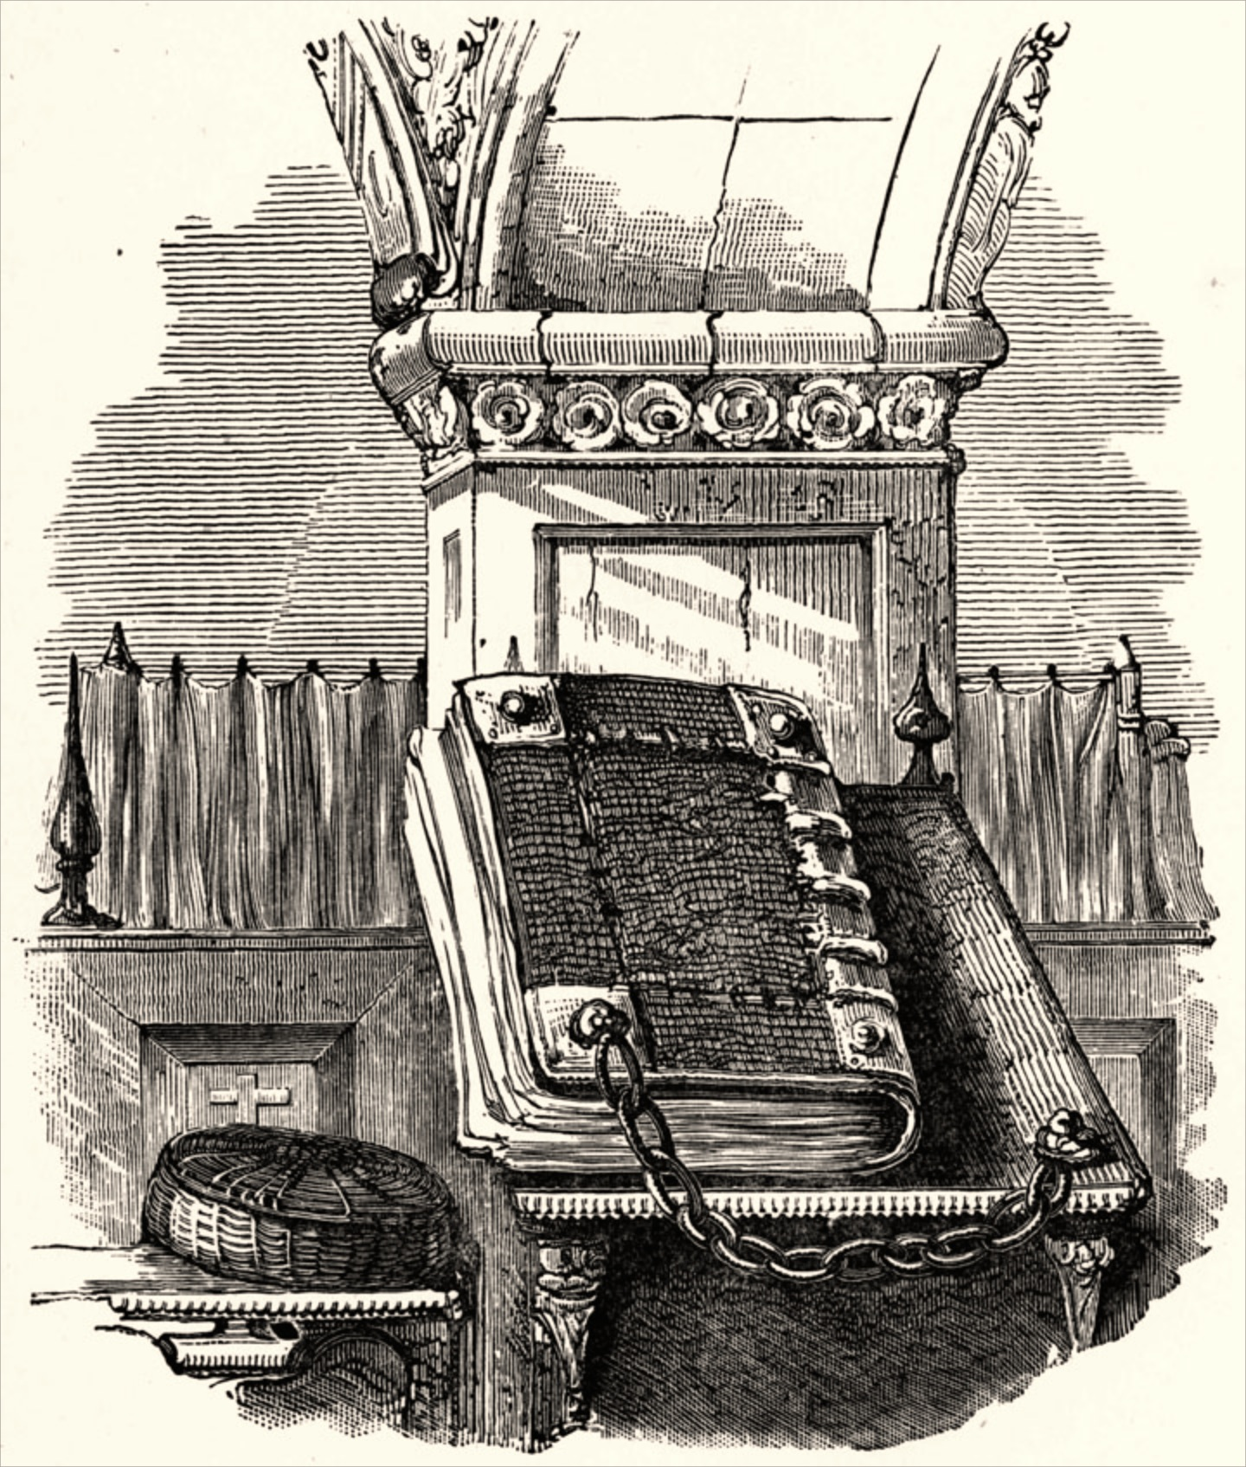
The Great Bible 1539
The Great Bible
Thomas Cromwell, advisor to King Henry VIII, authorized Miles Coverdale to revise the Matthew’s Bible.
The result was the Great Bible (1539).
Cromwell executed in 1540
The Great Bible
AD 1
500
1000
1500
2000
Notes:
The Great Bible 1539
The Great Bible of 1539 was the first authorized edition of the Bible in English, authorized by King Henry VIII of England to be read aloud in the church services of the Church of England. The Great Bible was prepared by Myles Coverdale, working under commission of Thomas, Lord Cromwell, Secretary to Henry VIII and Vicar General. In 1538, Cromwell directed the clergy to provide "one book of the bible of the largest volume in English, and the same set up in some convenient place within the said church that ye have care of, whereas your parishioners may most commodiously resort to the same and read it."

Slide 25
The Great Bible 1539
The Great Bible
In April 1540 there was a second edition of the Great Bible, this time with a prologue by the Archbishop of Canterbury, Thomas Cranmer. For this reason, the Great Bible is sometimes known as Cranmer’s Bible although he had no part in its translation. According to Kenyon, there were seven editions in total, up until the end of 1541, with the later versions including some revisions.
The Great Bible
AD 1
500
1000
1500
2000
Notes:
The Great Bible 1539
The Great Bible of 1539 was the first authorized edition of the Bible in English, authorized by King Henry VIII of England to be read aloud in the church services of the Church of England. The Great Bible was prepared by Myles Coverdale, working under commission of Thomas, Lord Cromwell, Secretary to Henry VIII and Vicar General. In 1538, Cromwell directed the clergy to provide "one book of the bible of the largest volume in English, and the same set up in some convenient place within the said church that ye have care of, whereas your parishioners may most commodiously resort to the same and read it."

Slide 26
The Great Bible 1539
The Great Bible
A copy of the Great Bible was placed in every church in England by order of Thomas Cranmer, archbishop under King Henry VIII.
To keep this Bible accessible to all people, it was chained to the church pillars, so it also became known as the “Chained Bible.”
The Great Bible
AD 1
500
1000
1500
2000

Slide 27
English Monarchs
Edward VI 28 January 1547 – 6 July 1553 (6 years, 160 days)
Edward Had will that appoints Lady Jane Grey as his successor. She lasted 9 days
He never truly reigned at dies at 15 years of age.
AD 1
500
1000
1500
2000
Notes:
The Great Bible 1539
The Great Bible of 1539 was the first authorized edition of the Bible in English, authorized by King Henry VIII of England to be read aloud in the church services of the Church of England. The Great Bible was prepared by Myles Coverdale, working under commission of Thomas, Lord Cromwell, Secretary to Henry VIII and Vicar General. In 1538, Cromwell directed the clergy to provide "one book of the bible of the largest volume in English, and the same set up in some convenient place within the said church that ye have care of, whereas your parishioners may most commodiously resort to the same and read it."

Slide 28
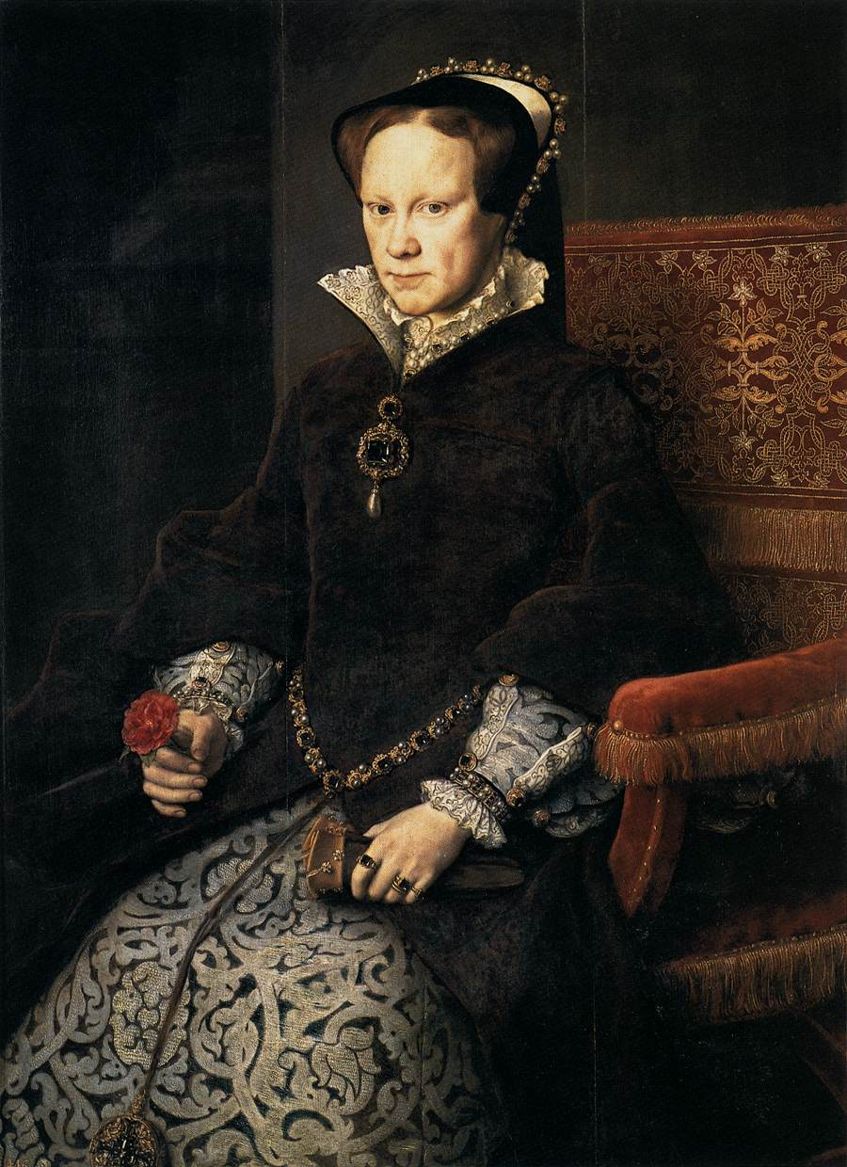
The Church of England Halted
Queen Mary 9 July 1553 – 17 November 1558
Mary rode triumphantly into London on 3 August 1553, on a wave of popular support. She was accompanied by her half-sister Elizabeth and a procession of over 800 nobles and gentlemen
Buy the end of 1553 the Church of England was unraveled.
Queen Mary
AD 1
500
1000
1500
2000

Slide 29
The Church of England Halted
Queen Mary
In the month following her accession, Mary issued a proclamation that she would not compel any of her subjects to follow her religion
September 1553, leading Protestant churchmen—including Thomas Cranmer, John Bradford, John Rogers, John Hooper, and Hugh Latimer—were imprisoned..
Queen Mary
AD 1
500
1000
1500
2000

Slide 30
The Church of England Halted
Queen Mary
Returning the English church to Roman jurisdiction and reaching an agreement took many months and Mary and Pope Julius III had to make a major concession
the confiscated monastery lands were not returned to the church but remained in the hands of their influential new owners..
Queen Mary
AD 1
500
1000
1500
2000

Slide 31
The Church of England Halted
Queen Mary
By the end of 1554, the pope had approved the deal, and the Heresy Acts were revived.
Around 800 rich Protestants, including John Foxe, fled into exile.
Feb 1555 283 heretics are burned.
Queen Mary
AD 1
500
1000
1500
2000

Slide 32
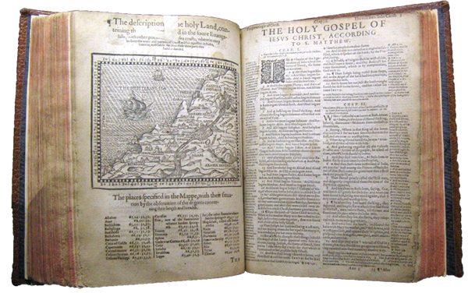
The Geneva Bible
Exiles from England fled to Geneva, Switzerland and published the Geneva Bible (1560).
It was a revision of the Great Bible with the Old Testament translated from Hebrew.
Geneva Bible
AD 1
500
1000
1500
2000

Slide 33
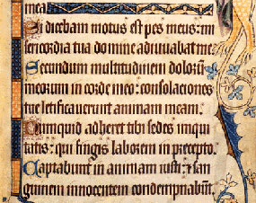
The Geneva Bible
The Geneva Bible
It was the first Bible to use roman type instead of blackletter.
It contained theological notes influenced by Protestant scholars:
John Calvin
Theodore Beza
John Knox
William Whittingham
Some notes seemed to question the legitimacy of absolute monarchs.
Blackletter Type
Roman Type
AD 1
500
1000
1500
2000

Slide 34
The Geneva Bible
Written in collaboration with Myles Coverdale, Christopher Goodman, Anthony Gilby, Thomas Sampson, and William Cole; several of this group later became
. Whittingham was directly responsible for the New Testament, which was complete and published in 1557 while Gilby oversaw the Old Testament.
Blackletter Type
Roman Type
AD 1
500
1000
1500
2000

Slide 35
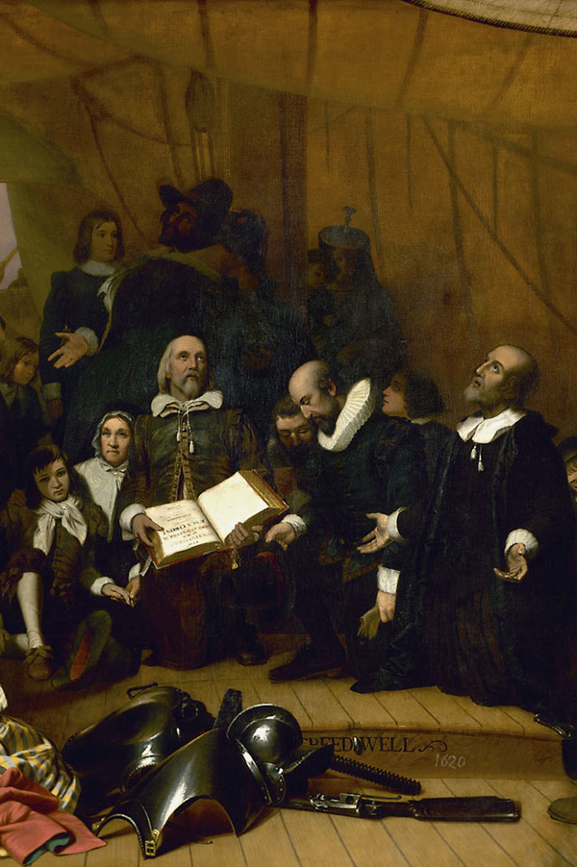
The Geneva Bible
The Geneva Bible
The Geneva Bible was brought to America on the Mayflower (1620).
It was also the Bible of William Shakespeare and John Bunyan.
It contained lots of notes, woodcuts and commentary that reflected Calvinist Doctrine.
Enlarged as our “Study” Bibles.
(note some KJV pick up these notes)
Pilgrims on the Mayflower
AD 1
500
1000
1500
2000

Slide 36
The Geneva Bible
The 1640 edition was the first English Bible to omit the Apocrypha completely.
Earlier Protestant Bibles had included the Apocrypha in a separate section between the Old and New Testaments
not printed in England until 1575 .
Pilgrims on the Mayflower
AD 1
500
1000
1500
2000

Slide 37
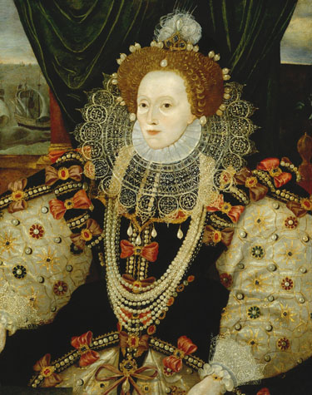
Time Line
Bishops Bible
A new English translation began under Queen Elizabeth in 1568.
The Bishops Bible failed to supersede the popular Geneva Bible.
Essentially a Copy of the Geneva Bible Scripture without the extra notes.
Queen Elizabeth
AD 1
500
1000
1500
2000

Slide 38
The Geneva Bible was the first English Bible to use verse numbers based on the work of Stephanus (Robert Estienne of Paris, by this point living in Geneva)

Slide 39
Roman Catholic Bible
Rheims-Douai Bible
The Rheims-Douai Bible was translated into English from the Latin Vulgate by Catholic scholar Gregory Martin, while in exile in France.
The New Testament was completed in 1582, and the Old Testament in 1609.
It became the standard English translation in the Roman Catholic Church for centuries.
AD 1
500
1000
1500
2000

Slide 40
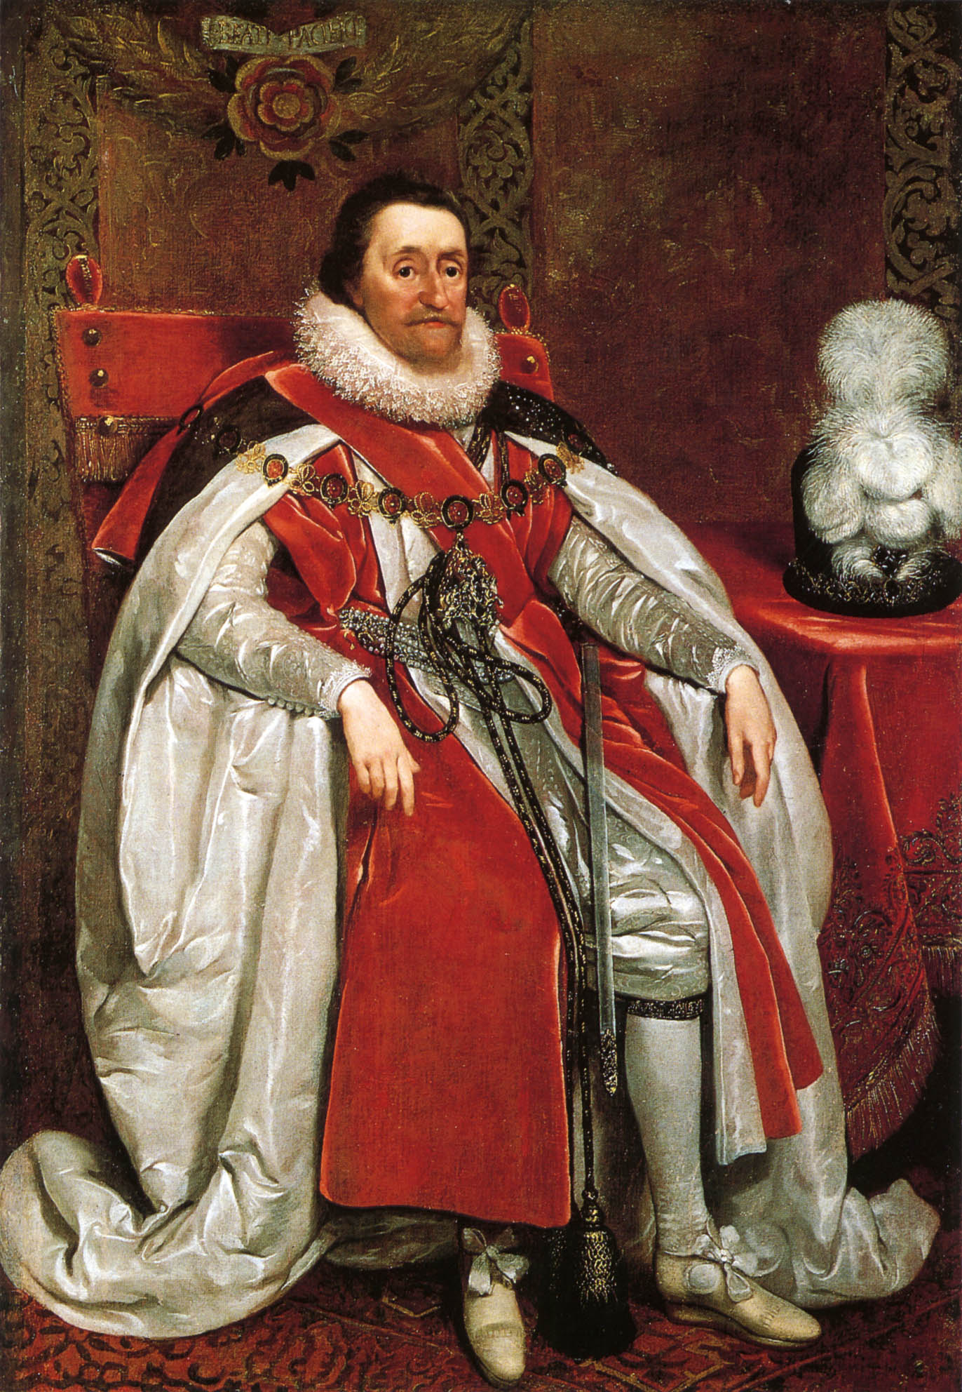
King James Version
At the Hampton Court Conference in 1604, Puritans asked King James I of England to introduce further reforms in the Church of England.
Most of their requests were denied, but the king did agree to a new English translation of the Bible.
King James I of England
AD 1
500
1000
1500
2000

Slide 41
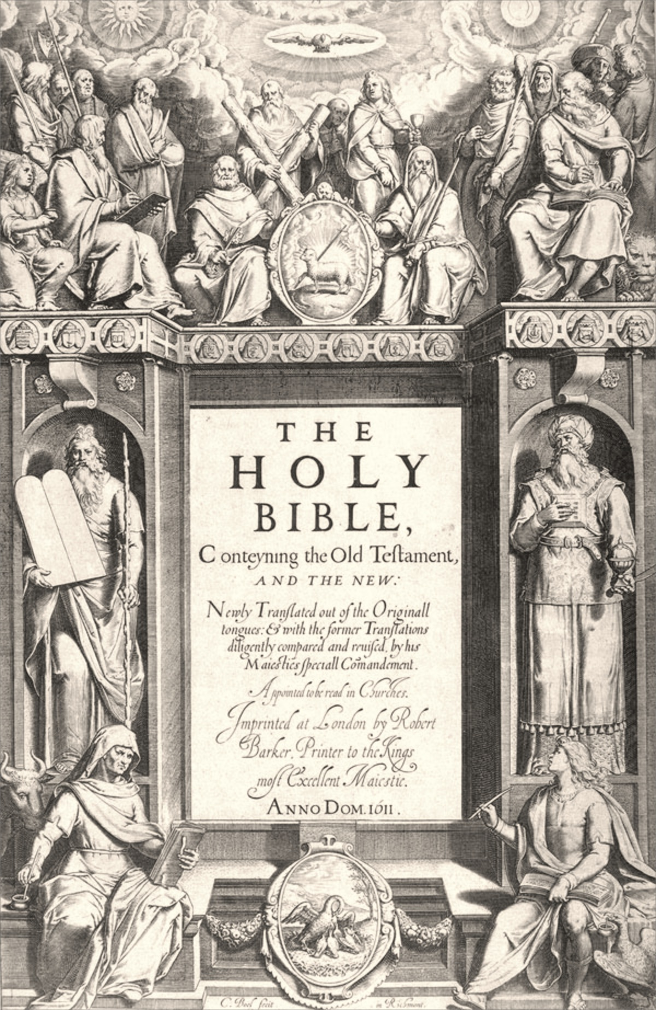
King James Version
King James commissioned 54 scholars to produce a Bible that did not include theological or political notes, like the Geneva Bible did.
Organized into six teams, they used:
Earlier English translations.
Greek New Testaments based on Erasmus’s text.
Hebrew and Aramaic texts.
Title page of the King James Version
AD 1
500
1000
1500
2000

Slide 42
King James Version
King James Version
The new version was completed in 1609 and published in 1611.
The King James Version is also known as “the Authorized Version.”
It was revised several times. The edition most often used today is the 1769 revision.
Title page of the King James Version
AD 1
500
1000
1500
2000

Slide 43
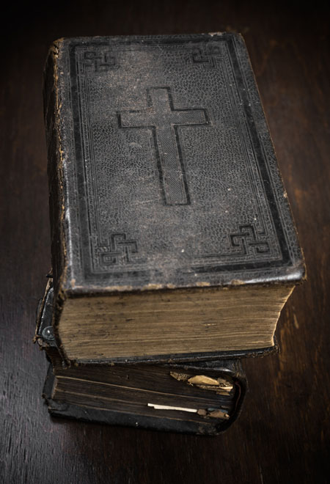
Time Line
King James Version
The King James Version remained the most popular Bible in English for more than 300 years.
At least two-thirds of the King James Version can be traced back to William Tyndale’s translations.
The New Testament is greater than 80% Tyndale.
AD 1
500
1000
1500
2000

Slide 44
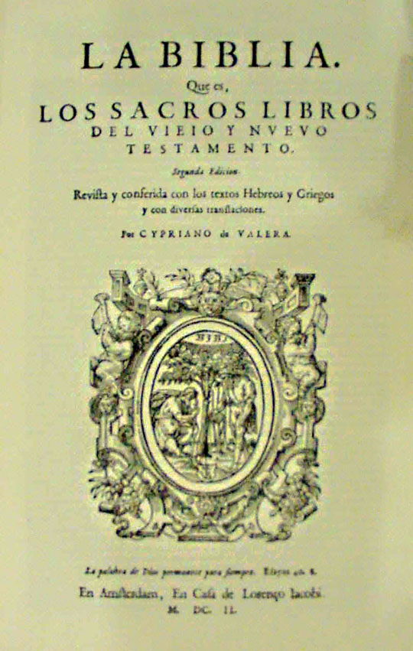
Reina-Valera Spanish Bible
Cipriano de Valera worked for 20 years on a revision of a Spanish translation, the Reina Bible.
His revision came to be known as Reina-Valera (1602).
Reina-Valera is currently the most widely-used Spanish Bible among Protestants and some Catholics.
Reina-Valera (1602)
AD 1
500
1000
1500
2000

