Slide 1
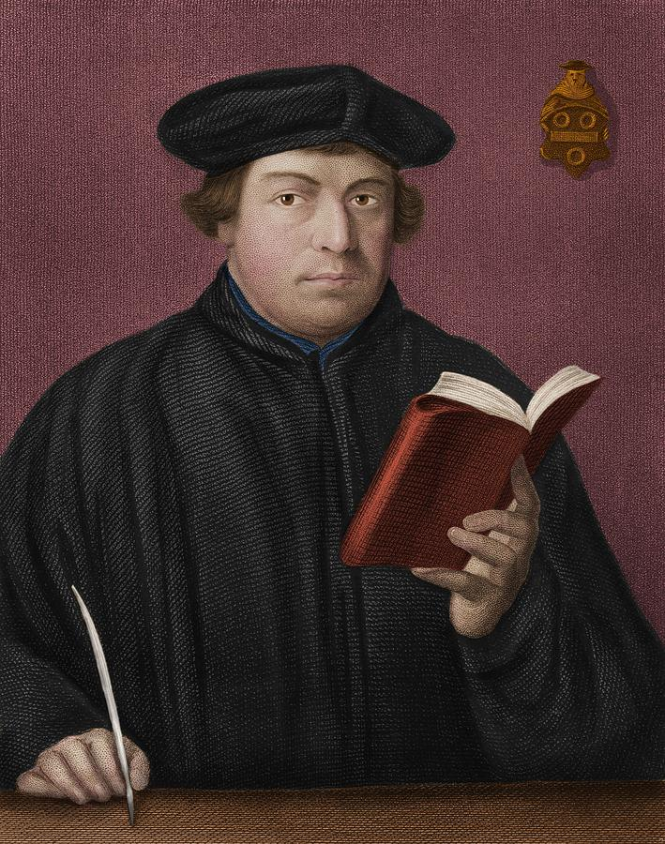
Martin Luther
Ordained as a German priest in 1507.
Rejected many teachings of the Catholic Church especially the practice on indulgences.
Luther wrote the 95 Thesis proclaiming the problems of the church leading to his excommunication by Pope Leo X in 1521.
Martin Luther
1483-1546
AD 1
500
1000
1500
2000

Slide 2
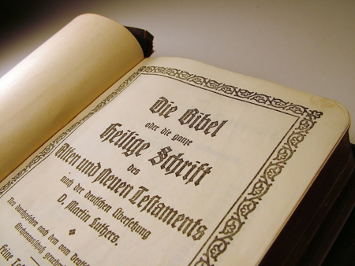
Martin Luther
Luther used the Second Edition of Erasmus’s Greek text to translate the New Testament into German.
He completed his translation in 1522.
Luther decided that “faith alone” was the path to salvation in contrast to the penance and absolution of sins by a priest.
Supported Predestination.
Received Erasmus work on free will in1524.
Wrote a rebuttal in 1525.
Luther’s German Translation
AD 1
500
1000
1500
2000

Slide 3
Martin Luther
Martin Luther
His vibrant and easily-understood translation helped to standardize the German language.
Luther’s German Translation
AD 1
500
1000
1500
2000

Slide 4
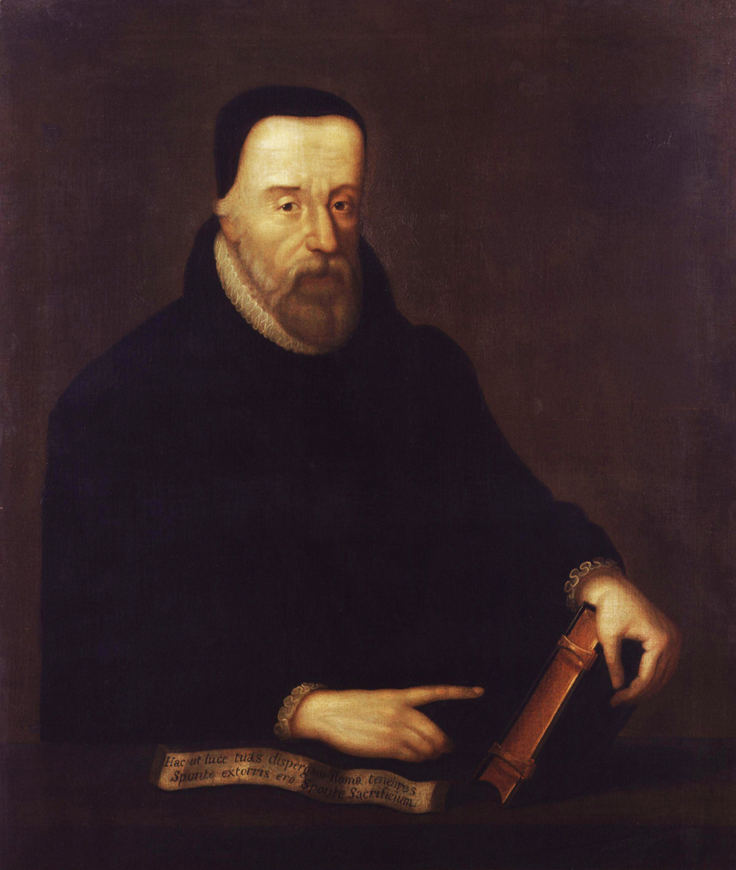
William Tyndale Web Information
Gods Outlaw (10) God's Outlaw: The Story Of William Tyndale (1986) | Full Movie | Roger Rees – YouTube
David Daniell Documentary (10) William Tyndale A Man and His Mission | Full Movie | Dr. David Daniell - YouTube
1937 Doc (10) "William Tyndale"- English Bible Translator Documentary (1937) - YouTube
Steve Lawson (10) Steven Lawson: Tyndale & the English Bible - YouTube
William Tyndale
1494- 1536
AD 1
500
1000
1500
2000

Slide 5
William Tyndale Oxford Educated
Born around 1494 in Melksham Court, Stinchcombe, a village near Dursley, Gloucestershire
B.A. Theology 13 May 1512
M.A. on 26 June 1515. (21 years old)
Tyndales degrees lacked an indepth study of scipture.
Tyndale's sojourn were strongly influenced by the spirit of the new learning and preaching of John Colet
William Tyndale
1494- 1536
AD 1
500
1000
1500
2000
Notes:
COLET, JOHN (1467?–1519), dean of St. Paul's and founder of St. Paul's School, was probably born in the parish of St. Antholin, London, where his family resided. The inscription on his monument states that he was fifty-three years old in 1519, which gives 1466 as the year of his birth. Erasmus, who, according to the best accounts, was born on 28 Oct. of the same year, states that Colet was his junior by two or three months. He was the eldest child of eleven sons and eleven daughters, all of whom died before 1498. His father, Sir Henry Colet [q.v.], was twice lord mayor of London. His mother was Christian, daughter of Sir John Knevet of Ashwellthorpe by Elizabeth, daughter of Sir Constantine de Clifton, second baron Clifton. She lived to a great age, and was alive as late as 1520, the year following her surviving son's death (Erasmi Opera, iii. 455). Colet frequently mentions her with great tenderness in his letters, and took his friends to visit her at Stepney.
It is probable that Colet was for a time a scholar in St. Anthony's school in Threadneedle Street. About 1483 he went to Oxford, but the date of his matriculation is lost, and his college has not been identified with certainty. Several of his surname are described by Wood as students at Magdalen College near the close of the fifteenth century, and it has been thence inferred that Colet was a Magdalen scholar. After seven years of severe study Colet is stated to have proceeded M. A. at Oxford, but the exact date is not known. At an early age Colet resolved to enter the clerical profession, and in accordance with a common contemporary practice his father and other wealthy relatives conferred on him a number of benefices while he was still in his minority, and before his ordination. On 6 Aug. 1485 Sir William Knevet and Joan his wife, relatives of his mother, instituted him to the rectory of St. Mary Dennington, Suffolk, which he held till his death. About the same time Sir Henry Colet's influence at Stepney procured for his son the rich vicarage of St. Dunstan and All Saints ; the rectory of St. Nicholas, Thurning, Huntingdonshire and Northamptonshire, which was in Sir Henry's gift, was conferred on him on 30 Sept. 1490, but Colet resigned this benefice three years later. On 5 March 1493-4 Colet became prebendary of Botevant at York, and the prebend of Goodeaster in the collegiate church of St. Martin-le-Grand and the free chapel of Hilberworth, Norfolk, were presented to him in early life.
Although Colet doubtless benefited by the emoluments of these preferments, there is no reason to suppose that he performed any of the duties attached to them, for none of which was he at the moment legally qualified. His studies absorbed all his attention. There was no part of mathematics in which 'he was not seen above his years,' and he read, besides the ordinary scholastic philosophy, all the classical literature to which a knowledge of Latin gave him access. Cicero was the favourite Latin author of his youth, but he explored Plato and Plotinus in recently published Latin translations, 'conferred and paralleled them, perusing the one as a commentary to the other.' About 1493 his zeal for learning induced him to undertake a continental tour, resembling that undertaken very shortly before by the Oxford tutors, Grocyn and Linacre. He went through France to Italy, and although no details of the journey are known, we learn that he mastered, while sojourning in foreign universities, the works of the fathers, and formed a decided preference for Dionysius, the so-called Areopagite, Origen, Ambrose, Cyprian, and Jerome, over St. Augustine, Duns Scotus, Aquinas, and the other mediaeval schoolmen who were still in vogue in the English universities. He also studied canon and civil law, together with all the books on English history and literature that came in his way, and probably made his first acquaintance with Greek. Colet told Erasmus that he met in Italy 'certain monks, of true wisdom and piety ;' he was obviously impressed by the strange contrast which their lives presented to the prevailing ecclesiastical corruption, and it has been suggested that he visited Savonarola at Florence. The sympathetic intimacy which he subsequently exhibited with the writings of two other contemporary Florentines, Ficino and Pico della Mirandola, supports the inference, but there is no positive evidence to confirm it. On returning to England Colet stayed at Paris, and met there the French historian, Gaguinus, author of 'De Origine et Gestis Francorum,' 1495. Through Gaguinus Colet first heard of Erasmus, who was also in Paris at the time ; but the two scholars, who became the closest friends a few years later, failed to meet on this occasion.
About the spring of 1496 Colet was again in England. On 17 Dec. 1497 he was ordained deacon, and on 25 March 1497-8 priest, but he did not confine himself to ecclesiastical work. He took up his residence at Oxford, and there delivered, in a voluntary capacity, a remarkable course of public lectures in Latin on St. Paul's Epistle to the Romans. They were probably begun in Michaelmas term 1497. His ease as a speaker and his originality as a commentator rapidly brought a large audience around him, includingthe most distinguished tutors at the university. Colet abandoned the scholastic and allegorical interpretation of scripture sentence by sentence or word by word, for a free critical exposition of the obvious meaning of the text as a whole. He illustrated the apostle's personal character; compared St. Paul's references to the state of Roman society with Suetonius ; rejected much of the recognised doctrine of verbal inspiration ; insisted on the necessity of loving rather than of knowing God ; and finally spoke with dissatisfaction of the condition of the church. No schoolman was quoted, but Ficino, Pico della Mirandola, and Plotinus were frequently referred to, and their writings clearly suggested some of Colet's phraseology, although the mazes of Neo-Platonic speculation were carefully avoided. The lectures produced an immediate effect. A priest called on Colet one winter night early in 1498 and entreated him to explain privately the attraction that St. Paul's Epistles had for him. Colet, with characteristic good nature, paraphrased the first chapter of the Epistle to the Romans, to the complete satisfaction of his listener, and he described the curious interview to his friend, Richard Kidderminster, abbot of Winchcombe, in a letter which attests his practical piety and his consciousness of originality (Epist. I. in Knight's Life, 265 et seq. ; Cambr. Univ. Libr. MSS. Gg. iv. 26, p. 62 et seq.) Another friend, whom Colet calls Radulphus, was stimulated at probably the same date by Colet's practical handling of St. Paul's Epistles to apply for assistance in interpreting other 'dark places of scripture,' and Colet replied in a treatise on the Mosaic creation. Radulphus has not been satisfactorily identified, and the theory that makes him out to be Ralph Collingwood, dean of Lichfield, is not well substantiated. In four letters Colet put forward the view that the first chapters of Genesis are to be treated as poetry as an attempt on the part of a great lawgiver to accommodate his teaching to the understanding of an ignorant people. The work is not free from inconsistencies and scholastic subtleties, but its spirit is, in the main, that of a scientific inquirer. From Pico della Mirandola's ' Heptaplus ' (1489) an exposition on the same subject some of Colet's philosophical dicta were drawn, and Philo Judaeus, Origen, and St. Augustine doubtless influenced his opinions. For a young man named Edmund, who has been doubtfully identified with his mother's grand nephew, Edmund Knevet (mentioned in Colet's will), Colet also prepared a very literal paraphrase of the text of the Epistle to the Romans, of which a fragment reaching to the close of the fifth chapter is alone extant. Meanwhile Colet was following up another line of thought, first suggested to him in his Italian travels. The chief Italian Neo-Platonists were well acquainted with a number of writings in Greek, ascribed to Dionysius, called the Areopagite, who was identified with the disciple of St. Paul mentioned in Acts xvii. 34. These works, which were first published in a Latin translation at Paris in 1498, described and explained in a mystical fashion the constitution and practices of the apostolic church, and Colet, like Ficino, regarded them as authoritative. The genuineness of the Dionysian books was disputed a short time afterwards by Grocyn and Erasmus, and has been demolished by later scholars. Canon Westcott insists that they are pseudonymous, and ascribes them to the Edessene school of the fifth or sixth century (Contemp. Review, May 1867) ; others represent them as much more modern forgeries (see art. 'Dionysius Pseudo-Areopagita ' in Dict. Christ. Biog.) Colet did not concern himself with these doubts, but drew up a series of abstracts of the pseudo-Dionysius's chief compositions, ' De Caelesti Hierarchia' and 'De Ecclesiastica Hierarchia,' and then based on them a number of treatises, of which 'De Sacramentis Ecclesiæ,' and ' De Compositione Sancti Corporis Christi Mystici,' are extracts. In these works Colet explains that man is related to God through an ascending series of emanations from the Divine Being, and that a symbolic meaning underlies all the details of the Christian sacerdotal and sacramental system. But, after examining these systems as they existed according to Dionysius at their institution, Colet was astonished by the degrading contrast presented by their shape in his own day. His passion for ecclesiastical reform was thus intensified, and henceforth declared itself in unmistakable utterances.
The chronology of Colet's career is difficult to fix precisely, but it would appear that not later than 1498 he delivered, under the same conditions as before, another course of lectures at Oxford. His subject was St. Paul's first epistle to the Corinthians, and he followed with increasing boldness much the same plan as in his first course. He depicted St. Paul's character with greater vividness ; introduced his theory of accommodation to account for St. Paul's views on marriage, with which he did not wholly agree ; attacked with redoubled vigour the corruptions of the church, and exhibited throughout a more intense religious fervour. Among Colet's auditors was the scholar Erasmus, who came to Oxford in 1498, and was entertained by Richard Charnock, prior of St. Mary's. Charnock told Colet of his guest's attainments ; Colet wrote to Erasmus a letter of welcome ; Erasmus replied in highly appreciative terms, and from that time the two men were the fastest friends. A fantastic dialogue between them on the story of Cain and Abel is reported by Erasmus (Epist. xliv.) as taking place in a college hall, and must be dated very soon after their first interview. Discussions on the schoolmen followed, and the warmth of Colet's attacks upon them and his illustrations of their fatuity directly contributed to Erasmus's distrust of them and later hostility. Late in 1498 the two scholars talked at length of Christ's agony in the garden, and each gave a different explanation. Colet adopted St. Jerome's view, that the agony was not to be confounded with human dread of death, but was Christ's sorrow for the fate of his persecutors. Erasmus contended that Christ's human side was for a time dissociated from the divine, and, while defending his view in a letter written later, adopted the scholastic theory, that scripture was capable of a multiplicity of interpretations. The enunciation of this doctrine called forth strong disapproval on the part of Colet, who insisted on the unity of the Bible's meaning (Erasmi Disputatiuncula de Tædio Jesu, in Opera, v. 1265-94). Erasmus's opinion of Colet, although in details they were at times at variance, grew with increase of intimacy. He compared his conversation to Plato's, and represents him as the centre of the little band of Oxford scholars and reformers at the beginning of the sixteenth century which included Grocyn, Linacre, and Thomas More. Much to Colet's regret, Erasmus refused to actively join him in his Oxford labours, and left England for Paris early in 1500.
In the five succeeding years Colet continued his lectures on the New Testament, although few if any of them have reached us. In 1504 his position underwent a great change. Robert Sherborne was translated from the deanery of St. Paul's, London, to the see of St. David's, And Henry VII conferred the vacant deanery on Colet. He had hitherto held all the preferments granted him in his youth, with the exception of the rectory at Thurning and the addition of a prebend in the church of Salisbury, in which he was installed in 1502. But on 26 Jan. 1503-4 he resigned the prebend at St. Martin-le-Grand, and on 21 Sept. 1505 the Stepney vicarage. He proceeded D.D. at Oxford in 1504, and on 5 May 1505 nearly a year after he had settled in London he received the temporalities of the deanery of St. Paul's, together with the prebend of Mora in the same church. Colet led in London the simple life that had characterised him at Oxford. He continued to wear a plain black robe instead of the rich purple vestments of his predecessors; he was frugal in his domestic arrangements, and preached frequently in the cathedral and often in English. His sermons resembled his Oxford lectures, and were often delivered in continuous courses. Colet's removal to London brought him into closer relations with Thomas More, who henceforth called him his spiritual director. Erasmus wrote to congratulate hjs friend on his elevation, sent him a copy of his 'Enchiridion,' which included an account of their discussion on Christ's agony, and expressed a desire to study with him. In 1570 Cornelius Agrippa studied with Colet at the deanery.
The death of his father in October 1505 made Colet the master of a vast fortune, but in the spirit of his tract ' Concerning a good Christian Man's Life,' which he wrote about this date, he contemplated the devotion of his money to public purposes. Meanwhile he improved the services at St. Paul's; invited Grocyn and others to deliver divinity lectures there ; reformed the statutes (28 April 1507) of the mediaeval guild of Jesus, which was associated with the cathedral ; and instituted an inquiry into the history of the numerous chantries at St. Paul's.
By 1509 Colet had resolved to apply a portion of his wealth to the foundation of a new school in St. Paul's Churchyard, where 153 boys, without restriction as to nationality, who could already read and write and were of good capacity, should receive a sound Christian education and a knowledge of Greek as well as of Latin. The site, which he had probably inherited from his father, was at the eastern end of St. Paul's Cathedral, occupied in 1505 by a number of bookbinders' shops. Colet busily superintended the erection of the school house, which embraced a large schoolroom, a small chapel, and dwellings for two masters—a head-master and a sur-master. Facing the street he placed the inscription 'Schola catechizationis pueroruni in Christi Opt. Max. fide et bonis literis . . . anno Verbi incarnati mdx.' Colet obtained royal license to transfer to the company of the Mercers, with which his father had been identified, a large estate in Buckinghamshire, of the value of 53l. a year, for the masters' salaries (12 July 1511), and to this he added much house property and land in London in 1514 for the provision of a chaplain to teach the boys divinity in English and for other school purposes. He expended in all a sum equivalent to 40,000l. of the money of our own day. Colet wrote some simple precepts for the guidance of the schoolmasters and scholars, and also drew up an English version of the creed and other prayers. The story told by Erasmus of the cruelty with which an unnamed teacher of his acquaintance treated his pupils has been applied to Colet wholly without warrant, and there is every reason to believe that Colet discountenanced severe punishments. The founder chose his friend and the friend of More, William Lilly, to be the first head-master ; induced a sound scholar, John Ritwyse, to be sur-master, in whose behalf he asked Wolsey for some ecclesiastical preferment in 1517 (Ellis, Orig. Letters, 3rd ser. i. 190); and engaged Linacre to write a simple Latin grammar. Linacre s grammar did not satisfy Colet, and he himself prepared in 1509 a short English treatise on the Latin Accidence, prefaced by his precepts and prayers. Lilly supplied a brief English syntax, which is usually bound up with Colet's accidence. At Colet's request Lilly also wrote a Latin syntax ('Libellus de Constructione Octo partium'), which Erasmus revised. A unique copy, with Colet's letter to Lilly prefixed, printed by Richard Pynson in London in 1513, is in the Bodleian Library (Notes and Queries, 6th ser. ii. 441, 461). Erasmus likewise drew up several prayers and a Latin phrase-book ('De Copia Verborum et Rerum ') for the use of Colet's scholars, and in Erasmus's edition of the ' Horæ ' (Paris, 1532) was printed Colet's English paraphrase of the Lord's Prayer, which was not specially prepared for his pupils. Colet's translation of this prayer and of the creed also appeared in the ' Horæ ' printed in London by Robert Wyer in 1533 (AMES, pp. 370-1), and the Lord's Prayer alone is in ' The Prymer of Salisbery Vse' (Lond. by John Gough, 1536).
On 6 Feb. 1511-12 convocation was summoned to consider the extirpation of the Lollard heresy, which had lately revived. Colet was appointed by Archbishop Warham to preach the preliminary sermon in St. Paul's Cathedral, and he seized the opportunity of denouncing the corruptions of the bishops and clergy their ignorance, their self-indulgence, and their simony and of boldly pleading for the church's internal reform. The sermon was published immediately in English, and convocation adjourned without devoting much attention to the Lollards, who are stated to have been the most attentive auditors of Colet's sermons at St. Paul's. The majority of churchmen regarded Colet as an advocate of dangerous doctrines, and they now attacked as heretical not only his preaching but the scheme of his new school. The aged bishop of London, FitzJames, who was jealous of Colet's reputation, took advantage of his unpopularity with his own order to bring specific charges of heresy against him before the Archbishop of Canterbury. Extracts from his sermons showed that he had denounced the worship of images and large episcopal revenues : some objections raised to the practice of preaching from written sermons were interpreted as reflections on the physical infirmities of his bishop. Such remarks formed the basis of the accusation. Tyndale adds that Colet was also charged with having translated the ' Paternoster ' into English. Archbishop Warham sensibly dismissed all the charges as frivolous. The persecution did not silence Colet. Henry VIII's continental wars disgusted him ; he had expected the new king, whose enlightenment was at one time a commonplace with the leaders of the New Learning, to inaugurate a reign of peace, and in sermons preached in 1512 and 1513 he lost no opportunity of expressing his disapproval of Henry's militant policy. Bishop FitzJames tried in vain to poison the Mng's mind against Colet on these grounds. After Good Friday, 27 March 1513, when the dean had denounced the expedition against France, Henry invited Colet to meet him at Greenwich, and they talked together of the possibilities of justifying war. Although they did not come to any agreement, they each made concessions in the argument and parted on the best of terms. The king is said to have marked his sense of Colet's honesty by making him a royal chaplain and admitting him to the privy council, but it is very doubtful if the latter honour was conferred on him. In 1514 Erasmus, who was bringing a second visit to England to a close, spent much of his time with Colet. Colet was involved in a quarrel with his uncle William on business matters, which Erasmus and Archbishop Warham induced him to settle amicably. About the same time the two friends made a pilgrimage together to the shrine of St. Thomas à Becket at Canterbury, where Colet openly expressed his disbelief in the healing effects of the relics and ridiculed the credulity of the vergers and his fellow-pilgrims. In 1514 the dean wrote to Erasmus that the persecution of the Bishop of London continued, and made him anxious to exchange public life for retirement in a Carthusian monastery ; but on 18 Nov. 1515 he preached at the installation of Wolsey as cardinal at Westminster Abbey, and openly warned the prelate against worldly ambition. From this time till his death Colet complained of ill-health and habitually spoke of himself as an old man, although he was barely fifty years of age. He welcomed eagerly Erasmus's new Latin translation of the New Testament (1516), and read with appreciation the 'De Arte Cabalistica' (1517) of Reuchlin, the eminent Hebraist. In 1518 he was for a third time seized with the sweating sickness, and, although his recovery seemed assured, he was conscious of the approach of death. His attention was now mainly directed towards his school, and the last year of his life was chiefly occupied with the composition of its final statutes, which are said to have been modelled on those of Banbury school. He formally appointed the Mercers' Company, and no ecclesiastical corporation, the governing body, and he desired the active governors to be ' married citizens ' a sign that his views on marriage had changed since he criticised the Epistle to the Corinthians. He wisely gave permission to the school authorities to alter the statutes in the future as occasion might require. This important business was completed on 18 June 1518, when he handed the book of statutes to Lilly. He next super-intended the erection of a monument for himself in St. Paul's Cathedral, with the simple inscription ' Joannes Coletus,' and he began building a mansion for himself (afterwards tenanted by Wolsey) in the precincts of the Charterhouse at Sheen. On 1 Sept. 1518 he presented to Cardinal Wolsey a thoroughly revised version of the statutes and customs of St. Paul's Cathedral, together with an exhaustive list of the duties attaching to every office, but the new statutes were not accepted by the chapter nor confirmed by the bishop. The book containing them was at one time extant in St. Paul's Cathedral Library, and a portion of it appears in Dugdale's ' History of St. Paul's, p. 360. The original document is not now known to exist. Colet's fame had by this time, spread to Germany, and he was agreeably surprised to receive in May 1519 a letter eulogising his labours from Marquard von Hatstein, canon of Mainz, and a connection of Ulrich von Hutten. Before 11 Sept. following Colet was seized with a mortal illness, and on 16 Sept. he died. Wood states that he was at the time lodging at Sheen. His disease seems to have been dropsy, complicated by a disorder of the liver. He was buried in St. Paul's Cathedral, but the Mercers' Company erected a more elaborate monument over his grave than the one he had designed for the purpose. It included a bust with several prose inscriptions in both Latin and English and elegiacs by William Lilly. In 1575-6 and 1617-18 the Mercers' Company restored and embellished it with new marble, but it was destroyed in the fire of 1666. In 1680 Colet's coffin was found under the walls of the old cathedral, and some inquisitive members of the Royal Society examined it without much result. An engraving of the tomb appears in Dugdale's ' History of St. Paul's Cathedral,' and is reproduced in Knight's ' Life of Colet.' A headless bust found in the cathedral vaults in 1809 was engraved in Churton's ' Life of Nowell,' p. 380, as the remains of Nowell's tomb, but there is good reason to believe that this was a fragment of Colet's monument (Notes and Queries, 5th ser. iii. 340). Erasmus passionately bewailed Colet's death in letters to his English friends, and Leland eulogises him in his ' Encomia,' 1549, p. 74.
Colet's last will is dated 22 Aug. 1518. No reference was made here to the Virgin Mary or to saints, and no money was appointed for masses for his soul. Most of his realty he had previously alienated, under dates 8 July 1511 and 10 June 1514, to the Mercers' Company for the endowment of St. Paul's School, but such portions as he retained he bequeathed to his mother's relative, Edmund Knevet, Serjeant-porter to Henry VIII, and to John Colet, son of his uncle William, and small money legacies and books were assigned to his friends, Dr. Aleyn, Dr. Morgan, Thomas Lupset, his amanuensis, and William Garrard, who, with his mother and Nicholas Curleus, was an executor. Erasmus is not mentioned, but in his later years Colet had allowed him a pension. St. Paul's School was rebuilt in 1670 on its original site after the fire of 1666 ; the second building was pulled down in 1823-4. A third building took its place and was demolished in 1884 on the removal of the school to new buildings at Hammersmith.
The bust on Colet's monument was doubtless a portrait of the dean, but it is indistinct in the extant engraving supplied by Dugdale. In a manuscript volume containing the gospels of St. Matthew and St. Mark, which was copied out under Colet's direction, and was presented by Archbishop Parker to the Cambridge University Library, there is a finely illuminated drawing containing three figures, one of which is subscribed ' Effigies ipsa D. Joh^{is} Coletti, Decani S. Pauli.' In 1585 an artist named Segar painted (from the bust on the tomb) another portrait of the dean on the cover of the book of St. Paul's School statutes, which is now among the Mercers' Company archives, and this is reproduced in Mr. Gardiner's 'Register of the School,' 1884. A fine drawing in coloured chalk by Holbein, at Windsor, is also stated to be a portrait of Colet; but as Holbein did not come to England till 1525, it could not have been drawn from the life. Erasmus describes Colet as tall and comely.
Colet's achievements seem slight compared with his posthumous fame. On education alone, where he diminished the ecclesiastical control at the same time that he increased the religious tone, did he exert a practical influence. He printed very few of his books, and their effect must have been consequently small. 'As for John Colet,' wrote Harding to Jewell, 'he hath never a word to show, for he wrote no workes.' His knowledge of Greek the chief source of the New Learning was slight. Hearne contended on slender grounds that he knew nothing of it till he was fifty. His Latin style is neither elegant nor correct ; his English is not distinctive. His scriptural exegesis often takes refuge in mystical subtleties. His practical efforts of church reform were confined to the reissue of old rules of discipline to prevent the clergy from neglecting their duties. He was, however, among the first not only to recognise the necessity of making the scriptures intelligible to the masses in vernacular translations, but to criticise their subject-matter with any approach to scholarly method. Yet his chief strength lay in the overwhelming force of his personal conviction that the church had lost its primitive purity, and that the schoolmen had contributed less to the advantage of piety or of human intelligence than the early fathers or the classics, a conviction which impressed itself on all with whom he came into close contact, stirring active antagonism in the slow-witted or self-interested, but stimulating men of Erasmus's or More's intelligence into effective thought and action. Colet was conservative in the passionate enthusiasm with which he urged his countrymen to seek salvation in pre-mediæval usages and literature ; reformation was in his eyes conformation to a very distant past. It is almost certain that the Lutheran Reformation, which he indirectly encouraged, although he did not foresee it, would have altogether exceeded his sense of the situation's needs, and that, had he lived, he would have been found at the side of More and Fisher.
The following separate works by Colet were published in the sixteenth and seventeenth centuries : 1. 'The Convocation Sermon of 1512.' An undated copy in English, printed by Berthelet, probably in Colet's lifetime, is at Lambeth. Herbert and Ames mention a convocation sermon by Colet, printed by Richard Pynson in 1511–12 (Typ. Ant. 256-8). This was reprinted in English Alone in 1661, 1701, and in the 'Phoenix,' 1708, vol. ii., and in Knight's 'Life' (1724 and 1823) in Latin and English. 2. ' A righte fruitfull Admonition concerning the order of a good Christian man's life . . . made by the famous Doctour Colete,' first printed alone by John Byddell in 1534 (copy at St. John's College, Cambridge), and reprinted by John Cawood (Bodleian). Gabriel Cawood in 1577 issued it with two other anonymous religious treatises. In later editions this book took the name of 'Daily Devotions, or the Christian's Morning and Evening Sacrifice. . . . By John Colet, D.D.,' where Colet's ' Order of a Christian Life ' is succeeded by a number of prayers, of which he is not the author. The eighteenth edition of Colet's so-called 'Devotions' contains Fuller's notice of the dean. A twenty-second edition appeared in 1722. 3. Colet's Grammar entitled 'Joannis Coleti Theologi olim Decani Divi Pauli aeditio una cum quibusdam G. Lilii Grammatices rudimentis.' This book is almost all in English. It opens with Colet's precepts, the articles of the faith, and other religious pieces. A Latin dedication to Lilly follows, and is dated 1 Aug. 1509. After the eight parts of speech are duly treated of, 'G. Lilii Angli Rudimenta' are given in a few concluding pages. A copy dated 1527, without printer's name, is in Peterborough Cathedral Library. Several copies of an edition printed by Wynkyn de Worde in 1534 are known. In 1529 and 1536 Colet's ' Æditio ' was issued with Wolsey's ' Rudimenta Grammatices,' drawn up for the use of his school at Ipswich, and first printed by Peter Treveris. There was doubtless an earlier edition, dated about 1510, but no trace of it has been found. The 'Æditio' was reprinted at Antwerp in 1535 and 1536, and in London in 1539. Lilly's Latin syntax rather than Colet's accidence is the original of nearly all the Latin grammars of the sixteenth and seventeenth centuries.
Colet's numerous manuscript treatises were left by his will at the disposition of his executors. After many wanderings some are now in St. Paul's School Library, and others are at Cambridge. Many are extant in the handwriting of Peter Meghen, one of Colet's amanuenses. Their publication was not undertaken till our own time. It was begun by the Rev. J. H. Lupton, sur-master of St. Paul's School, in 1867, and completed by him in 1876. All the volumes are carefully edited, and the Latin works are in most instances translated. Mr. Lupton's publications are as follows : 1. 'Opus de Sacramentis Ecclesiæ,' the Latin text alone, from a manuscript in St. Paul's School Library, 1867. 2. Two treatises on the Hierarchies of Dionysius, from a manuscript in St. Paul's School Library ; the first treatise is also collated with Cambr. Univ. Libr. MS. Gg. iv. 26 (the Latin text with an English translation), 1869. 3. 'An Exposition of St. Paul's Epistle to the Romans,' from Cambr. Univ. Libr. MS. Gg. iv. 26 (the Latin text with an English translation), 1873. 4. ' An Exposition of St. Paul's First Epistle to the Corinthians,' from Cambr. Univ. Libr. MS. Gg. iv. 26 (the Latin text with an English translation), 1874. 5. Letters to Radulphus on the Mosaic account of the Creation, and an unfinished exposition of St. Paul's Epistle to the Romans, both from Archbishop Parker's MSS. in Corpus Christi Coll. Libr. ccclv. ; 'Christ's Mystical Body of the Church,' from Cambr. Univ. Libr. MS. Gg. iv. 26 ; 'Commentary on 1 Peter,' from Gale's MSS. in Trin. Coll. Cambr. O. 4. 44 (all with Latin text and translation), 1876. The identification of the author oi the commentary on Peter with Colet is very doubtful.
The St. Paul's School statutes drawn up by Colet in 1518 are extant with the author's autograph in the Mercers' Hall archives, and a copy is in the British Museum, Addit. MS. 6274. They have been printed in Knight's 'Life' and in Rev. R. B. Gardiner's ' Register of St. Paul's School,' 375–88. Colet's revised statutes for St. Paul's Cathedral, presented to Wolsey in 1518, were printed from a chapter manuscript, now lost, by Dugdale in his 'History of St. Paul's,' and are reprinted in Rev. W. Sparrow Simpson's 'Registrum Statutorum Ecclesiae Cathedralis S. Pauli' (1873), pp. 237–48. Dr. Simpson has also printed in the same volume, pp. 446–52, from the Tanner MS. 221 in the Bodleian, the major part of Colet's revised statutes for the fraternity of Jesus at St. Paul's. Pits gives the largest list of Colet's works, and mentions, besides those already described, 'In Proverbia Salomonis;' ' In Evangelium S. Matthsei Lib. i.;' 'Breviloquium dictorum Christi Lib. i.;' 'Excerptiones Doctorum, Lib. i.;' 'Conciones Ordinariæ, Lib. i. ; ' 'Conciones Extraordinariæ;' 'Epistolæ ad Tailerum, Lib. i.' None of these are now known. The 'Ortolanus Lib. i.' and the 'Abbreviationes,' also mentioned by Pits, may perhaps be respectively the apophthegms and abstracts of St. Paul's Epistles in the Gale MS. in Trin. Coll. Cambr. Libr. O. 4. 44. Colet's letters to Erasmus and to the abbot of Winchcombe are in the collected edition of Erasmus's letters. Colet's contributions to the works of Erasmus are mentioned in the article. Most of these are printed in Knight's appendices.
[Erasmus sketched Colet's life, together with that of Jehan Vitrier, in a Latin letter to Justus Jonas of Wittenberg, dated apparently in 1520 (see Erasmi Epistolæ (Leyden), iii. No. ccccxxxv.) The sketch consists almost entirely of personal reminiscences, and is, therefore, far from complete. The portion relating to Colet was translated with notes by Thomas Smith of Christ's College, Cambridge, in 1661, by J. G. Nichols in 1849, and by Mr. W. Palmer in 1851. The whole was translated and edited by the Rev. J. H. Lupton in 1883. Thomas Smith, in 1661, intended to publish some of Colet's treatises, but the plan was abandoned, except as it affected the Convocation Sermon, perhaps after the destruction of St. Paul's School and its library in 1666. John Postlethwayte, high-master of St. Paul's School, who died in 1713, designed a life of Colet, which was never completed. About the same time Dr. White Kennet was making collections for the same purpose, and they filled a folio volume of 181 pages, which is now among, the Lansdowne MSS. (1030) at the British Museum, but before March 1721 other labours compelled Kennet to hand his materials over to Dr. Samuel Knight. Knight's Life appeared in 1724, and was republished with a few additions in 1823. It is a very diffuse book, and treats Colet as a protestant reformer, but it contains a large-mass of information in both text and appendices. In 1867 appeared the first, and in 1869 the second, edition of Mr. Frederic Seebohm's Oxford Reformers, Colet, Erasmus, and More, where a thorough examination of Erasmus's numerous letters to or about Colet, and of most of Colet's sermons and treatises, has enabled the author to present his readers with a very vivid biography. Mr. Lupton, who has kindly revised this article, has just (1887) crowned his labours in connection with Colet by issuing a full biography. Mr. Lupton's imprints of Colet's manuscript treatises, mentioned above, also include some valuable introductory biographical notes, of which full use has been made in the article. The notices of Colet in Wood's Athenæ Oxon. ed. Bliss, i. 22, in Bale's Scriptores, in Foxe's Acts (1837), iv. 246–8, in Pits, De Rebus Anglicis, in Tanner's Bibliogr., in Holland's Heroologia Anglica, p. 155, and in Fuller's Abel Redivivus, are based almost entirely on Erasmus's letters to Jonas, with occasional supplements from the scanty memoranda of Polydore Vergil and Leland. The long notice in the Biog. Brit. (Kippis) is an abstract of Knight's Life. For the bibliography the Rev. J. H. Lupton's Appendix to his imprint of Colet's Letters on the Mosaic Creation should be consulted, and the Introduction and Appendices to Mr. R. B. Gardiner's Register of St. Paul's School, 1884, are valuable. Among the manuscripts in the Chapter House of St. Paul's are an account of the expenses incurred by Colet in a visitation of the chapter's property in 1506, a copy of Colet's will, and a bill addressed to him by a glazier for glazing the windows of his father's house at Stepney, and emblazoning the arms of the Mercers' Company in one of the windows : see, Hist. MSS. Comm. 9th Rep. 44 a, 48 b, 51 a.]

Slide 6
William Tyndale Cambridge Educator
Was an instructor at Cambridge. Missed Erasmus by a few years
in 1521, he fell in with a group of humanist scholars meeting at the White Horse Inn. John Fyrth and Tyndale became convinced that the Bible alone should determine the practices and doctrines of the church and that all believers should be able to read the Bible in their own language.
Preached that the Priest could not absolve Sins.
John Fyrth who be killed for his teaching.
William Tyndale
1494- 1536
AD 1
500
1000
1500
2000

Slide 7
William Tyndale – John Walsh Family
At a pinnacle of University Teaching and Scholarship,. Tyndale withdrew and returned to a location near his childhood home.
In Gloucester there was a wonderful manor house called Little Sodbury belonging to Sir John and Lady Walsh.
The Walsh’s hired Tyndale as a tutor for there young children. This took little time and he was devoted to Greek and translation.
William Tyndale
1494- 1536

Slide 8
William Tyndale
Possibly Tyndale's New Testament began in 1522, when Tyndale acquired a copy of the German New Testament.
Tyndale began a translation into English using a Greek text compiled by Erasmus and from several manuscripts older than the Latin Vulgate of Jerome.
William Tyndale
1494- 1536
AD 1
500
1000
1500
2000

Slide 9
William Tyndale – John Walsh Family
The Walsh family had connections and often had dinner guest which would converse with Tyndale.
At dinner, a priest once said to him, “We had better be without God’s law than the Pope’s.”
Tyndale retorted, “If God spares my life, I will cause a boy that driveth the plow to know more of the Scripture than you do.”
William Tyndale
1494- 1536

Slide 10
William Tyndale – Tunstall Bishop of London
After the stay with Sir John and Lady Walsh, Tyndale made his way to London to seek approval and financial support from Tunstall Bishop of London for his English Translation of the Bible. .
Bishop Cuthbert Tunstall, a well-known classicist who had praised Erasmus after working together with him on a Greek New Testament
Tyndale exhibited his excellent Greek to English translation of Isocrates impressing Tunstall. Both Tunstall and Tyndale were well aware of the work of Erasmus and the potential of a translation.
William Tyndale
1494- 1536

Slide 11
William Tyndale – Tunstall Bishop of London
.
Tunstall rejected any notion of a translation as heresy reflecting the views of powerful Cardinal Woolsey who had his eyes set on being Pope.
This rejection set in motion his move knowing that his work cannot ne completed in England.
William Tyndale
1494- 1536

Slide 12
William Tyndale – Henry Monmouth
After Tunstall’s rejection. Tyndale remained in London about a year and established a relationship with merchant Monmouth.
Henry Monmouth was a wealthy merchant that helped fund the escape to Europe and the initial printing of the New Testament.
The Roman Catholic authorities later (years) learned of Mommoths involvement in the scheme to support and distribute bibles and he was jailed (never executed) and his business ruined.
William Tyndale
1494- 1536
AD 1
500
1000
1500
2000

Slide 13
William Tyndale – William Roy
Tyndale left England for continental Europe, perhaps at Hamburg, in the spring of 1524, possibly traveling on to Wittenberg. There is an entry in the matriculation registers of the University of Wittenberg of the name "Guillelmus Daltici ex Anglia", and this has been taken to be a Latinisation of "William Tyndale from England".[e began translating the New Testament at this time, possibly in Wittenberg, completing it in 1525 with assistance from Observant Friar William Roy.
William Tyndale
1494- 1536
AD 1
500
1000
1500
2000

Slide 14
William Tyndale – Luther ?
In 1524 Tyndale went to Hamburg, Germany, where Martin Luther's reforms were changing the shape of Christianity there. Historians believe Tyndale visited Luther in Wittenberg and consulted Luther's recent translation of the Bible in German. In 1525, while living in Wittenberg, Tyndale finished his translation of the New Testament in English.
William Tyndale
1494- 1536
AD 1
500
1000
1500
2000

Slide 15
William Tyndale – Peter Quantell
In 1525 the publication Tyndale's translation publication was started Peter Quentell in Cologne.
An informer worked against Quantell for printing Lutheran based documents and alerted Henry VIII of Tyndale's work.
The Printing of Matthew was near completion but news of the impending raid reached Tyndale .
He escaped with the help of William Roy with his manuscript to Worms
William Tyndale
1494- 1536
AD 1
500
1000
1500
2000

Slide 16
William Tyndale – Peter Schöffer
A full edition of the New Testament was produced in 1526 by printer Peter Schöffer the Younger in Worms
6,000 copies of the first edition were printed and smuggled to England hidden in sacks of flour, grain, and casks of wine.
The testaments were pocket sized.
Woolsey and Tunstall confiscated copies, persecuted owners, and bought copies to be burned.
Backfire - a shift of view of the Catholic Church (wkb)
William Tyndale
1494- 1536
AD 1
500
1000
1500
2000

Slide 17
William Tyndale – Hebrew
While in Worms Tyndale took advantage of the Rabbinical population and studied Hebrew.
He began work on a Hebrew to English translation of the Old Testament
William Tyndale
1494- 1536
AD 1
500
1000
1500
2000

Slide 18
Tyndale – Other Writings
William Tyndale, The obedience of a Christen man (1528)
Summary
The pope is not in control
A man needs to understand scripture
A man may need to act against authority if it is in conflict with scripture.
Henry VIII read this and in some way may have impacted his decision to break away from Rome. (excuse?)
( WKB comments subject to verification)

Slide 19
Tyndale – Other Writings
In 1530, Tyndale wrote The Practice of Prelates, opposing Henry's plan to seek the annulment of his marriage on the grounds that it contravened scripture.

Slide 20
William Tyndale – Merten de Keyser (publisher)
Tyndale sought sanctuary in the English House of Antwerp.
Tyndale's Pentateuch was published in 1530.
The Second Editon (1534) of the new testament was published with a distribution of more than 14,00 volumes.
Tyndale had translated the old testament through Chronicles but the total of this work would not be published until Rogers took up the mantle.
William Tyndale
1494- 1536
AD 1
500
1000
1500
2000

Slide 21
William Tyndale – Stephen Vaughn
Vaugh was sent from court of Henry VIII to compel Tyndale to become a part of the Kings court.
Met in a field outside of English House
Tyndale asked that the King’s authorize the English Bible.
This infuriated Henny VII
William Tyndale
1494- 1536
AD 1
500
1000
1500
2000

Slide 22
William Tyndale – Henry Phillips
Henry VIII was now against Tyndale.
Phillips was hired by Bishop Stokesley to gain Tyndale's confidence and then betray him.
Phillips was acting in desperation as he has lost a large sum of money.
He befriended Tyndale at English House and compelled him to go to dinner.
John Rogers of the English house thought this was a bad idea.
Holy Roman authorities were waiting and Tyndale was captured summer of 1835
William Tyndale
1494- 1536
AD 1
500
1000
1500
2000

Slide 23
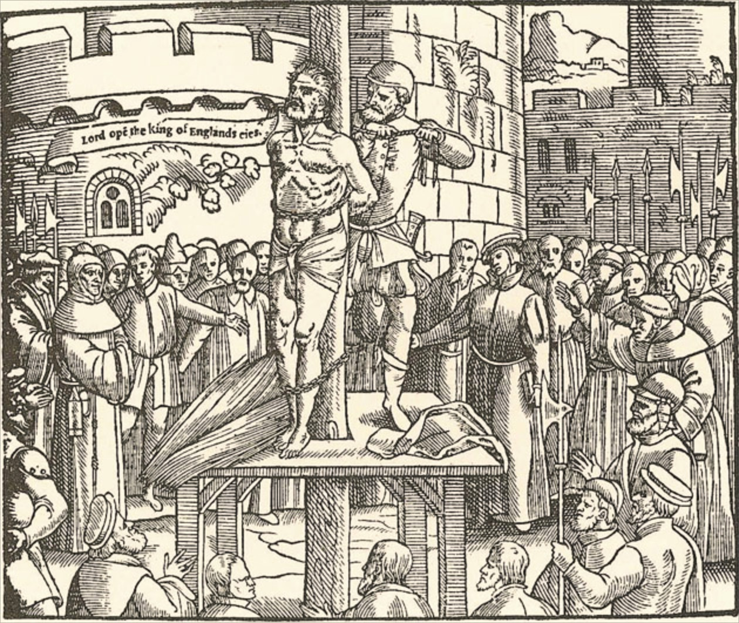
William Tyndale in prison Vilvoorde
William Tyndale
Lived in wrenched conditions in jail
Asked for return of his clothes, a light, his Hebrew text, and his Hebrew lexicon. (Letter in Latin)
October 6, 1536 Tyndale, and was strangled and burned at the stake.
His final words were, “Lord, open the King of England’s eyes.”
Tyndale’s death
AD 1
500
1000
1500
2000

Slide 24
William Tyndale
42
AD 1
500
1000
1500
2000

Slide 25
Tyndale Memorial
A memorial to Tyndale stands in Vilvoorde, Flanders, where he was executed. It was erected in 1913 by Friends of the Trinitarian Bible Society of London and the Belgian Bible Society. There is also a small William Tyndale Museum in the town, attached to the Protestant church.[

Slide 26
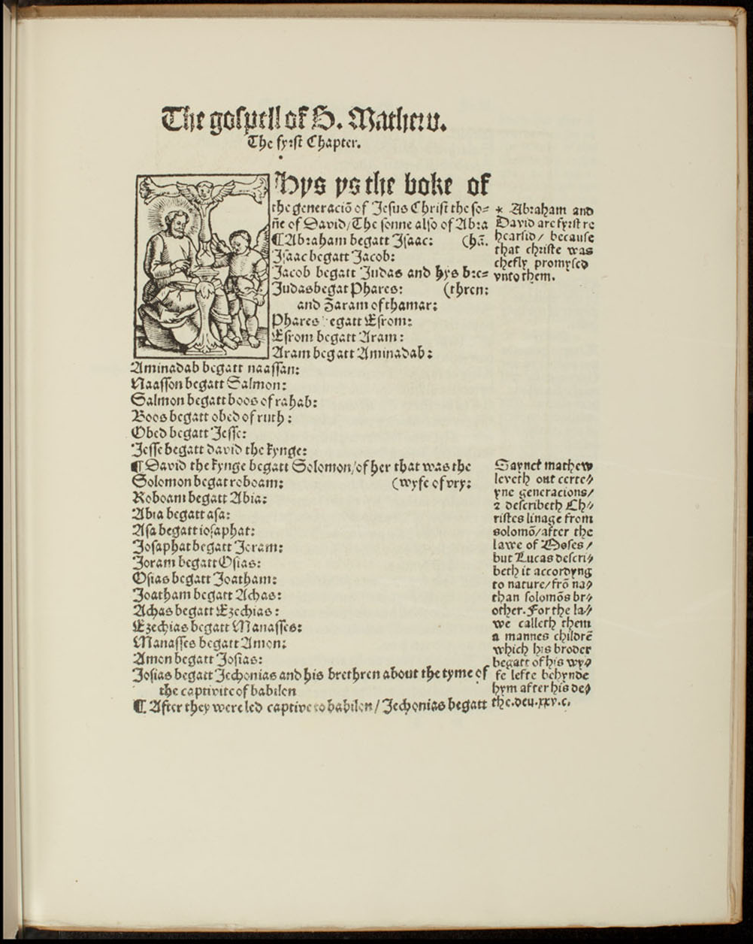
William Tyndale
William Tyndale
Tyndale is known as the “Father of the English Bible.”
His translation has influenced almost every English translation of the Bible.
Much of the style and vocabulary we know as “biblical English” is traceable to his work.
Page from the Tyndale Bible
AD 1
500
1000
1500
2000

Slide 27
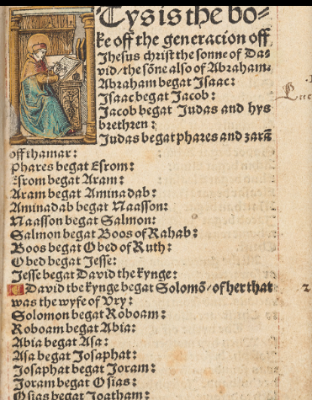
William Tyndale
William Tyndale’s Translation
Matthew
William Tyndale's New Testament | The British Library (bl.uk)
The copy is in the British Musesm.
It had beloned to Anne BoLyn.
Page from the Tyndale Bible
AD 1
500
1000
1500
2000

Slide 28
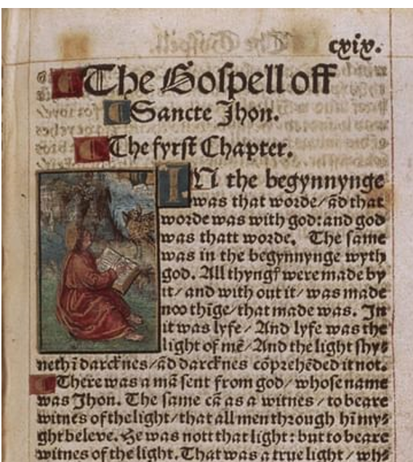
William Tyndale
William Tyndale’s Translation
John from the British Library copy
Page from the Tyndale Bible
AD 1
500
1000
1500
2000

Slide 29
William Tyndale
Words
Scapegoat, Passover, Jehovah
Overseer instead of bishop, repentance instead of do penance
Constructs
“eat, drink and be merry”
“the spirit is willing”
“fight the good fight”
Congregation audience, gathering, assembly, crowd, throng, host, mass
Church adjective -- ecclesiastical, clerical, religious, priestly, apostolic, papal
Church noun -- minister, cathedral, basilica, house of worship, place of worship
AD 1
500
1000
1500
2000

Slide 30
William Tyndale
William Tyndale’s Bible Translation
First English translation to use Jehovah ("Iehouah") as God's name as preferred by English Protestant Reformers.
Used the word congregation to translate ekklēsia to differentiate from the baggage imposed by the word church.
Page from the Tyndale Bible
AD 1
500
1000
1500
2000

Slide 31
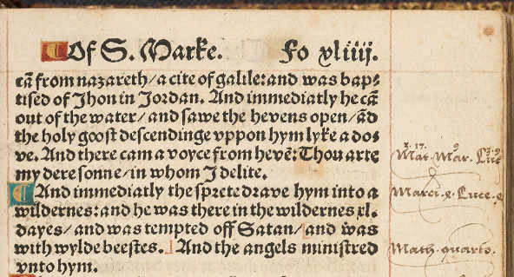
William Tyndale
16 to 20 thousand copies made there way to England.
The “church” purchased many copies and burned them.
The second edition eliminated marginal notes making it smaller (pocket size)
AD 1
500
1000
1500
2000

Slide 32
William Tyndale
The Catholic Churches rejection was there were over 2000 “errors” in Tyndale's version.
AD 1
500
1000
1500
2000

Slide 33
William Tyndale
Ekklēsia ἐκκλησία is translated congregation by Tyndale
(77 “errors”)
First From a compound of ἐκ (G1537) and a derivative of καλέω (G2564)
ἐκ translated as of (366x), from (181x), out of (162x), by (55x), on (34x), with (25x), miscellaneous (98x)
καλέω translated call (125x), bid (16x), be so named (1x), named (with G3686) (1x), miscellaneous (3x)..
Congregation audience, gathering, assembly, crowd, throng, host, mass (synonyms form Microsoft word)
AD 1
500
1000
1500
2000

Slide 34
William Tyndale
Contrast of synonyms from Microsoft Word Thesaurus
Congregation audience, gathering, assembly, crowd, throng, host, mass
Church adjective -- ecclesiastical, clerical, religious, priestly, apostolic, papal
Church noun -- minister, cathedral, basilica, house of worship, place of worship
AD 1
500
1000
1500
2000

Slide 35
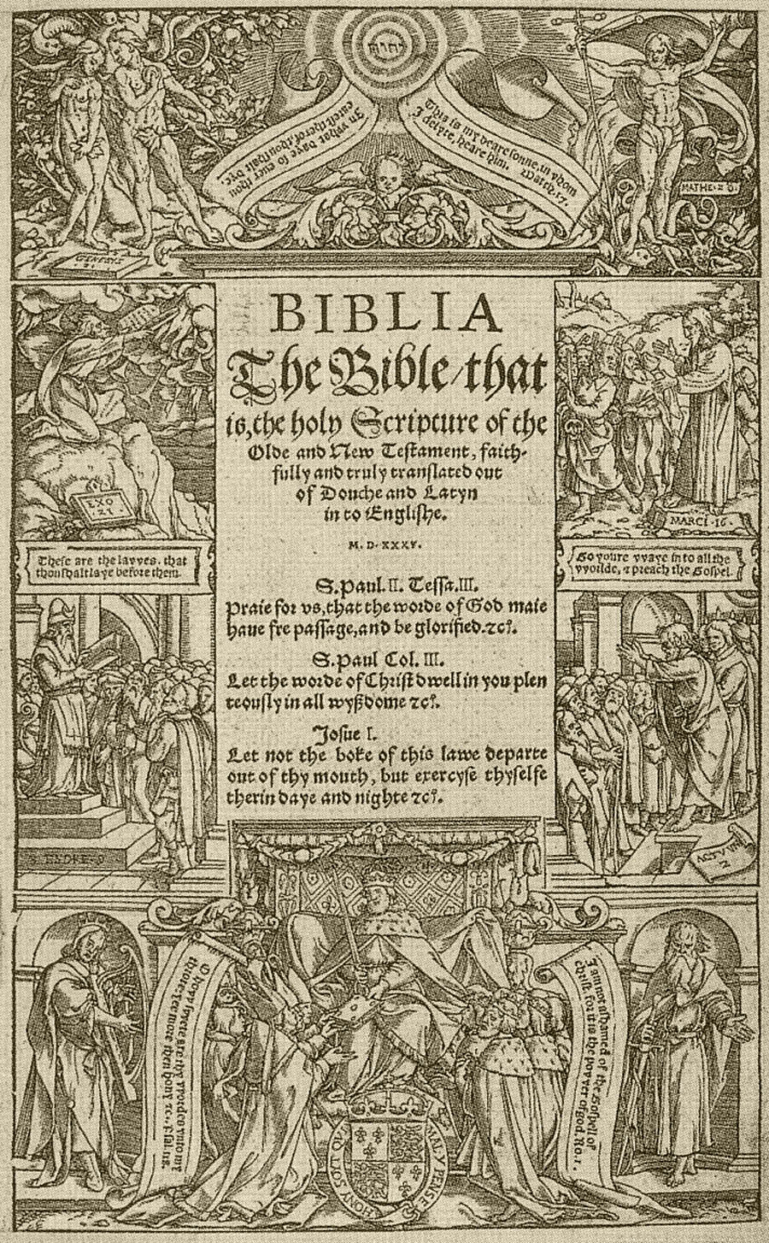
Coverdale Bible
This Bible was completed by Miles Coverdale while Tyndale was in prison (1535).
It was based on Tyndale’s work.
It was dedicated to Anne Boleyn, one of King Henry VIII’s wives.
Title Page of the Coverdale Bible
AD 1
500
1000
1500
2000

Slide 36
The Coverdale Bible
This was the first complete Bible to be printed on a printing press in English.
Title Page of the Coverdale Bible
AD 1
500
1000
1500
2000

Slide 37
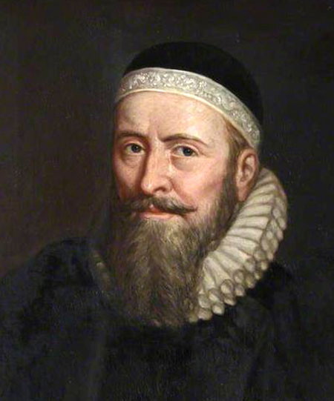
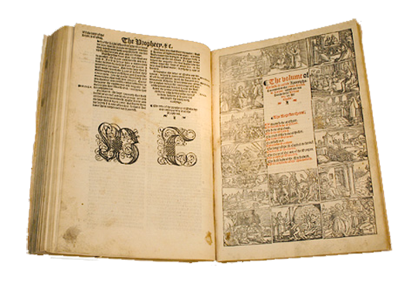
The Matthew’s Bible
The year after Tyndale died, John Rogers published an English Bible under the pen name “Thomas Matthew.”
It was the first English Bible printed with the king’s permission (1537).
John Rogers
The Matthew’s Bible
AD 1
500
1000
1500
2000

Slide 38
Opposition to Henry VIII's annulment
In 1530, Tyndale wrote The Practice of Prelates, opposing Henry VIII's desire to secure the annulment of his marriage to Catherine of Aragon in favour of Anne Boleyn, on the grounds that it was unscriptural and that it was a plot by Cardinal Wolsey to get Henry entangled in V to have the writer apprehended and returned to England under the terms of the Treaty of Cambrai; however, the emperor responded that formal evidence was required before extraditionTyndale developed his case in An Answer unto Sir Thomas More's Dialogue

Slide 39
John Rogers (a.k.a Thomas Matthew) tribute to Tyndale
The Matthew’s Bible
God had answered William Tyndale’s dying plea to “open the King of England’s eyes.”
John Rogers
The Matthew’s Bible
AD 1
500
1000
1500
2000

Slide 40
John Rogers (a.k.a Thomas Matthew) tribute to Tyndale
Between the Old and New Testament the 2 ½” letters WT appear as a tribute to
Tyndale in the Matthews Bible
The Matthew’s Bible
AD 1
500
1000
1500
2000

Slide 41
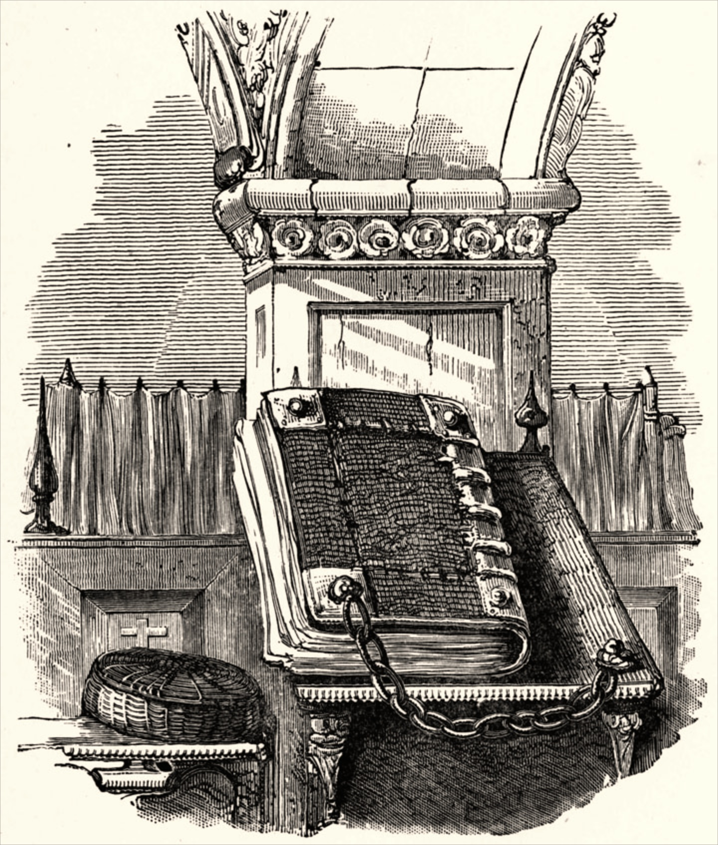
Time Line
The Great Bible
Thomas Cromwell, advisor to King Henry VIII, authorized Miles Coverdale to revise the Matthew’s Bible.
The result was the Great Bible (1539).
The Great Bible
AD 1
500
1000
1500
2000

Slide 42
Time Line
The Great Bible
A copy of the Great Bible was placed in every church in England by order of Thomas Cranmer, archbishop under King Henry VIII.
To keep this Bible accessible to all people, it was chained to the church pillars, so it also became known as the “Chained Bible.”
The Great Bible
AD 1
500
1000
1500
2000

Slide 43
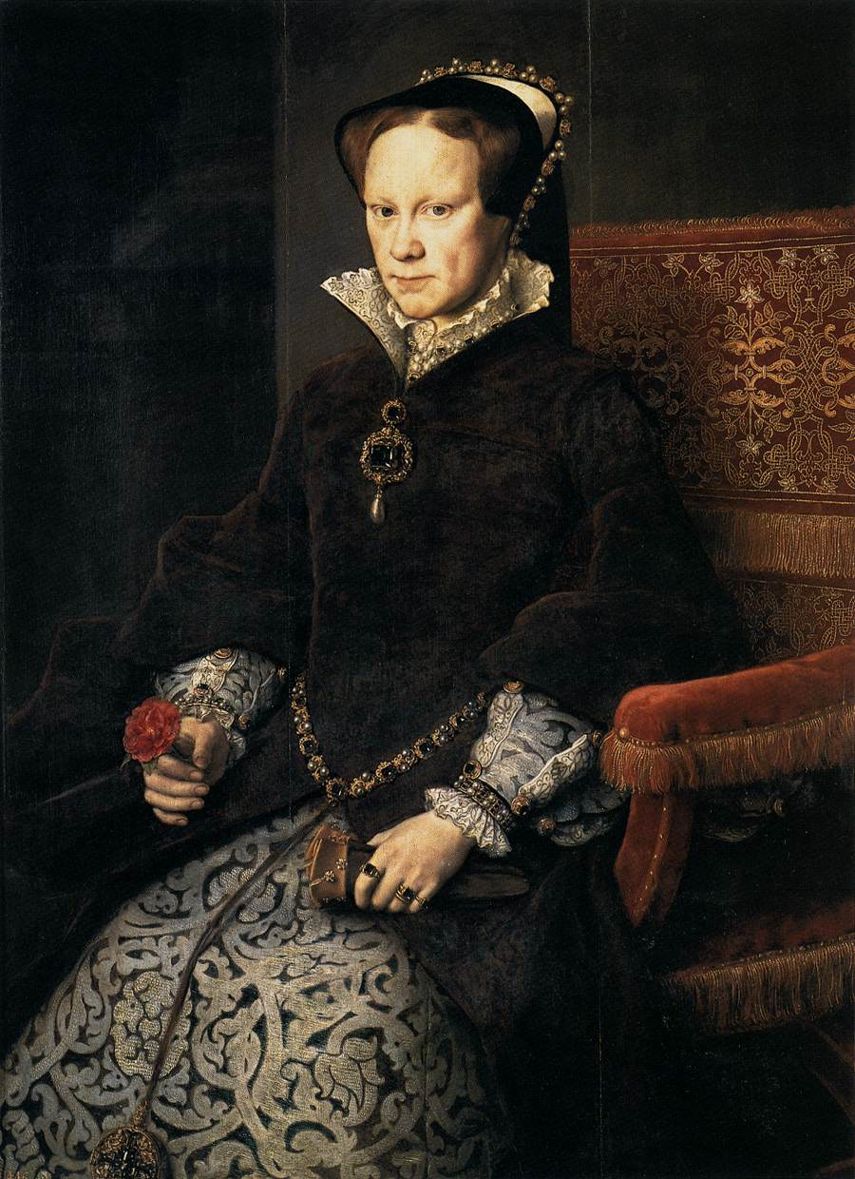
Time Line
Queen Mary
England’s Queen Mary banned Protestant translations of the English Bible.
The Matthew’s Bible translator John Rogers and archbishop Thomas Cranmer were burned at the stake.
Later some 300 men, women, and children were also burned.
Queen Mary
AD 1
500
1000
1500
2000

Slide 44
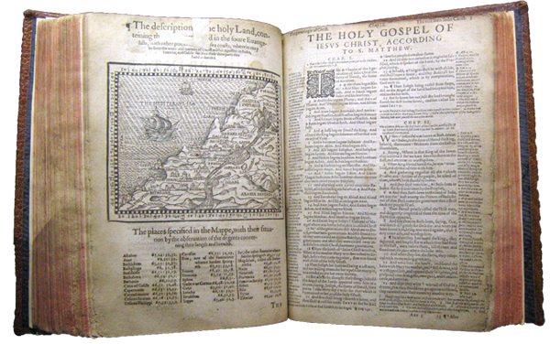
Time Line
The Geneva Bible
Exiles from England fled to Geneva, Switzerland and published the Geneva Bible (1560).
It was a revision of the Great Bible with the Old Testament translated from Hebrew.
Geneva Bible
AD 1
500
1000
1500
2000

Slide 45
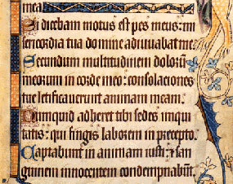
Time Line
The Geneva Bible
It was the first Bible to use roman type instead of blackletter.
It contained theological notes influenced by Protestant scholars:
John Calvin
Theodore Beza
John Knox
William Whittingham
Some notes seemed to question the legitimacy of absolute monarchs.
Blackletter Type
Roman Type
AD 1
500
1000
1500
2000

Slide 46
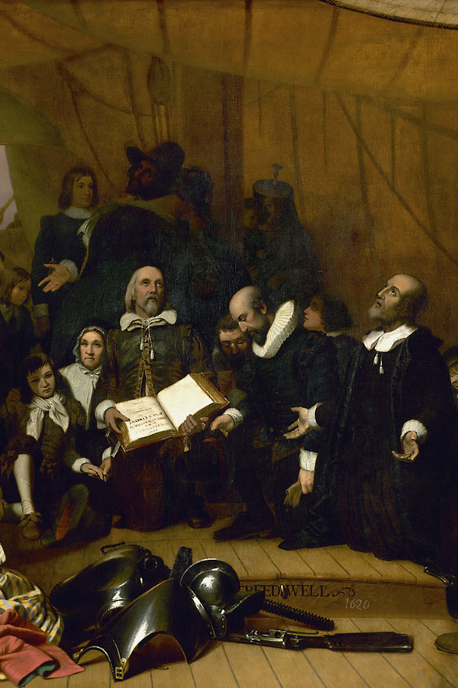
Time Line
The Geneva Bible
The Geneva Bible was brought to America on the Mayflower (1620).
It was also the Bible of William Shakespeare and John Bunyan.
Pilgrims on the Mayflower
AD 1
500
1000
1500
2000

Slide 47
Time Line
The Geneva Bible
The 1640 edition was the first English Bible to omit the Apocrypha completely.
Earlier Protestant Bibles had included the Apocrypha in a separate section between the Old and New Testaments.
Pilgrims on the Mayflower
AD 1
500
1000
1500
2000

Slide 48
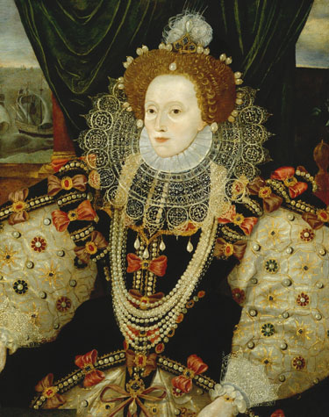
Time Line
Bishops Bible
A new English translation began under Queen Elizabeth in 1568.
The Bishops Bible failed to supersede the popular Geneva Bible.
Queen Elizabeth
AD 1
500
1000
1500
2000

Slide 49
Time Line
Rheims-Douai Bible
The Rheims-Douai Bible was translated into English from the Latin Vulgate by Catholic scholar Gregory Martin, while in exile in France.
The New Testament was completed in 1582, and the Old Testament in 1609.
It became the standard English translation in the Roman Catholic Church for centuries.
AD 1
500
1000
1500
2000

Slide 50
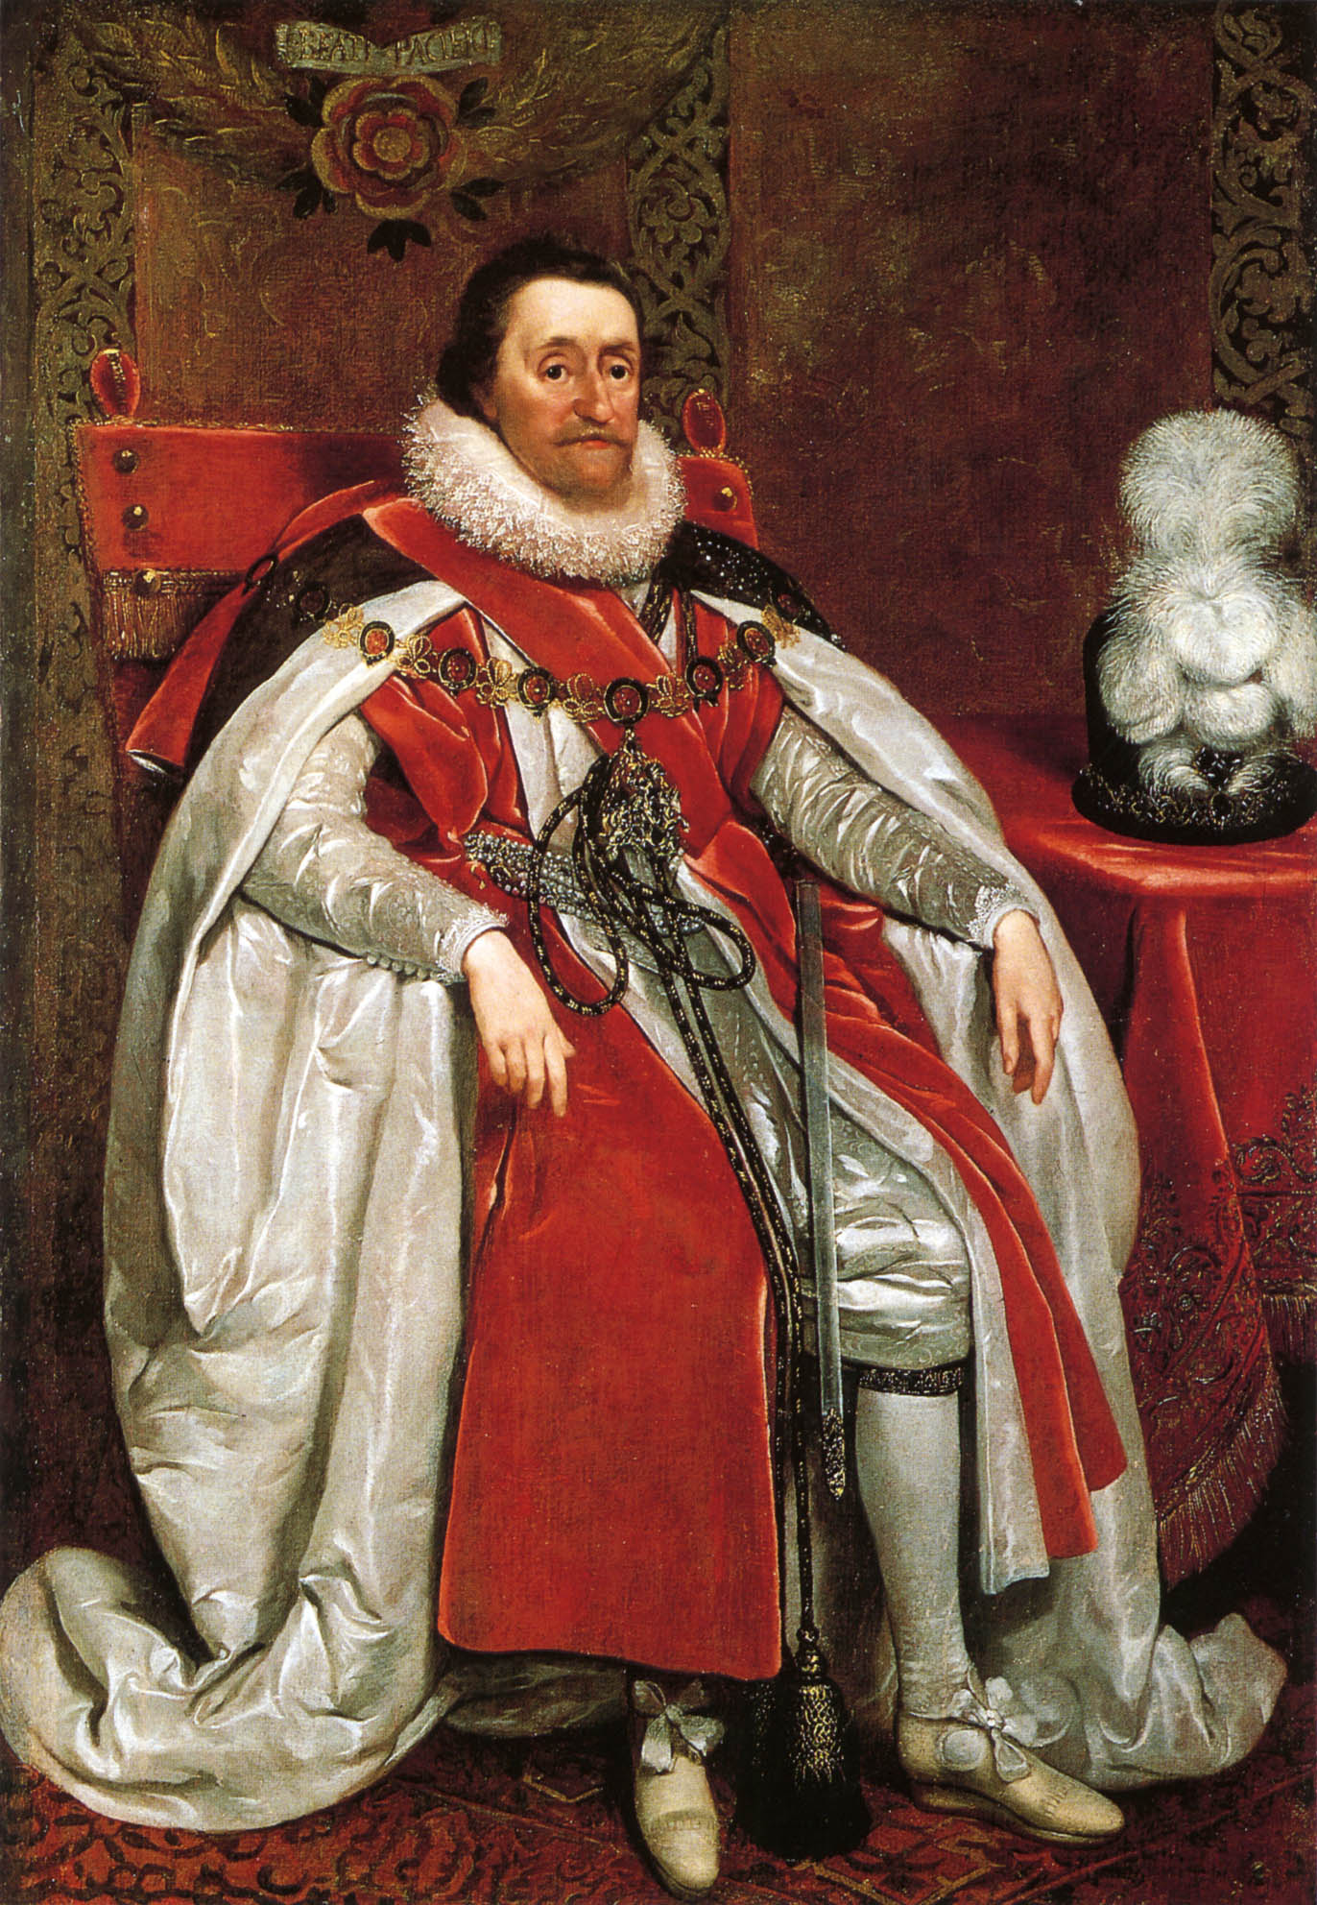
Time Line
King James Version
At the Hampton Court Conference in 1604, Puritans asked King James I of England to introduce further reforms in the Church of England.
Most of their requests were denied, but the king did agree to a new English translation of the Bible.
King James I of England
AD 1
500
1000
1500
2000

Slide 51
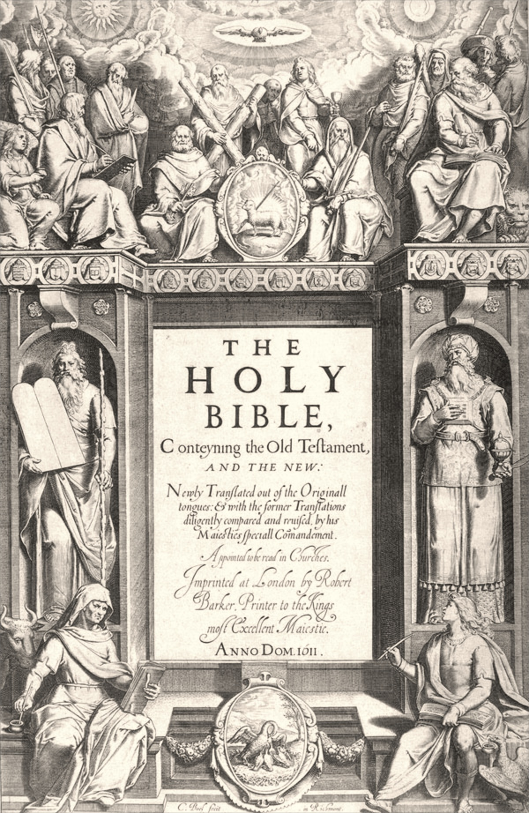
Time Line
King James Version
King James commissioned 54 scholars to produce a Bible that did not include theological or political notes, like the Geneva Bible did.
Organized into six teams, they used:
Earlier English translations.
Greek New Testaments based on Erasmus’s text.
Hebrew and Aramaic texts.
Title page of the King James Version
AD 1
500
1000
1500
2000

Slide 52
Time Line
King James Version
The new version was completed in 1609 and published in 1611.
The King James Version is also known as “the Authorized Version.”
It was revised several times. The edition most often used today is the 1769 revision.
Title page of the King James Version
AD 1
500
1000
1500
2000

Slide 53
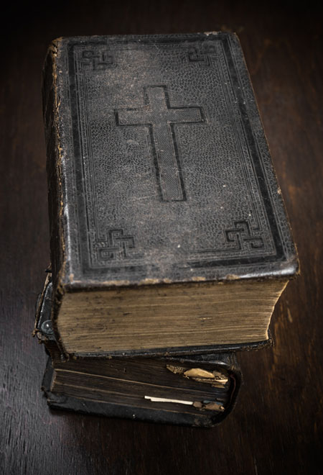
Time Line
King James Version
The King James Version remained the most popular Bible in English for more than 300 years.
At least two-thirds of the King James Version can be traced back to William Tyndale’s translations.
AD 1
500
1000
1500
2000

Slide 54
Time Line
Reina-Valera Spanish Bible
Cipriano de Valera worked for 20 years on a revision of a Spanish translation, the Reina Bible.
His revision came to be known as Reina-Valera (1602).
Reina-Valera is currently the most widely-used Spanish Bible among Protestants and some Catholics.
Reina-Valera (1602)
AD 1
500
1000
1500
2000

