Slide 1
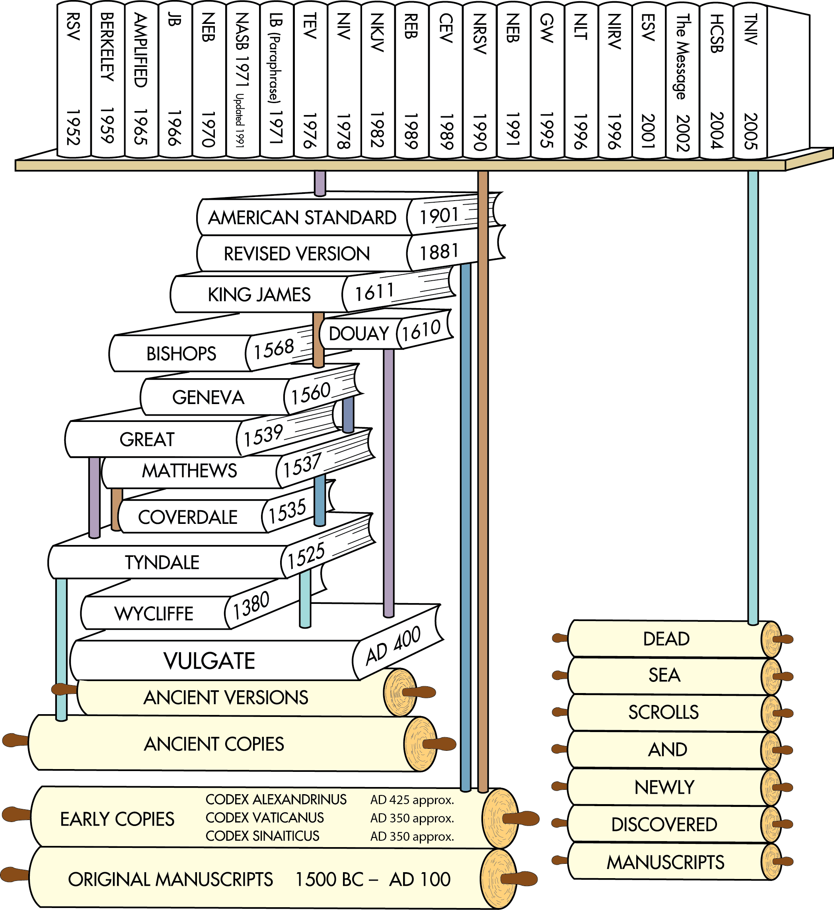
Translations after the discovery of the Dead Sea Scrolls
Translations after earlier ancient manuscripts were discovered in the 1700s and 1800s
English Translations from ancient versions and copies available at that time
Latin Translation
Chart does not include all English translations. Chart idea from Back to the Bible Broadcast, Lincoln NE..

Slide 2
HEXAPLA Old Testament Greek
SEPTUIGENT Old Testament Greek
Hebrew Text

Slide 3
Codex Sinaiticus
https://codexsinaiticus.org/
https://www.blueletterbible.org/
http:/weldonbeardain.website

Slide 4
Take aways.
You do not need to be a Greek scholar.
The researches continue to CONFIRM the bible.
The RSV was first to use the oldest Codices and no fundamental truths are changed..
P66 is a copy of John’s Gospel circa ~200 and it is the same Gospel.

Slide 5
Review Questions
What political figure established the Library at Alexandria?
What is the LXX and why was it formulated?
Which important school did Origen Attend?
Which school did Origen found?
What important work of Origen contributes to the old testament?
What actions of Eusebius impacted the New Testament?
What role did Jerome have in how we got the bible?

Slide 6
Bonus Questions
What exciting discover was made at Saint Catherine's Monastery in the Sinai Peninsula circa 1844?
Who made the discovery?

Slide 7
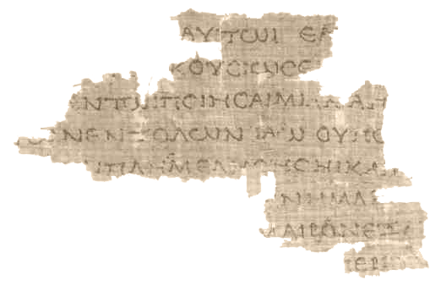
Old Testament Septuagint
Greek Translation
The Translation of the Seventy derives from the story recorded in the Letter of Aristeas to Philocrates that "the laws of the Jews" were translated into the Greek language at the request of Ptolemy II Philadelphus (285–247 BCE) by seventy-two Jewish translators—six from each of the Twelve Tribes of Israel.
Septuagint Fragment (4Q120, from Leviticus, 100s BC)

Slide 8
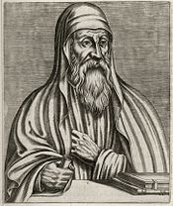
Origen 185 AD – 253AD
Born in Alexandria.
Catechetical School of Alexandria
Compiled Hexapla
Wrote over 2000 Christian Treatises
Formed Christian school in Caesarea
Responsible for the Hexapla
Founded Christian school in Caesarea.

Slide 9
Eusebius of Caesarea 260/265 – 30 May 339
Through the activities of the theologian Origen (185/6–254) and the school of his follower Pamphilus (later 3rd century – 309), Caesarea became a center of Christian learning. Origen was largely responsible for the collection of usage information, or which churches were using which gospels, regarding the texts which became the New Testament. The information used to create the late-fourth-century Easter Letter, which declared accepted Christian writings, was probably based on the Ecclesiastical History ] [HE] of Eusebius of Caesarea, wherein he uses the information passed on to him by Origen to create both his list at HE 3:25 and Origen's list at HE 6:25

Slide 10
Codex Sinaiticus
Until Biblical scholar (and manuscript hunter) Constantin von Tischendorf's discovery of Codex Sinaiticus in 1844, the Greek text of Codex Vaticanus was unrivalled. Since its discovery, study of Codex Sinaiticus has proven to be useful to scholars for critical studies of the biblical text.
Codex Sinaiticus came to the attention of scholars in the 19th century at Saint Catherine's Monastery in the Sinai Peninsula

Slide 11
HEXAPLA Old Testament Greek
SEPTUIGENT Old Testament Greek
Hebrew Text

Slide 12
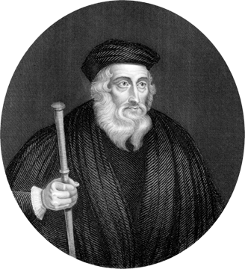
Translation of New testament from Latin to English
John Wycliffe
The first complete English Bible was translated from Latin in 1382.
His followers, ridiculed as Lollards (“mumblers”), included some of his criticisms of church traditions in the preface to the Wycliffe Bible.
This Bible was banned and burned.
In 1428, 44 years after Wycliffe’s death, his bones were exhumed and burned for heresy.
John Wycliffe
1324-1384
AD 1
500
1000
1500
2000
Notes:
ohn Wycliffe
From Wikipedia, the free encyclopedia
Jump to navigationJump to search"John Wickliffe" and "Wycliff" redirect here. For the ship, see John Wickliffe (ship). For other uses and other people, see Wycliffe.
John Wycliffe
Copy of an anonymous portrait of Wycliffe
Bornc. 1328 Hipswell, Yorkshire, Kingdom of England
Died31 December 1384 (aged 56) Lutterworth, Leicestershire, England^{[1]}
Alma materMerton College, OxfordNotable workWycliffe's BibleEraMedieval philosophyhideInfluences
Roger Bacon
William of Ockham
Augustine of Hippo
Robert Grosseteste
Thomas Bradwardine
Richard Fitzralph
hideInfluenced
Jan Hus
Martin Luther
Henry VIII
John Calvin
Huldrych Zwingli
William Tyndale
John Wycliffe (/ˈwɪklɪf/; also spelled Wyclif, Wickliffe, and other variants; c. 1328 – 31 December 1384)^{[2]} was an English scholastic philosopher, theologian, biblical translator, reformer, Catholic priest, and a seminary professor at the University of Oxford. He became an influential dissident within the Catholic priesthood during the 14th century and is considered an important predecessor to Protestantism. Wycliffe questioned the privileged status of the clergy, who had bolstered their powerful role in England, and the luxury and pomp of local parishes and their ceremonies.^{[3]}
Wycliffe advocated translation of the Bible into the common vernacular. According to tradition, Wycliffe is said to have completed a translation direct from the Vulgate into Middle English – a version now known as Wycliffe's Bible. While it is probable that he personally translated the Gospels of Matthew, Mark, Luke, and John, it is possible he translated the entire New Testament. At any rate, it is assumed that his associates translated the Old Testament. Wycliffe's Bible appears to have been completed prior to 1384 with additional updated versions being done by Wycliffe's assistant John Purvey, and others, in 1388 and 1395. More recently, historians of the Wycliffite movement have suggested that Wycliffe had at most, a minor role in the actual translations.^{[4]}
Wycliffe's later followers, derogatorily called Lollards by their orthodox contemporaries in the 15th and 16th centuries, adopted many of the beliefs attributed to Wycliffe such as theological virtues, predestination, iconoclasm, and the notion of caesaropapism, while questioning the veneration of saints, the sacraments, requiem masses, transubstantiation, monasticism, and the legitimacy of the Papacy. Like the Waldensians, Hussites and Friends of God,^{[5]} the Lollard movement in some ways anticipated the Protestant Reformation.^{[6]} Wycliffe was accordingly characterised as the "evening star" of scholasticism and as the morning star or stella matutina of the English Reformation,^{[7]} an epithet first accorded to the theologian by the 16th century historian and controversialist John Bale in his Illustrium maioris britanniae scriptorum (Wesel, 1548).^{[8]}
Wycliffe's writings in Latin greatly influenced the philosophy and teaching of the Czech reformer Jan Hus (c. 1369–1415), whose execution in 1415 sparked a revolt and led to the Hussite Wars of 1419–1434.^{[9]}
Contents
1Life and career
1.1Early life
1.2Career in education
1.3Politics
1.4Conflict with the Church
1.5Anti-Wycliffe synod
1.6Death and posthumous declaration of heresy
2Works
3Doctrines
3.1Attack on monasticism
3.2Views on the papacy
3.3Basic positions in philosophy
3.4Attitude toward speculation
3.5Sacraments
3.6Soteriology
4Legacy
5See also
6Citations
7General and cited sources
8Further reading
9External links
Life and career[edit]
Early life[edit]
Wycliffe was born in the village of Hipswell near Richmond in the North Riding of Yorkshire, England, around the 1320s. He has conventionally been given a birth date of 1324 but Hudson and Kenny state only records "suggest he was born in the mid-1320s".^{[10]} Conti states that he was born "before 1331 ".^{[11]} His family was long settled in Yorkshire. The family was quite large, covering considerable territory, principally centred on Wycliffe-on-Tees, about ten miles to the north of Hipswell.
Wycliffe received his early education close to his home.^{[12]} It is unknown when he first came to Oxford, with which he was so closely connected until the end of his life, but he is known to have been at Oxford around 1345. Thomas Bradwardine was the Archbishop of Canterbury, and his book On the Cause of God against the Pelagians, a bold recovery of the Pauline-Augustine doctrine of grace, would greatly shape young Wycliffe's views,^{[13]} as did the Black Death which reached England in the summer of 1348.^{[14]} From his frequent references to it in later life, it appears to have made a deep and abiding impression upon him. According to Robert Vaughn, the effect was to give Wycliffe "Very gloomy views in regard to the condition and prospects of the human race."^{[15]} Wycliffe would have been at Oxford during the St Scholastica Day riot in which sixty-three students and a number of townspeople were killed.
Career in education[edit]
Wycliffe completed his arts degree at Merton College as a junior fellow in 1356.^{[16]} That same year he produced a small treatise, The Last Age of the Church. In the light of the virulence of the plague that had subsided seven years previously, Wycliffe's studies led him to the opinion that the close of the 14th century would mark the end of the world. While other writers viewed the plague as God's judgment on sinful people, Wycliffe saw it as an indictment of an unworthy clergy. The mortality rate among the clergy had been particularly high, and those who replaced them were, in his opinion, uneducated or generally disreputable.^{[14]}
He was Master of Balliol College in 1361.^{[17]} In this same year, he was presented by the college to the parish of Fillingham in Lincolnshire, which he visited rarely during long vacations from Oxford.^{[18]} For this he had to give up the headship of Balliol College, though he could continue to live at Oxford. He is said to have had rooms in the buildings of The Queen's College. In 1362 he was granted a prebend at Aust in Westbury-on-Trym, which he held in addition to the post at Fillingham.
His performance led Simon Islip, Archbishop of Canterbury, to place him in 1365 at the head of Canterbury Hall, where twelve young men were preparing for the priesthood. In December 1365 Islip appointed Wycliffe as warden^{[19]} but when Islip died the following year his successor, Simon Langham, a man of monastic training, turned the leadership of the college over to a monk. In 1367 Wycliffe appealed to Rome. In 1371 Wycliffe's appeal was decided and the outcome was unfavourable to him. The incident was typical of the ongoing rivalry between monks and secular clergy at Oxford at this time.^{[18]}
In 1368, he gave up his living at Fillingham and took over the rectory of Ludgershall, Buckinghamshire, not far from Oxford, which enabled him to retain his connection with the university. Tradition has it that he commenced his translation of the Bible into English whilst sitting in a room above what is now the porch in Ludgershall Church.^{[20]} In 1369 Wycliffe obtained a bachelor's degree in theology, and his doctorate in 1372.^{[21]} In 1374, he received the crown living of St Mary's Church, Lutterworth in Leicestershire,^{[22]} which he retained until his death.
Politics[edit]
William Frederick Yeames, Wyclif Giving "The Poor Priests" His Translation of the Bible
In 1374 his name appears second, after a bishop, on a commission which the English Government sent to Bruges to discuss with the representatives of Gregory XI a number of points in dispute between the king and the pope.^{[22]} He was no longer satisfied with his chair as the means of propagating his ideas, and soon after his return from Bruges he began to express them in tracts and longer works. In a book concerned with the government of God and the Ten Commandments, he attacked the temporal rule of the clergy, the collection of annates, indulgences, and simony.
He entered the politics of the day with his great work De civili dominio ("On Civil Dominion"), which drew arguments from the works of Richard FitzRalph's.^{[23]} This called for the royal divestment of all church property.^{[24]} His ideas on lordship and church wealth caused his first official condemnation in 1377 by Pope Gregory XI, who censured 19 articles. Wycliffe argued that the Church had fallen into sin and that it ought therefore to give up all its property and that the clergy should live in complete poverty. The tendency of the high offices of state to be held by clerics was resented by many of the nobles, such as the backroom power broker John of Gaunt, who would have had his own reasons for opposing the wealth and power of the clergy, since it challenged the foundation of his power.
Conflict with the Church[edit]
Wycliffe was summoned before William Courtenay, Bishop of London, on 19 February 1377. The exact charges are not known, as the matter did not get as far as a definite examination. Lechler suggests that Wycliffe was targeted by John of Gaunt's opponents among the nobles and church hierarchy.^{[25]} Gaunt, the Earl Marshal Henry Percy, and a number of other supporters accompanied Wycliffe. A crowd gathered at the church, and at the entrance, party animosities began to show, especially in an angry exchange between the bishop and Wycliffe's protectors.^{[22]} Gaunt declared that he would humble the pride of the English clergy and their partisans, hinting at the intent to secularise the possessions of the Church. The assembly broke up and Gaunt and his partisans departed with their protégé.^{[26]}
Most of the English clergy were irritated by this encounter, and attacks upon Wycliffe began. The second and third books of his work dealing with civil government carry a sharp polemic. On 22 May 1377 Pope Gregory XI sent five copies of a bull against Wycliffe, dispatching one to the Archbishop of Canterbury, and the others to the Bishop of London, King Edward III, the Chancellor, and the university; among the enclosures were 18 theses of his, which were denounced as erroneous and dangerous to Church and State. Stephen Lahey suggests that Gregory's action against Wycliffe was an attempt to put pressure on King Edward to make peace with France.^{[24]} Edward III died on 21 June 1377, and the bull against Wycliffe did not reach England before December. Wycliffe was asked to give the king's council his opinion on whether it was lawful to withhold traditional payments to Rome, and he responded that it was.^{[27]}
Back at Oxford the Vice-Chancellor confined Wycliffe for some time in Black Hall, but his friends soon obtained his release. In March 1378, he was summoned to appear at Lambeth Palace to defend himself. However, Sir Lewis Clifford entered the chapel and in the name of the queen mother (Joan of Kent), forbade the bishops to proceed to a definite sentence concerning Wycliffe's conduct or opinions.^{[15]} The bishops, who were divided, satisfied themselves with forbidding him to speak further on the controversy. Wycliffe then wrote his De incarcerandis fedelibus, in which he demanded that it should be legal for the excommunicated to appeal to the king and his council against the excommunication; in this writing he laid open the entire case, in such a way that it was understood by the laity. He wrote his 33 conclusions in Latin and English. The masses, some of the nobility, and his former protector, John of Gaunt, rallied to him. Before any further steps could be taken at Rome, Gregory XI died in 1378.
The attacks on Pope Gregory XI grew ever more extreme. Wycliffe's stand concerning the ideal of poverty became continually firmer, as well as his position with regard to the temporal rule of the clergy. Closely related to this attitude was his book De officio regis, the content of which was foreshadowed in his 33 conclusions. This book, like those that preceded and followed, was concerned with the reform of the Church, in which the temporal arm was to have an influential part.
From 1380 onwards, Wycliffe devoted himself to writings that argued his rejection of transubstantiation, and strongly criticised the friars who supported it.^{[28]: 281}
Anti-Wycliffe synod[edit]
In the summer of 1381 Wycliffe formulated his doctrine of the Lord's Supper in twelve short sentences, and made it a duty to advocate it everywhere. Then the English hierarchy proceeded against him. The chancellor of the University of Oxford had some of the declarations pronounced heretical. When this was announced to Wycliffe, he declared that no one could change his convictions. He then appealed – not to the pope nor to the ecclesiastical authorities of the land, but to the king. He published his great confession upon the subject and also a second writing in English intended for the common people.^{[29]}
As long as Wycliffe limited his attacks to abuses and the wealth of the Church, he could rely on the support of part of the clergy and aristocracy, but once he dismissed the traditional doctrine of transubstantiation, his theses could not be defended any more.^{[11]} This view cost him the support of John of Gaunt and many others.^{[27]}
In the midst of this came the Peasants' Revolt of 1381. The revolt was sparked in part by Wycliffe's preaching carried throughout the realm by "poor priests" appointed by Wycliffe (mostly laymen). The preachers didn't limit their criticism of the accumulation of wealth and property to that of the monasteries, but rather included secular properties belonging to the nobility as well.^{[30]} Although Wycliffe disapproved of the revolt, some of his disciples justified the killing of Simon Sudbury, Archbishop of Canterbury. In 1382 Wycliffe's old enemy William Courtenay, now Archbishop of Canterbury, called an ecclesiastical assembly of notables at London. During the consultations on 21 May an earthquake occurred; the participants were terrified and wished to break up the assembly, but Courtenay declared the earthquake a favourable sign which meant the purification of the earth from erroneous doctrine, and the result of the "Earthquake Synod" was assured.^{[31]}
Of the 24 propositions attributed to Wycliffe without mentioning his name, ten were declared heretical and fourteen erroneous. The former had reference to the transformation in the sacrament, the latter to matters of church order and institutions. It was forbidden from that time to hold these opinions or to advance them in sermons or in academic discussions. All persons disregarding this order were to be subject to prosecution. To accomplish this the help of the State was necessary; but the Commons rejected the bill. The king, however, had a decree issued which permitted the arrest of those in error.
The citadel of the reformatory movement was Oxford, where Wycliffe's most active helpers were; these were laid under the ban and summoned to recant, and Nicholas of Hereford went to Rome to appeal.^{[32]}
On 17 November 1382, Wycliffe was summoned before a synod at Oxford. He still commanded the favour of the court and of Parliament, to which he addressed a memorial. He was neither excommunicated then, nor deprived of his living.
Wycliffe aimed to do away with the existing hierarchy and replace it with the "poor priests" who lived in poverty, were bound by no vows, had received no formal consecration, and preached the Gospel to the people. Itinerant preachers spread the teachings of Wycliffe. The bull of Gregory XI impressed upon them the name of Lollards, intended as an opprobrious epithet, but it became, to them, a name of honour. Even in Wycliffe's time the "Lollards" had reached wide circles in England and preached "God's law, without which no one could be justified."^{[33]}
Death and posthumous declaration of heresy[edit]
Portrait of John Wycliffe by Bernard Picart, showing the burning of his works (1714)
In the years before his death in 1384 he increasingly argued for Scriptures as the authoritative centre of Christianity, that the claims of the papacy were unhistorical, that monasticism was irredeemably corrupt, and that the moral unworthiness of priests invalidated their office and sacraments.^{[34]}
Wycliffe returned to Lutterworth, and sent out tracts against the monks and Urban VI, since the latter, contrary to Wycliffe's hopes, had not turned out to be a reforming pope. The literary achievements of Wycliffe's last days, such as the Trialogus, stand at the peak of the knowledge of his day. His last work, the Opus evangelicum, the last part of which he named in characteristic fashion "Of Antichrist", remained uncompleted. While he was saying Mass in the parish church on Holy Innocents' Day, 28 December 1384, he suffered a stroke, and died a few days later.^{[clarification needed]}
The Anti-Wycliffite Statute of 1401 extended persecution to Wycliffe's remaining followers. The "Constitutions of Oxford" of 1408 aimed to reclaim authority in all ecclesiastical matters, and specifically named John Wycliffe as it banned certain writings, and noted that translation of Scripture into English by unlicensed laity was a crime punishable by charges of heresy.^{[clarification needed]}
Burning Wycliffe's bones, from Foxe's Book of Martyrs (1563)
The Council of Constance declared Wycliffe a heretic on 4 May 1415, and banned his writings, effectively both excommunicating him retroactively and making him an early forerunner of Protestantism. The Council decreed that Wycliffe's works should be burned and his bodily remains removed from consecrated ground. This order, confirmed by Pope Martin V, was carried out in 1428.^{[11]} Wycliffe's corpse was exhumed and burned and the ashes cast into the River Swift, which flows through Lutterworth.
None of Wycliffe's contemporaries left a complete picture of his person, his life, and his activities. Paintings representing Wycliffe are from a later period. In The Testimony of William Thorpe (1407), Wycliffe appears wasted and physically weak. Thorpe says Wycliffe was of unblemished walk^{[clarification needed]} in life, and regarded affectionately by people of rank, who often consorted with him, took down his sayings, and clung to him. "I indeed clove to none closer than to him, the wisest and most blessed of all men whom I have ever found."
Thomas Netter highly esteemed John Kynyngham in that he "so bravely offered himself to the biting speech of the heretic and to words that stung as being without the religion of Christ". But this example of Netter is not well chosen, since the tone of Wycliffe toward Kynyngham is that of a junior toward an elder whom one respects, and he handled other opponents in similar fashion.^{[clarification needed]}
Works[edit]
John Wycliffe portrayed in Bale's Scriptor Majoris Britanniæ 1548.
In keeping with Wycliffe's belief that scripture was the only authoritative reliable guide to the truth about God, he became involved in efforts to translate the Bible into English. While Wycliffe is credited, it is not possible exactly to define his part in the translation, which was based on the Vulgate.^{[35]} There is no doubt that it was his initiative, and that the success of the project was due to his leadership. From him comes the translation of the New Testament, which was smoother, clearer, and more readable than the rendering of the Old Testament by his friend Nicholas of Hereford. The whole was revised by Wycliffe's younger contemporary John Purvey in 1388.
There still exist about 150 manuscripts, complete or partial, containing the translation in its revised form. From this, one may easily infer how widely diffused it was in the 15th century. For this reason the Wycliffites in England were often designated by their opponents as "Bible men".
Wycliffe's other works include:
The Last Age of the Church (1356)
De Logica ("On Logic") 1360
De Universalibus ("On Universals") 1368
De Dominio Divino (1373)
De Mandatis Divinis (1375)
De Statu Innocencie (1376)
De Civili Dominio (1377)
Responsio (1377)
De Ecclesia ("On the Church") 1379
De veritate sacrae scripturae (On the Truthfulness of Holy Scripture) 1378
On the Pastoral Office 1378
De apostasia ("On Apostasy") 1379
De Eucharistia (On the Eucharist") 1379
Objections to Friars (1380)
The last age of the pope^{[dubious – discuss]} (1381)
Doctrines[edit]
John Wycliffe at work in his study
Wycliffe had come to regard the scriptures as the only reliable guide to the truth about God, and maintained that all Christians should rely on the Bible rather than on the teachings of popes and clerics. He said that there was no scriptural justification for the papacy.^{[36]}
Theologically, his preaching expressed a strong belief in predestination that enabled him to declare an "invisible church of the elect", made up of those predestined to be saved, rather than in the "visible" Catholic Church.^{[37]} To Wycliffe, the Church was the totality of those who are predestined to blessedness. No one who is eternally lost has part in it. There is one universal Church, and outside of it there is no salvation.
His first tracts and greater works of ecclesiastical-political content defended the privileges of the State. By 1379 in his De ecclesia ("On the Church"), Wycliffe clearly claimed the supremacy of the king over the priesthood.^{[11]} He also rejected the selling of indulgences.
So far as his polemics accord with those of earlier antagonists of the papacy, it is fair to assume that he was not ignorant of them and was influenced by them. It was Wycliffe who recognised and formulated one of the two major formal principles of the Reformation – the unique authority of the Bible for the belief and life of the Christian.
Attack on monasticism[edit]
The battle against what he saw as an imperialised papacy and its supporters, the "sects", as he called the monastic orders, takes up a large space not only in his later works, such as the Trialogus, Dialogus, Opus evangelicum, and in his sermons, but also in a series of sharp tracts and polemical productions in Latin and English (of which those issued in his later years have been collected as "Polemical Writings").
In the 1380 Objections to Friars, he calls monks the pests of society, enemies of religion, and patrons and promoters of every crime.^{[14]} He directed his strongest criticism against the friars, whose preaching he considered neither scriptural nor sincere, but motivated by "temporal gain".^{[18]} While others were content to seek the reform of particular errors and abuses, Wycliffe sought nothing less than the extinction of the institution itself, as being repugnant to scripture, and inconsistent with the order and prosperity of the Church.^{[15]} He advocated the dissolution of the monasteries.
Views on the papacy[edit]
Rudolph Buddensieg finds two distinct aspects in Wycliffe's work. The first, from 1366 to 1378, reflects a political struggle with Rome, while 1378 to 1384 is more a religious struggle. In each Wycliffe has two approaches: he attacks both the Papacy and its institutions, and also Roman Catholic doctrine.^{[38]}
Wycliffe's influence was never greater than at the moment when pope and antipope sent their ambassadors to England to gain recognition for themselves. In 1378, in the ambassadors' presence, he delivered an opinion before Parliament that showed, in an important ecclesiastical political question (the matter of the right of asylum in Westminster Abbey), a position that was to the liking of the State. He argued that criminals who had taken sanctuary in churches might lawfully be dragged out of sanctuary.^{[27]}
The books and tracts of Wycliffe's last six years include continual attacks upon the papacy and the entire hierarchy of his times. Each year they focus more and more, and at the last, the pope and the Antichrist seem to him practically equivalent concepts. Yet there are passages which are moderate in tone: G. V. Lechler identifies three stages in Wycliffe's relations with the papacy. The first step, which carried him to the outbreak of the schism, involves moderate recognition of the papal primacy; the second, which carried him to 1381, is marked by an estrangement from the papacy; and the third shows him in sharp contest.
Basic positions in philosophy[edit]
Wycliffe was a prominent English theologian and scholastic philosopher of the second half of the 14th century.^{[11]} He earned his great repute as a philosopher at an early date. Henry Knighton says that in philosophy he was second to none, and in scholastic discipline incomparable.^{[39]} There was a period in his life when he devoted himself exclusively to scholastic philosophy. His first book, De Logica (1360), explores the fundamentals of Scholastic Theology. He believed that "one should study Logic in order to better understand the human mind because ...human thoughts, feelings and actions bear God's image and likeness".^{[40]}
The centre of Wycliffe's philosophical system is formed by the doctrine of the prior existence in the thought of God of all things and events. While Platonic realism would view "beauty' as a property that exists in an ideal form independently of any mind or thing, "for Wycliffe every universal, as part of creation, derived its existence from God, the Creator".^{[40]} Wycliffe was a close follower of Augustine, and always upheld the primacy of the Creator over the created reality.
A second key point of Wycliffe's is his emphasis on the notion of divine Lordship, explored in De dominio Divino (c. 1373), which examines the relationship between God and his creatures. The practical application of this for Wycliffe was seen in the rebellious attitude of individuals (particulars) towards rightful authority (universals). In De civili dominio he discusses the appropriate circumstance under which an entity may be seen as possessing authority over lesser subjects. Dominium is always conferred by God. "Beyond all doubt, intellectual and emotional error about universals is the cause of all sin that reigns in the world."^{[41]} In some of his teachings, as in De annihilatione, the influence of Thomas Aquinas can be detected.
He said that Democritus, Plato, Augustine, and Grosseteste far outranked Aristotle. So far as his relations to the philosophers of the Middle Ages are concerned, he held to realism as opposed to the nominalism advanced by William of Ockham.
A number of Wycliffe's ideas have been carried forward in the twentieth century by philosopher and Reformed theologian Cornelius Van Til.^{[citation needed]}
Attitude toward speculation[edit]
Wycliffe's fundamental principle of the preexistence in thought of all reality involves the most serious obstacle to freedom of the will; the philosopher could assist himself only by the formula that the free will of man was something predetermined of God. He demanded strict dialectical training as the means of distinguishing the true from the false, and asserted that logic (or the syllogism) furthered the knowledge of catholic verities; ignorance of logic was the reason why men misunderstood Scripture, since men overlooked the connection, the distinction between idea and appearance.
Wycliffe was not merely conscious of the distinction between theology and philosophy, but his sense of reality led him to pass by scholastic questions. He left aside philosophical discussions that seemed to have no significance for the religious consciousness and those that pertained purely to scholasticism: "We concern ourselves with the verities that are, and leave aside the errors which arise from speculation on matters which are not."
Sacraments[edit]
John Wycliffe rejected transubstantiation along with the sacrament of confession, saying it was against scripture.^{[42]} Wycliffe was attacked as being a Donatist, however the claim was a misconception, perhaps used to discredit his views on the Eucharist.^{[43]}
Soteriology[edit]
Wycliffe appears to have had similar ideas of justification as the later reformers would. According to Wycliffe faith was sufficient for salvation:^{[42]}
Trust wholly in Christ; rely altogether on his sufferings; beware of seeking to be justified in any other way than by his righteousness. Faith in our Lord Jesus Christ is sufficient for salvation.
— John Wycliffe^{[42]}Legacy[edit]
A stained glass window in Wycliffe College Chapel, Toronto
Wycliffe was instrumental in the development of a translation of the Bible in English, thus making it accessible to laypeople. He also had a strong influence on Jan Hus.^{[19]} Several institutions are named after him:
Wycliffe Global Alliance, an alliance of organisations with the common objective of translating the Bible for every language group that needs it.
Wycliffe Hall, Oxford, one of the Church of England's designated Evangelical theological colleges.
Wycliffe College, Toronto, a graduate theological school federated with the University of Toronto.
Wycliffe College, Gloucestershire, an English independent, private day and boarding school.
Wycliffe is honoured with a commemoration in the Church of England on 31 December,^{[44]} and in the Anglican Church of Canada.^{[45]}
See also[edit]
Saints portal
John Bankin
Ecclesiae Regimen
General Prologue of the Wycliffe Bible
Lollardy
William Tyndale
Citations

Slide 13
Translation of New testament from Latin to English
John Wycliffe
His followers, ridiculed as Lollards (“mumblers”), included some of his criticisms of church traditions in the preface to the Wycliffe Bible.
Not all of the Lollards had a copy of a bible due to the expense.
They worked in cells (groups) to memorize sections of scripture.
They preached sermons based on outlines provided by Wycliffe .
It was clear that Wycliffe wanted to have the Christian religion based on scripture.
John Wycliffe
1324-1384
AD 1
500
1000
1500
2000
Notes:
Wycliffe taught that Scripture, not church tradition, was the ultimate and final authority for God’s people.
Wycliffe became known as “the Morning Star of the Reformation.”

Slide 14
Translation of New testament from Latin to English
John Wycliffe
In the 1380 Objections to Friars, he calls monks the pests of society, enemies of religion, and patrons and promoters of every crime He directed his strongest criticism against the friars, whose preaching he considered neither scriptural nor sincere, but motivated by "temporal gain".
John Wycliffe
AD 1
500
1000
1500
2000
Notes:
Wycliffe taught that Scripture, not church tradition, was the ultimate and final authority for God’s people.
Wycliffe became known as “the Morning Star of the Reformation.”

Slide 15
Translation of New testament from Latin to English
John Wycliffe
The books and tracts of Wycliffe's last six years include continual attacks upon the papacy and the entire hierarchy of his times. Each year they focus more and more, and at the last, the pope and the Antichrist seem to him practically equivalent concepts.
John Wycliffe
1324-1384
AD 1
500
1000
1500
2000
Notes:
Wycliffe taught that Scripture, not church tradition, was the ultimate and final authority for God’s people.
Wycliffe became known as “the Morning Star of the Reformation.”

Slide 16
Translation of New testament from Latin to English
John Wycliffe
While others were content to seek the reform of particular errors and abuses, Wycliffe sought nothing less than the extinction of the institution itself (monks /friars) , as being repugnant to scripture, and inconsistent with the order and prosperity of the Church He advocated the dissolution of the monasteries.
John Wycliffe
1324-1384
AD 1
500
1000
1500
2000
Notes:
Wycliffe taught that Scripture, not church tradition, was the ultimate and final authority for God’s people.
Wycliffe became known as “the Morning Star of the Reformation.”

Slide 17
Translation of New testament from Latin to English
John Wycliffe
John Wycliffe rejected transubstantiation along with the sacrament of confession, saying it was against scripture.
John Wycliffe
1324-1384
AD 1
500
1000
1500
2000
Notes:
Wycliffe taught that Scripture, not church tradition, was the ultimate and final authority for God’s people.
Wycliffe became known as “the Morning Star of the Reformation.”

Slide 18
Translation of New testament from Latin to English
John Wycliffe
John Wycliffe Wycliffe's writings in Latin greatly influenced the philosophy and teaching of the Czech reformer Jan Hus (c. 1369–1415), whose execution in 1415 sparked a revolt and led to the Hussite Wars of 1419–1434.
Copies of Jan Hussites sermons were studied and influenced Martin Luther.
John Wycliffe
1324-1384
AD 1
500
1000
1500
2000
Notes:
Wycliffe's writings in Latin greatly influenced the philosophy and teaching of the Czech reformer Jan Hus (c. 1369–1415), whose execution in 1415 sparked a revolt and led to the Hussite Wars of 1419–1434.

Slide 19
Translation of New testament from Latin to English
John Wycliffe
John 3:16
For God louede so þe world that he ȝaf his oon bigetun sone þat ech man þat bileueþ in him perische not but haue euerlastynge lijf.
.
John Wycliffe
1324-1384
AD 1
500
1000
1500
2000
Notes:
Wycliffe's writings in Latin greatly influenced the philosophy and teaching of the Czech reformer Jan Hus (c. 1369–1415), whose execution in 1415 sparked a revolt and led to the Hussite Wars of 1419–1434.

Slide 20
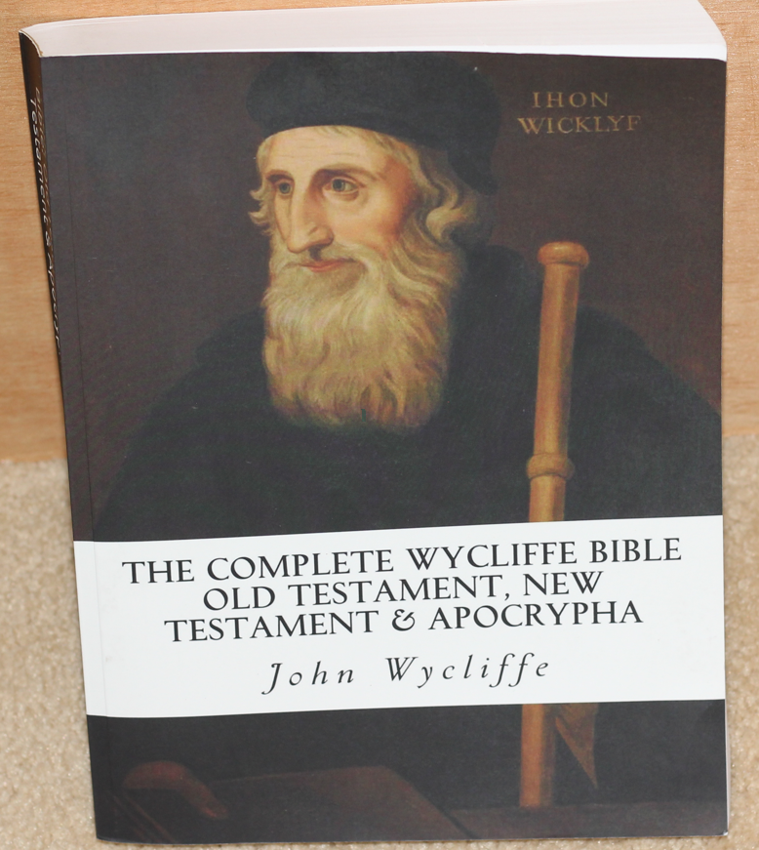
Translation of New testament from Latin to English
John Wycliffe
John Wycliffe Wycliffe’s Bible is available as a typeset version of his work.
The words are of late middle English and have spellings and vernacular that may be strange to us. (uses modern letters)
Although based on the Vulgate the story of Jesus is clear.
This translation was a powerful tool of enlightenment and a shift from tradition to scripture.
AD 1
500
1000
1500
2000

Slide 21
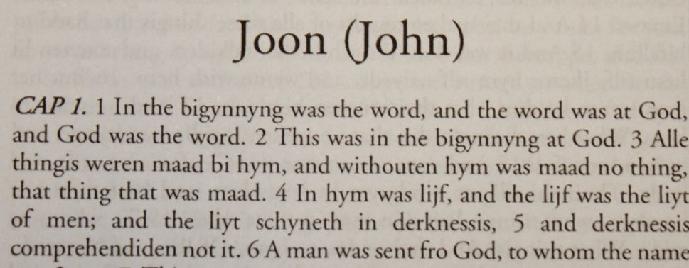
Translation of New testament from Latin to English
What could the Lollards do with this ?
John Wycliffe
AD 1
500
1000
1500
2000
Notes:
Wycliffe's writings in Latin greatly influenced the philosophy and teaching of the Czech reformer Jan Hus (c. 1369–1415), whose execution in 1415 sparked a revolt and led to the Hussite Wars of 1419–1434.

Slide 22
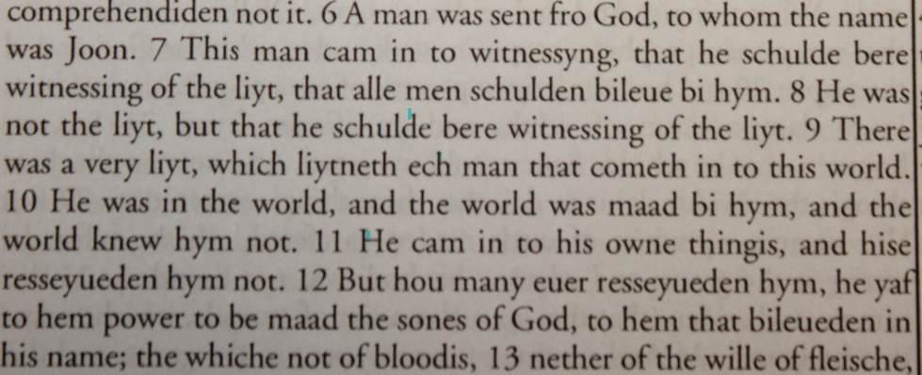
Translation of New testament from Latin to English
What could the Lollards do with this ?
John Wycliffe
AD 1
500
1000
1500
2000
Notes:
Wycliffe's writings in Latin greatly influenced the philosophy and teaching of the Czech reformer Jan Hus (c. 1369–1415), whose execution in 1415 sparked a revolt and led to the Hussite Wars of 1419–1434.

Slide 23
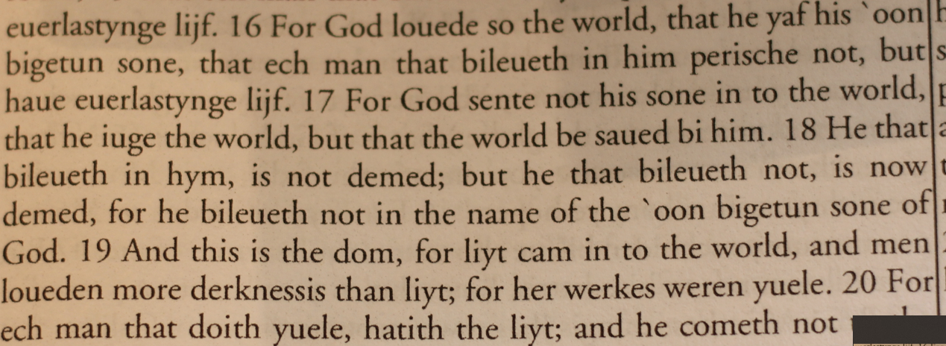
Translation of New testament from Latin to English
What could the Lollards do with this ? What can we do with this ?
John Wycliffe
AD 1
500
1000
1500
2000
Notes:
Wycliffe's writings in Latin greatly influenced the philosophy and teaching of the Czech reformer Jan Hus (c. 1369–1415), whose execution in 1415 sparked a revolt and led to the Hussite Wars of 1419–1434.

Slide 24
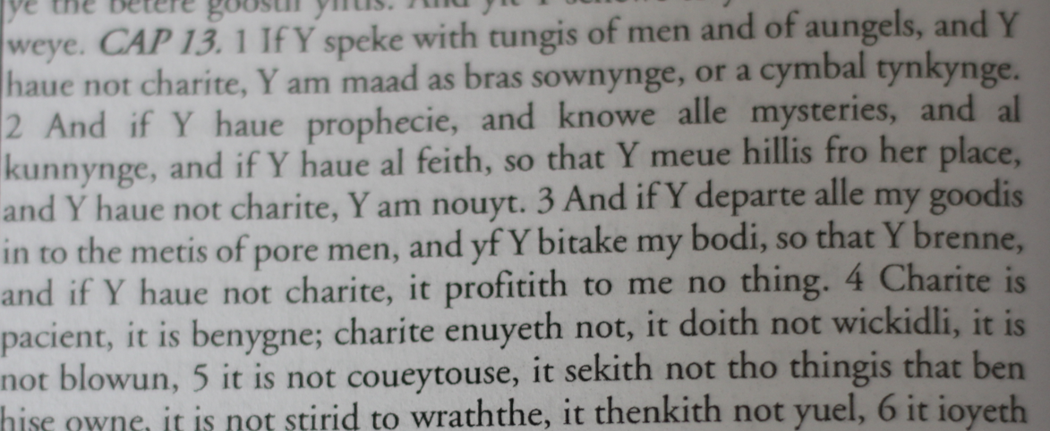
Translation of New testament from Latin to English
The agape issue.
John Wycliffe
AD 1
500
1000
1500
2000
Notes:
Wycliffe's writings in Latin greatly influenced the philosophy and teaching of the Czech reformer Jan Hus (c. 1369–1415), whose execution in 1415 sparked a revolt and led to the Hussite Wars of 1419–1434.

Slide 25
Translation of New testament from Latin to English
Translation from tradition.
John Wycliffe
Luther looking at this verse in Greek has an epiphany.
AD 1
500
1000
1500
2000
Notes:
Wycliffe's writings in Latin greatly influenced the philosophy and teaching of the Czech reformer Jan Hus (c. 1369–1415), whose execution in 1415 sparked a revolt and led to the Hussite Wars of 1419–1434.

Slide 26
Translation of New testament from Latin to English
John Wycliffe
As a matter of clarification, the translation work of this version of the Bible was not that solely of Wycliffe, but he was the motivating force.
He may have done as little as the Gospels and may have done as much as the New Testament.
John Wycliffe
AD 1
500
1000
1500
2000
Notes:
Wycliffe taught that Scripture, not church tradition, was the ultimate and final authority for God’s people.
Wycliffe became known as “the Morning Star of the Reformation.”

Slide 27
Historical Context
John Wycliffe
In the Late Middle Ages Europe experienced the deadliest disease outbreak in history when the Black Death, the infamous pandemic of bubonic plague, hit in 1347, killing one-third of the European human population. Some historians believe that society subsequently became more violent as the mass mortality rate cheapened life and thus increased warfare, crime, popular revolt, waves of flagellants, and persecution.
John Wycliffe
AD 1
500
1000
1500
2000
Notes:
Wycliffe taught that Scripture, not church tradition, was the ultimate and final authority for God’s people.
Wycliffe became known as “the Morning Star of the Reformation.”

Slide 28
Time Line
England
In 1408, in England, it became illegal to translate or read the Bible in common English without permission of a bishop.
AD 1
500
1000
1500
2000

Slide 29
Constantinople Largest and Richest city in Europe for over 1000 years
Founded 324 by roman Emperor Constantine
Capital of the Eastern Roman Empire
Byzantine Empire; 330–1204
Latin Empire (1204–1261) (In 1204, however, the armies of the Fourth Crusade took and devastated the city and, for several decades, its inhabitants resided under Latin occupation in a dwindling and depopulated city.
Byzantine Empire; 1261–1453. In 1261 the Byzantine Emperor Michael VIII Palaiologos liberated the city, and after the restoration under the Palaiologos dynasty, it enjoyed a partial recovery.
Ottoman Empire (1453–1922).

Slide 30
Constantinople Largest and Richest city in Europe for over 1000 years
Ottoman Empire (1453–1922).
With the advent of the Ottoman Empire in 1299, the Byzantine Empire began to lose territories and the city began to lose population. Between 1346 and 1349 the Black Death killed almost half of the inhabitants of Constantinople By the early 15th century, the Byzantine Empire was reduced to just Constantinople and its environs. The city was an enclave in the midst of the Ottoman Empire.
Mehmed II succeeded his father in 1451, he was just nineteen years old. (Europe was happy as they did not think he would be a good leader)

Slide 31
Constantinople Largest and Richest city in Europe for over 1000 years
He built forts up the Bosporus, Accumulated 60 huge cannons and built road from Adrianople to handle the massive movement of equipment.
Amassed .120,000 troupes for the siege.
6 April – 29 May 1453 (1 month, 3 weeks and 2 days) 1500 POUNS OF GUN POWER

Slide 32
The migration waves of Byzantine scholars and émigrés in the period following the sacking of Constantinople and the fall of Constantinople in 1453 is considered by many scholars key to the revival of Greek and Roman studies that led to the development of the Renaissance humanism
The refugees brought to Western Europe the far greater preserved and accumulated knowledge of Byzantine civilization.

Slide 33
86 years
Erasmus
145 years
980 years

Slide 34
Complutensian Polyglot Bible
In 1502 in Spain, Cardinal Francisco Jiménez de Cisneros had put together a team of Spanish translators to create a compilation of the Bible in four languages: Greek, Hebrew, Aramaic and Latin. (old testament)

Slide 35
Complutensian Polyglot Bible
The New Testament was completed and printed in 1514, but its publication was delayed while work on the Old Testament continued.

Slide 36
Complutensian Polyglot Bible
The New Testament was completed and printed in 1514, but its publication was delayed while work on the Old Testament continued.
In the meantime, word of the Complutensian project reached Desiderius Erasmus in Rotterdam, who produced his own printed edition of the Greek New Testament. Erasmus obtained an exclusive four-year publishing privilege from Emperor Maximilian and Pope Leo X in 1516.

Slide 37
Complutensian Polyglot Bible
The Complutensian Old Testament was completed in 1517. Because of Erasmus' exclusive privilege, publication of the Polyglot was delayed until Pope Leo X could sanction it in 1520. It is believed to have not been distributed widely before 1522. (six volumes 600 copies
Of note Cardinal Francisco Jiménez de Cisneros was also a Grand Inquisitor of Castile from 1507 to 1517 and archbishop of Toledo 1495 to 1517. We was a confessor for Isabella in 1492 and she secured a papal bull for him being archbishop.
Complutense University was located in Madrid.

Slide 38
Erasmus
Erasmus
Collected byzantine Greek Manuscripts
Created a parallel Greek - Latin Bible
Eventually there were a total of five editions.
Edition 2 was used by Martin Luther to translate the new testament into German
Edition 3 was used by William Tyndale
Desiderius Erasmus
1466 (1469) - 1536

Slide 39
Erasmus
Erasmus
Desiderius Erasmus is reported to have been born in Rotterdam on 28 October 1466.
He was the second illegitimate son of Roger Gerard.
Erasmus began his education at the age of 4, attending a school in Gouda, a town near Rotterdam.
When he was 9 years old, his father sent him to a prestigious Latin grammar school, where his natural academic ability blossomed.
Desiderius Erasmus
1466 (1469) - 1536

Slide 40
Erasmus
Erasmus
Parents die of the black death in 1843.
Guardians send him to a Catholic boarding school from age 13-16.
He counted these years as wasted
In 1492 ordained a Catholic priest, but it seems that he never actively worked as a cleric.
After his priestly ordination he was offered the post of secretary to the Bishop of Cambrai, Henry of Bergen.
Desiderius Erasmus
1466 (1469) - 1536

Slide 41
Erasmus
Erasmus
In 1495 with Bishop Henry's consent and a stipend, Erasmus went on to study at the University of Paris in the Collège de Montaigu.
In 1499 he was invited to England by William Blount, 4th Baron Mountjoy, who offered to accompany him on his trip to England.
Established a friendship with John Collet and Thomas More.
Erasumus taught at Oxford (1499) but he returned to continent to study Geek
Desiderius Erasmus
1466 (1469) - 1536

Slide 42
Erasmus
Erasmus
Had several years of scholarly study in Italy.
Collaborated with Collet to write Greek text books and helped find staff for new St. Pauls school headed by John Fisher.
1510-1515 Professor of divinity Queens Collage , Cambridge.
1512 Started work on the Greek / Latin parallel bible.
Desiderius Erasmus
1466 (1469) - 1536

Slide 43
Erasmus
1st Ed. 1516 Rushed effort and lack of editing made a book full of errors. Based on Miniscule 2
2st Ed. 1519 Used by Luther to translate NT into German.
3rd Ed. 1522 probably used by Tyndale for his English NT 1526 also the basis of the 1550 critical Greek text comparing Erasmus with the Complutensian Polyglot. (Editio Regia (Royal edition) by Robert Stephanus aka Robert Estienne) evolved into the Textus Receptus.
4th Ed. 1527 Parallel columns of Greek, Vulgate, Erasmus Latin
5th Ed. 1535 Vulgate removed.
Erasmus used manuscripts: 1, 1^{rK}, 2e, 2^{ap}, 4^{ap}, 7, 817
The TR continued revisions until 1633 but is mostly the work of Erasmus.

Slide 44
Erasmus Correspondence
Pope Adrian VI
Nicolaus Olahus
Henricus Afinius (Hendrik van den Eynde)
Georg Agricola
Heinrich Cornelius Agrippa
Cornelius Aurelius
Albert of Brandenburg
Faustus Andrelinus
William Blount, 4th Baron Mountjoy - pupil of Erasmus, who called him inter nobiles doctissimus.
William Budaeus
Henry Bullock (Bovillus)^{[1]}
William Burbank
Henry Byers
Lorenzo Campeggi
John Claymond
John Colet
Martin Dorp
Wolfgang Faber Capito
John Fisher
Richard Foxe
Duke Frederick of Saxony
Duke George of Saxony
Damião de Góis
Thomas Grey
William Grocyn

Slide 45
Erasmus Correspondence
Johannes Oecolampadius
Richard Pace
Johann Reuchlin
Beatus Rhenanus
Servatius Rogerus
Margaret Roper
Georg Spalatin
Peter Thaborita
Cuthbert Tunstall
Polydore Vergil
Juan Luis Vives
William Warham
Thomas Wolsey
Paracelsus
Nicolaas Everaerts
Henry VIII
Ulrich von Hutten
Justus Jonas
William Latimer
Edward Lee
Pope Leo X
Thomas Linacre
Maarten Lips
Thomas Lupset
Martin Luther
Aldus Manutius
Philip Melanchthon
Thomas More
Petrus Mosellanus

Slide 47
Take aways.
List of English Bible translations - Wikipedia

