Slide 1
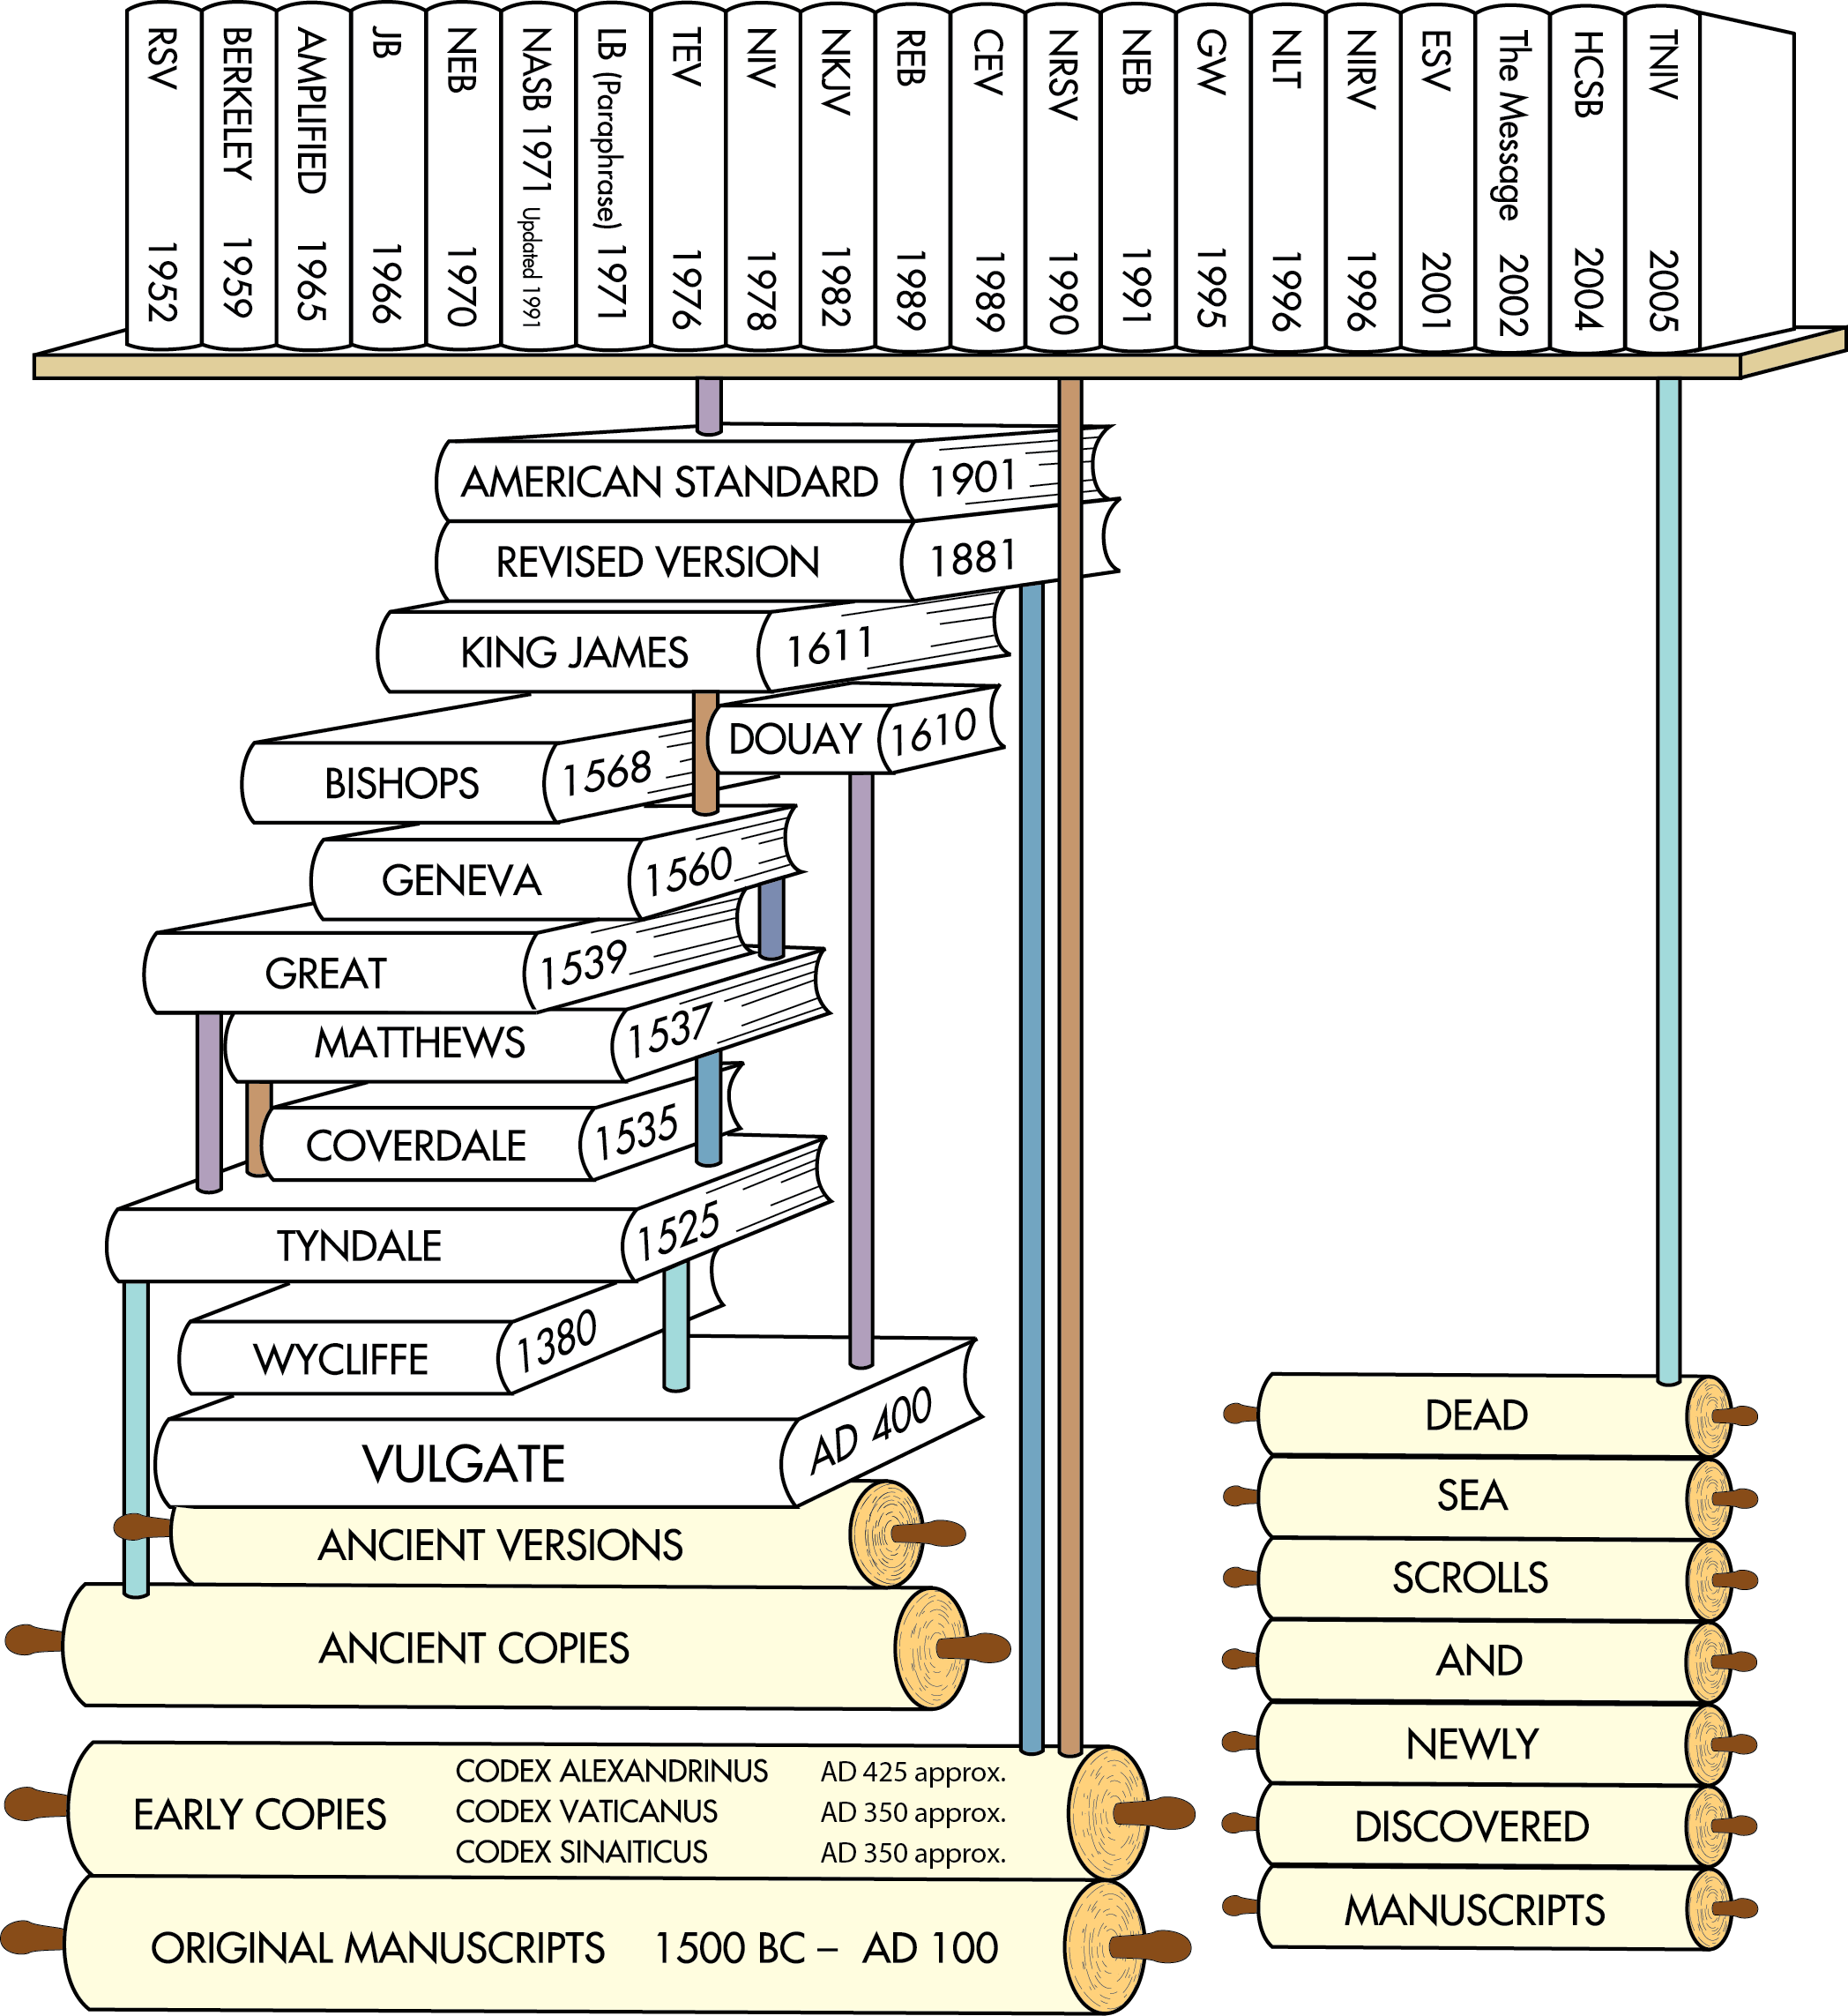
Translations after the discovery of the Dead Sea Scrolls
Translations after earlier ancient manuscripts were discovered in the 1700s and 1800s
English Translations from ancient versions and copies available at that time
Latin Translation
Chart does not include all English translations. Chart idea from Back to the Bible Broadcast, Lincoln NE..

Slide 2
HEXAPLA Old Testament Greek
SEPTUIGENT Old Testament Greek
Hebrew Text
Notes:
The Septuagint and the Hexapla have been inserted into the chart as these are important documents linking the old Hebrew text to Greek as related to the old testament

Slide 3
Books not included in the Protestant Old Testament in blue.
Orthodox Old Testament
Roman Catholic Old Testament
Genesis
Exodus
Leviticus
Numbers
Deuteronomy
Joshua
Judges
Ruth
1 Samuel
2 Samuel
1 Kings
2 Kings
1 Chronicles
2 Chronicles
1 Esdras
Ezra
Nehemiah
Esther (additions)
Judith
Tobit
1 Maccabees
2 Maccabees
3 Maccabees
Psalms (plus Ps. 151)
Prayer of Manasseh
Job
Proverbs
Ecclesiastes
Song of Songs
Wisdom of Solomon
Sirach (Ecclesiasticus)
Hosea
Amos
Micah
Joel
Obadiah
Jonah
Nahum
Habakkuk
Zephaniah
Haggai
Zechariah
Malachi
Isaiah
Jeremiah
Baruch
Lamentations
Letter of Jeremiah
Ezekiel
Daniel (includes Susanna; Bel and the Dragon)
4 Maccabees (in appendix)
Malachi
Genesis
Exodus
Leviticus
Numbers
Deuteronomy
Joshua
Judges
Ruth
1 Samuel
2 Samuel
1 Kings
2 Kings
1 Chronicles
2 Chronicles
Ezra
Nehemiah
Tobit
Judith
Esther (additions)
1 Maccabees
2 Maccabees
Job
Psalms
Proverbs
Ecclesiastes
Song of Songs
Wisdom of Solomon
Sirach (Ecclesiasticus)
Isaiah
Jeremiah
Lamentations
Baruch (includes letter of Jeremiah)
Ezekiel
Daniel (includes Susanna; Bel and the Dragon)
Hosea
Joel
Amos
Obadiah
Jonah
Micah
Nahum
Habakkuk
Zephaniah
Haggai
Zechariah
Malachi

Slide 4
Books not included in the Protestant Old Testament in blue.
Roman Catholic Old Testament
Ezra
Nehemiah
Tobit
Judith
Esther (additions)
1 Maccabees
2 Maccabees
Job
Psalms
Proverbs
Ecclesiastes
Song of Songs
Wisdom of Solomon
Sirach (Ecclesiasticus)
Isaiah
Jeremiah
Lamentations
Baruch (includes letter of Jeremiah)
Ezekiel
Daniel (includes Susanna; Bel and the Dragon)
Hosea

Slide 5
Books not included in the Protestant Old Testament in blue.
Orthodox Old Testament
2 Chronicles
1 Esdras
Ezra
Nehemiah
Esther (additions)
Judith
Tobit
1 Maccabees
2 Maccabees
3 Maccabees
Psalms (plus Ps. 151)
Prayer of Manasseh
Job
Proverbs
Ecclesiastes
Song of Songs
Wisdom of Solomon
Sirach (Ecclesiasticus)
Hosea
Amos
Micah
Joel
Obadiah
Jonah
Nahum
Habakkuk
Zephaniah
Haggai
Zechariah
Malachi
Isaiah
Jeremiah
Baruch
Lamentations
Letter of Jeremiah
Ezekiel
Daniel (includes Susanna; Bel and the Dragon)
4 Maccabees (in appendix)
Malachi

Slide 6
The 2 Maccabees was originally written in Koine Greek by an unknown diaspora Jew living in Hellenistic Egypt. It was likely written some time between 150 and 120 BC. Together with the book 1 Maccabees, it is one of the most important sources on the Maccabean Revolt.
Not a sequel to 1 Macabees - a different account.
Starts with Heridous a Seleucid official tzxing tempe im 176 BC. Ends with Battle of Adasa in 161 BC

Slide 7
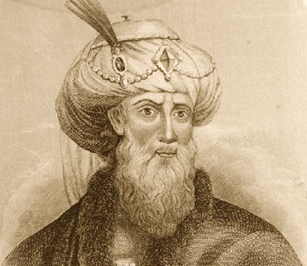
Old Testament Additions
Apocrypha
Evidence derived from 1st century AD Jewish writers, like Josephus, indicates that the Hebrew and Aramaic Bible never included the Apocrypha.
Josephus
37 -100 AD
AD 1
500
1000
1500
2000

Slide 8
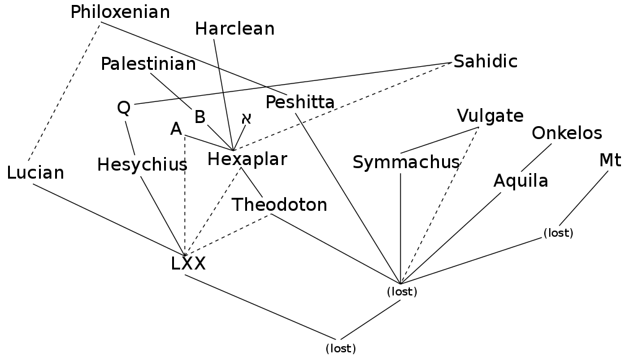
Codices א Sinaiticus A Alexandrinus
B Vaticanus
Q Marchalianus
Mt Track
LXX - Septuagint Mt Masoretic Text
Notes:
he relationships among the various ancient manuscripts of the Old Testament, according to the Encyclopaedia Biblica.^{[page needed]} Dotted pale blue lines indicate texts which were used to correct the main source. The isolated letters are standard siglums designating particularly significant manuscripts: א [aleph] = Codex Sinaiticus A = Codex Alexandrinus B = Codex Vaticanus Q = Codex Marchalianus In addition, the standard abbreviations: MT = Masoretic Text LXX = Septuagint - in this diagram, this refers to the original version of the Septuagint (as opposed to Lucian, Heysicius, Hexaplar, A, B, X [aleph], etc., the Old Testaments/Hebrew Bibles of which are commonly also called Septuagint) See also File:ATtextgeschichte farb.jpg

Slide 9
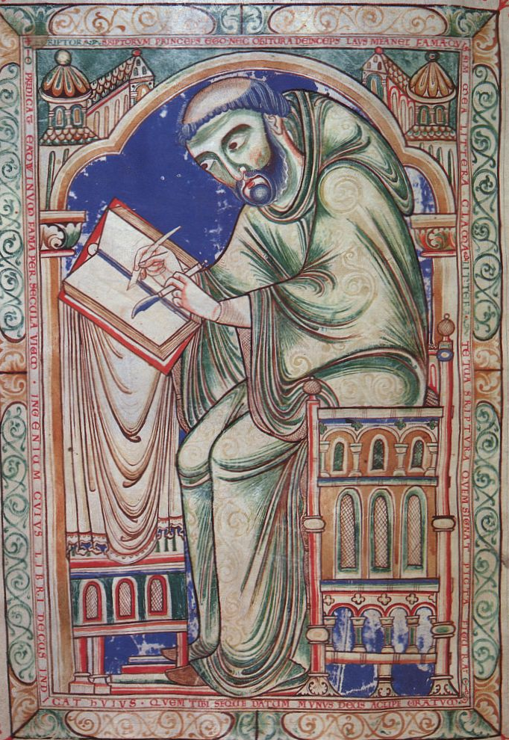
Time Line
Masoretes
Masoretes were Jewish scribes who preserved the Hebrew and Aramaic Scriptures (AD 400–1000).
Hebrew and Aramaic have no written vowels. Masoretes added accents and vowel markings (“vowel points”) to guide readers.
AD 1
500
1000
1500
2000

Slide 10
Time Line
Masoretes
Masoretes kept statistics about:
How often certain words were used.
Differences (variants) in the manuscripts.
Number of words in each book and section of the Scriptures.
The Old Testament preserved by the Masoretes is known today as the Masoretic Text.
500 BC
1500
2000
AD 1
500
1000

Slide 11
Take note there are many more Greek translations than the Septuagint

Slide 12
HEXAPLA Old Testament Greek
SEPTUIGENT Old Testament Greek
Hebrew Text

Slide 13
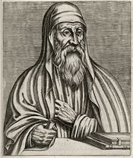
Origen 185 AD – 253AD
Born in Alexandria.
Catechetical School of Alexandria
May have been Dean of school succeeding Clement of Alexandria.
Compiled Hexapla
Wrote over 2000 Christian Treatises
Formed Christian school in Caesarea

Slide 14
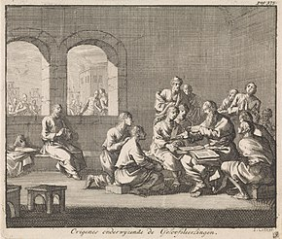
Origen 185 AD – 253 AD
Founded Christian school in Caesarea.
Taught :Logic, Cosmology, Natural History, Theology.
Regarded by churches of Palestine and Arabia as the ultimate authority on all matters of theology. Tortured during Decian persecution 250 died 3 years later from injuries.
The Hexapla may have been destroyed during Arab invasion 653 AD

Slide 15
Desius new Roman Leader 249 Loyalty Oath
The Decian persecution of Christians occurred in 250 AD under the Roman Emperor Decius. He had issued an edict ordering everyone in the Empire to perform a sacrifice to the Roman gods and the well-being of the emperor. The sacrifices had to be performed in the presence of a Roman magistrate, and be confirmed by a signed and witnessed certificate from the magistrate. Although the text of the edict has been lost, many examples of the certificates have survived. (Jews were exempt)

Slide 16
ORIGEN HEXAPLA
The Hexapla is a critical comparison of Greek and Hebrew
text written in six parallel columns written over 7000 pages.
40 year Effort Ended Up in Caesarea. Destroyed apx. 600
1. Hebrew Text
4.Symmachus the Ebionite
2. Hebrew Transliterated to Greek
5.Recension of Septuagint
3. Aquia of Sinpoe
6. Theodotion

Slide 17
Codices א Sinaiticus A Alexandrinus
B Vaticanus
Q Marchalianus
LXX - Septuagint Mt Masoretic Text
Notes:
he relationships among the various ancient manuscripts of the Old Testament, according to the Encyclopaedia Biblica.^{[page needed]} Dotted pale blue lines indicate texts which were used to correct the main source. The isolated letters are standard siglums designating particularly significant manuscripts: א [aleph] = Codex Sinaiticus A = Codex Alexandrinus B = Codex Vaticanus Q = Codex Marchalianus In addition, the standard abbreviations: MT = Masoretic Text LXX = Septuagint - in this diagram, this refers to the original version of the Septuagint (as opposed to Lucian, Heysicius, Hexaplar, A, B, X [aleph], etc., the Old Testaments/Hebrew Bibles of which are commonly also called Septuagint) See also File:ATtextgeschichte farb.jpg

Slide 18
Classical Syriac
Polycarp
Aramaic
Classical Syriac
Latin Track
Jerome using Hexapla
Codices א Sinaiticus A Alexandrinus
B Vaticanus
Q Marchalianus
Hebrew Track
LXX - Septuagint Mt Masoretic Text

Slide 19
Classical Syriac
Polycarp
Aramaic
Classical Syriac
Latin Track
Jerome using Hexapla
Codices א Sinaiticus A Alexandrinus
B Vaticanus
Q Marchalianus
Hebrew Track
LXX - Septuagint Mt Masoretic Text

Slide 20
HEXAPLA Old Testament Greek ~240
Original New Testament Greek ~50-~100
SEPTUIGENT Old Testament Greek
Hebrew Text

Slide 21
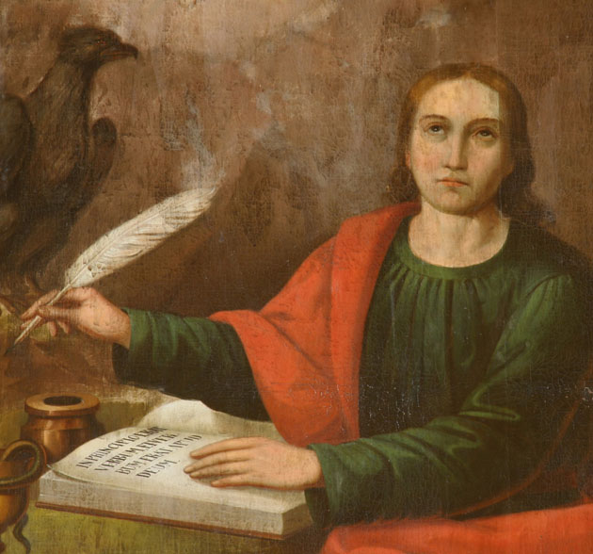
Forming the New Testament
Followers of Jesus
Eyewitnesses of the risen Lord Jesus and their close associates wrote:
Accounts of the life of Jesus (Gospels) written by Matthew, Mark, Luke, and John.
History of the early church (Acts) written by Luke.
The Apostle John
AD 1
500
1000
1500
2000

Slide 22
Forming the New Testament
Followers of Jesus
Letters (epistles) to churches and to individual Christians written by Paul, Peter, John, and others.
An apocalypse, known as Revelation, written by John.
The Apostle John
AD 1
500
1000
1500
2000

Slide 23
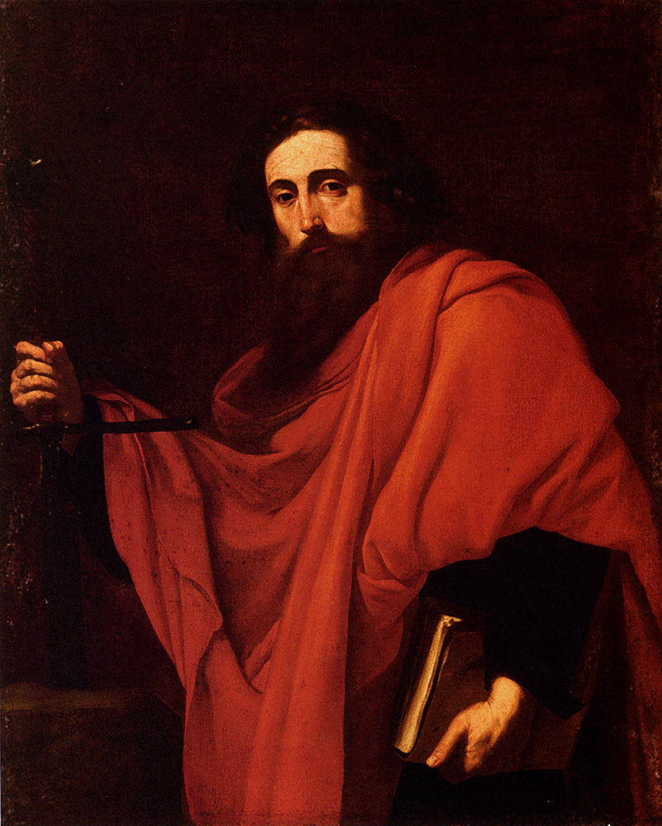
Forming the New Testament
Followers of Jesus
They quote from all but eight of the books found in the Hebrew and Aramaic Old Testament.
Their writings became known by the end of the 100s AD as the “New Covenant” or “New Testament.”
The Apostle Paul
AD 1
500
1000
1500
2000

Slide 24
Forming the New Testament
Followers of Jesus
“New Testament” or “New Covenant” refers to the covenant that God promised in Jeremiah 31:31–34:
“‘The days are coming,’ declares the Lord, ‘when I will make a new covenant with the people of Israel and with the people of Judah.’”—Jeremiah 31:31
AD 1
500
1000
1500
2000
Notes:
See also Luke 22:20, 1 Corinthians 11:25, and the letter to the Hebrews.

Slide 25
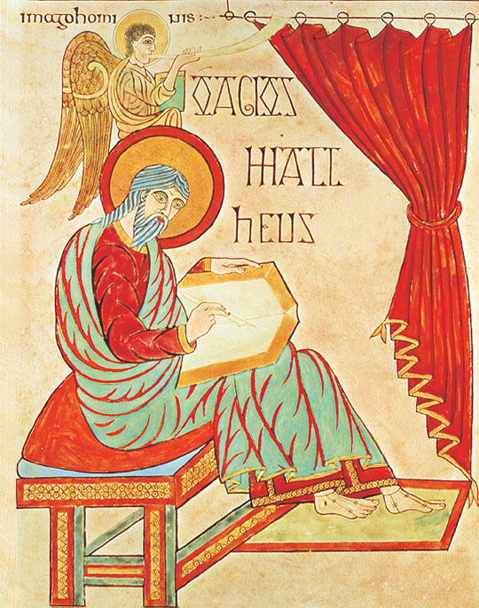
Forming the New Testament
Books of the New Testament
Church leaders received the writings of the apostles and their close associates as canonical.
Canon is from a Greek word referring to standard of faith.
Matthew writing his Gospel
AD 1
500
1000
1500
2000

Slide 26
Forming the New Testament
Books of the New Testament
Texts that seem to have been universally recognized as authoritative from the very beginning were:
The four Gospels
Acts
Paul’s letters
At least one of John’s letters
Matthew writing his Gospel
AD 1
500
1000
1500
2000

Slide 27
An example of canonical Issue
In his Church History, Eusebius writes that Bishop Serapion of Antioch had been informed that a Christian community in Rhosus was using the Gospel of Peter in their liturgy and had sent a letter authorizing them to do so, while also denying that such Gospel was actually written by Saint Peter. Later, however, Serapion was informed that the Gospel of Peter "hid a heresy", which he attributed to Marcian of Rhossos and that he identified with docetism. Serapion reports that he read the Gospel carefully and had the opportunity "to find, along with much of the Savior's true doctrine, some additions".

Slide 28
Eusebius of Caesarea 260/265 – 30 May 339
Greek historian of Christianity wrote the Ecclesiastical History.
Wrote a book on Christian apologetics Preparations for the Gospel
He also produced a biographical work on Constantine the Great
Eusebius divided his edition of the New Testament into paragraphs and provided it with a synoptical table so that it might be easier to find the pericopes that belong together. These canon tables or "Eusebian canons" remained in use throughout the Middle Ages,

Slide 29
Eusebius of Caesarea 260/265 – 30 May 339
Through the activities of the theologian Origen (185/6–254) and the school of his follower Pamphilus (later 3rd century – 309), Caesarea became a center of Christian learning. Origen was largely responsible for the collection of usage information, or which churches were using which gospels, regarding the texts which became the New Testament. The information used to create the late-fourth-century Easter Letter, which declared accepted Christian writings, was probably based on the Ecclesiastical History ] [HE] of Eusebius of Caesarea, wherein he uses the information passed on to him by Origen to create both his list at HE 3:25 and Origen's list at HE 6:25

Slide 30
Eusebius of Caesarea 260/265 – 30 May 339
Eusebius got his information about what texts were accepted by the third-century churches throughout the known world, a great deal of which Origen knew of firsthand from his extensive travels, from the library and writings of Origen.

Slide 31
Eusebius of Caesarea 260/265 – 30 May 339
At the Concil of Nicaea. Constantine had invited all 1,800 bishops of the Christian church within the Roman Empire (about 1,000 in the East and 800 in the West), but a smaller and unknown number attended. Eusebius of Caesarea counted more than 250,[

Slide 32
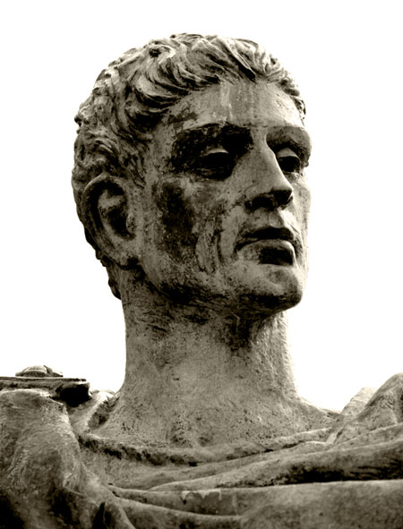
Time Line
Books of the New Testament
The books of the New Testament had already circulated throughout the known world by the time the Emperor Constantine allowed Christians to practice their religion freely in AD 313.
Emperor Constantine had no impact or influence on which books became part of the Bible.
Emperor Constantine
AD 1
500
1000
1500
2000

Slide 33
Time Line
Books of the New Testament
By the 400s AD, a consensus had emerged throughout the churches:
27 books could be traced to the testimony of apostolic eyewitnesses and their close associates.
This consensus was confirmed by:
Church fathers such as Athanasius, Jerome, and Augustine.
Three church councils, including the Synod of Carthage in AD 397.
AD 1
500
1000
1500
2000

Slide 34
HEXAPLA Old Testament Greek
SEPTUIGENT Old Testament Greek
Hebrew Text

Slide 35
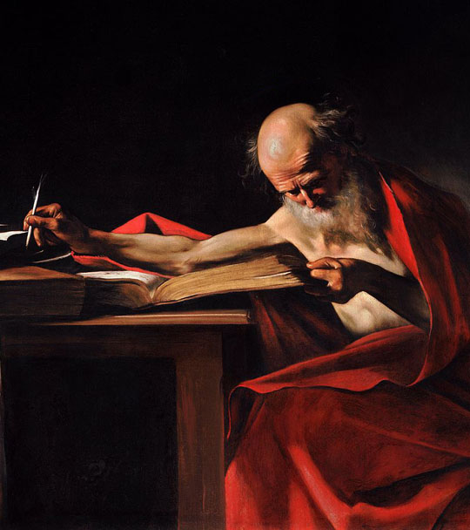
Jerome
Latin Vulgate circa 405 SUMMARY
Jerome began translating the Scriptures into Latin in AD 382 and finished 23 years later.
This translation became known as the Latin Vulgate, from vulgo, “to make common, accessible.”
For centuries, it remained the official Bible of churches in fellowship with the bishop of Rome.
Jerome
Jerome
345-420
Notes:
Translation of the Bible (382–405)[edit]
Saint Jerome Writing, by Michelangelo Merisi da Caravaggio, 1607, at St John's Co-Cathedral, Valletta, Malta
Jerome was a scholar at a time when that statement implied a fluency in Greek. He knew some Hebrew when he started his translation project, but moved to Jerusalem to strengthen his grip on Jewish scripture commentary. A wealthy Roman aristocrat, Paula, funded his stay in a monastery in Bethlehem and he completed his translation there. He began in 382 by correcting the existing Latin-language version of the New Testament, commonly referred to as the Vetus Latina. By 390 he turned to translating the Hebrew Bible from the original Hebrew, having previously translated portions from the Septuagint which came from Alexandria. He believed that the mainstream Rabbinical Judaism had rejected the Septuagint as invalid Jewish scriptural texts because of what were ascertained as mistranslations along with its Hellenistic heretical elements.^{[c]} He completed this work by 405. Prior to Jerome's Vulgate, all Latin translations of the Old Testament were based on the Septuagint, not the Hebrew. Jerome's decision to use a Hebrew text instead of the previous-translated Septuagint went against the advice of most other Christians, including Augustine, who thought the Septuagint inspired. Modern scholarship, however, has sometimes cast doubts on the actual quality of Jerome's Hebrew knowledge. Many modern scholars believe that the Greek Hexapla is the main source for Jerome's "iuxta Hebraeos" (i.e. "close to the Hebrews", "immediately following the Hebrews") translation of the Old Testament.^{[23]} However, detailed studies have shown that to a considerable degree Jerome was a competent Hebraist.^{[24]}
Commentaries (405–420)[edit]
St Jerome in His Study by Antonello da Messina
For the next 15 years, until he died, Jerome produced a number of commentaries on Scripture, often explaining his translation choices in using the original Hebrew rather than suspect translations. His patristic commentaries align closely with Jewish tradition, and he indulges in allegorical and mystical subtleties after the manner of Philo and the Alexandrian school. Unlike his contemporaries, he emphasizes the difference between the Hebrew Bible "Apocrypha" and the Hebraica veritas of the protocanonical books. In his Vulgate's prologues, he describes some portions of books in the Septuagint that were not found in the Hebrew as being non-canonical (he called them apocrypha);^{[25]} for Baruch, he mentions by name in his Prologue to Jeremiah and notes that it is neither read nor held among the Hebrews, but does not explicitly call it apocryphal or "not in the canon".^{[26]} His Preface to the Books of Samuel and Kings^{[27]} (commonly called the Helmeted Preface) includes the following statement:
This preface to the Scriptures may serve as a "helmeted" introduction to all the books which we turn from Hebrew into Latin, so that we may be assured that what is not found in our list must be placed amongst the Apocryphal writings. Wisdom, therefore, which generally bears the name of Solomon, and the book of Jesus, the Son of Sirach, and Judith, and Tobias, and the Shepherd are not in the canon. The first book of Maccabees I have found to be Hebrew, the second is Greek, as can be proved from the very style.
Jerome in the desert, tormented by his memories of the dancing girls, by Francisco de Zurbarán, 1639, Monastery of Santa María de Guadalupe
Jerome's commentaries fall into three groups:
Historical and hagiographic writings[edit]
Description of vitamin A deficiency[edit]
The following passage, taken from Jerome's Life of St. Hilarion which was written about 392, appears to be the earliest account of the etiology, symptoms and cure of severe vitamin A deficiency:^{[28]}
From his thirty-first to his thirty-fifth year he had for food six ounces of barley bread, and vegetables slightly cooked without oil. But finding that his eyes were growing dim, and that his whole body was shrivelled with an eruption and a sort of stony roughness (impetigine et pumicea quad scabredine) he added oil to his former food, and up to the sixty-third year of his life followed this temperate course, tasting neither fruit nor pulse, nor anything whatsoever besides.^{[28]}
Letters[edit]
Saint Jerome by Matthias Stom, 1635
Jerome's letters or epistles, both by the great variety of their subjects and by their qualities of style, form an important portion of his literary remains. Whether he is discussing problems of scholarship, or reasoning on cases of conscience, comforting the afflicted, or saying pleasant things to his friends, scourging the vices and corruptions of the time and against sexual immorality among the clergy,^{[29]} exhorting to the ascetic life and renunciation of the world, or debating his theological opponents, he gives a vivid picture not only of his own mind, but of the age and its peculiar characteristics. Because there was no distinct line between personal documents and those meant for publication, we frequently find in his letters both confidential messages and treatises meant for others besides the one to whom he was writing.^{[30]}
Due to the time he spent in Rome among wealthy families belonging to the Roman upper-class, Jerome was frequently commissioned by women who had taken a vow of virginity to write to them in guidance of how to live their life. As a result, he spent a great deal of his life corresponding with these women about certain abstentions and lifestyle practices.^{[7]}
Francesco St Jerome by Jacopo Palma il Giovane, c. 1595
Theological writings[edit]
The Virgin and Child with Saints Jerome and Nicholas of Tolentino by Lorenzo Lotto, 1522
Eschatology[edit]
Jerome in his study, made by the Flemish drawer de Bry.^{[31]}
Jerome warned that those substituting false interpretations for the actual meaning of Scripture belonged to the "synagogue of the Antichrist".^{[32]} "He that is not of Christ is of Antichrist," he wrote to Pope Damasus I.^{[33]} He believed that "the mystery of iniquity" written about by Paul in 2 Thessalonians 2:7 was already in action when "every one chatters about his views."^{[34]} To Jerome, the power restraining this mystery of iniquity was the Roman Empire, but as it fell this restraining force was removed. He warned a noblewoman of Gaul:^{[35]}
He that letteth is taken out of the way, and yet we do not realize that Antichrist is near. Yes, Antichrist is near whom the Lord Jesus Christ "shall consume with the spirit of his mouth". "Woe unto them," he cries, "that are with child, and to them that give suck in those days." ... Savage tribes in countless numbers have overrun all parts of Gaul. The whole country between the Alps and the Pyrenees, between the Rhine and the Ocean, has been laid waste by hordes of Quadi, Vandals, Sarmatians, Alans, Gepids, Herules, Saxons, Burgundians, Allemanni, and – alas! for the commonweal! – even Pannonians.
His Commentary on Daniel was expressly written to offset the criticisms of Porphyry,^{[36][full citation needed]} who taught that Daniel related entirely to the time of Antiochus IV Epiphanes and was written by an unknown individual living in the second century BC. Against Porphyry, Jerome identified Rome as the fourth kingdom of chapters two and seven, but his view of chapters eight and eleven was more complex. Jerome held that chapter eight describes the activity of Antiochus Epiphanes, who is understood as a "type" of a future antichrist; 11:24 onwards applies primarily to a future antichrist but was partially fulfilled by Antiochus. Instead, he advocated that the "little horn" was the Antichrist:
We should therefore concur with the traditional interpretation of all the commentators of the Christian Church, that at the end of the world, when the Roman Empire is to be destroyed, there shall be ten kings who will partition the Roman world amongst themselves. Then an insignificant eleventh king will arise, who will overcome three of the ten kings. ... After they have been slain, the seven other kings also will bow their necks to the victor.^{[37]}
In his Commentary on Daniel,^{[37]} he noted, "Let us not follow the opinion of some commentators and suppose him to be either the Devil or some demon, but rather, one of the human race, in whom Satan will wholly take up his residence in bodily form."^{[37]} Instead of rebuilding the Jewish Temple to reign from, Jerome thought the Antichrist sat in God's Temple inasmuch as he made "himself out to be like God."^{[37]}
Jerome identified the four prophetic kingdoms symbolized in Daniel 2 as the Neo-Babylonian Empire, the Medes and Persians, Macedon, and Rome.^{[37](ch. 2, vv. 31–40)} Jerome identified the stone cut out without hands as "namely, the Lord and Savior".^{[37](ch. 2, v. 40)}
Jerome refuted Porphyry's application of the little horn of chapter seven to Antiochus. He expected that at the end of the world, Rome would be destroyed, and partitioned among ten kingdoms before the little horn appeared.^{[37](ch. 7, v. 8)}
Jerome believed that Cyrus of Persia is the higher of the two horns of the Medo-Persian ram of Daniel 8:3.^{[37]} The he-goat is Greece smiting Persia.^{[37](ch. 8, v. 5)}
Reception by later Christianity[edit]
Statue of Saint Jerome, Bethlehem, Palestine Authority, West Bank
Jerome is the second-most voluminous writer – after Augustine of Hippo (354–430) – in ancient Latin Christianity. The Catholic Church recognizes him as the patron saint of translators, librarians, and encyclopedists.^{[38]}
Jerome translated many biblical texts into Latin from Hebrew, Aramaic, and Greek. His translations formed part of the Vulgate; the Vulgate eventually superseded the preceding Latin translations of the Bible (the Vetus Latina). The Council of Trent in 1546 declared the Vulgate authoritative "in public lectures, disputations, sermons, and expositions".^{[39][40]}
Jerome showed more zeal and interest in the ascetic ideal than in abstract speculation. He lived as an ascetic for 4~5 years in the Syrian desert, and later near Bethlehem for 34 years. Nevertheless, his writings show outstanding scholarship^{[41]} and his correspondence has great historical importance.^{[42]}
The Church of England honours Jerome with a commemoration on 30 September.^{[43]}
In art[edit]
Jerome is also often depicted with a lion, in reference to the popular hagiographical belief that Jerome had tamed a lion in the wilderness by healing its paw. The source for the story may actually have been the second century Roman tale of Androcles, or confusion with the exploits of Gerasimus (Jerome in later Latin is "Geronimus");^{[44][d]} it is "a figment" found in the thirteenth-century Golden Legend by Jacobus de Voragine.^{[45]} Hagiographies of Jerome talk of his having spent many years in the Syrian desert, and artists often depict him in a "wilderness", which for West European painters can take the form of a wood.^{[46]}
From the late Middle Ages, depictions of Jerome in a wider setting became popular. He is either shown in his study, surrounded by books and the equipment of a scholar, or in a rocky desert, or in a setting that combines both aspects, with him studying a book under the shelter of a rock-face or cave mouth. His study is often shown as large and well-provided for, he is often clean-shaven and well-dressed, and a cardinal's hat may appear. These images derive from the tradition of the evangelist portrait, though Jerome is often given the library and desk of a serious scholar. His attribute of the lion, often shown at a smaller scale, may be beside him in either setting. The subject of "Jerome Penitent" first appears in the later 15th century in Italy; he is usually in the desert, wearing ragged clothes, and often naked above the waist. His gaze is usually fixed on a crucifix and he may beat himself with his fist or a rock.^{[47]}
Jerome is often depicted in connection with the vanitas motif, the reflection on the meaninglessness of earthly life and the transient nature of all earthly goods and pursuits. In the 16th century Saint Jerome in his study by Pieter Coecke van Aelst and workshop, the saint is depicted with a skull. Behind him on the wall is pinned an admonition, Cogita Mori ("Think upon death"). Further reminders of the vanitas motif of the passage of time and the imminence of death are the image of the Last Judgment visible in the saint's Bible, the candle and the hourglass.^{[48]}
Jerome is also sometimes depicted with an owl, the symbol of wisdom and scholarship.^{[49]} Writing materials and the trumpet of final judgment are also part of his iconography.^{[49]}

Slide 36
Jerome
Born 342AD -347AD Died 420
Education: Catechetical School of Alexandria
Began translation of Old Testament from LXX and switched to using some Hebrew Texts.
Made Have used the Origen’s Hexapla for some of his work.
Jerome was known for his teachings on Christian moral life, especially to those living in cosmopolitan centers such as Rome.
Jerome
345-420
The Council of Trent in 1546 declared the Vulgate authoritative "in public lectures, disputations, sermons, and expositions.”

Slide 37
Jerome
Latin Vulgate circa 405
The Epistle of Jerome to Pope Damasus I written in 376 or 377 AD, is a response of Jerome to Pope Damasus I's letter urging him to make a new Latin translation of the four gospels, to replace the Vetus Latina translation. The letter predates the 382–405 period when Jerome worked on his translation, the Vulgate.
Jerome
345-420

Slide 38
Jerome
Epistle of Jerome to Pope Damasus I
In the epistle, Jerome agreed that the Vetus Latina translation of the four gospels should be revised and corrected, acknowledging the numerous differences between every Latin manuscript such that each one looked like its own version. To remedy the problem, Jerome agreed that they should be corrected on the basis of the Greek manuscripts (Greek New Testament). Jerome explained why the old Latin order of the Gospels (Matthew, John, Luke, Mark) should be changed to Matthew, Mark, Luke, John, because it is the order of the Greek manuscripts. He also explained the importance of the Eusebian Canons and how to use them.
Jerome
345-420

Slide 39
Jerome
Epistle of Jerome to Pope Damasus I
In the epistle, Jerome agreed that the Vetus Latina translation of the four gospels should be revised and corrected, acknowledging the numerous differences between every Latin manuscript such that each one looked like its own version. To remedy the problem, Jerome agreed that they should be corrected on the basis of the Greek manuscripts (Greek New Testament).
Jerome
345-420

Slide 40
Jerome
Epistle of Jerome to Pope Damasus I
Jerome explained why the old Latin order of the Gospels (Matthew, John, Luke, Mark) should be changed to Matthew, Mark, Luke, John, because it is the order of the Greek manuscripts. He also explained the importance of the Eusebian Canons and how to use them.
Jerome
345-420

Slide 41
Jerome
Epistle of Jerome to Pope Damasus I
Jerome’s letter was included in the preface of some bibles to explain the motivation behind the translation.
The beginning of the Epistle in Codex Sangallensis and in Codex Beneventanus

Slide 42
Jerome
Latin Vulgate circa 405
Prior to Jerome's Vulgate, all Latin translations of the Old Testament were based on the Septuagint, not the Hebrew. Jerome's decision to use a Hebrew text instead of the previous-translated Septuagint went against the advice of most other Christians, including Augustine, who thought the Septuagint inspired.
Jerome
345-420

Slide 43
Jerome
Latin Vulgate circa 405
Modern scholarship, however, has sometimes cast doubts on the actual quality of Jerome's Hebrew knowledge. Many modern scholars believe that the Greek Hexapla is the main source for Jerome's "iuxta Hebraeos" (i.e. "close to the Hebrews", "immediately following the Hebrews") translation of the Old Testament.
Jerome
345-420

Slide 44
HEXAPLA Old Testament Greek
SEPTUIGENT Old Testament Greek
Hebrew Text

Slide 45
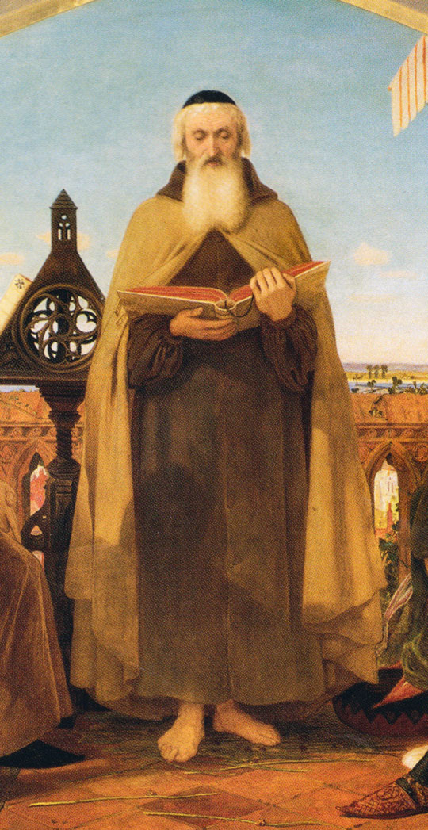
Time Line
John Wycliffe
The first complete English Bible was translated from Latin in 1382.
This project was inspired by a priest named John Wycliffe and perhaps overseen by him as well.
Wycliffe had wanted the people of England to have the Bible in their language.
John Wycliffe
AD 1
500
1000
1500
2000

Slide 46
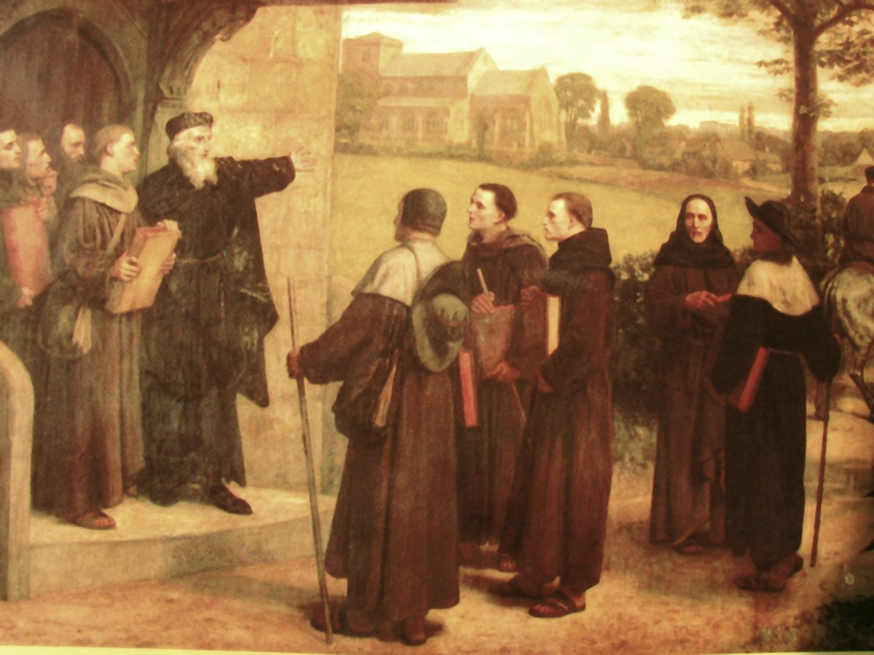
Time Line
John Wycliffe
Wycliffe taught that Scripture, not church tradition, was the ultimate and final authority for God’s people.
Wycliffe became known as “the Morning Star of the Reformation.”
Wycliffe Preaching
AD 1
500
1000
1500
2000

Slide 47
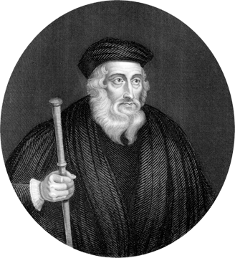
Time Line
John Wycliffe
His followers, ridiculed as Lollards (“mumblers”), included some of his criticisms of church traditions in the preface to the Wycliffe Bible.
This Bible was banned and burned.
In 1428, 44 years after Wycliffe’s death, his bones were exhumed and burned for heresy.
John Wycliffe
AD 1
500
1000
1500
2000

Slide 48
Time Line
England
In 1408, in England, it became illegal to translate or read the Bible in common English without permission of a bishop.
AD 1
500
1000
1500
2000

Slide 49
Codex Sinaiticus
The Codex Sinaiticus It is a fourth-century Christian manuscript of a Greek Bible, containing the majority of the Greek Old Testament, including the Apocrypha, and the Greek New Testament, with both the Epistle of Barnabas and the Shepherd of Hermas included. It is written in uncial letters on parchment. It is one of the four great uncial codices.

Slide 50
Codex Sinaiticus
Along with Codex Alexandrinus and Codex Vaticanus, it is one of the earliest and most complete manuscripts of the Bible, and contains the oldest complete copy of the New Testament. It is a historical treasure and using the study of comparative writing styles (palaeography), it has been dated to the mid-4th century.

Slide 51
Codex Sinaiticus
Until Biblical scholar (and manuscript hunter) Constantin von Tischendorf's discovery of Codex Sinaiticus in 1844, the Greek text of Codex Vaticanus was unrivalled. Since its discovery, study of Codex Sinaiticus has proven to be useful to scholars for critical studies of the biblical text.
Codex Sinaiticus came to the attention of scholars in the 19th century at Saint Catherine's Monastery in the Sinai Peninsula

Slide 52
Checkup
What is an uncial?
What is a minuscule?
What is a majuscule?
When was the Codex Sinaiticus written?
By what method is the date assigned?
By whom, when and where was it discovered?

Slide 53
Codex Sinaiticus
https://codexsinaiticus.org/
https://www.blueletterbible.org/

Slide 54
John 1:1
https://www.blueletterbible.org/
1:1 Ἐν ἀρχῇ ἦν ὁ λόγος
καὶ ὁ λόγος ἦν πρὸς τὸν θεόν
καὶ θεὸς ἦν ὁ λόγος

Slide 55
Codex Sinaiticus
https://codexsinaiticus.org/

Slide 56
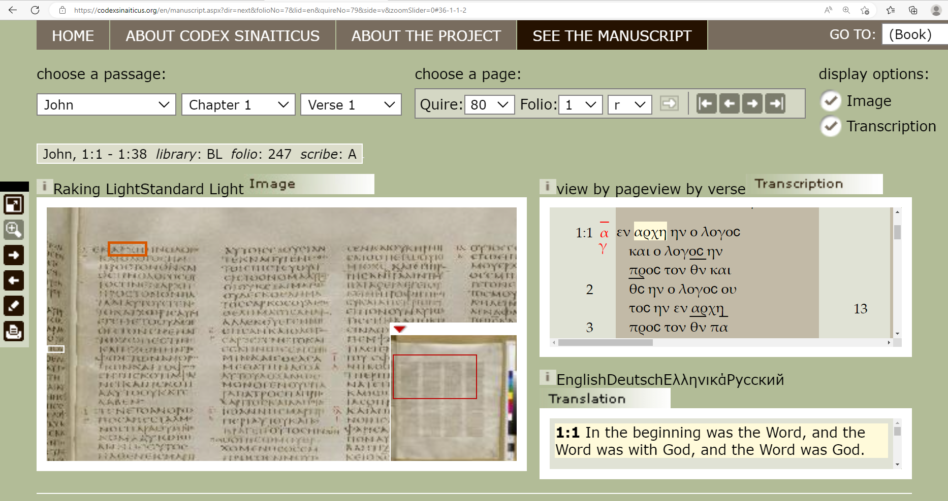
codexsinaiticus.org
Codex Sinaiticus - See The Manuscript | John |

Slide 57
Codex Sinaiticus
https://codexsinaiticus.org/

Slide 58
Codex Sinaiticus
https://codexsinaiticus.org/

Slide 59
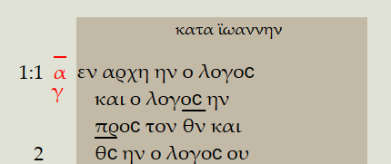
Codex Sinaiticus
https://codexsinaiticus.org/

Slide 60
Take aways.
You do not need to be a Greek scholar.
The researches continue to CONFIRM the bible.
The RSV was first to use the oldest Codices and no fundamental truths are changed..
P66 is a copy of John’s Gospel circa ~200 and it is the same Gospel.

Slide 61
Take aways.
List of English Bible translations - Wikipedia

