Slide 1
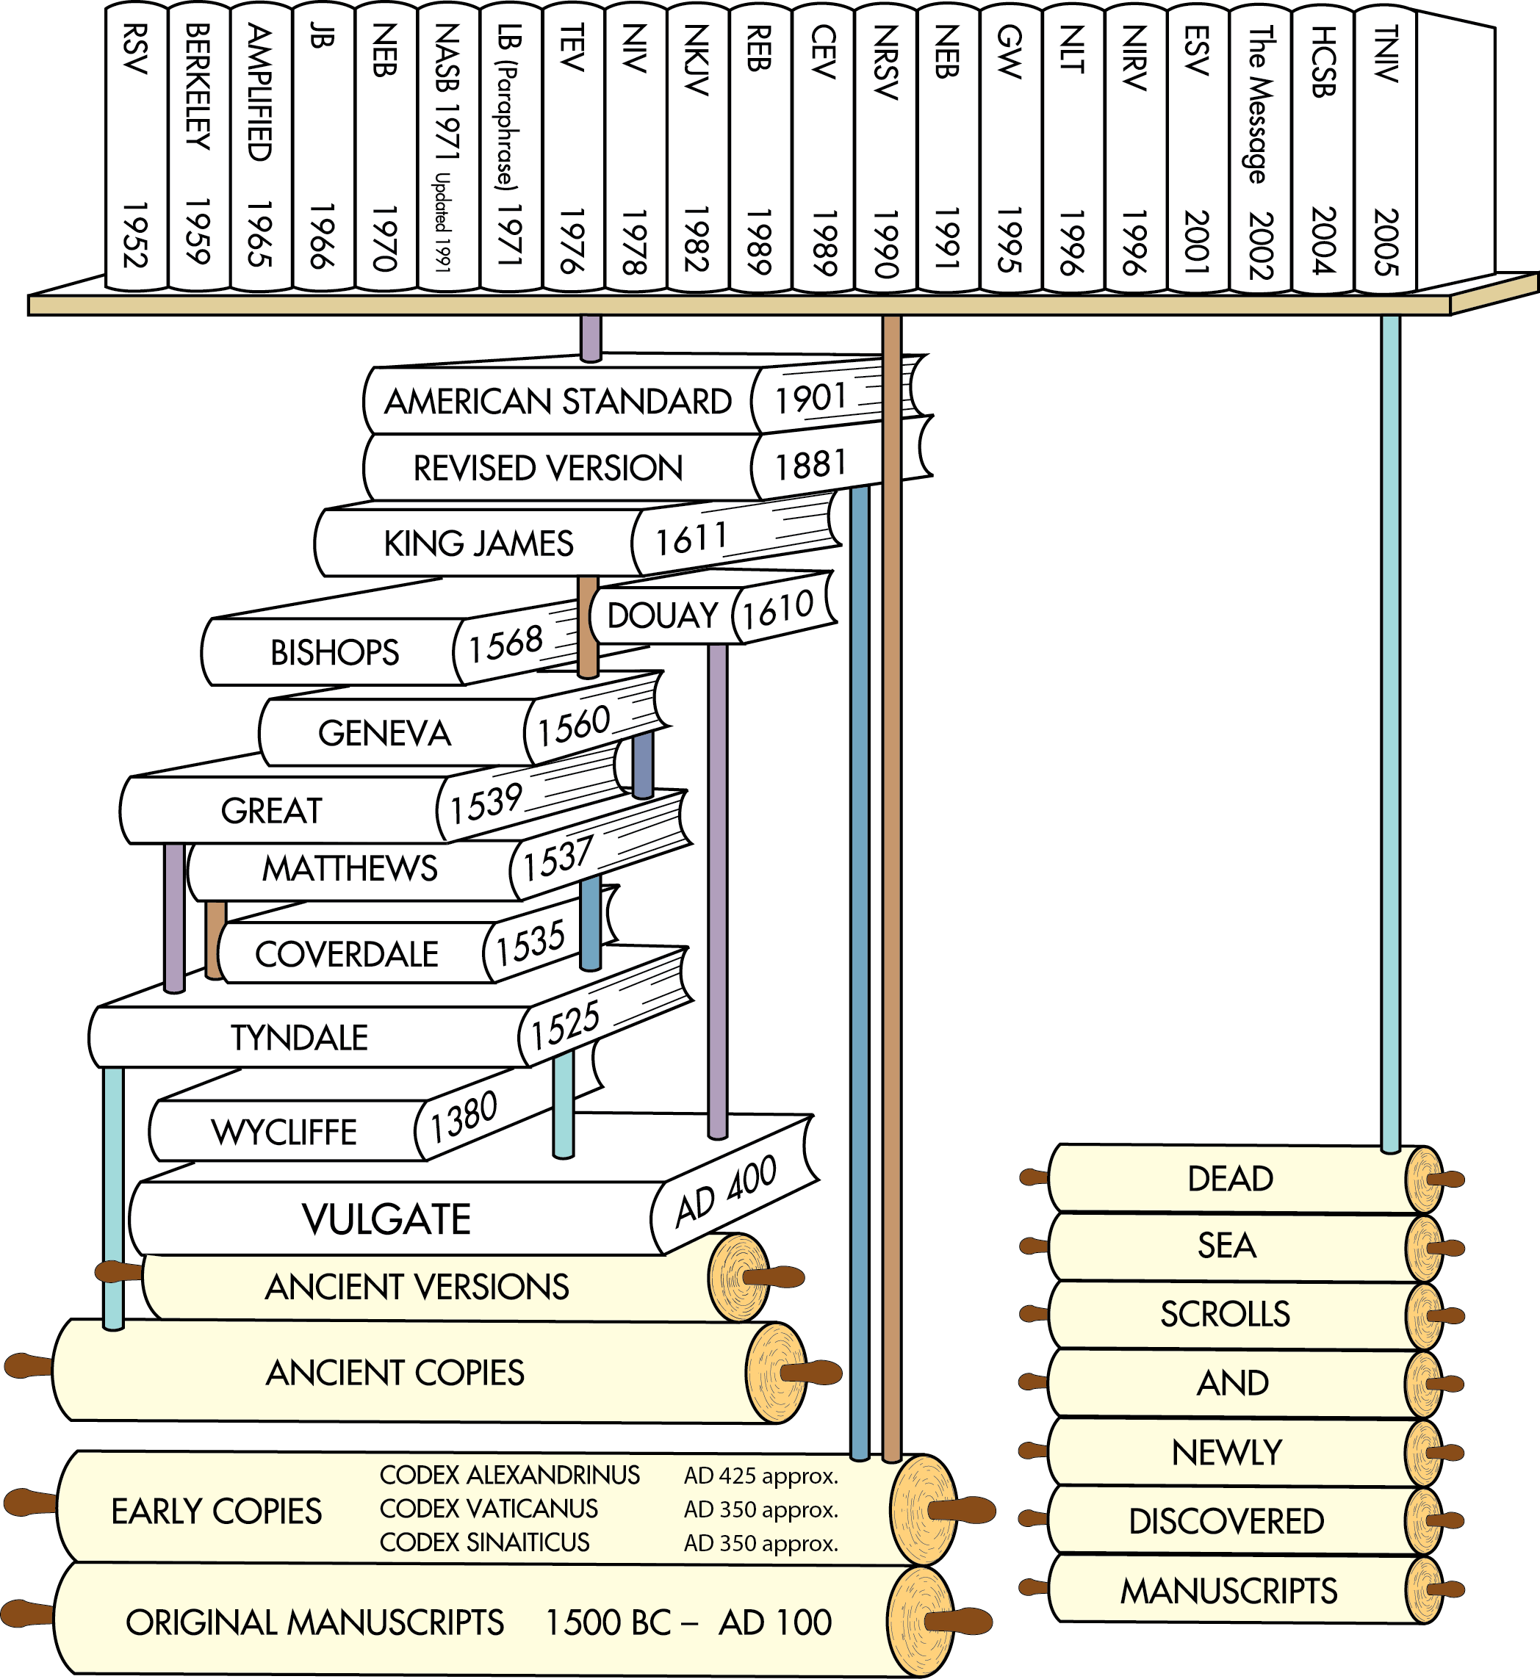
Translations after the discovery of the Dead Sea Scrolls
Translations after earlier ancient manuscripts were discovered in the 1700s and 1800s
English Translations from ancient versions and copies available at that time
Latin Translation
Chart does not include all English translations. Chart idea from Back to the Bible Broadcast, Lincoln NE..

Slide 3
HEXAPLA Old Testament Greek
SEPTUIGENT Old Testament Greek
Hebrew Text
Notes:
The Septuagint and the Hexapla have been inserted into the chart as these are important documents linking the old Hebrew text to Greek as related to the old testament

Slide 4
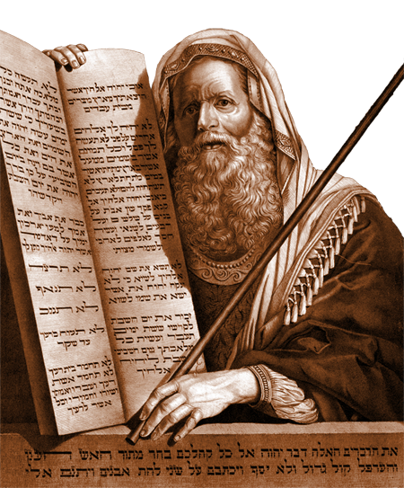
Old Testament
Old Testament
Old Testament events were written down in Hebrew (some portions in Aramaic) over centuries.
In Exodus, the Lord tells Moses to write in a book (Exodus 17:14; 24:4, 7).
2000 BC
1500 BC
1000 BC
500 BC
AD 1

Slide 5
Old Testament
Old Testament
Other Old Testament writers, inspired by God, include leaders, kings, and prophets.

Slide 6
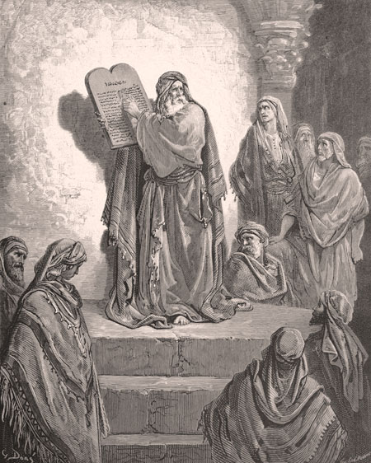
Old Testament
Old Testament
Ezra, a priest and scribe, may have collected and arranged the books of the Hebrew Bible, about 450 BC.
Ezra reading the law

Slide 7
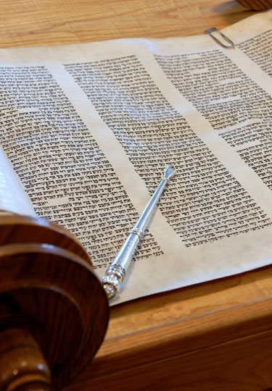
Old Testament
Old Testament
These writings were known as:
“the Law, the Prophets, and the Writings,”
“the Law, the Prophets, and David,”
Or simply, “the Law and the Prophets” (Luke 16:16; 24:44).
Paul referred to them as “the old covenant” or “old testament” (2 Corinthians 3:14).
2000 BC
1500 BC
1000 BC
500 BC
AD 1

Slide 8
HEXAPLA Old Testament Greek
SEPTUIGENT Old Testament Greek
Hebrew Text
Notes:
The Septuagint and the Hexapla have been inserted into the chart as these are important documents linking the old Hebrew text to Greek as related to the old testament

Slide 9
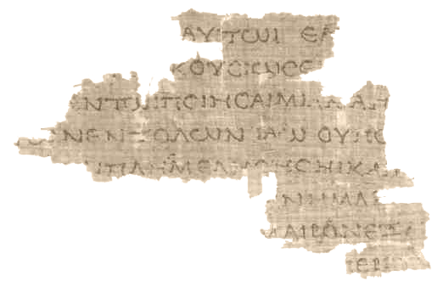
Old Testament Septuagint
Greek Translation
The Septuagint (sometimes referred to as the Greek Old Testament or The Translation of the Seventy, often abbreviated as LXX) is the earliest extant Greek translation of the Hebrew
Septuagint Fragment (4Q120, from Leviticus, 100s BC)
2000 BC
1500 BC
1000 BC
500 BC
AD 1

Slide 10
Old Testament Septuagint
Greek Translation
The Translation of the Seventy derives from the story recorded in the Letter of Aristeas to Philocrates that "the laws of the Jews" were translated into the Greek language at the request of Ptolemy II Philadelphus (285–247 BCE) by seventy-two Jewish translators—six from each of the Twelve Tribes of Israel.
Septuagint Fragment (4Q120, from Leviticus, 100s BC)

Slide 12
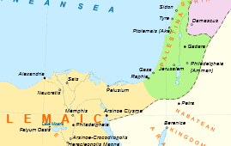

Slide 13
Alexandria the Great 356 BC -323 BC
Became leader on death of Philip II 336 (age 20)
Alexandria Founded 331 BC By Alexander the Great
Ptolemy gain control of Egypt 321..

Slide 14
Old Testament Septuagint
Greek Translation
Biblical scholars agree that the first five books of the Hebrew Bible were translated from Biblical Hebrew into Koine Greek by Jews living in the Ptolemaic Kingdom, probably in the early or middle part of the third century BC. The remaining books were presumably translated in the 2nd century BC.
Septuagint Fragment (4Q120, from Leviticus, 100s BC)
Notes:
Some targumim translating or paraphrasing the Bible into Aramaic were also made during the Second Temple period.^{[11]}
Among the Jewish community, few could speak and even fewer could read in the Hebrew language during the Second Temple period; Greek was the most widely spoken language at that time.^{[3][12][13][14]} The Septuagint therefore satisfied a need in the Jewish community.^{[8][15]}
Some scholars claim that the Septuagint includes only the books of the Pentateuch, while others claim it includes all twenty-four books of the Tanakh (5 books of the Torah, 8 books of the Nevi'im, and 11 books of the Ketuvim). Still others claim that the Septuagint includes not only all of the books of the Tanakh,^{[16]} but also several books (such as the Book of Tobit, the Books of the Maccabees, and the Book of Sirach)^{[17]} which are not recognized in the official Jewish canon.^{[18]} Modern critical editions of the Greek Old Testament are based on the Codices Alexandrinus, Sinaiticus, and Vaticanus.^{[citation needed]} There are important differences among these three versions. For example, the Codex Alexandrinus contains all four books of the Maccabees, the Codex Sinaiticus contains only 1 and 4 Maccabees, and the Codex Vaticanus contains none of the four books.^{[citation needed]}

Slide 15
Old Testament Septuagint
Benefit of a Greek translation of the Hebrew bible ?

Slide 16
Old Testament Septuagint Summary
Greek Translation
The Septuagint is a Greek translation of the Hebrew Bible (the Old Testament).
It was probably translated no later than the 100s BC by Jewish scholars in Alexandria, Egypt.
Septuagint Fragment (4Q120, from Leviticus, 100s BC)

Slide 17
Old Testament
Greek Translation
The word Septuagint means 70, referring to the legend that 70 or 72 Jewish scholars translated it.
It is often abbreviated LXX, the Roman numeral for 70.
The books were arranged by subject: historical, poetic, and prophetic.
Septuagint Fragment (4Q120, from Leviticus, 100s BC)
2000 BC
1500 BC
1000 BC
500 BC
AD 1

Slide 18
Old Testament Additions
Apocrypha
The Septuagint included some Jewish religious writings—later known as “Apocrypha”—that had never been included in the Hebrew and Aramaic Scriptures.
The word apocrypha is from the Greek meaning “hidden” or “unclear.”
Today, they are not included in Protestant Bibles, but many of the books can be found in Orthodox and Roman Catholic Old Testaments. (These books not a part of Hebrew Cannon)
2000 BC
1500 BC
1000 BC
500 BC
AD 1

Slide 19
Books not included in the Protestant Old Testament in blue.
Orthodox Old Testament
Roman Catholic Old Testament
Genesis
Exodus
Leviticus
Numbers
Deuteronomy
Joshua
Judges
Ruth
1 Samuel
2 Samuel
1 Kings
2 Kings
1 Chronicles
2 Chronicles
1 Esdras
Ezra
Nehemiah
Esther (additions)
Judith
Tobit
1 Maccabees
2 Maccabees
3 Maccabees
Psalms (plus Ps. 151)
Prayer of Manasseh
Job
Proverbs
Ecclesiastes
Song of Songs
Wisdom of Solomon
Sirach (Ecclesiasticus)
Hosea
Amos
Micah
Joel
Obadiah
Jonah
Nahum
Habakkuk
Zephaniah
Haggai
Zechariah
Malachi
Isaiah
Jeremiah
Baruch
Lamentations
Letter of Jeremiah
Ezekiel
Daniel (includes Susanna; Bel and the Dragon)
4 Maccabees (in appendix)
Malachi
Genesis
Exodus
Leviticus
Numbers
Deuteronomy
Joshua
Judges
Ruth
1 Samuel
2 Samuel
1 Kings
2 Kings
1 Chronicles
2 Chronicles
Ezra
Nehemiah
Tobit
Judith
Esther (additions)
1 Maccabees
2 Maccabees
Job
Psalms
Proverbs
Ecclesiastes
Song of Songs
Wisdom of Solomon
Sirach (Ecclesiasticus)
Isaiah
Jeremiah
Lamentations
Baruch (includes letter of Jeremiah)
Ezekiel
Daniel (includes Susanna; Bel and the Dragon)
Hosea
Joel
Amos
Obadiah
Jonah
Micah
Nahum
Habakkuk
Zephaniah
Haggai
Zechariah
Malachi

Slide 20
The 2 Maccabees was originally written in Koine Greek by an unknown diaspora Jew living in Hellenistic Egypt. It was likely written some time between 150 and 120 BC. Together with the book 1 Maccabees, it is one of the most important sources on the Maccabean Revolt.
Not a sequel to 1 Macabees - a different account.
Starts with Heridous a Seleucid official tzxing tempe im 176 BC. Ends with Battle of Adasa in 161 BC

Slide 21
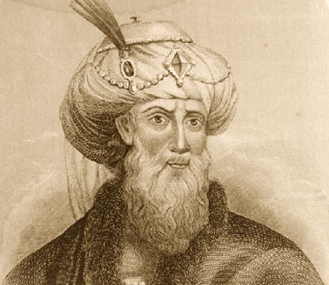
Old Testament Additions
Apocrypha
Evidence derived from 1st century AD Jewish writers, like Josephus, indicates that the Hebrew and Aramaic Bible never included the Apocrypha.
Josephus
AD 1
500
1000
1500
2000

Slide 22
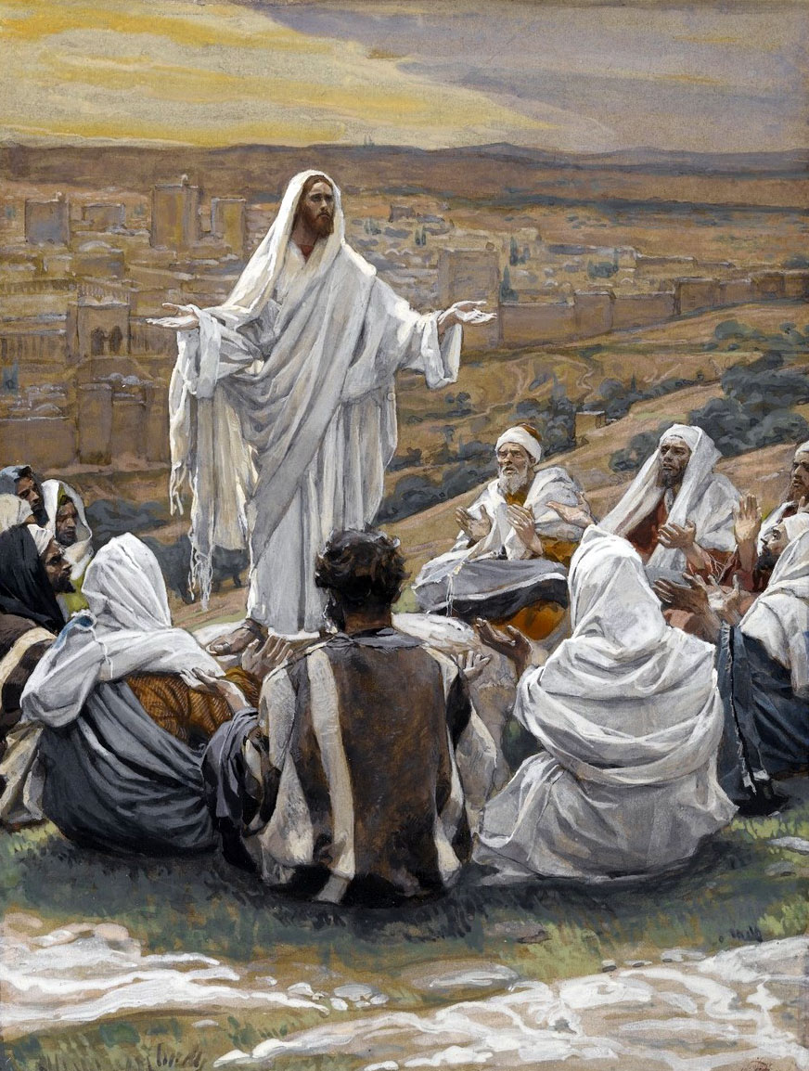
Jesus and the Old Testament
Jesus (c. 4 BC–AD 33) quoted the Old Testament Scriptures often.
He said that he did not come to destroy the Old Testament Scriptures, but to fulfill them.
“Do not think that I have come to abolish the Law or the Prophets; I have not come to abolish them but to fulfill them.”—Matthew 5:17
Jesus and his disciples
AD 1
500
1000
1500
2000

Slide 23
Jesus and the Old Testament
He said to his disciples:
‘This is what I told you while I was still with you: Everything must be fulfilled that is written about me in the Law of Moses, the Prophets and the Psalms.’ Then he opened their minds so they could understand the Scriptures.”—Luke 24:44–45
The “Law of Moses,” “Prophets,” and “Psalms” refer to the three sections of the Hebrew Bible as it was organized in Jesus’ time.
AD 1
500
1000
1500
2000

Slide 24
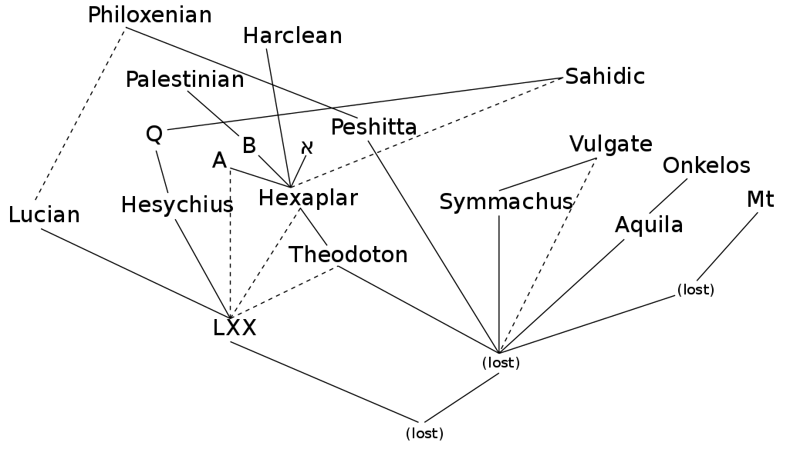
Codices א Sinaiticus A Alexandrinus
B Vaticanus
Q Marchalianus
Mt Track
LXX - Septuagint Mt Masoretic Text
Notes:
he relationships among the various ancient manuscripts of the Old Testament, according to the Encyclopaedia Biblica.^{[page needed]} Dotted pale blue lines indicate texts which were used to correct the main source. The isolated letters are standard siglums designating particularly significant manuscripts: א [aleph] = Codex Sinaiticus A = Codex Alexandrinus B = Codex Vaticanus Q = Codex Marchalianus In addition, the standard abbreviations: MT = Masoretic Text LXX = Septuagint - in this diagram, this refers to the original version of the Septuagint (as opposed to Lucian, Heysicius, Hexaplar, A, B, X [aleph], etc., the Old Testaments/Hebrew Bibles of which are commonly also called Septuagint) See also File:ATtextgeschichte farb.jpg

Slide 25
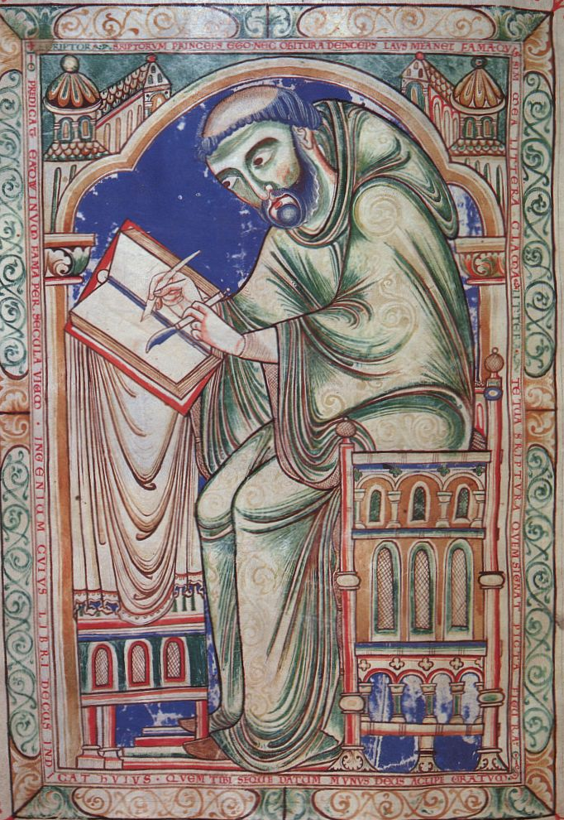
Time Line
Masoretes
Masoretes were Jewish scribes who preserved the Hebrew and Aramaic Scriptures (AD 400–1000).
Hebrew and Aramaic have no written vowels. Masoretes added accents and vowel markings (“vowel points”) to guide readers.
AD 1
500
1000
1500
2000

Slide 26
Time Line
Masoretes
Masoretes kept statistics about:
How often certain words were used.
Differences (variants) in the manuscripts.
Number of words in each book and section of the Scriptures.
The Old Testament preserved by the Masoretes is known today as the Masoretic Text.
500 BC
1500
2000
AD 1
500
1000

Slide 27
Take note there are many more Greek translations than the Septuagint

Slide 28
HEXAPLA Old Testament Greek
SEPTUIGENT Old Testament Greek
Hebrew Text

Slide 29
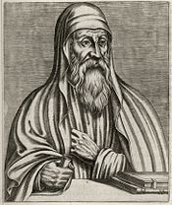
Origen 185 AD – 253AD
Born in Alexandria.
Catechetical School of Alexandria
May have been Dean of school succeeding Clement of Alexandria.
Compiled Hexapla
Wrote over 2000 Christian Treatises
Formed Christian school in Caesarea

Slide 30
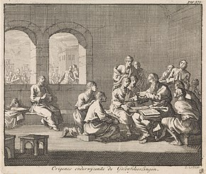
Origen 185 AD – 253 AD
Founded Christian school in Caesarea.
Taught :Logic, Cosmology, Natural History, Theology.
Regarded by churches of Palestine and Arabia as the ultimate authority on all matters of theology. Tortured during Decian persecution 250 died 3 years later from injuries.
The Hexapla may have been destroyed during Arab invasion 653 AD

Slide 31
Desius new Roman Leader 249 Loyalty Oath
The Decian persecution of Christians occurred in 250 AD under the Roman Emperor Decius. He had issued an edict ordering everyone in the Empire to perform a sacrifice to the Roman gods and the well-being of the emperor. The sacrifices had to be performed in the presence of a Roman magistrate, and be confirmed by a signed and witnessed certificate from the magistrate. Although the text of the edict has been lost, many examples of the certificates have survived. (Jews were exempt)

Slide 32
ORIGEN HEXAPLA
The Hexapla is a critical comparison of Greek and Hebrew
text written in six parallel columns written over 7000 pages.
40 year Effort Ended Up in Caesarea. Destroyed apx. 600
1. Hebrew Text
4.Symmachus the Ebionite
2. Hebrew Transliterated to Greek
5.Recension of Septuagint
3. Aquia of Sinpoe
6. Theodotion

Slide 33
Codices א Sinaiticus A Alexandrinus
B Vaticanus
Q Marchalianus
LXX - Septuagint Mt Masoretic Text
Notes:
he relationships among the various ancient manuscripts of the Old Testament, according to the Encyclopaedia Biblica.^{[page needed]} Dotted pale blue lines indicate texts which were used to correct the main source. The isolated letters are standard siglums designating particularly significant manuscripts: א [aleph] = Codex Sinaiticus A = Codex Alexandrinus B = Codex Vaticanus Q = Codex Marchalianus In addition, the standard abbreviations: MT = Masoretic Text LXX = Septuagint - in this diagram, this refers to the original version of the Septuagint (as opposed to Lucian, Heysicius, Hexaplar, A, B, X [aleph], etc., the Old Testaments/Hebrew Bibles of which are commonly also called Septuagint) See also File:ATtextgeschichte farb.jpg

Slide 34
HEXAPLA Old Testament Greek
SEPTUIGENT Old Testament Greek
Hebrew Text

Slide 35
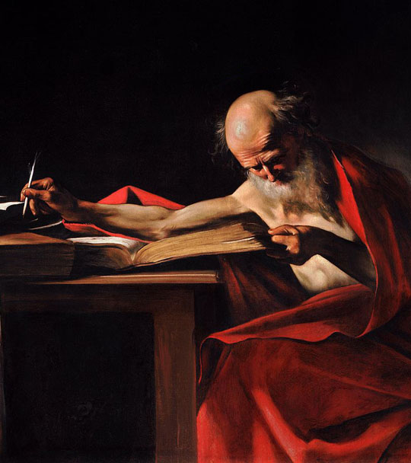
Jerome
Latin Vulgate
Jerome began translating the Scriptures into Latin in AD 382 and finished 23 years later.
This translation became known as the Latin Vulgate, from vulgo, “to make common, accessible.”
For centuries, it remained the official Bible of churches in fellowship with the bishop of Rome.
Jerome

Slide 36
Jerome
Born 342AD -347AD Died 420
Education: Catechetical School of Alexandria
Began translation of Old Testament from LXX and switched to using some Hebrew Texts.
Made Have used the Origen’s Hexapla for some of his work.
Jerome was known for his teachings on Christian moral life, especially to those living in cosmopolitan centers such as Rome.
Jerome
The Council of Trent in 1546 declared the Vulgate authoritative "in public lectures, disputations, sermons, and expositions.”

Slide 37
HEXAPLA Old Testament Greek
SEPTUIGENT Old Testament Greek
Hebrew Text

Slide 38
Codex Sinaiticus
The Codex Sinaiticus It is a fourth-century Christian manuscript of a Greek Bible, containing the majority of the Greek Old Testament, including the Apocrypha, and the Greek New Testament, with both the Epistle of Barnabas and the Shepherd of Hermas included. It is written in uncial letters on parchment. It is one of the four great uncial codices.

Slide 39
Codex Sinaiticus
Along with Codex Alexandrinus and Codex Vaticanus, it is one of the earliest and most complete manuscripts of the Bible, and contains the oldest complete copy of the New Testament. It is a historical treasure and using the study of comparative writing styles (palaeography), it has been dated to the mid-4th century.

Slide 40
Codex Sinaiticus
Until Biblical scholar (and manuscript hunter) Constantin von Tischendorf's discovery of Codex Sinaiticus in 1844, the Greek text of Codex Vaticanus was unrivalled. Since its discovery, study of Codex Sinaiticus has proven to be useful to scholars for critical studies of the biblical text.
Codex Sinaiticus came to the attention of scholars in the 19th century at Saint Catherine's Monastery in the Sinai Peninsula

Slide 41
Checkup
What is an uncial?
What is a minuscule?
What is a majuscule?
When was the Codex Sinaiticus written?
By what method is the date assigned?
By whom, when and where was it discovered?

Slide 42
Codex Sinaiticus
https://codexsinaiticus.org/
https://www.blueletterbible.org/

Slide 43
John 1:1
https://www.blueletterbible.org/
1:1 Ἐν ἀρχῇ ἦν ὁ λόγος
καὶ ὁ λόγος ἦν πρὸς τὸν θεόν
καὶ θεὸς ἦν ὁ λόγος

Slide 44
Codex Sinaiticus
https://codexsinaiticus.org/

Slide 45
Codex Sinaiticus
https://codexsinaiticus.org/

Slide 46
Codex Sinaiticus
https://codexsinaiticus.org/

Slide 47
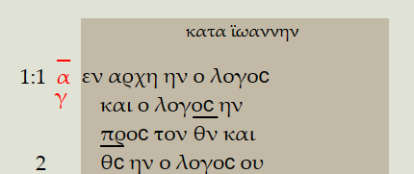
Codex Sinaiticus
https://codexsinaiticus.org/

Slide 48
Take aways.
You do not need to be a Greek scholar.
The researches continue to CONFIRM the bible.
The RSV was first to use the oldest Codices and no fundamental truths are changed..
P66 is a copy of John’s Gospel circa ~200 and it is the same Gospel.

