Slide 1
How we got the Bible

Slide 2
Flow of Biblical Information
Inspiration-> Transmission -> Translation

Slide 3
1And seeing the multitudes, he went vp into a mountaine: and when he was set, his disciples came vnto him.
2And he opened his mouth, and taught them, saying,
3Blessed are the poore in spirit: for theirs is the kingdome of heauen.
MATTHEW CHAPTER 5 (ORIGINAL 1611 KJV) (kingjamesbibleonline.org)

Slide 4
Roman Catholic Influence
magisterium
noun
: teaching authority especially of the Roman Catholic Church
The idea of having people read the bible and make up their own mind was not acceptable
Interpretation was from the pope.
Translators were persecuted at every turn.

Slide 5
Write This Down

Slide 6
Write This Down
God Instructed Men to write things down.
Moses:

Slide 7
Write This Down the event:
Exodus 17:11 And it came to pass, when Moses held up his hand, that Israel prevailed: and when he let down his hand, Amalek prevailed

Slide 8
Write This Down
Exodus 17:14 And the LORD said unto Moses, Write this for a memorial in a book, and rehearse it in the ears of Joshua: for I will utterly put out the remembrance of Amalek from under heaven. KJV

Slide 9
Write This Down record the event:
Exodus 17:14 And the LORD said unto Moses, Write this for a memorial in a book, and rehearse it in the ears of Joshua: for I will utterly put out the remembrance of Amalek from under heaven. KJV

Slide 10
Write This Down record the event:
Exodus 17:14 Then the LORD said to Moses, “Write this on a scroll as something to be remembered and make sure that Joshua hears it, because I will completely blot out the name of Amalek from under heaven.” NIV (differences from KJV ?)

Slide 11
Write This Down
What are the attributes of a person that are best suited to chronicle an event?

Slide 12
Write This Down
What are the attributes of a person that are best suited to chronicle an event?
These author attributes will be used to help establish which books are to be included in the bible.

Slide 13
Write This Down
Exodus 34:1 And the LORD said unto Moses, Hew thee two tables of stone like unto the first: and I will write upon these tables the words that were in the first tables, which thou brakest.

Slide 14
Write This Down
Exodus 34:27 And the LORD said unto Moses, Write thou these words: for after the tenor of these words I have made a covenant with thee and with Israel.

Slide 15
Write This Down
Review Deuteronomy 6:4 – 6:8

Slide 16
Write This Down
Review Deuteronomy 6:4 – 6:8 8: And thou shalt bind them for a sign upon thine hand, and they shall be as frontlets between thine eyes.

Slide 17
Write This Down
Review Deuteronomy 6:4 – 6:8 9: And thou shalt write them upon the posts of thy house, and on thy gates.

Slide 18
Write This Down
Review Deuteronomy 6:4 – 6:8 9: And thou shalt write them uphon the posts of thy house, and on thy gates.
My epiphany: V6 teach V9 write learning and literacy

Slide 19
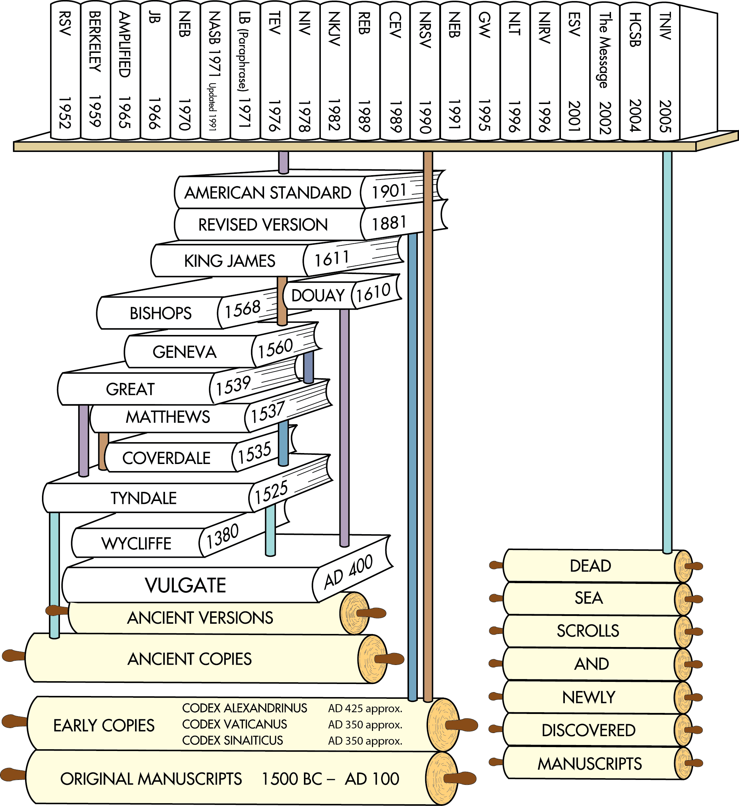
Translations after the discovery of the Dead Sea Scrolls
Translations after earlier ancient manuscripts were discovered in the 1700s and 1800s
English Translations from ancient versions and copies available at that time
Latin Translation
Chart does not include all English translations. Chart idea from Back to the Bible Broadcast, Lincoln NE..

Slide 20
Latin Translation

Slide 21
Early Greek copies written in uncials / majuscules. All capital letters, no spaces between words
Greek minuscules replaced the majuscules.

Slide 22
Time Period of Bible
The time span for the writing of the Bible covers approximately fifteen-hundred years.
Old Testament (1445—400 B.C.)
.
Job (lived in patriarchal times) Genesis (1445) Exodus (1445) Leviticus (1445)
Numbers (1405)
Deuteronomy (1405)

Slide 23
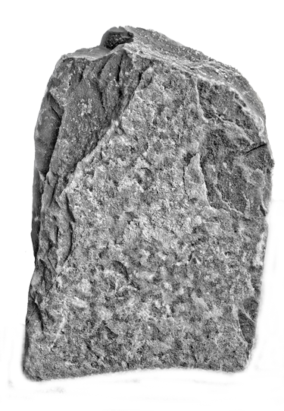
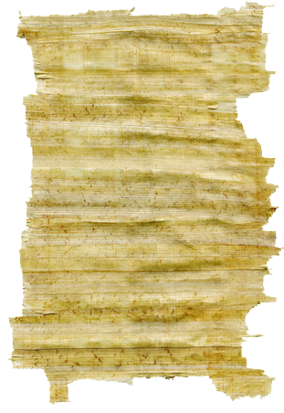
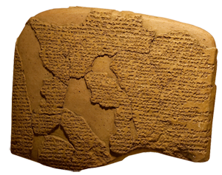
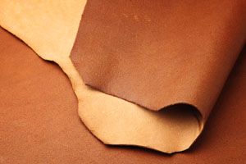
Materials
Over the centuries, Scripture has been copied onto many different materials.
The Old Testament was written on materials such as stone, clay, leather, and papyrus.

Slide 24
Materials
Papyrus
The New Testament books were probably written first on papyrus scrolls.
The papyrus plant is cut into strips and pressed into sheets of writing material and can be made into a scroll or a codex.
Papyrus Plants

Slide 25
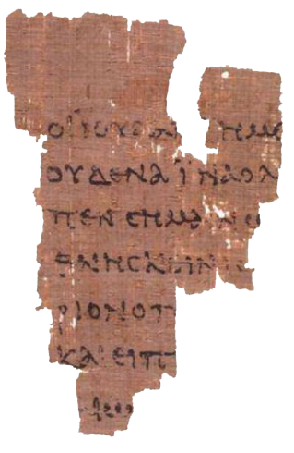
Materials
Papyrus
One of the oldest New Testament fragments (P52) that survives today was copied in Greek on a papyrus codex.
It is from John 18 and was written sometime between AD 90 and 150.
Ryland’s Library Papyrus P52

Slide 26
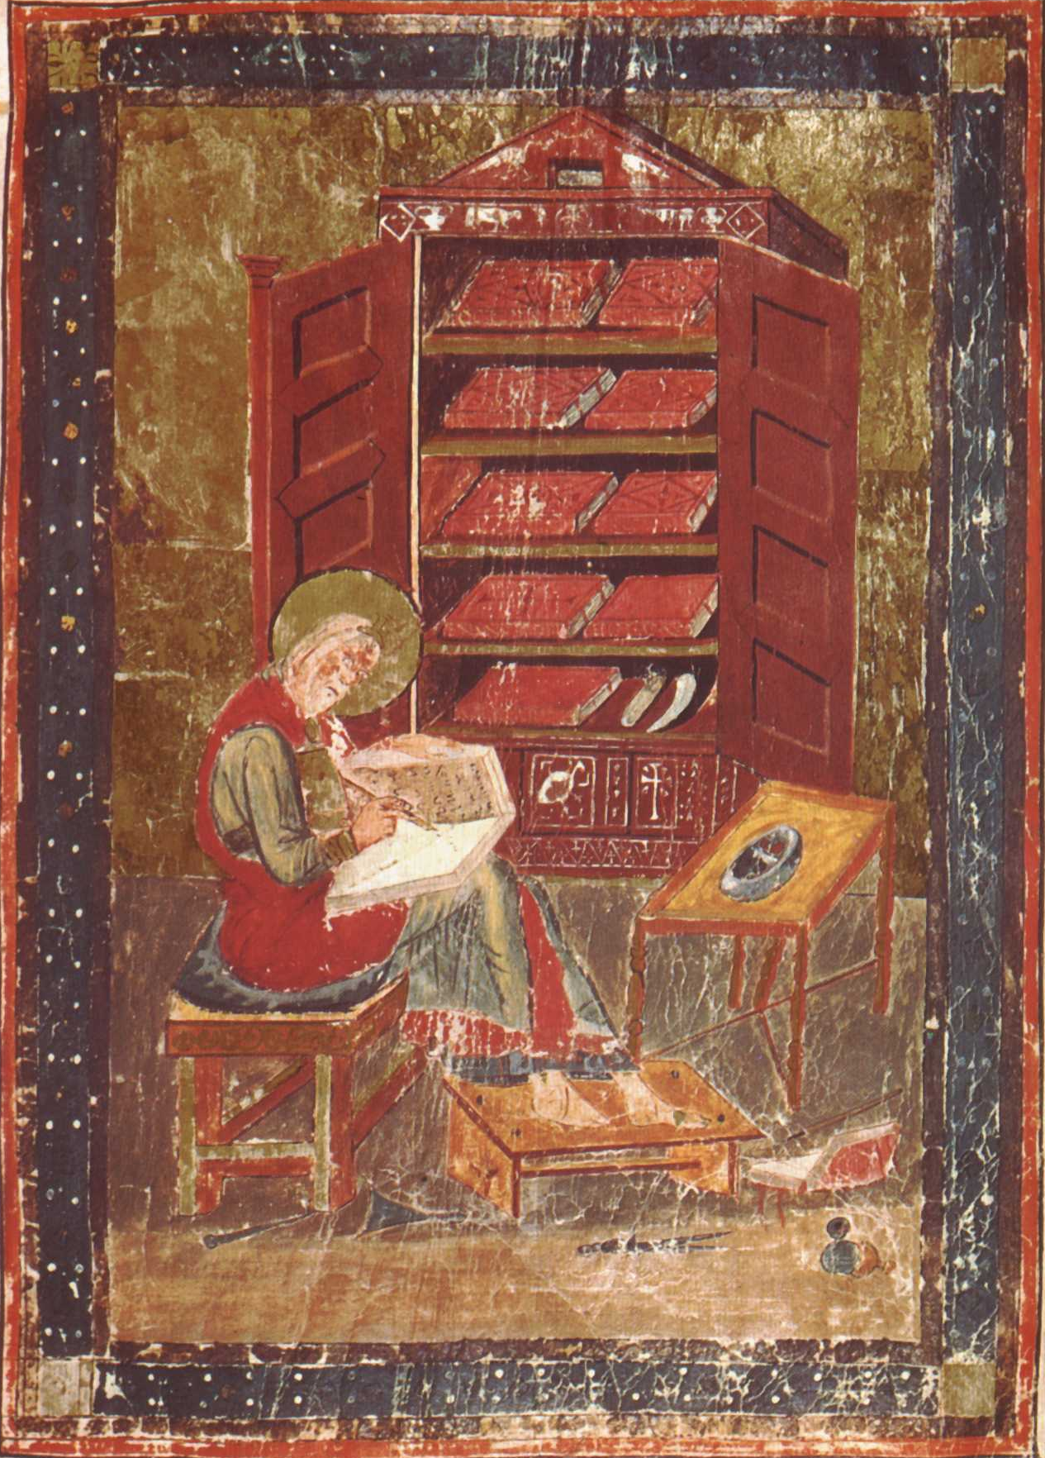
Use of Material
Codex
A “codex” is a bound volume made from sheets folded and sewn together, sometimes with a cover.
Christians began using them instead of scrolls no later than the early 100s AD.

Slide 27
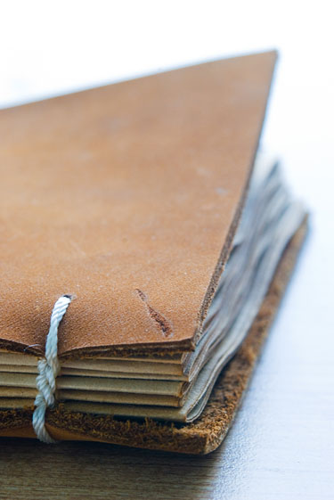
Materials enlargements follow
Animal Skins
Fine quality animal skins were used for over 1,000 years to make copies of the Bible, AD 300–1400.
Parchment: scraped and stretched skin, usually from calves, sheep, or goats
Vellum: higher quality parchment, usually calfskin, rubbed with pumice and treated with chalk

Slide 28
Materials
Animal Skins
Fine quality animal skins were used for over 1,000 years to make copies of the Bible, AD 300–1400.
Parchment: scraped and stretched skin, usually from calves, sheep, or goats
Vellum: higher quality parchment, usually calfskin, rubbed with pumice and treated with chalk

Slide 29
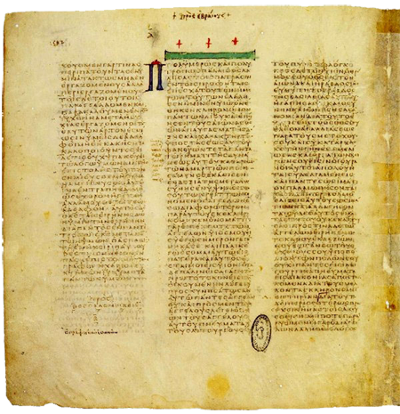
Materials enlargements follow
Vellum
Two of the oldest vellum copies of the New Testaments that exist today are:
Codex Vaticanus, which was copied in the early 300s AD.
Codex Sinaiticus, which was copied in the mid 300s AD.
Codex Vaticanus

Slide 30
Materials
Vellum
Two of the oldest vellum copies of the New Testament that exist today are:
Codex Vaticanus, which was copied in the early 300s AD.
Codex Sinaiticus, which was copied in the mid 300s AD.

Slide 31
Codex Vaticanus

Slide 32
Materials

Slide 33
Amount of work for one bible
Words in the bible typing time
KJV 783,137 217 hrs @60 words per minute
NIV 812,924 226 hrs @60 words per minute
NASB 860,080 240 hrs @60 words per minute

Slide 34
Amount of work for one Bible
Words in the bible Writing time
KJV 783,137 2170 hrs @ 6 words per minute
NIV 812,924 2260 hrs @ 6 words per minute
NASB 860,080 2400 hrs @ 6 words per minute

Slide 35
Materials for Codex Sinaiticus
Skins from 360 calves.
Dehaired polished chalked and scribe lines added for layout
Layout
4 columns
48 lines per column
12 to 15 characters per line
.
Ink and quills to write 4,000,000 characters.
Cost of copy reckon life time a wages for a comon man.

Slide 36
Materials for one Bible
Words in the bible Writing time
KJV 783,137 2170 hrs @ 6 words per minute
NIV 812,924 2260 hrs @ 6 words per minute
NASB 860,080 2400 hrs @ 6 words per minute

Slide 37
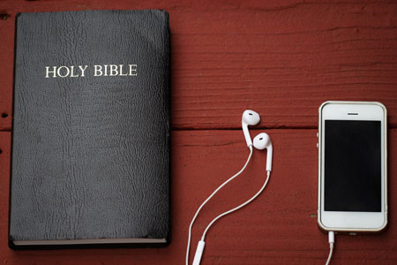
Materials
The Bible is now printed on paper and comes in many digital formats, in many versions and languages.
Menu

Slide 38
Paper
It has been said that knowledge of papermaking was passed to the Islamic world after the Battle of Talas in 751 AD when two Chinese papermakers were captured- as prisoners.
Samakan->Bagdad-> Europe(13th Century)
Made from fibers of recycled clothes.
(ragpickers)
De-inking (1774) led to recycling.
Wood pulp paper appeared in 1843.
from Wikipedia.
Notes:
Samaan vert old city now in Uzbekistan.

Slide 39
Technology
. The Bible was the first complete book printed on the printing press with moveable metal type.
Johannes Gutenberg invented the printing press in Germany in the mid-1400s.
Gutenberg Printing Press

Slide 40
Technology + Paper
Think of the movable type and paper as the 16th Century internet.
Gutenberg Printing Press

Slide 41
Gutenberg Printing Information
Date | Event
1440 | Johannes Gutenberg began developing the printing press.
1450 | Gutenberg perfected his machine and it was commercially distributed, allowing the publication of books, posters and pamphlets across Germany, and eventually across Europe.

Slide 42
Gutenberg Printing Information
Date | Event
1465 | The Gutenberg Printing Press was brought to Italy. The Roman Catholic Church was able to commission the printing of various religious texts. The Papacy even used the Printing Press to issue indulgences and distribute pamphlets to help with the Catholic Crusade against the Turks.
1476 | William Caxton brought the technology of the Gutenberg Printing Press to Westminster, England.

Slide 43
Gutenberg Printing Information
Date | Event
1465 | The Gutenberg Printing Press was brought to Italy. The Roman Catholic Church was able to commission the printing of various religious texts. The Papacy even used the Printing Press to issue indulgences and distribute pamphlets to help with the Catholic Crusade against the Turks.
1476 | William Caxton brought the technology of the Gutenberg Printing Press to Westminster, England.

Slide 44
Gutenberg Printing Information
Date | Event
1501 | Pope Alexander I prohibited the printing of books without the Roman Catholic Church’s permission and threatened excommunication. This was due to fear that printing would be used to disseminate anti-Catholic literature or facilitate dangerous misunderstandings of religious texts. Estimates state that there were around 9-20 million books in Europe at this time..

Slide 45
Gutenberg Printing Information
Date | Event
1517 | Martin Luther wrote his 95 theses. The work was copied, printed, and distributed throughout Germany using the Gutenberg Printing Press. Some historians estimate that within 17 days of publication, the 95 theses were being printed in London, England.

Slide 46
Old Testament

Slide 47
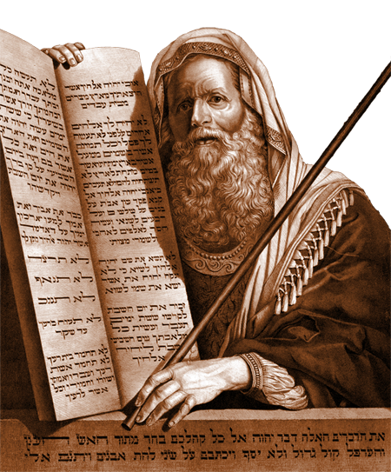
Old Testament
Old Testament
Old Testament events were written down in Hebrew (some portions in Aramaic) over centuries.
In Exodus, the Lord tells Moses to write in a book (Exodus 17:14; 24:4, 7).
2000 BC
1500 BC
1000 BC
500 BC
AD 1

Slide 48
Old Testament
Old Testament
Other Old Testament writers, inspired by God, include leaders, kings, and prophets.
2000 BC
1500 BC
1000 BC
500 BC
AD 1

Slide 49
Old Testament
These writings were known as:
“the Law, the Prophets, and the Writings,”
“the Law, the Prophets, and David,”
Or simply, “the Law and the Prophets” (Luke 16:16; 24:44).
Paul referred to them as “the old covenant” or “old testament” (2 Corinthians 3:14).
2000 BC
1500 BC
1000 BC
500 BC
AD 1

Slide 50
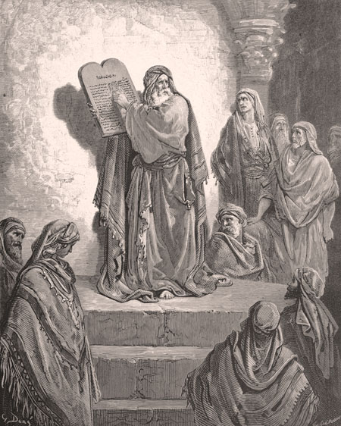
Old Testament
Old Testament
Ezra, a priest and scribe, may have collected and arranged the books of the Hebrew Bible, about 450 BC.
Ezra reading the law
2000 BC
1500 BC
1000 BC
500 BC
AD 1

Slide 51
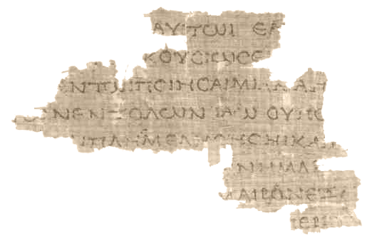
Old Testamant
Greek Translation
The Septuagint is a Greek translation of the Hebrew Bible (the Old Testament).
It was probably translated no later than the 100s BC by Jewish scholars in Alexandria, Egypt.
Septuagint Fragment (4Q120, from Leviticus, 100s BC)
2000 BC
1500 BC
1000 BC
500 BC
AD 1

Slide 52
Time Line
Greek Translation
The word Septuagint means 70, referring to the legend that 70 or 72 Jewish scholars translated it.
It is often abbreviated LXX, the Roman numeral for 70.
The books were arranged by subject: historical, poetic, and prophetic.
Septuagint Fragment (4Q120, from Leviticus, 100s BC)
2000 BC
1500 BC
1000 BC
500 BC
AD 1

Slide 53
Old Testament
Apocrypha
The Septuagint included some Jewish religious writings—later known as “Apocrypha”—that had never been included in the Hebrew and Aramaic Scriptures.
The word apocrypha is from the Greek meaning “hidden” or “unclear.”
Today, they are not included in Protestant Bibles, but many of the books can be found in Orthodox and Roman Catholic Old Testaments.
2000 BC
1500 BC
1000 BC
500 BC
AD 1

Slide 54
Books not included in the Protestant Old Testament in blue.
Orthodox Old Testament
Roman Catholic Old Testament
Genesis
Exodus
Leviticus
Numbers
Deuteronomy
Joshua
Judges
Ruth
1 Samuel
2 Samuel
1 Kings
2 Kings
1 Chronicles
2 Chronicles
1 Esdras
Ezra
Nehemiah
Esther (additions)
Judith
Tobit
1 Maccabees
2 Maccabees
3 Maccabees
Psalms (plus Ps. 151)
Prayer of Manasseh
Job
Proverbs
Ecclesiastes
Song of Songs
Wisdom of Solomon
Sirach (Ecclesiasticus)
Hosea
Amos
Micah
Joel
Obadiah
Jonah
Nahum
Habakkuk
Zephaniah
Haggai
Zechariah
Malachi
Isaiah
Jeremiah
Baruch
Lamentations
Letter of Jeremiah
Ezekiel
Daniel (includes Susanna; Bel and the Dragon)
4 Maccabees (in appendix)
Malachi
Genesis
Exodus
Leviticus
Numbers
Deuteronomy
Joshua
Judges
Ruth
1 Samuel
2 Samuel
1 Kings
2 Kings
1 Chronicles
2 Chronicles
Ezra
Nehemiah
Tobit
Judith
Esther (additions)
1 Maccabees
2 Maccabees
Job
Psalms
Proverbs
Ecclesiastes
Song of Songs
Wisdom of Solomon
Sirach (Ecclesiasticus)
Isaiah
Jeremiah
Lamentations
Baruch (includes letter of Jeremiah)
Ezekiel
Daniel (includes Susanna; Bel and the Dragon)
Hosea
Joel
Amos
Obadiah
Jonah
Micah
Nahum
Habakkuk
Zephaniah
Haggai
Zechariah
Malachi

Slide 55
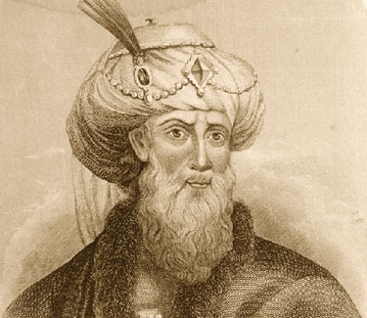
Old Testament
Apocrypha
Evidence derived from 1st century AD Jewish writers, like Josephus, indicates that the Hebrew and Aramaic Bible never included the Apocrypha.
Josephus
AD 1
500
1000
1500
2000

Slide 56
Codex Sinaiticus
The Codex Sinaiticus It is a fourth-century Christian manuscript of a Greek Bible, containing the majority of the Greek Old Testament, including the Apocrypha, and the Greek New Testament, with both the Epistle of Barnabas and the Shepherd of Hermas included. It is written in uncial letters on parchment. It is one of the four great uncial codices.

Slide 57
Codex Sinaiticus
Along with Codex Alexandrinus and Codex Vaticanus, it is one of the earliest and most complete manuscripts of the Bible, and contains the oldest complete copy of the New Testament. It is a historical treasure and using the study of comparative writing styles (palaeography), it has been dated to the mid-4th century.

Slide 58
Codex Sinaiticus
Until Biblical scholar (and manuscript hunter) Constantin von Tischendorf's discovery of Codex Sinaiticus in 1844, the Greek text of Codex Vaticanus was unrivalled. Since its discovery, study of Codex Sinaiticus has proven to be useful to scholars for critical studies of the biblical text.
Codex Sinaiticus came to the attention of scholars in the 19th century at Saint Catherine's Monastery in the Sinai Peninsula

Slide 59
Checkup
What is an uncial?
What is a minuscule?
What is a majuscule?
When was the Codex Sinaiticus written?
By what method is the date assigned?
By whom, when and where was it discovered?

Slide 60
Codex Sinaiticus
https://codexsinaiticus.org/
https://www.blueletterbible.org/

Slide 61
John 1:1
https://www.blueletterbible.org/
1:1 Ἐν ἀρχῇ ἦν ὁ λόγος
καὶ ὁ λόγος ἦν πρὸς τὸν θεόν
καὶ θεὸς ἦν ὁ λόγος

Slide 62
Codex Sinaiticus
https://codexsinaiticus.org/

Slide 63
Codex Sinaiticus
https://codexsinaiticus.org/

Slide 64
Codex Sinaiticus
https://codexsinaiticus.org/

Slide 65
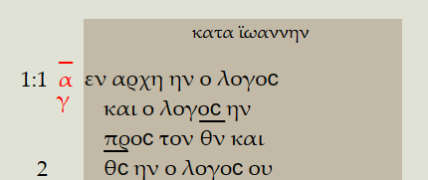
Codex Sinaiticus
https://codexsinaiticus.org/

Slide 66
Take aways.
You do not need to be a Greek scholar.
The researches continue to CONFIRM the bible.
The RSV was first to use the oldest Codices and no fundamental truths are changed..
P66 is a copy of John’s Gospel circa ~200 and it is the same Gospel.

